Slide 1
Simulation of large scintillators for future HEP experiments using GEANT4
Diogo Mendonça
Francisco Ferreira

Slide 2
Topics
ATLAS experiment and contextualization of this simulation
(Attempting to) explain scintillators
Simulation results and data analysis
Conclusion
Further work
Links

Slide 3
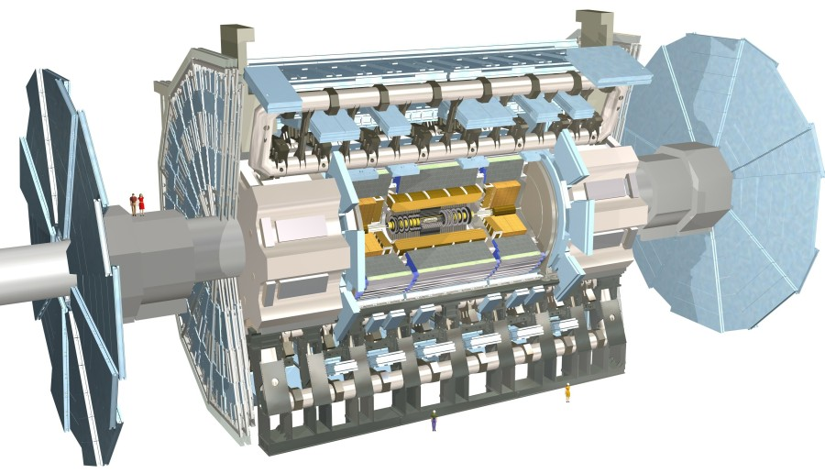

Slide 4
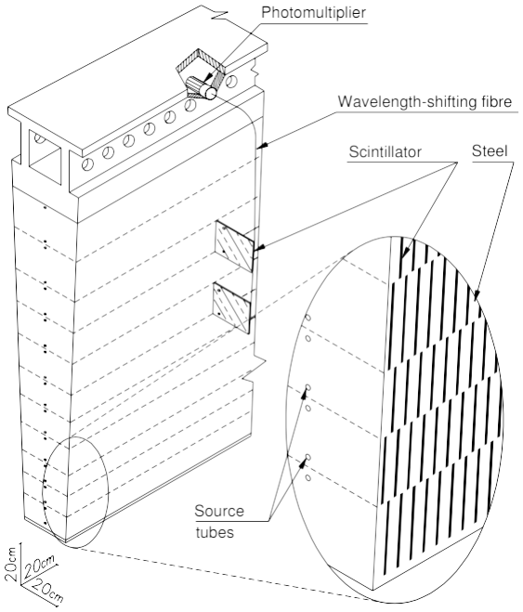
Main goals:
Alter the already developed code so that everything ran according to what was physically expected (fix bugs);
Develop graphical output that helps the user to better understand what is going on in the beginning of each event.
Side goals:
Compare results from events with different thickness tiles;
Develop new variables that can explain where and how energy is deposited;

Slide 5
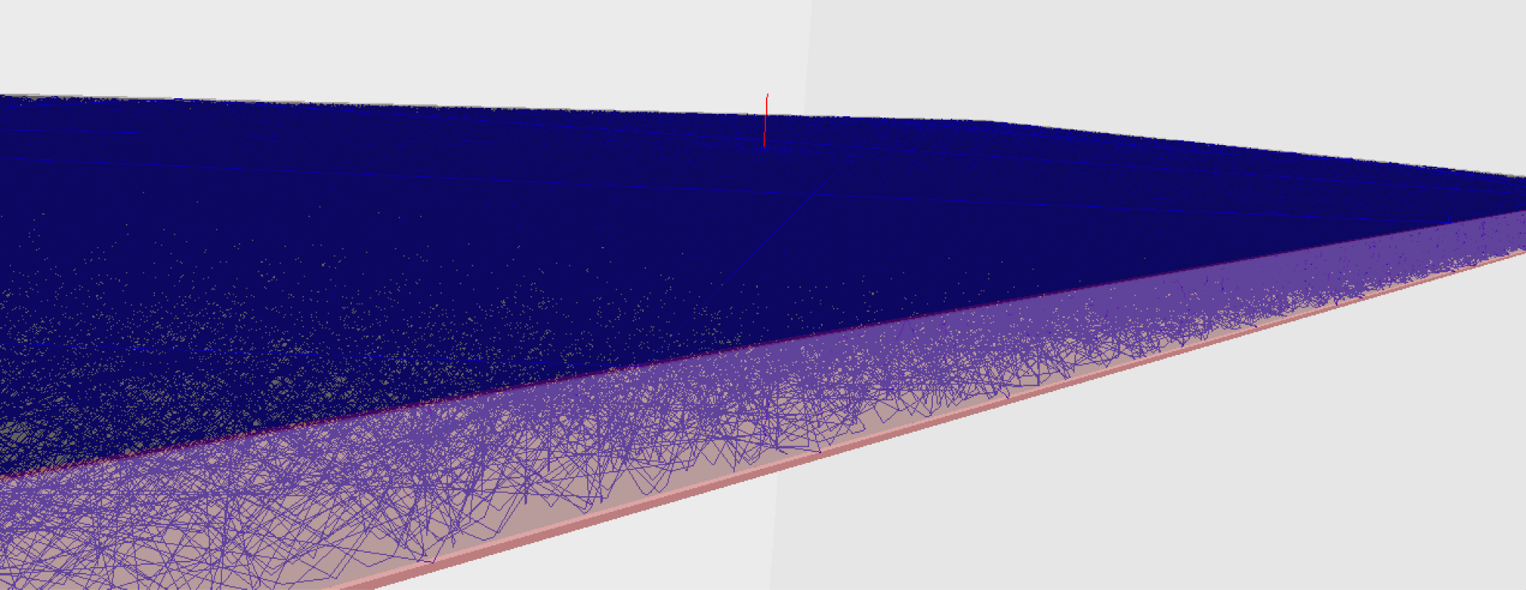
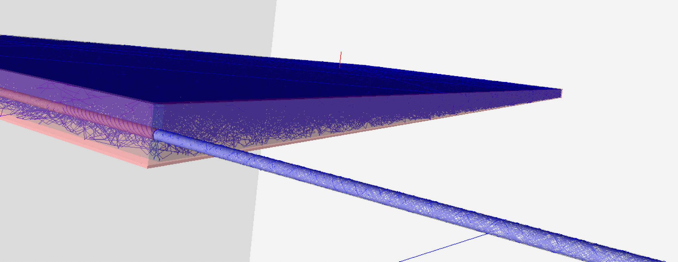

Slide 6
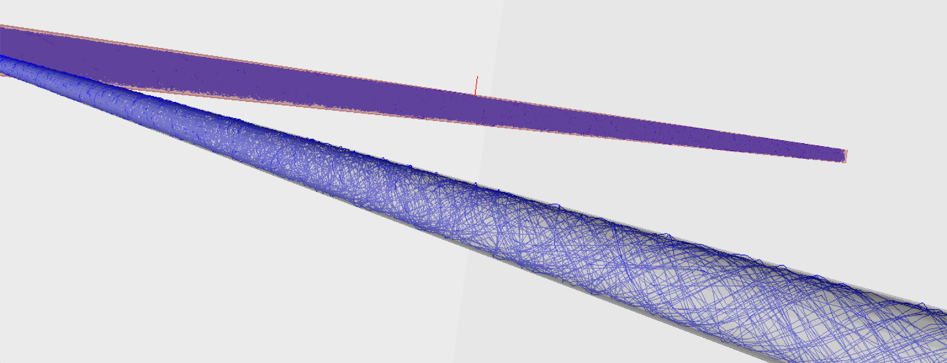

Slide 7
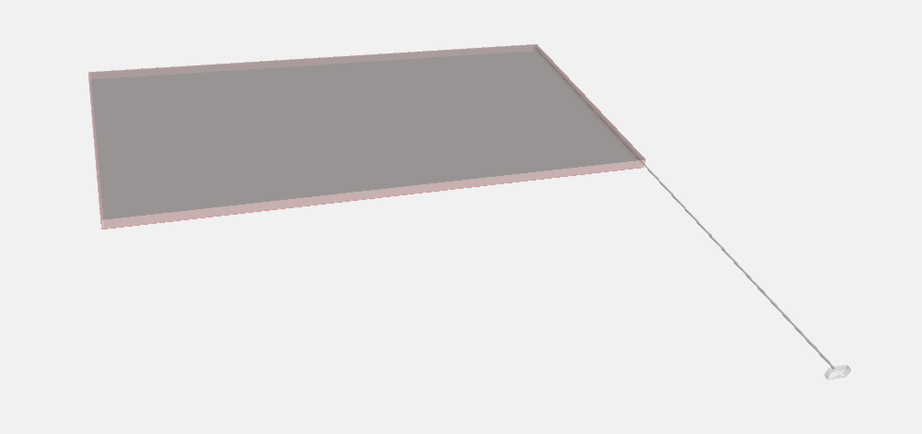
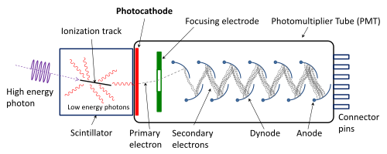

Slide 8
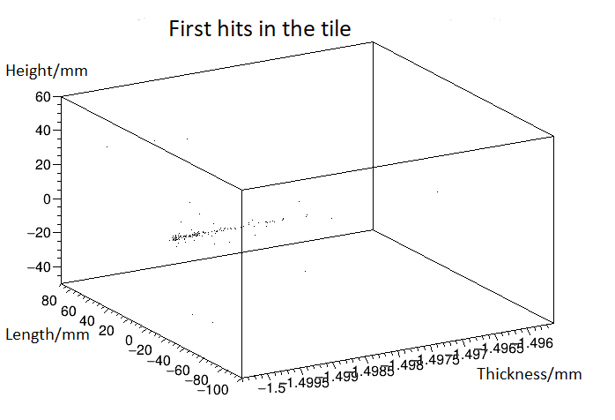
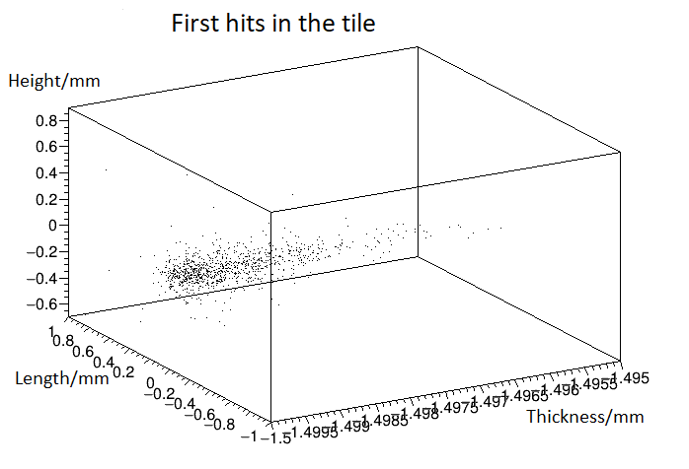
Simulation results and data analysis

Slide 9
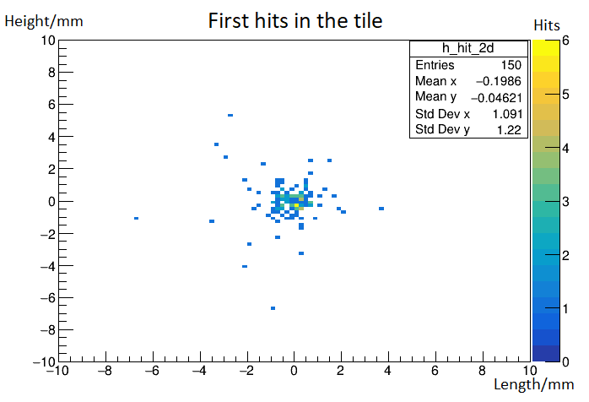
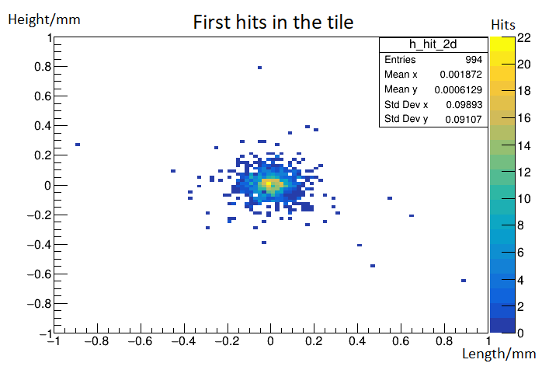
Simulation results and data analysis

Slide 10
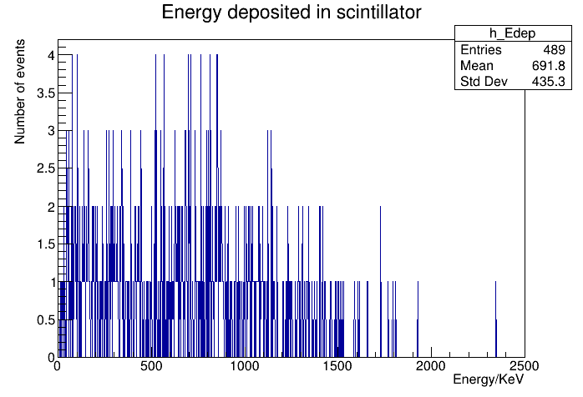
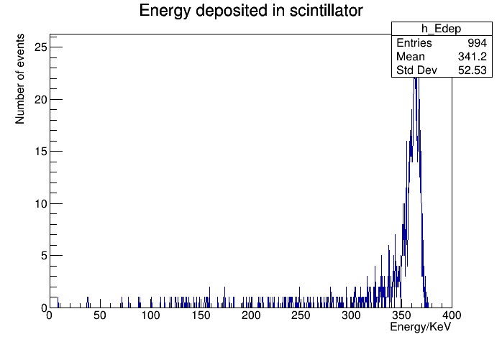
Simulation results and data analysis

Slide 11
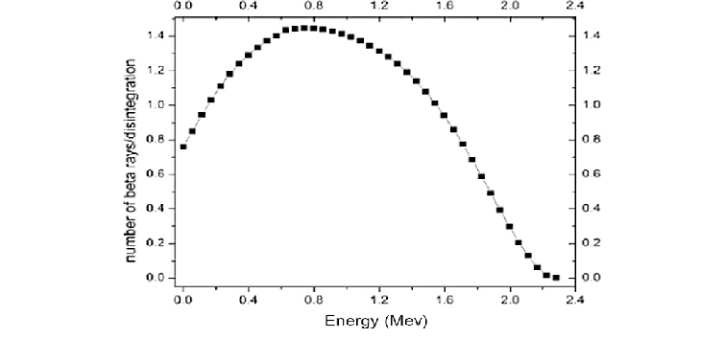
Simulation results and data analysis

Slide 12
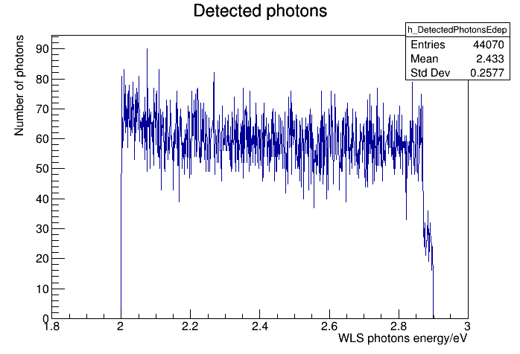
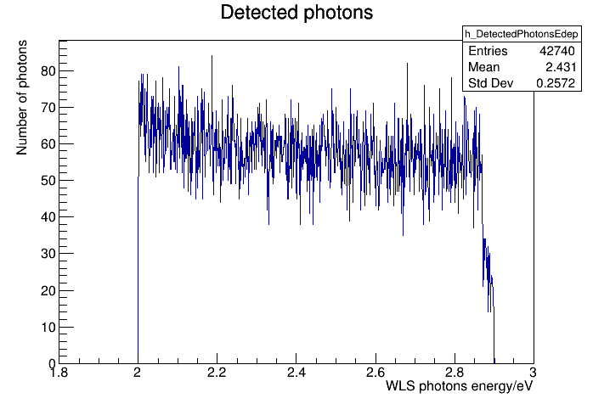
Simulation results and data analysis

Slide 13
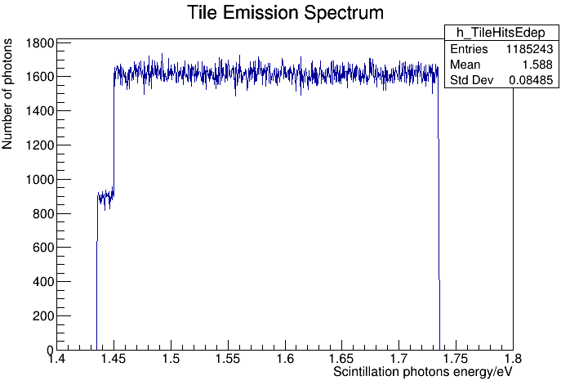
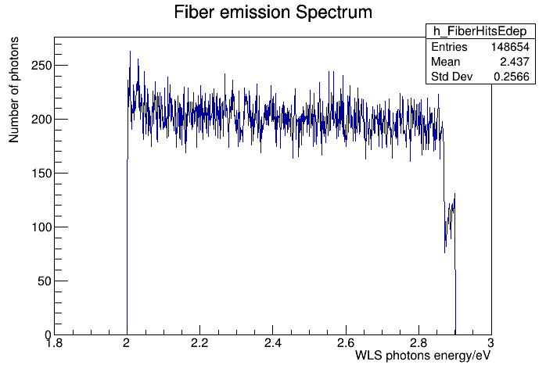
Simulation results and data analysis

Slide 14
Conclusion
Only 15% of the electrons hit in the ion case;
No differences between different thicknesses tiles;
Major differences between electron beam and radioactive ion reside in the dispersion and energy curve;

Slide 15
Further work
Comparison of simulated data with experimental data;
Uniform tile and fiber emission spectrums;
Only 15% of the electron hit in the ion case;
Creation of a tyvek variable (account all energy loses);

Slide 16
Links:
http://people.na.infn.it/~elly/TesiAtlas/SeminariAtlas/Detector/IengoAtlasCalo.pdf
https://www.google.com/search?q=atlas+experiment+cern+exploded+view&source=lnms&tbm=isch&sa=X&ved=2ahUKEwiNiKeervzyAhXvAWMBHcskCVIQ_AUoAXoECAEQAw&biw=1366&bih=657#imgrc=ybiRqpRFlqJb9M
https://physics.nist.gov/cgi-bin/Star/e_table.pl
https://en.wikipedia.org/wiki/Photomultiplier_tube
https://www.researchgate.net/figure/The-energy-spectrum-of-90-Sr-90-Y_fig1_305922539

