Slide 1
QCD effects in the muon anomalous magnetic moment
LIP Internships 2021
André Nunes
Mário Amaro
Professor Gernot Eichmann

Slide 2
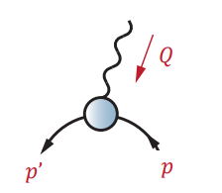
Introduction
Muon has spin ½, so it has a magnetic moment (“g factor”), encoded in electromagnetic coupling of the photon to the muon
g=2 for a pointlike particle
Anomalous magnetic moment (“g-2” or $a_{μ}$ = (g-2)/2 ) comes from quantum effects (tiny): $a_{μ}$ = 0.00116…
Experiments at BNL, Fermilab (run 1 2021), JPARC (future)
01

Slide 3
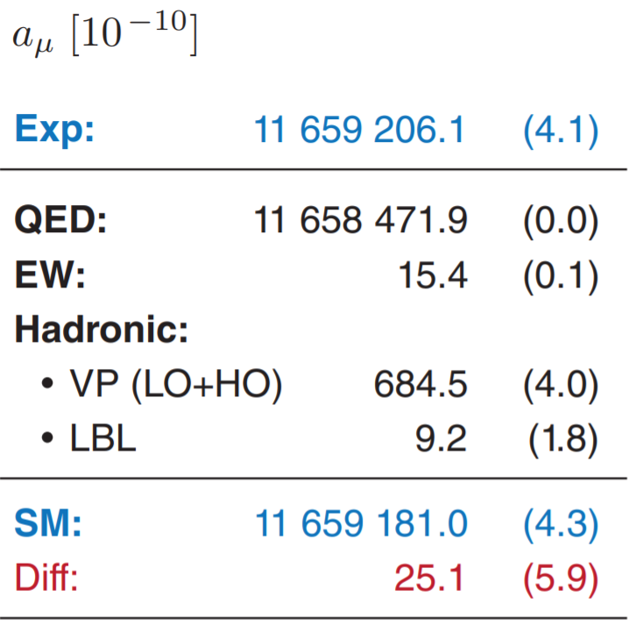
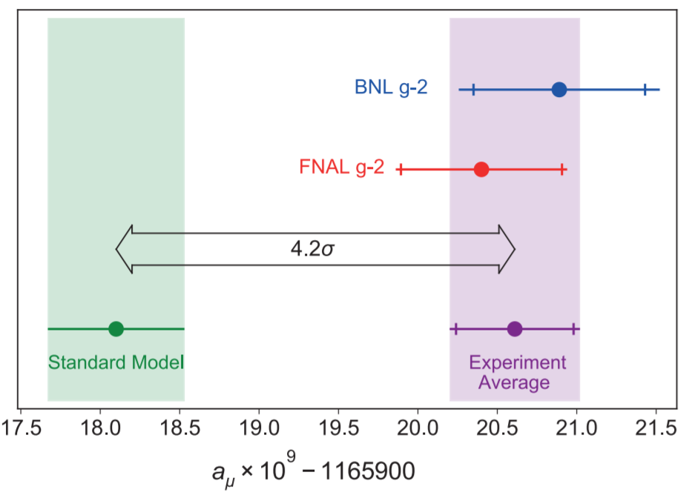
Introduction
Muon g-2 Theory Initiative White Paper: Aoyama et al., Phys. Rept. 887 (2020)
FNAL Run-1: Abi et al., PRL 126, 141801 (2021)
02

Slide 4
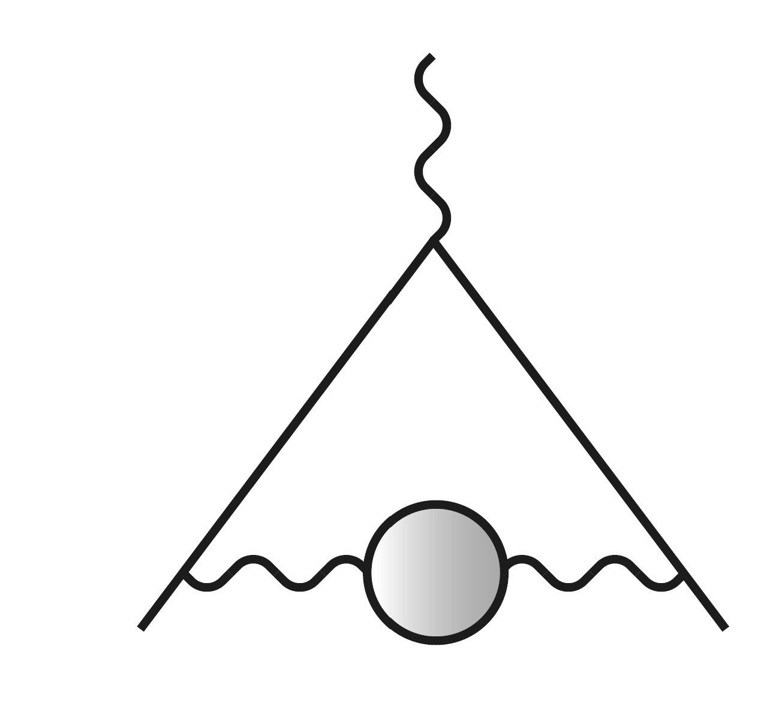
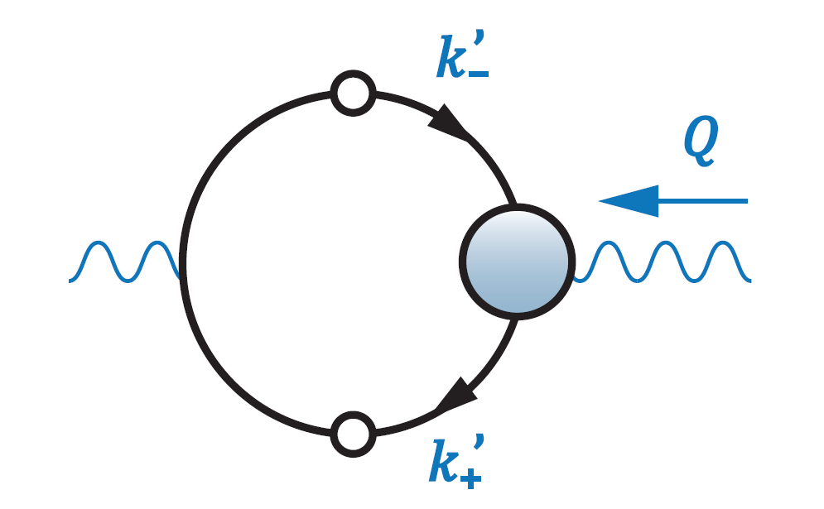
Hadronic Vacuum Polarization (HVP)
Biggest QCD contribution, contributes main uncertainty in SM prediction
Different ways to calculate $a_{μ}^{HVP}$ employed in literature; here: alternative method
Two ingredients: quark propagator and quark-photon vertex
03

Slide 5
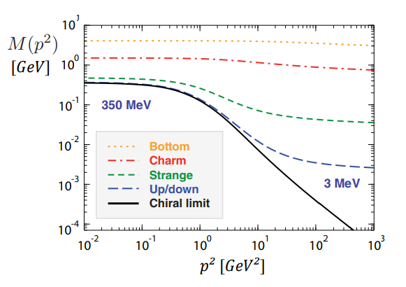
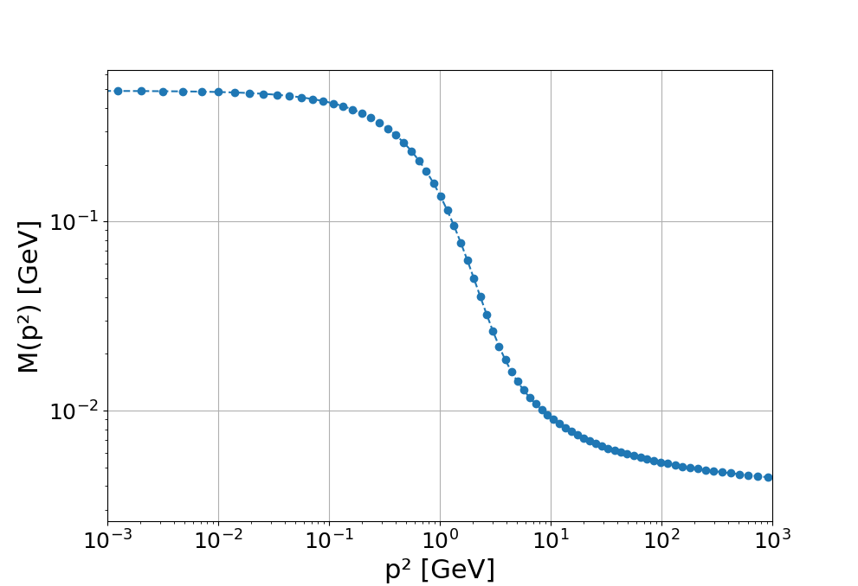
Quark propagator
Free particle:
"Dressed” quark (spin ½ )
Quark mass becomes large at small momenta (spontaneous chiral symmetry breaking)
04

Slide 6
Quark propagator
Spontaneous chiral symmetry breaking is non-perturbative
Quark Dyson-Schwinger Equation (DSE):
$$f\left(x\right) = 1 + xf(x)$$
05

Slide 7
Quark-photon vertex
Quark-photon vertex describes the electromagnetic coupling of quarks to photons
Bethe-Salpeter Equations (BSE)
06

Slide 8
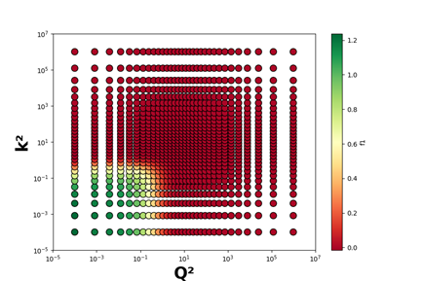
Quark-photon vertex (practice)
Start with an orthonormal basis
Chebyshev polynomials
Change to {g, f} basis
07

Slide 9
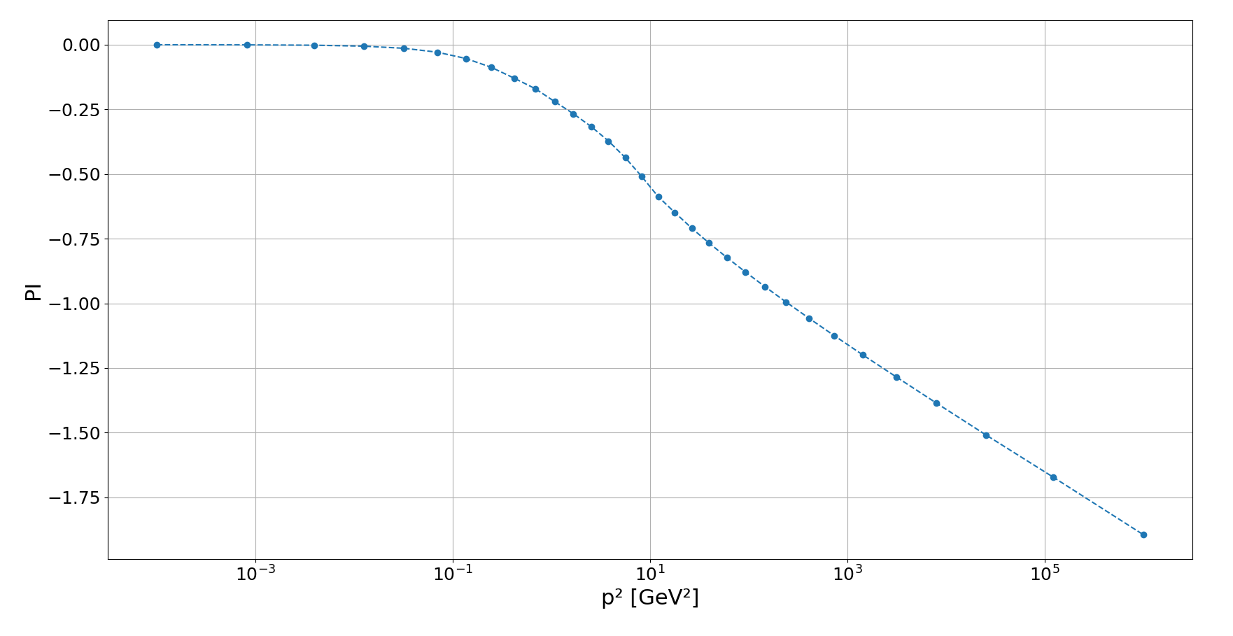
Hadronic vacuum polarization
08

Slide 10
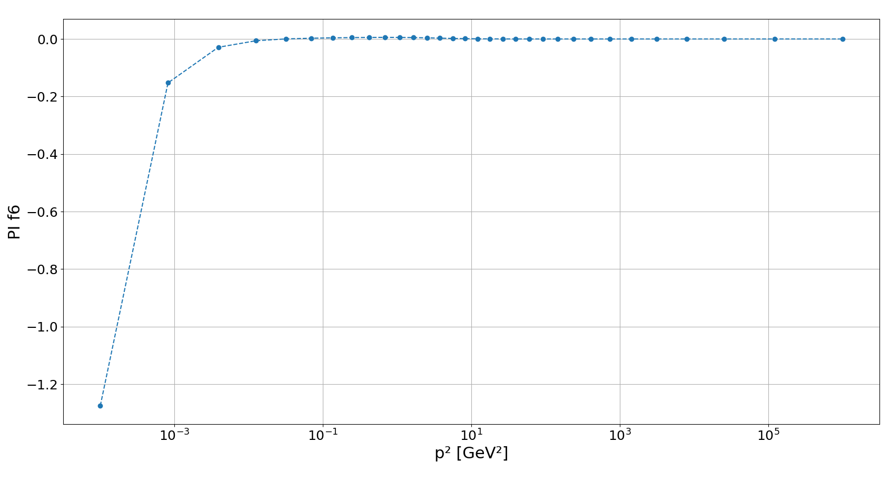
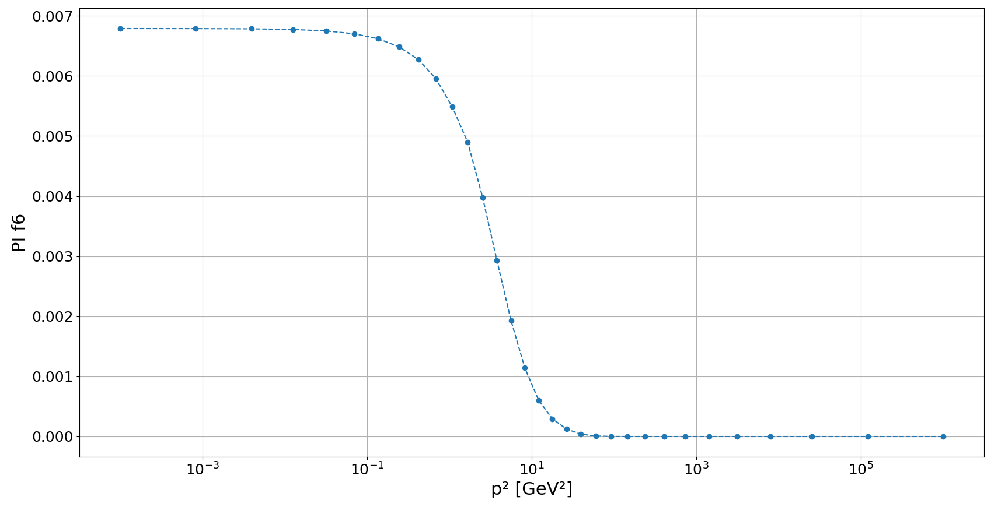

Hadronic vacuum polarization
We need to fit a quadratic function for small $Q^{2}$:
09

Slide 11
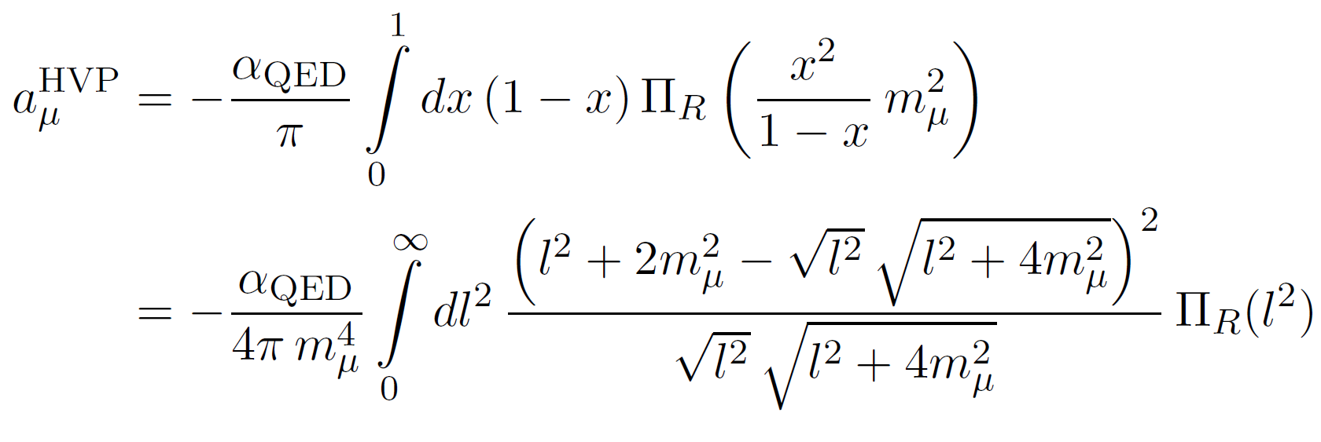
Anomalous magnetic moment
Having calculated all ingredients, we finally obtain:
10

Slide 12
Results and Discussion
$a_{μ}^{HVP}$(u, d) + $a_{μ}^{HVP}$(s) + $a_{μ}^{HVP}$ (c) = 768(21) x${10}^{−10}$ ... if scale adjusted to $π$ = 711(21) x${10}^{−10}$ …if scale adjusted to $ρ$meson (errors are model uncertainties)
Somewhat larger than current SM prediction
Need to increase precision, test sensitivity to fits, etc.
11

