Slide 1
Neutron Data From The SNO+ Neutrino Detector
Interns: André Soares, Teresa Miranda
Advisors: Valentina Lozza, Sofia Andringa

Slide 2
SNO+
Located 2km underground
Sudbury, Canada
Multi- Purposes:
Neutrinoless Double Beta Decay
Geo and Reactor Anti-Neutrinos
Solar Neutrinos
Rare decays
Supernovae Neutrinos
https://snoplus.phy.queensu.ca/about.html

Slide 3
Three Fases
The Water Phase (finished)
The Scintillator Phase (ongoing)
Te-loaded scintillator phase

Slide 4
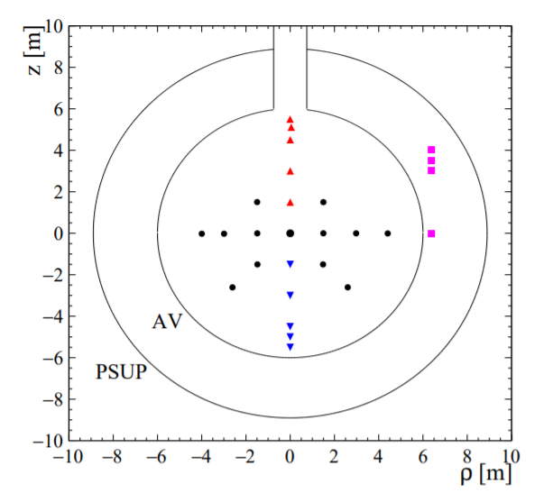
Am-be source
$${}_{95}^{241}{Am → {}_{93}^{237}{Np+ {}_{2}^{4}{He}}}$$
$${}_{4}^{9}{Be+ {}_{2}^{4}{H→ {}_{6}^{12}C+n}}$$
https://arxiv.org/pdf/2002.10351.pdf
Neutrons thermalize in the detector, capture a H and it’s emmited a 2.2 MeV gamma particle
60% of the time, ${}_{}^{12}C$ is produced in na excited state; it immediatly de-excites, emitting a 4.4 MeV gamma particle

Slide 5
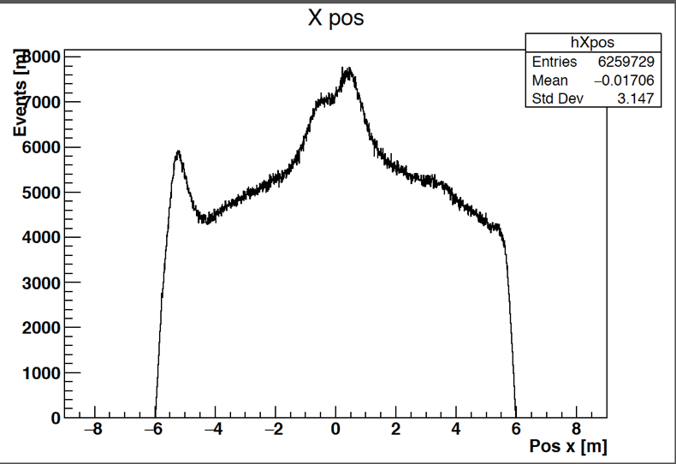
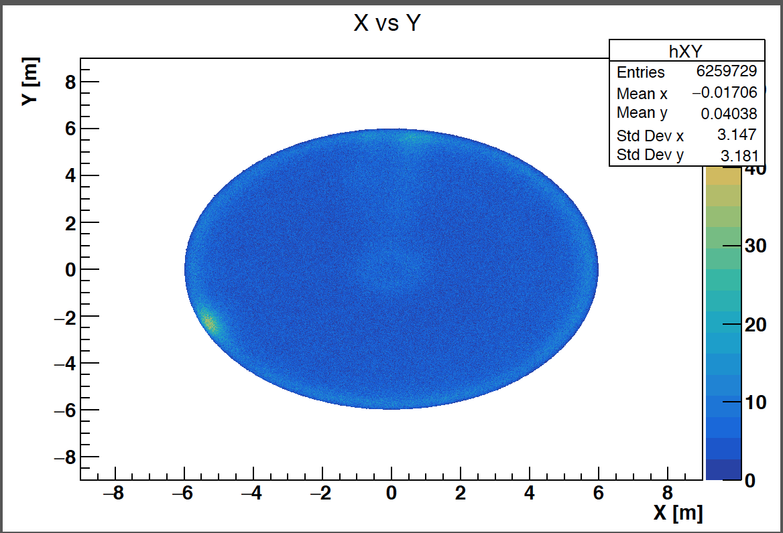
2 kinds of histograms

Slide 6
No source vs Source On
2nd position

Slide 8
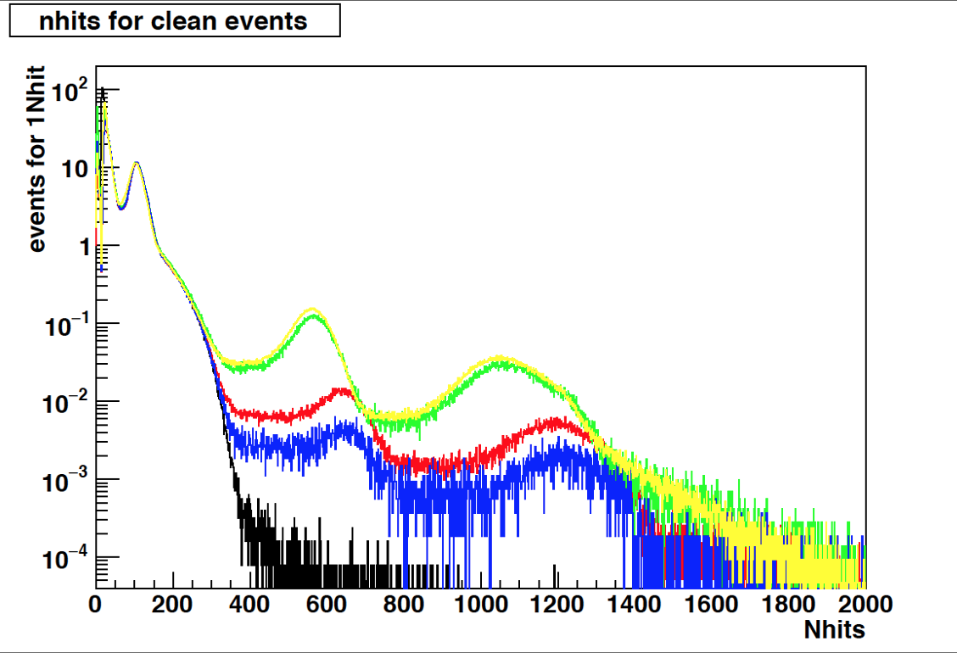
Position of the source (X,Y,Z):
Red curve : (-586,11; -252,41;100,0)
Blue curve : (-586,11;-252,41; 25,02)
Green curve : (118,1; -119,4; 591,1)
Yellow curve : (118,1; -119,4; 597,69)
Black curve : No source

Slide 9
Summary of Results
z (cm) | Gamma 2.2 MeV per second | Gamma 4.4 MeV per second | peak 2 / peak 1 (%) | Total rate (events per second) | position peak 1 (nHit) | position peak 2 (nHit)
25,02 | 0,74 | 0,497 | 67,16216216 | 795,291 | 620,53 | 1201,29
100 | 2,12 | 1,36 | 64,1509434 | 920,971 | 624,61 | 1180,38
591,1 | 11,99 | 6,0254 | 50,25354462 | 782,337 | 562,98 | 1064,8
597,69 | 14,17 | 7,71 | 54,41072689 | 763,166 | 558,81 | 1056,12

Slide 10
Thank you all involved in this project for the opportunity.
We hope to see you next year!

