Slide 1
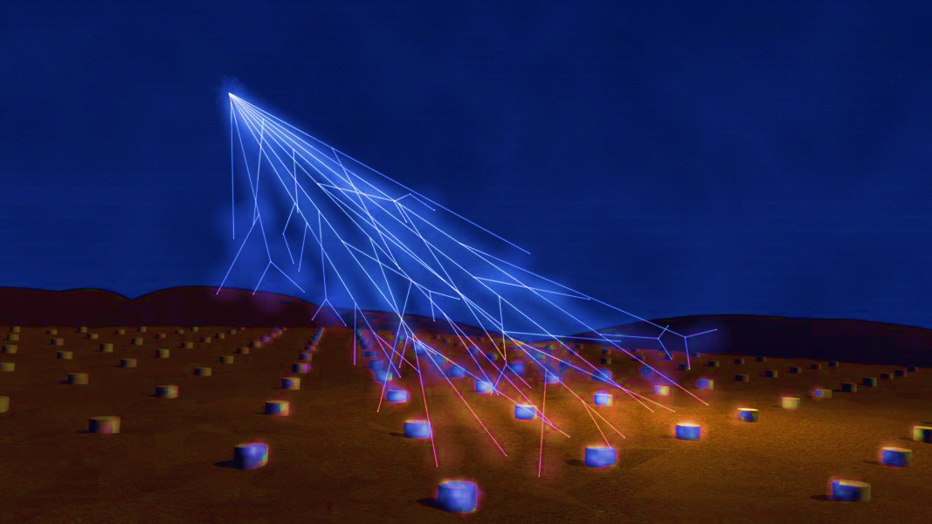
Pierre Auger vs The Machine
Final Report
Diogo Costa
Supervisors: Felix Riehn, Ruben Conceição, Lorenzo Cazon

Slide 2
Quick Recap

Slide 3
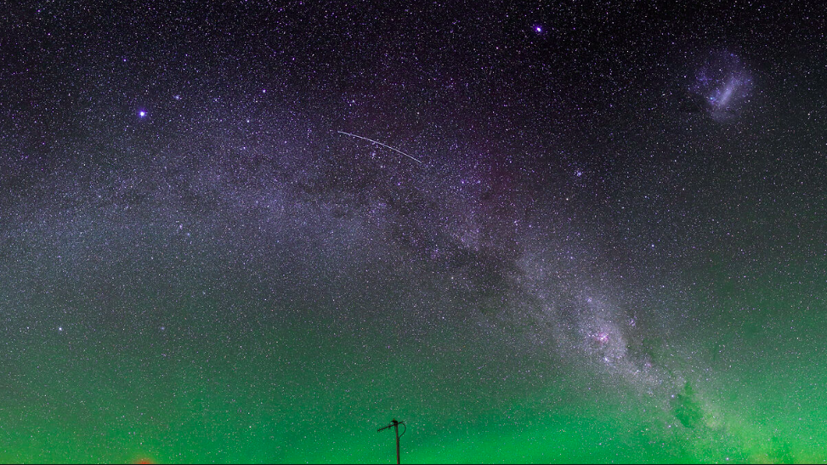
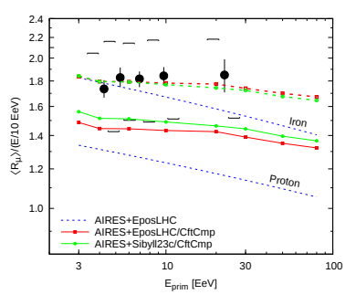
Quick Recap | Hadronic Models
Deficit in the # of predicted muons compared to the Auger Data
Information about UHECRs is extracted using simulations based on hadronic interaction models which rely on extrapolations of accelerator measurements to unexplored regions of phase space
The muon deficit in simulations starts around ${10}^{16}$ eV and steadily increases with energy. Depending on model and experiment, the deficit at ${10}^{20}$ eV ranges between tens of percent up to a factor of 2
Diogo Costa | Pierre Auger vs The Machine - LIP Internship
Sep 2021

Slide 4
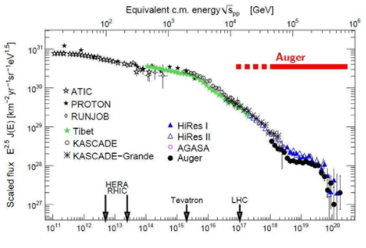
Quick Recap | Hadronic Models 2
Understand the highest energies cr origin and sudden flux decrease
Estimate the primary mass and charge
Study hadronic interactions at high energy
Diogo Costa | Pierre Auger vs The Machine - LIP Internship
Sep 2021

Slide 5
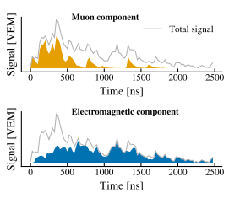
Quick Recap | Machine Learning
With the current design of the SD, the separation of the muon and electromagnetic components can only be done for events with large zenith angles or for distances far off from the shower core
Currently most variables are estimated trough MC simulations which induce great uncertainty
Additional composition-sensitive information will help to reduce systematic uncertainties related to modeling hadronic showers and to limitations of reconstruction algorithms.
Diogo Costa | Pierre Auger vs The Machine - LIP Internship
Sep 2021

Slide 6
Papers

Slide 7
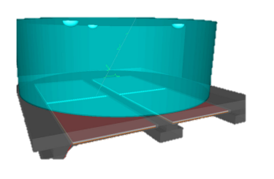
Papers|MARTA
Marta - Muon Array with RPCs for Tagging Air showers
UMD - Underground Muon Detector
4 RPC’s per tank
Each RPC divided into 8x8 pads
Double layer pads
Diogo Costa | Pierre Auger vs The Machine - LIP Internship
Sep 2021

Slide 8
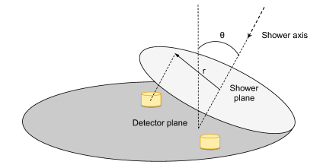
Papers|Neural Network
Info:
RNN architecture
Input – core distance, sectheta (zenith angle) and a vector of size 200
Output – vector of size 200 (predicted signal)
4 hidden layers with f(x) = max(0,x) and f(x) = tanh(x) as activation functions
Loss Function(L) $=\frac{1}{200}\sum_{i=1}^{200}{{\left(s_{i}^{p}−s_{i}\right)}^{2}}$
Training:
Energies ranging from ${10}^{18.5}−{10}^{20.2}$eV
# of events per set: training-390 000 , validation-22 000, test-34 000
Zenith angles up to 60°
Diogo Costa | Pierre Auger vs The Machine - LIP Internship
Sep 2021

Slide 9
Project

Slide 10
Project | Marta and Neural Network
Simulate the air shower events using Epos-lhc
Simulate the WCD and MARTA
Calculate the NN prediction for the muon shower componente
Compare all of them
Diogo Costa | Pierre Auger vs The Machine - LIP Internship
Sep 2021

Slide 11
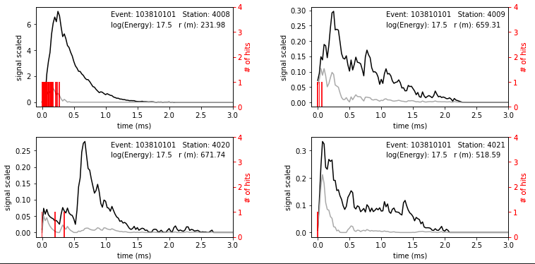
Project | Results
Using MARTA data as a verification procedure for the NN
Current problems:
MARTA synchronization with the WCD
Diogo Costa | Pierre Auger vs The Machine - LIP Internship
Sep 2021

Slide 12
Conclusion

Slide 13
Conclusion
This method shows a new oportunity to gather machine learning with physical detectors
With new and better detectors one can further train this or other NN, but the ultimate goal is to come up with a model which can correctly explain the hadronic interactions and solve the “muon puzzle”
Diogo Costa | Pierre Auger vs The Machine - LIP Internship
Sep 2021

