Slide 1
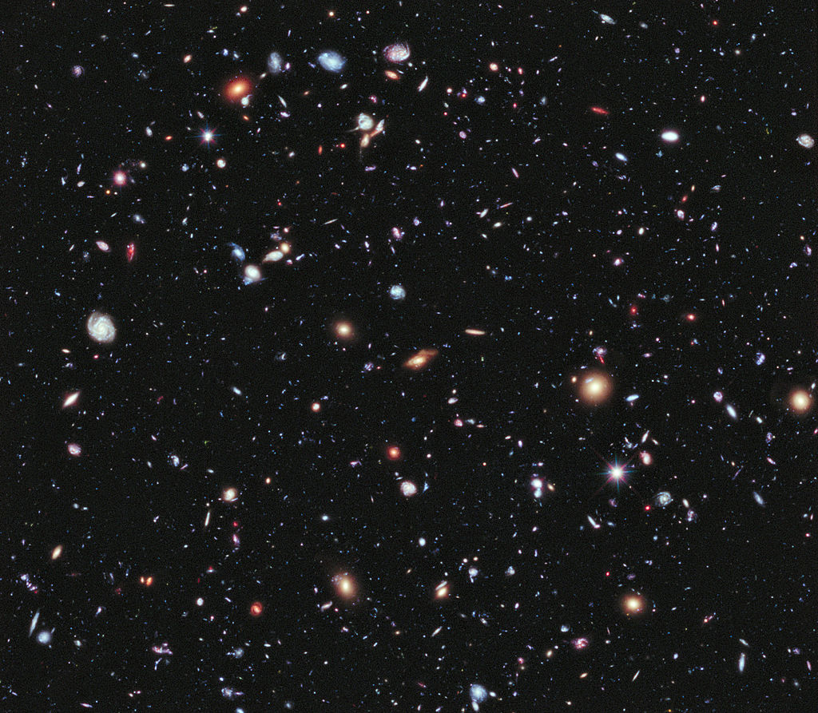
Cosmological and astrophysical applications of modified theories of gravity
João Luís de Figueiredo Rosa
IDPASC/LIP students’ workshop 25 – 27 June 2020

Slide 2
MY PAPERS DURING IDPASC
Chapter 3: J. L. Rosa, S. Carloni, J. P. S. Lemos, F. S. N. Lobo, “Cosmological solutions in generalized hybrid metric-Palatini gravity”, Physical Review D95 124035 (2017); arxiv:1703.03335 [gr-qc].
Chapter 4: J. L. Rosa, S. Carloni, J. P. S. Lemos, “The cosmological phase space of generalized hybrid metric-Palatini theories of gravity”, Physical Review D101 104056 (2020); arxiv:1908.07778 [gr-qc].
Chapter 5: J. L. Rosa, J. P. S. Lemos, “Junction conditions of the generalized hybrid metric-Palatini gravity and their consequences”, in final stages of preparation.
Chapter 6: J. L. Rosa, J. P. S. Lemos, F. S. N. Lobo, “Wormholes in generalized hybrid metric-Palatini gravity obeying the matter null energy condition everywhere”, Physical Review D98 064054 (2018); arxiv:1808.08975 [gr-qc].
Chapter 7: J. L. Rosa, J. P. S. Lemos, F. S. N. Lobo, “Stability of Kerr black-holes in generalized hybrid metric-Palatini gravity”, Physical Review D101 044055 (2020); arxiv:2003.00090 [gr-qc].
Chapter 8:: S. Carloni, J. L. Rosa, J. P. S. Lemos, “Cosmology of f(R,□R) gravity”, Physical Review D99 104001 (2019); arxiv:1808.07316 [gr-qc].
Chapter 9: S. Carloni, J. L. Rosa, “Derrick’s theorem in curved spacetime”, Physical Review D100 025014 (2019); arxiv:1906.00702 [gr-qc].
Fulbright: E. Berti, R. Brito, C. F. B. Macedo, G. Raposo, J. L. Rosa, “Ultralight boson cloud depletion in binary systems”, Physical Review D99 104039 (2019); arxiv:1904.03131 [gr-qc].
Thesis: J. L. Rosa, “Cosmological and astrophysical applications of modified theories of gravity”, Instituto Superior Técnico, Lisboa, Portugal; arxiv:1911.08257 [gr-qc].
IDPASC Students’ Workshop 2020 1/7

Slide 3
PART I
INTRODUCTION

Slide 4
MOTIVATION
If General Relativity (GR) is so successful, why do we need modified gravity?
GR PROBLEMS:
No quantum description
Dark matter and dark energy
Exotic matter in wormholes
Existence of singularities
Need for modified gravity!
How can we modify gravity?
TWO
WAYS
By adding extra fields to the action
By adding higher-order terms
Sometimes, the two representations are connected, e.g., f(R) with scalar-tensor.
IDPASC Students’ Workshop 2020 2/7

Slide 5
METRIC AND PALATINI
Two different variational approaches: metric and Palatini formalisms
Metric formalism: is Levi-Civita of
Consequences?
Palatini formalism: is independent of
General Relativity
Same field equations
f(R) Gravity
Formalism dependent
QUESTION: what happens if we combine both formalisms in the same framework?
IDPASC Students’ Workshop 2020 3/7

Slide 6
PART II
COSMOLOGY

Slide 7
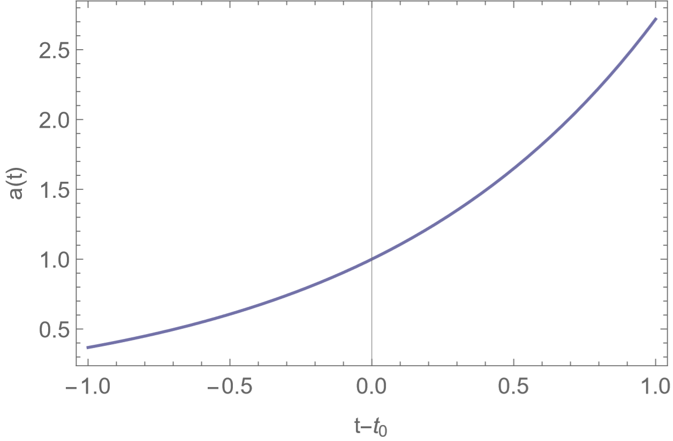
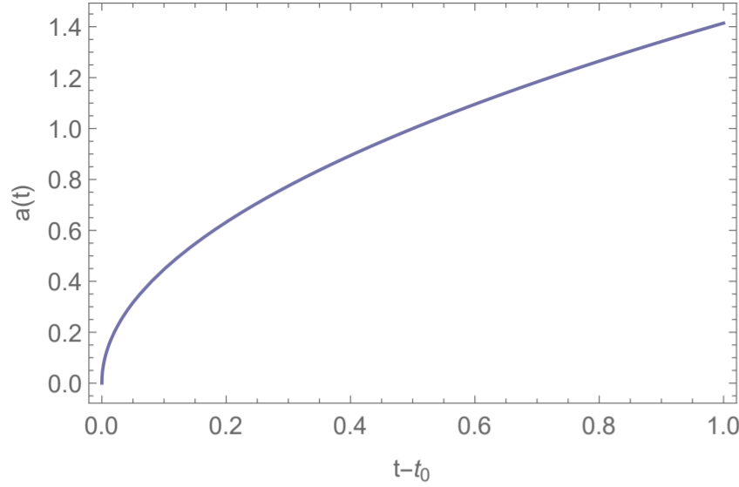
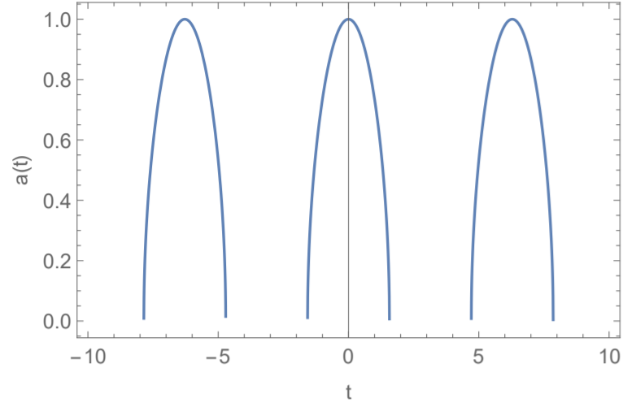
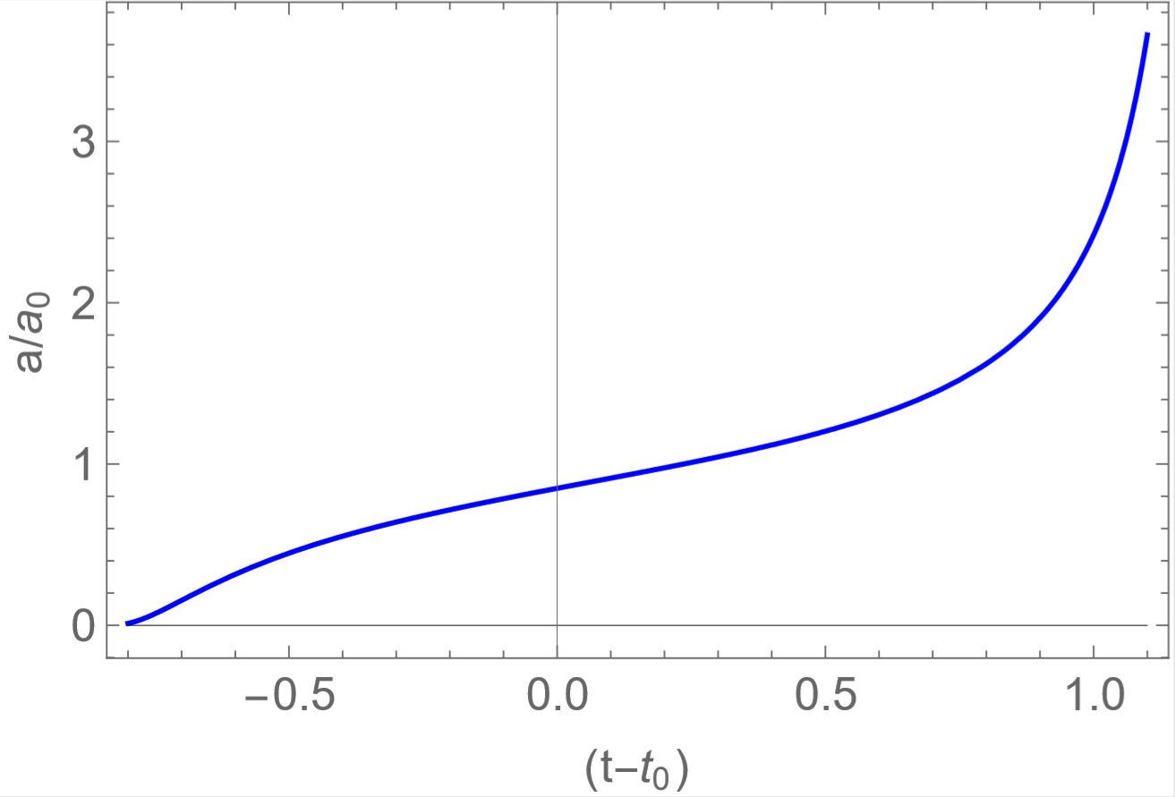
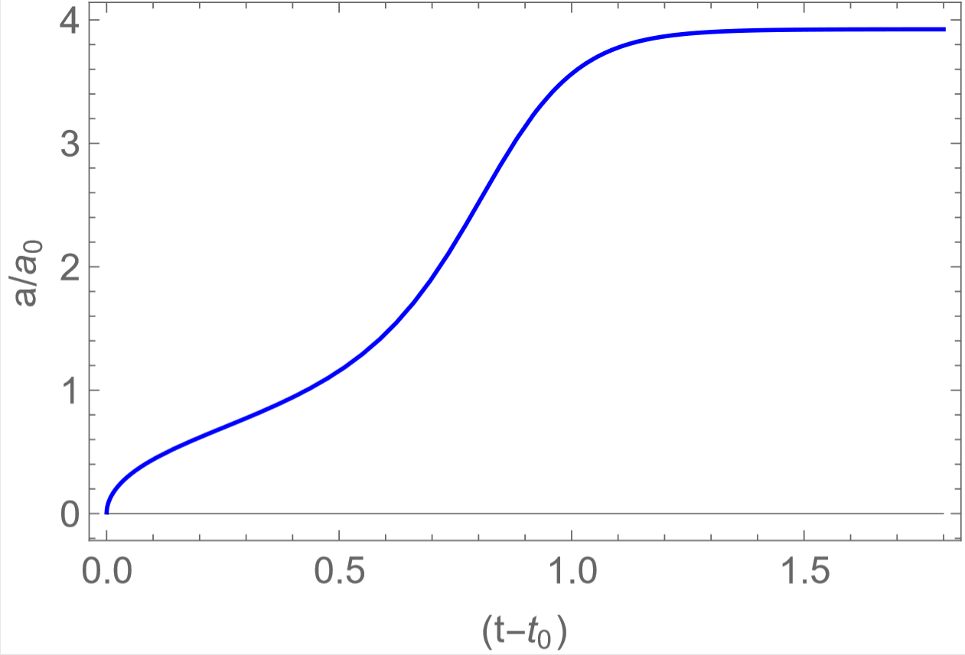
COSMOLOGICAL APPLICATIONS
Problem 1: can modified gravity reproduce the observed expansion laws?
(a) Exponentials
(b) Power-laws
(c) Oscillating
Bonus: we found that for every vacuum model there are numerous matter-populated models with the same behavior for any equation of state
Problem 2: what are the fixed points of the universe as a dynamical system?
Inflationary behaviors
Late-time acceleration
Asymptotics
You are here:
(a) Solution with
(b) Solution with
IDPASC Students’ Workshop 2020 4/7
Notes:
Fluido perfeito

Slide 8
PART III
ASTROPHYSICS

Slide 9
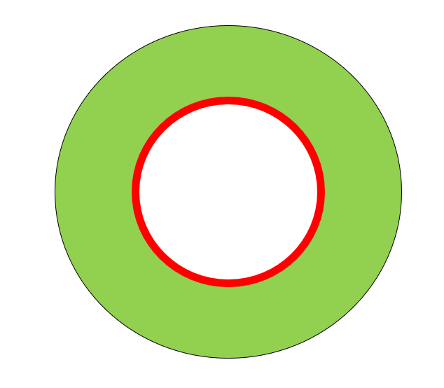
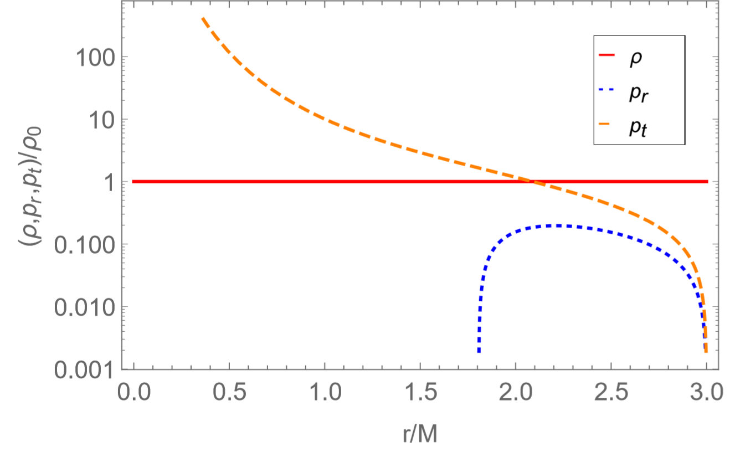
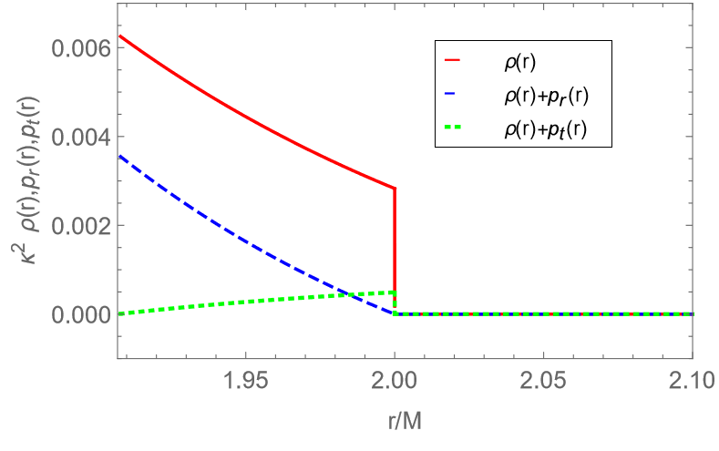
ASTROPHYSICAL APPLICATIONS
Problem 3: are there solutions for very compact objects without singularities?
Schwarzschild
Perfect Fluid
Minkowski
Thin-shell
(a) Schematic representation
(b) Matter components
Bonus: This object is indistinguishable from a black-hole (presents a shadow).
Problem 4: can traversable wormholes solutions be free of exotic matter sources?
Kottler
Thin-shell
Throat
Perfect Fluid
(a) Schematic representation
(b) Matter components
IDPASC Students’ Workshop 2020 5/7

Slide 10
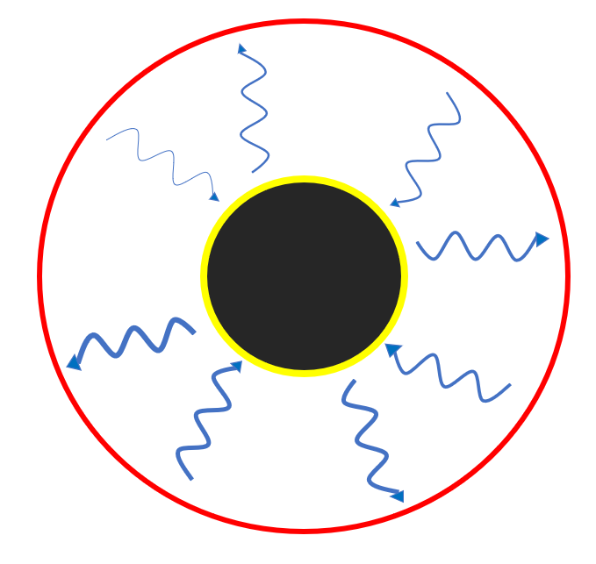
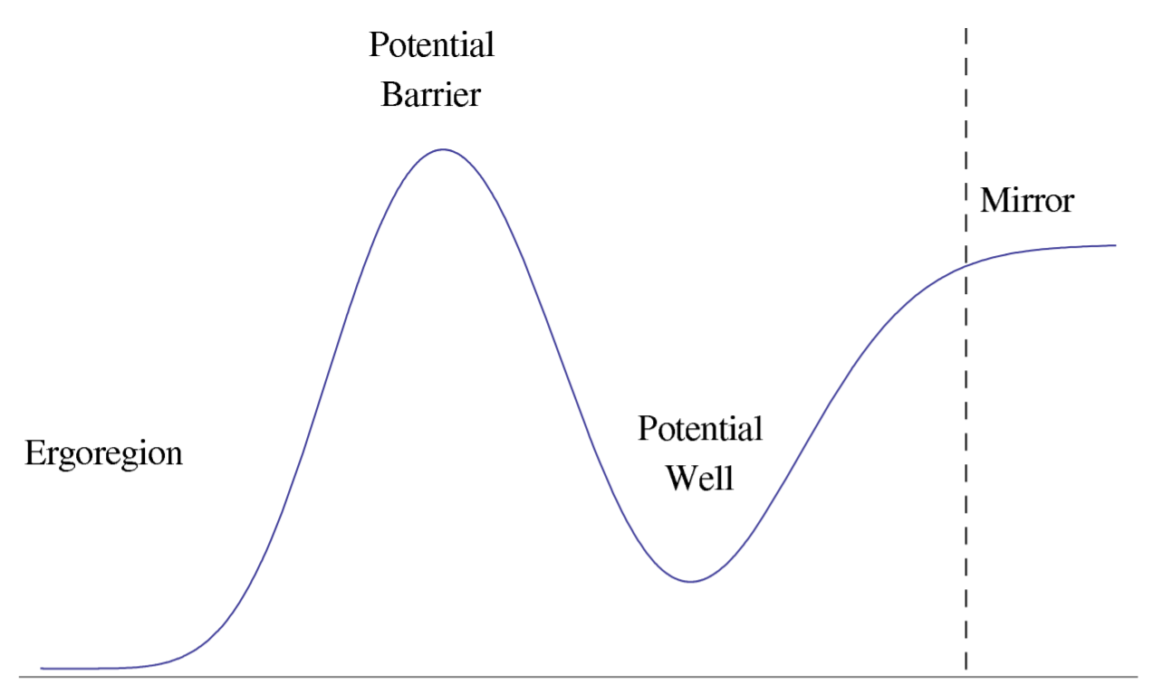
ASTROPHYSICAL APPLICATIONS
Problem 5: can modified gravity reproduce the (meta-)stability of black-holes?
Might lead to superradiant instabilities!
(Black-hole bombs)
(a) Superradiance
(b) Perturbation potential
CONCLUSIONS: Modified gravity theories can provide:
- Cosmological solutions consistent with observations without dark sources;
- Qualitative unification of inflation and late-time cosmic acceleration;
- Solutions for black-hole alternatives without horizons or singularities;
- Traversable wormhole solutions always satisfying the null energy condition;
- Solutions for astrophysical black-holes stable against tensor perturbations.
IDPASC Students’ Workshop 2020 6/7

Slide 11
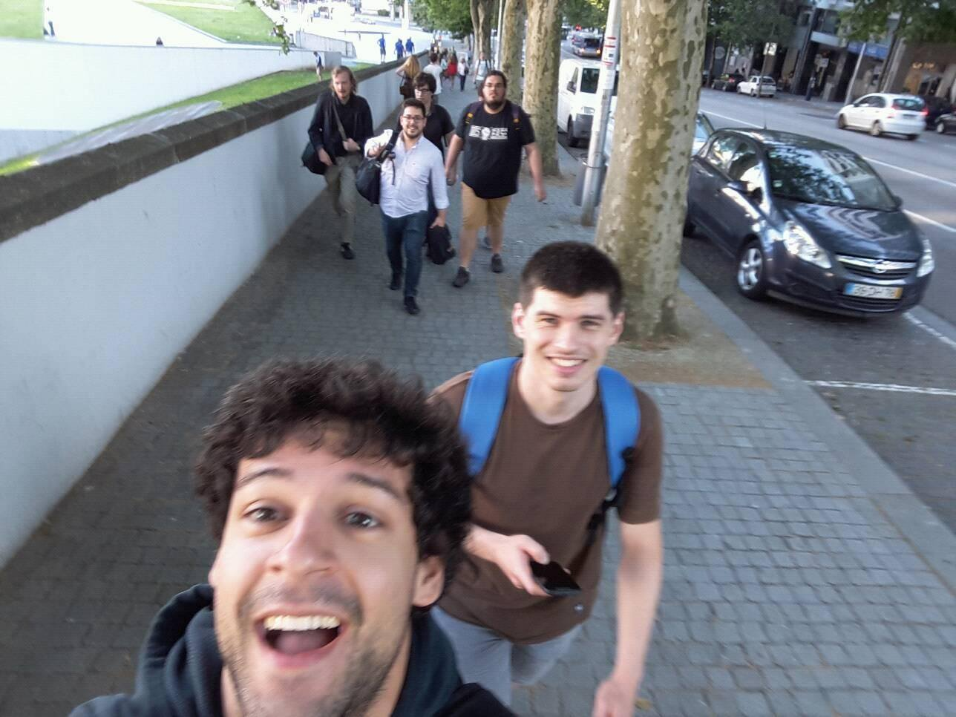
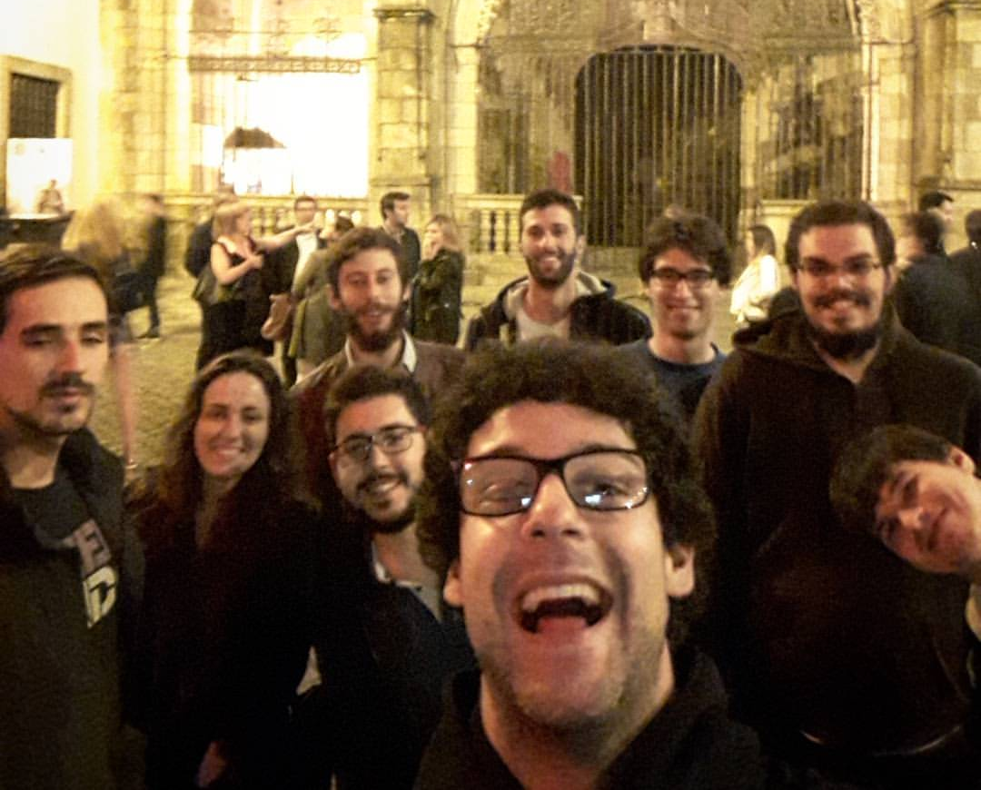
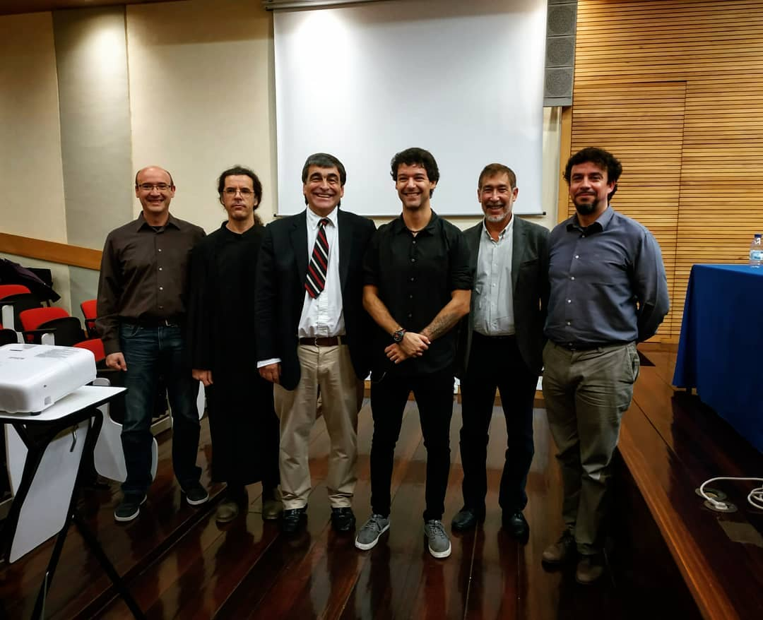
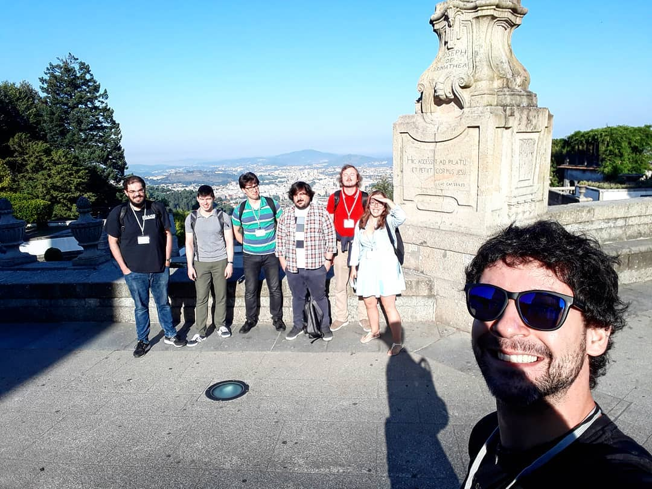
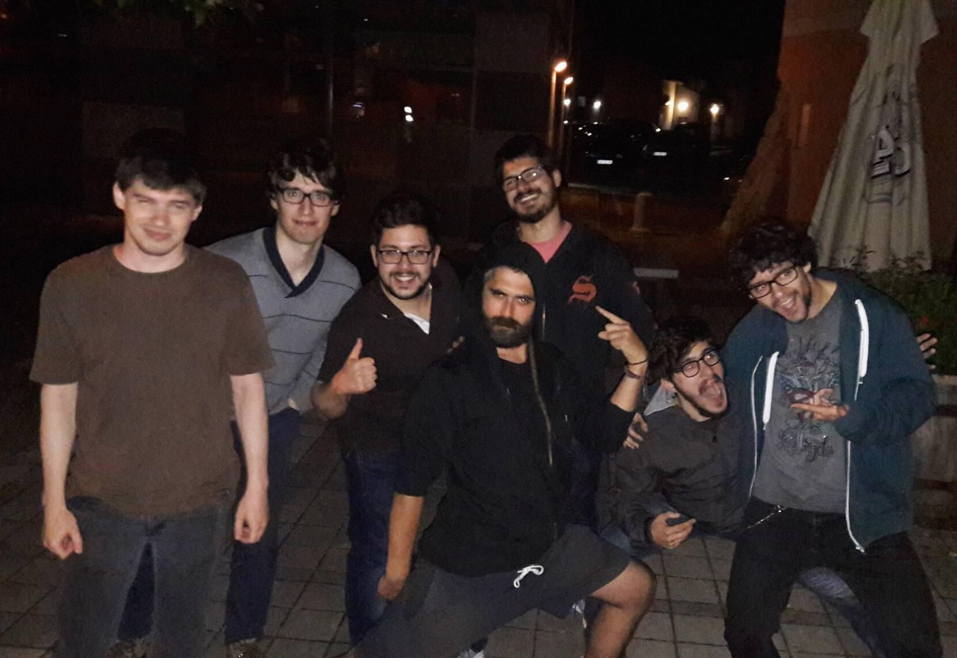
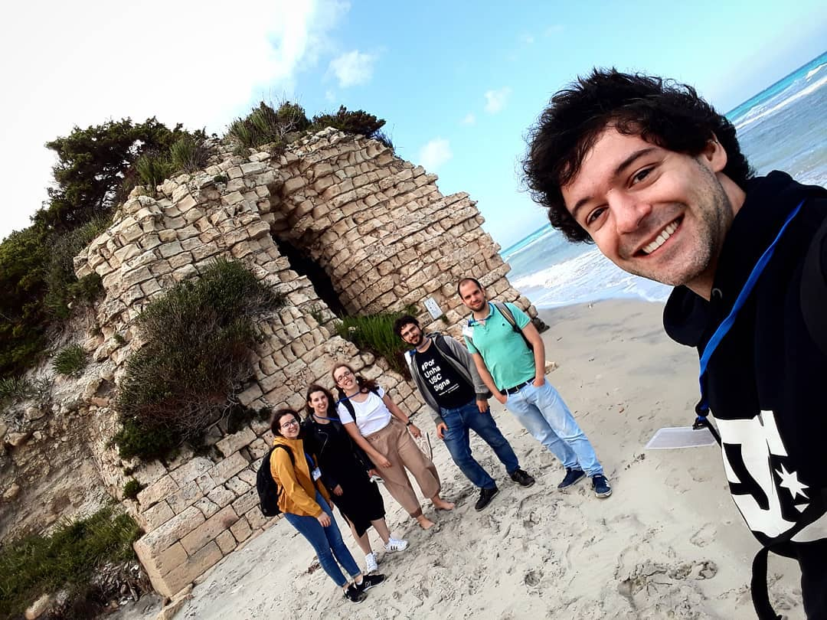
THANK YOU IDPASC!!!
WS Porto 2016
WS Aveiro 2017
WS Coimbra 2018
WS Braga 2019
School Vipava 2016
School Otranto 2019
IDPASC Students’ Workshop 2020 7/7

