Slide 1
Search for exclusive top quark pair production at the LHC
Summer Internship
Supervisors: Beatriz Ribeiro Lopes
Dr. Michele Gallinaro
Miguel Nobre Guerreiro

Slide 2
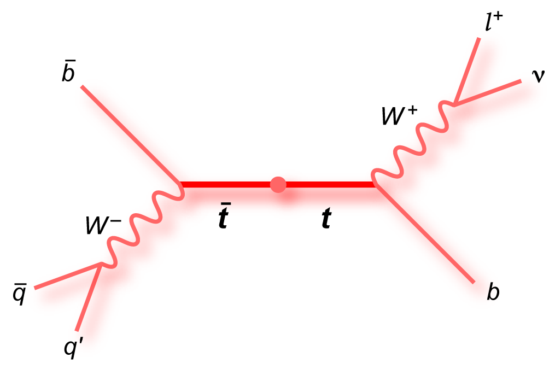
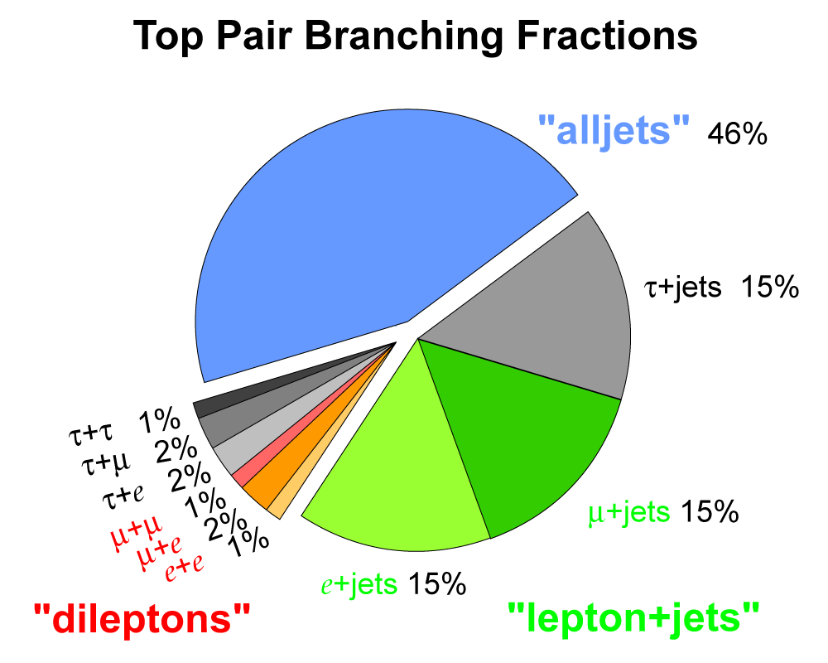
Brief Introduction
[1]
[1]
Top quark -> b-jet + W boson
We are interested in the dileptonic decaying channel
[1] https://www-d0.fnal.gov/Run2Physics/top/top_public_web_pages/top_feynman_diagrams.html
Notes:
Top quark decays almost exclusively in SM to a b jet and a W boson.
The difference between the Top quark decaying final products lies on the diferent W boson decaying channels:
. All jets;
. Lepton+jets;
. Dileptons.

Slide 3
Exclusive $t\overline{t}$
Dileptonic decaying channel
Photon-photon interaction
Missing transverse energy (met) due to neutrinos
Protons preserved and detected by the PPS (allow the kinematic reconstruction even with met)

Slide 4
PPS Detector
(Proton Precision Spectometer)
LHC magnets bend scattered protons outside of the beam envelope
Roman Pots placed a few mm from the beamline
Detect protons at about ± 200 m of the IP (positive and negative sides)

Slide 5
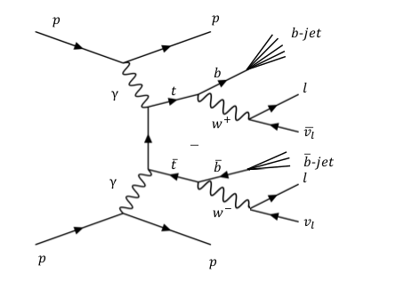
Central Selection
Require for leptons:
≥ 2
|𝜂| ≤ 2.5
p_{T} ≥ 13 GeV
Require for jets:
≥ 1
≥ 1 b-jet

Slide 6
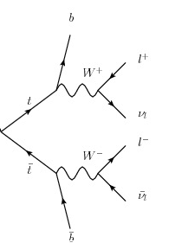
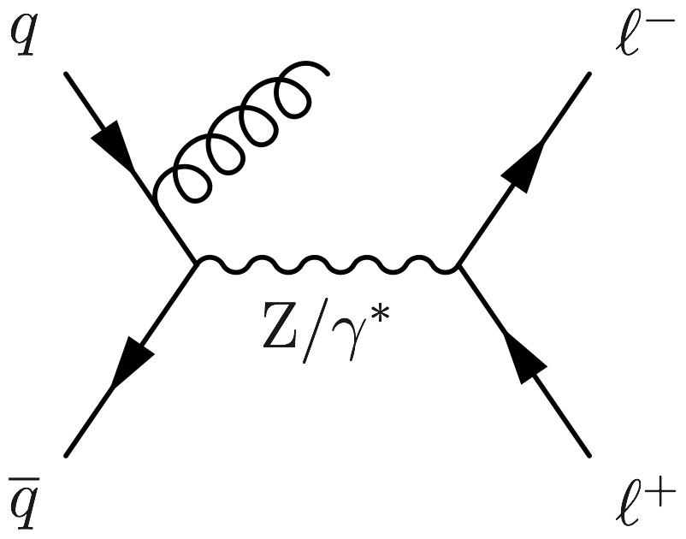
Main Background
Inclusive $t\overline{t}$
Drell-Yan
’
’

Slide 7
Kinematic Analysis
Monte Carlo samples from 2017
Inclusive $t\overline{t}$
Drell-Yan
Exclusive $t\overline{t}$
$\sqrt{s}$=13 TeV
Tools for multivariable analysis on real data

Slide 8
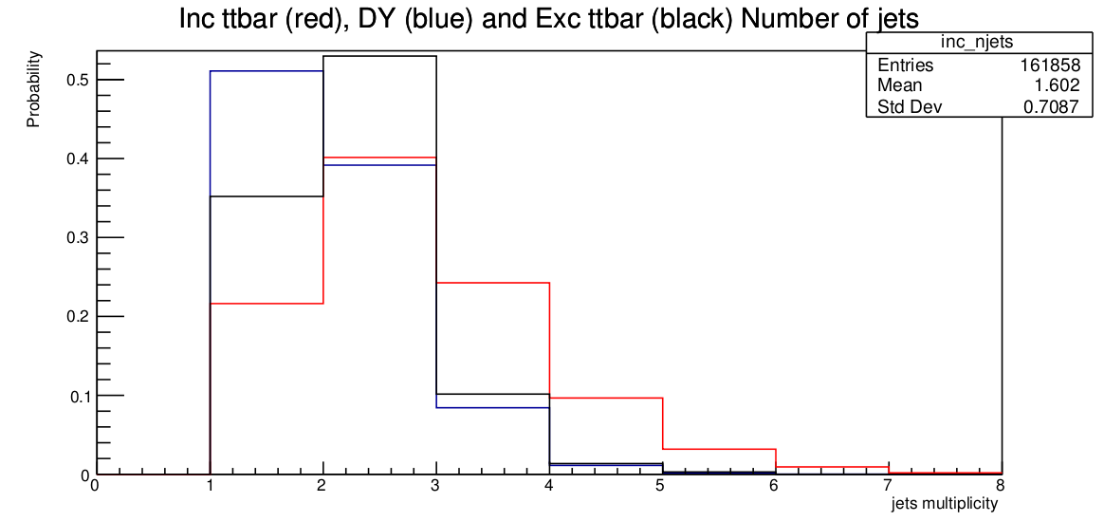
DY
Notes:
We can see here that the inclusive ttbar is distributed to higher number of jets. This results from the fact that, in the inclusive ttbar, the process results from fusion of gluons of the two interacting prontos (strong force) – whereas the exclusive comes from photon-photon interaction, mediated by electroweak force. Therefore, the inclusive ttbar generates a higher number of pair quark anti quark that will then hadronize, forming a higher number of “extra jets”. Thus, a possible selection cut could be to require a maximum number of Jets that are not b-Jets. Which would increase the significance of the analysis.

Slide 9
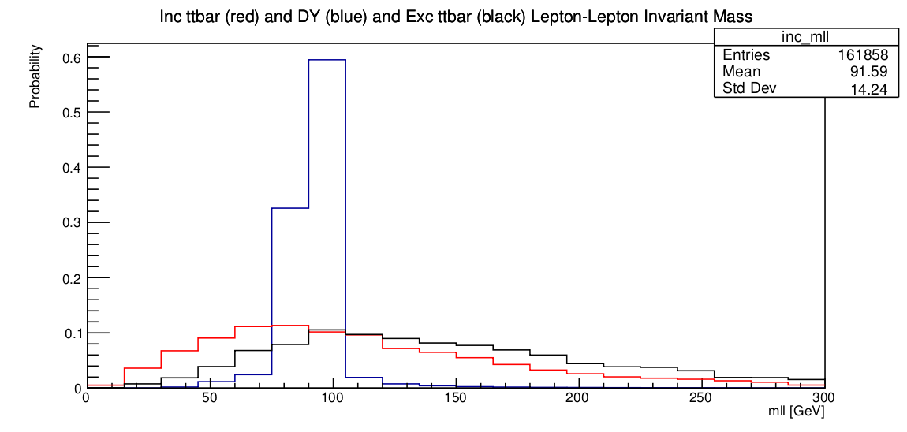
DY

Slide 10
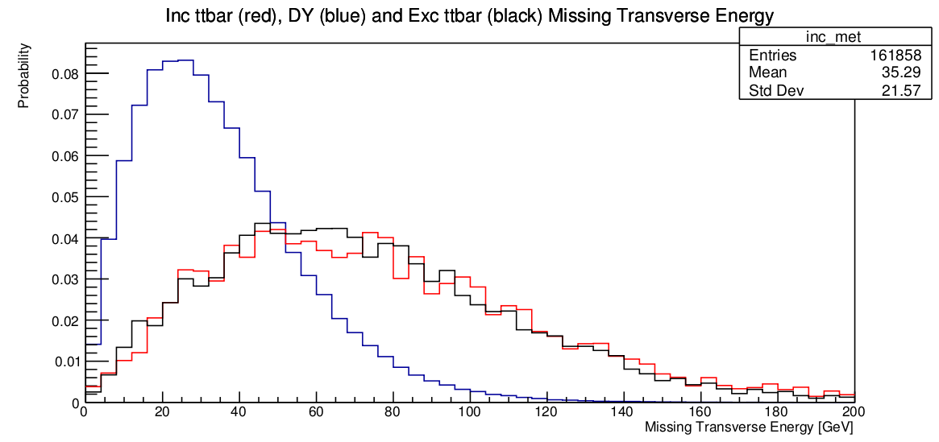
DY

Slide 11
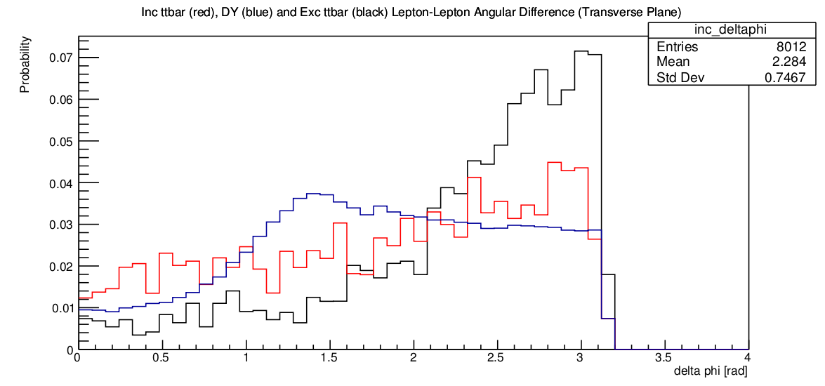
exc

Slide 12
Further Goals
Better highlight the differences between inclusive and exclusive $t\overline{t}$
PPS-RP: ξ(ll) Vs ξ(pp)

Slide 13
Thank you!

Slide 14
Backup

Slide 15
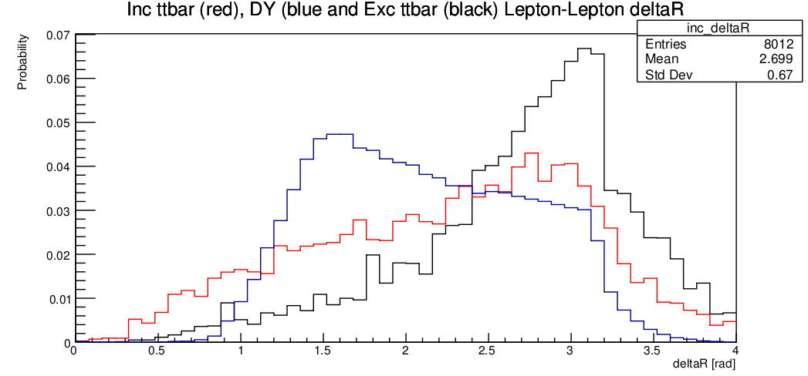
exc

Slide 16
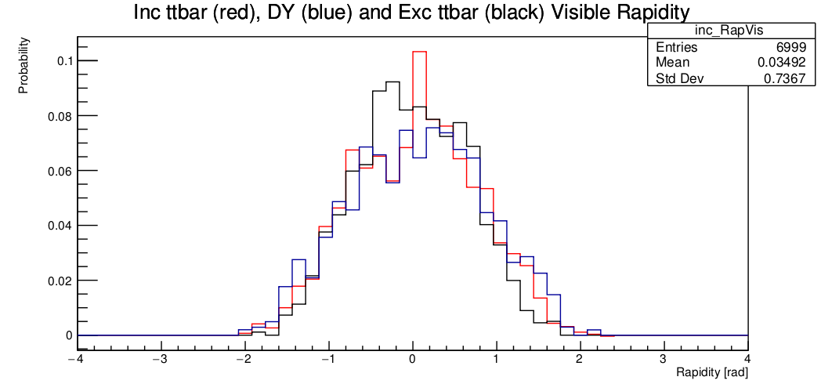
inc

Slide 17
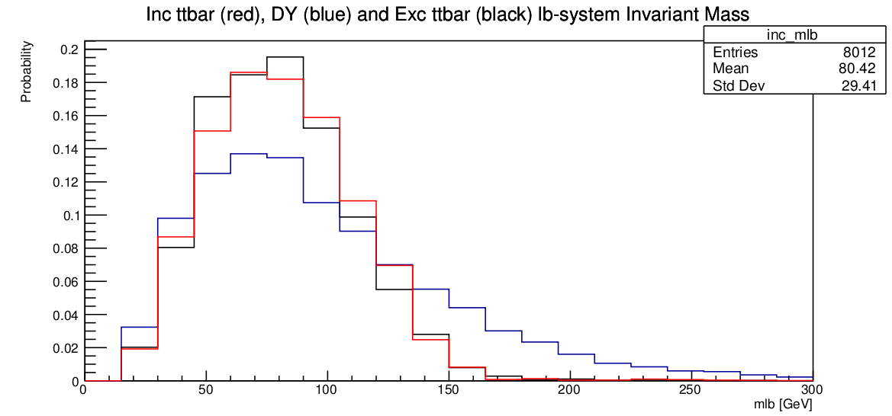
exc

Slide 18
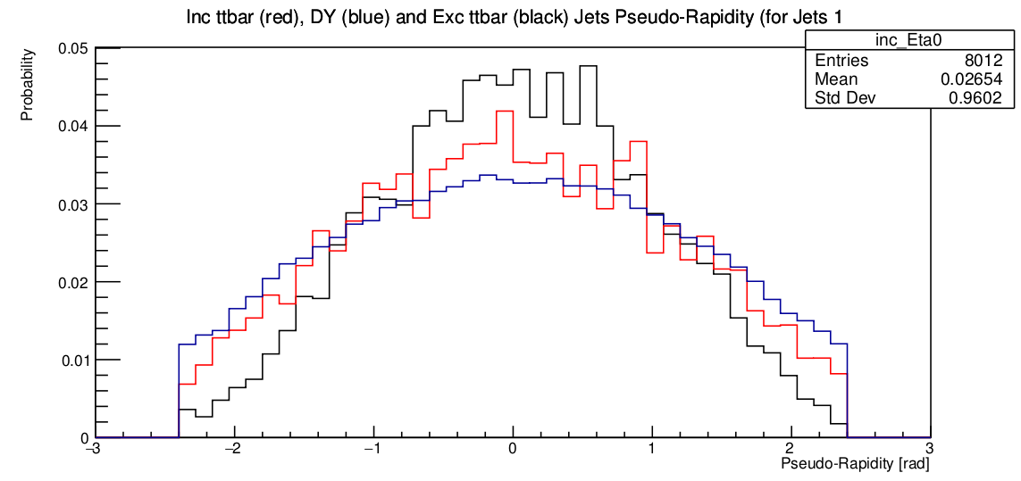
exc

Slide 19
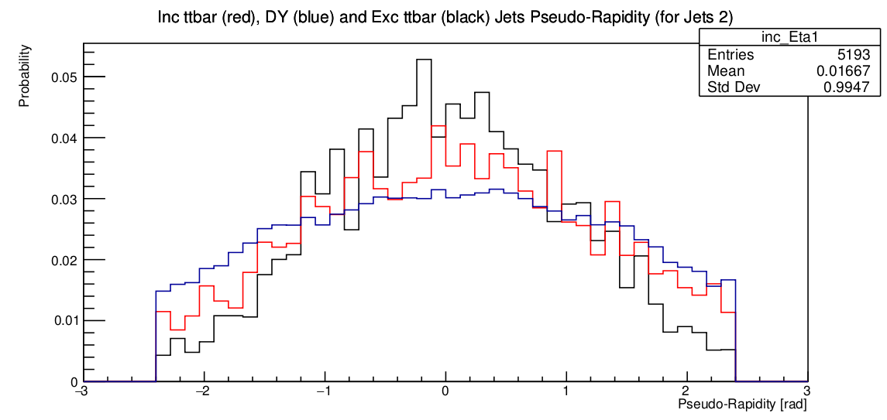
exc

Slide 20
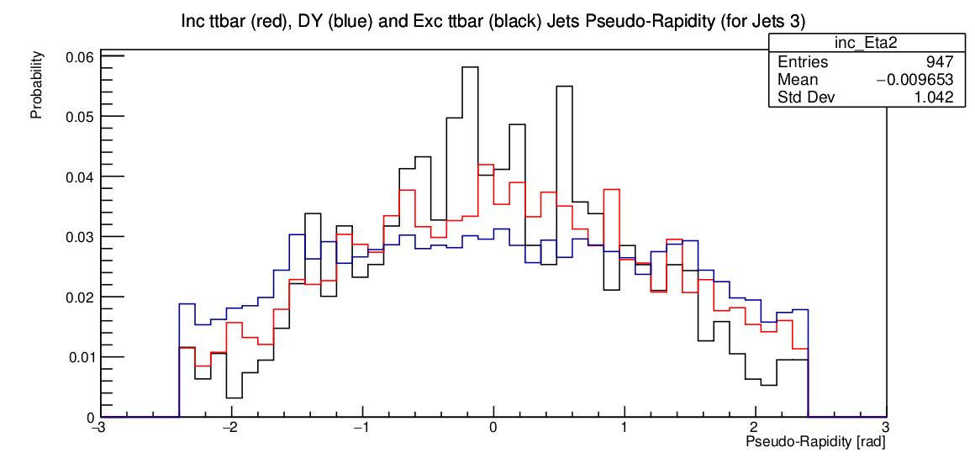
exc

Slide 21
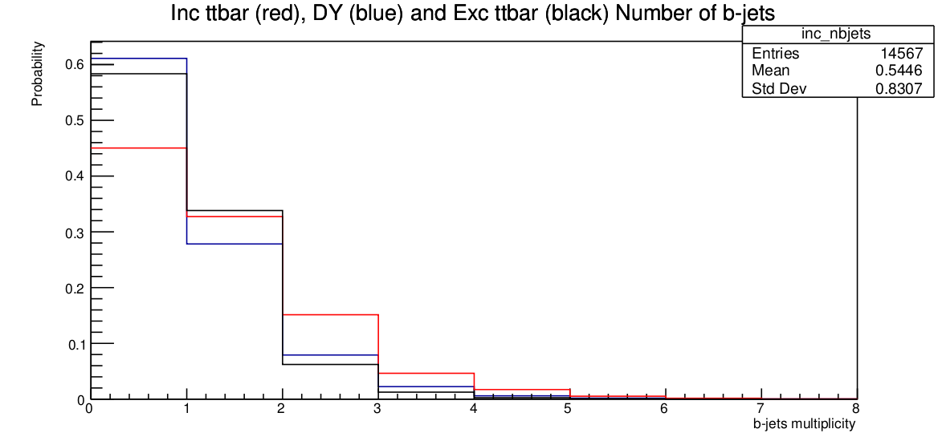
DY

Slide 22
Forward Tracks IN PPS
From each track we get the momentum loss of the proton
Reconstruct tracks on both sides ($ξ_{1}$ and $ξ_{2}$)
We can reconstruct the mass and rapidity of the system
$$m_{RP}=\sqrt{sξ_{1}ξ_{2}}$$
$$y_{RP}=\frac{1}{2} ln⁡\left(\frac{ξ_{1}}{ξ_{2}}\right)$$
$$ξ=\frac{p_{i}−p_{f}}{p_{i}}$$
1 per track in the RP
for every possible combination
$$y=0$$
check which mass and rapidity values are compatible with what we are looking for!
$$y=∞$$

