Slide 1
b-jets in Pb+Pb collisions with the ATLAS detector

Slide 2
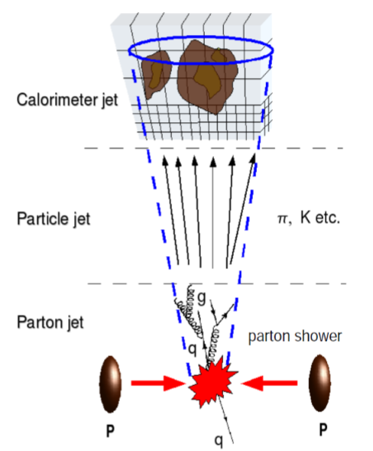
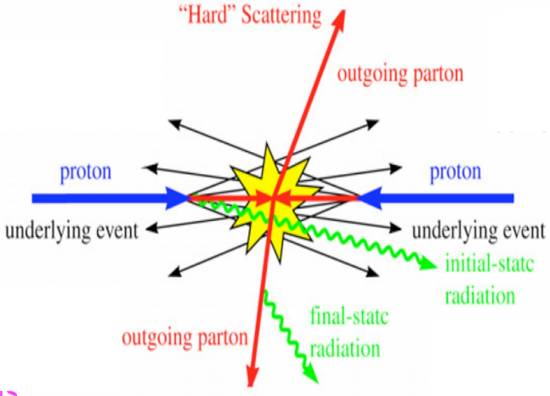
Introduction
What are jets?
Pb
Pb

Slide 3
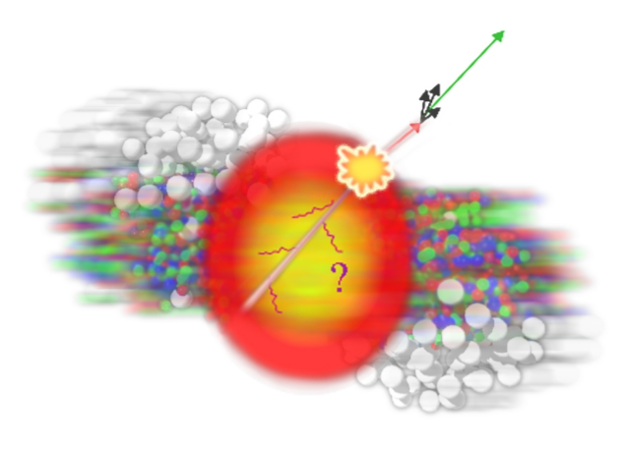
Introduction
Why are we studying them?
Why use b jets?

Slide 4
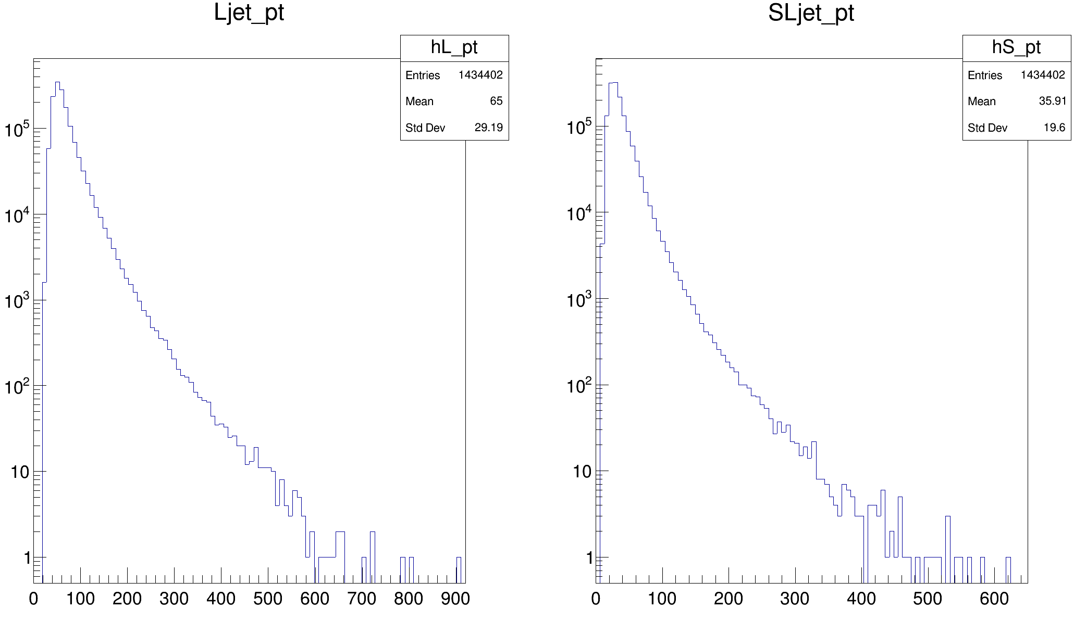
Pt-Transverse momentum
$$Pt=p×\sin{θ}$$

Slide 5
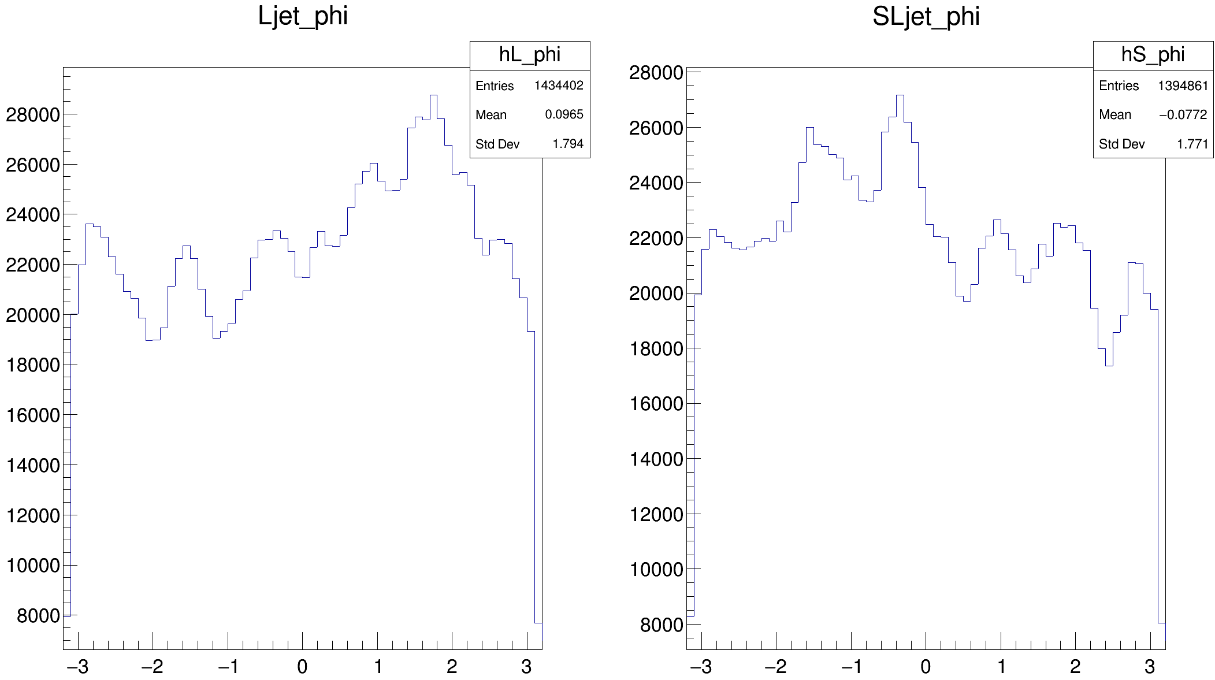
Phi (φ) - Azimuthal angle

Slide 6
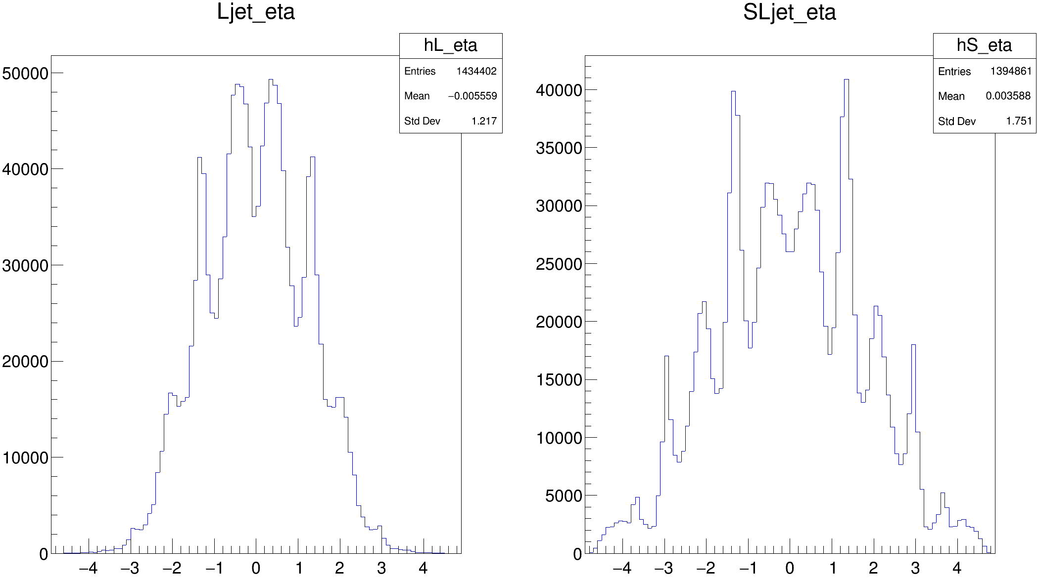
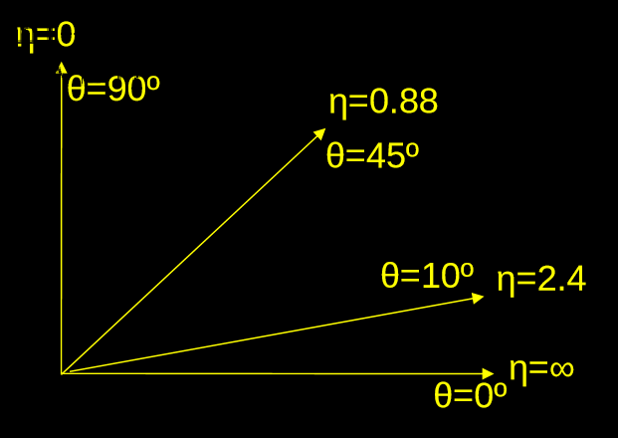
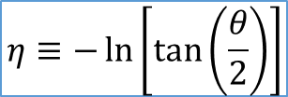
Eta (η) - Pseudorapidity
$$η≡−\ln\left[\tan\left(\frac{θ}{2}\right)\right]$$
$$ATLAS coverage: −4.9<η<4.9$$

Slide 7
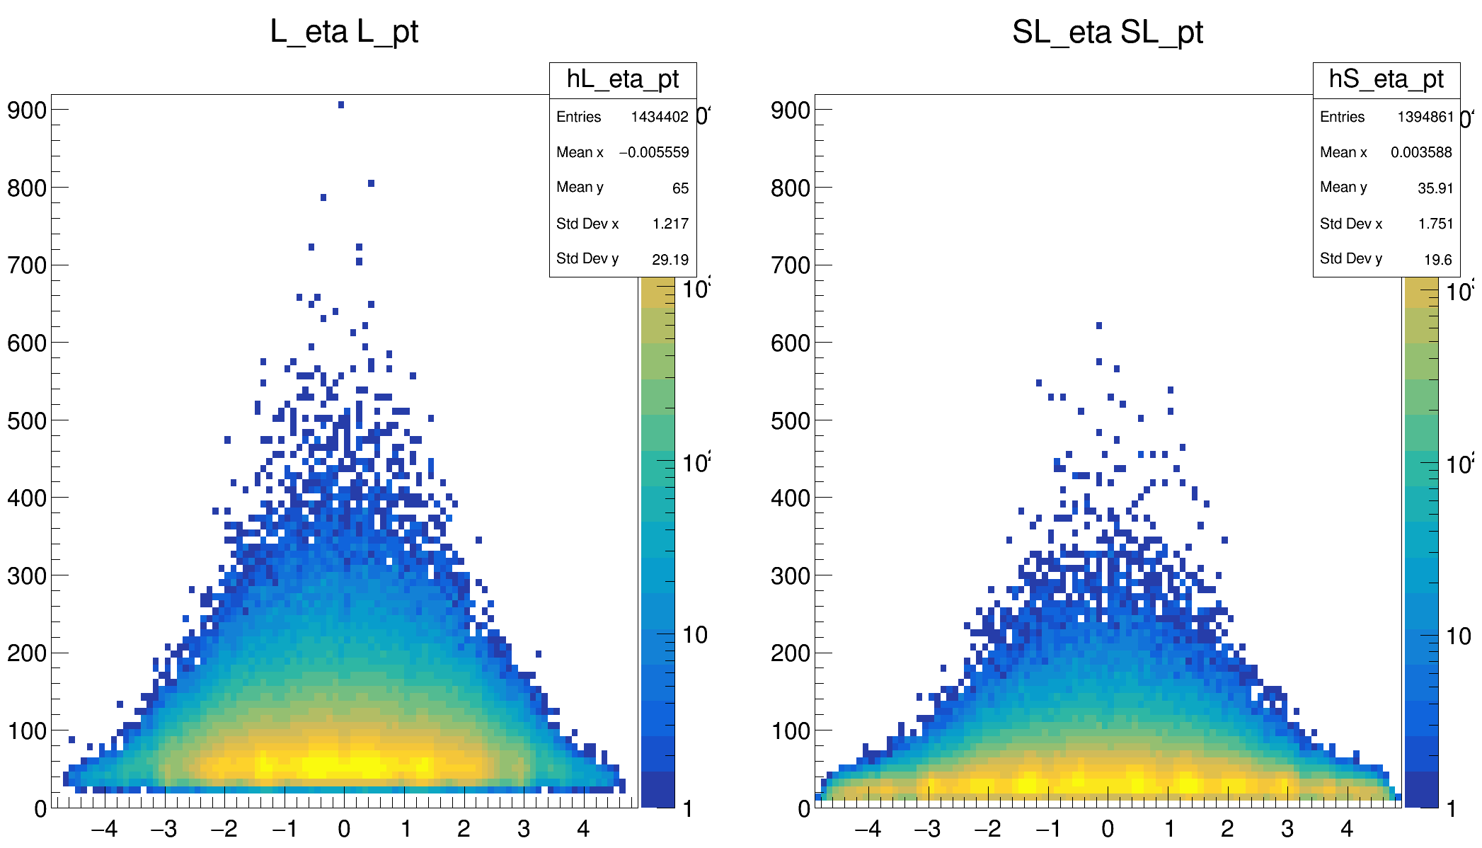
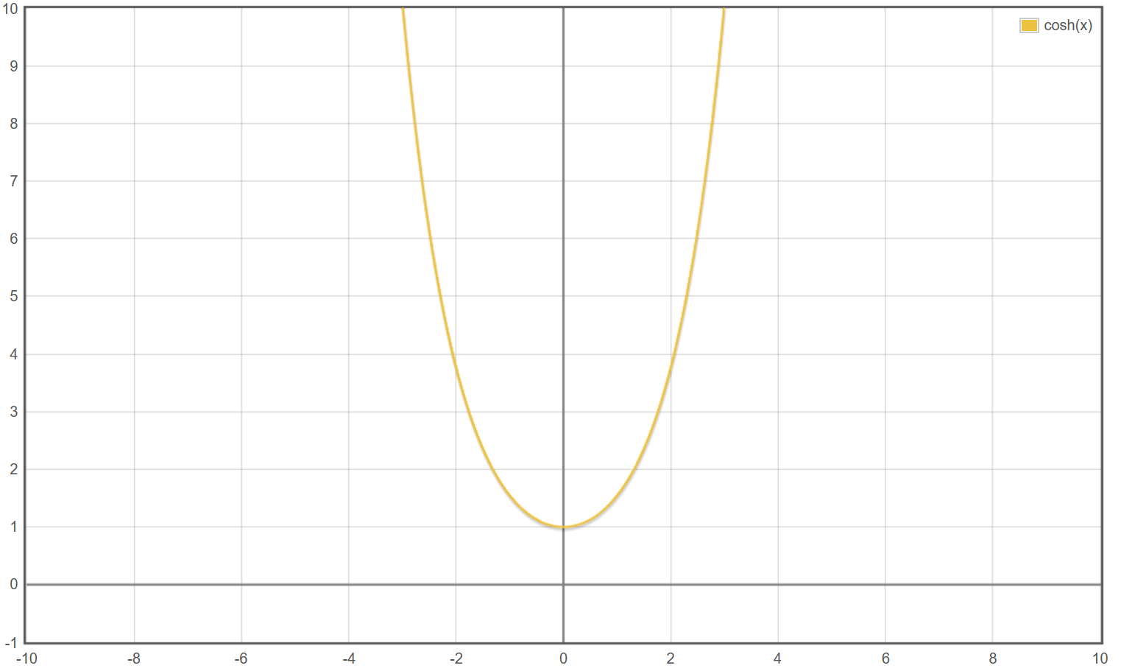
Eta (η) and Pt
$$pt=\frac{\left|p\right|}{\cosh{η}}$$

Slide 8
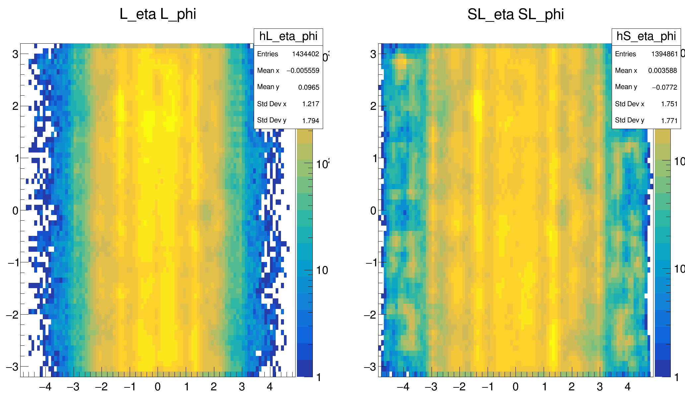
Eta (η) and Phi (φ)

Slide 9
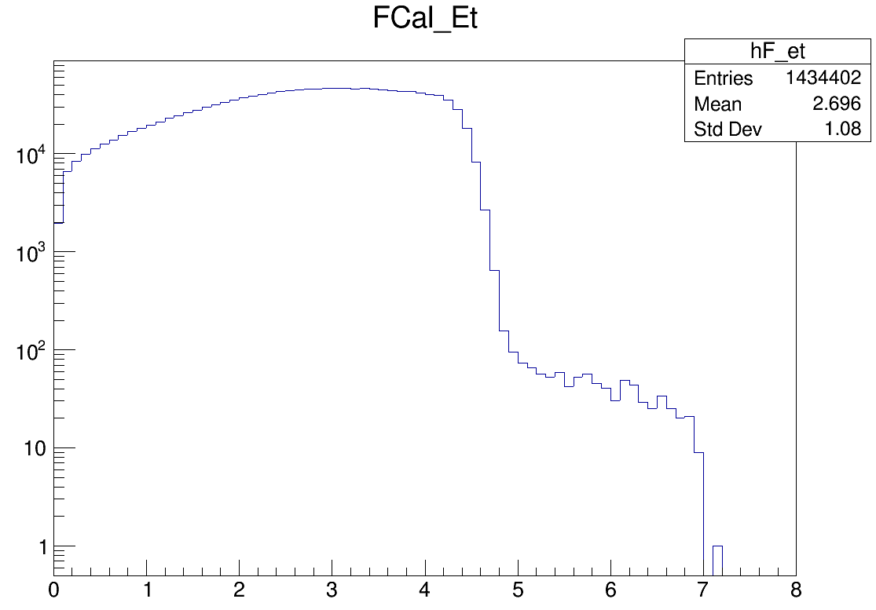
Centrality

Slide 10
What’s next?
We will “clean up” the histograms by trying to remove as much as we can of the background and the pile up;
Compare the jets in diferente percentages of centrality;
Study the dijet pt asymmetry and the Δφ;
Differentiate the b jets from light quark jets by making cuts in the variables Xjet_mv2c10 and Xjet_dl1.

