Slide 1
Dune & ARTIE: Argon transparency to neutrons
Leonardo oliveira | LIP 2019

Slide 2
Fig. 1: Illustration of DUNE setup
2

Slide 3
Liquid-Argon Time Projection Chambers
Fig. 2: Modified illustration of DUNE setup
3

Slide 4
Liquid-argon time projection chamber
Fig. 3: Animation of LArTPC mechanism
Fig. 4: CERN scientist inside the unfinished ProtoDUNE LArTPC
4

Slide 5
Pulsed neutron source calibration
Pulsed Neutron Source (PNS) shoots neutrons into LArTPC
Elastic scattering distributes neutrons throughout volume
Neutron capture reaction with Argon atom
Gamma rays provide current profile of the detector
PNS calibration relies on large scattering length for ⁴⁰Ar
Fig. 5: Illustration of PNS calibration mechanism
5

Slide 6
Scattering length
Depends on cross-section (isotope-specific)
Measured only once for 40-Ar (Winters, 1991)
Focused on resonance peaks
Not enough precision for anti-resonance peak
Anti-resonance peak at 57 keV
Predicted by theory, but not yet measured
Integral for PNS calibration to actually work!
Fig. 6: Total cross section data for ⁴⁰Ar
6

Slide 7
Artie
A rgon R esonant T ransport I nteraction E xperiment
Seeks to confirm scattering length for natural Liquid Argon at the 40 – 70 keV range
Fig. 7: Illustration of ARTIE setup
7

Slide 8
Current work
Simulations using Geant4
Time-energy reconstruction
Effect of 150ns noise from pulse
Fig. 8: Plots of Initial Energy (dashed red) and Reconstructed Energy (solid blue)
8

Slide 9
Current work
Fig. 9: Plot of neutron hits at counter
Fig. 10: Plot of radial distribution of hits

Slide 10
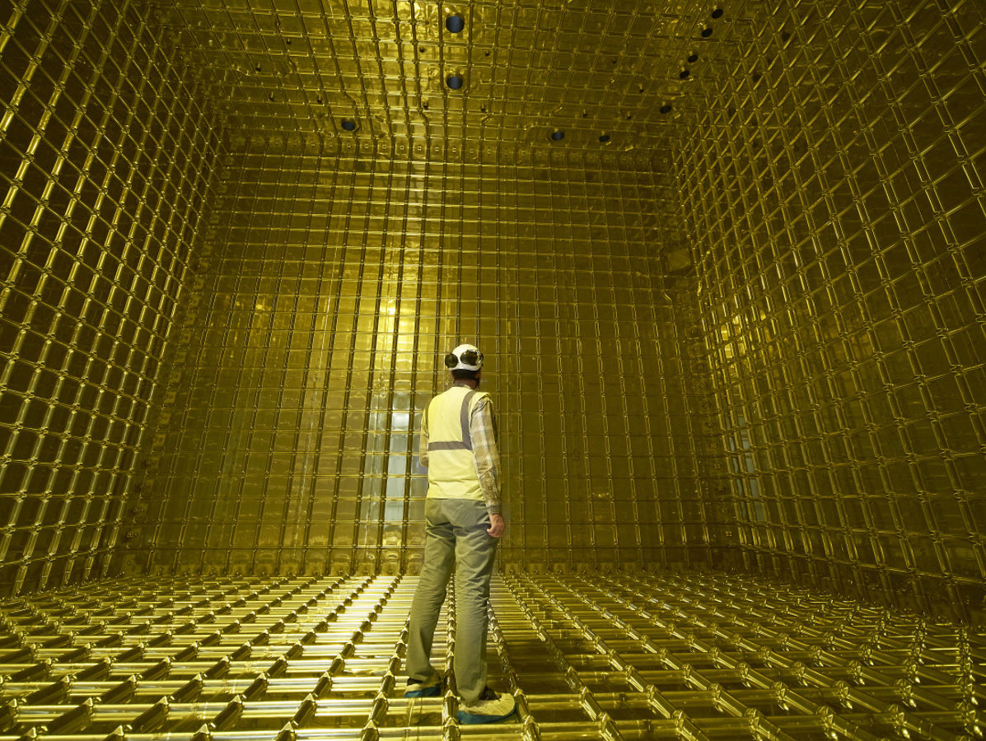
Thank You
Questions?

