Slide 1
Parton Shower: From QCD to Monte Carlo event generators
Íris Silva
Sérgio Carrôlo

Slide 2
Dijets and particle splitting

Slide 3
Pythia
Pythia is a tool for the generation of high-energy collisions;
It can generate pp, pp, e +e − and µ +µ − collisions;
Initial- and final-state algorithms are based on k⊥-ordered evolution ;
In our project we use pythia to simulate pp collisions.

Slide 4
Pythia – exemple of an event

Slide 5
Project and its applications
Our main goal is to be able to visualize an entire collision from the beggining using the data from a pythia event.
Its main applications:
For education purposes
Analyzing jet reconstruction theories’ consistency
Better understanding of how today’s theories reconstruct jets and what it looks like

Slide 6
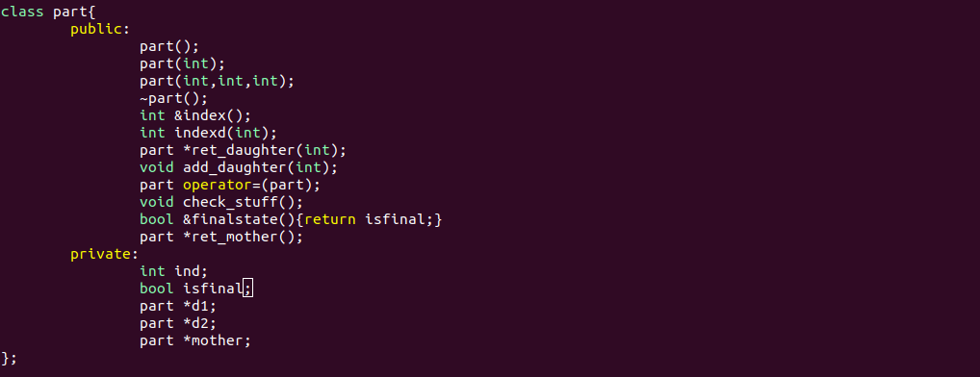
The class that makes everything possible

Slide 7
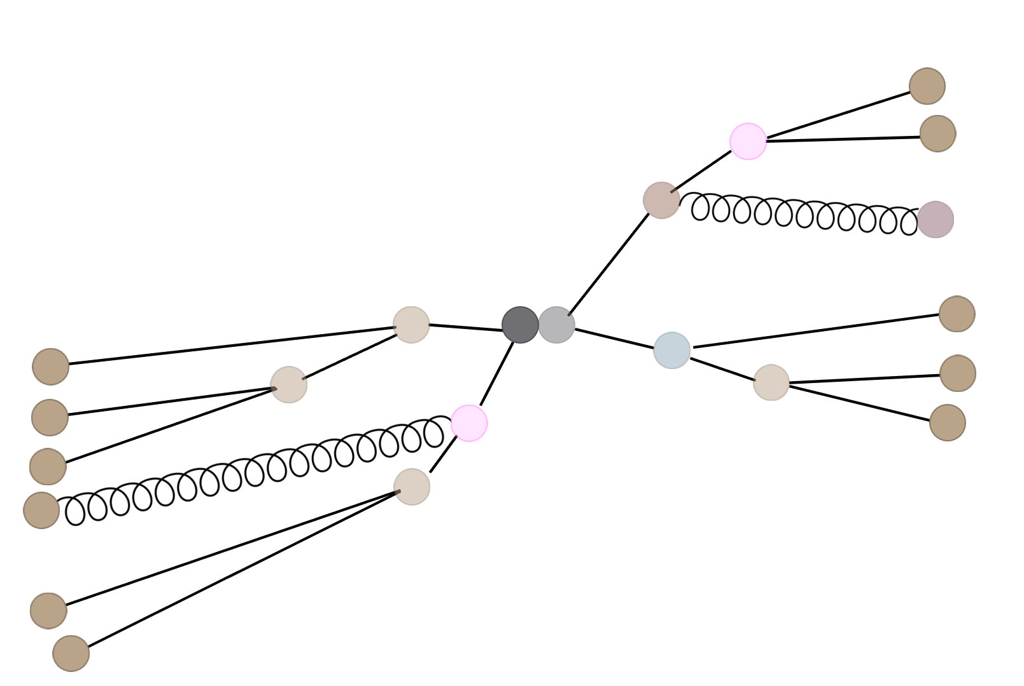
Our algorithm

Slide 8
Where we’re at

