Slide 1
Neutron Star Cooling in Strong Magnetic Field : Neutrino -Antineutrino Pair Emission and Diret Urca Processes
Tomoyuki Maruyama BRS, Nihon University
T.M. et al., PLB805 (2020) 135413, T.M. et al., arXiv:2103.01703
Collaborators
Toshitaka Kajino Beihang Univ., China
Myong-Ki Cheoun Soongsil Univ., Korea
A. Baha Balantekin Univ . of Wisconsin, USA
Grand. J. Mathews Univ. of Notre Dome, USA
1

Slide 2
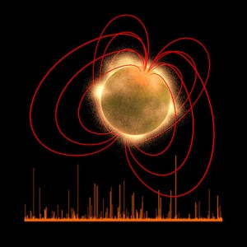
Magnetars Neutron-Star with Strong Magnetic-Field
Very Strong Magnetic Field B ～ 10^{14ー15} G (surface)
B ～ 10^{17－19} G (insides)
Normal Neutron Star B ～ 10^{12 －13} G
2) Long Spin Period
P = 2 ～ 12 s
Higher Temperature
Magnetic Eng. -> Thermal Eng.
4) Emitting High Energy Photons
Soft Gamma Repeater (SGR)
Anomalous Xray pulsar (AXP)

Slide 3
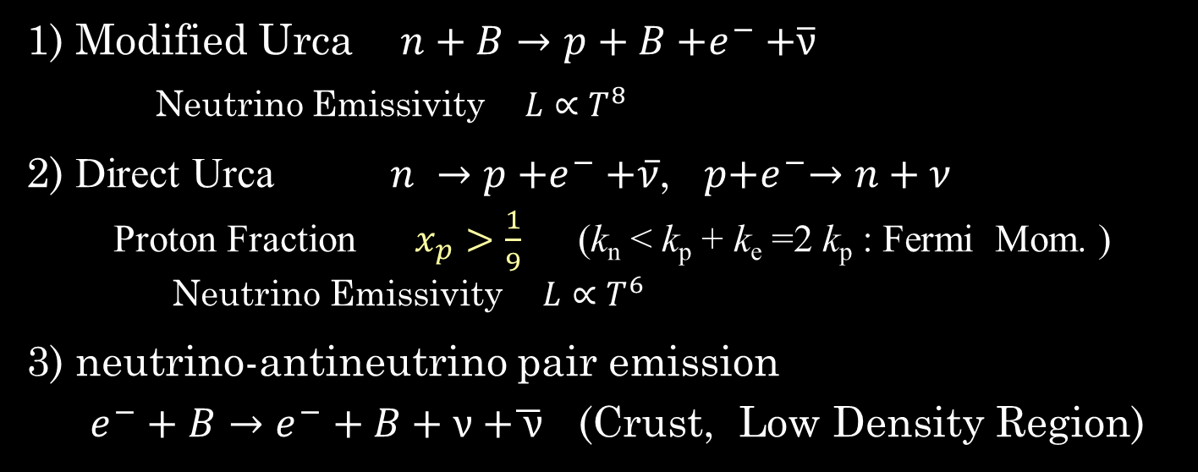
Neutron Star Cooling
Neutrino Emission → Information on Inside of NSs
1) Modified Urca $n+B→p+B{+e}^{−}+\overline{ν}$
Neutrino Emissivity $L∝T^{8}$
2) Direct Urca $n →p{+e}^{−}+\overline{ν}$, $p{+e}^{−}→n+ν$
Proton Fraction $x_{p}>\frac{1}{9}$ (k_{n} < k_{p} + k_{e} =2 k_{p} : Fermi Mom. )
Neutrino Emissivity $L∝T^{6}$
3) neutrino-antineutrino pair emission
$e^{−}+B→e^{−}+B+\text{ν}\text{ +}\overline{ \text{ν}}$ (Crust, Low Density Region)
Conditions are determined by Energy-Momentum Conservation
In Strong Magnetic Field
Momentum Conservation is not necessary
Trans. bet. Two Landau Levels give Additional Momentum

Slide 4

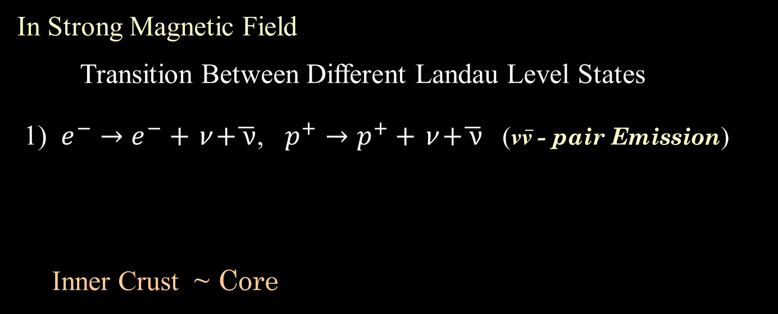




The Present Work
In Strong Magnetic Field
Transition Between Different Landau Level States
1) $e^{−}→e^{−}+\text{ν}\text{ +}\overline{ \text{ν}}$, $p^{+}→p^{+}+\text{ν}\text{ +}\overline{ \text{ν}}$ (ν$\overline{\text{ν}}$ - pair Emission)
Inner Crust ~ Core
p, $e$
$$\overline{ \text{ν}}$$
T.M. et al., PLB805 (2020) 135413
$$\text{ν}$$
2) $n→p+e^{−}\text{ +}\overline{ \text{ν}}$ (DU) Core
n
$$\overline{ \text{ν}}$$
T.M. et al., arXiv:2103.01703
p
$$e$$

Slide 5

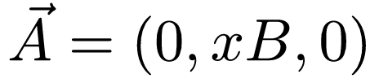
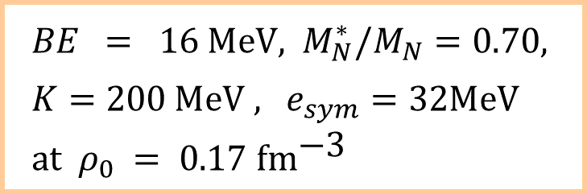


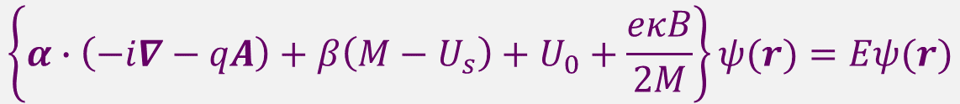
Neutron-Star Matter with Strong Mag. Field
Nucleon Mean-Fields RMF Theory
Magnetic Field :
Dirac Eq.
$$\left\{α∙\left(−i∇−qA\right)+β\left(M−U_{s}\right)+U_{0}+\frac{eκB}{2M}\right\}ψ(r)=Eψ(r)$$
$U_{s}$:Scalar Mean-Field
$U_{0}$:Vector Mean-Field
AMM
$$BE = 16 \text{MeV}\text{, }M_{N}^{∗}/M_{N}=0.70, \\ K=200 \text{MeV}\text{ , }e_{sym}=32\text{MeV} \\ \text{at} ρ_{0} =\text{ 0.17 }\text{f}{\text{m}}^{\text{−3}}$$
e

Slide 6
Single Particle Energies and Wave-Functions
Single Pariicle Energy
Landau Level Number
Anomalous Mag. Mom.
p & e
n
Wave-Fuction
p & e
p
e
Neutron

Slide 7
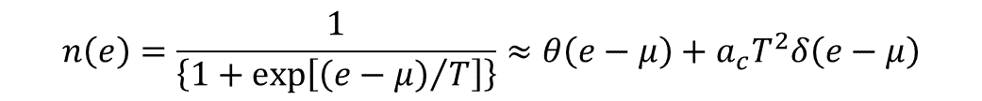
Decay Width of ν$\overline{\text{ν}}$ - pair Emission
Total Emissivity (Luminosity)
Landau Level Transition Energy is kept to be a few MeV
In Strong Mag. Fld. n(e_{i}) ~(1－n(e_{f})) <<1
(e_{i} – e_{f}) >> T
Low Temperature Expansion ( T < < 1 )
Emitted Particle Energy > T (Temperature)
$$n\left(e\right)=\frac{1}{\left\{1+\exp\left[{\left(e−μ\right)}/T\right]\right\}}≈θ\left(e−μ\right)+a_{c}T^{2}δ\left(e−μ\right)$$
Unavailable!

Slide 8

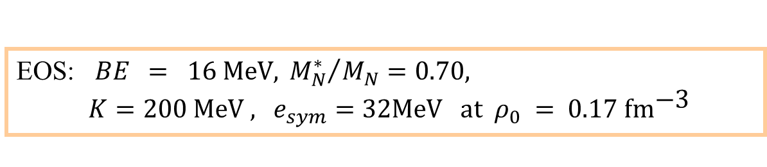
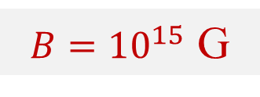
Emission Energy / A in ν$\overline{\text{ν}}$ - pair Emission
Temperature Dependence
$B={10}^{15}$ G
proton
proton
MU
MU
($\text{ν}\overline{ \text{ν}}$-Pair) >> (Modified Urca)
EOS: $BE = 16 \text{MeV}\text{, }{M_{N}^{∗}}/{M_{N}}=0.70,$
$K=200 \text{MeV}\text{ , }e_{sym}=32\text{MeV} \text{at} ρ_{0} =\text{ 0.17 }\text{f}{\text{m}}^{\text{−3}}$

Slide 9

Density Dependence
proton
MU
electron
($\text{ν}\overline{ \text{ν}}$-Pair) >> (Modified Urca)
Effects of Magnetic Fields are Very Large

Slide 10


Direct Urca Process
Low Temperature Limit
$T→0$
All Particles on Fermi Surface
Neutrino Emissivity
$f_{n}\left(x\right)$ :１dim. HO Wave-Function

Slide 11
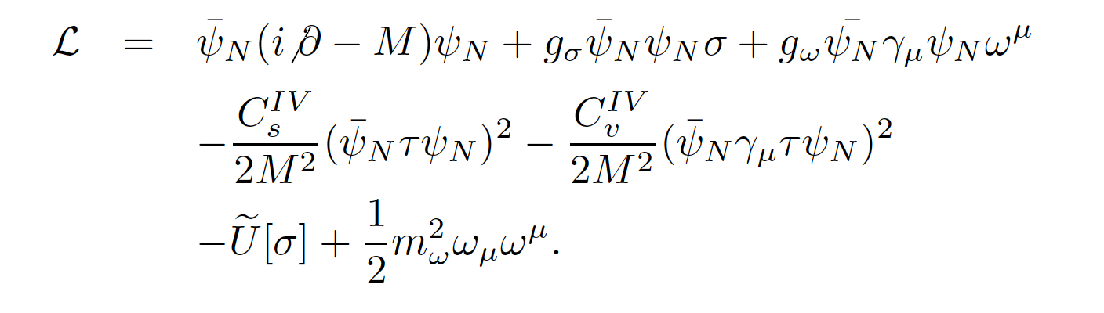
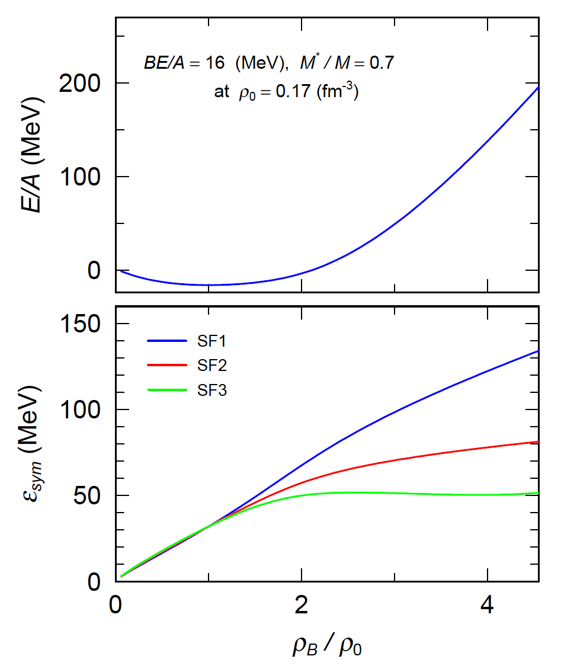
Nuclear Matter RMF Equations of State
Two kinds of symmetric force
Lorenz Vector & Scalar
SF1 : Vector Type Sym. Force
SF2 : Scalar Type Sy, Force
SF3: Negative Vector

Slide 12
Density-Dependence of the Neutrino Emissivity in DU
NS matter consistss of
n & p & e
Spikes reflect the density of states given by the Landau levels
Neutrinos emitted through Transitions between Landau levels
Proton Fraction
⇑ DU
DU does not appear
when B=0
⇓ no DU

Slide 13
Density & Mag. Fld. Dep. of the Neutrino Emissivity
n & p & e
n & p & e & μ

Slide 14
Summary
Laudau Levels are introduced into Calculations
of Neutrino Emissions in Strong Magnetic Field
ν$\overline{\text{ν}}$ - Pair Emission
Energy Loss ≫ MU
DU process from NS matter
Three Parameter-sets for Symmetry Energy
Proton Fraction ←→ the Neutrino Emissivity.
In the forbidden region x_{p} < 1/9
Mag. Flds. make DU
At Low Temp. Limit, Mag. Effect in DU is not very Large when x_{p} < 1/9 .
Because of Low Temperature Approximation (?) .
ν-Emissivity may become Larger in Exact Calculations

Slide 15
Thank you

Slide 16
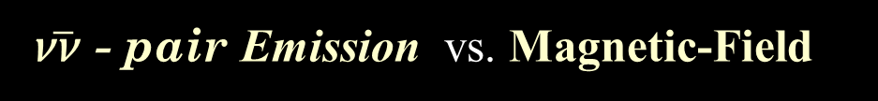
ν$\overline{\text{ν}}$ - pair Emission vs. Magnetic-Field

Slide 17
Neutrino Emissivity in SF1

Slide 18
Matter include MuonEmissivity

