Slide 1
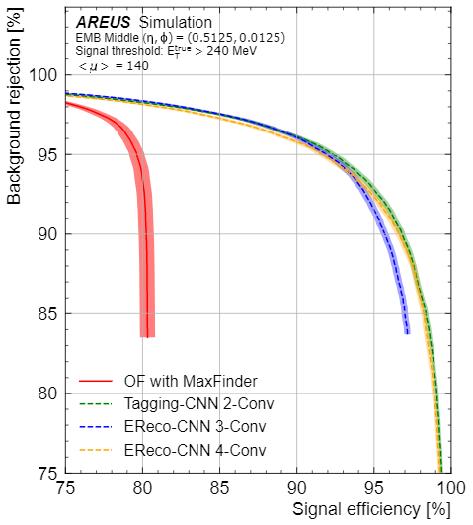
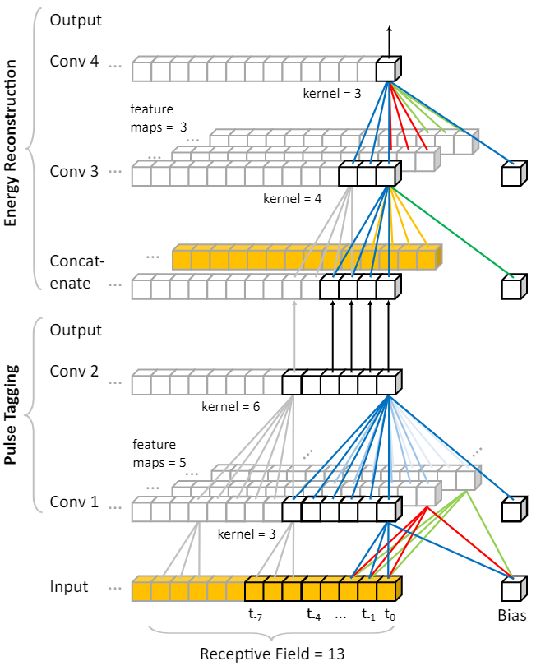
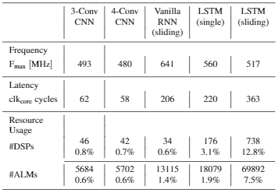
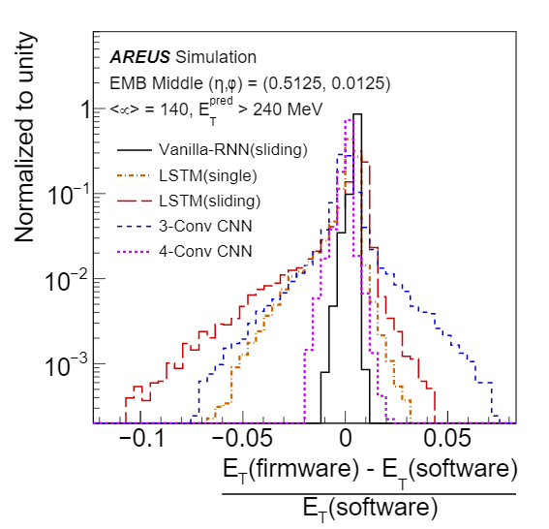
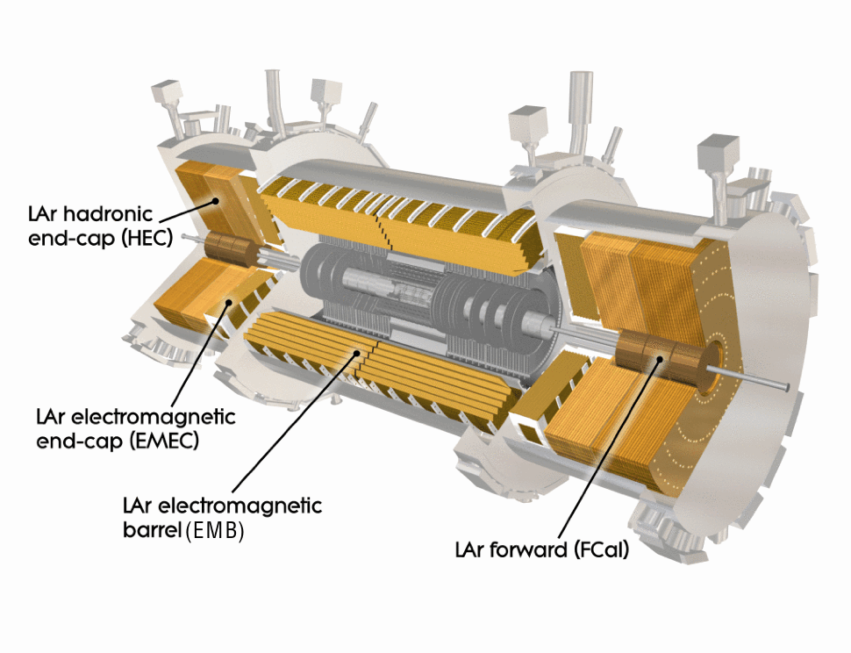
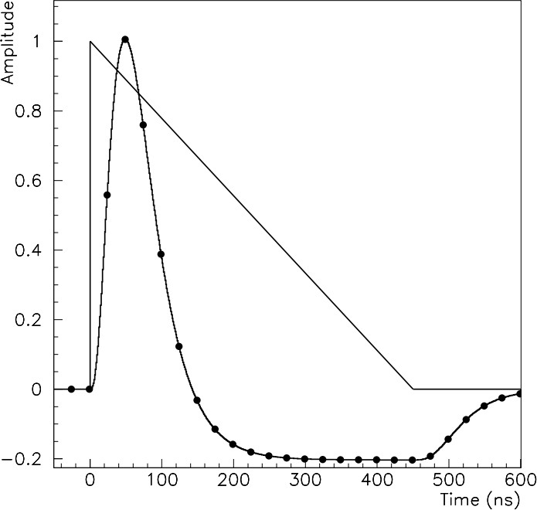
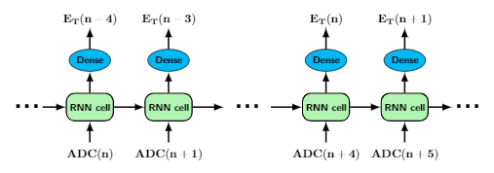
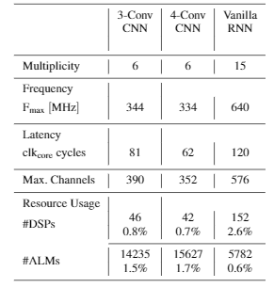
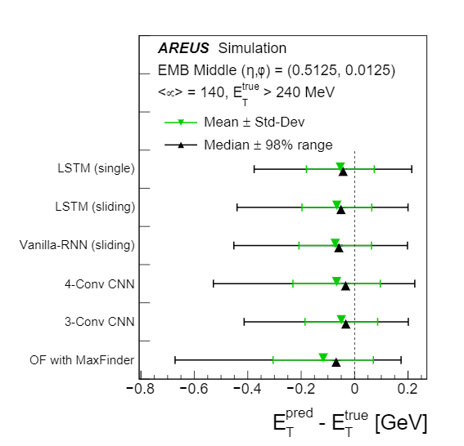
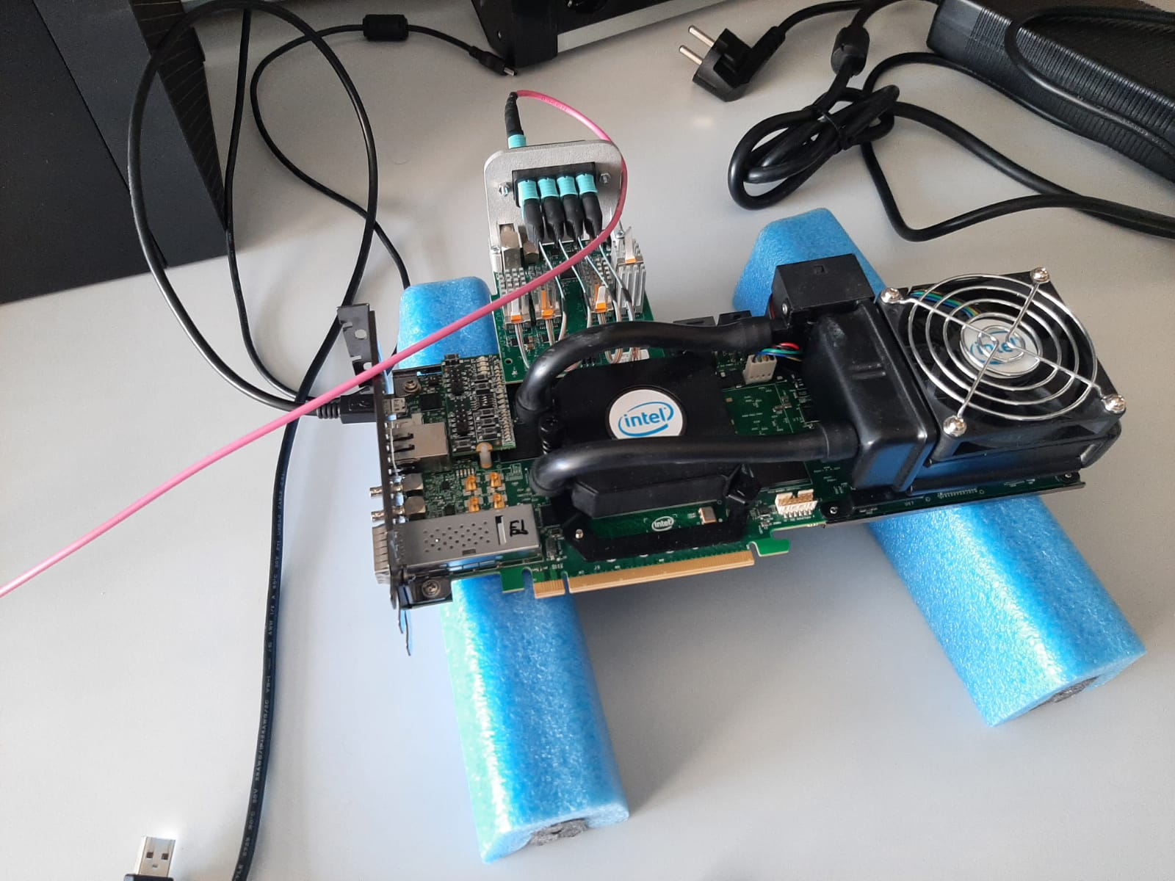
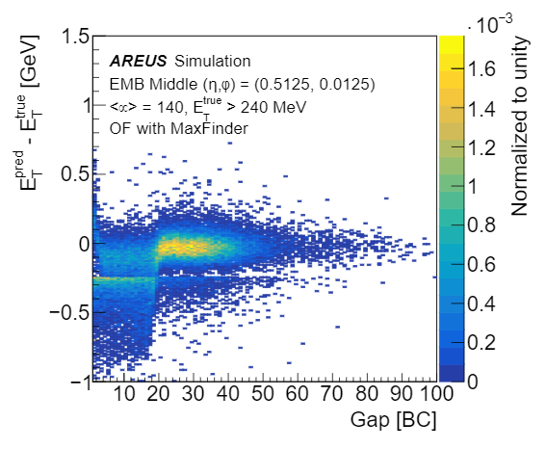
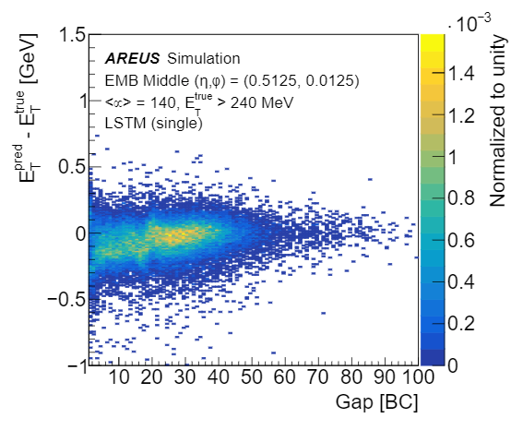
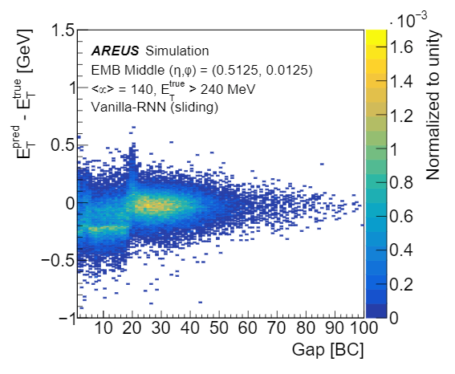
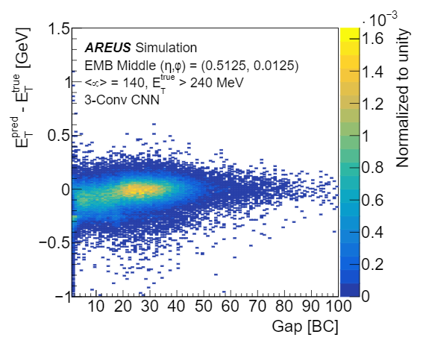
Artificial Neural Networks on FPGAs for Real-Time Energy Reconstruction of the ATLAS LAr Calorimeters
PANIC Lisbon Portugal – Particles and Nuclei International Conference
ATLAS Liquid Argon Calorimeter
The LAr Calorimeter measure the energy deposited by electrons photons and positrons.
The triangular pulse is shaped to be a bipolar shape. Then it is sampled and digitized at 40 MHz.
Current Energy Reconstruction algorithm is : Optimal Filter with Maximum Finder (OFMax)
Linear Combination of up to 5 samples
Convolutional Neural Network (CNN)
FPGA Firmware Implementation
CNN architecture is designed to compute energy deposits from samples
Pulse tagging sub-networks ( 2 Layers):
Trained to detect energy deposits above noise threshold.
Sigmoid activation function
Receiver operating characteristic (ROC) curve shows performance better than OFmax
Energy Reconstruction sub-network (1-2 Layers):
Uses results of tagging sub-network and raw ADC samples
Respectively one and two reconstruction layer results in 3D and 4D Conv networks
ReLU activation function
Trained and evaluated on simulated samples using the AREUS software package
CNN: Direct Implementation in VHDL
Optimal use of DSP internal architecture in FPGA
Architecture automatically configured from files obtained during training
RNN: High Level Synthesis approach
More flexibility in architecture, optimized for high frequency
Good agreement between firmware simulation results and software reference model
Recurrent Neural Network (RNN)
Performance and rss usage for single instance
RNN algorithms are designed for interference of time series and underlying parameters:
Natural candidates for the interference of deposited energies from time ordered digitalized Lar signals
Vanilla RNN : Simple recurrent structure with a ReLU activation function.
Long Short-Term Memory(LSTM) with sigmoid and tanh functions which is more suited for longer term effects
Phase-II Readout Electronic upgrade
High Luminosity LHC(HL-LHC) is expected to produce 5-7 times the instantaneous luminosity of the current system.
140-200 simultaneous proton-proton collisions on average
Challenges for LAr calorimeter readout under HL-LHC conditions:
Overlapping of signals
New trigger scheme allows the selection of subsequent bunch crossing (BC), i.e. every 25ns
OFMax decreases in performance under HL-LHC conditions
FPGA to implement more complex real-time energy reconstruction algorithms.
Very low latency required for reconstructing the energy (typically up to 150 ns)
One FPGA should process 384 or 512 Lar Calorimeter cells
Machine Learning solutions under investigation to replace the OF in the future HL-LHC conditions.
Single Cell LSTM:
Operates sample per sample on entire sequence
Feeding data by continuous stream of digitized samples for single cells.
CNN shows lower latency and resource (rss) usage but needs improvement for frequency in the multiplexed model.
Vanilla RNN meets the requirements for rss usage and Clock frequency in the multiplexed model, but has higher latency than CNN.
LHC
HL-LHC
Sliding-Window LSTM:
Feeding data in a window size of 5 including one sample before the pulse
Sliding-Window and Single cell LSTM:
Dense operation which corresponds to the single neuron decoder which reads the LSTM output and calculates the energy
Performance and rss usage for multiplexed model
Run 1
Run2
Run 3
Run 4
Energy Reconstruction using CNNs/RNNs can be implemented on LASP FPGA and show good agreement between software and firmware model and outperform OF
2011-2013
30 Fb⁻¹
2015-2018
190 Fb⁻¹
2022-2024
350 Fb⁻¹
2027-2040
3000-4000 Fb⁻¹
Energy Reconstruction Performance
FPGA Hardware Implementation
CNNs and RNNs outperform OF in both mean and resolution
CNNs and RNNs better reconstruct pulses distorted by previous events
Reconstruction of overlapping pulses is better when additional information from past events are used (number of samples before the pulse)
RNN implemented on Intel FPGA development Kit Stratix 10 GX
Build a test firmware environment (with VHDL) around the RNN IP generated from the HLS code
Tests on Hardware compatible with firmware simulation
Validation of the design in the Hardware: The Firmware runs at the expected frequency without timing violations.
Tests carried with one RNN implemented in the FPGA, multiple RNN instances inside one FPGA is ongoing.
Peter Matta on behalf of the ATLAS Liquid Argon Calorimeter Group
Ecole des Mines de Saint-Etienne, Centre de Physique des Particules de Marseille

