Slide 1
WP4 – Capacity building for thematic services
Ignacio Blanquer
Notes:
Añadir logo de IBERGRID

Slide 2
DETAILS OF THE WORKPACKAGE
Duration: PM1 – PM30
Participants/Contact persons
WP Leader: UPV (Ignacio Blanquer, Amanda Calatrava))
CSIC-IFCA (Isabel Bernal),
CSIC-CNB (Laura del Caño, José María Carazo),
CSIC-BSC (Nadia Tonello / Francesco Benincasa + Salvador Capella-Gutierrez)
CSIC-CIEMAT (Rafa Mayo/Antonio J. Rubio)
LIP (Mario David)
KIT (Marcus Hardt)
CESNET (Aleš Křenek)
IISAS (Viet Tran)
IRD (Fabien Durand)
LNEC (Alberto Azevedo / Anabela Oliveira)
INDRA (Manuel Pavesio)
CSIC (ES-JRU) | LIP | KIT | CESNET | IISAS | IRD | UPV | LNEC | INDRA
68 | 10 | 15 | 15 | 10 | 20 | 30 | 47 | 24
(Names in red need to be confirmed)

Slide 3
Communication Means
Mailing list (wp4-eosc-synergy@listas.csic.es - TBC)
Ignacio Blanquer <iblanque@dsic.upv.es>, Amanda Calatrava <amcaar@i3m.upv.es>, Mayo Garcia Rafael <rafael.mayo@ciemat.es>, Antonio Rubio <antonio.rubio@ciemat.es>, Salvador Capella-Gutierrez <salvador.capella@bsc.es>, Francesco Benincasa <francesco.benincasa@bsc.es>, Nadia Tonello <nadia.tonello@bsc.es>, Jose Maria Carazo <carazo@cnb.csic.es>, Laura del Caño <ldelcano@cnb.csic.es>, Mario David <david@lip.pt>, Ludek Matyska <ludek@ics.muni.cz>, Alberto Azevedo <aazevedo@lnec.pt>, Anabela Oliveira <aoliveira@lnec.pt> , Fabien Durand <fabien.durand@ird.fr>, "Pavesio Blanco, Manuel" <mpavesio@indra.es>, Viet Tran <viet.ui@savba.sk> , Peter Braesicke <peter.braesicke@kit.edu>, Sylvia Kellmann <sylvia.kellmann@kit.edu>,
Shared Folder in Google Docs: https://drive.google.com/drive/folders/0AIdRBFBb42CgUk9PVA
Other means: Trello (URL to be pasted)

Slide 4
OBJECTIVES OF THE WP
To harmonize EOSC-relevant thematic initiatives and use cases in relevant scientific areas (Earth Observation, Biomedicine, Astrophysics and Environment) providing open research data and services, to expand the use of the mature national services in an international scope.
To define best practices for the adoption of common EOSC core tools and services identified in WP3, considering community-wide standards, to increase the capacity of dealing with more complex user demands.
To increase the capacity, performance, reliability and/or functionality of mature thematic services currently not integrated into the EOSC portal or which have limited integration by means of EOSC core tools and services.
To increase the number of users of these thematic services and users’ satisfaction in an international scale through its integration in the EOSC framework and targeted training providing content for the WP6 skills development activities.
To increase service quality by supporting the uptake of certification and FAIR data practices, defining and presenting incentives to do so in coordination with other activities in the project.

Slide 5
HOW CAN WE MEASURE IT?
Define canonical applications as templates considering realistic scenarios (performance, service quality, availability and fault tolerance).
To evaluate several key metrics and their improvement: capacity, performance, reliability and/or functionality of (the most of them).
To measure the increase on the number of users and origin (internationalisation).
To produce training material for the use cases.
To demonstrate the fulfilment of FAIR principles.
To achieve EOSC-Synergy Ready Quality certifications for the services and to publish them in the EOSC Portal / Marketplace.

Slide 6
Workplan
[M1-M6] Task 4.1. Services and Best Practices harmonisation. UPV (10), CSIC-IFCA (2), CSIC-CNB (2), CSIC-BSC (2), CSIC-CIEMAT (2), LIP (1), KIT (2), CESNET (2), IISAS (1), IRD (2), LNEC (4), INDRA (2)
[M7-M24] Task 4.2. Thematic Services for the EOS community. LNEC (37), LIP (7), IRD (16), UPV (5), INDRA (18)
[M7-M24] Task 4.3. Thematic Services for the Biomedicine community. CSIC-CNB (12), CSIC-BSC (10), CESNET (5), UPV (3)
[M7-M24] Task 4.4. Thematic Services for the Astrophysics community. CSIC-CIEMAT (18), UPV (3)
[M7-M24] Task 4.5. Thematic Services for the Environmental community. CSIC-BSC (8), KIT (10), CESNET (6), IISAS (7)
[M18-M30] Task 4.6. Thematic Services Validation. UPV (9), CSIC-CNB (4), CSIC-BSC (4), CSIC-CIEMAT (4), LIP (2), KIT (3), CESNET (2), IISAS (2), IRD (2), LNEC (6), INDRA (4)
D4.1 – Best Practices Elicitation including Data Management Plans (R, PU) – M6 – Lead: UPV
D4.2 - First prototype of the EOSC Thematic services (DEM, PU) – M16 – Lead: UPV

Slide 7
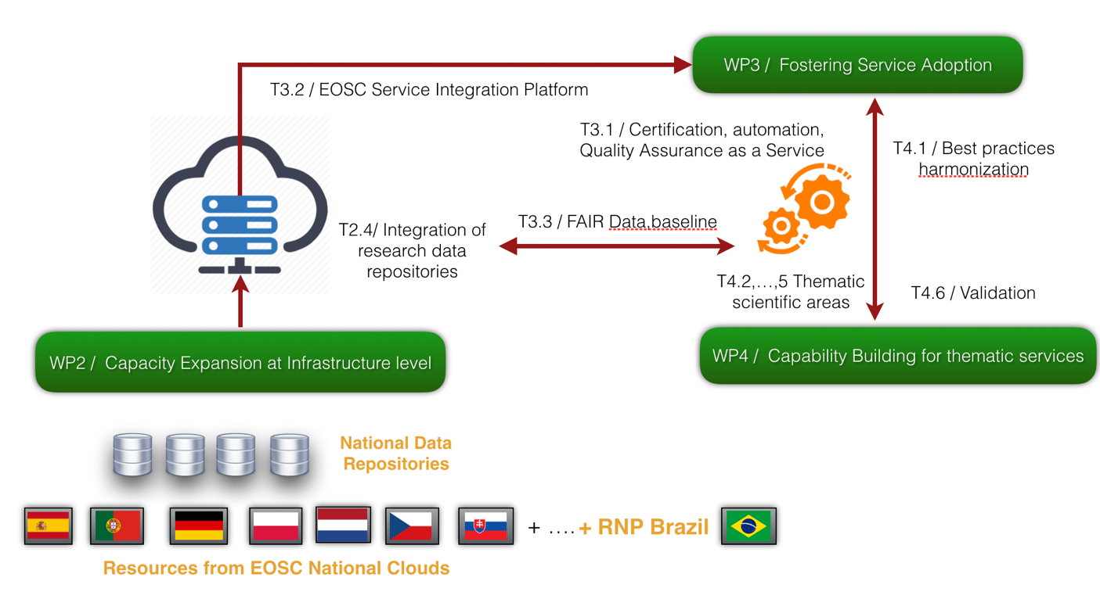
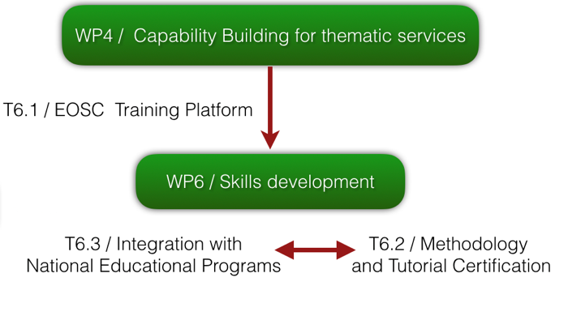
Relation to Other Activities
T2.2 / Integration at the level of technical standards
T2.3 / Integration at the level of policies
T2.1 Integration at the level of EOSC core services
Principles
Usable and functional services
Long-term preservation of the services.

Slide 8
Task 4.1. Services and Best Practices harmonisation M1-M6
It will define and explore current use cases, limitations, evaluation metrics and the baseline for the validation of the services.
It will produce consolidated input to WP3 and will gather the necessary information to implement Task4.2-5 activities.
Activities
Describe the thematic cases in detail
Current approach, limitations and technologies
Expected results and impact
Validation means, baseline and expected results.
Identify commonalities and abstract (canonical) use cases.
Identify the links for the quality certifications.
D4.1 – Best Practices Elicitation including Data Management Plans (R, PU) – M6 – Lead: UPV
This report will describe the methodology, the use cases elicited and the harmonisation of them so they can be used for both guiding the WP3 activities and for the validation activity.

Slide 9
THEMATIC SERVICES & AREAS
Coastal changes and Inundations
Sand and Dust storm warning
Earth Observation
Environment
Satellite Image Processing
Requirements and Best Practices
Data Repositories
Thematic Services
Validation
Mass-spectrometry analysis for toxics
Forest Mass Estimation
Water network distribution
Ozone Projections and Forecast
Benchmarking en Genómica
Biomedicine
Astrophysics
Cyro-Electron Microscopy
Latin American Giant Observatory

Slide 10
Thematic Services for the EOS community
Each Thematic task will go through:
Integration of EOSC Services,
Testing of the services by selected groups,
Development of community-specific training material and
Liaison with the user community.
All thematic tasks address objectives that are verified and quantified in Task 4.6.

Slide 11
WorSiCa: Water mOnitoRing SentInel Cloud plAtform (1/2)
Description: European-wide service for the detection of the coastlines changes, coastal inundation areas and inland waterbodies
Data: Copernicus satellite data, Pleiades satellite data, UAV data, EMODNET-Physics, EMODNET- Bathymetry and OPENCoastS forecast data.
Expected Impact: Will enable researchers to generate maps of coastal and inland regions, useful for emergency and prevention methodologies in case of inundations or reservoir leaks.

Slide 12
WorSiCa: Water mOnitoRing SentInel Cloud plAtform (2/2)
Objective in EOSC-Synergy: integration of WorSiCA as an EOSC service.
User profiles: private single or group access
Bottlenecks: download of the satellite data, storage and computation of the water and vegetation indexes
Service needs: Storage, CPU and GPU processing power.
Current status with respect to EOSC services: Integrated in LNEC's private infrastructure resources, in deployment at INCD

Slide 13
G-Core (1/2)
G-Core IS a production-ready technology used as a service at ESA’s and national programs led by INDRA for the acquisition, storage, cataloguing and processing data from several EOS missions
Data Manager for spatial and non-spatial purposes; Ground Control points, GPS data, DEM, meteorological data, …
Processing framework to host external processors developed by third parties to generate added value products based on Satellite imageries.
Data:
Sentinel data (public mission of EU/ESA).
SMOS (ESA Mission for Scientific community).
PAZ mission (Spanish Earth Observation program).
Expected Impact: We will democratize the usage of EO data out of the scope of nominal fields. It will help defining new products and services mixing Earth Observation data with other type of data for scientific and social environments.

Slide 14
G-Core (2/2)
Objective: To explore the sustainability of the EOS services exposed through the creation of added-value products through the integration of G-Core as a data manager.
User profiles
EO data for science community to use the satellite data in the scientific studies.
EO data for public organizations to use the satellite imageries as background data.
EO data for value adders to create added value products from satellite imageries.
Bottleneck
Access to data repository, remotely or locally
Infrastructure resources for processing and reprocessing large data sets
Service requirements
Interoperable interfaces to access and discover data from different sources.
Cloud Infrastructure to use resources on demand for processing and reprocessing great volumes of data.
Distributed catalogue to ease the data discovering.

Slide 15
SAPS: Serviço Automático de Processamento automático do SEBAL (1/2)
SAPS is a service to compute the Surface Energy Balance Algorithm for Land (SEBAL) and similar information for estimating the evolution of forest masses and crops.
Data: It requires integrating access to the LANDSAT data repository (http://landsat.gsfc.nasa.gov/) .
9 very high spatial-resolution NetCDF files of 12 GB each.
Historical information regarding various climate and vegetation indicators for a time range spanning from 1984 to 1995.
Expected impact: The deployment of a federated site of SAPS in EOSC to facilitate European scientists to exploit the evapotranspiration estimation services from remote sensing imagery).

Slide 16
SAPS: Serviço Automático de Processamento automático do SEBAL (2/2)
Objective: It will provide wider access to knowledge on the impact of human and environmental actions on vegetations, leading better forest management and analysis of risks
Current status with respect to EOSC services:
SAPS uses a cloud offering as back-end. A processing engine submits jobs on a federated infrastructure
Code in https://github.com/ufcg-lsd/saps-engine .
Demo instance in http://demo.saps.lsd.ufcg.edu.br/ and video available in https://www.youtube.com/watch?v=-x3shbRMHkI
It does not use EOSC service, although developments are aware of EGI Federated cloud, Infrastructure Manager and authentication mechanisms.
User profiles
Researchers in Agriculture Engineering and Environment.
Bottlenecks
Computing resources and data access.
Service needs
Standardisation, integration with other sources, larger-scale deployment.

Slide 17
Thematic Services for the Biomedicine community

Slide 18
OpenEBench (1/2)
OpenEBench is a platform to support technical monitoring and scientific benchmarking activities carried by Life Sciences Communities. It is designed following a three-level architecture to facilitate support and interactions to Life Sciences communities at any maturity stage.
Data: Data model is at github.com/inab/benchmarking-data-model, which is used to organize data generated by any Life Sciences Communities. Data is bundled and deposited in services like Zenodo where they receive a DOI. It also connects with Core Data Resources to deposit and/or access data produced/needed by the Scientific Communities activities.
Expected Impact: Scientists will be able to have up-to-date collections of analytical workflows, which can be deployed across heterogeneous systems.

Slide 19
OpenEBench (2/2)
Objectives: Integrate those services in the EOSC Portal by exposing and deploying the benchmarked analytical workflows. This use-case will also provide best practices for organizing communities around scientific benchmarking activities.
OpenEBench aims to serve research software developers aiming to identify relevant datasets and metrics to test their software performance; researchers looking for a mechanism to take informed decision on the best tools and/or workflows for their scientific problem at hand; scientific communities that are interested to use a platform for their benchmarking activities, and others stakeholders e.g. funding agencies and policy-makers, who are interested to understand the current state-of-the-art of a particular area in Life Sciences.
Current status with respect to EOSC services: We already used ELIXIR AAI, which is intended to evolve together with other services e.g. GEANT; as Life Sciences AAI in the context of EOSC Life. We expect also to make use of some of EOSC Life outcomes e.g. MyExperiment 2.0; to access richly annotated workflows.

Slide 20
Scipion Cryo-Electron Microscopy Service (1/2)
Scipion: Cryo-Electron Microscopy service serves structural biology community with Scipion (a workflow-oriented image processing software integrator developed by the CNB in Spain) running on resources provided by the Masaryk University in the Czech Republic l.
Data: Raw data and preprocessing project coming from an EM facility session.
Expected Impact: Researchers can have all their data pre-loaded loaded on a cloud instance powered by EOSC compute resources on the back-end. This means that scientists with minimal computational background (or compute resources of their own) can access the latest tools as well as powerful computational resources.
http://scipion.i2pc.es/

Slide 21
Scipion Cryo-Electron Microscopy service (1/2)
Objective: To integrate Scipion in EOSC so it will be able to provide cloud deployments on demand which could deal with the scientist’s own data with an automatic setup of the tools and environments.
User profiles: Scientists acquiring data on a EM facility and later on analyzing these data from their home laboratories.
Bottlenecks: Cloud resources insufficient (processing and storage), data transfer performance.
Service needs: Authentication (how to link session users with EOSC identities and VOs), powerful VMs (GPU enabled), big storage (this depends if raw data is transferred), releasing of cloud resources after a suitable time.
Current status with respect to EOSC services: Latest service implementation is based on Cloudify and Puppet and allow to deploy on CESNET and IISAS sites using occi client. Work was also started to mount a OneData drive for big data storage. However, due to the discontinuation of occi support in most sites, the new plan is to migrate the service to use a container's based solution in collaboration with CESNET.

Slide 22
Thematic Services for the Astrophysics community

Slide 23
Latin American Giant Observatory - LAGO (1/2)
The Latin American Giant Observatory (LAGO) is an extended cosmic ray observatory composed of a network of water-Cherenkov detectors (WCD) spanning over different sites located at significantly different altitudes (from sea level up to more than 5,000m) and latitudes across Latin America.
Data: Raw data measured and lately preprocessed by the consortium prior to their availability. Simulations will be available too.
Impact: Data will be made public to the Cosmic Ray, Radiation and Space Weather communities, complementing those provided by major consortiums such as the Pierre Auger Observatory. This data sharing will be largely improved by integrating the EOSC services.
http://lagoproject.net/

Slide 24
Latin American Giant Observatory - LAGO (2/2)
Objectives: The integration of the processing and data access system of LAGO to run the codes used to perform the simulations as a service into the EOSC portal and the LAGO measured data harvested from the EOSC services.
Users: Scientists working on HEP, effects of cosmic radiation, space weather, volcanology, etc.
Bottlenecks: Prior to the EOSC integration, the main drawback is the data preprocess needed in order to make the measured data meaningful
Service needs: Data storage, curation and harvesting; computing power for simulations
Current status with respect to EOSC services: No EOSC services are integrated already, though data curation processes and scientific codes execution methodologies have been implemented following de facto standards promoted by initiatives such as EGI

Slide 25
Thematic Services for the Environmental community

Slide 26
Sand and Dust Storms Warning Advisory and Assessment System - SDS-WAS (1/2)
SDS-WAS is a World Meteorological Organisation programme to improve capabilities for more reliable sand and dust storm forecasts.
The SDS-WAS runs, collects and offers several numerical models outputs for dust forecast (e.g. https://sds-was.aemet.es/forecast-products/dust-forecasts).
Data: model simulation (daily runs of 72 hours forecast, two variables) numerical outputs formatted in an international well documented standard (netCDF) and organized per year/month
Expected Impact: By the integration of such services in the EOSC, a more complete set of derived services can be built and offered to a wider group of users. The geographical area of interest of this service is reaching less favoured countries and having the potential to increase the life quality.

Slide 27
Sand and Dust Storms Warning Advisory and Assessment System - SDS-WAS (2/2)
Objectives: The integration of the numerical data of models simulations for dust forecast, observational data and data processing into the EOSC catalogue to disseminate data, improve FAIRness and provide some data analysis results
Users: dust scientific community, PhD students, researchers, meteo services, enterprises working on businesses affected by dust (solar, aviation, agriculture, etc …)
Bottlenecks: reliability of data sources. Data not simulated locally are retrieved from partners servers, often in experimental mode, so not fully operational
Services needed: Data storage and curation; computing power for data analysis
Current status with respect to EOSC services: currently has been implemented two EUDAT services, B2SAFE (Storage/Backup) and B2STAGE (staging, moving data from HPC to Storage).

Slide 28
UMSA: UNTARGETED MASS-SPECTROMETRY ANALYSIS (1/2)
UMSA is an untargeted mass-spectrometry analysis service from RECETOX (Research Centre for Toxic Compounds in the Environment at Masaryk University) in the Czech Republic.
Data: unprocessed (raw) data on mass spectra of liquid and gas chromatography measurements, and associated metadata -- origin of samples, conditions of the measurements etc.
Expected Impact: The service is expected to evolve to a key component of the emerging EIRENE ESFRI. By means of the integration in EOSC, uniform access to data and computing resources will be provided, scaling the service to the target European-wide user community.

Slide 29
UMSA: UNTARGETED MASS-SPECTROMETRY ANALYSIS (2/2)
Objectives: Typically, mass spectrometry is done in targeted way -- confirm or disprove presence of a specific compound in a sample. On the contrary, we aim at data processing that will allow correlating the whole spectra (ie. all the present compounds) with other data (social, medical, other sample analyses, …) to work with more complex hypotheses of environmental impacts on human health.
Users: mass spectrometry researchers (the initial analysis) and data analysts (complex hypotheses) of the EIRENE community.
Bottlenecks: long term data storage (decades), data provenance tracking, lack of stable implementation (most existing software is focused on targeted experiments)
Service needs: data storage and curation, computing, workflows
Current status with respect to EOSC services: “hand powered”, ie. manually spawned virtual machines at CZ cloud site are used in prototype development and evaluation

Slide 30
MSWSS : Modelling Service for Water Supply System (1/2)
MSWSS is a service for analysis of water network distribution with regards to the mitigation of hazardous events, by the integration of existing on-line analysis of toxics in drinking water supply networks with distribution network simulation of EPANET.
Data:
WSS operators owned data (GIS, CIS and SCADA),
Open data - ZBGIS, OpenStreetMap, DEM50 (from slovak GKU WMS service)
Expected Impact: MSWSS services require a more powerful and efficient infrastructure for modelling complex drinking water supply system for being offered in a global extend. By the integration of MSWSS in EOSC it will be possible to offer the service to a wider community.

Slide 31
MSWSS : Modelling Service for Water Supply System (2/2)
Objective: In the frame of this task, the previous services will be made available through the EOSC Portal, including added-value processing services.
User profiles:
private single or group access
Bottlenecks:
Download of the WSS operators owned data, storage and postprocessing of various scenarios results.
Service needs:
Storage, CPU
Current status with respect to EOSC services: No EOSC services are integrated already.

Slide 32
O3AS: Ozone Assessment (1/2)
O3AS is a service set up to analyse ozone projections and forecast their evolution on a long-term basis.
Data: Chemistry–Climate Modelling Initiative (CCMI)
Expected Impact: For the Scientific Assessment of Ozone Depletion large data volumes have to be analysed to generate key metrics for policy makers (e.g. ozone return dates). This analysis is always time critical and speeding it up will ease the assessment process for future ecycles (e.g. 2022, the 2018 Assessment will be published in December). Researchers to study, for example, how stratospheric ozone protects life on Earth from harmful UV radiation by providing robust results of ozone projections for impact studies to gauge potential damage and avoided damage

Slide 33
O3AS: Ozone Assessment (2/2)
Objective: Made O3AS services available through the EOSC Portal, including added-value processing services.
User profiles, bottlenecks, service needs
Current status with respect to EOSC services: No EOSC services are
integrated already.

Slide 34
Plans for D4.1(Best Practices Elicitation including Data Management Plans)
It is important to outline that EOSC-SYNERGY is not aiming at developing new EOSC services but to use existing services to build up the use cases.
However, there may be room for small adaptation, tuning and customization actions.
The analysis process will try to identify common architectures, best practices and examples of the EOSC services to improve the Use Case Services.
The aim of the deliverable will be:
Describe the use cases.
Identify commonalities and gaps.
Define metrics and evaluate the baseline.
Define canonical applications as templates considering realistic scenarios (performance, service quality, availability and fault tolerance).
We will organize a bi-weekly call until the document is generated.

Slide 35
EXPECTED IMPACT
7 - 11 New EOSC Federated Data centres
5 - 8 New Services in the EOSC Portal
8 - 12 FAIR Data Collections
7-15
Tutorials available with Hand- on exercises
1
10 -20
SQaaS
Certified Services
5-8
National and International co-organized Workshops.

Slide 36
ACTIONS
# | Description | Who | Due Date | Status
1 | Confirm contacts | All | TBD
2 | Agree on a periodic telco | Ignacio leads, all | TBD
3 | Agree on a template for the Use Cases detailed description | Ignacio leads, all | TBD
4 | Collect first version for the descriptions | All | TBD

