Slide 1
A Data Science framework in the INCD
António Lorvão Antunes, Tiago Martins, José Barateiro, Anabela Oliveira & Alberto Azevedo

Slide 2
Presentation Contents
A Data Science framework in the INCD
Case Study #1: Behavior Prediction
Case Study #2: Outlier Detection
Case Study #3: Using Deep Learning
Conclusions and Future Work

Slide 3
Introduction
INCD provides computing and storage services
LNEC develops use cases that take advantage from the INCD
Data Science framework based on Conda developed

Slide 4
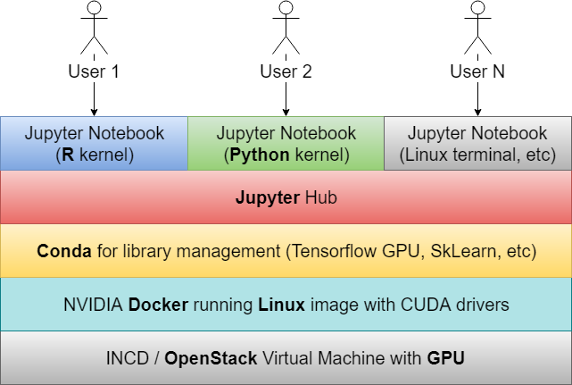
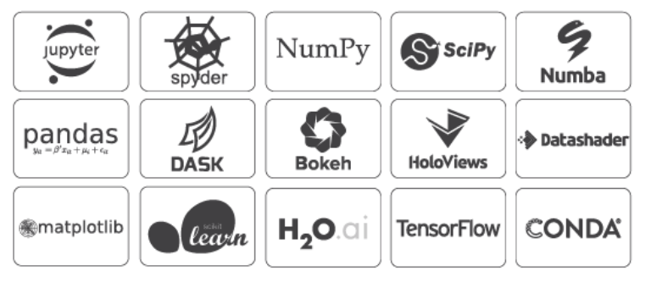
A Data Science framework in the INCD
Online via browser (Jupyter Notebook)
Case studies as proof of concept

Slide 5
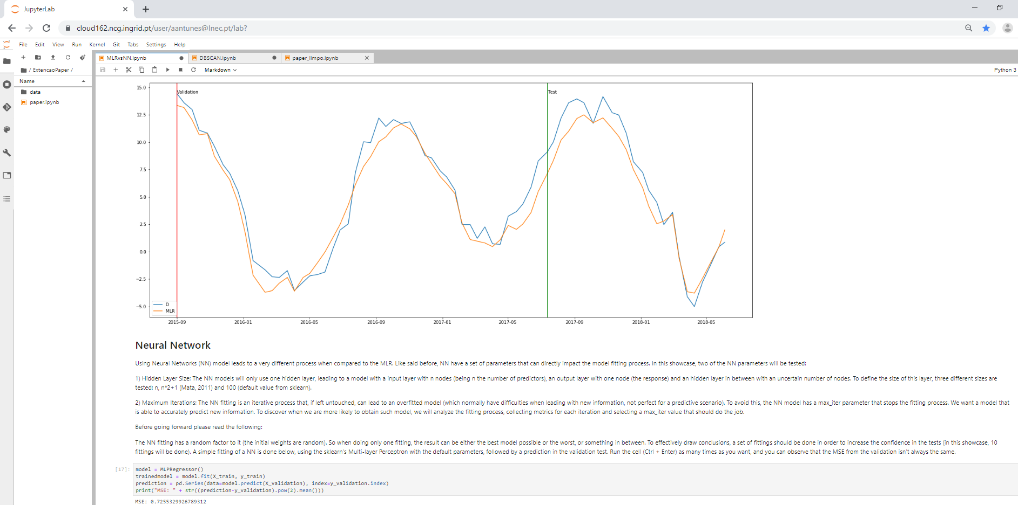
Case Study #1: Behavior Prediction
Python
Prediction of dam behavior in manually collected data
Multiple Linear Regression (MLR) against Neural Networks (NN)
Based on the work from (Mata, 2011)

Slide 6
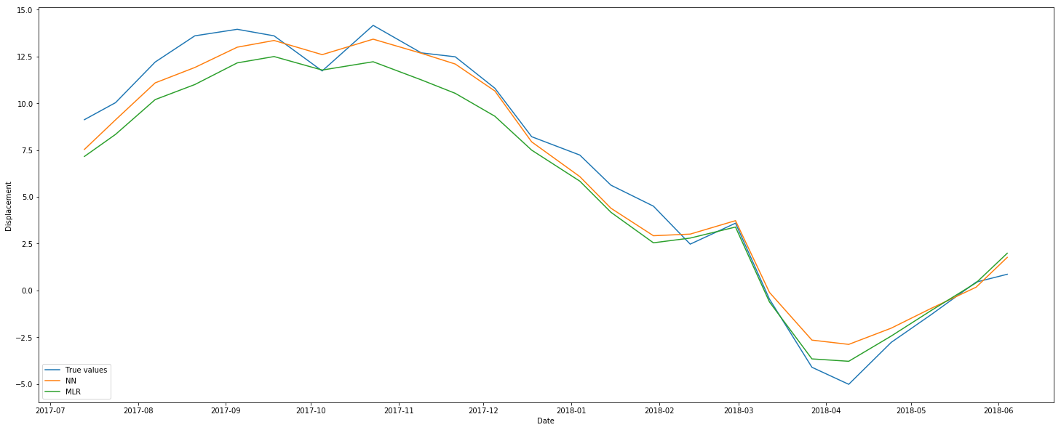
Case Study #1: Behavior Prediction

Slide 7
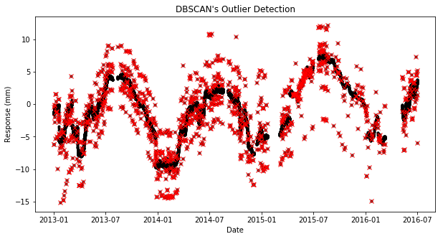
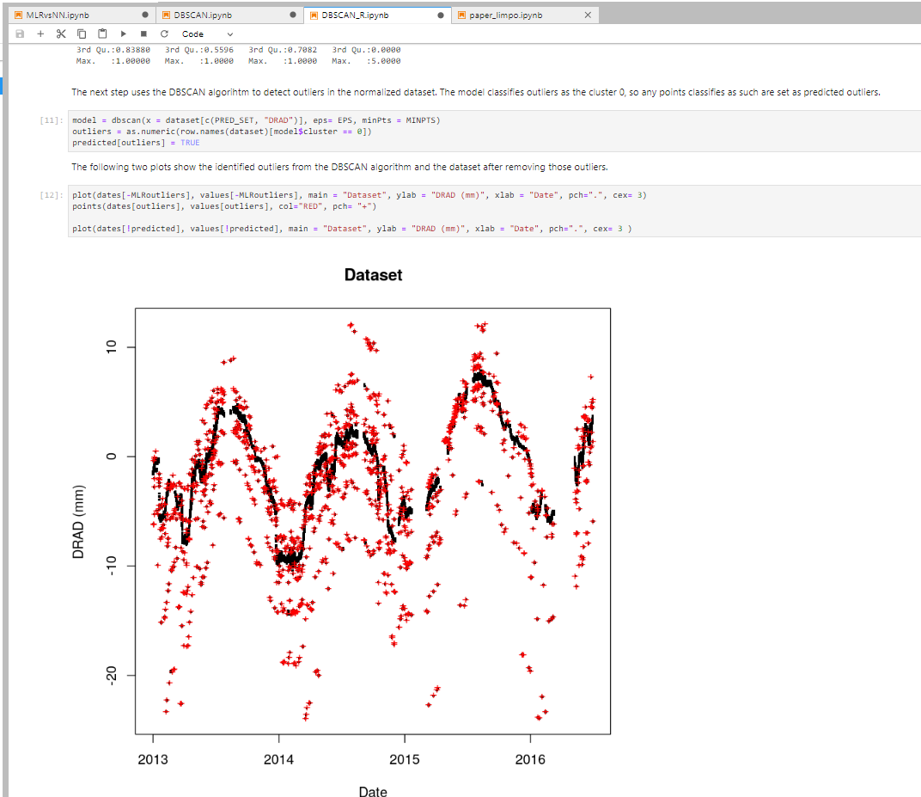
Case Study #2: Outlier Detection
Python and R
Outlier detection in automatically collected data
DBSCAN (Density-based spatial clustering of applications with noise)
Based on (Antunes, Cardoso & Barateiro, 2018)

Slide 8
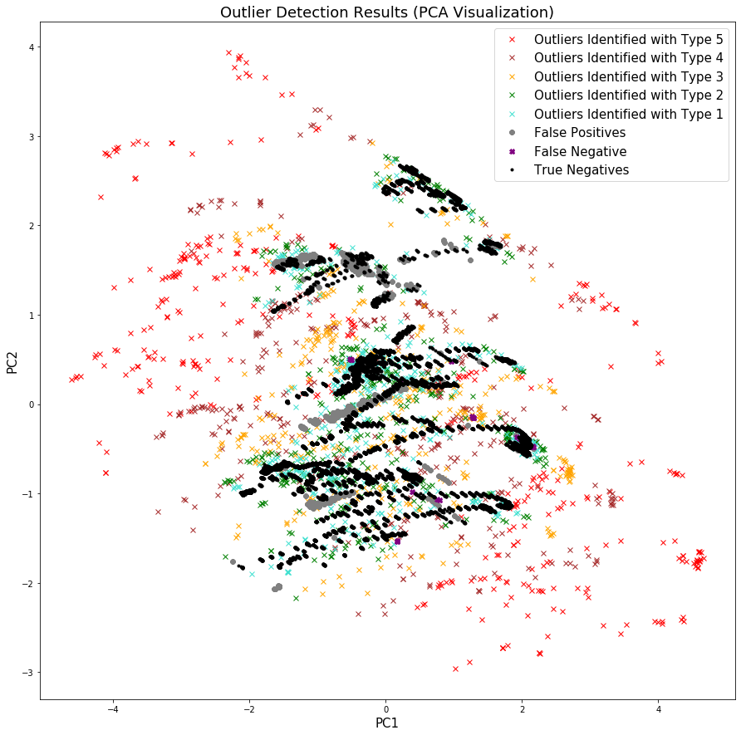
Case Study #2: Outlier Detection

Slide 9
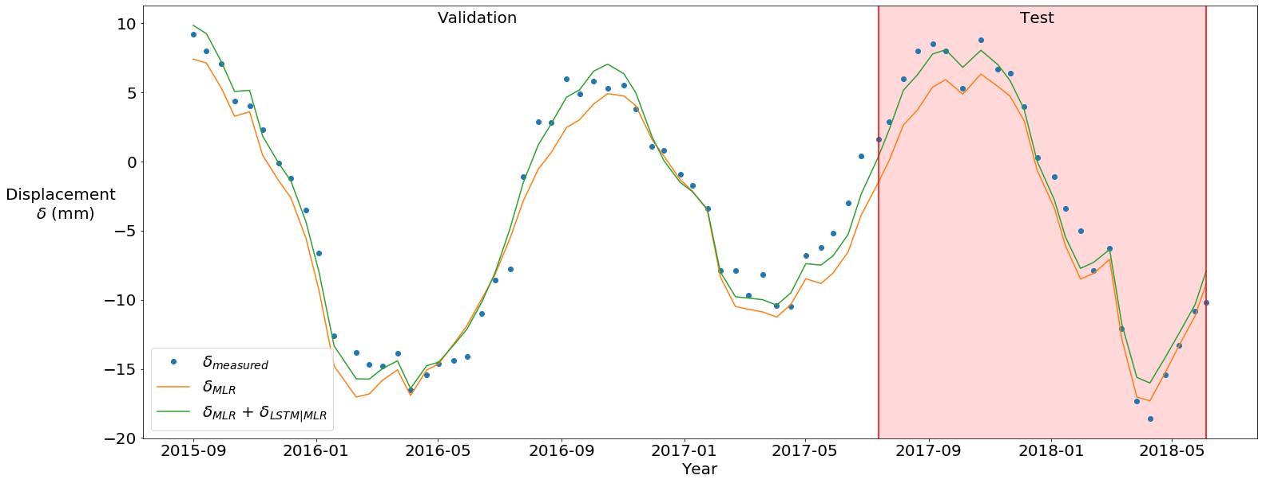
Case Study #3: Using Deep Learning
Improving prediction of dam behavior using Deep Learning methods
Keras and Tensorflow libraries
Computation times improved with the use of GPU in the INCD
Published in (Rico et al., 2019)

Slide 10
Conclusions and Future Work
The framework allows the creation of personalized application and scripts to aid in several knowledge areas
LNEC researchers were already introduced to the framework, showing a large interest on its approach
Researchers already started to take advantage of the framework and the INCD to create and run their own scripts in a cloud environment

Slide 11
Bibliography
Mata, J. (2011). Interpretation of concrete dam behaviour with artificial neural network and multiple linear regression models. Engineering Structures, 33(3), 903-910.
Antunes, A. L., Cardoso, E., & Barateiro, J. (2018). Adding value to sensor data of civil engineering structures: Automatic outlier detection. In 2018 9th International Conference on Information, Intelligence, Systems and Applications (IISA) (pp. 1-6). IEEE.
Rico, J., Barateiro, J., Mata, J., Antunes, A., & Cardoso, E. (2019). Applying Advanced Data Analytics and Machine Learning to Enhance the Safety Control of Dams. In Machine Learning Paradigms (pp. 315-350). Springer, Cham.

