Slide 1
Spanish Node RDA 4

Slide 2
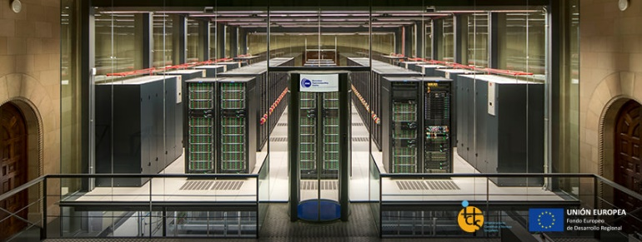
RDA & BSC
BSC has been a pioneer in supporting RDA since its establishment in 2013
Bringing in the HPC and big data point of view within important research communities
Good connections with industry
Severo Ochoa Centre of Excellence

Slide 3
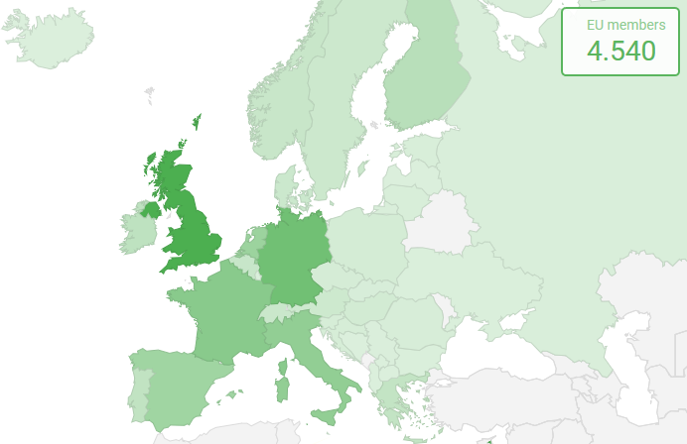
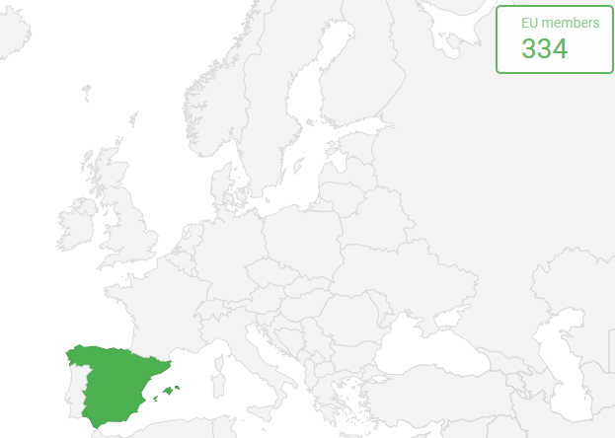
RDA in Spain
Glocalization: national focus in a global context
RDA national and regional bodies
334 registered members in RDA Spain

Slide 4
As the Spanish node, it is our mission to…
Increase the presence in RDA of actors involved in research data in Spain
Advertise funding opportunities and help the Spanish community to reach them
Support data research at a local level and strengthen the relations with other national groups
Promote RDA recommendations in the region
Give visibility and support to Spanish initiatives on the exchange of open research data

Slide 5
What has happened so far…
RDA Spain Kick-Off at RES Annual Meeting
Relations established with other RDA EU 4.0 National nodes and relevant EU initiatives
Supported Spanish participation in RDA Global events
RDA Europe 4.0 grants to support the Adoption of RDA Recommendations and Outputs:
BSC: Improving the Copernicus Climate Data Store metadata scheme with the “RDA metadata standards repository”
IAC: Template for reproducible, shareable and achievable data analysis
RDA Europe Ambassadors: https://www.rd-alliance.org/rda-disciplines/rda-europe-ambassadors

Slide 6
Future…
Promote RDA Open Calls. Financial support for Early Career and Expert European Researchers & Scientists to attend the RDA Plenary meetings
Collaborations with other EU H2020 projects and EOSC initiatives
Working towards a long-term sustainability after H2020

Slide 7
THANK YOU!
Tamara Kovazh: tamara.kovazh@bsc.es
Fabrizio Gagliardi: fgagliar@bsccns.onmicrosoft.com

