Slide 1
HPC and Cloud Resources for Running Mathematical Simulations Efficiently
Javier Carnero, Víctor Sande, Carlos Fernández, F. Javier Nieto, IBERGRID 2018, Lisbon

Slide 2
Outline
Why HPC & Cloud?
Proposed Solution
Use Case
Conclusions & Future Work

Slide 3
Why HPC & Cloud?
+ Flexibility
+ Provision
+ Ease of Usage
+ €€€
- Performance
- €€€
+ Performance
+ Scalability
- Access
- Provision
- Ease of Usage

Slide 4
Why HPC & Cloud?
Maths workflow model

Slide 5
Why HPC & Cloud?
Steps Analysis
 | Pre/Post | Simulation | Visualization
Features | Small number of cores Small communication between processes Not HPC efficient | Many cores, don’t fit in one node Heavy communication between processes | Long-time running tasks Small number of cores Small communication between processes
Examples | Data Movements Big Data Meshing | Feel++ FEniCS OPM Gromacs | Paraview SALOME

Slide 6
Proposed Solution
Key-value proposition:
Get full potential of both HPC and Cloud
Automation: Encapsulation, CI/CD, Orchestration, Federation, Software as a service
No vendor specific
Open Source: Easy adoption & extensible
Implementation needs:
DSL following TOSCA
Two orchestration layers: “Meta-scheduler”
Agentless architecture for HPC infrastructures monitoring
Singularity containers

Slide 7
Proposed Solution
CI/CD/CD
Code
Containerize
Test
Deliver
Ready to use!

Slide 8
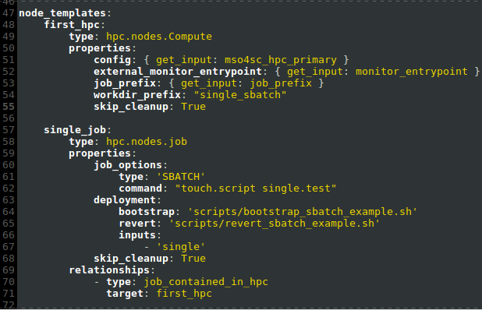
Proposed Solution
MSO4SC Orchestrator
MSO4SC Monitoring
Torque

Slide 9
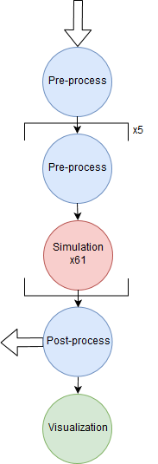
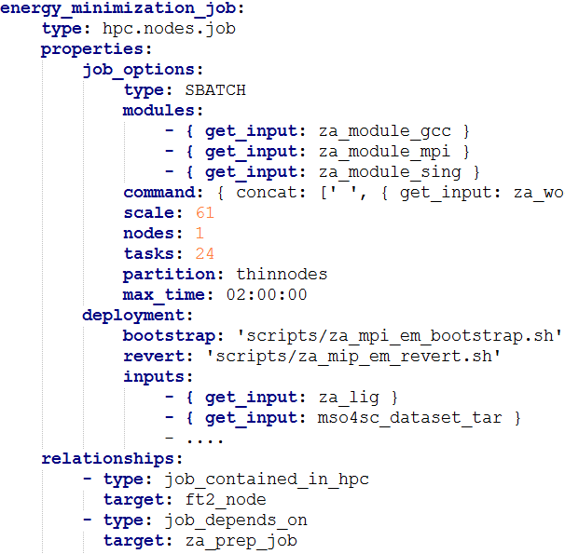
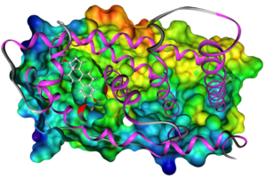
Use case: ZibAffinity

Slide 10
Use case: ZibAffinity
Single executable Vs TOSCA DSL Blueprint
Single executable
24x61 cores during 40 minutes, wasting 23x61 cores during 5:44 minutes (mono core tasks)
Over 80 hours to compile and deploy on a new HPC
TOSCA blueprint:
17.03% core/h improvement (didn’t waste any resources)
Around 30 hours to build the blueprint and the containers. Runnable in multiple infrastructures.
Inputs: much easier to execute by a non expert user.
The TOSCA blueprints usage improves the resources efficiency, but the allocation time in the HPC may increase.

Slide 11
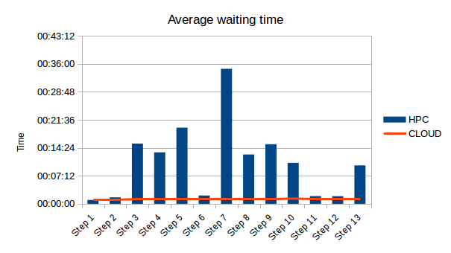
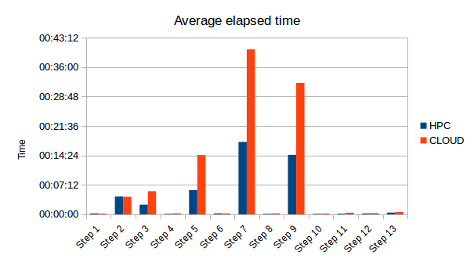
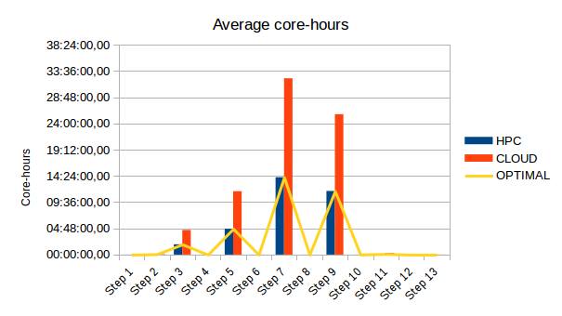
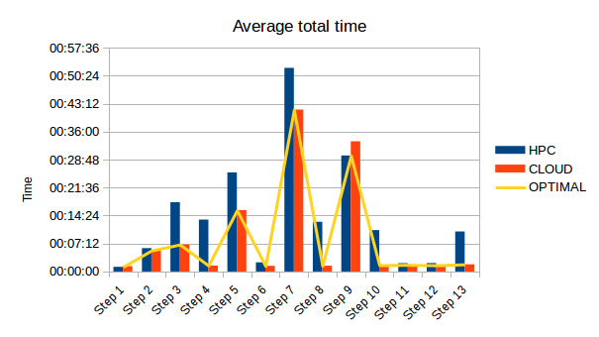
Use case: ZibAffinity

Slide 12
Use case: ZibAffinity
 | Pre/Post | Simulation | Total
Exec Time | HPC ≈ Cloud | HPC < Cloud | 46’ / 99’ | 46.82% HPC < Cloud HPC
Alloc Time | HPC ≈ Cloud | HPC > Cloud | 646’’ / 77’’ | 88% HPC > Cloud Cloud
Total Time | HPC > Cloud 80% | HPC > Cloud 25.7% | 186’ / 115’ | 38% HPC > Cloud Cloud
Core/h | HPC ≈ Cloud | HPC < Cloud 55% | HPC < Cloud| 34,47%
Atos Croupier:
143’ total time, 23.34% improvement over pure HPC execution.
48.3 % core/h improvement over pure cloud.
The orchestrator reverts and improves the overall time lost by using blueprints, while keeping the core/h optimizations.

Slide 13
Conclusions and Future Work
Mixing both HPC & Cloud may improve the execution (depending on data size):
In core/hours spent
In total time to run
Releasing valuable HPC resources
Different scheduling algorithms can be applied to optimize different aspects of a simulation
Smarter resource allocation, Improve data management, reconfiguration on the fly
Test and compare with HPC in Cloud (i.e. through GoogleCloud)
Create the VO for mathematics at EOSC

Slide 14
MSO4SC
Web: www.mso4sc.eu
Docs: http://book.mso4sc.cemosis.fr
Source: https://github.com/MSO4SC
Follow us @mso4sc
Contact us if you want to try!

Slide 15
Thank you for your attention!
Contact information:
Scientific Coordinator: Zoltán Horváth (SZE) horvathz@math.sze.hu
Project Coordinator: Francisco Javier Nieto (ATOS) francisco.nieto@atos.net
Website: www.mso4sc.eu
Grant agreement No. 731063

Slide 16
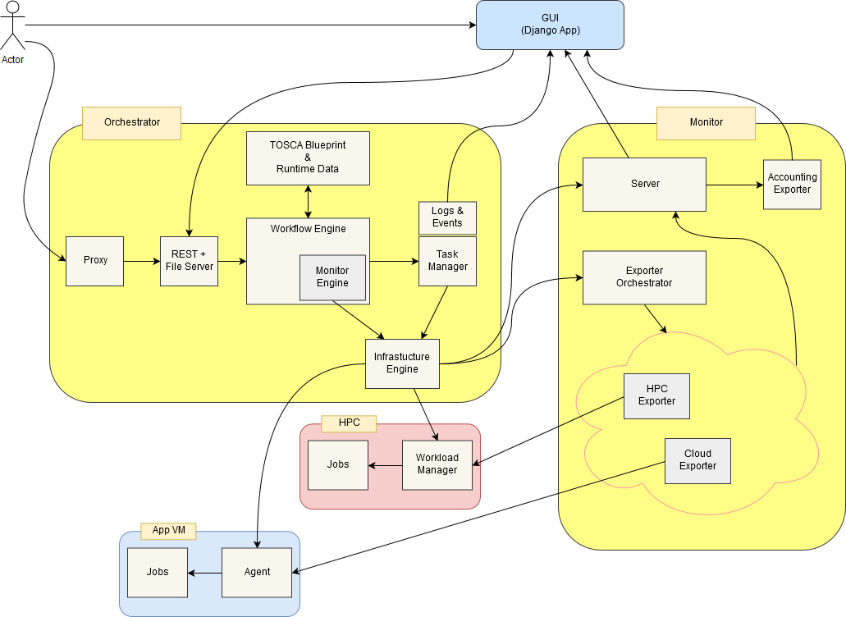
Proposed Solution

