Slide 1
Sentiment analysis on social media
ASDARS

Slide 2
ASDARS
ASDARS
Big Data
Sentiment Analysis

Slide 3
Big data
Volume
Velocity
Variability
High Volume
Hadoop

Slide 4
twitter
Data filters
Hashtags
Metadata
Influencers
Bad data
2016 Presidential Campaign
Cynk (How a company with one employee, no assets, and $0.00 revenue, got a $6 billion market value and blew up)
BotOrNot

Slide 5
asdars
Sources
Processing
API
Twitter
Blogs
Reviews
Hadoop
Machine Learning
Facebook
…
Web
Mobile

Slide 6
BiG data pipeline, v1
Flume
HDFS
Hive
Oozie
Flume: Sources, Sinks, Channels
Twitter Source
Memory Channel
HDFS Sink
Oozie: Job Scheduler
HDFS
SerDe
Hive
Hive: Distributed Storage, SQL

Slide 7
Machine learning
Classification Algorithms: polarity detection
Naive Bayes, SVM, SGD, Random Forests
Labeled datasets

Slide 8
training
Clean Up: remove html characters; remove stopwords
Word Stemming
Unigrams and Bigrams
Bag of Words/TF-IDF

Slide 9
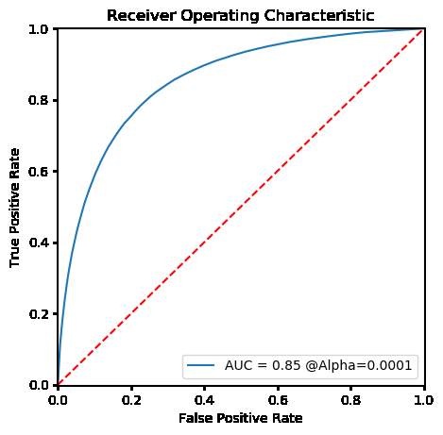
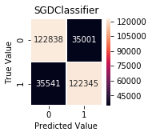
Evaluation, train/test 80/20
ROC Curve
Confusion Matrix

Slide 10
Results
Algorithm | Precision %
Random Forest | 78
Naïve Bayes | 77
Linear SVM | 80
SGD | 78

Slide 11
Model update
Hive
OOV
Classify
New Data
Label
Train
Evaluate
Update

Slide 12
Next steps
Twitter, Facebook, …
Spark
MongoDB
Kafka
Bag of Words – Word Embeddings

