Slide 1
Data Science @ FCUL
João Marques Silva, FCUL

Slide 2
Plan
What?
Why?
How?
Who?
When?

Slide 3
What is Data Science?
Data Science?
Statistics
(w/ fancy name)?
Big Data?
(w/ modern name?)
Analytics?
Does it matter?

Slide 4
What is Data Science?
Data science is an interdisciplinary field of scientific methods, processes, algorithms and systems to extract knowledge or insights from data in various forms, either structured or unstructured.
Wikipedia
Statistics
Visualization
Data Mining
Machine Learning
Artificial Intelligence
Algorithmics
Security
& Trust
Distributed Computing
Database Systems
Knowledge Engineering
Web Science
IoT, NLP, …
Physics,
Astronomy
Chemistry
Medicine,
Biology
Marketing,
Banking, …
Fascinating new interdisciplinary field

Slide 5
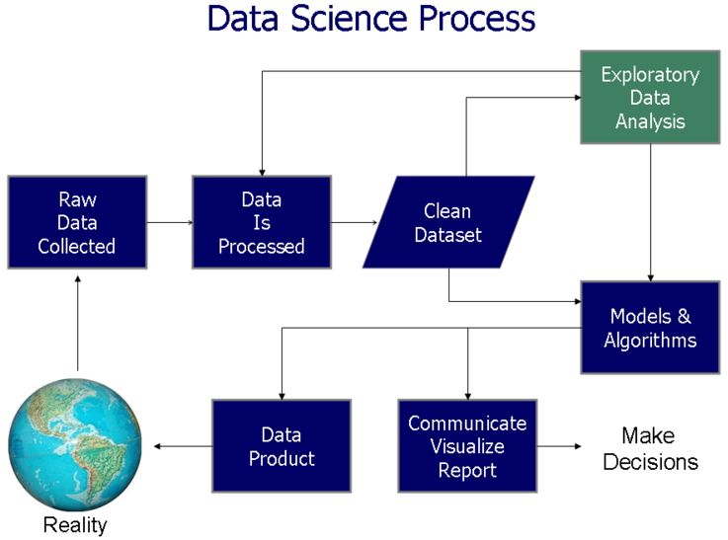
What is Data Science?
Wikipedia

Slide 6
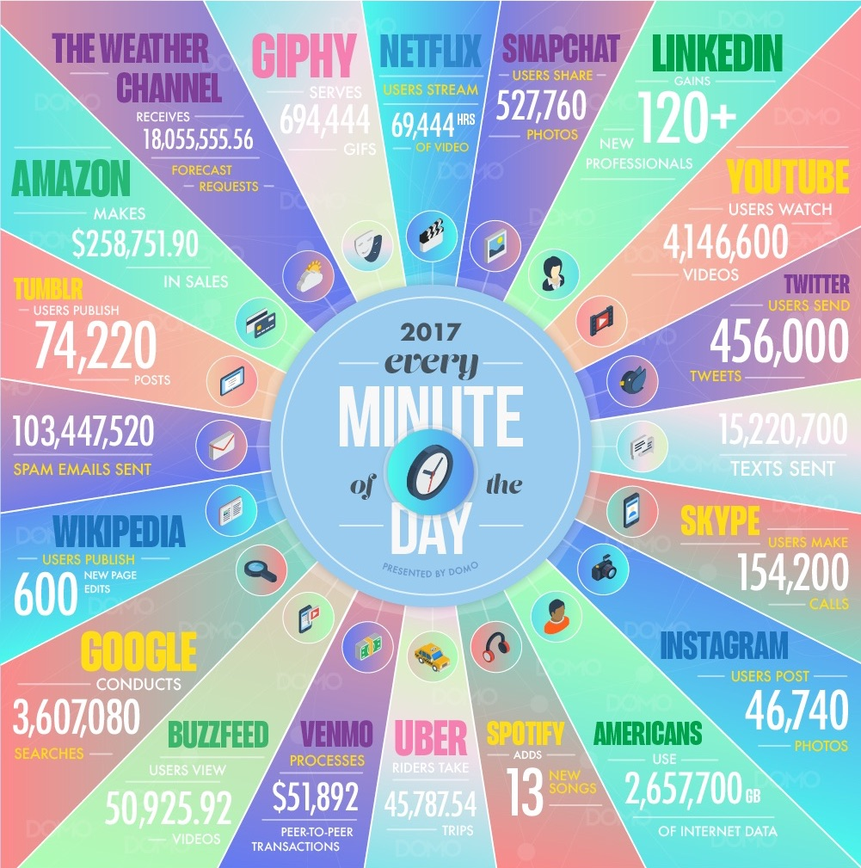
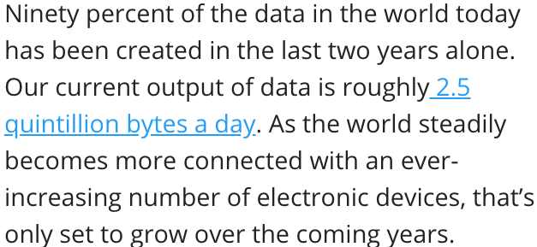
Why Data Science?
Data Never Sleeps!
Domo, 2017
iflscience, Jul 17
Forbes, Apr 17
Domo, 2017

Slide 7
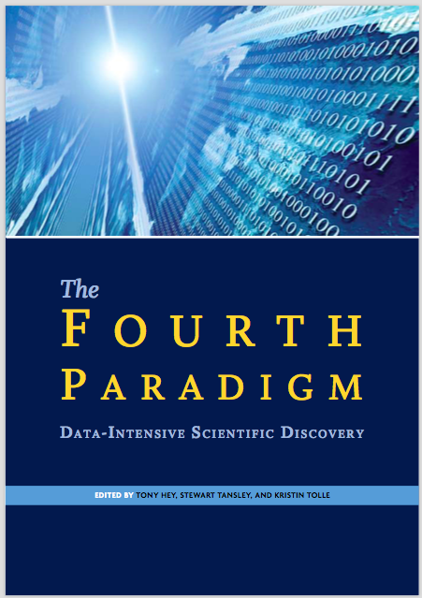
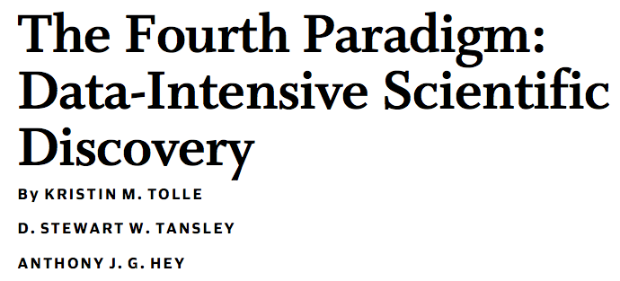
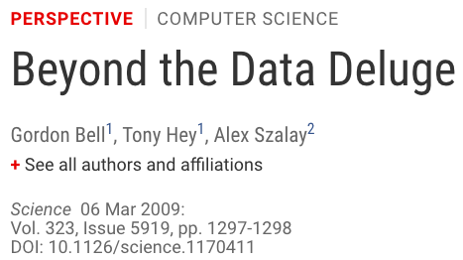
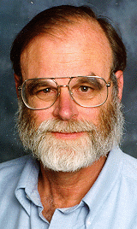
Why Data Science?
IEEE Proc, 2011
Science paradigms: Empirical, Theoretical, Computational and Data-driven (eScience)
2009
Jim Gray

Slide 8
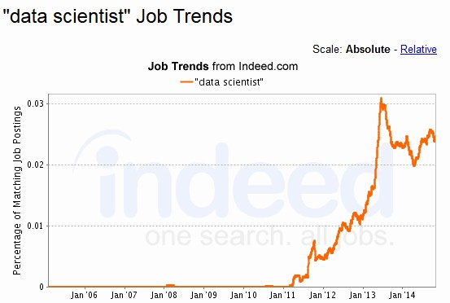
Why Data Science (before 2016)?
Term has long history: 1960s, 70s, 1996, 1997, 00s

Slide 9
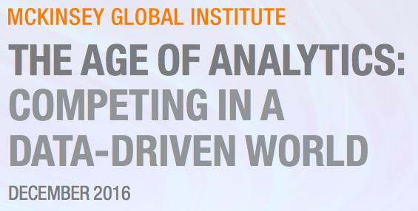
Why Data Science (in 2016/17)?
Forbes, Jan 17
CBSnews, Jan 17
Gigabit Mag, Jun 17

Slide 10
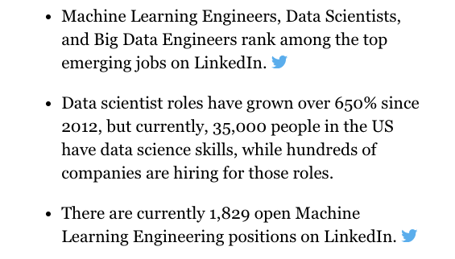
Why Data Science (in 2017/18)?
Forbes, May 17
Forbes, Dec 17
Forbes, Dec 17

Slide 11
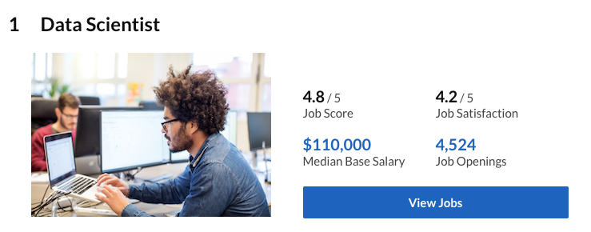
Why Data Science (in 2017/18)?
Forbes, Jan 18
Glassdoor, Jan 18

Slide 12
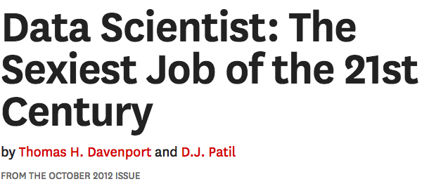
Why Data Science?
HBR, Oct 12

Slide 13
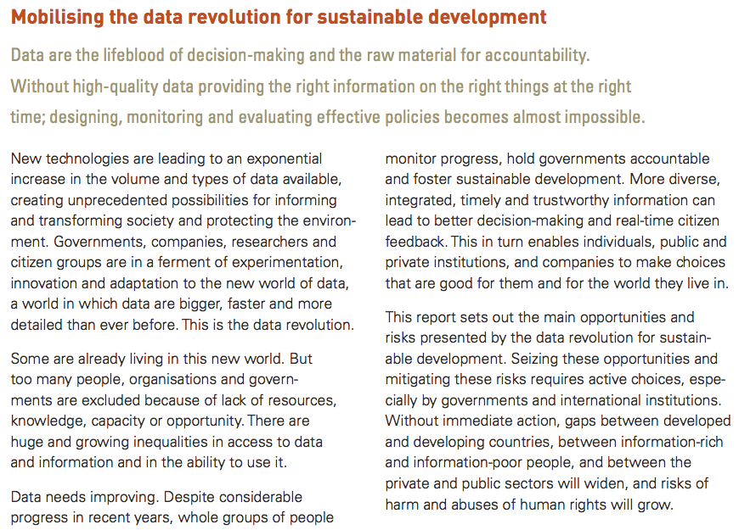
Why Data Science?
Data4sdgs, Jun 17
UN, 2014

Slide 14
The Need for Data Literacy
Data literacy is the ability to read, create and communicate data.
Wikipedia
Techtarget, Jun 17
Inc.Com, Jan 18
∴ An imperative to provide training (and research) in Data Science!

Slide 15
How to Data Science (@FCUL)?
Training & Outreach
Research & Innovation
3rd Cycle
High
Impact
Post Grad Training
2nd Cycle
DSI @ LASIGE
1st Cycle
Tech Transfer
Partnerships
Training
High Schools

Slide 16
Post-Graduation in DS – 2017/18
Adapt to PT requirements
Instantiation: Univ. Southampton, UK
EDSA Recommendations

Slide 17
Post-Graduation in DS – 2017/18
G0: Mandatory Courses
18 ECTS
G1: Statistics
12 ECTS
G2: Foundations
12 ECTS
60 ECTS
1 Year
G4: Electives
6 ECTS
G3: Technology
12 ECTS

Slide 18
PGDS – Courses (each 6 ECTS)
G0: Mandatory (18 ECTS)
Foundations of Data Science (3 ECTS)
Data Science Seminar (3 ECTS)
Machine Learning
Database Technologies
G1: Statistics (12 ECTS)
Statistical Models
Bayesian Statistics
Decision & Prediction Processes
Multivariate Data Analysis
Statistical Methods
Probability & Statistics
Computational Methods in Statistics & OR
G2: Foundations (12 ECTS)
Data Mining
Complements of Machine Learning
Foundations of the Semantic Web
Design & Analysis of Algorithms
Modeling in Physics & Engineering
Quantitative Methods in Systems Biology
G3: Technologies (12 ECTS)
Data Visualization
Data Processing Technologies
Web Applications
Cloud Computing
Intrusion Detection & Tolerance
Cluster & Multicore Programming

Slide 19
PGDS – Courses (each 6 ECTS)
G4: Electives (6 ECTS)
Bioinformatics
Internet of Thins
Elementary Statistical Physics
Data Analysis in the Life Sciences
“Omics” Approaches in the Life Sciences
Computational Mathematics
Topics in Mathematics
Other courses*: …
Overall adequate mix of theory and practice
Interest from PT, EU, South America, Middle East, etc.

Slide 20
Sample of Technologies
Scikit-learn, Orange, RapidMiner, KNIME, Anaconda, etc.
Python, R, Julia, Scala
SQL, NoSQL,
MongoDB, etc.
Spark, Hadoop,
Map reduce, etc.

Slide 21
MSc in DS (MCD) – 2018/19
G0: Mandatory Courses
18 ECTS
G1: Statistics
12 ECTS
G2: Foundations
12 ECTS
120 ECTS
2 Years
G4: Electives
6 ECTS
G3: Technology
12 ECTS
Intro to Research
6 ECTS
MSc Thesis
54 ECTS

Slide 22
MSc in DS -- Courses
Courses shared
with PGDS
Students can attend some courses at IST
(and vice-versa)

Slide 23
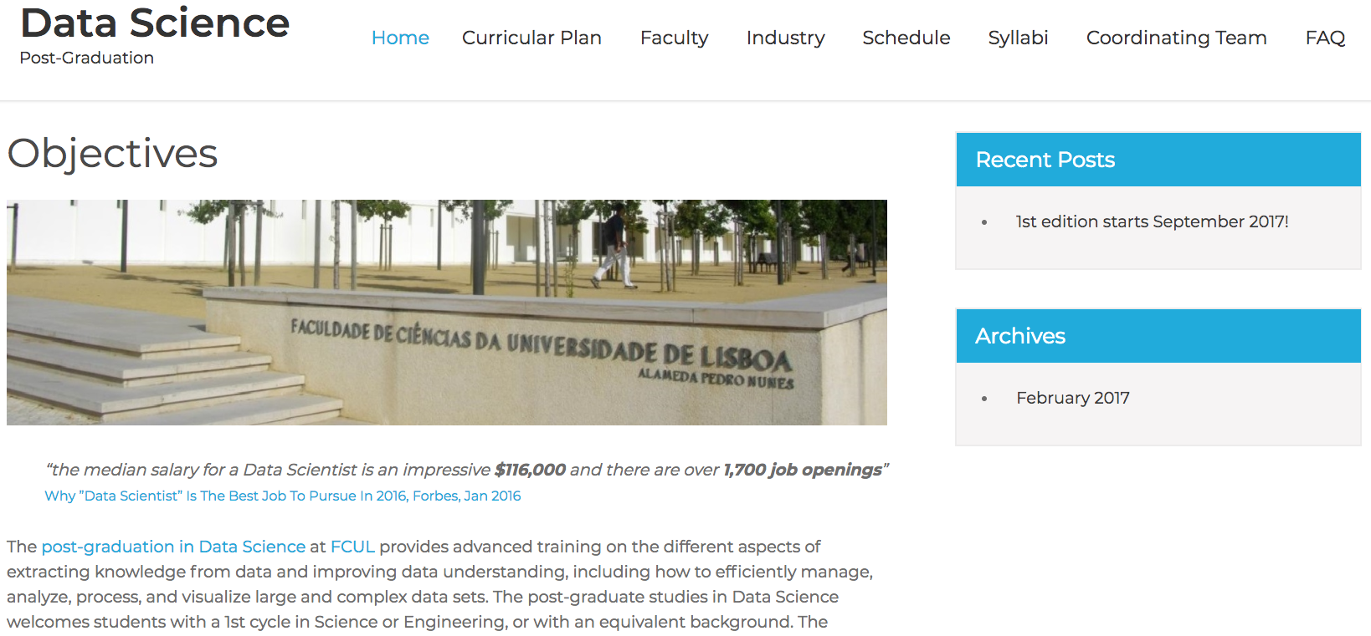
Our Site(s)
http://datascience.campus.ciencias.ulisboa.pt/

Slide 24
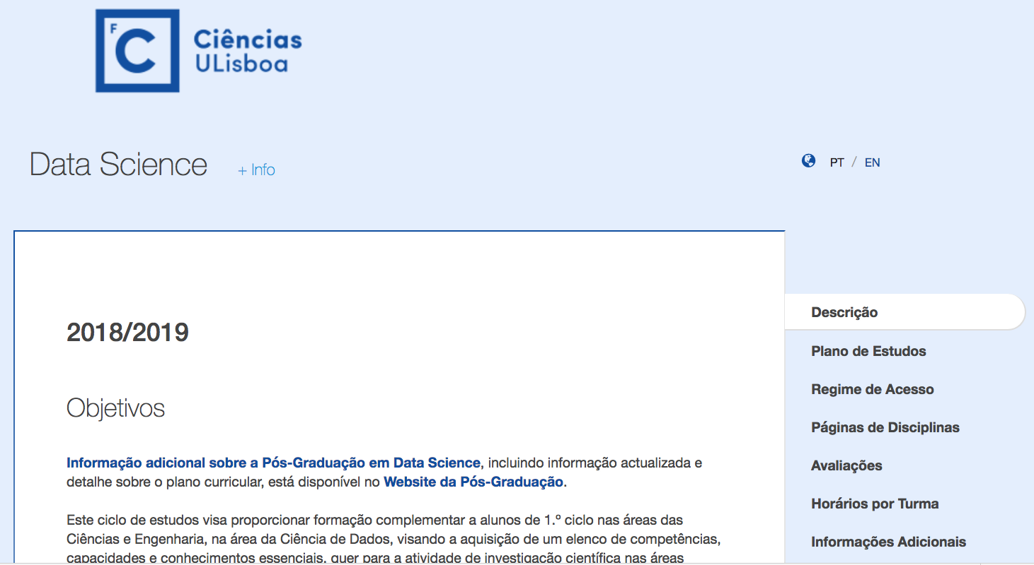
Our Site(s)
https://fenix.ciencias.ulisboa.pt/degrees/pgdsc-283025459904514

Slide 25
When Data Science?
Additional plans ...
MCD: 2018/19
PGDS: 2017/18

Slide 26
Research in Data Science?
@ LASIGE
Data & Systems Intelligence: >10 PIs
Bioinformatics
Medical Informatics
Data Mining / Clustering
…
Ontologies
Chemo Informatics
Cloud Computing
Knowledge Engineering
Logic in CS
Optimization

Slide 27
Questions?

