Slide 1
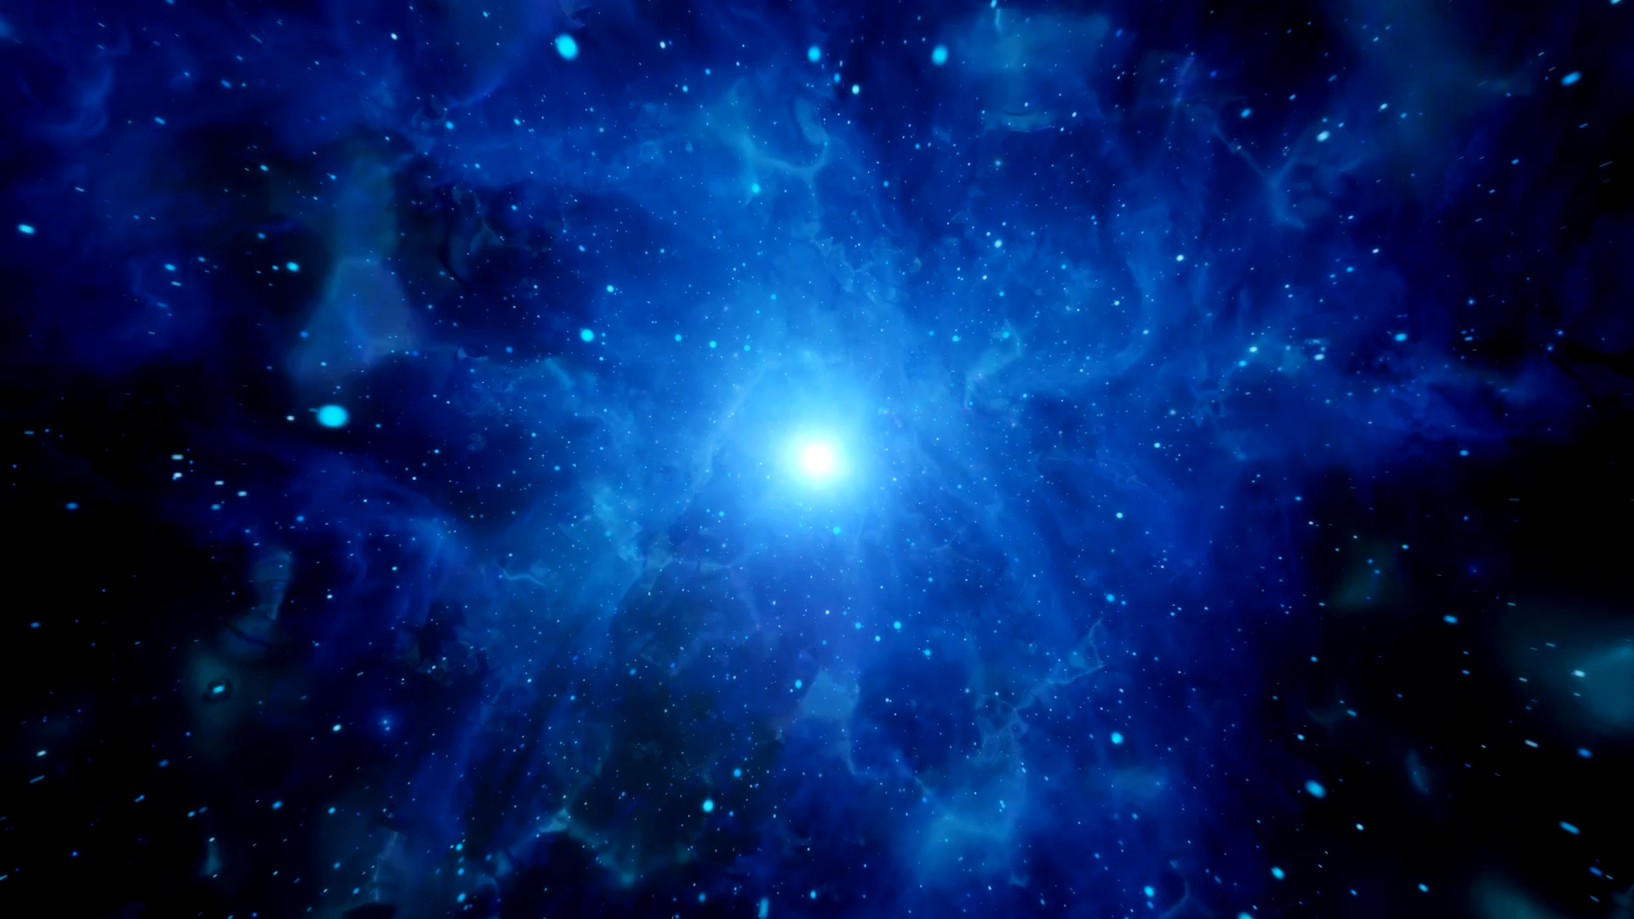




Radiation Environment in Space
Luisa Arruda
luisa@lip.pt

Slide 2
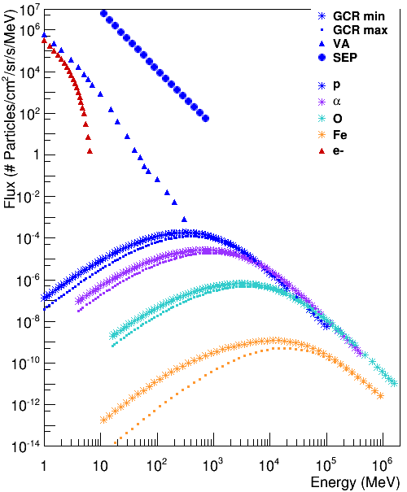
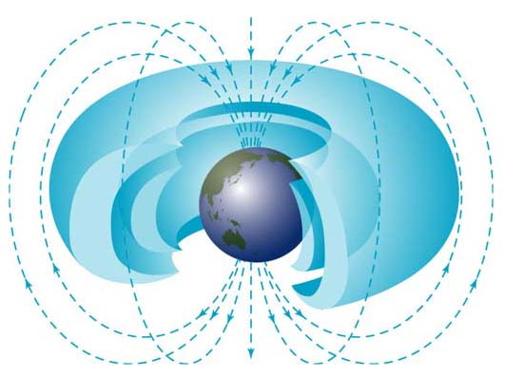
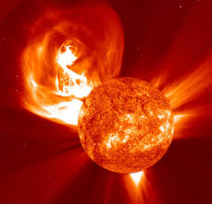
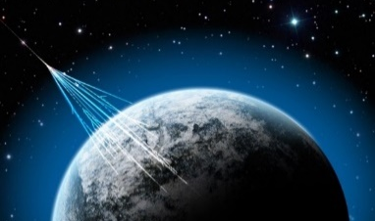

Space Radiation Environment
Van Allen
Radiation Belts
SEP event
Protons and electrons
AP-8 and AE-8 models
Galactic Cosmic
Radiation (GCR)
Protons
Integrated 14 day SEP event of December 2006
p, $α$, O and Fe
ISO 15390
Solar min: 30 Jan 2009
Solar max: 30 Jan 2014
1 AU from Earth

Slide 3
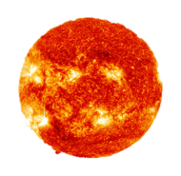
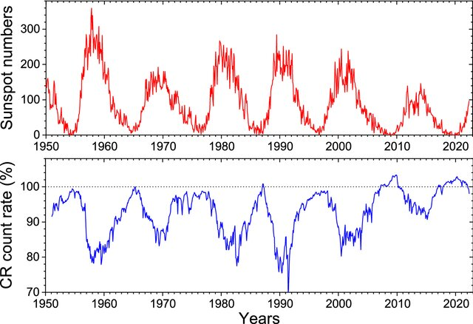
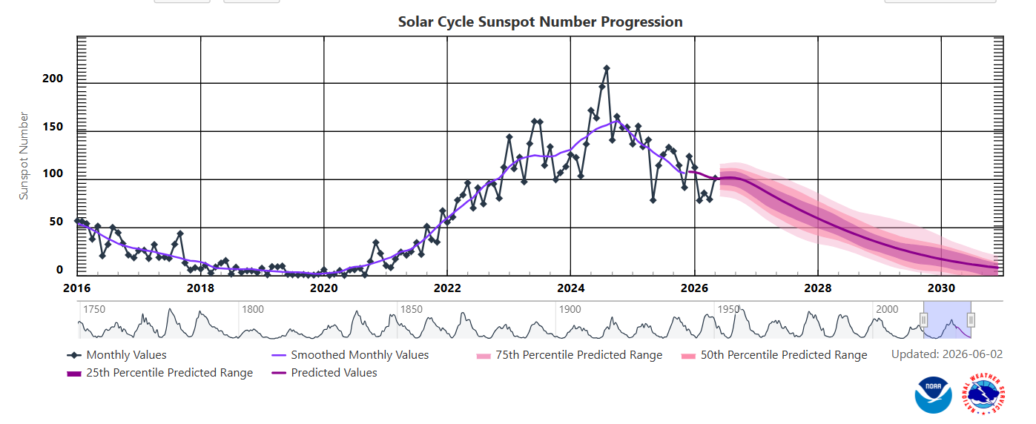
GCR and Solar cycle activity
α
Modulation with solar activity – 11 yr cycle
Solar cycle modulated flux inversely proportional to the Sun’s activity
Maximum: solar storms and SEP
Minimum: more GCR
https://www.swpc.noaa.gov/products/solar-cycle-progression
Content available from Living Reviews in Solar Physics

Slide 4
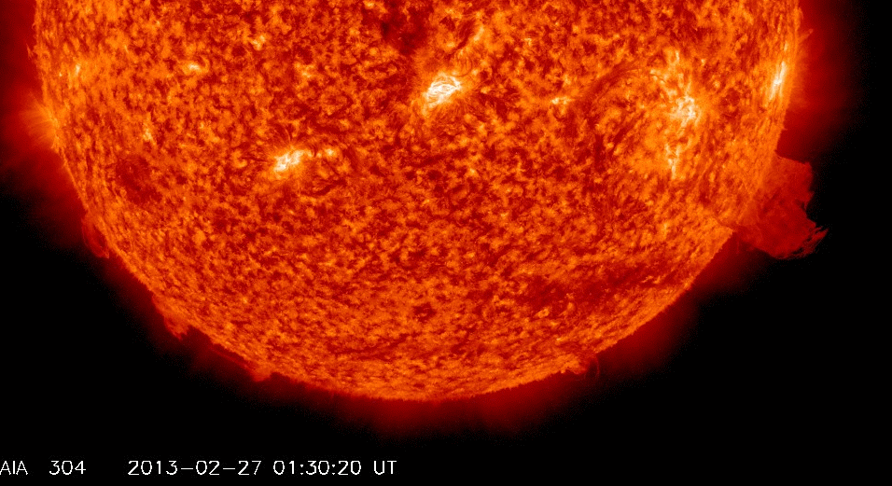
SEP – Solar energetic particles
Associated to
Solar flare
Coronal mass ejections (CME)
Mainly protons and electrons
Energies from several hundred MeV/nuc to GeV/nuc
List from 1976-present @ https://umbra.nascom.nasa.gov/SEP
At Earth's surface, the atmosphere in conjunction with the geomagnetic field provides considerable protection against cosmic rays and solar particle events!
In Space, SEPs are responsible for spacecraft system and component hazard and damage and impose strict constrains on human space exploration.

Slide 5
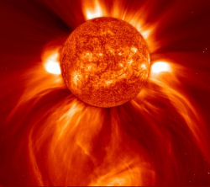
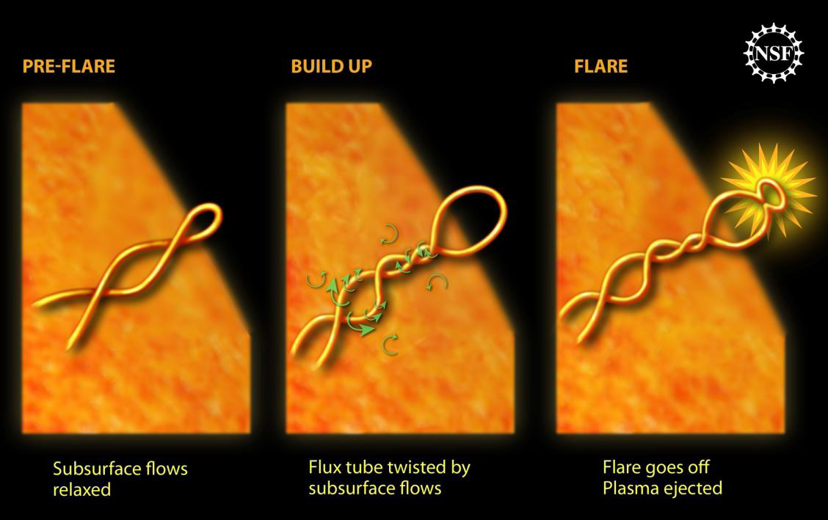
SEP - Eventos solares
Notes:
Solar Flares are huge explosions on Sun’s surface, usually occuring near sunspots. When the tangled magnetic fields, coming out of the surface, reach a "breaking point", like a rubber band that snaps when wound too tight, huge bursts of energy are released as the field lines reconnect. This can lead to the formation of a Solar flare, as depicted in figure. In the magnetic reconnection process, a huge amount of magnetic energy is rapidly released and transformed to thermal and kinetic energy of the particles. Reconnection can accelerate particles to a high energy (few GeV) within a short time, as required by the very impulsive SEP events. Ejected particles may either remain trapped, or escape into the interplanetary space, if the upper magnetic configuration becomes open. The particles emitted during these kind of events are mainly photons (γ-rays and X-rays), protons and electrons.
CME are quite common during periods of high Solar Activity and are characterized by being spatially larger and temporarily slower than Solar flares. During a CME, huge quantities of plasma, initially trapped in closed coronal magnetic field lines, are ejected into interplanetary space (involving typically 1012 to 1013 kg of mass, and kinetic energies of 1024 to 1025 J).

Slide 6
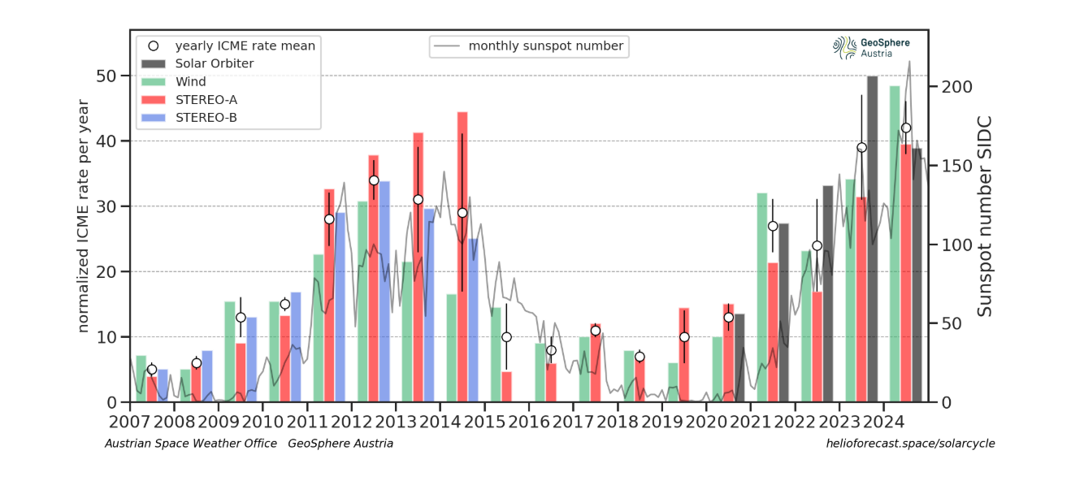
Solar Energetic Particle Events
Long term record
More in “maximum” solar activity years
Highly unpredictable
Design for by making a statistical assessment

Slide 7
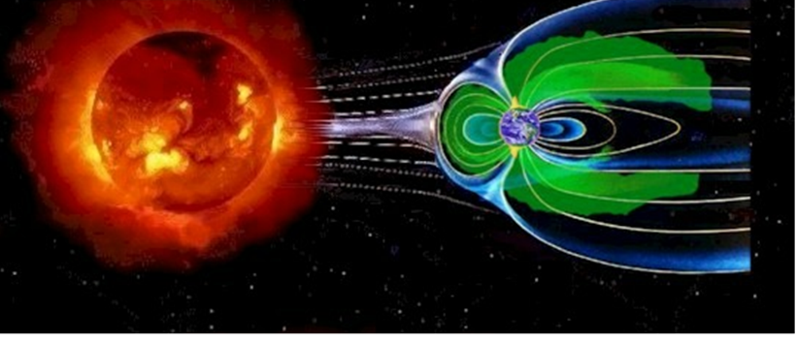
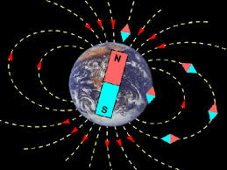
The Magnetosphere: an invisible shield
Particles coming from space and produced in their interaction with the atmosphere are trapped by the Earth’s magnetosphere forming the Earth´s radiation belts
In Earth orbits the radiation belts containing trapped electrons and protons constitute the major radiation source

Slide 8
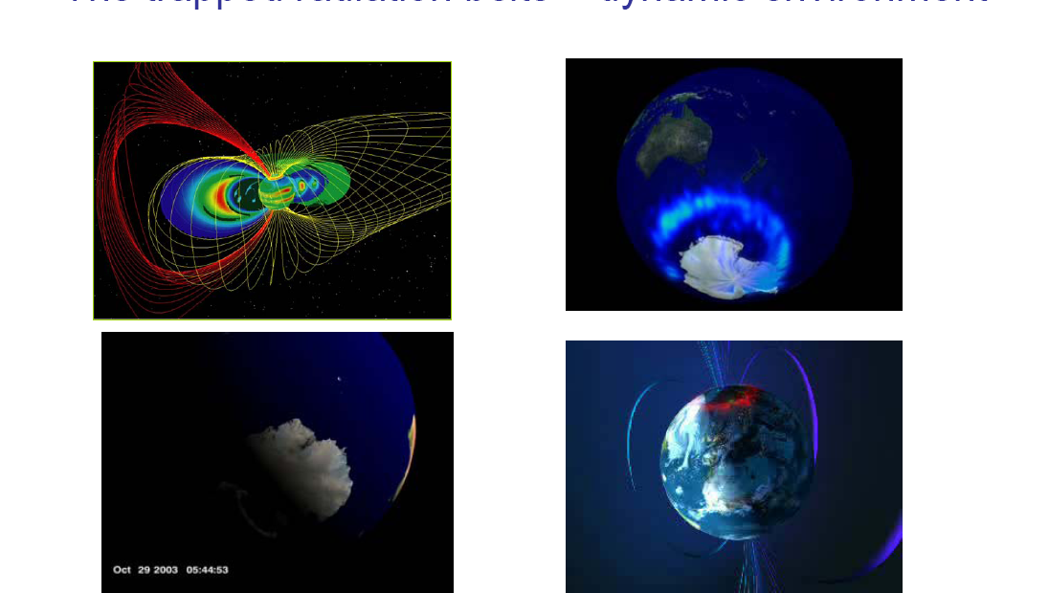
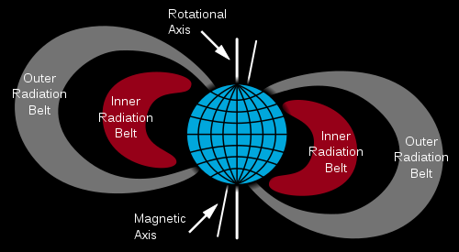
Earth radiation belts
Particles coming from Space depending on their R may be trapped by the geomagnetic field and form the Earth’s radiation belts.
In Earth’s orbits the radiation belts containing trapped e⁻ and p constitute the major radiation source = dynamic environment
Inner belt (700-10000km)
Dominated by p
Product of CR Neutron Decay
E~100’s MeV
Outer belt (~20000-70000km)
    Dominated by e⁻
    Controlled by “storms”
Dominates GEO environment & Navigation (Galileo, GPS) orbits & certain Science missions in highly elliptic orbits (XMM-Newton, INTEGRAL)
    E~ MeV

Slide 9
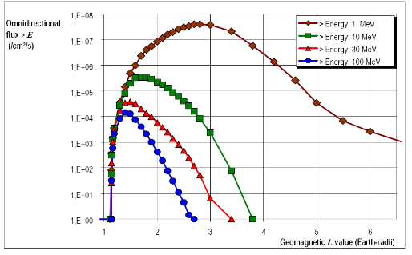
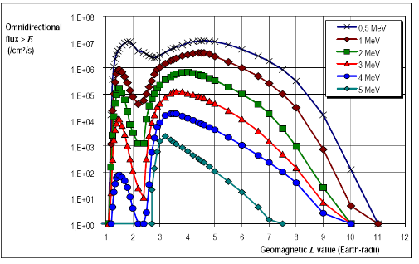
Earth Radiation Belt Models
Examples of models: AP8, AE8 (but there are more…)
Based on data from 1960-1970
Long term averages
but : outer belt is very stormy
ongoing work to update models
protons
electrons
ISS
Nav
GEO
Electrons

Slide 10
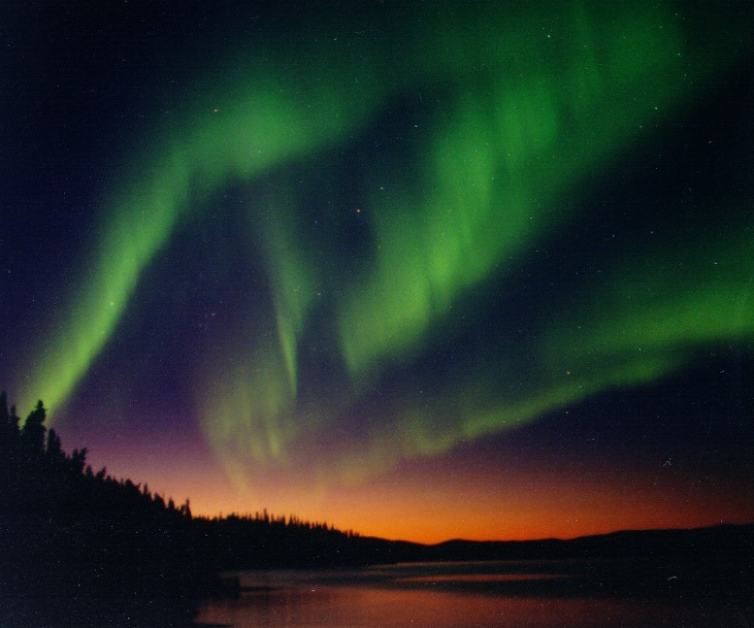
Aurora
The charged particles trapped in the radiation belts may excite the Earth’s atmosphere N₂ and O₂ that when return to the fundamental state emit visible radiation.

Slide 11
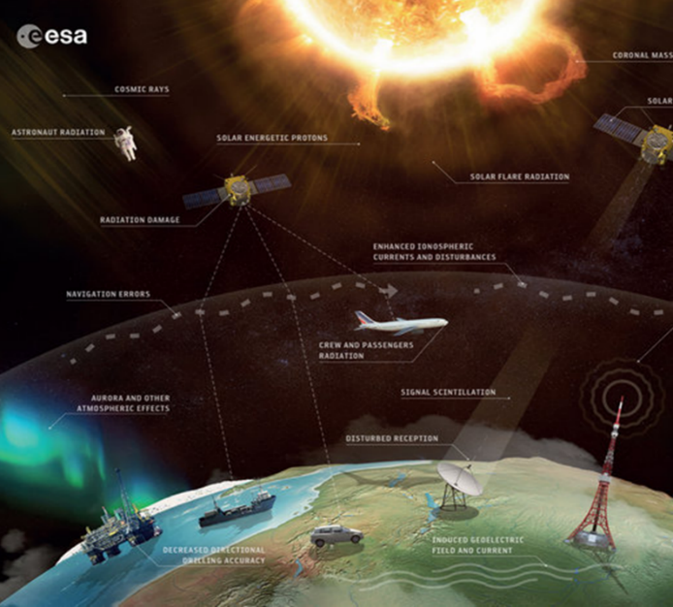
Radiation effects in Earth orbits

Slide 12
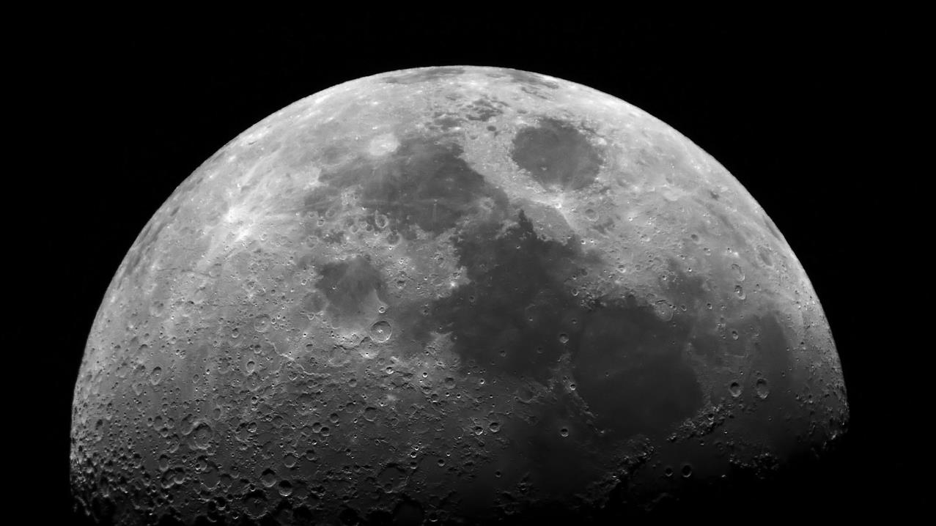
The Moon

Slide 13
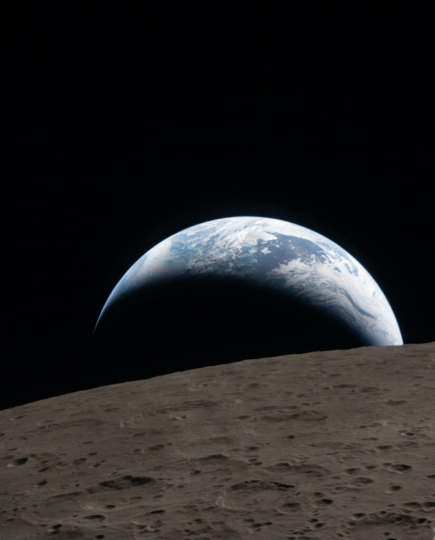
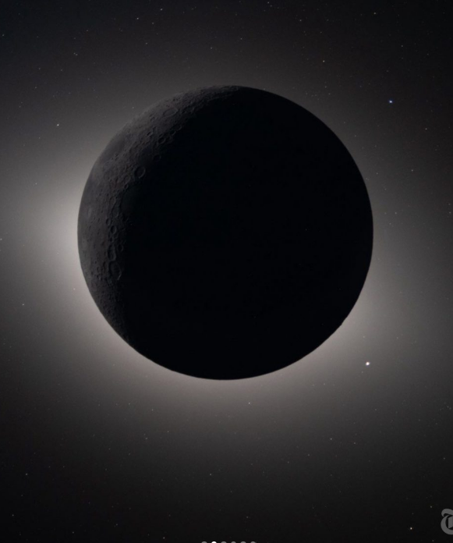
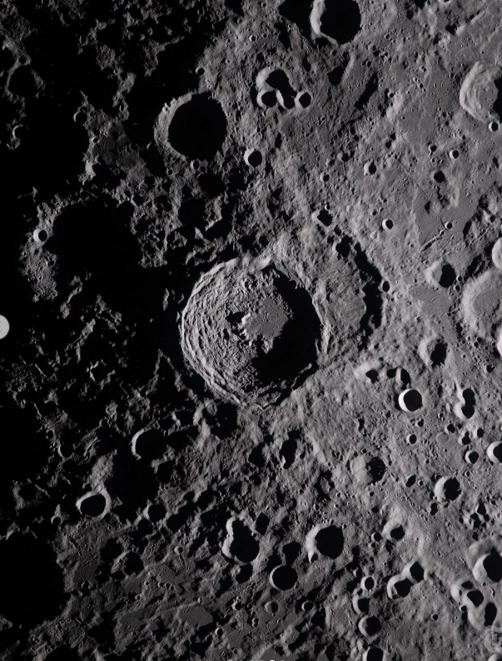
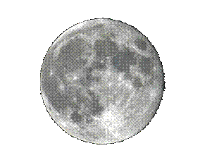
The Moon
No Atmosphere
Very weak localized crustal magnetic field
Radiation environment
SEP and GCR @ 1AU
Albedo neutrons (modulated by H₂O)
No radiation belts
6:41 p.m. EDT, on April 6, 2026, ARTEMIS II, NASA

Slide 14


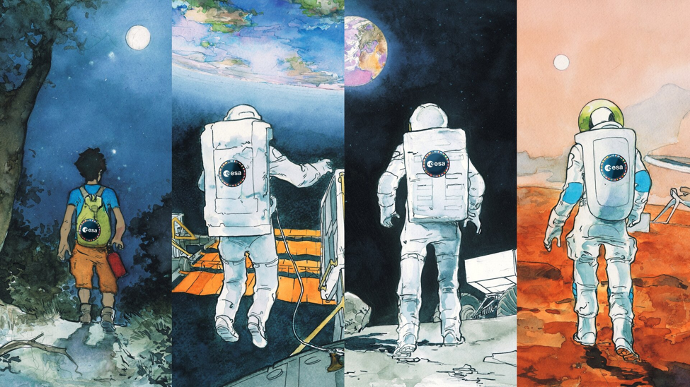
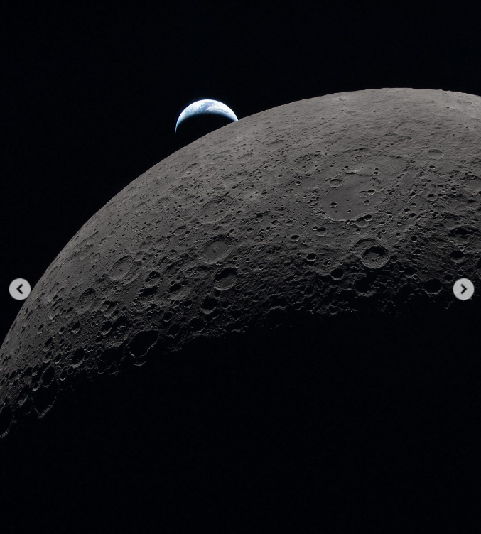
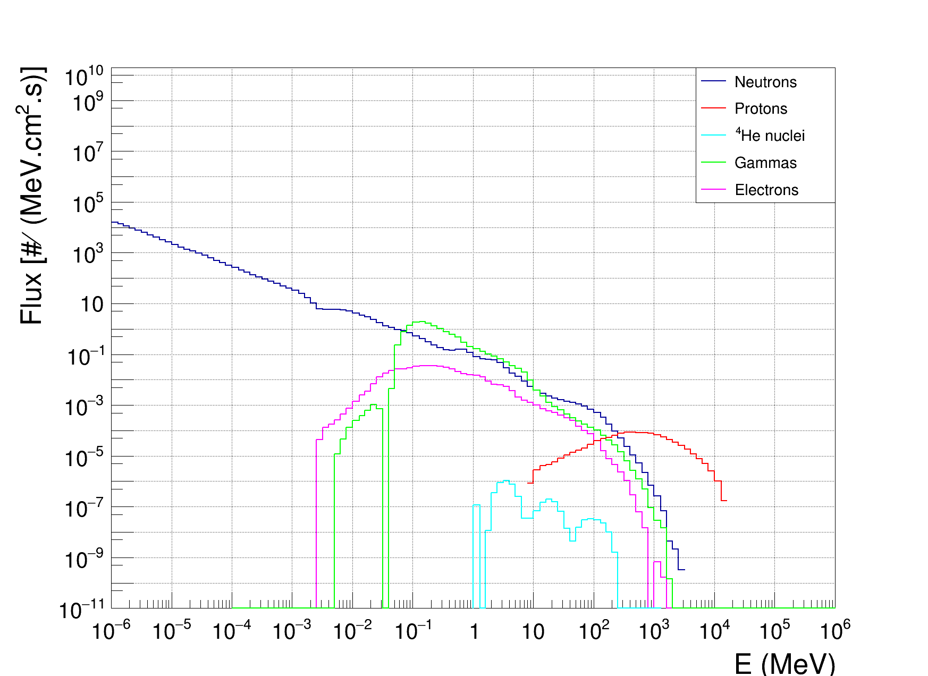
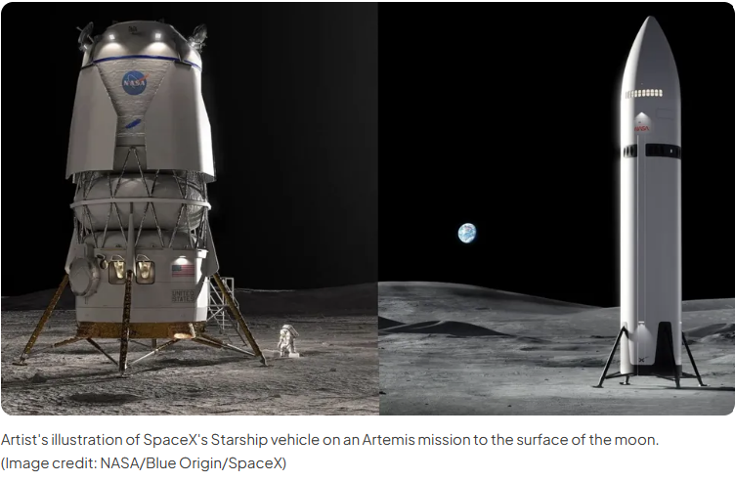
Lunar Radiation Model
LUNAIRE – LUNar Ionizing Radiation Environment
Primaries: Protons GCR Solar Max
ARTEMIS II, NASA
Credits: Bruna Lima

Slide 15
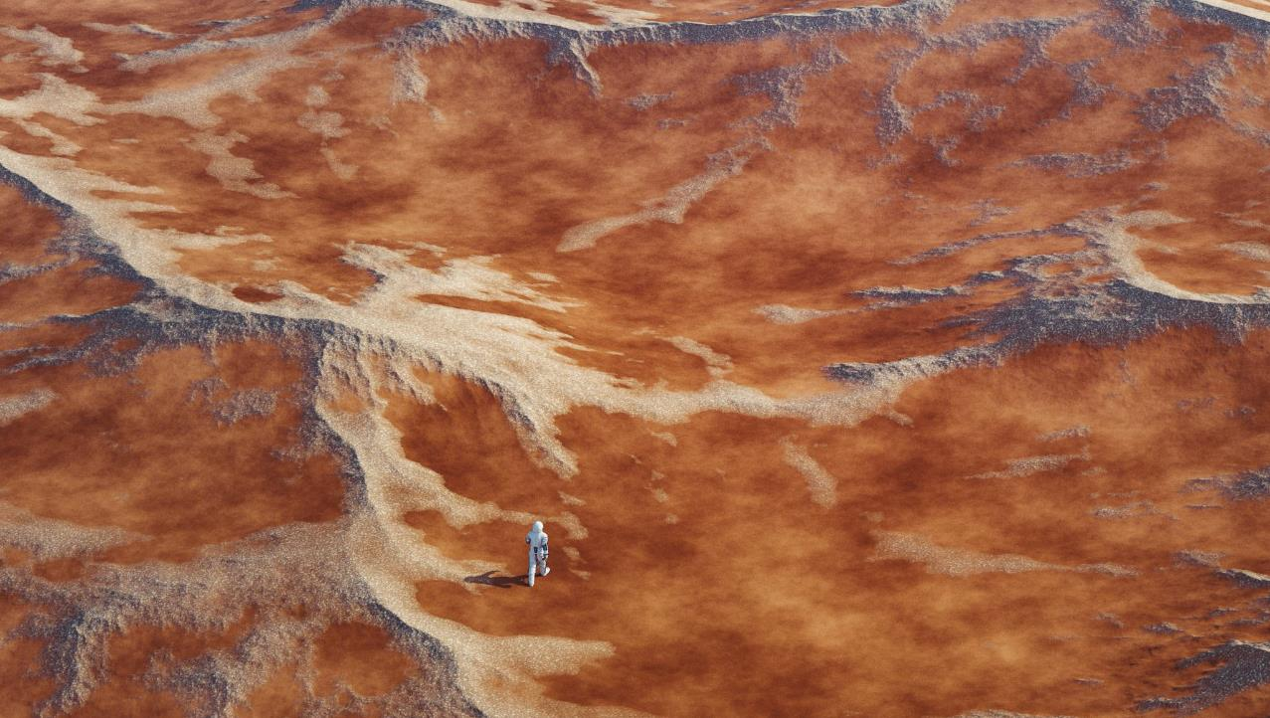
Mars
Away from home

Slide 16
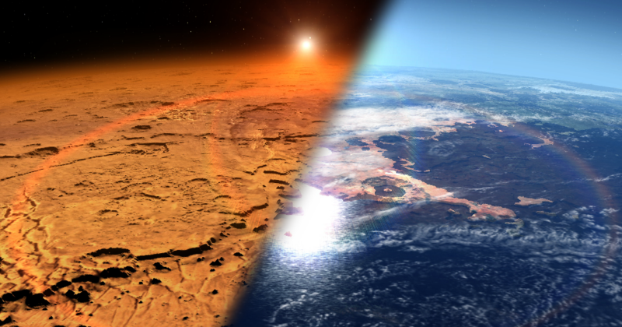
Mars Radiation Environment
Corresponds to proton range on Mars atmosphere
Spectral
changes

Slide 17
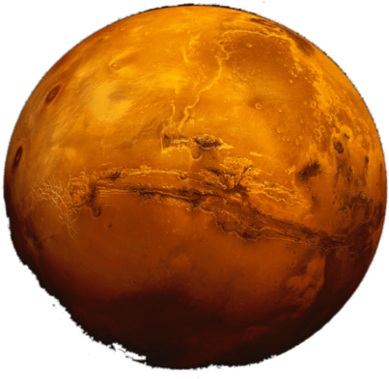
Radiation Environment Modelling
MarsREM: the Mars Energetic Radiation Environment Models
LIP developed dMEREM, a Geant4 based model for the radiation environment on Mars, Phobos and Deimos, including local treatment of surface topography and composition, atmospheric composition and density (including diurnal + annual variations) and local magnetic fields.
Inputs given as a function of latitude, longitude, in a 5º x 5º grid, and season.
Example of dMEREM results:
Particle radiation arriving on Mars surface after GCR-alpha interaction with atmosphere and soil
17

Slide 18
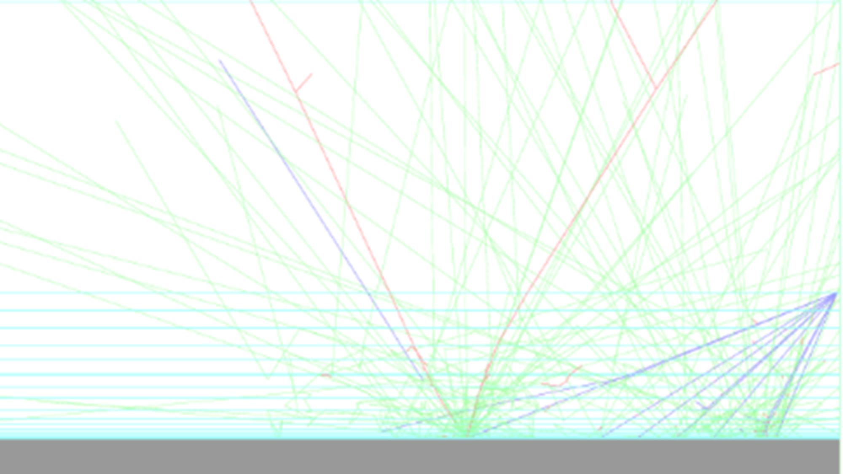
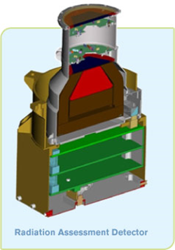
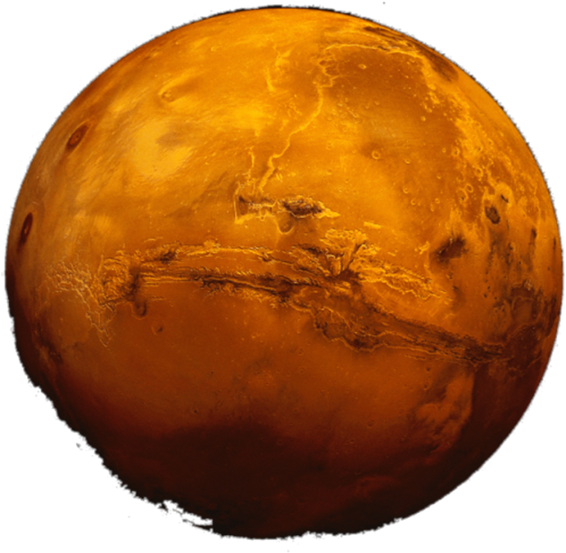
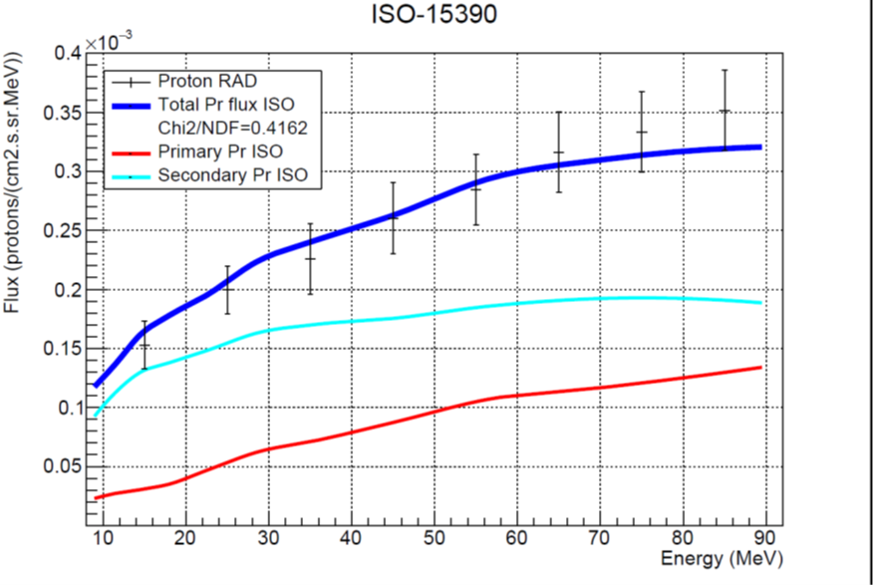
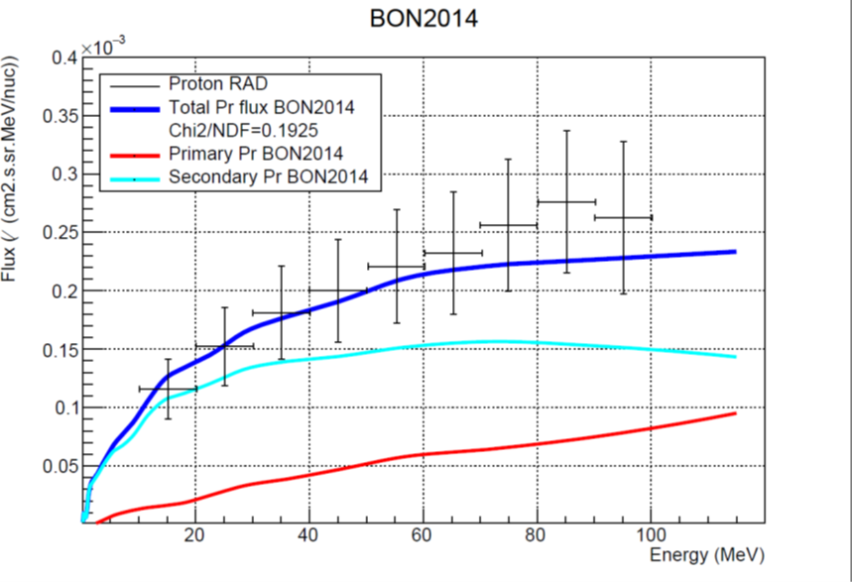
Validation of dMEREM, the Detailed Mars Energetic Radiation Environment Model, with RAD Data from the Surface of Mars
Protons at the surface of Mars
September 2017
Protons at the surface of Mars
Nov 2015 – Jan 2016
P. Gonçalves L. Arruda, M. Pinto, Front. Astron. Space Sci., 21 February 2022, Sec. Planetary Science

Slide 19
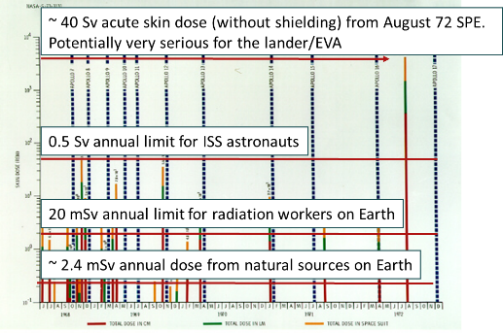
30 days on Mars
30 days on the Martian surface at Solar Minimum (worst case for GCR)
Effect of Galactic Cosmic Rays
Mars location | Ambient Dose Equivalent (mSv)
Viking 1/Phoenix/ Mawrth * | 21.0/20.3/14.4
15-20 mSv/30 days = 0,5 - 0,7 mSv /day
~ < anual limit for Earth radiation workers
~ Daily dose on the ISS
In “Characterization of the Martian radiation environment on selected locations using the ESA Mars Energetic Radiation Environment Models”, Icarus 218 (2012) 723–734, S. McKenna-Lawlor, P. Gonçalves, A. Keating, B.bMorgado, D. Heynderickx, P. Nieminen, G. Santin, P. Truscot, F. Lei, B. Foing and J. Balaz

Slide 20
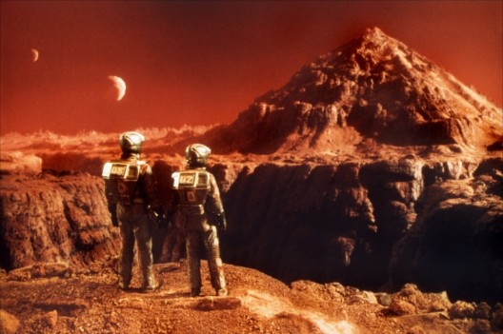
...it is possible !
It is possible to remain in Martian surface for some time with no serious risk for the astronauts!
For longer permanences shelters are required...
20
Notes:
20

Slide 21

Jupiter
Beyond the belt

Slide 22
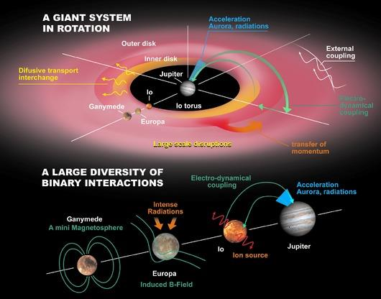
JUICE
ESA L-Mission to the Jovian System

Slide 23
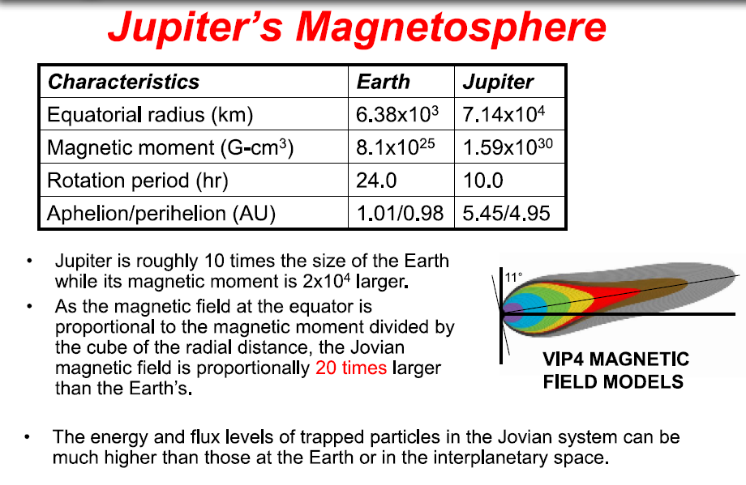
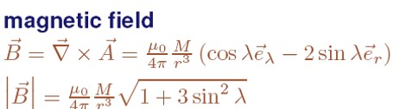
Slide: courtesy of Insoo Jun (RADECS 2012)

Slide 24
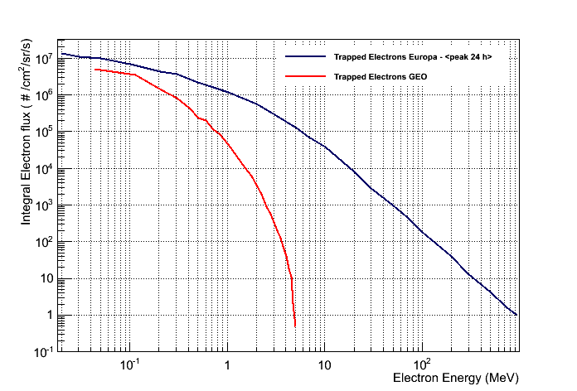
Very Hard Electron Spectrum
Trapped particles:
Main contributor to the Jovian System
Jupiter’s trapped particles are much more energetic than the ones found on Earth
    Jupiter‘s trapped electrons: up to 100MeV
    Jupiter’s trapped protons: up to 1 GeV
300 keV
40 MeV

Slide 25
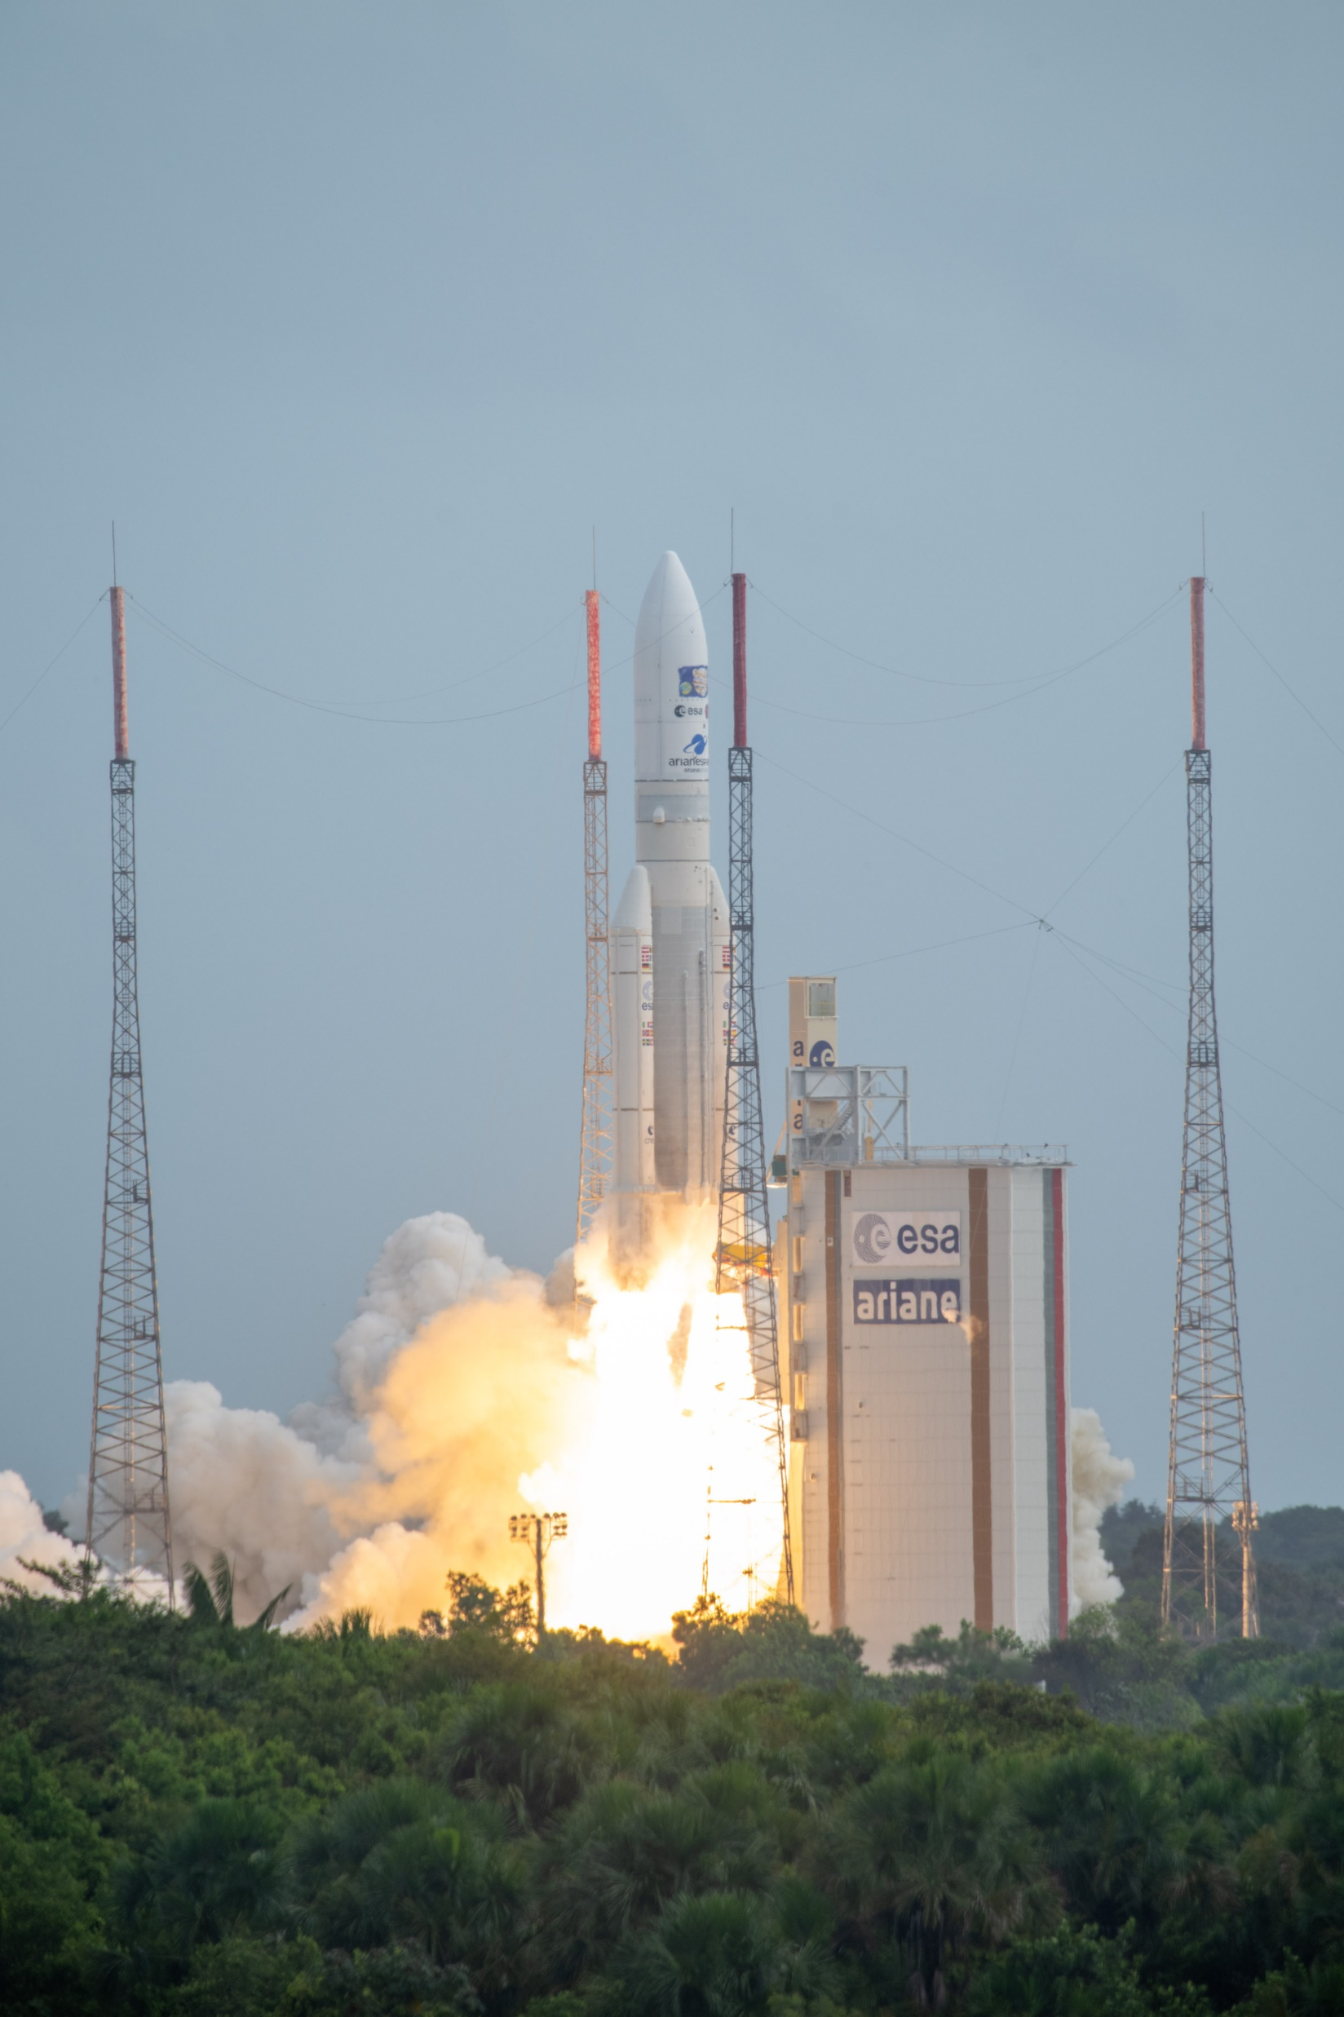
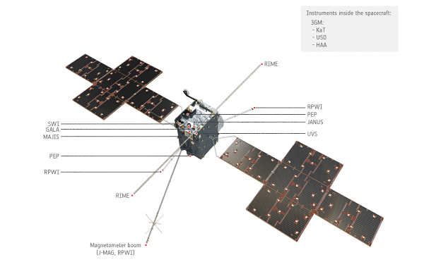
JUICE
JUpiter
ICy moons Explorer
Exploring the emergence of habitable worlds around gas giants
7.6 years cruise &
3.5 years in the Jovian system
14th April 2023

Slide 26
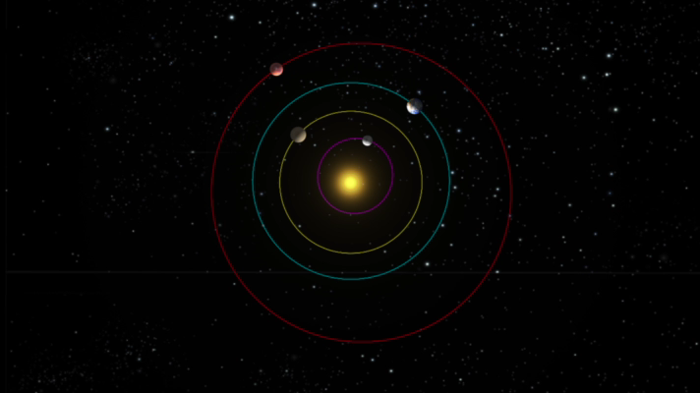
The radiation environment in the solar system:
Jupiter
To Jupiter – ESA Juice Mission (2023): RADEM – RADiation hard Electron Monitor
ESA Contract No. 4000137865/22/ES/JD CCN2 - Expert support to BERM (BepiColombo Environment Radiation Monitor) & RADEM units on board BepiColombo and JUICE spacecraft (LIP)
ESA Contact No. 4000110643/13/NL/HB - RADEM Proto-Flight Model (EFACEC, PSI, IDEAS, LIP)

Slide 27
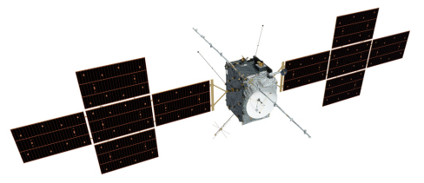
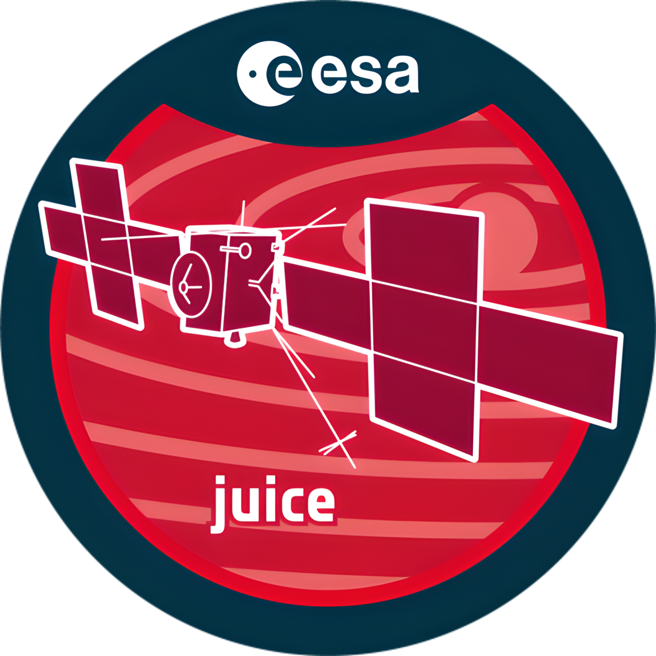
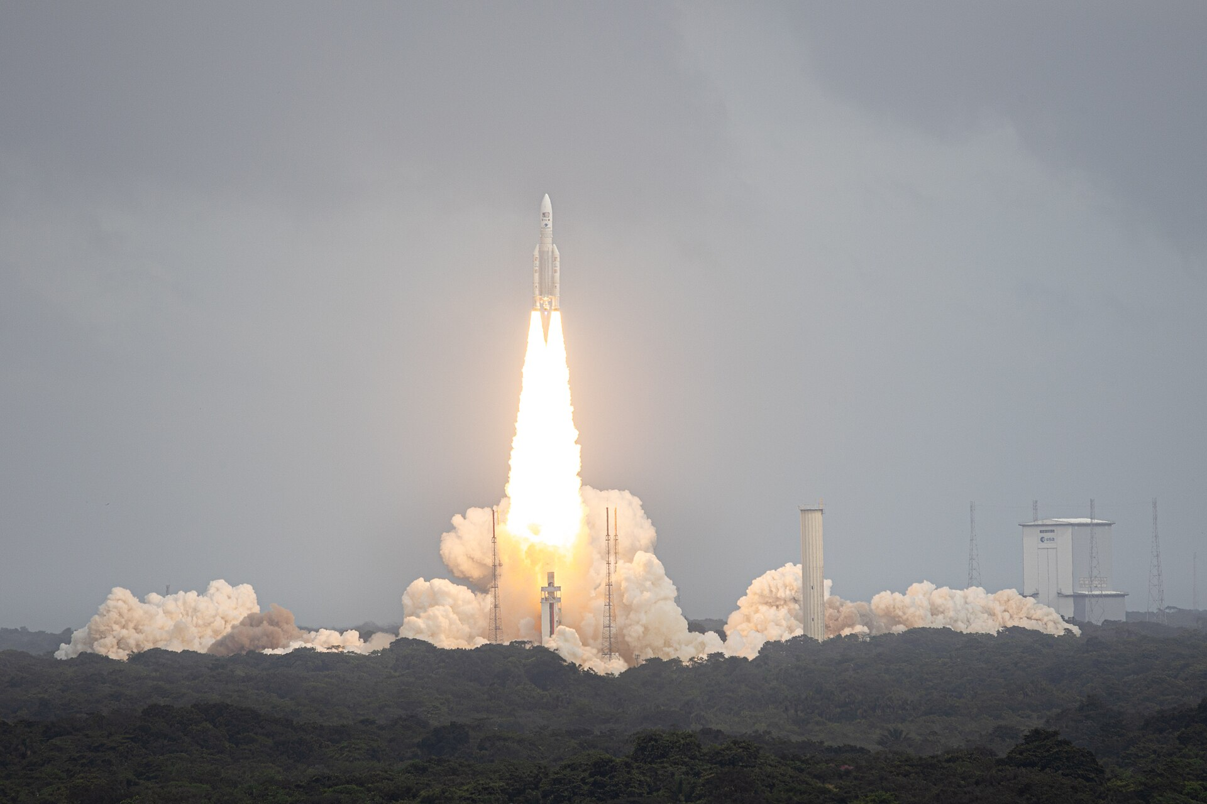
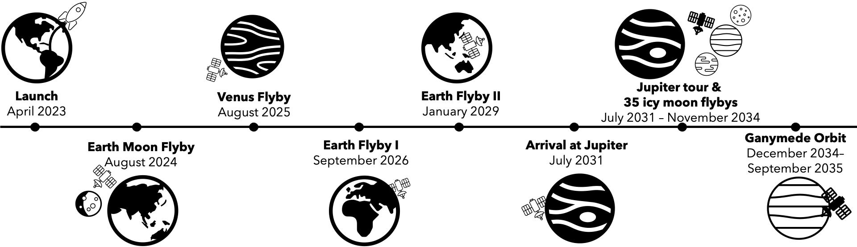
JUICE Mission

Slide 28



Study the emergence of habitable worlds around gas giants
Characterise the Jupiter Icy Moons:
Ganymede, Europa and Callisto as planetary objects and potential habitats
Explore the Jovian system as an archetype for gas giants
Europa
Callisto
Ganymede

Slide 29



RADEM – RADiation hard Electron Monitor
Measurement
electron and proton spectra
ion LET
electron directionality
ESA Contract No. 4000137865/22/ES/JD - Expert support to BERM (BepiColombo Environment Radiation Monitor) & RADEM units on board BepiColombo and JUICE spacecraft (LIP)
ESA Contact No. 4000110643/13/NL/HB - RADEM Proto-Flight Model (EFACEC, PSI, IDEAS, LIP)

Slide 30



RADEM – Cruise Phase
March 2024
May 2024

Slide 31


RADEM @JUICE
LEGA flyby August 2024 RADEM analysis
RADEM can measure energetic electrons, successfully!
Pinto, M., Rodrigues, A., Roussos, E., Schmid, D., Volwerk, M., Kotsiaros, S., Brown, P., Dougherty, M., Arruda, L., and Witasse, O.: RADEM observations of the Van Allen belts during the JUICE Lunar-Earth Gravity Assist, EGUsphere [preprint], https://doi.org/10.5194/egusphere-2026-2055, 2026. (submitted, under discussion)

Slide 32



Cruise phase so far
Credit
M. Pinto

Slide 33

Mercury
M
e
r
c
r
U
Y

Slide 34

BepiColombo Mission
Understand the origin & evolution of Mercury and its surrounding environment:
The planet closest to the Sun
The only terrestrial planet besides Earth with a self-sustained magnetic field
The smallest planet in our Solar System.
Key planet for understanding the evolutionary history of our Solar System and therefore also for the question of how the Earth and our Planetary System were formed.
The scientific objectives focus on a global characterization of Mercury through the investigation of its interior, surface, exosphere, and magnetosphere.
Perform tests on Einstein’s theory of general relativity.

Slide 35

BepiColombo timeline

Slide 36



BepiColombo Mission
First European Mission to Mercury
ESA/JAXA
Radiation Monitoring is a task of the
BepiColombo Environment Radiation Monitor (BERM)

Slide 37



BERM
40º
BERM stack: 11 silicon sensors
Sensors areas: [0.5; 903] mm²
Sensors thickness: 0.2 mm or 0.3 mm
Absorber layers: aluminium and tantalum
Shield walls: tantalum
Entrance: beryllium cut-off layer and 40º FOV
12.00 cm
17.48 cm
10.60 cm

Slide 38



BERM-SIXS SEP Sept 2023
SIXS-P
Particle Spectrometer also on board of the MPO

Slide 39



BERM + Artemis II
BepiColombo during Artemis II → privileged position between Earth and the Sun to provide valuable space weather forecasting relevant to crew safety and spacecraft electronics performance.
  COSMOS Heliospheric Conditions at BepiColombo - BepiColombo - Cosmos
BERM measurements used to provide ARTEMIS II support, requested by NASA
Earthset observed from Artemis II. Credit: NASA.
For BERM data: "We acknowledge the use of data from the BERM instrument provided by the Laboratory for Instrumentation and Experimental Particle Physics, funded by ESA and FCT, onboard the ESA/JAXA BepiColombo mission."

Slide 40

Cruise phase is over: next stop Mercury! But…

Slide 41















SpaceRad @LIP
Patrícia Gonçalves
Luísa Arruda
Marco Pinto
Bernardo Tomé
Pedro Assis
António Gomes
Bruna Lima
Tiago Neves
André Rodrigues
Rafael Parente
Filipe Rodrigues
Inês Rosa
Magda Soares
Isabel Dias
Marta Semblano
Tiago Neves

Slide 42
Backup slides

Slide 43




Solar Wind
Continuous flux of charged particles from the Sun ~400km/s
  mainly e- and p (E~0.5MeV)
  ~10¹² particles/m².s
~4 days to reach the Earth (1UA).
First continuous observation by spacecraft Mariner 2 (1962).
Detailed measurement by spacecraft Ulysses (3 orbits).
“Swepts” the solar magnetic field to IP space

Slide 44


Solar Magnetic Field
α
Sun rotation period ~27.26 days
( Carrington rotation – started 9 Nov 1853)
Magnetic field and magnetic poles approach a dipole.
Continuous Shift between the Sun rotation axis and the magnetic field direction when solar activity comes from Min to Max.
Complex configuration during Solar Max.
Polarity reverses each 11 yrs, returning to its original configuration every 22 years
α

Slide 45



NASA’s three mission profiles
Proposed (2015) by NASA for 2030’s
1 – Short stay
2 – Long stay i)
3 – Long stay ii)
Short stay
Comparison
Long stay i), ii)
https://nssdc.gsfc.nasa.gov/planetary/mars/marsprof.html (Nov. 2015)

Slide 46
NCRP dose limits used by NASA
Dose limits for exposed classes
In 2022, NASA adopted a new unified standard of 0.6 Sv as the career limit for all astronauts, regardless of age and sex, to promote equity.
https://www.nationalacademies.org/read/26155/chapter/1
Astronauts dose restrictions
Space Flight Human-System Standard – Volume 1, Revision A: Crew Health, NASA Technical Standard, NASA-STD-3001. Technical report, NASA, 2015.
G. Dietze et al. Assessment of Radiation Exposure of Astronauts in Space. Technical report, The International Commission on Radiological Protection, 2013.
Notes:
Equity concerns — The previous age/sex-based system effectively limited career opportunities for women and younger astronauts, who had lower permissible doses and therefore fewer or shorter missions available to them.
BFO - No adulto, a medula óssea vermelha (encontrada em ossos como o esterno, costelas, vértebras, pélvis e epífises dos ossos longos) é o principal órgão hematopoiético.
No feto, o fígado e o baço desempenham um papel central na produção de sangue.
Em certas doenças (como mielofibrose), o baço e o fígado podem retomar a hematopoiese — processo chamado hematopoiese extramedular.

