Slide 1
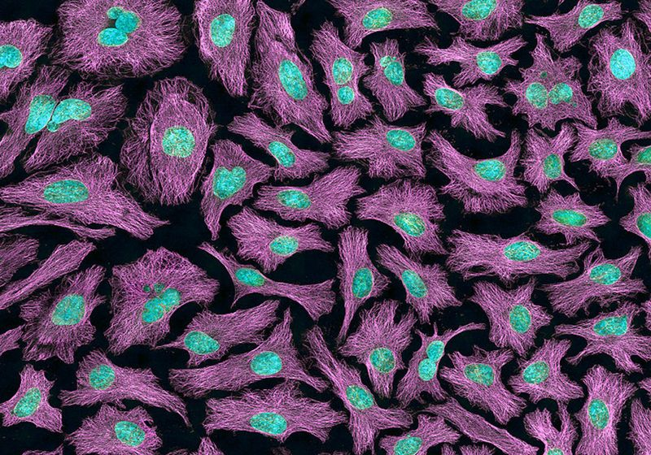





Boron-Enhanced Radiosensitization of Amyloid Structures Using Low-Dose Radiation
Francisca Afonso
Supervisors: Daniel Galaviz, Federico Herrera, and Belén Cortés-Llanos
NUC-RIA Internal Days
15th July 2026

Slide 2
Table of Contents
Background
CMAM set up
Irradiations results
CNA HISPAnoS line dosimetry characterization
Conclusions
Future Work

Slide 3
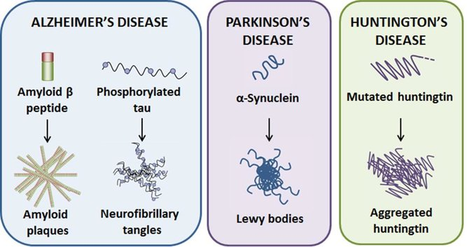
Neurodegenerative Disorders
Progressive loss of neuronal population
Increasing prevalence
Hallmarks: Accumulation of misfolded proteins (amyloids), neuroinflammation
No curative treatments are available
Protein aggregation in neurodegenerative diseases [1]

Slide 4
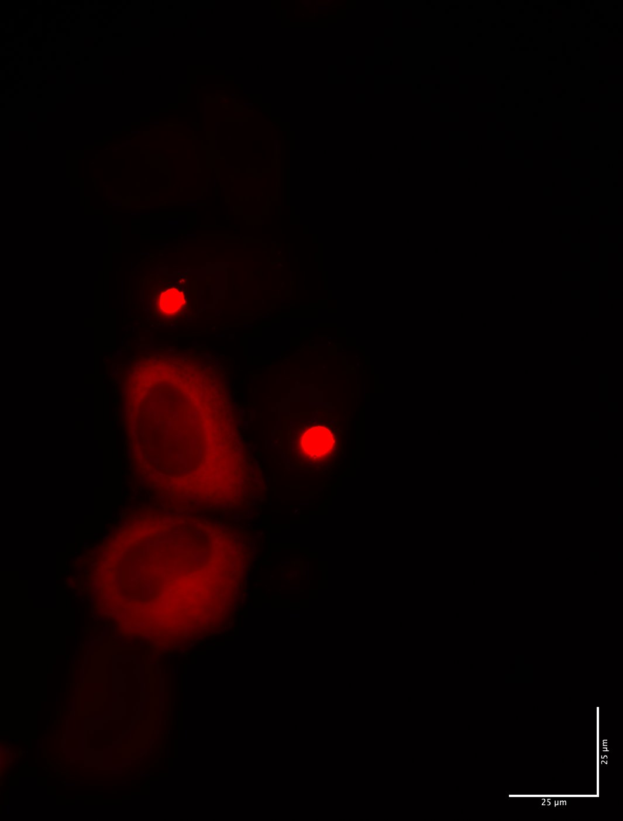
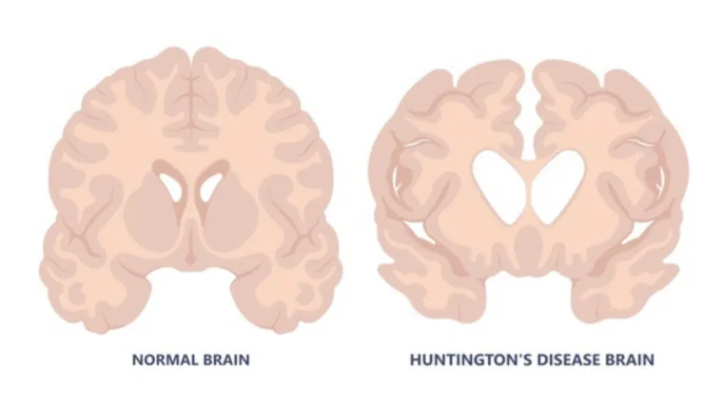
Huntington’s Disease (HD)
Inherited rare brain disorder that affects movement, thinking, and mood
Early signs can include clumsiness, mood changes, memory problems, and involuntary movements called chorea
Aggregation occurs in the cytoplasm

Slide 5
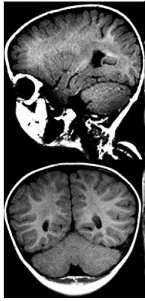
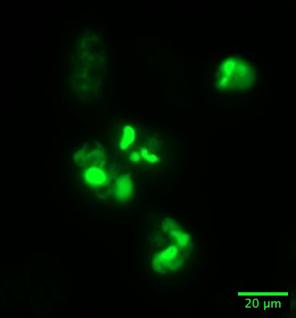
Spastic Ataxia 8 (SPAX8)
  Rare autosomal recessive neurodevelopmental disorder
  It affects the brain and spinal pathways that control movement, balance, and muscle tone
  NKX6-2 mutations in SPAX8 may cause protein misfolding, specially L163V mutation
  Death in early childhood

Slide 6
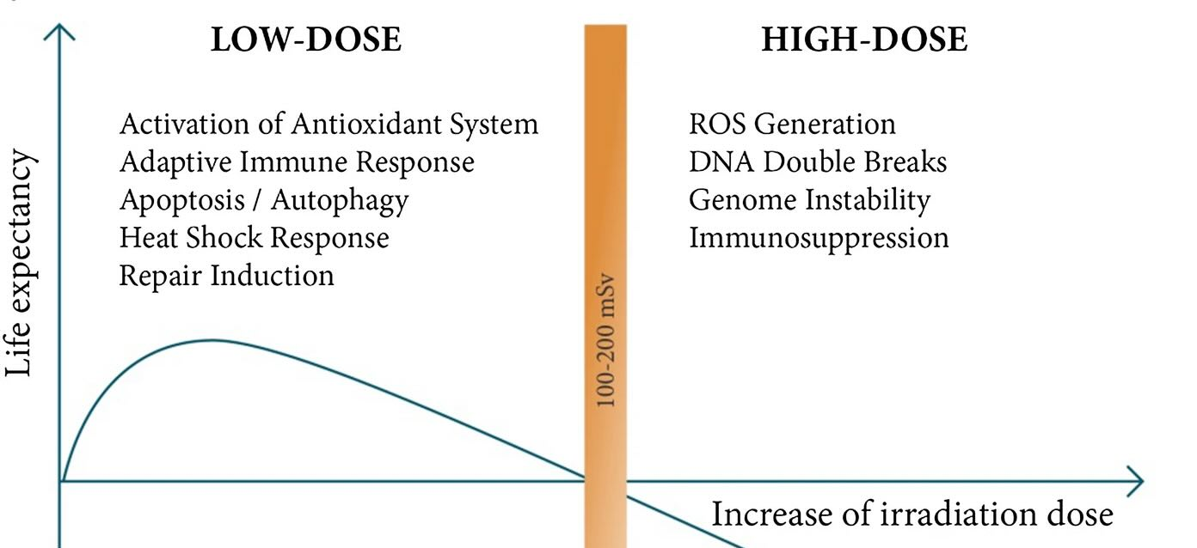
Why Low Dose Radiation Therapy (LD-RT)?
Hormetic nature
Non-toxic biological effects
Successfully treating peripheral amyloidosis
Hypothesis: LD-RT for neurodegenerative disorders
  Break the H-bonds of amyloid structures
  Induce anti-inflammatory responses, decreasing neuroinflammation
Representation of molecular and cellular mechanisms of low- and high-dose radiation doses [2]

Slide 7
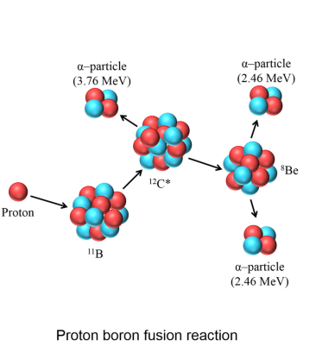
Proton Boron Capture Therapy (PBCT)
¹¹B + p → 3α + 8.68 MeV
Nuclear fusion reaction releases 3 alpha particles
Probability of occurrence in low-energy protons (675 keV)
Alpha Particles:
  High linear energy transfer (LET)
  Short linear path (under 30 µm) targeting the closest cells
  8.68 MeV released energy
Representation of proton boron (¹¹B) fusion reaction [4]
[4] Shahmohammadi, B. et al. Sci Rep 12, 18098 (2022)
Notes:
One of the modalities to mitigate the limitations of PRT is PBCT. PBCT uses the introduction of specific agents into the desired volume to increase the accumulative dose in the target without hindering healthy tissues. This is done by adding boron to the target volume, as the boron and proton reaction produces three alpha particles.
Most of the energy of this fusion nuclear reaction is from the released alpha particles. These alpha particles have high linear energy transfer and short linear path, affecting only cells in close vicinity.
This permits the maximization of the dose in the desired region and minimizing the outside by coupling boron compounds and accumulate inside the target volume

Slide 8
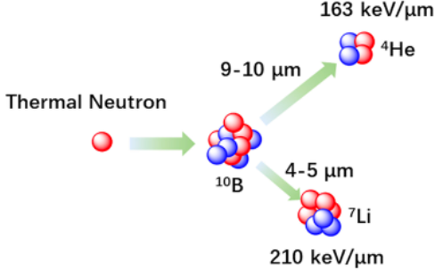
Boron Neutron Capture Therapy (BNCT)
Reaction of thermal and epithermal neutrons with non-reactive ¹⁰B
Resultant alpha particle and a recoiled lithium nucleus (⁷Li)
  High LET
  Short linear path
¹⁰B + n → α + ⁷Li + 2.79 MeV (6%)
¹⁰B + n → α + ⁷Li * + 2.31 MeV (94%)
⁷Li * → ⁷Li + γ (0.48 MeV)
Representation of neutron-boron (¹⁰B) reaction [5]
[5] S. Wang, Z. Zhang, L. Miao, and Y. Li, “Boron Neutron Capture Therapy: Current Status and Challenges,” Frontiers in Oncology, vol. 12, Mar. 2022,
Notes:
Another modality which employs an isotope of Boron, is BNCT, When in contact with neutros, 10B captures neutrons and disintegrates into an alpha particle and a recoloid lithium nucleus. The high-energy particles deposit all their energy over a very short plath, causing localized damanage to the target area.

Slide 9
Objectives
Explore the potential of RT combined with boron compounds to reduce amyloid aggregation
Simulation of particle beam impact on boron-doped protein aggregates
In vitro coupling of boron-based molecules to amyloids
Irradiation with particle beams, namely neutrons (CNA), protons (CMAM and CNA), and gammas (CT2N)
Notes:
The main objectives of my PhD are the study the application of proton radiation therapy in neurodegenerative disorders, by testing the radiosensitizing effects of boron and fluorine compounds on amyloid structure. This is a multidisciplinary project that combines nuclear physics and biochemistry.
Simulate the protein structures doped with boron molecules and the effect it has on protons. As well as the relationship between dose deposition and alpha production.
As well as in vitro coupling of boron-based molecules to amyloids. Utilizing radiosensitizers and testing their effects on the amyloid cell models before and after proton irradiation.
Irradiate the cell lines expressing disease-associated proteins and compare the RBE of protons with or without boron. We will compare the biological effectiveness of these treatments with and without the added molecules, and with other radiotherapy modalities.

Slide 10
CMAM

Slide 11
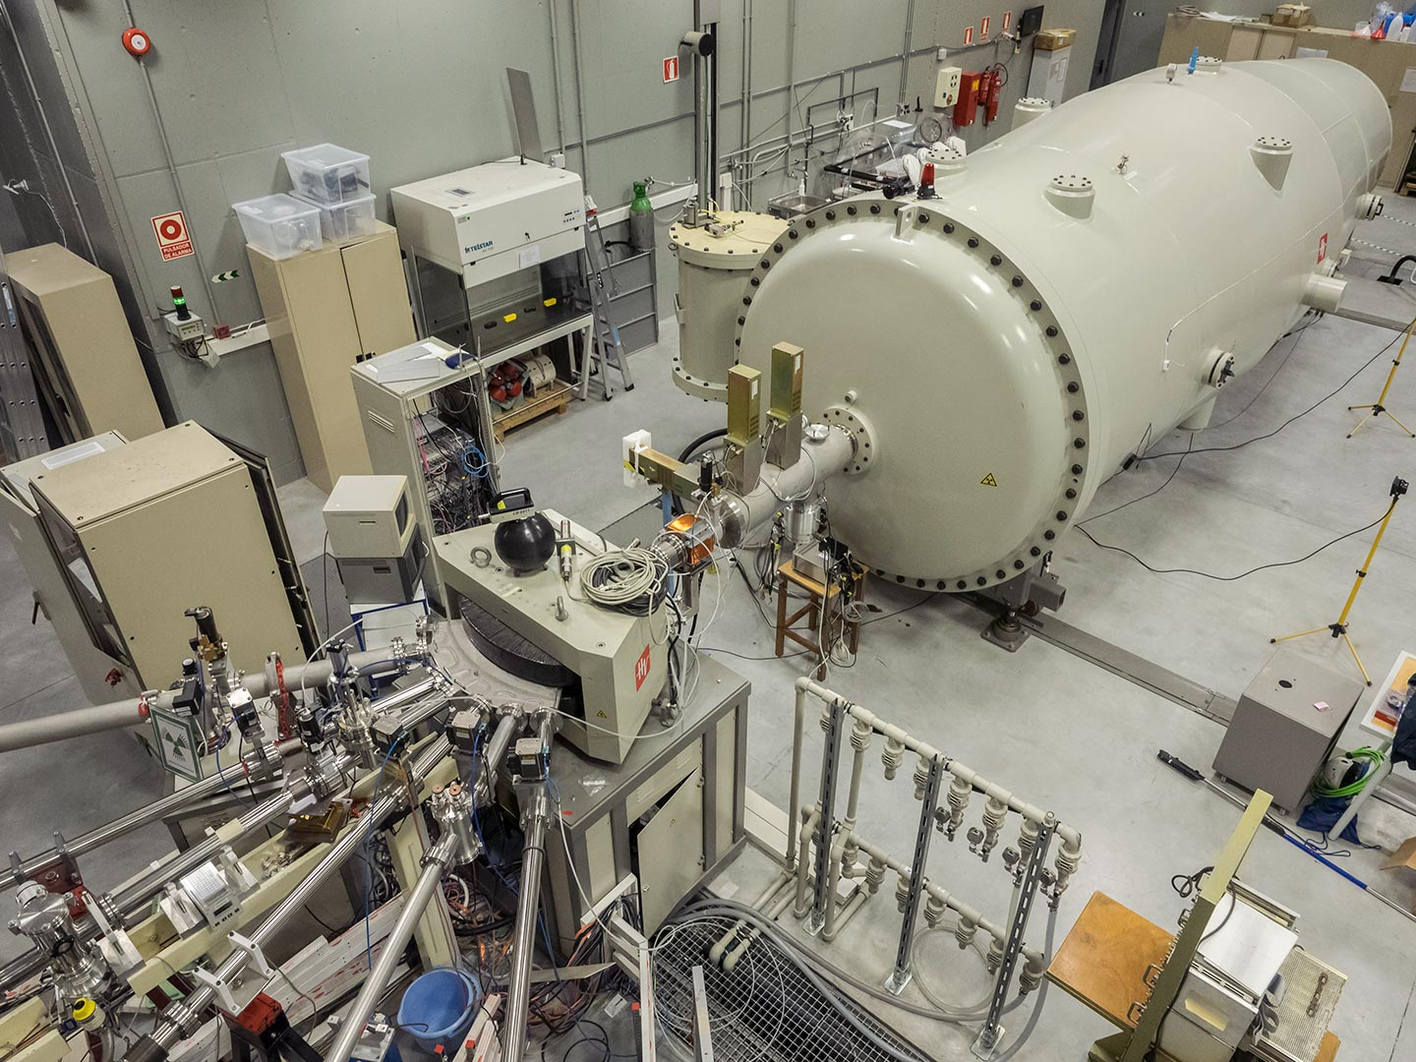
CMAM
Electrostatic ion accelerator with a maximum terminal voltage of 5 MV
CMAM operates six beamlines:
  Standard
  Internal Microbeam
  Time of Flight (TOF)
  Nuclear Physics
  External Microbeam
  Implantation Line
Notes:
At the heart of CMAM is a 5 MV electrostatic tandem accelerator, which produces a wide range of ion beams, including protons, alpha particles, and heavier ions.

Slide 12
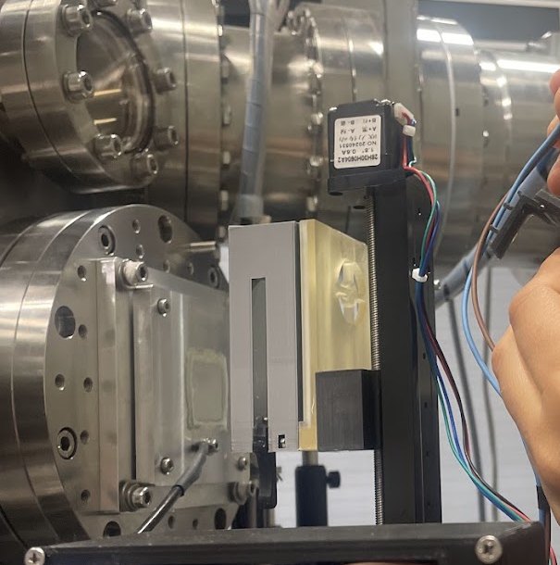
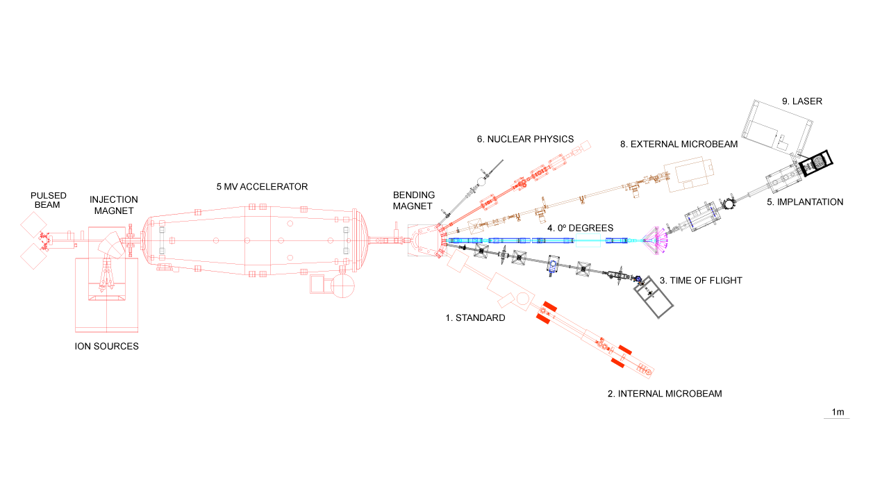
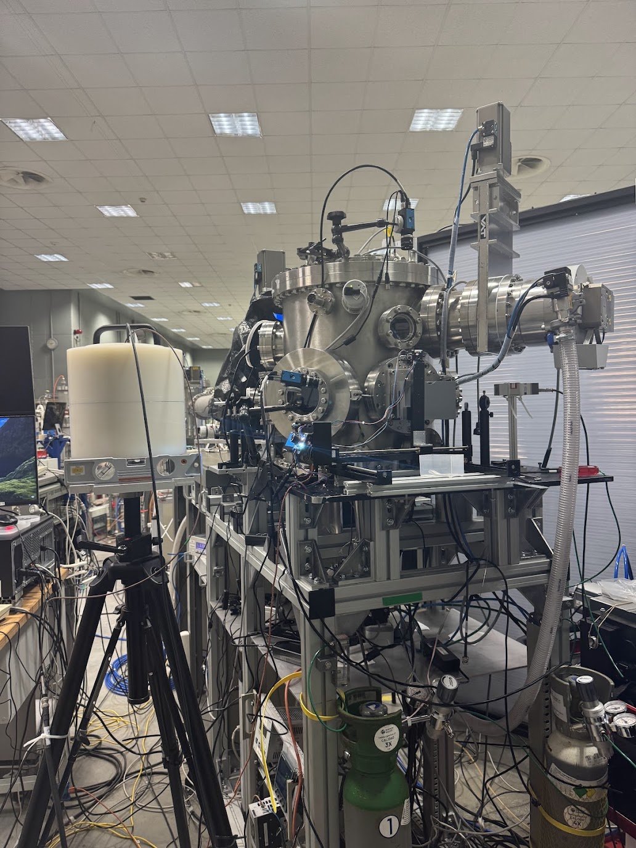
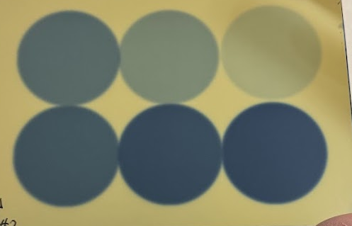
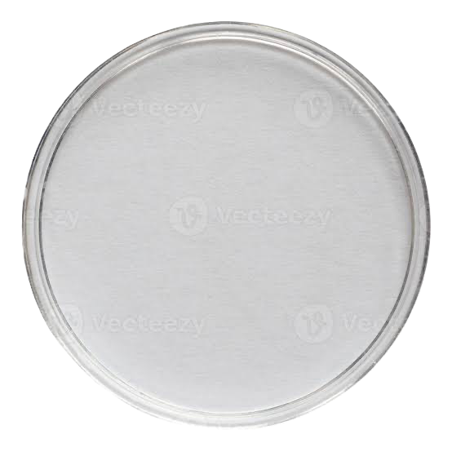
Implantation Line (IMP)
<
Notes:
beam rastering (beam sweep) system, which scans the ion beam over the sample surface to produce a highly uniform irradiation.

Slide 13
Experimental

Slide 14
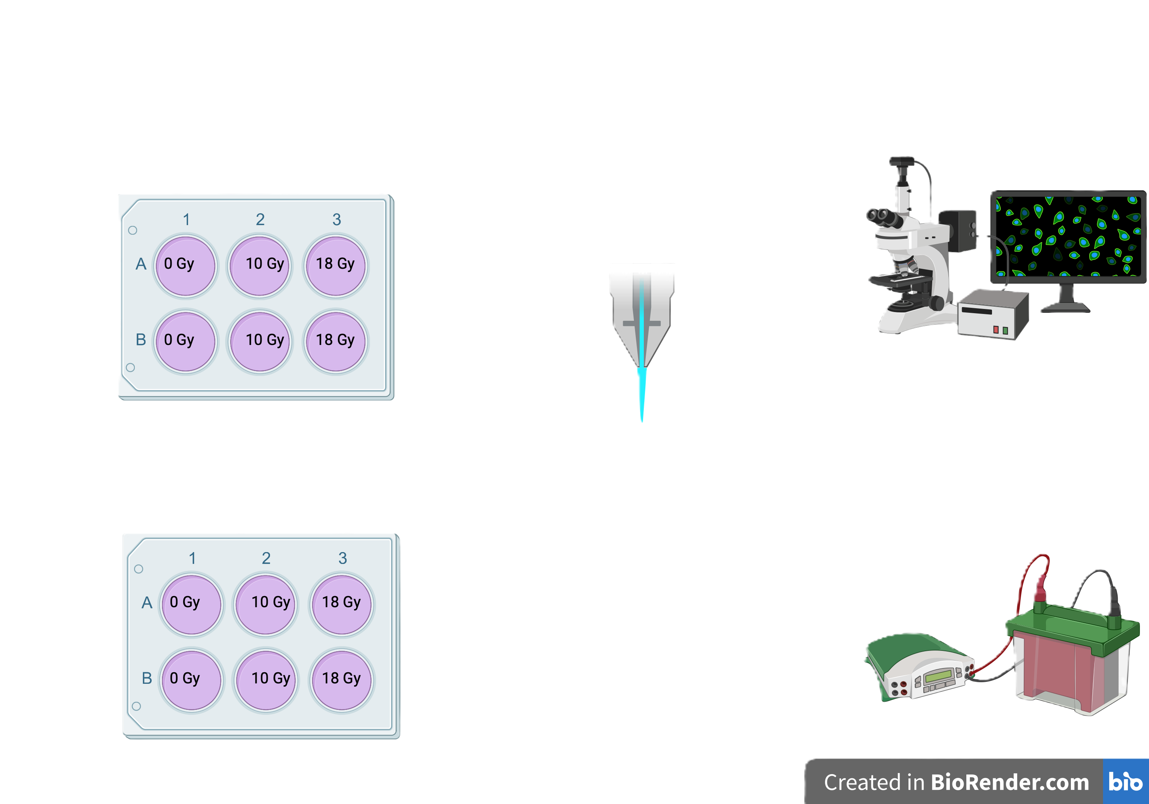
Methodology - Irradiation
Microscopy
mHTT
NKX6-2 L163V
Western
Blot

Slide 15
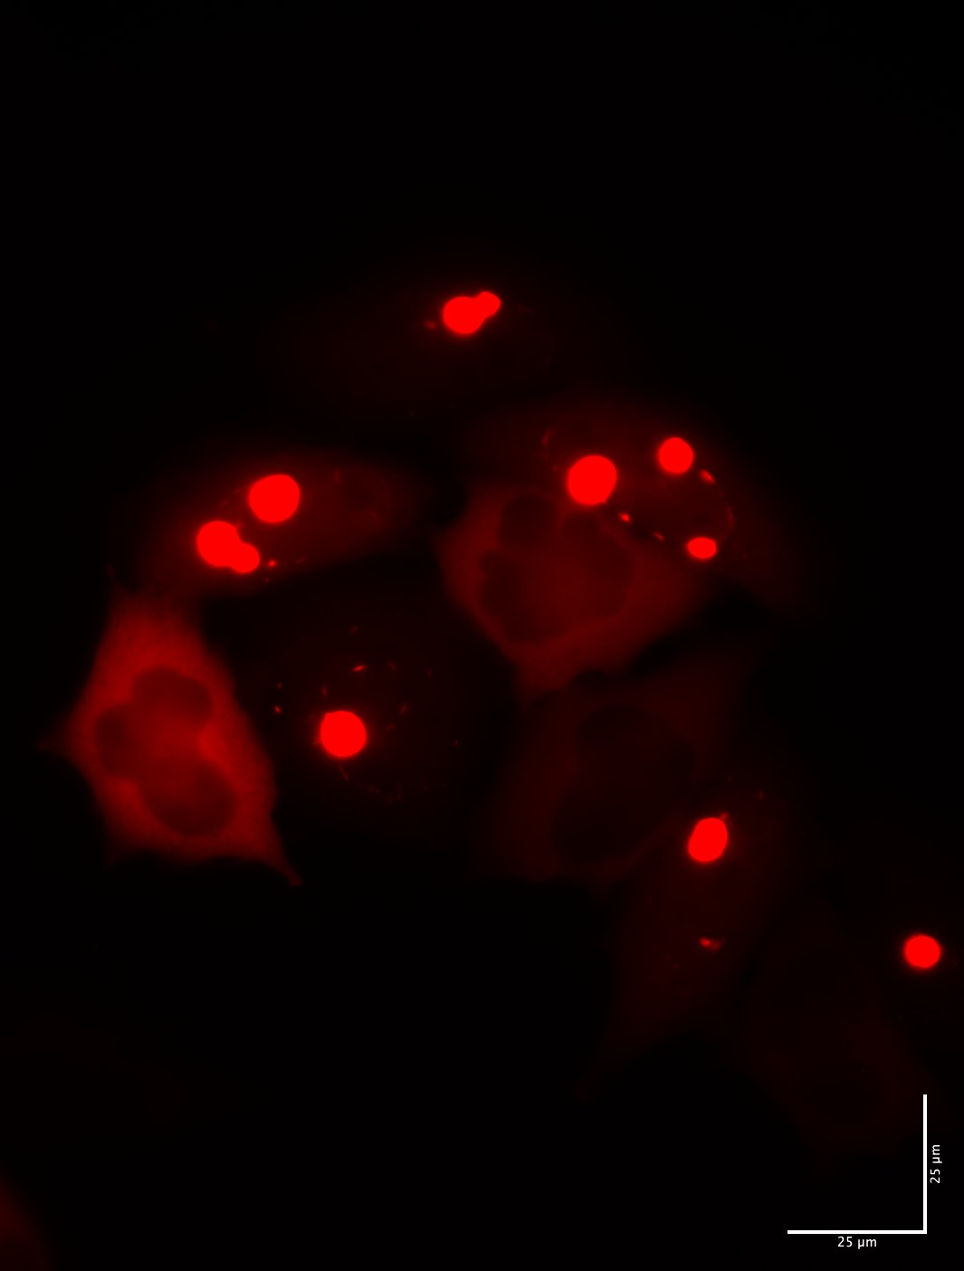
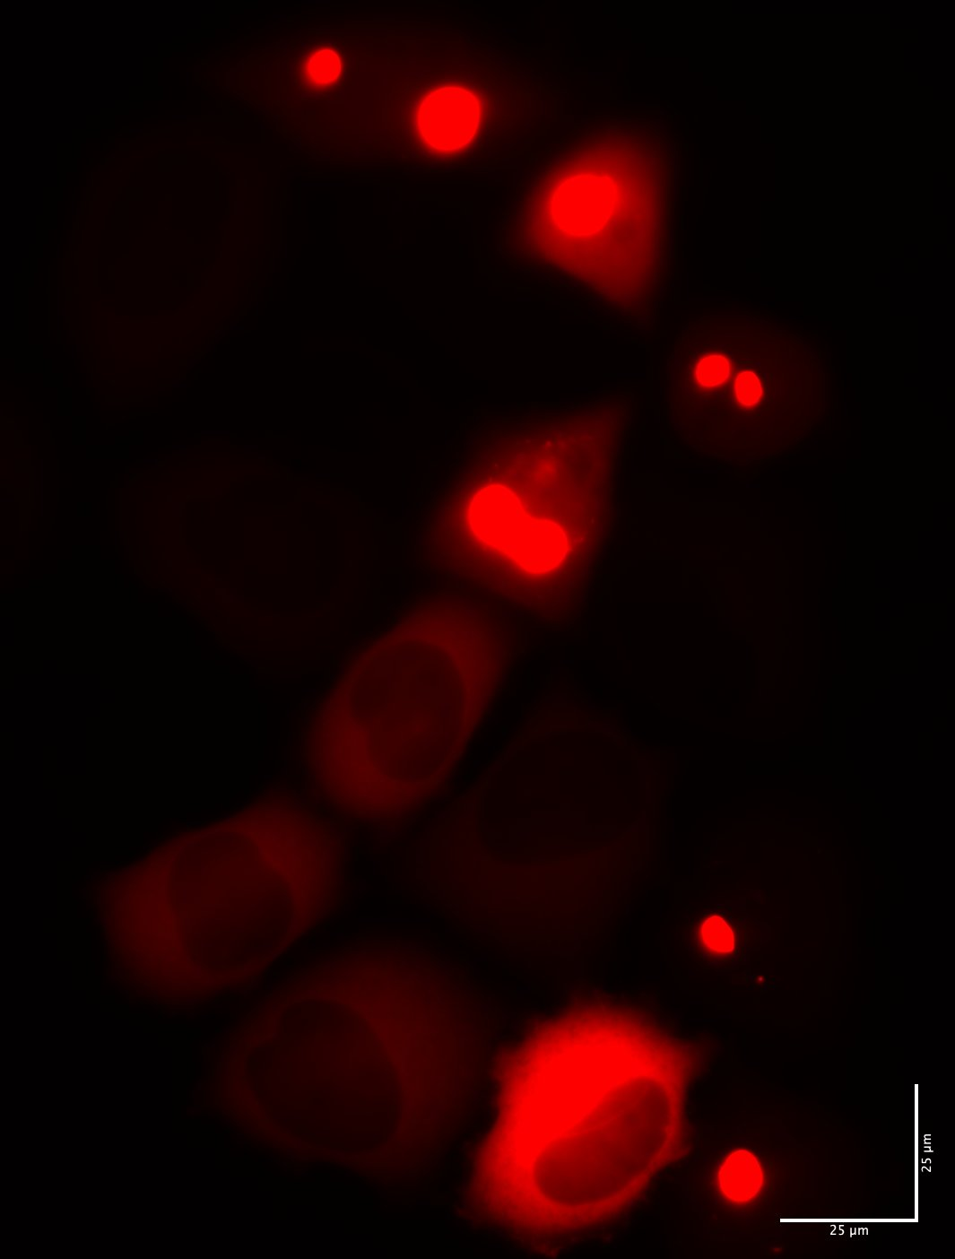

Irradiations | Gammas
0 Gy
5 Gy
10 Gy
Irradiated cells display a higher percentage, increased area, and larger aggregates compared to the non-irradiated group.

Slide 16
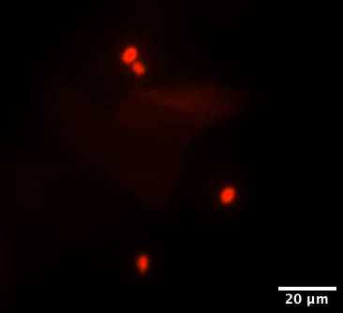
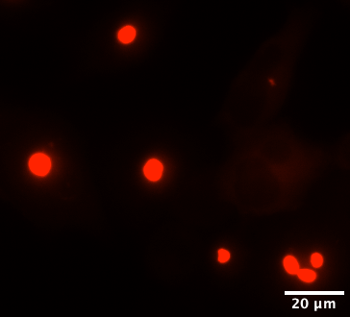
Irradiations | Protons – mutated huntingtin
0 Gy
10 Gy
8 Gy
Irradiated cells exhibit a higher percentage, greater area, and larger aggregates than the non-irradiated group.

Slide 17
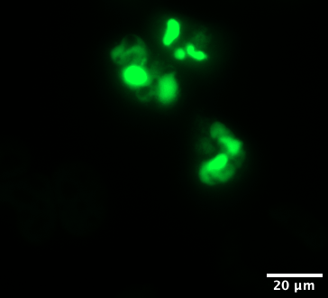
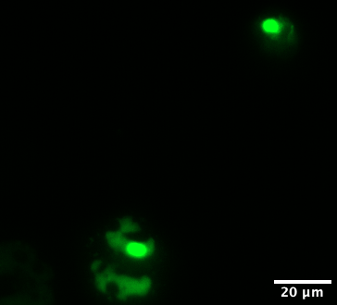
Irradiations | Protons – mutated NKX6-2
Irradiated cells exhibit similar percentage, a lesser area than the non-irradiated group.

Slide 18
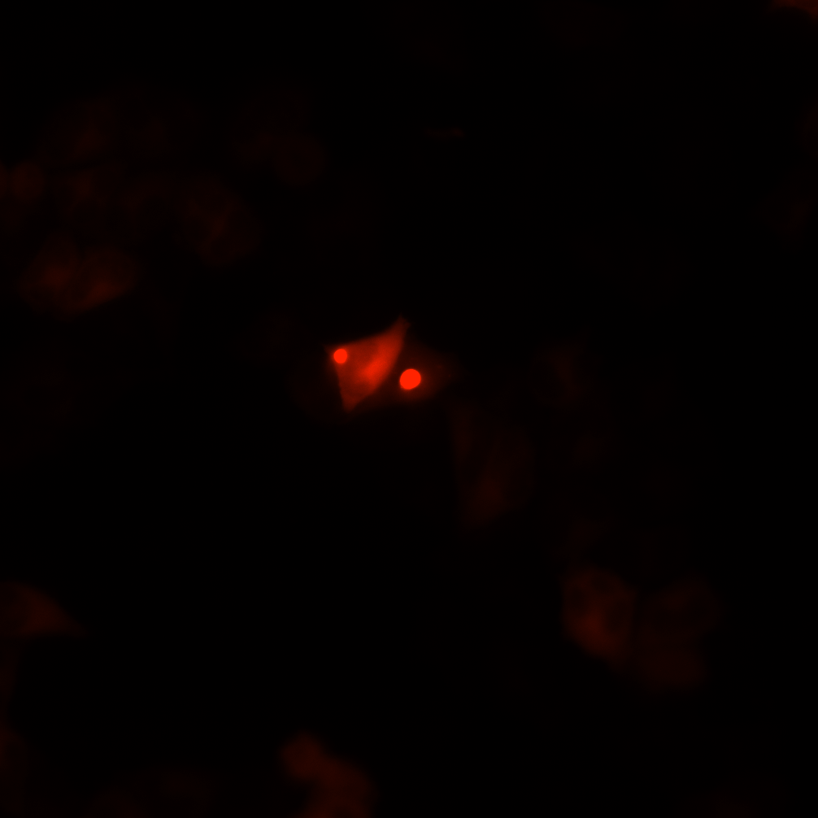
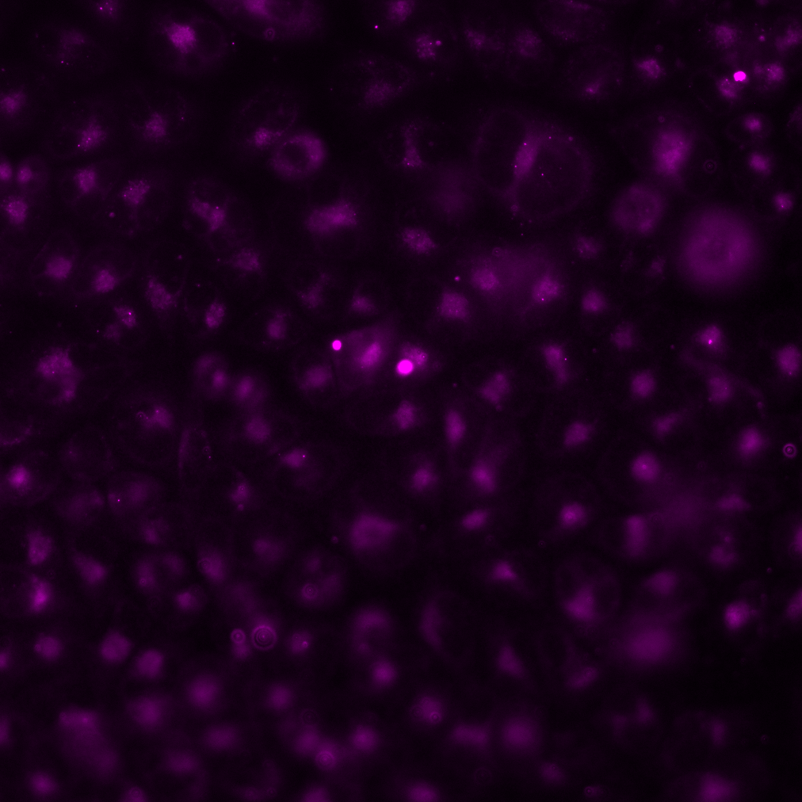
The (un)coupling of boron compounds
mScarlet
CRANAD-2

Slide 19
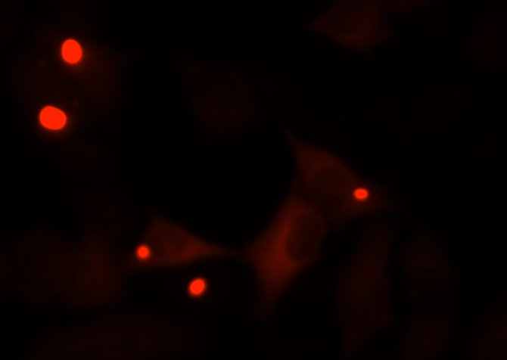
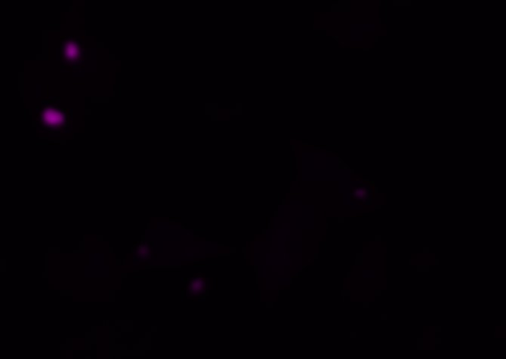
DMSO (0.2%) –mHTT-mScarlet
mScarlet
DMSO

Slide 20
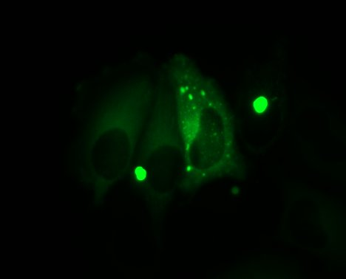
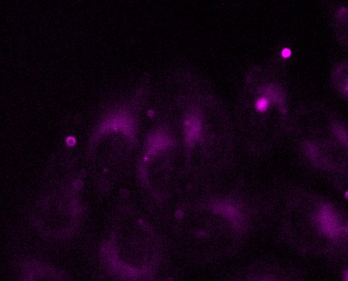
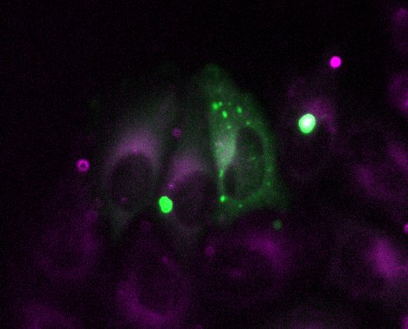
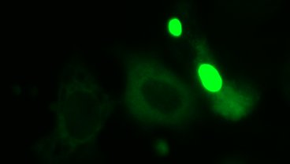

CRANAD-2 mHTT-Venus
Venus
CRANAD-2
Venus
DMSO

Slide 21
Simulations

Slide 22
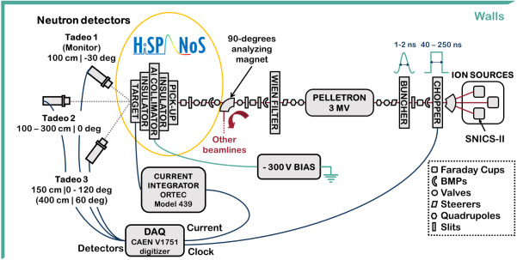
Characterization of CNA HISPANoS beam line

Slide 23
HISPANoS line
Accelerated beams of protons (epithermal) and deuterons (fast neutrons) that are produced by different reactions in lithium target (thin and thick), deuterium (thin) and beryllium (thick) targets.
Simulations: Epithermal neutrons produced by the reaction ⁷Li(p,n)
Notes:
Neutron capture by nitrogen, 14N(n,p)14C – neutron capture by hydrogen, 1H(n,)2H

Slide 24
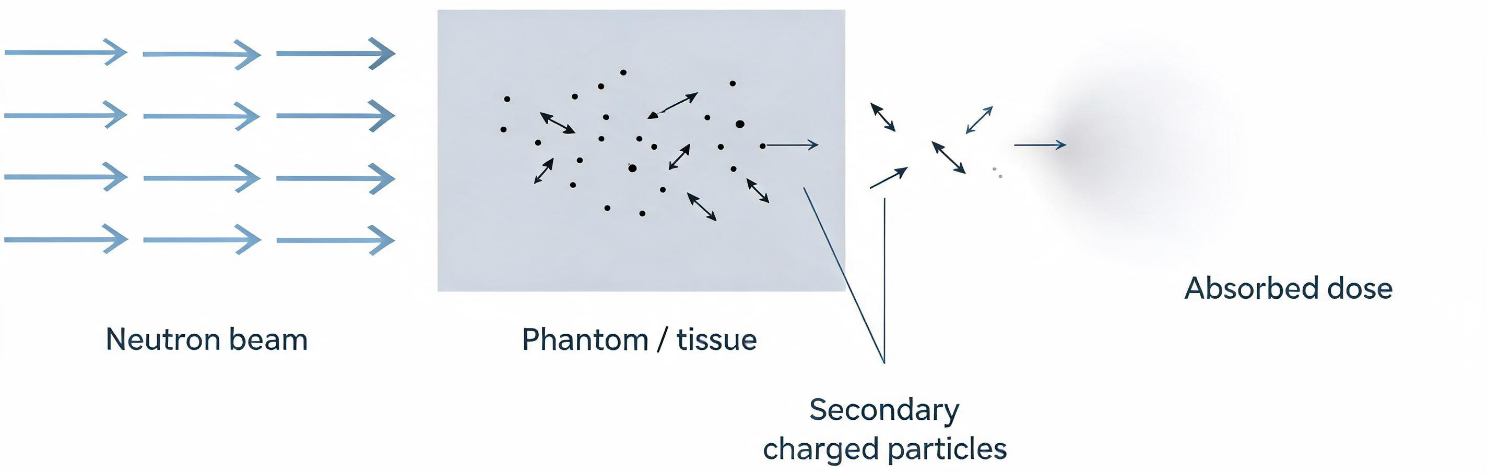
Neutron dosimetry
Transfer energy through nuclear interactions and recoil particles
Main interactions :
  neutron capture by nitrogen ¹⁴N(n,p)¹⁴C
  neutron capture by hydrogen, ¹H(n,gamma)²H
Notes:
Neutron capture by nitrogen, 14N(n,p)14C – neutron capture by hydrogen, 1H(n,)2H

Slide 25
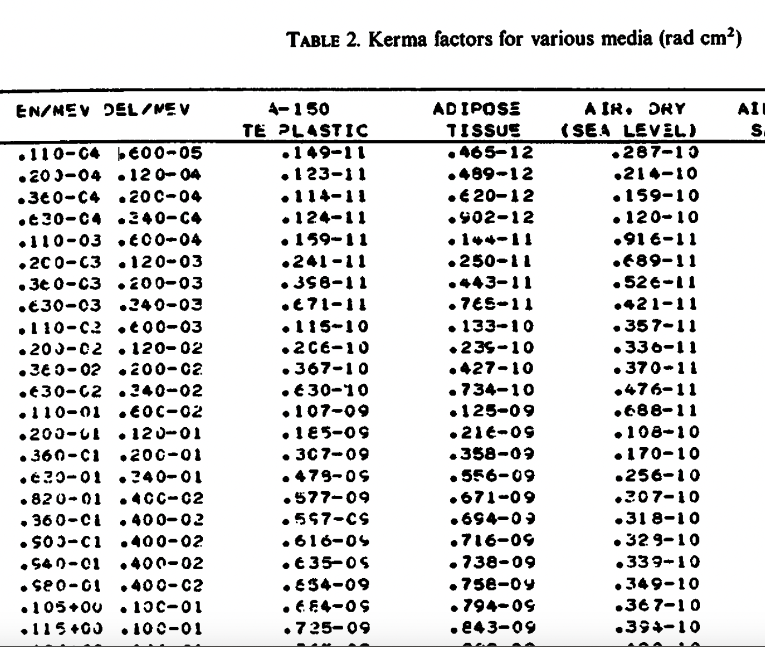
Neutron dosimetry
D = K= Φ F_{n}(T,Z)
K being the kerma factor, defined as the sum of the initial kinetic energies of all the charged particles liberated by uncharged ionizing radiation
F_{n} (T,Z) is the neutron kerma factor, a function of the target nucleus and neutron energy, and Φ is the neutron flux
Notes:
D is the absorbed dose, which is the amount of energy deposited per unit mass of material.K is the kerma, short for Kinetic Energy Released per Unit Mass. Kerma represents the energy transferred from uncharged radiation, such as neutrons, to charged particles within a material.Φ (phi) is the neutron flux, which is the number of neutrons passing through a unit area per unit time. A higher neutron flux means more neutron interactions and, therefore, a higher potential dose.$F_{n}\left(T , Z\right)$ is the neutron kerma factor. It depends on the neutron energy (T) and the target nucleus (Z), or the atomic number of the material. This factor indicates how efficiently neutrons transfer their energy to the material through the charged particles they produce.
The equation tells us that the absorbed dose is proportional to both the neutron flux and the neutron kerma factor. In other words, the dose increases either when more neutrons interact with the material or when the material is more effective at converting neutron energy into kinetic energy of charged particles.

Slide 26
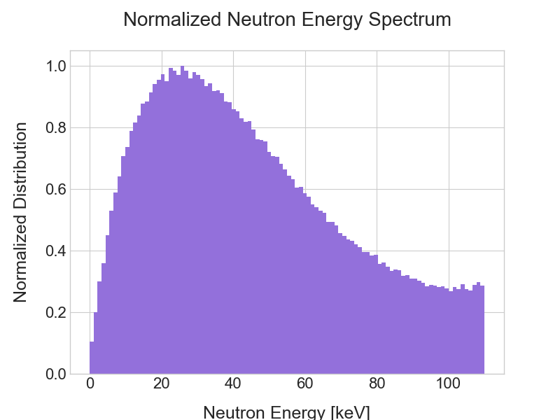
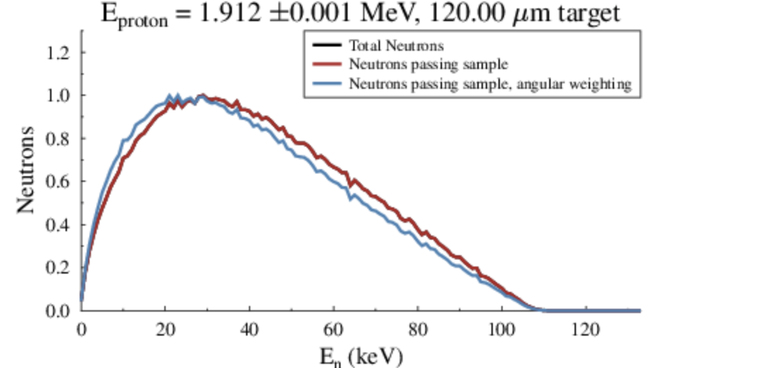
Neutrons - PhaseSpace
Number of neutrons: 1000000
Mean neutron energy: 45.43 keV
Neutrons per 100 µA: 2.53 x 10⁹/s
Notes:
Ver o espetro
Fazer com o angulo

Slide 27
Absorved Dose
F_{n}= 5.34×10⁻¹³ Gy/cm²
Distance to the beam (cm) | Flux per neutron cm⁻² s⁻¹ per 100 μA | Dose (Gy/s) | Dose (Gy) per 15 min
1 | 7,81E+09 | 4,17E-03 | 3,754
2 | 7,80E+09 | 4,16E-03 | 3,748
5 | 6,04E+09 | 3,22E-03 | 2,901
10 | 3,64E+09 | 1,95E-03 | 1,751
25 | 1,54E+09 | 8,21E-04 | 0,739
50 | 7,24E+08 | 3,87E-04 | 0,348

Slide 28
Conclusion
The effects on amyloid structures largely depend on the protein rather than the radiation type
On the hungtiton’s disease cell model, gamma and proton irradiation induce aggregation and increase in aggregate’s size
In contrast, mutated NKX6-2 displays a reduction the aggregate size.
A first dosimetry characterization of the HISPANoS line has been accessed, which will allow us to have a clear idea of the dose rate in future irradiations

Slide 29
Future Work
Experimental:
  Find a boron compound that couples with the amyloids I am working with
  Neutron irradiations at CNA
Simulations:
  Add boron compounds to assess the dose enhancement
  Add the dose originating from the gammas induced with the ⁷Li(p,n) target
  Assess the microdosimetry of the neutron beam

