Slide 1


QCD
Colour charge and the $e^{−}e^{+}→q\overline{q}$ annihilation

Slide 2
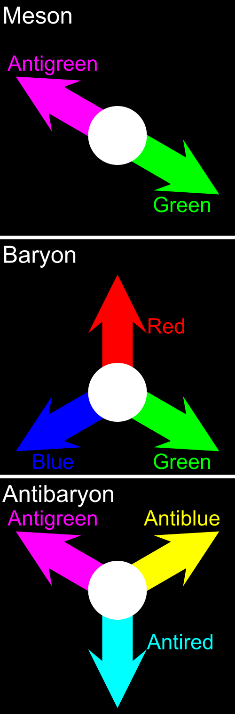
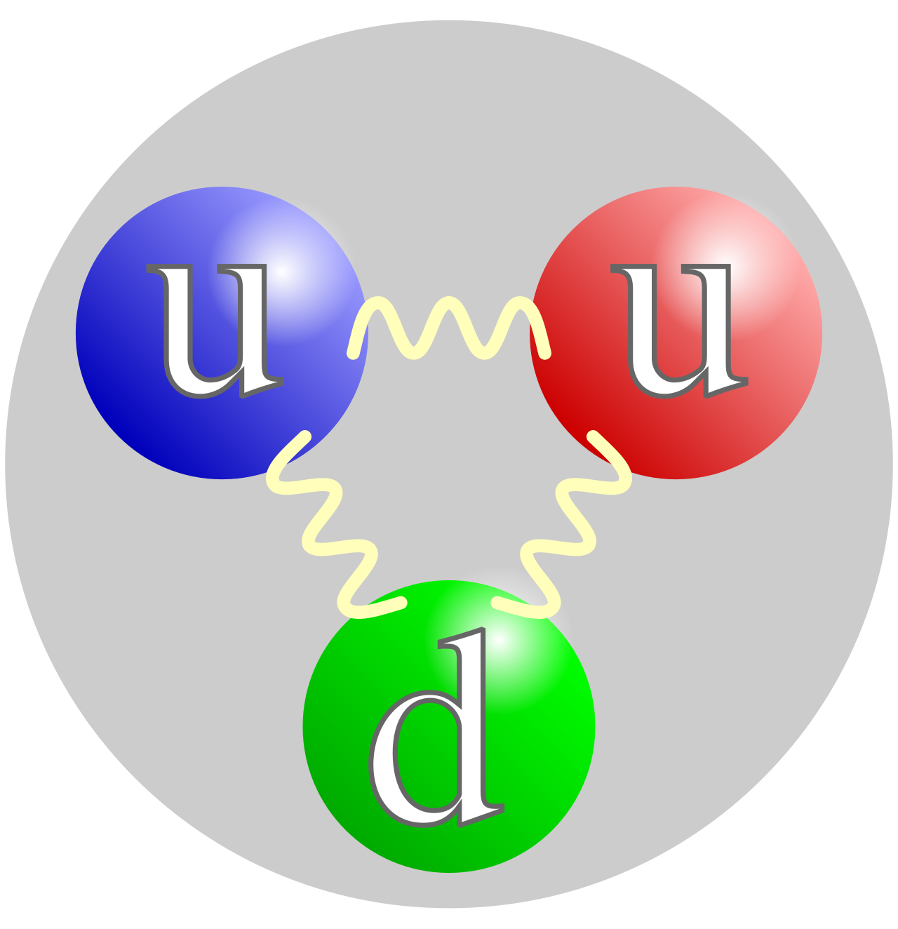

Colour charge
Container: quarks
Mediator: gluons
Types: red, green, blue, anti-red, anti-green and anti-blue
Known hadrons: Mesons ($q\overline{q}$), Baryons (qqq), Antibaryons ($\overline{q}\overline{q}\overline{q}$), Tetraquarks ($qq\overline{q}\overline{q}$) and Pentaquarks ($qqqq\overline{q}$)
proton

Slide 3




Colour confinement
All hadrons must be colorless and quarks cannot exist unbounded.
Only combinations whose colour vectors can be contracted to a scalar may exist.

Slide 4
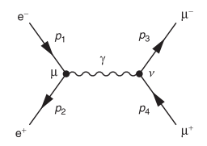
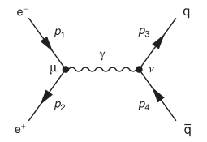





$e^{−}e^{+}→μ\overline{μ}$ vs $e^{−}e^{+}→q\overline{q}$

Slide 5
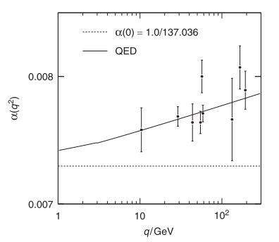
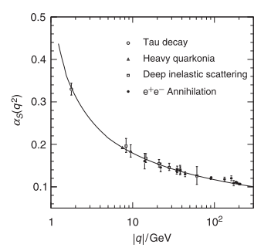

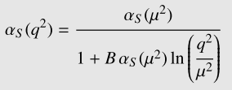

Running of the coupling constants

Slide 6


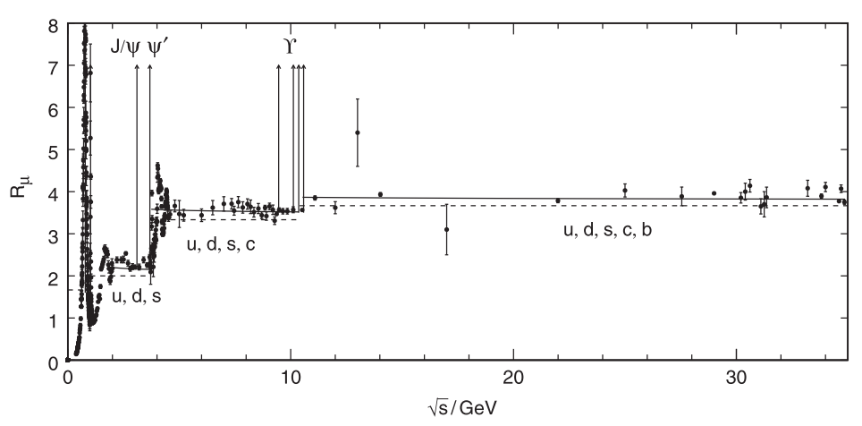







The Hadronic Cross-Section Ratio
With the factor 3, the experimental results agree with the theory – colour charge exists and has 3 basis vectors.
Top quark/anti-quark pairs have never been produced out of $e^{−}e^{+}$ collisions. At least 348 GeV needed!

Slide 7
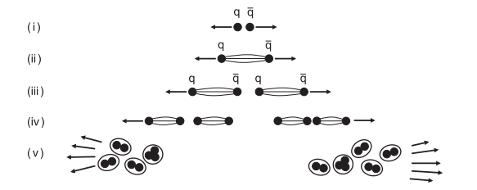

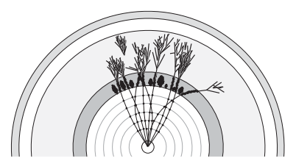


Hadronization
$$E_{p}>2mc^{2}$$

Slide 8
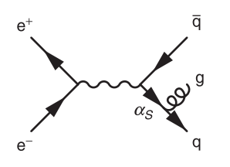
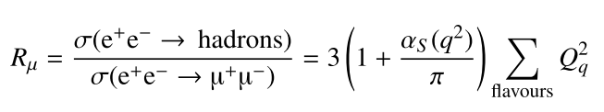
First Order Correction

