Slide 1

Matrix element calculation: from time-ordered perturbation theory to Feynman diagrams, currents and propagators
Leandro Alves | Master’s Degree in Physics

Slide 2
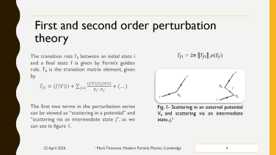
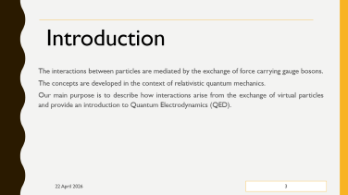
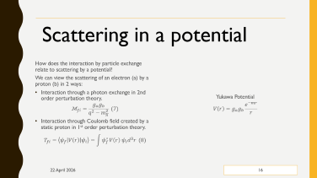
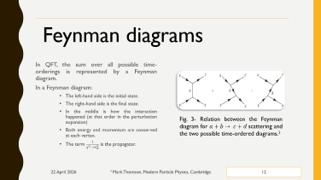
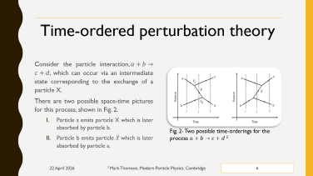
Index

Slide 3
Introduction
The interactions between particles are mediated by the exchange of force carrying gauge bosons.
The concepts are developed in the context of relativistic quantum mechanics.
Our main purpose is to describe how interactions arise from the exchange of virtual particles and provide an introduction to Quantum Electrodynamics (QED).

Slide 4
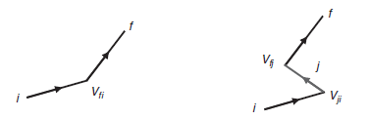
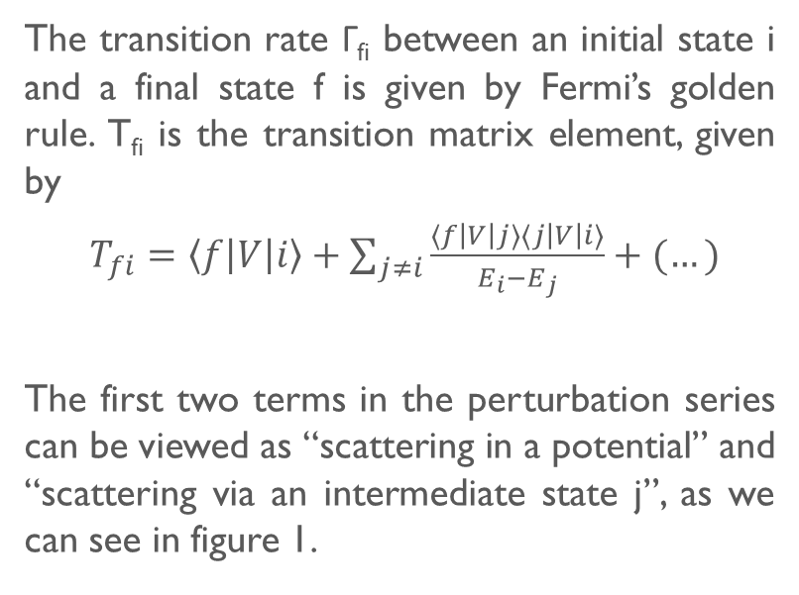

First and second order perturbation theory
The transition rate Γ_{fi} between an initial state i and a final state f is given by Fermi’s golden rule. T_{fi} is the transition matrix element, given by
$T_{fi}=\left\langle f\left|V\right|i\right\rangle +\sum_{j≠i}{\frac{⟨f\left|V\right|j⟩⟨j\left|V\right|i⟩}{E_{i}−E_{j}}+(…)}$
The first two terms in the perturbation series can be viewed as “scattering in a potential” and “scattering via an intermediate state j”, as we can see in figure 1.
$$Γ_{fi}=2π \left\|T_{fi}\right\| ρ(E_{f})$$
Fig. 1- Scattering in an external potential V_{fi} and scattering via an intermediate state, j.¹

Slide 5
In the classical picture of interactions, particles act as sources of force fields that give rise to a potential in which other particles scatter.
In the Quantum Field Theory view, forces arise due to exchange of virtual particles – e.g. 2 electrons interact through exchange of a photon travelling at the speed of light (no action at a distance.

Slide 6
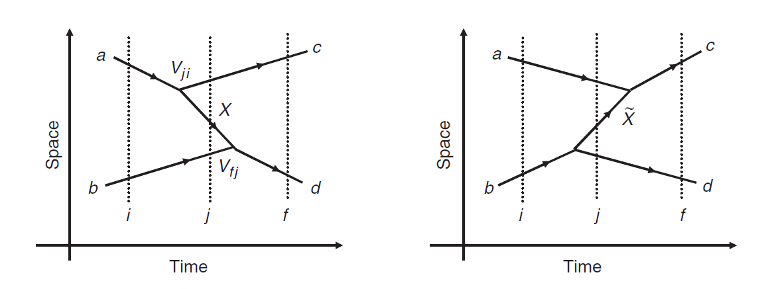
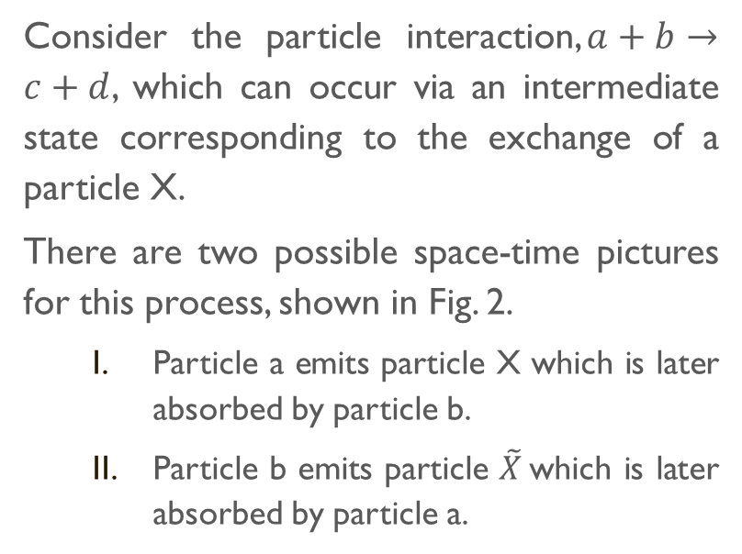
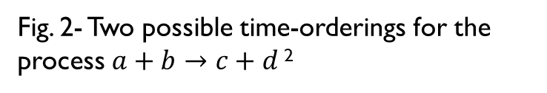
Time-ordered perturbation theory
Consider the particle interaction,$a+b→c+d$, which can occur via an intermediate state corresponding to the exchange of a particle X.
There are two possible space-time pictures for this process, shown in Fig. 2.
Particle a emits particle X which is later absorbed by particle b.
Particle b emits particle $\tilde{X}$which is later absorbed by particle a.
Fig. 2- Two possible time-orderings for the process $a+b→c+d$ ²

Slide 7
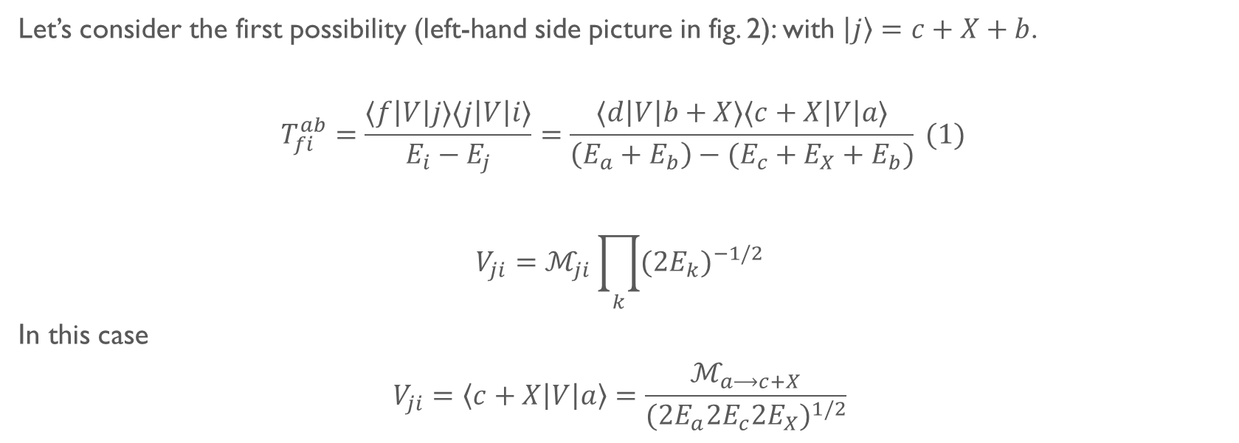
Let’s consider the first possibility (left-hand side picture in fig. 2): with $\left|j\right\rangle =c+X+b$.
$$T_{fi}^{ab}=\frac{⟨f\left|V\right|j⟩⟨j\left|V\right|i⟩}{E_{i}−E_{j}}=\frac{⟨d\left|V\right|b+X⟩⟨c+X\left|V\right|a⟩}{\left(E_{a}+E_{b}\right)−(E_{c}+E_{X}+E_{b})} (1)$$
$$V_{ji}=ℳ_{ji}\prod_{k}{{{(2E}_{k})}^{−1/2}}$$
In this case
$$V_{ji}=\left\langle c+X\left|V\right|a\right\rangle =\frac{ℳ_{a⟶c+X}}{{({2E}_{a}{2E}_{c}{2E}_{X})}^{1/2}}$$

Slide 8
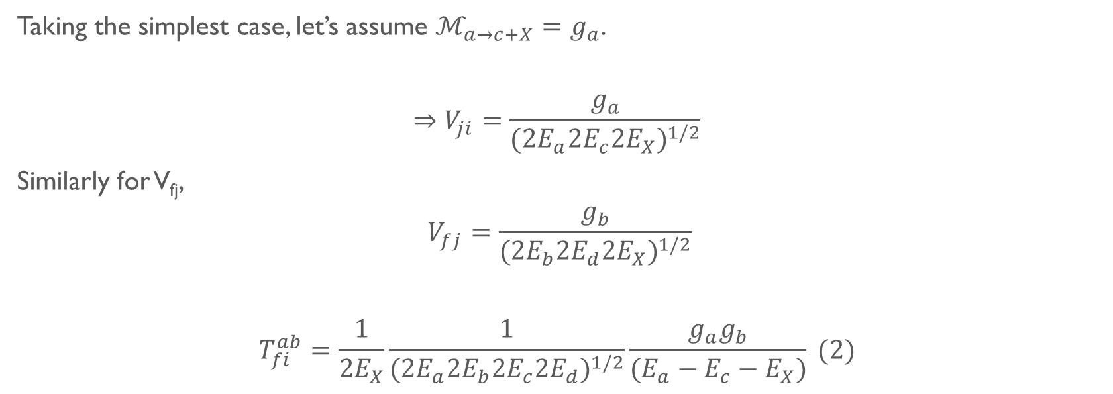
Taking the simplest case, let’s assume $ℳ_{a→c+X}=g_{a}$.
$$⇒V_{ji}=\frac{g_{a}}{{({2E}_{a}{2E}_{c}{2E}_{X})}^{1/2}}$$
Similarly for V_{fj},
$$V_{fj}=\frac{g_{b}}{{({2E}_{b}{2E}_{d}{2E}_{X})}^{1/2}}$$
$$T_{fi}^{ab}=\frac{1}{2E_{X}}\frac{1}{{({2E}_{a}{2E}_{b}{2E}_{c}{2E}_{d})}^{1/2}}\frac{g_{a}g_{b}}{(E_{a}−E_{c}−E_{X})} (2)$$

Slide 9
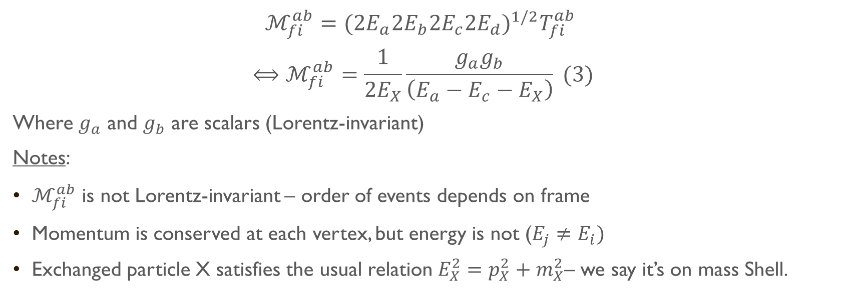
$$ℳ_{fi}^{ab}={({2E}_{a}{2E}_{b}{2E}_{c}{2E}_{d})}^{1/2}T_{fi}^{ab}$$
$$⟺ℳ_{fi}^{ab}=\frac{1}{{2E}_{X}}\frac{g_{a}g_{b}}{\left(E_{a}−E_{c}−E_{X}\right)} (3)$$
Where $g_{a}$ and $g_{b}$ are scalars (Lorentz-invariant)
Notes:
$ℳ_{fi}^{ab}$ is not Lorentz-invariant – order of events depends on frame
Momentum is conserved at each vertex, but energy is not ($E_{j}≠E_{i})$
Exchanged particle X satisfies the usual relation $E_{X}^{2}=p_{X}^{2}+m_{X}^{2}$– we say it’s on mass Shell.

Slide 10
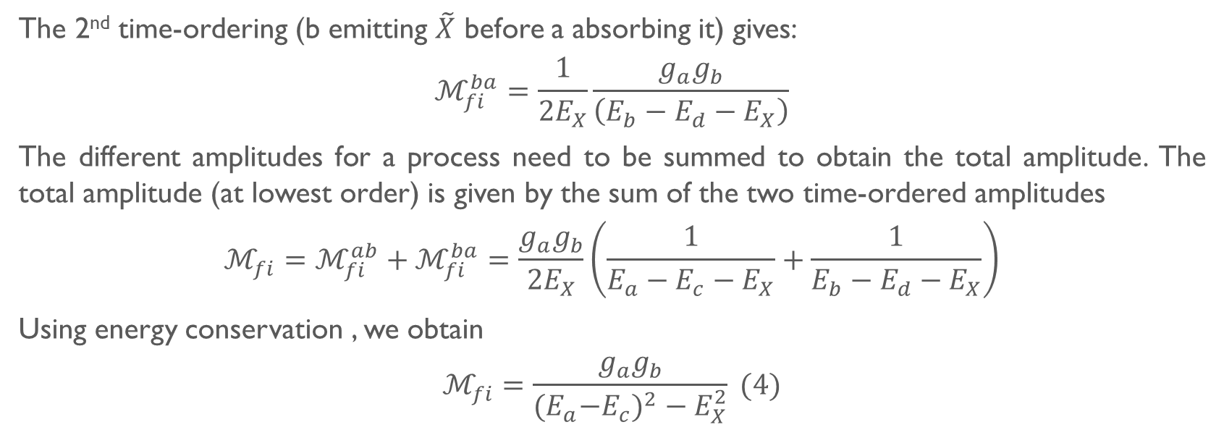
The 2nd time-ordering (b emitting $\tilde{X}$ before a absorbing it) gives:
$$ℳ_{fi}^{ba}=\frac{1}{{2E}_{X}}\frac{g_{a}g_{b}}{\left(E_{b}−E_{d}−E_{X}\right)}$$
The different amplitudes for a process need to be summed to obtain the total amplitude. The total amplitude (at lowest order) is given by the sum of the two time-ordered amplitudes
$$ℳ_{fi}=ℳ_{fi}^{ab}+ℳ_{fi}^{ba}=\frac{g_{a}g_{b}}{{2E}_{X}}\left(\frac{1}{E_{a}−E_{c}−E_{X}}+\frac{1}{E_{b}−E_{d}−E_{X}}\right)$$
Using energy conservation , we obtain
$$ℳ_{fi}=\frac{g_{a}g_{b}}{{{(E}_{a}−E_{c})}^{2}−E_{X}^{2}} (4)$$

Slide 11

$$E_{X}^{2}={\vec{p}}_{X}^{2}+m_{X}^{2}$$
Substituting this expression for $E_{X}^{2}$ into (11) leads to
$$ℳ_{fi}=\frac{g_{a}g_{b}}{q^{2}−m_{X}^{2}} (5)$$
where $q=p_{a}−p_{b}$.
$$\frac{1}{q^{2}−m_{X}^{2}} (6)$$

Slide 12
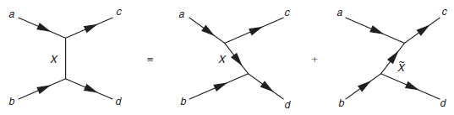
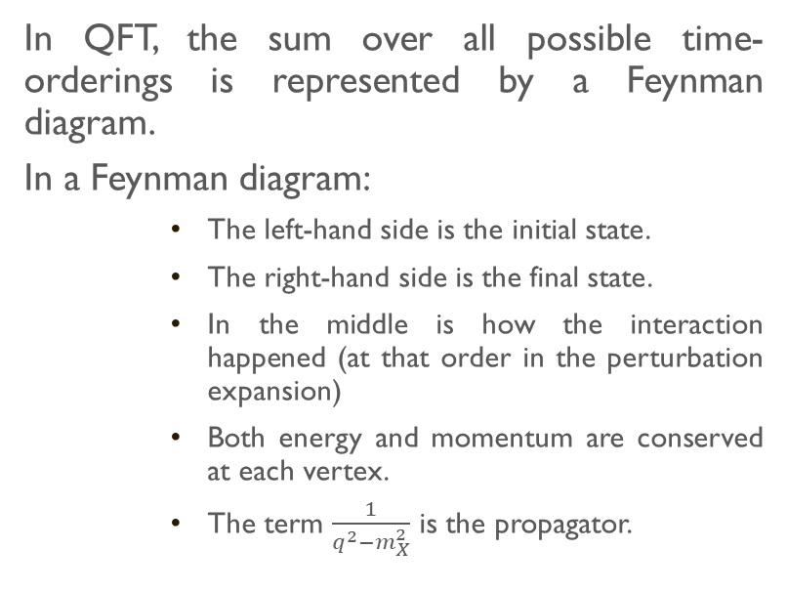
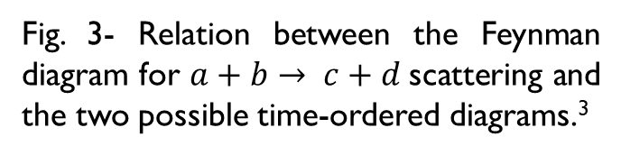
Feynman diagrams
In QFT, the sum over all possible time-orderings is represented by a Feynman diagram.
In a Feynman diagram:
The left-hand side is the initial state.
The right-hand side is the final state.
In the middle is how the interaction happened (at that order in the perturbation expansion)
Both energy and momentum are conserved at each vertex.
The term $\frac{1}{q^{2}−m_{X}^{2}}$ is the propagator.
Fig. 3- Relation between the Feynman diagram for $a+b→ c+d$scattering and the two possible time-ordered diagrams.³

Slide 13
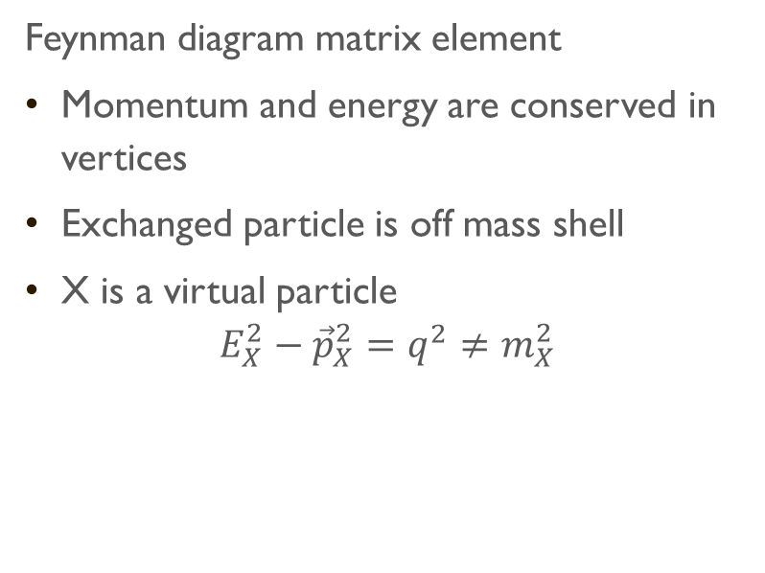
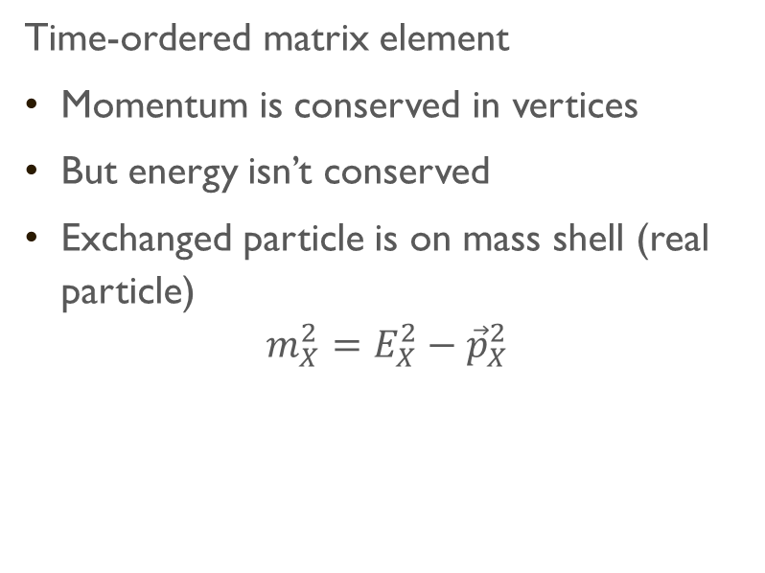
The intermediate particle X
Time-ordered matrix element
Momentum is conserved in vertices
But energy isn’t conserved
Exchanged particle is on mass shell (real particle)
$$m_{X}^{2}=E_{X}^{2}−{\vec{p}}_{X}^{2}$$
Feynman diagram matrix element
Momentum and energy are conserved in vertices
Exchanged particle is off mass shell
X is a virtual particle
$$E_{X}^{2}−{\vec{p}}_{X}^{2}=q^{2}≠m_{X}^{2}$$

Slide 14
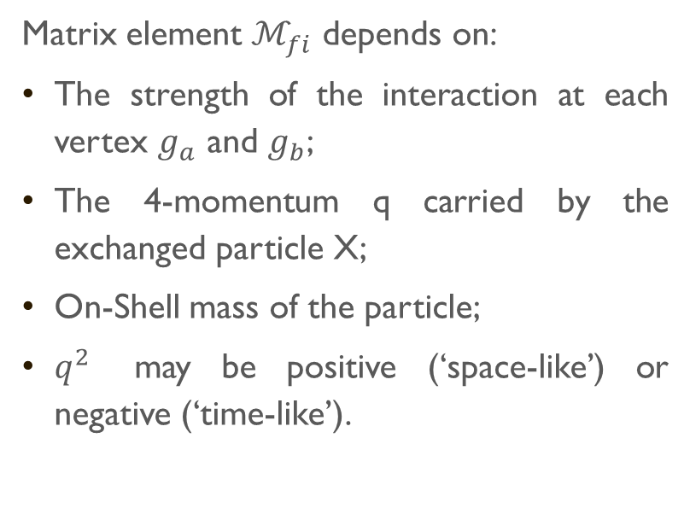
Time-like and Space-like interactions
Matrix element $ℳ_{fi}$ depends on:
The strength of the interaction at each vertex $g_{a}$ and $g_{b}$;
The 4-momentum q carried by the exchanged particle X;
On-Shell mass of the particle;
$q^{2}$ may be positive (‘space-like’) or negative (‘time-like’).

Slide 15
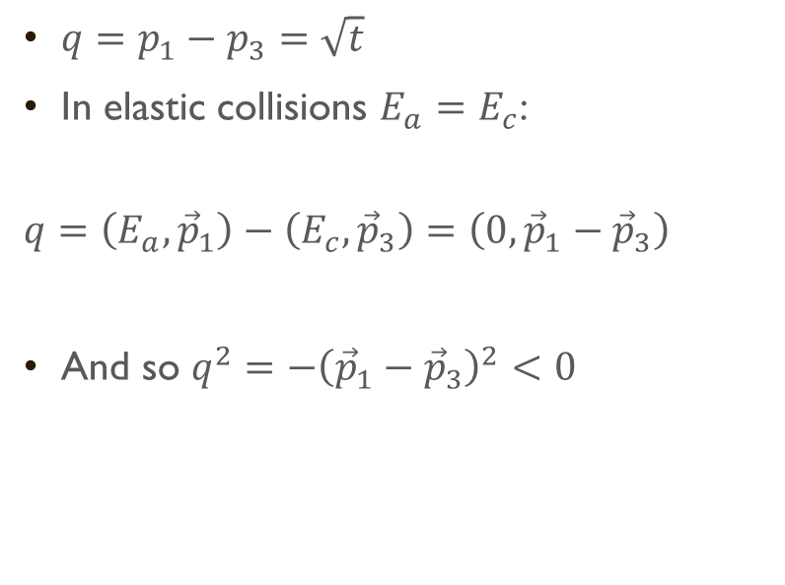
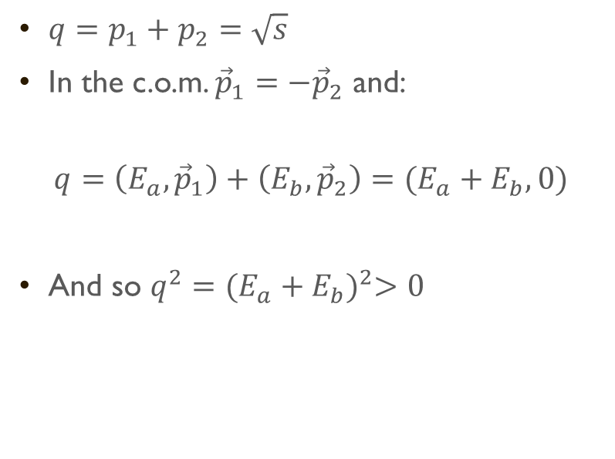
$q=p_{1}+p_{2}=\sqrt{s}$
In the c.o.m. ${\vec{p}}_{1}=−{\vec{p}}_{2}$ and:
$$q=\left(E_{a}, {\vec{p}}_{1}\right)+\left(E_{b}, {\vec{p}}_{2}\right)=(E_{a}+E_{b},0)$$
And so $q^{2}={(E_{a}+E_{b})}^{2}>0$
$q=p_{1}−p_{3}=\sqrt{t}$
In elastic collisions $E_{a}=E_{c}$:
$$q=\left(E_{a},{\vec{p}}_{1}\right)−\left(E_{c},{\vec{p}}_{3}\right)=\left(0,{\vec{p}}_{1}−{\vec{p}}_{3}\right)$$
And so $q^{2}=−{\left({\vec{p}}_{1}−{\vec{p}}_{3}\right)}^{2}<0$

Slide 16

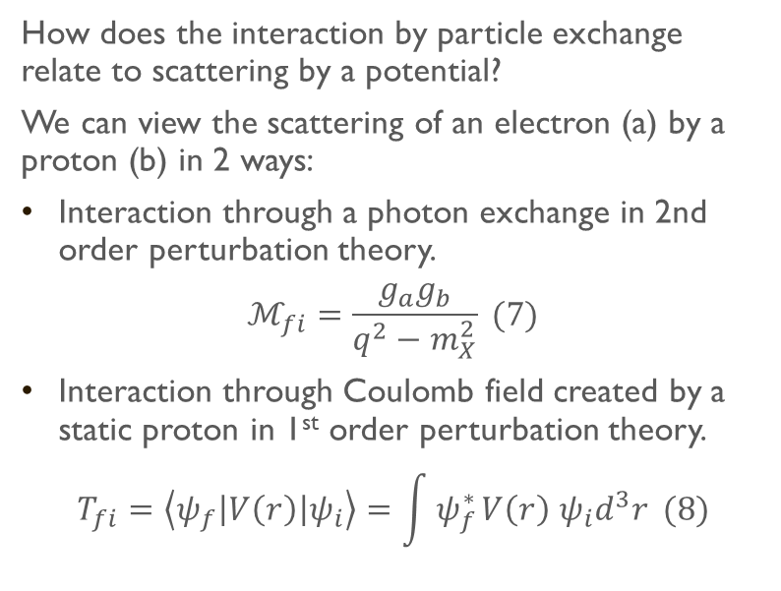
Scattering in a potential
How does the interaction by particle exchange relate to scattering by a potential?
We can view the scattering of an electron (a) by a proton (b) in 2 ways:
Interaction through a photon exchange in 2nd order perturbation theory.
$$ℳ_{fi}=\frac{g_{a}g_{b}}{q^{2}−m_{X}^{2}} (7)$$
Interaction through Coulomb field created by a static proton in 1st order perturbation theory.
$$T_{fi}=\left\langle ψ_{f}\left|V\left(r\right)\right|ψ_{i}\right\rangle =\int{ψ_{f}^{∗ }V\left(r\right) ψ_{i}d^{3}r} (8)$$
Yukawa Potential
$$V\left(r\right)=g_{a}g_{b}\frac{e^{−mr}}{r}$$

Slide 17
References
Mark Thomson, Modern Particle Physics, Cambridge University Press, 2013
R. Gonçalo, High Energy Physics: Interactions by Particle Exchange, Lecture Slides, 2026.

