Slide 1
A Large Ion Collider Experiment
Manuel Baptista, 2019230967

Slide 2
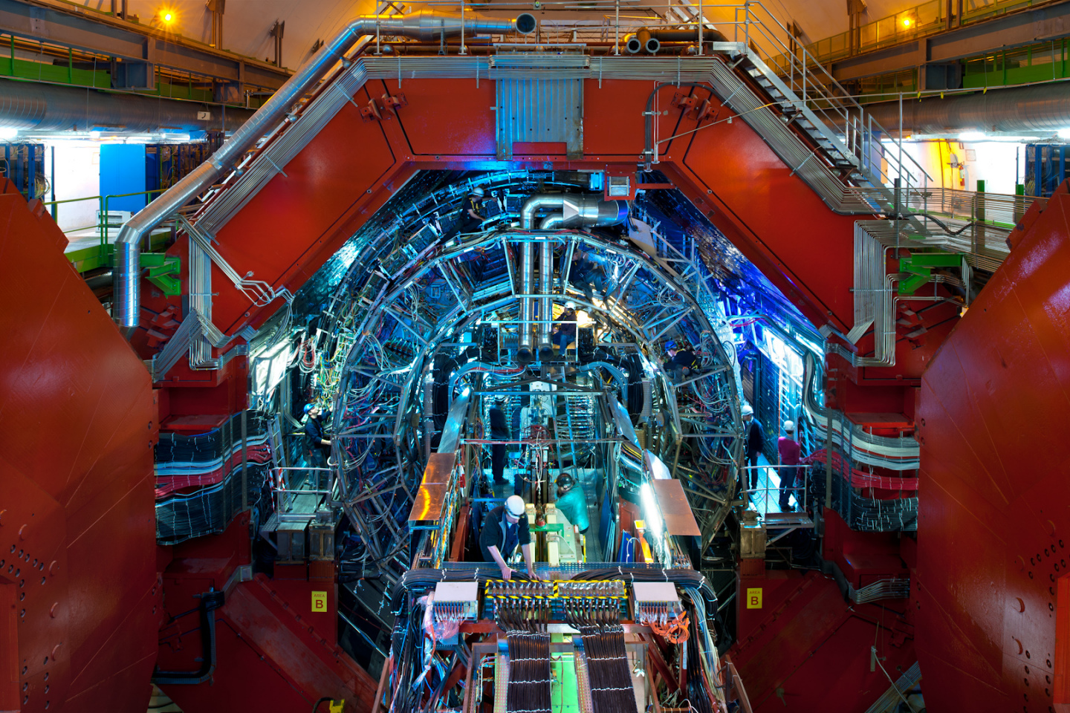
ALICE
One of nine detectors experiments at the Large Hadron Collider (LHC)
Fig. 1: ALICE

Slide 3
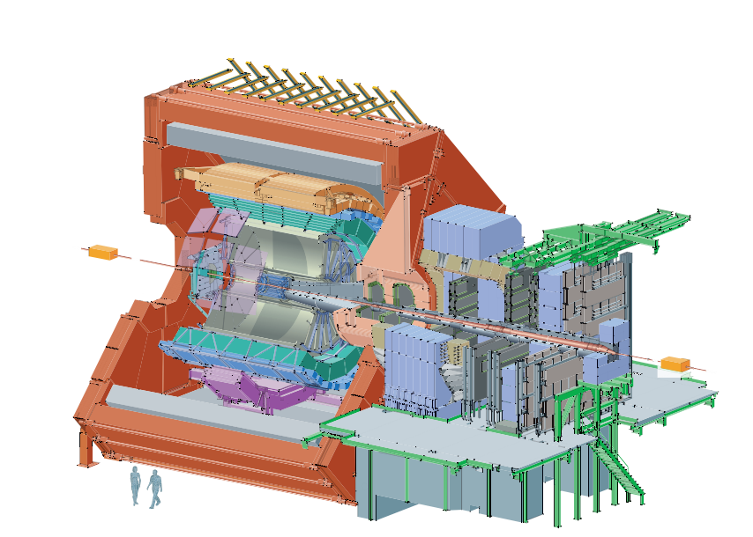
ALICE
Central part, composed of detectors dedicated to the study of hadronic signals and electrons
Forward muon spectrometer, dedicated to the study of quarkonia behaviour in dense matter
Fig. 2: ALICE schematic layout

Slide 4
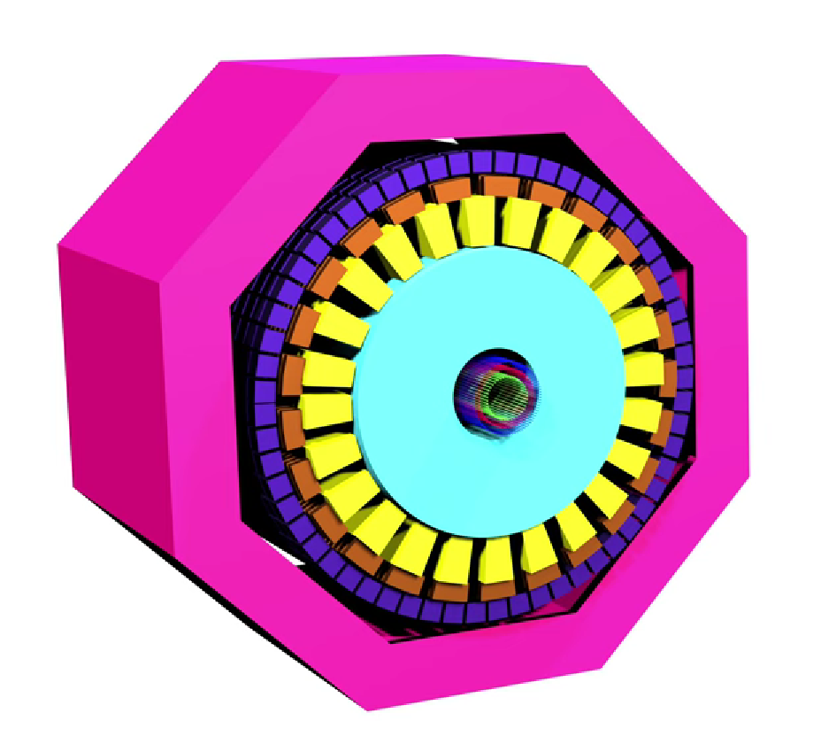
ALICE
Inner tracking system (ITS) and the outer tracking system (TPC)
Fig. 3: Simple 3D model of ALICE

Slide 5
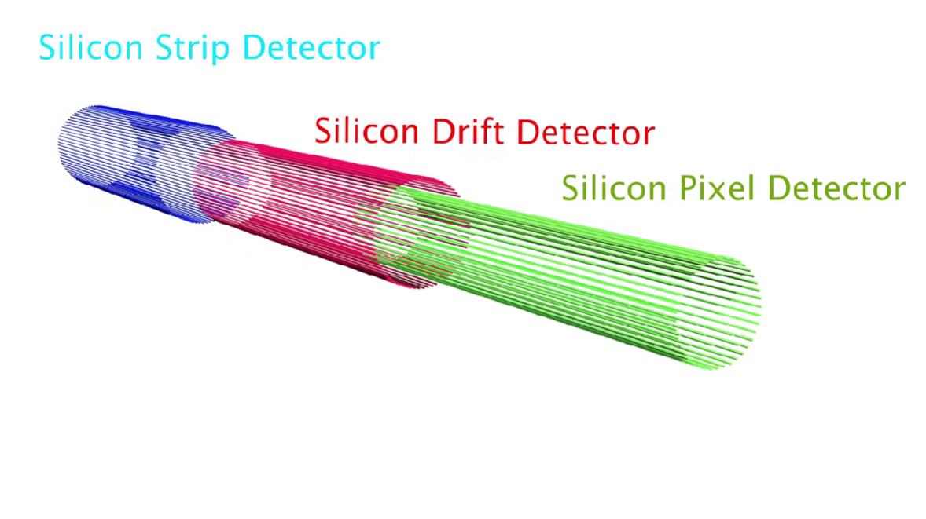
Inner Tracking System (ITS)
Track and identify particles with momentum below 200 MeV/c
Improve the momentum and angle resolution for particles reconstructed by the TPC
Reconstruct particles traversing dead regions of the TPC
Fig. 4: Simple 3D model of the ITS

Slide 6
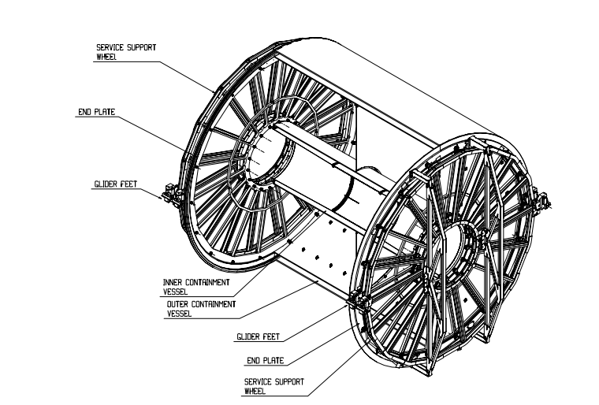
Outer tracking system (TPC)
Separating, tracking and identifying thousands of charged particles in a dense environment
Large cylindrical field cage, filled with 90 m³ 0f Ne/CO₂/N₂
Based on a design with a central high voltage electrode and two opposite axial potential dividers
Fig. 5: 3D view of the TPC field cage

Slide 7
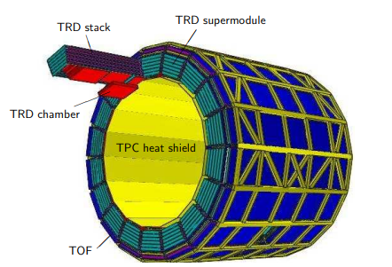
Transition Radiation Detector (TRD)
Provide electron identification in the central barrel
Pion rejection capability, position and momentum resolution, radiation length minimized
Fig. 6: Schematic of the TRD layout

Slide 8
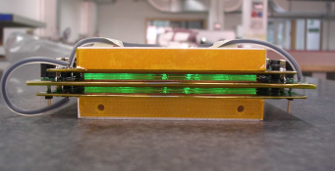
Time-Of-Flight Detector (TOF)
Large array that covers the central pseudorapidity
Provides event by event identification of large samples of pions, kaons and protons
Fig. 7: 10-gap double-stack MRPC strip

Slide 9
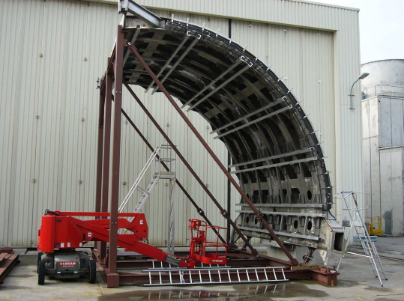
Electromagnetic Calorimeter (EMCal)
Enables ALICE to explore in detail physics of jet quenching
Large Pb scintillator sampling calorimeter with cylindrical geometry
Increases the electromagnetic calorimeter coverage of ALICE and provides fast and efficient trigger
Fig. 8: EMCal support structure

Slide 10
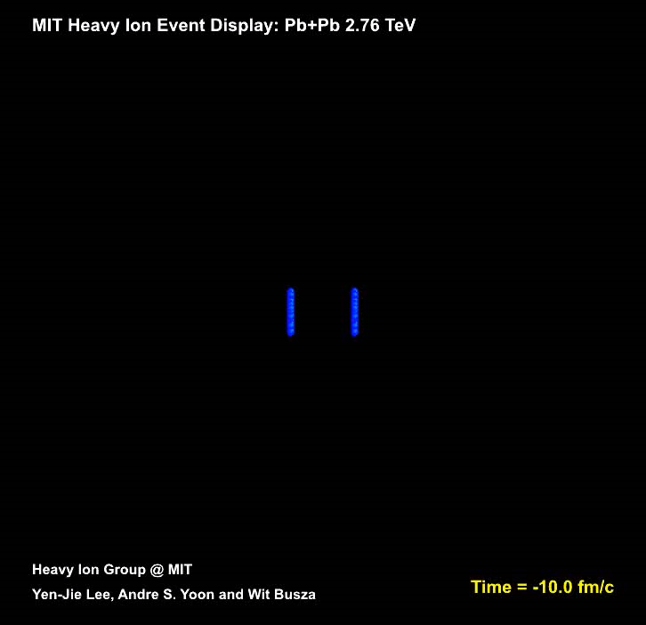
Quark-Gluon Plasma (QGP)

Slide 11
Quark-Gluon Plasma (QGP)
1970s: universe was too hot for protons, neutrons or any other hadrons to have formed
1980s: possible observable consequences in cosmology of a first order phase transition
2000s: primordial hot QCD matter to hadronic matter via a continuous crossover

Slide 12
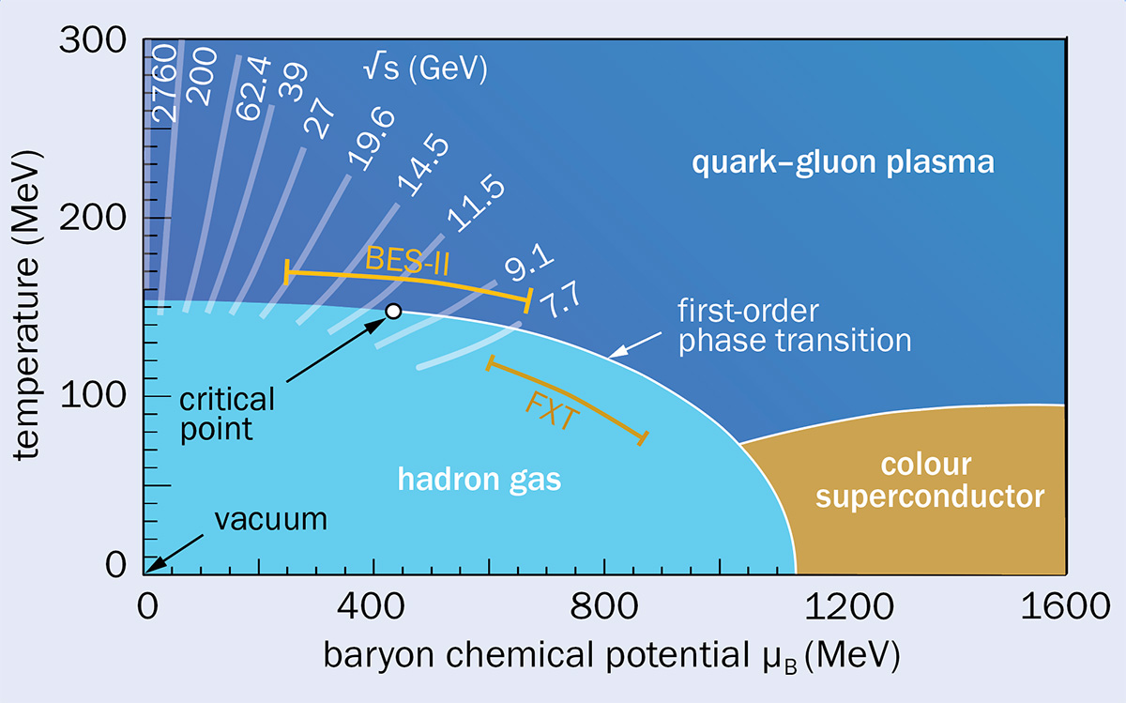
Quark-Gluon Plasma (QGP)
1970s: universe was too hot for protons, neutrons or any other hadrons to have formed
1980s: possible observable consequences in cosmology of a first order phase transition
2000s: primordial hot QCD matter to hadronic matter via a continuous crossover
Fig. 9: QCD phase diagram

Slide 13
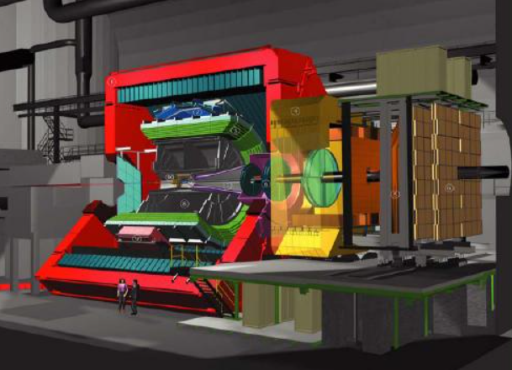
Future of ALICE
Long Shutdown 3 (≈ July 2026-2029)

Slide 14
Thank you for your attention
Manuel Baptista, 2019230967

