Slide 1


Particles4Health
Radiotherapy Application Development and Optimization

Slide 2
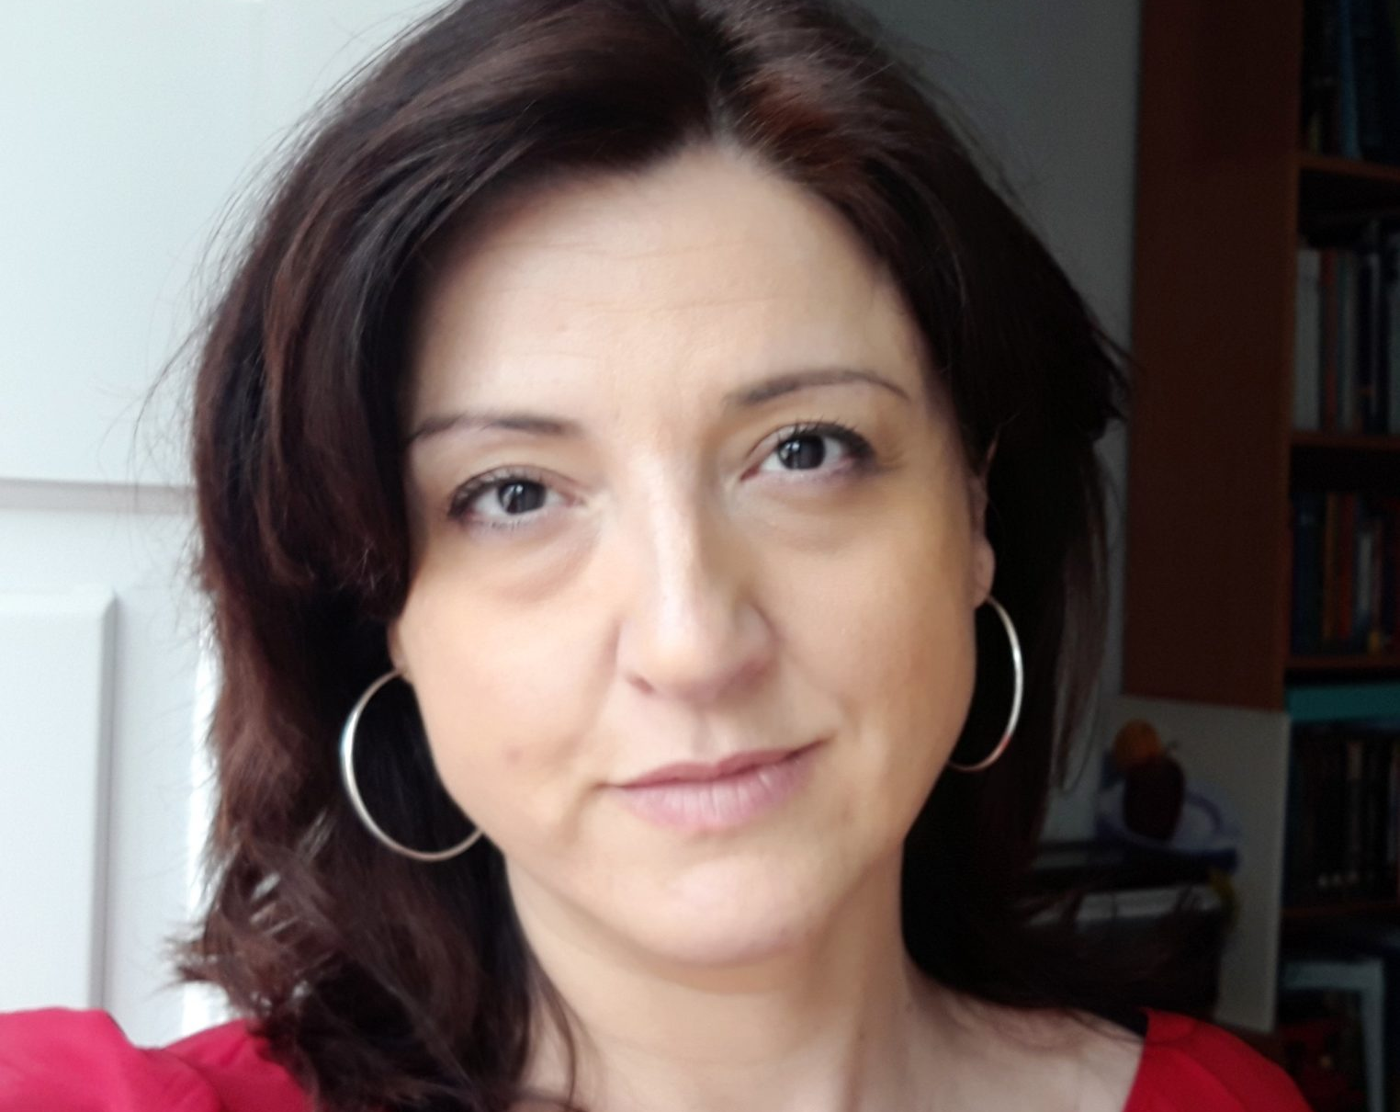
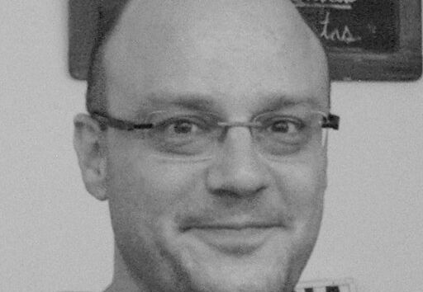
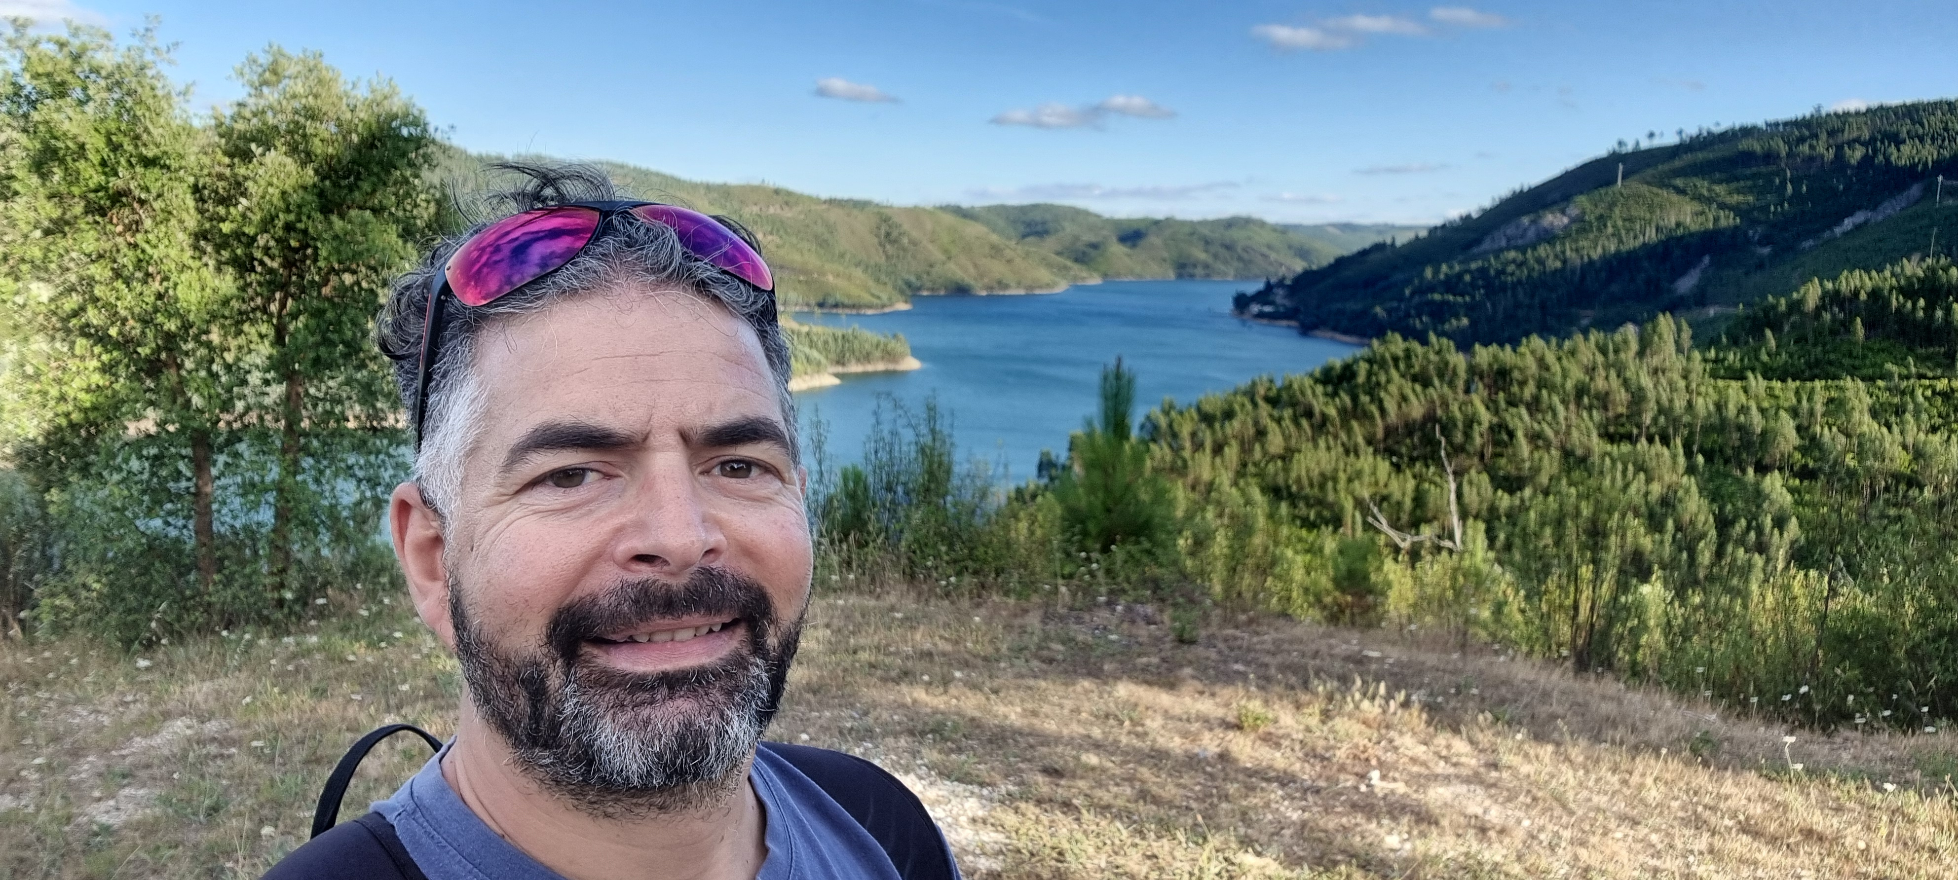
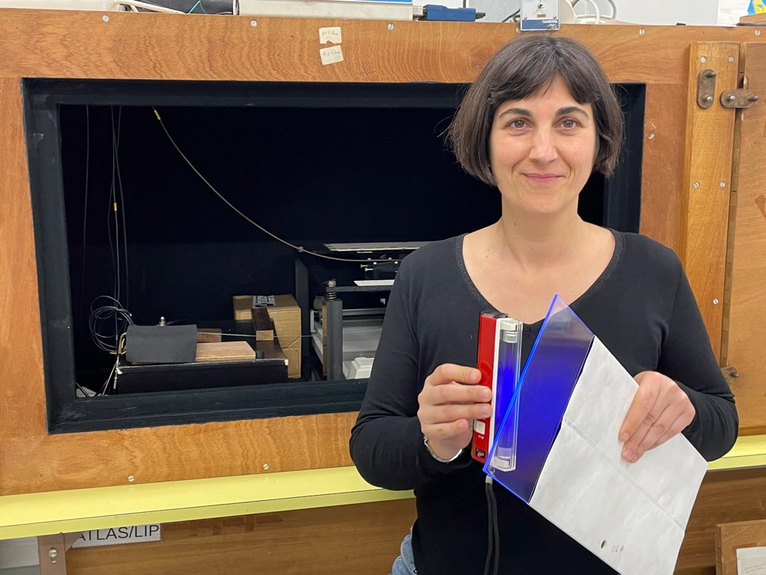
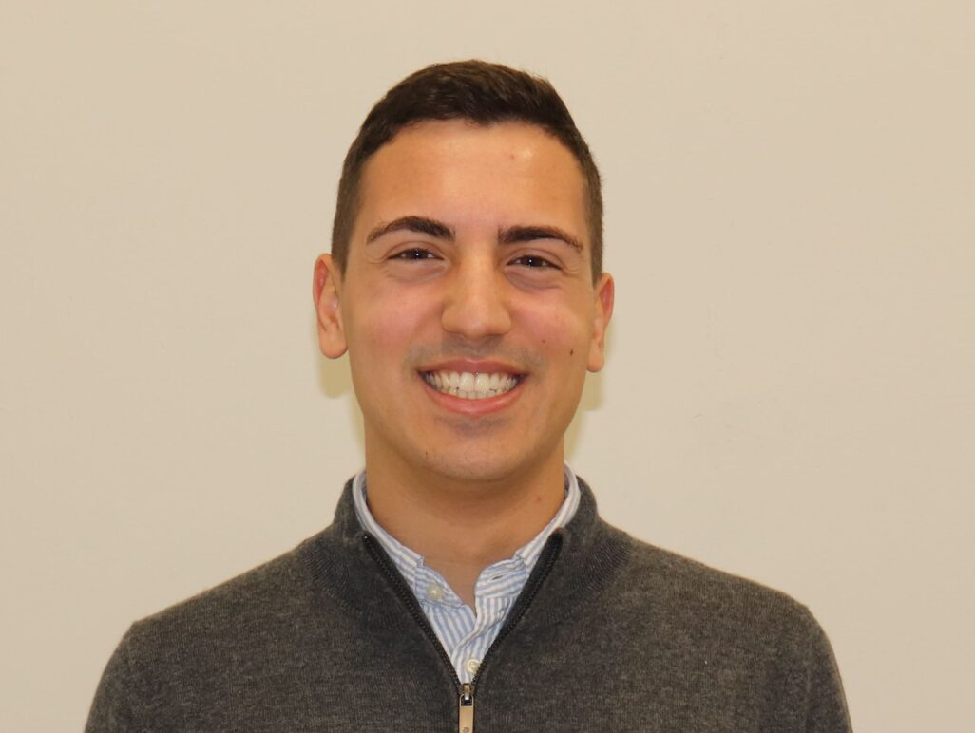
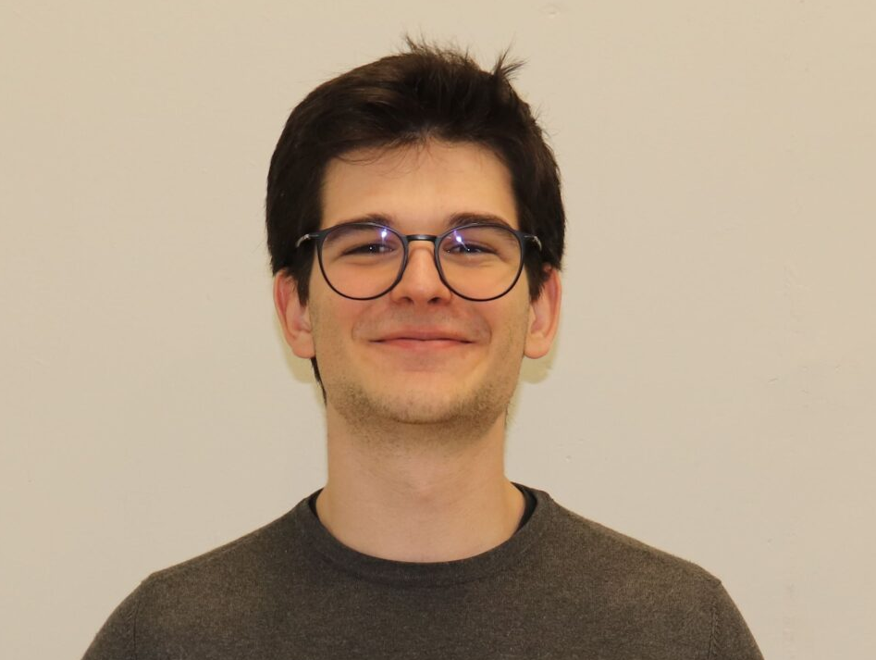
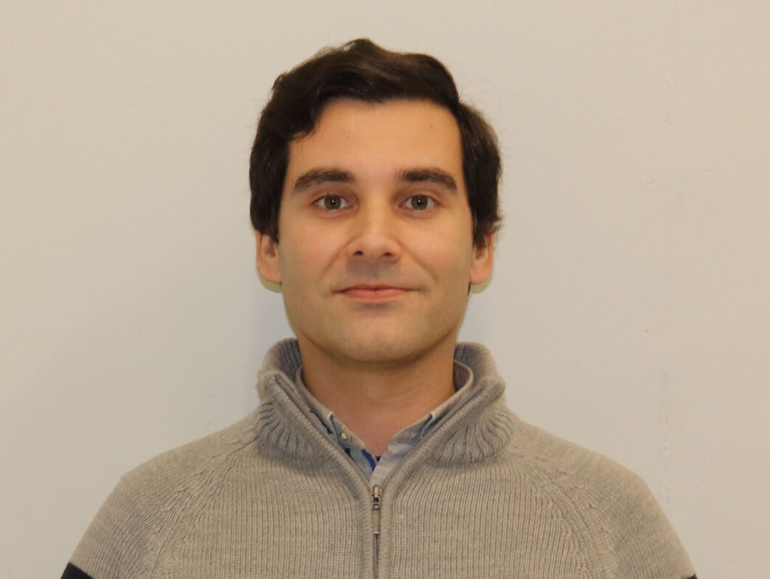
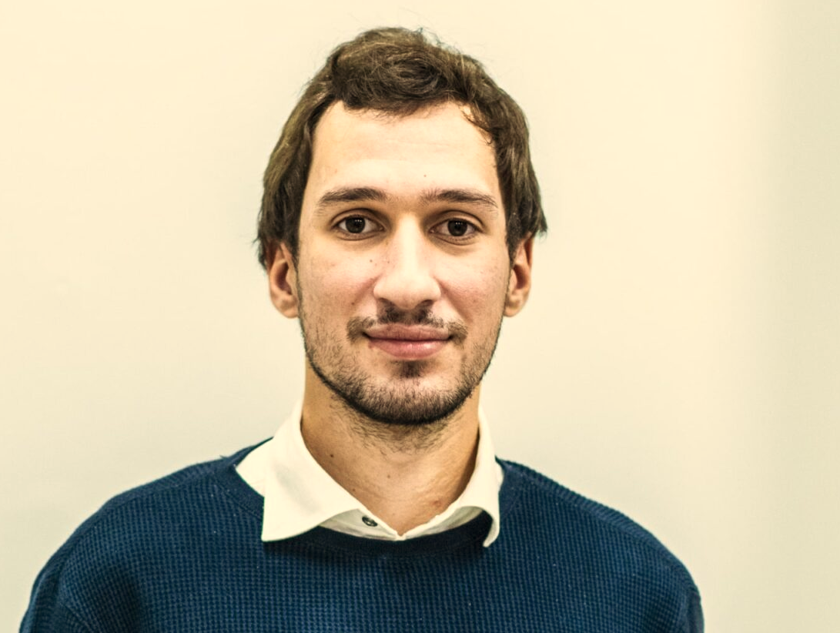
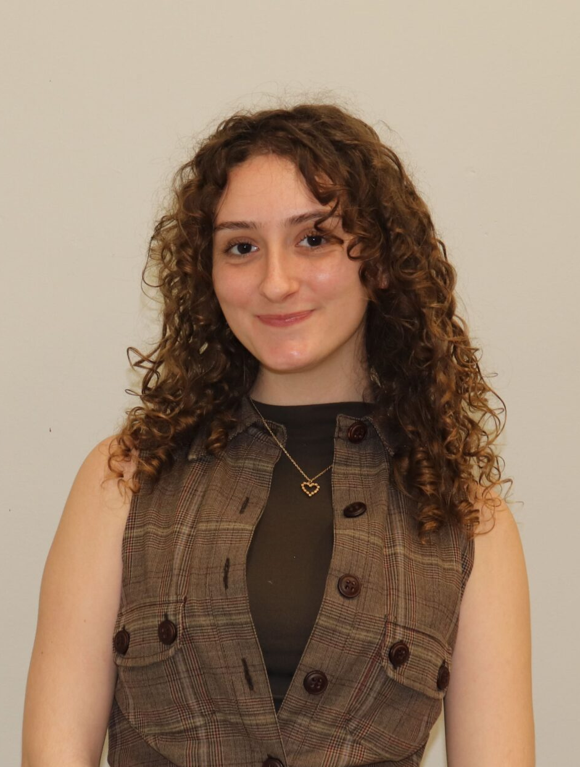
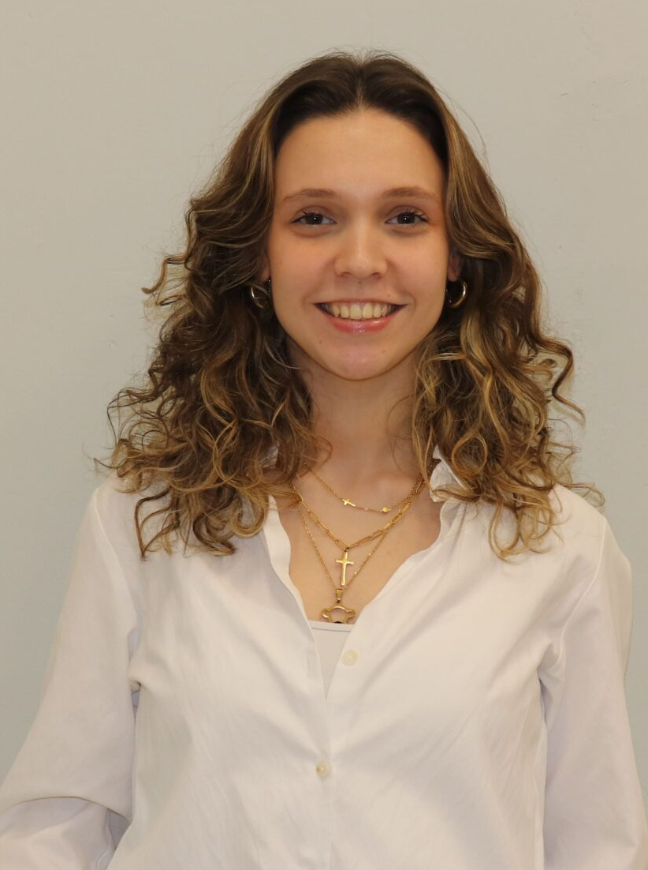
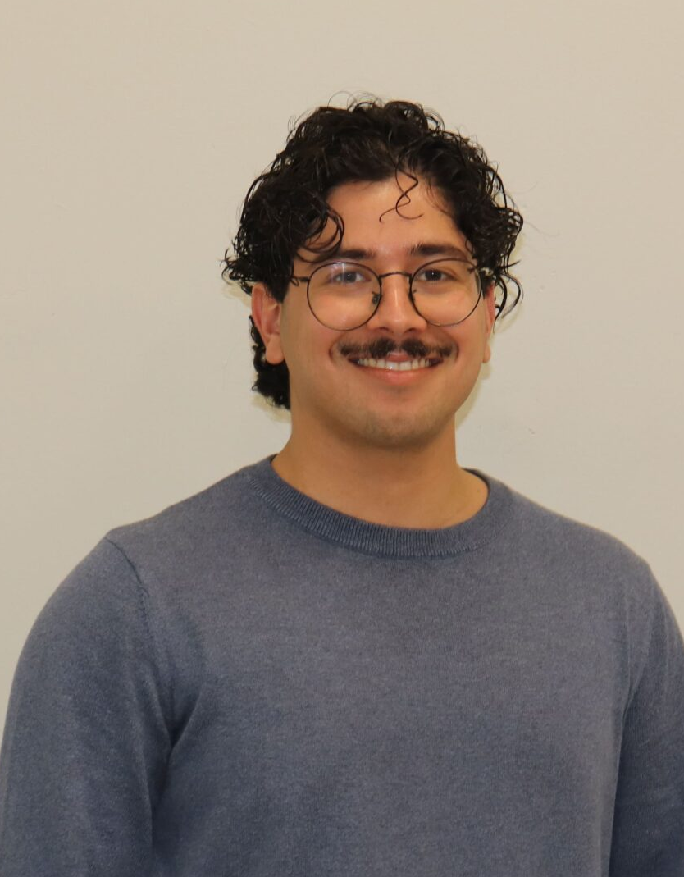
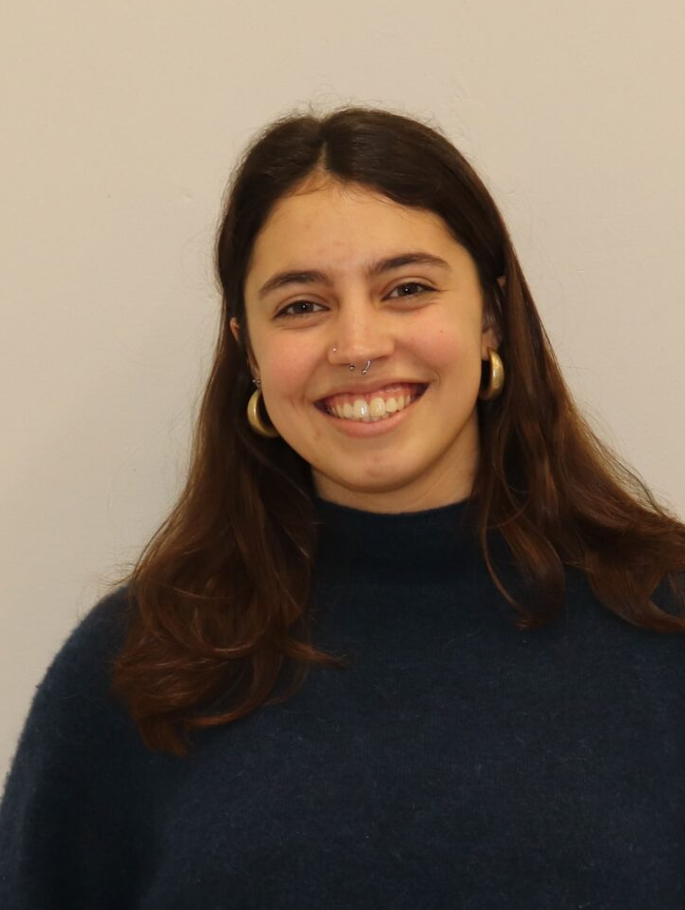
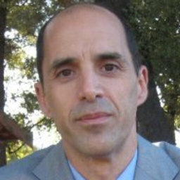
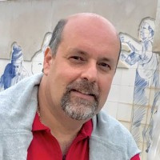
Team
And the most valued help from the electronics lab.
Thank you Miguel Ferreira, José Carlos Nogueira

Slide 3
Activities
Activities mainly related to technology development for beam control and monitoring with very fast detectors and electronics
Three main activities at this moment:
BoneOscopy
FlashGuard
PicoMonitoring
These activities are direct spin-offs from fundamental research in Astroparticle (Auger) and Particle Physics (ATLAS, CMS)

Slide 4
BoneOscopy
Estimate calcium concentration during proton treatments
LIP responsibilities
  Trigger detector to signal particles entering treatment room
  Electronics: Fast front-end electronics
  Participation in all WP
Funding: EIC grant 550 k€
Timeline: 5 years

Slide 5
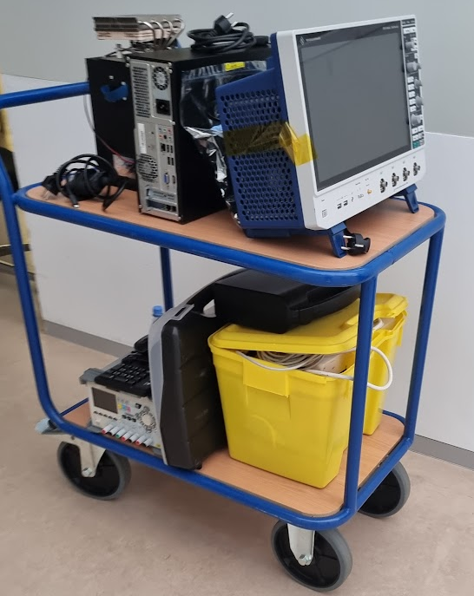
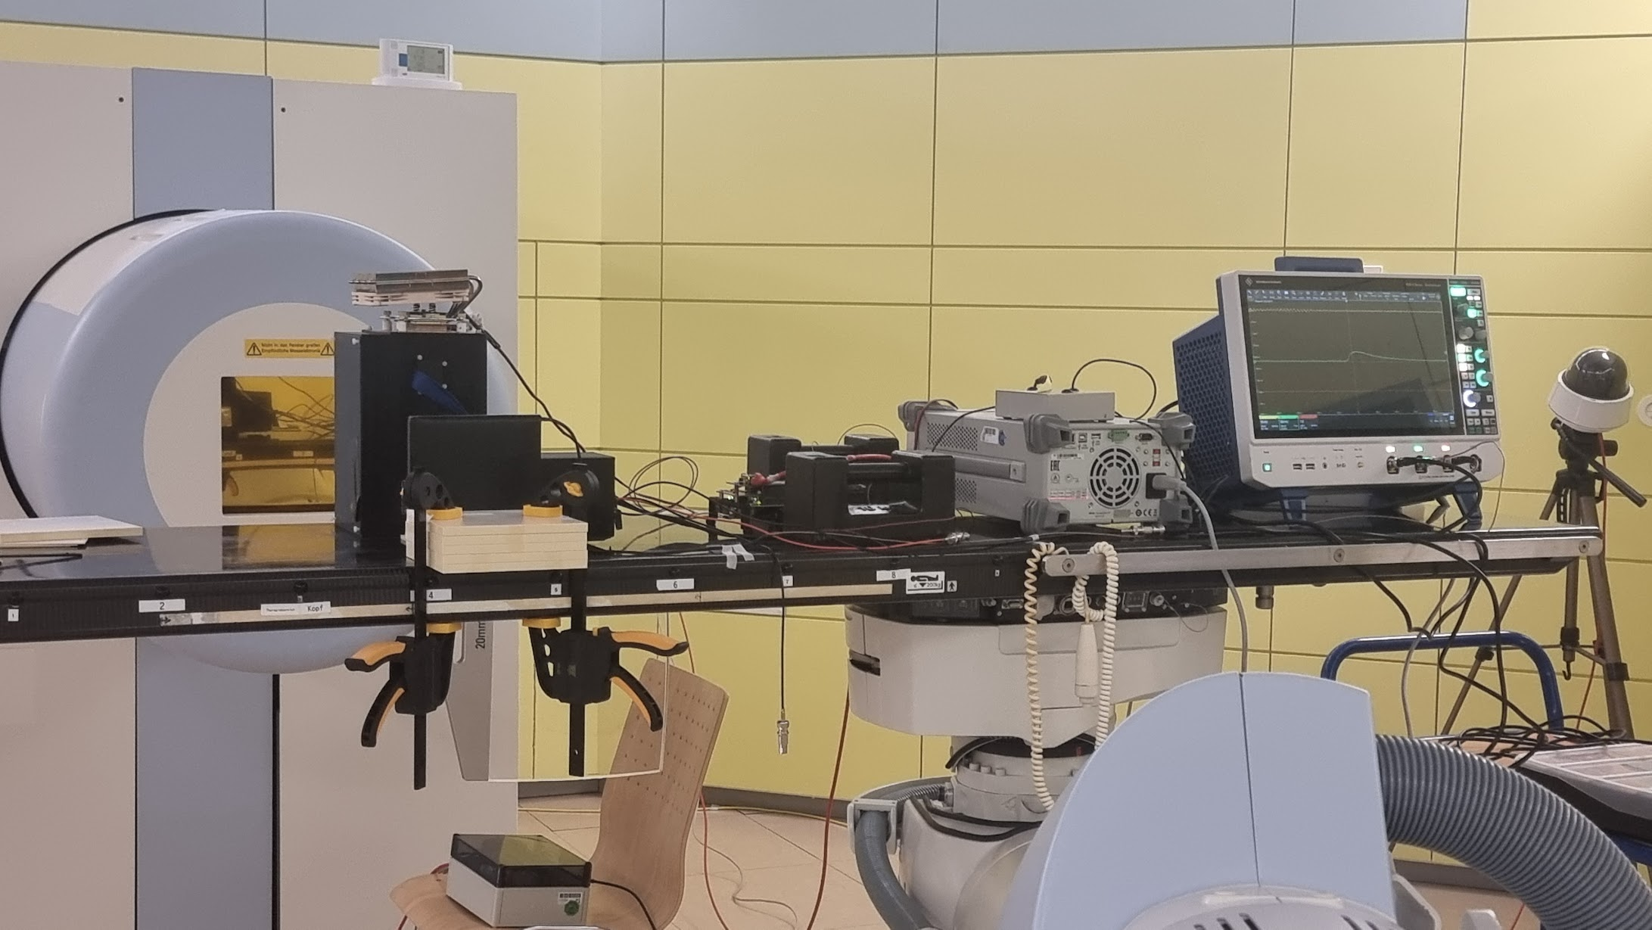
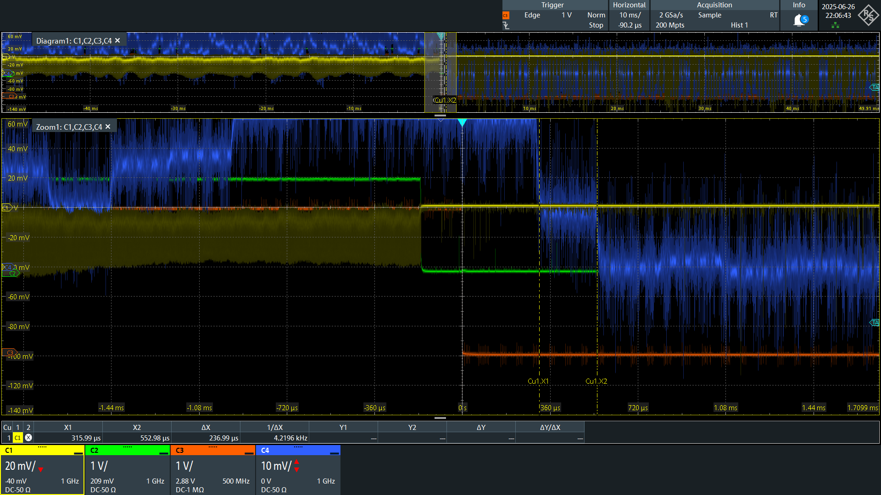
BoneOscopy
First year
  Defining requirements and standards (deliverable)
  Started detectors design and performance tests
    Trigger detector (our responsibility) based on fibres + SIPM
    Procurement
    Testing readout of SiPM: target 1ns resolution
    Planning tests on timing resolution
  First tests at Marburg (MIT)
    Understand the beam structure

Slide 6
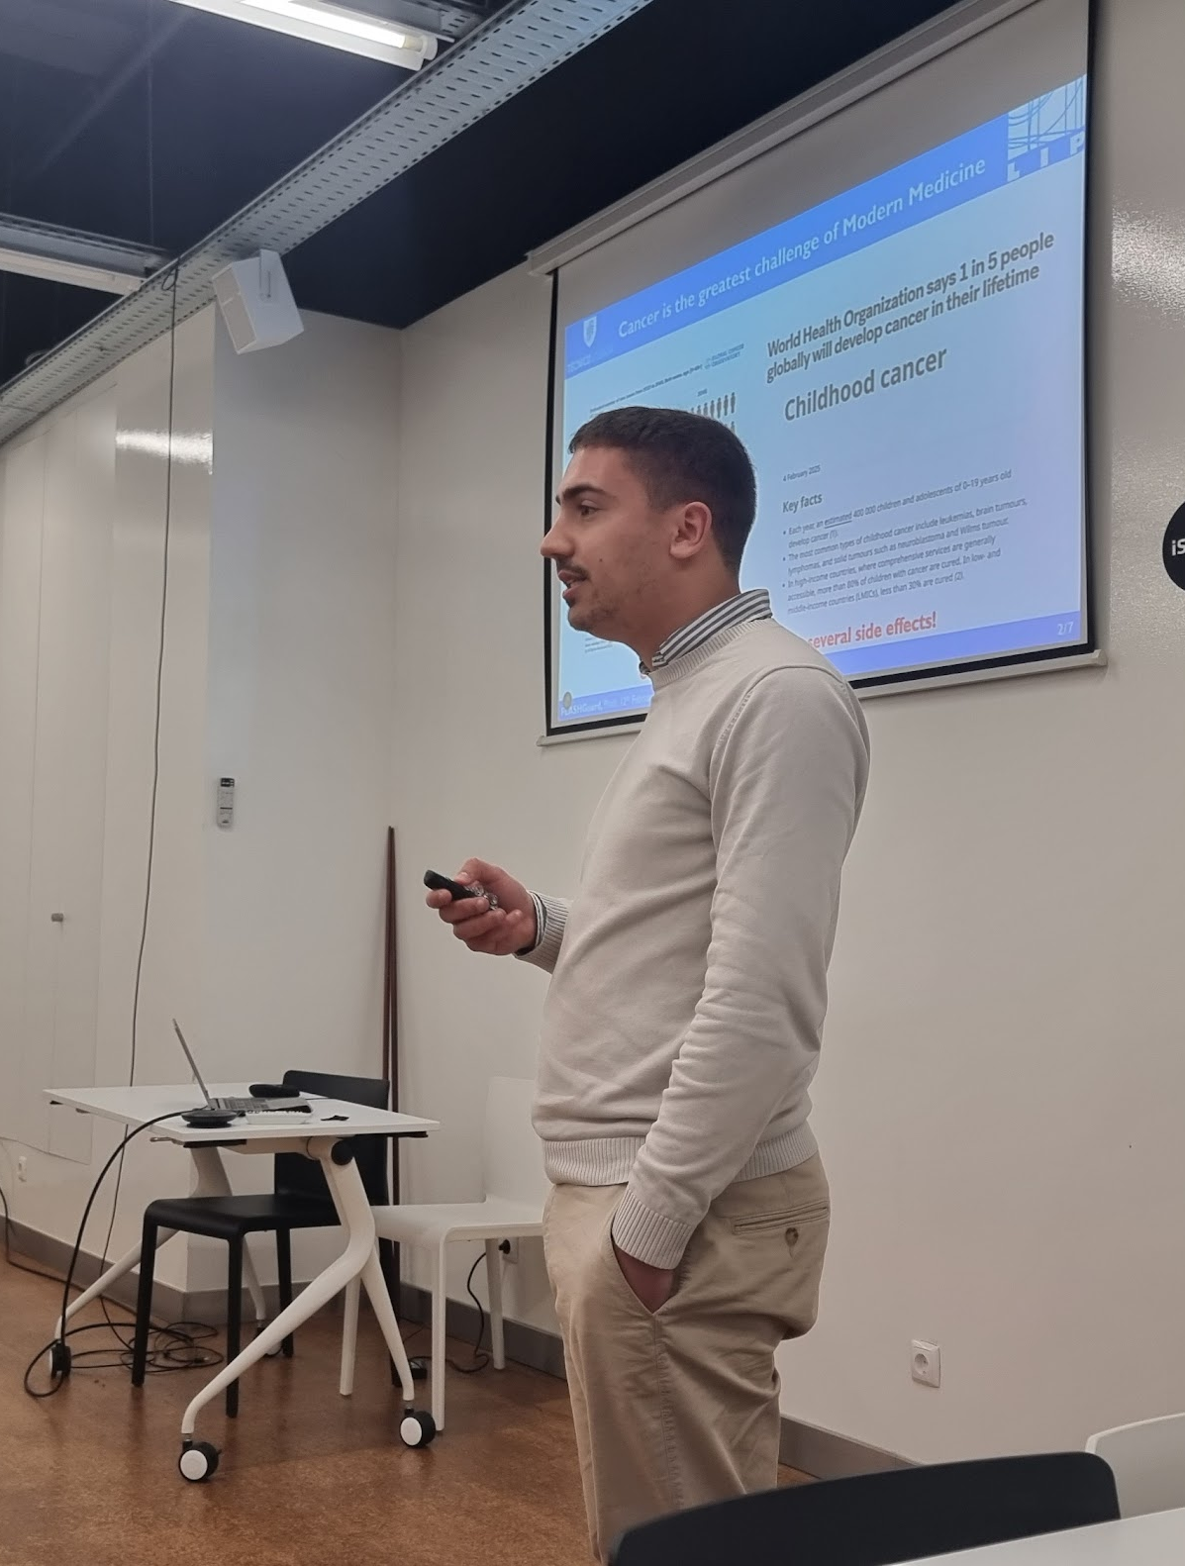
FlashGuard
2025
A Cherenkov detector to monitor FLASH beams
Applicable to all RT beams
Patent application
Selected for 2nd phase of lab2market
2 prizes at JEF awards
Application to La Caixa Health impulse, stage 1
1 PhD, 1 Master, 1 Graduation student involved

Slide 7
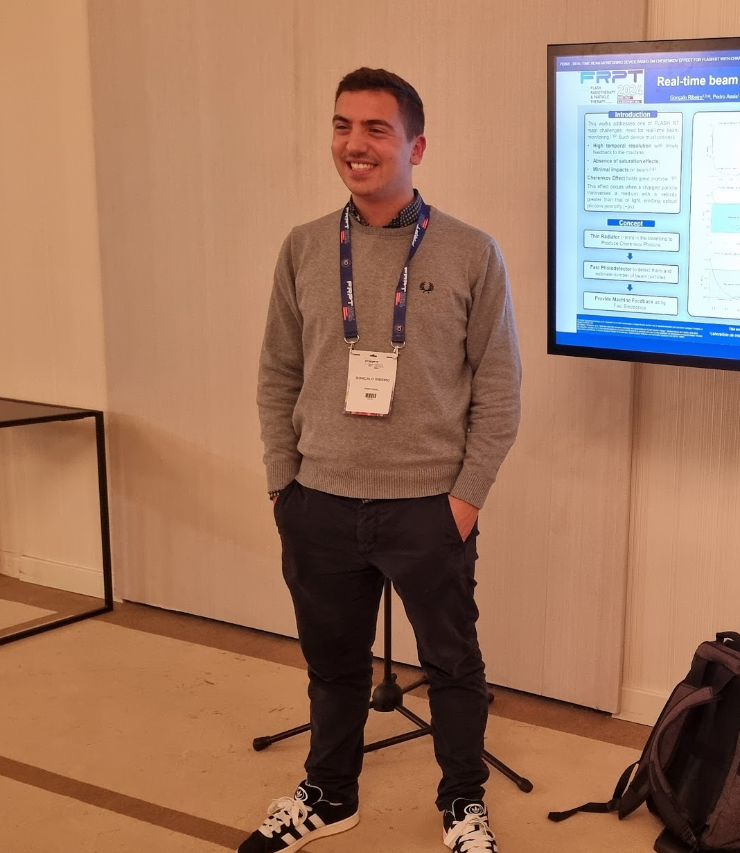
FlashGuard
A Cherenkov detector to monitor FLASH beams
Applicable to all RT beams
Patent application
WON lab2market
FUNDED by La Caixa Health impulse, stage 1 (50k€ 1 year)
WON Youth Start-up competition
WON MIT Portugal 100K
Spin-off company RTBeamTech
Second (Provisional) patent
2 PhD, 1 Master, 1 Graduation student involved
Possibility to apply for Health impulse stage2
First Tests of a full prototype

Slide 8
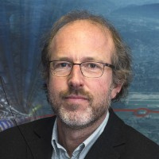


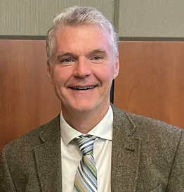


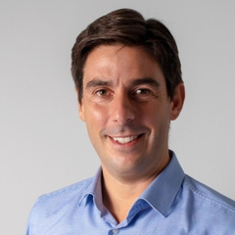

Advisory Board
Dr. Maurizio Vretenar, PhD:
  Coordinator of the EuCARD2, ARIES and IFAST European Projects at CERN and part of the Hitriplus project.
  Leader of NIMMS (Next Ion Medical Machine Study) group at CERN.
  Provides contacts and technical support.
Prof. Brian Pogue, PhD:
  Robert A. Pritzker Professor of Biomedical Engineering, Dartmouth.
  Co-Founder and President, DoseOptics LLC.
  Several patents on Cherenkov based technology for radiotherapy, more than 600 published articles and $52 million in research funding.
  Voluntarily accepted to be a part of advisory board as he believes in the team, solution and potential.
Vitor Crespo:
  Partner at HealthTech Portugal.
  Co-Founder and CEO, Criam.
  Extensive experience in Business Management, Business Scaling and Fundraising.
  Provides Mentoring and Coaching, as well as guidance in the setup and expansion of the business.
7/9

Slide 9


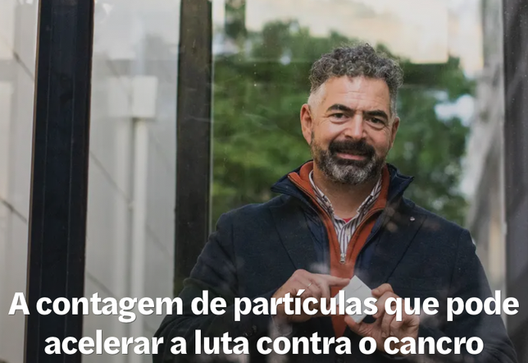
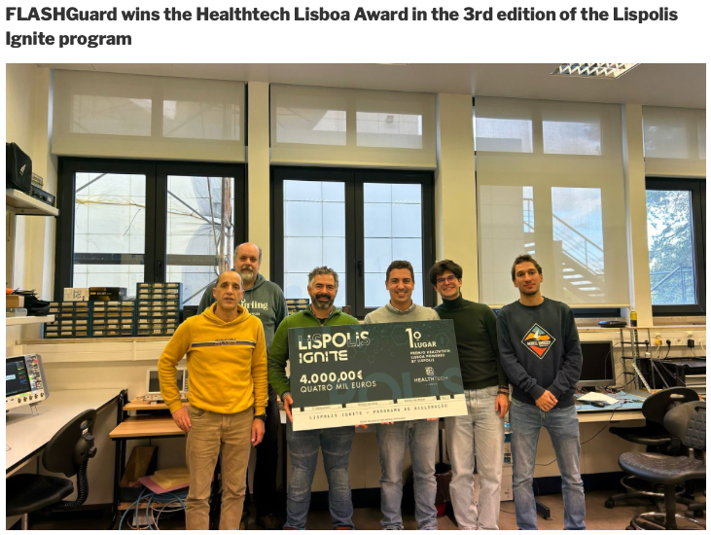

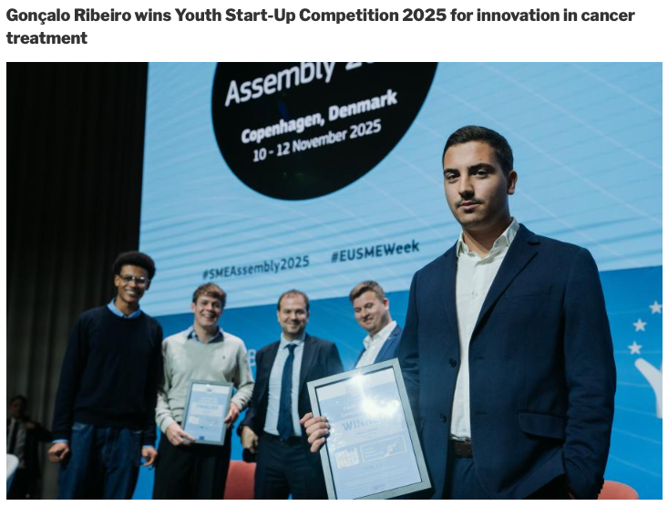
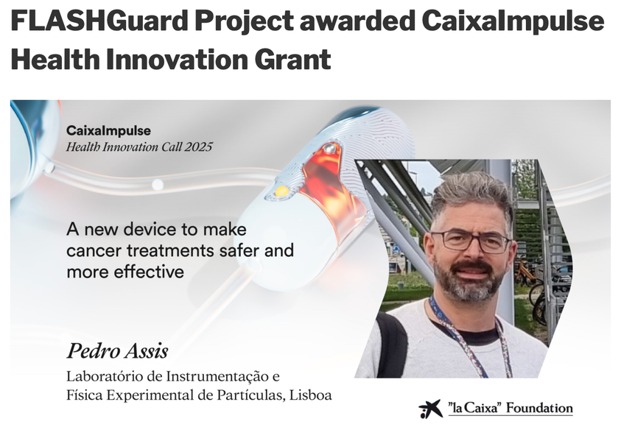
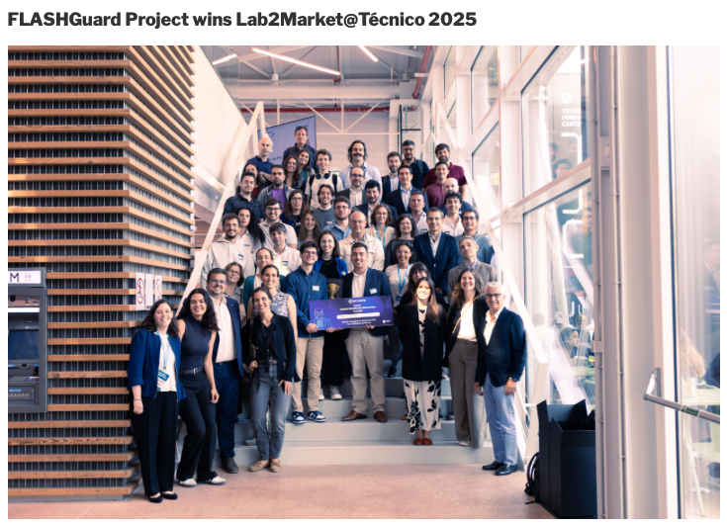
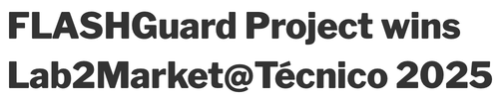
Awards and Distinctions
8/9

Slide 10
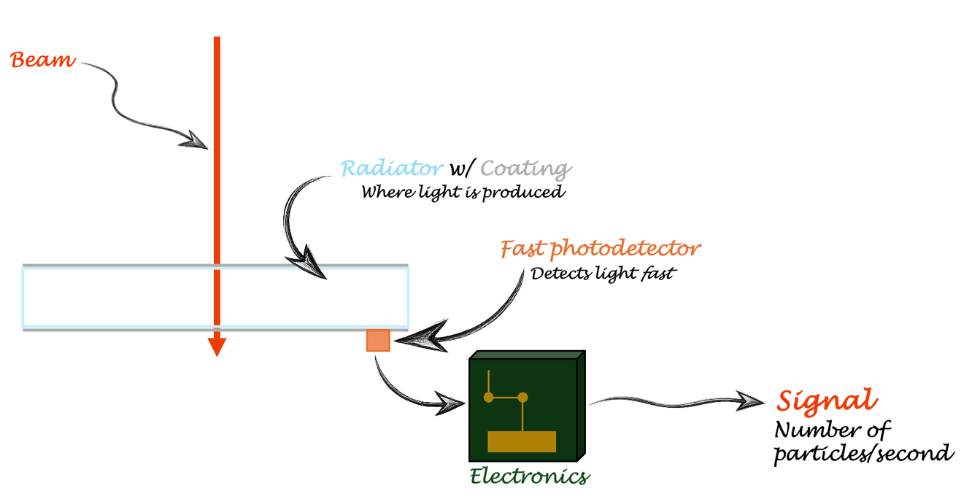
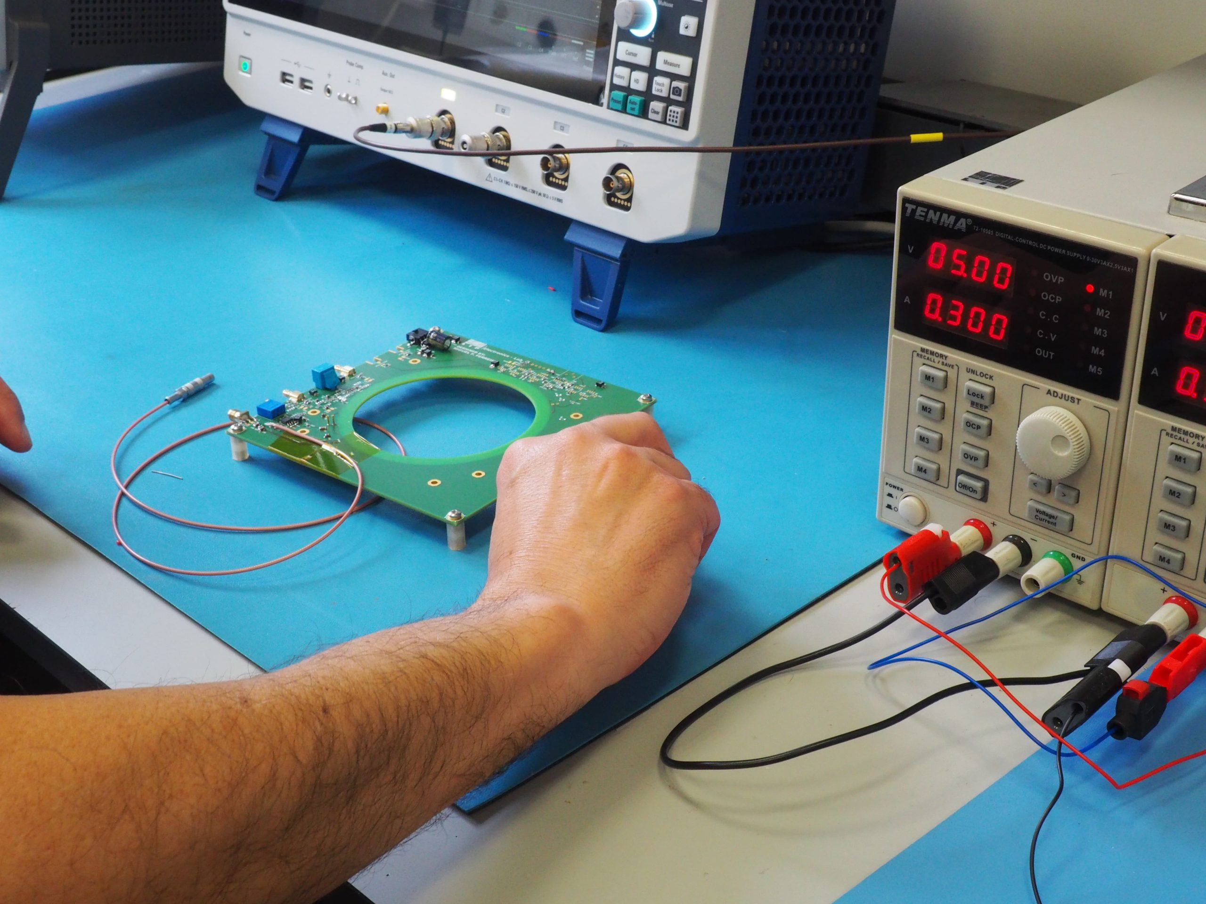
First prototype

Slide 11
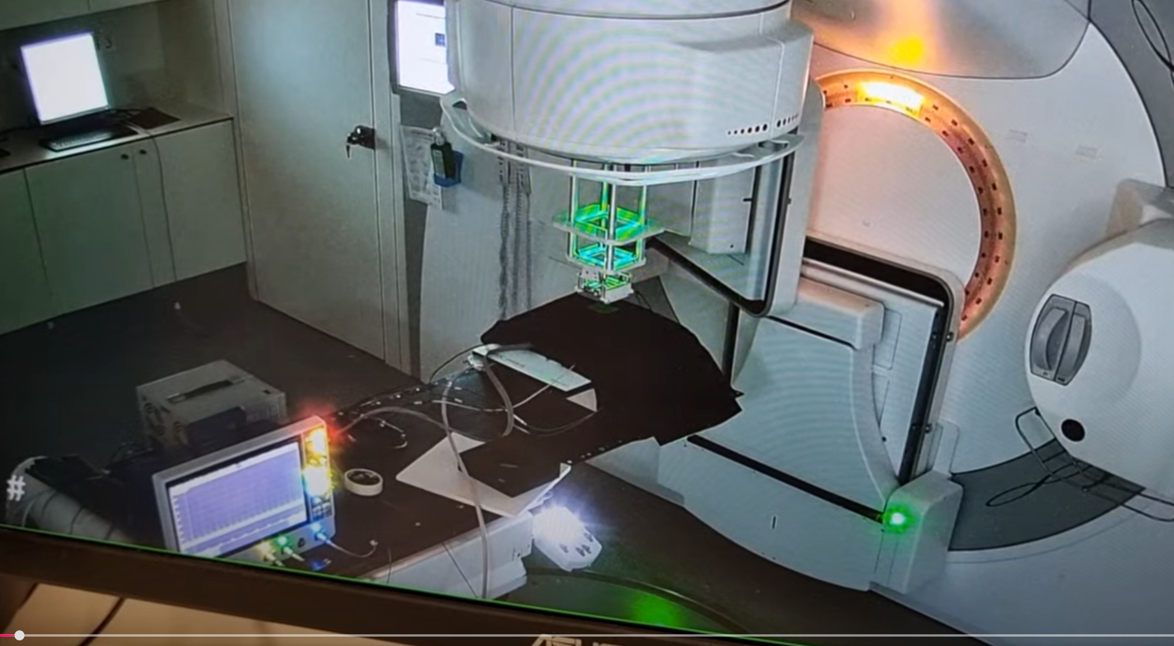

Slide 12
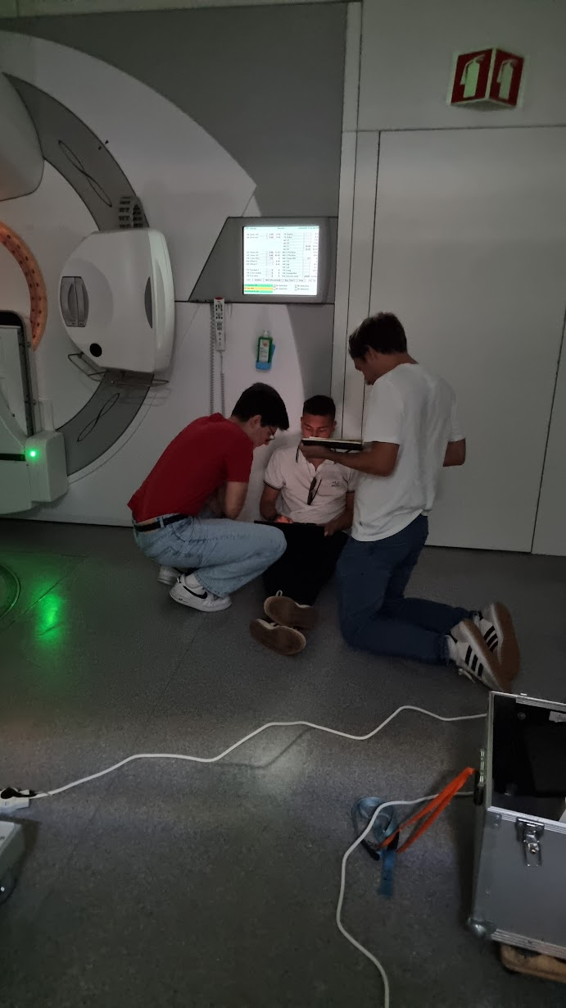
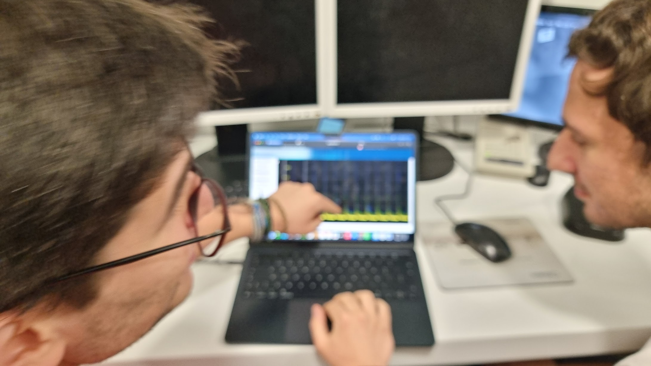
First data on protype

Slide 13
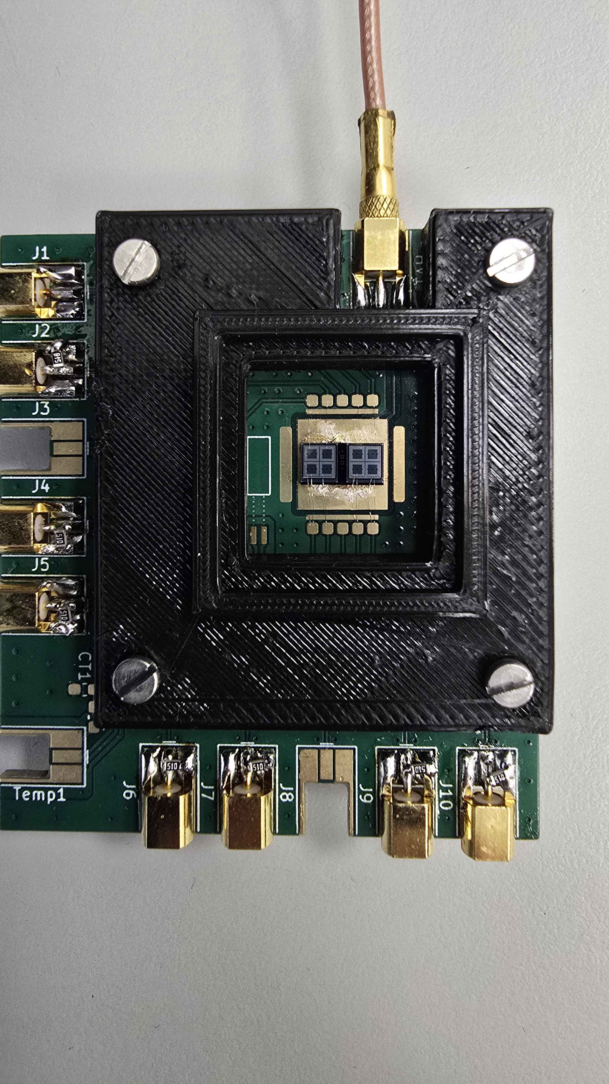
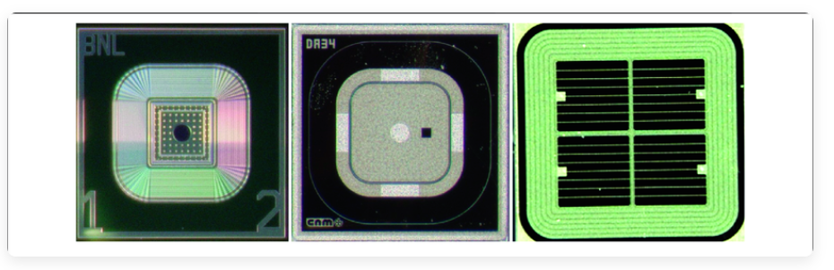
PicoMonitoring
LGAD based sensor for beam monitoring
Developing prototype setup for tests at Germany
A reference detector for other systems
Main challenge will be to reduce perturbations on beam
LGAD to measure
sub-ns structure
Thanks to CMS and ATLAS groups

Slide 14




FLASHGuard
An RTBEAMTECH technology
A new device to make cancer treatments safer and more effective

Slide 15
BoneOscopy
Live Cell Spectroscopy Analysis for Personalised Particle Radiation Therapy of Metastatic Bone Cancer
Pedro Assis | BoneOscopy information
Scientific Advisory meeting | LIP | Apr. 2026

Slide 16


Thank you
for your attention.

Slide 17
FLASH Radiotherapy:
A breakthrough waiting to happen
Needs a beam monitoring device before being used in clinic!
The problem:
Patented Technology
FLASHGuard
Cherenkov Effect Particle Counter
3/9

Slide 18
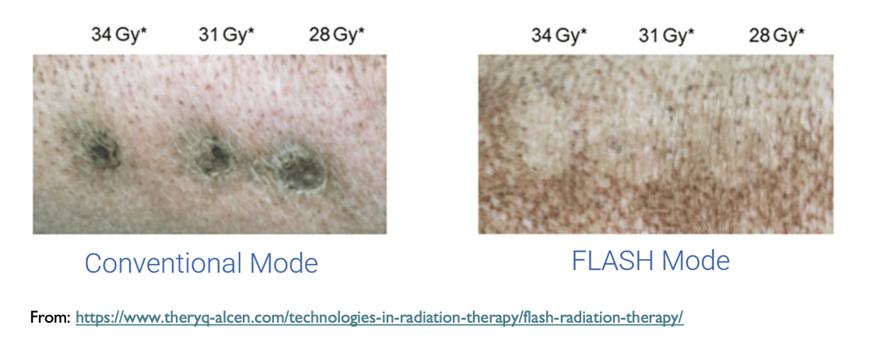
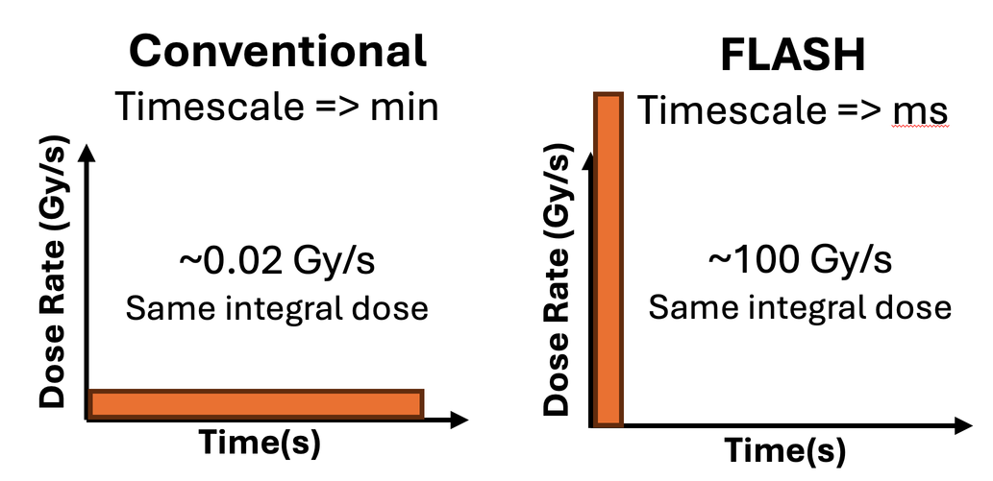
FLASH Radiotherapy:
A breakthrough in cancer treatment
Dose delivered 1000 times faster protects healthy tissues!
Conventional
FLASH
Nº Sessions
~20 to 30
1
Duration
Weeks
Single Visit
Tumor Control
Same Effectiveness
Toxicity and Side Effects
Reduces patient side effects significantly, leads to improved QoL
Substitution Potential
50% of Cancer treatments use Conventional Radiotherapy
Back to Lean Canvas Overview
2/9

Slide 19
Strategy and Vision
IP Strategy
  Foundational patents covering key concepts, reinforced by trade-secret protection for critical know-how.
  Company owned IP by design: all employees and collaborators sign NDAs.
  Seeking international specialized legal support, advising on IP strategy, structuring and long-term protection.
Protection of the company’s IP is a priority and an asset
Exit Strategy
  A strong IP strategy ensures full control over core concepts and products, enabling flexible licensing and exit options.
  Our plan is to advance the technology to TRL 7, validating industrial readiness. Exit via licensing or strategic acquisition by a leading industry player with established manufacturing, regulatory, and global distribution capabilities.
Clear exit paths aligned with technology maturity and market adoption.
FLASH Radiotherapy is a disruptive treatment.
RTBEAMTECH develops the technology that enables its clinical implementation.
9/9

Slide 20
PicoMoni
To detect particles in the beam using LGADs
LGADs have timing resolution in sub-nanosecond scale
1 PhD in co-supervision with HIT

Slide 21
Activities
Activities mainly related to technology development for beam control and monitoring with very fast detectors and electronics
Three main activities at this moment:
BoneOscopy
FlashGuard
PicoMonitoring

Slide 22
Use your previous title here
Use narratives
Tell stories or share examples that illustrate the relevance and impact of the information you're sharing. This will help you engage your audience and make the information easier to remember.
03
Prefer visual contents
Be creative in how you share information and keep the audience focused on your presentation, there's more to it than bullet points!
01
02
Promote dialogue
Include the audience in your presentation, allow time for questions and answers, promoting interaction and dynamism.

Slide 23
Modify the layout
This prevents your audience from getting bored and losing focus on the information you are sharing.
It also shows that you have taken care with the way you present the information.
Remember that some topics may require more graphic emphasis, while others will be better explained with examples, stories, or images. Changing the layout allows you to tailor the presentation to the specific needs of each topic.
Make slight changes to the layout
of your presentation

Slide 24
Use
contrast

Slide 25
Use contrast
Because this way you can highlight important information such as key points or essential elements.
1
Mas porquê?
Appropriate contrasts between text and background, or between graphic elements, improve readability and facilitate understanding of the content.
2

Slide 26
Photos?
Use the same principles as in slide 3 and consider the following points
Copyright: Make sure you have permission to use the images that are included in the presentation, or use images in the public domain or with Creative Commons licences.
Image quality: Use high-quality images to ensure that they are sharp and clear in the presentation. Avoid pixelated or low-resolution images, which end up damaging the visual experience.
Relevance: Images should be relevant to the content of the presentation and support or reinforce the message being conveyed. Irrelevant or disconnected images can confuse the audience and distract them from the main topic.

Slide 27
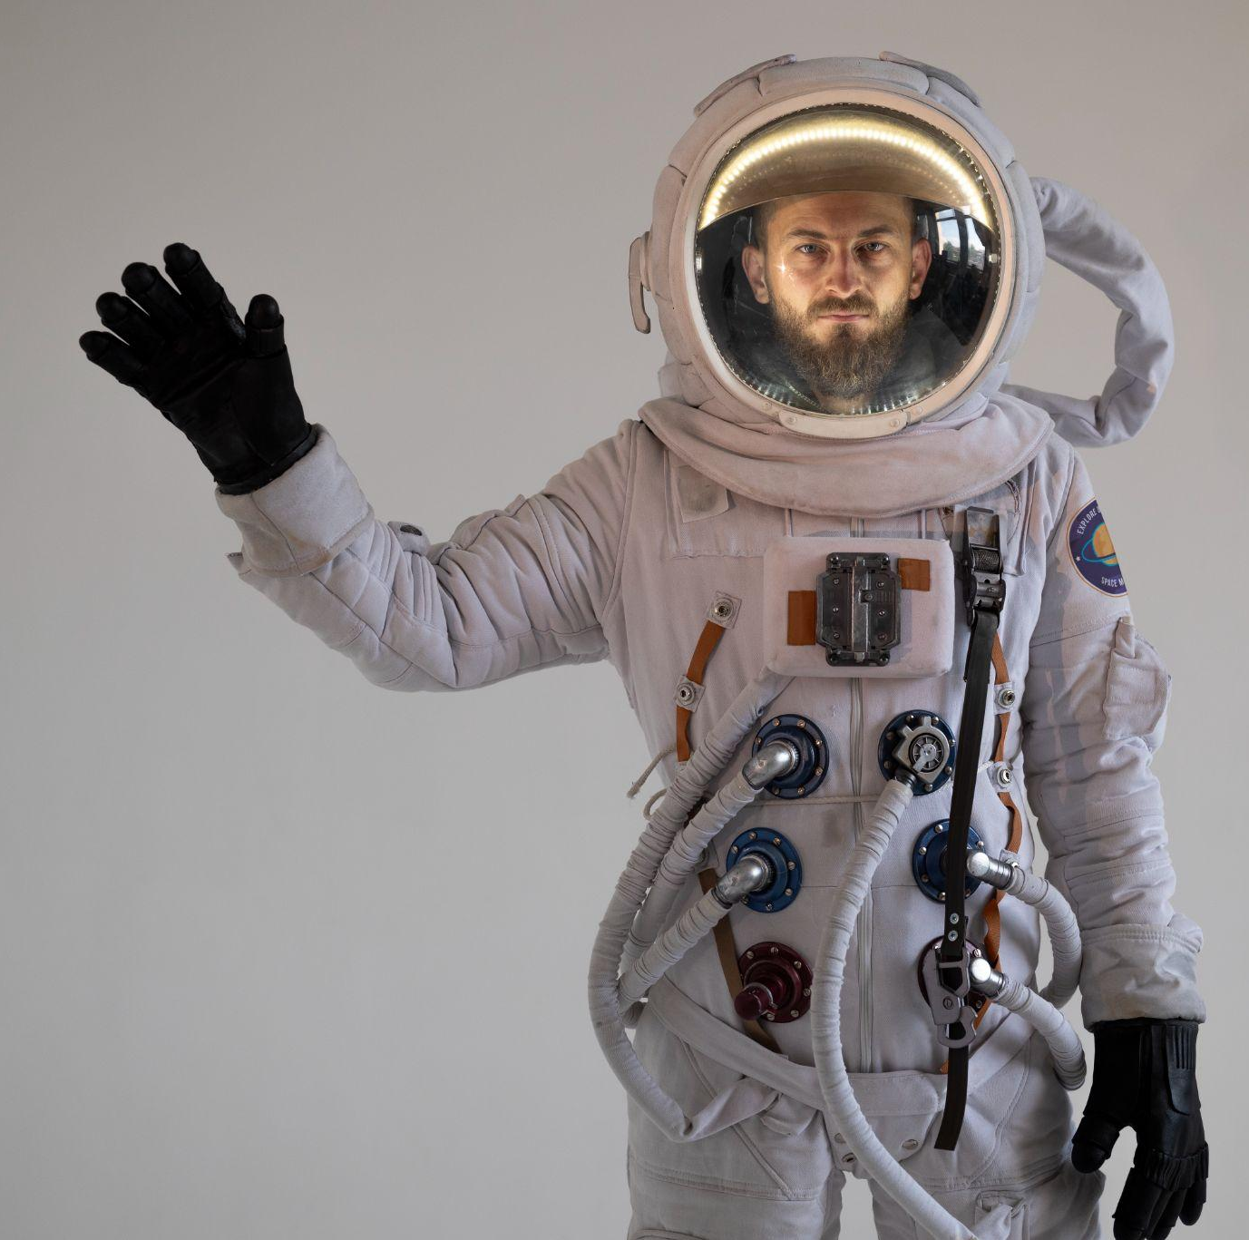
Photos?
Examples
If you need to overlay text on an image, ensure that it is legible and contrasting enough to stand out.
Avoid using images with too much information, as this makes the text difficult to read.
short caption
short caption

Slide 28
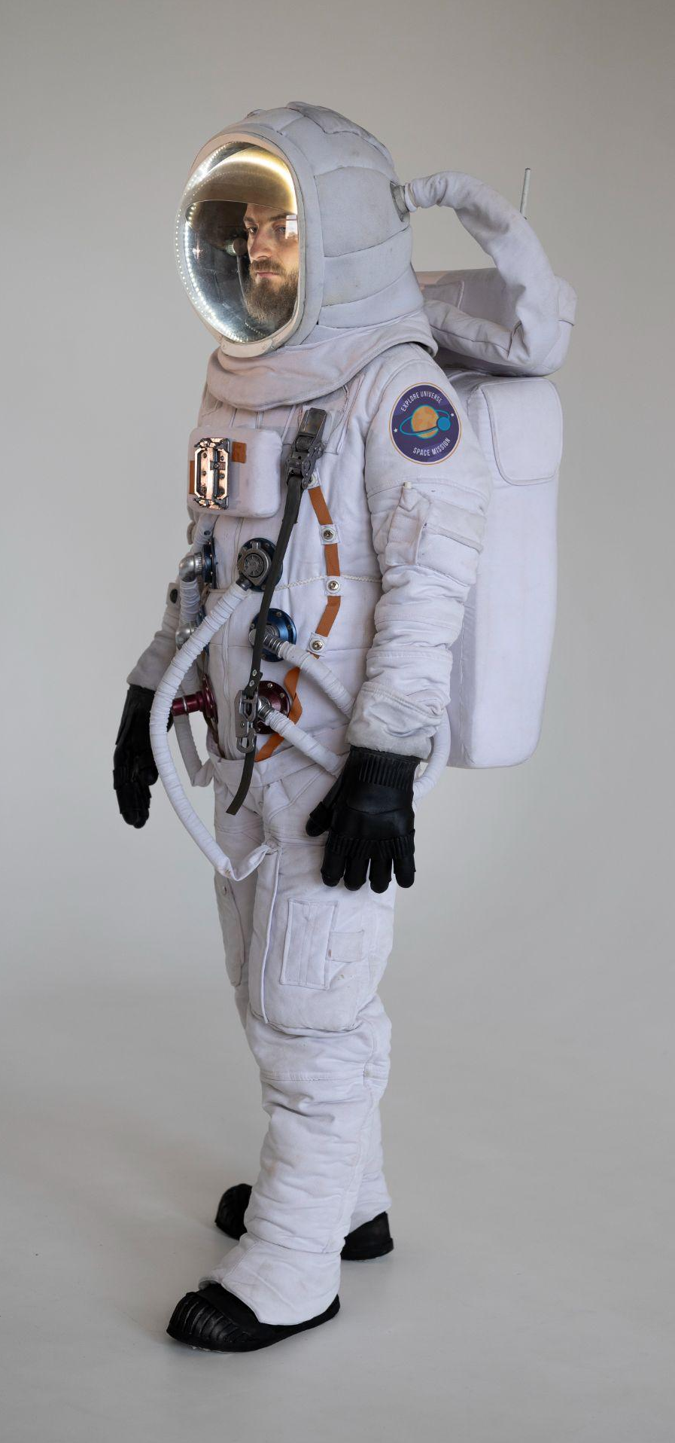
Photos?
Examples
short caption
short caption
short caption

Slide 29
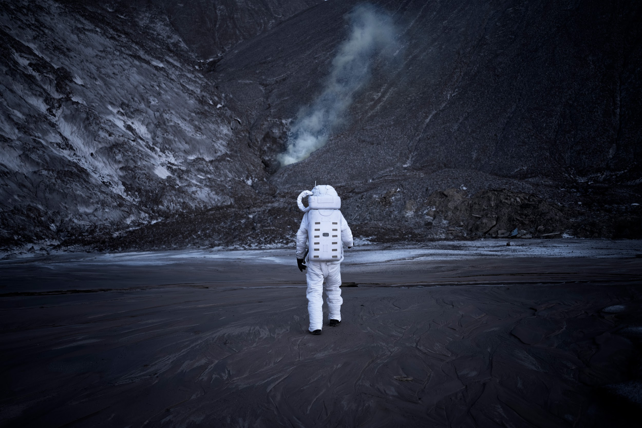
Photos as background?
It is possible, but more difficult to compose.
Select a layout that suits the image you are using.
Use as little text as possible and ensure that it is legible.
Well-chosen and appropriately presented images can make your presentation more engaging and memorable for your audience.

