Slide 1
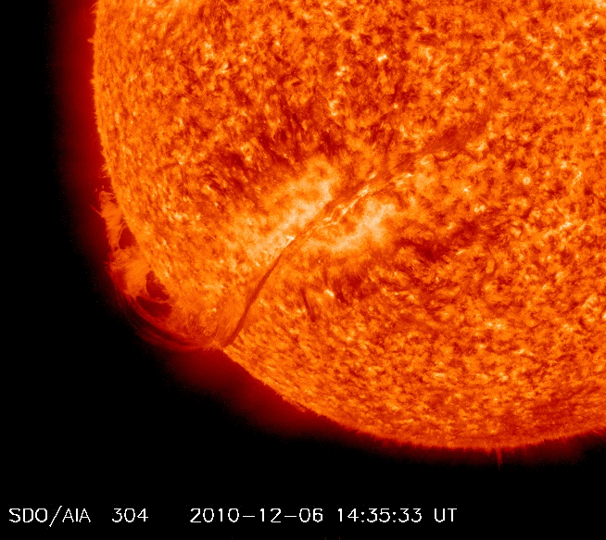

Space RADIATION Environment and its Effects
Team Members:
Patrícia Gonçalves
Marco Pinto
Luísa Arruda
Tiago Neves (software engineer)
António Gomes (PhD) – BERM (M. Pinto + P. Gonçalves)
Bruna Lima (PhD) – SpaceRad (L. Arruda + M. Pinto + P. Gonçalves)
André Rodrigues (MSc) – JUICE (M. Pinto)
Rafael Parente (MSc) – JUICE (M. Pinto)
Inês Rosa (MSc) – BERM (M. Pinto + A. Gomes)
Isabel Dias (BSc) – SpaceRad (B. Lima + M.Pinto)
Magda Sousa (BSc) – SpaceRad (B. Lima + M.Pinto)
Tomás Gonçalves (BSc) – JUICE (M.Pinto)
Marta Semblano (BSc) – BERM (M. Pinto + A. Gomes)
Bernardo Tomé (2%)
Pedro Assis (2%)
Members moving to i-Astro in 2026:
António Amorim (instrumentation for ESO)
André Moitinho (GAIA)
José Figueiredo (Optoelectronics)
Paulo Gordo
+ Students and Technicians

Slide 2
SpaceRad Ongoing Projects
BARD – Expert support to BERM and RADEM Radiation Monitors (archiving & operation) - CCN2
SpaceRAD - An integrated Model for planetary radiation environment prediction for human space flight
M-PRISE - Modular Particle Radiation Instrument and Spectrometer for Europe
 | Period | Entity | 2022 | 2023 | 2024 | 2025 | 2026 | 2027 | 2028
Expert Support to BERM and RADEM - BARD (103.75 k€) | 2022-2025 | ESA | 25 | 25 | 25 | 28.75
Expert Support to BERM and RADEM –BARD CCN2 (240 k€) | 2025-2028 | ESA |  |  |  | 72 | 40 | 75 | 53
SpaceRad (138.6 k€) | 2024-2027 | ESA |  |  | 46 | 46 | 46
M-Prise (30 k€) | 2025-2027 | ESA |  |  |  |  | 20 | 10
Total (k€) |  |  |  |  | 71 | 146.75 | 106 | 85 | 53
Good probability to be renewed until the end of the missions
2034 for JUICE

Slide 3


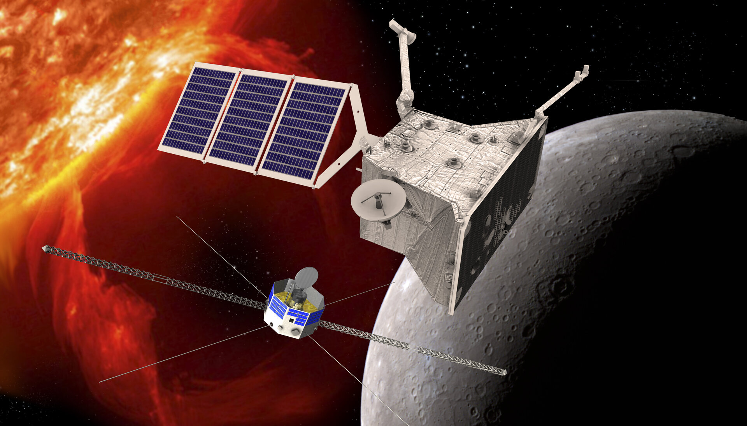
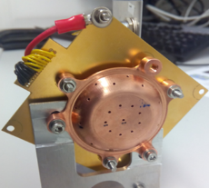
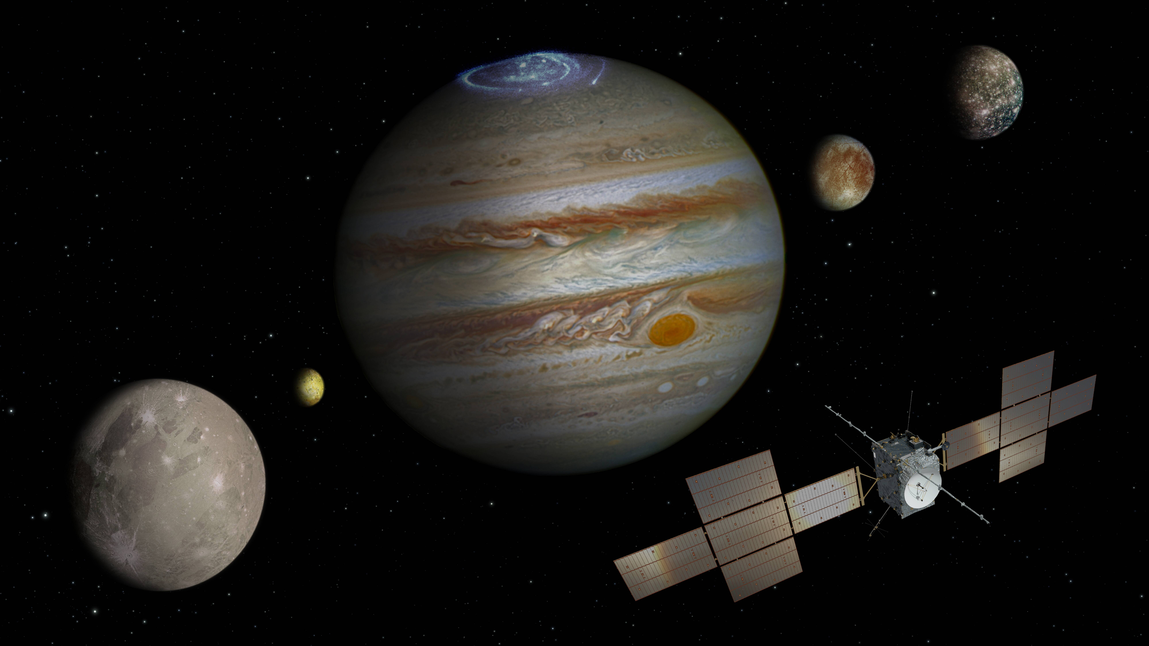
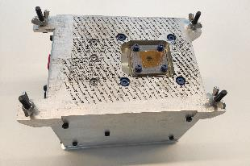
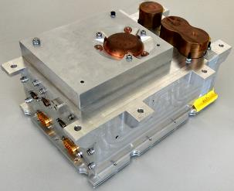
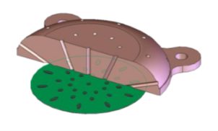
BERM (BepiColombo Environment Radiation Monitor) & RADEM (RADiation Hard Electron Monitor) - BARD
Responsibilities:
Provide operational support to BERM and RADEM
Maintain documentation for both & reporting
Development of raw-to-cal pipelines
Archive Science Data
Contribute to the science data exploration
Analyze the Juice Monitoring Unit (JMU) data
BERM
RADEM

Slide 4
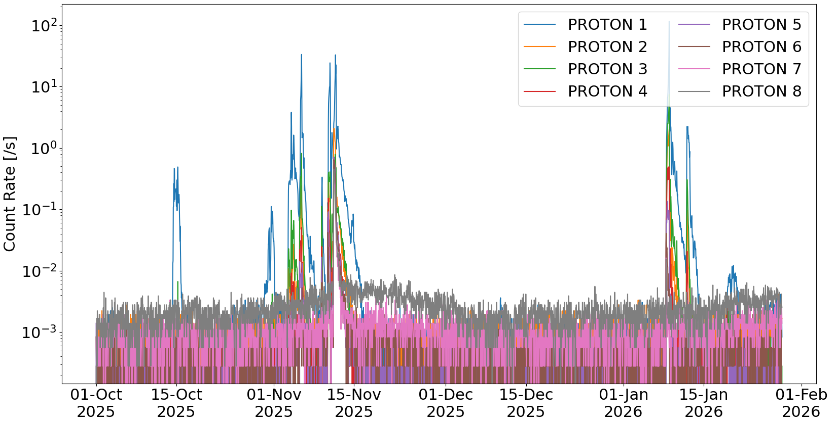
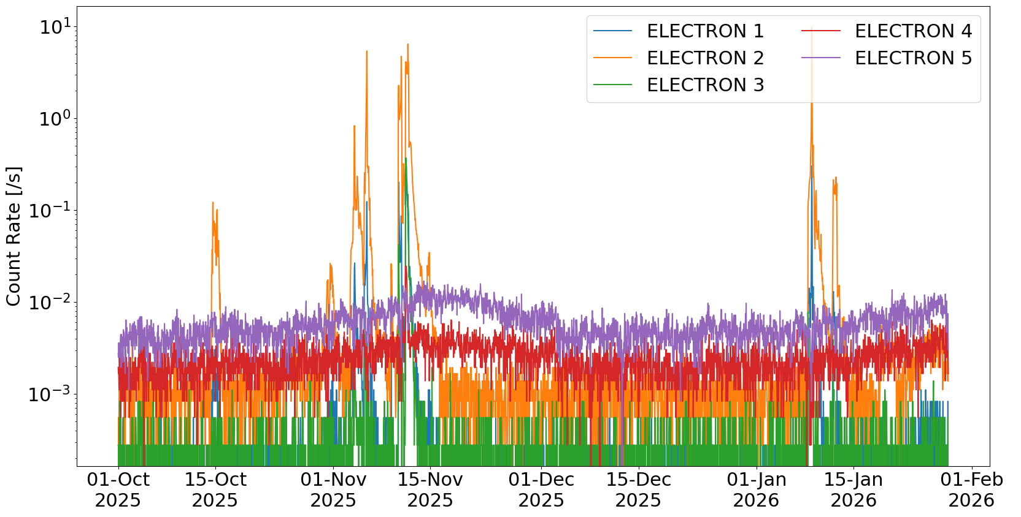
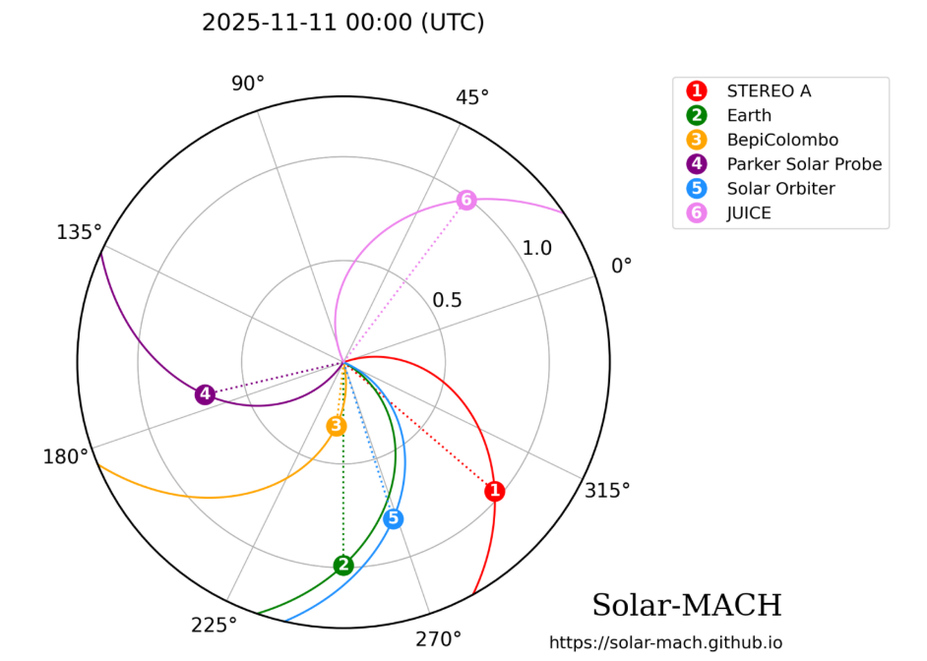
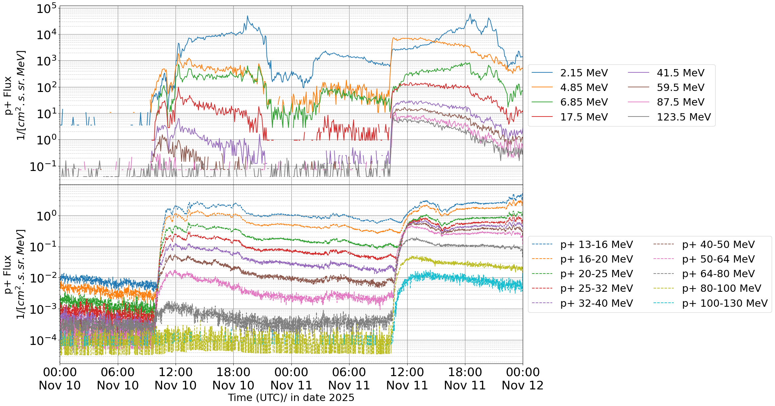
BERM @Bepicolombo
BepiColombo will reach Mercury in November 2026 - MCP
LIP is preparing the BERM MCP with ESA
BERM archive peer-review almost finished: BERM data public first half 2026
Multispacecraft analysis of BERM data: e.g. GLE#77 11th November: BERM + Solar Orbiter + Stereo A
LIP is hosting the BC SWT meeting in Lisbon, 2-6 November 2026

Slide 5
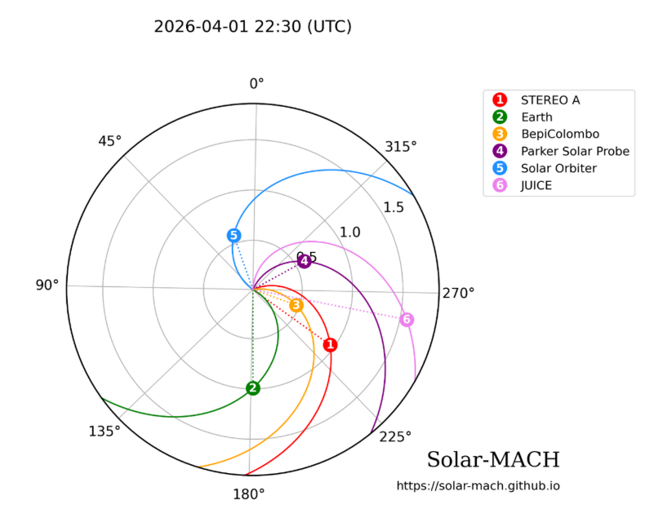
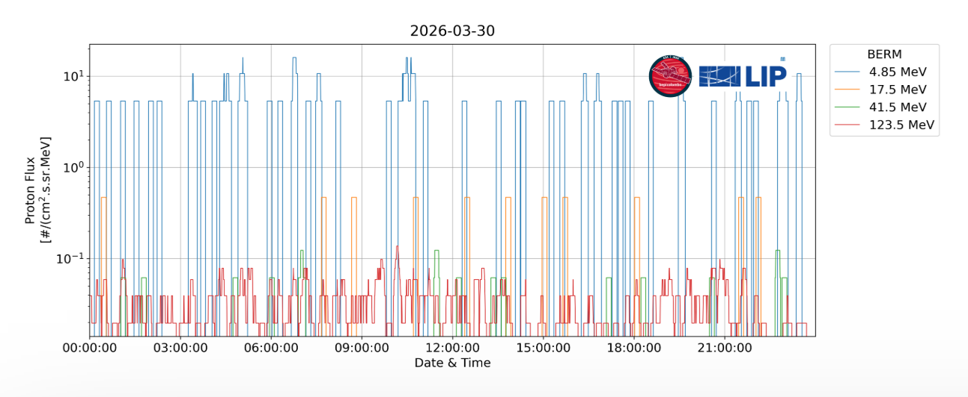
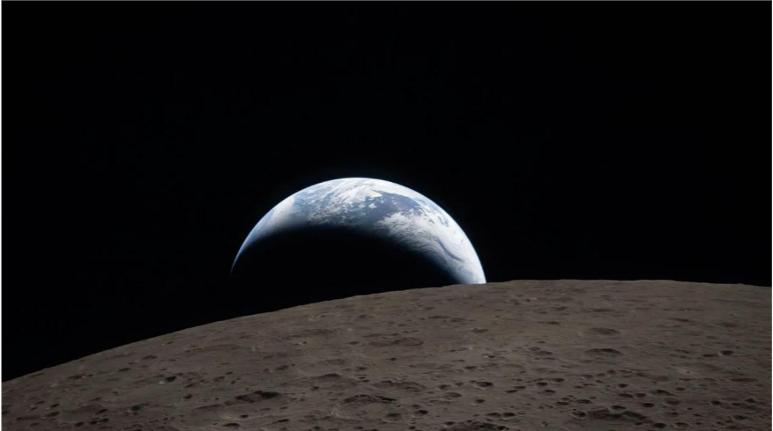
BERM + Artemis II
BepiColombo during Artemis II → privileged position between Earth and the Sun to provide valuable space weather forecasting relevant to crew safety and spacecraft electronics performance.
COSMOS Heliospheric Conditions at BepiColombo - BepiColombo - Cosmos
BERM measurements used to provide ARTEMIS II support, requested by NASA
Earthset observed from Artemis II. Credit: NASA.
For BERM data: "We acknowledge the use of data from the BERM instrument provided by the Laboratory for Instrumentation and Experimental Particle Physics, funded by ESA and FCT, onboard the ESA/JAXA BepiColombo mission."

Slide 6
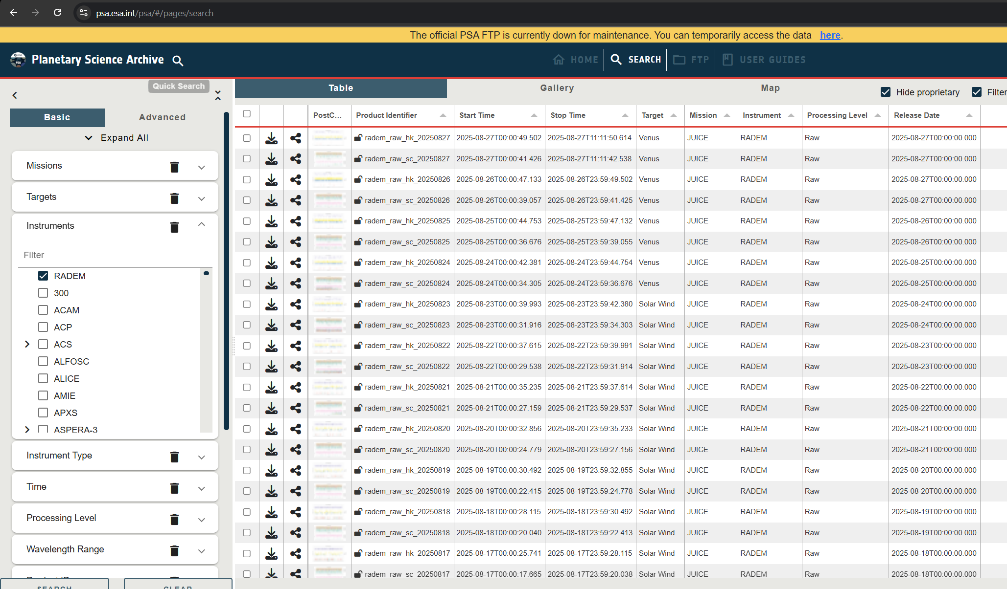
RADEM @JUICE
First archive peer-review process finished July 2025 - RADEM RAW data is public!
RADEM is the 1st JUICE instrument with public data!

Slide 7
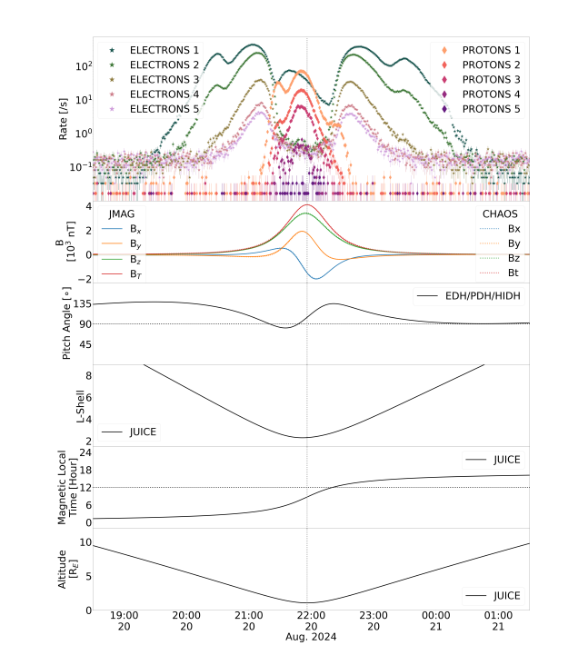
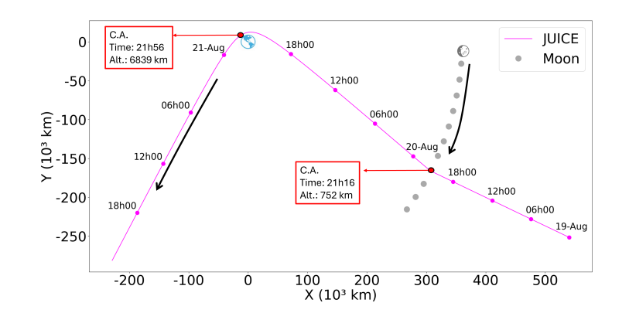
RADEM @JUICE
LEGA flyby August 2024 RADEM analysis
RADEM can measure energetic electrons, successfully!
Pinto, M., Rodrigues, A., Roussos, E., Schmid, D., Volwerk, M., Kotsiaros, S., Brown, P., Dougherty, M., Arruda, L., and Witasse, O.: RADEM observations of the Van Allen belts during the JUICE Lunar-Earth Gravity Assist, EGUsphere [preprint], https://doi.org/10.5194/egusphere-2026-2055, 2026. (submitted, under discussion)

Slide 8
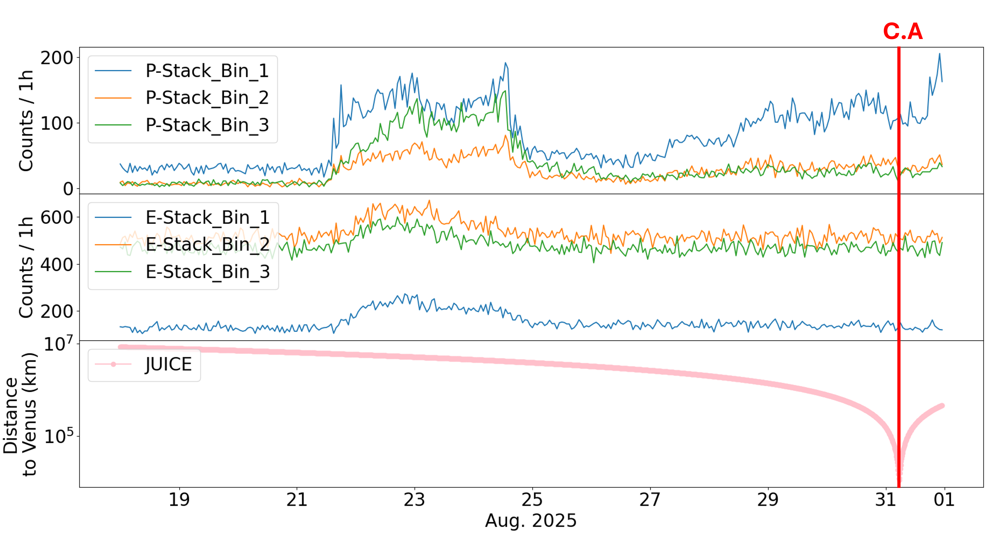
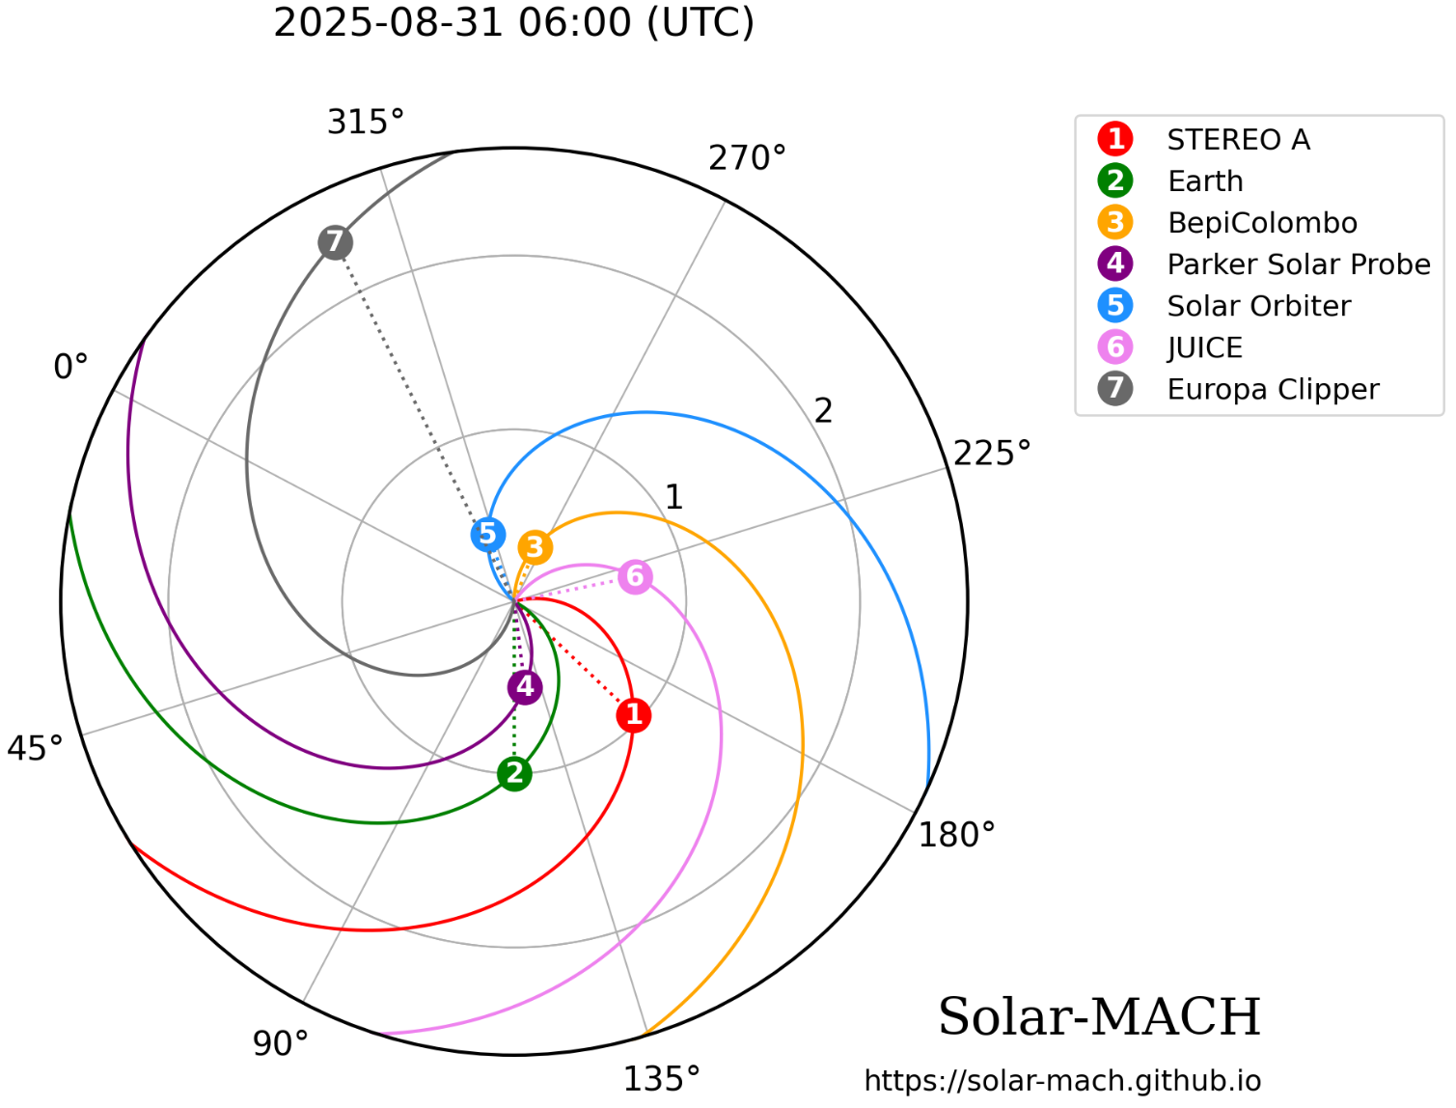
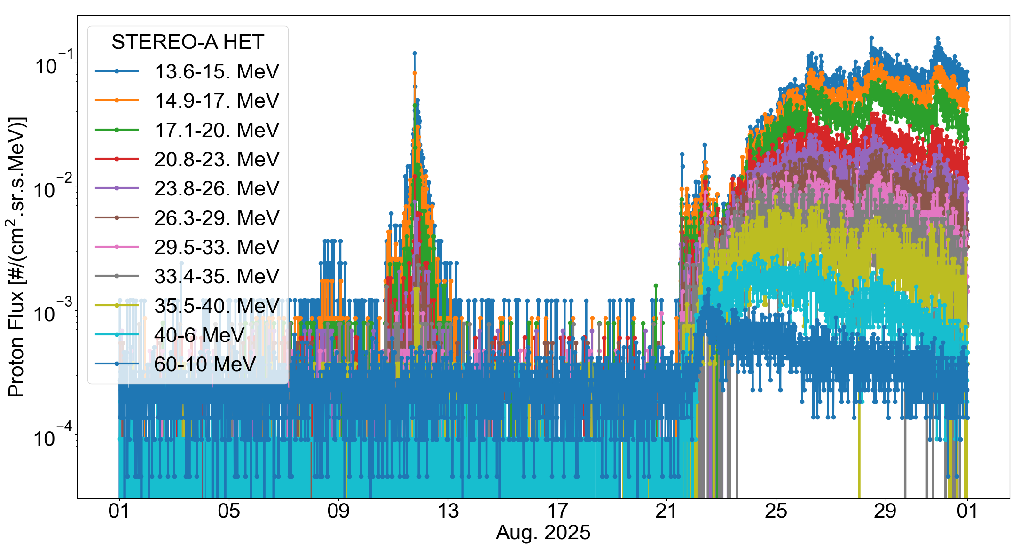
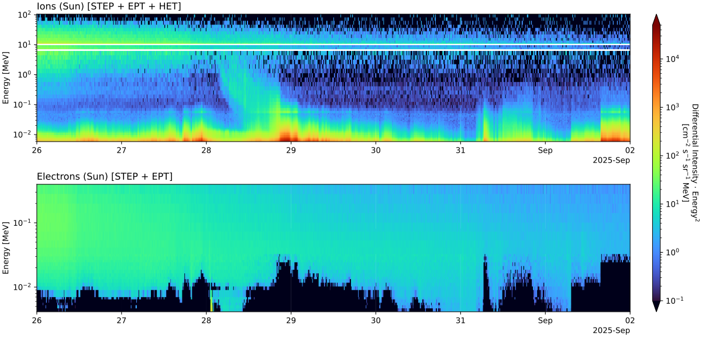
RADEM @JUICE
Venus flyby completed with success August 2025

Slide 9
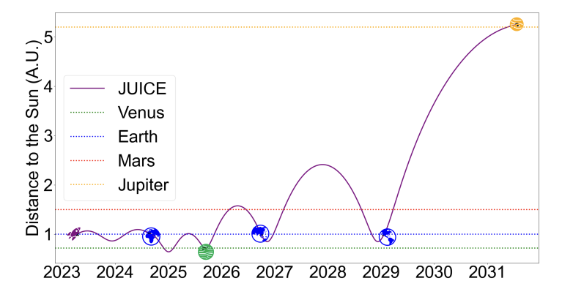
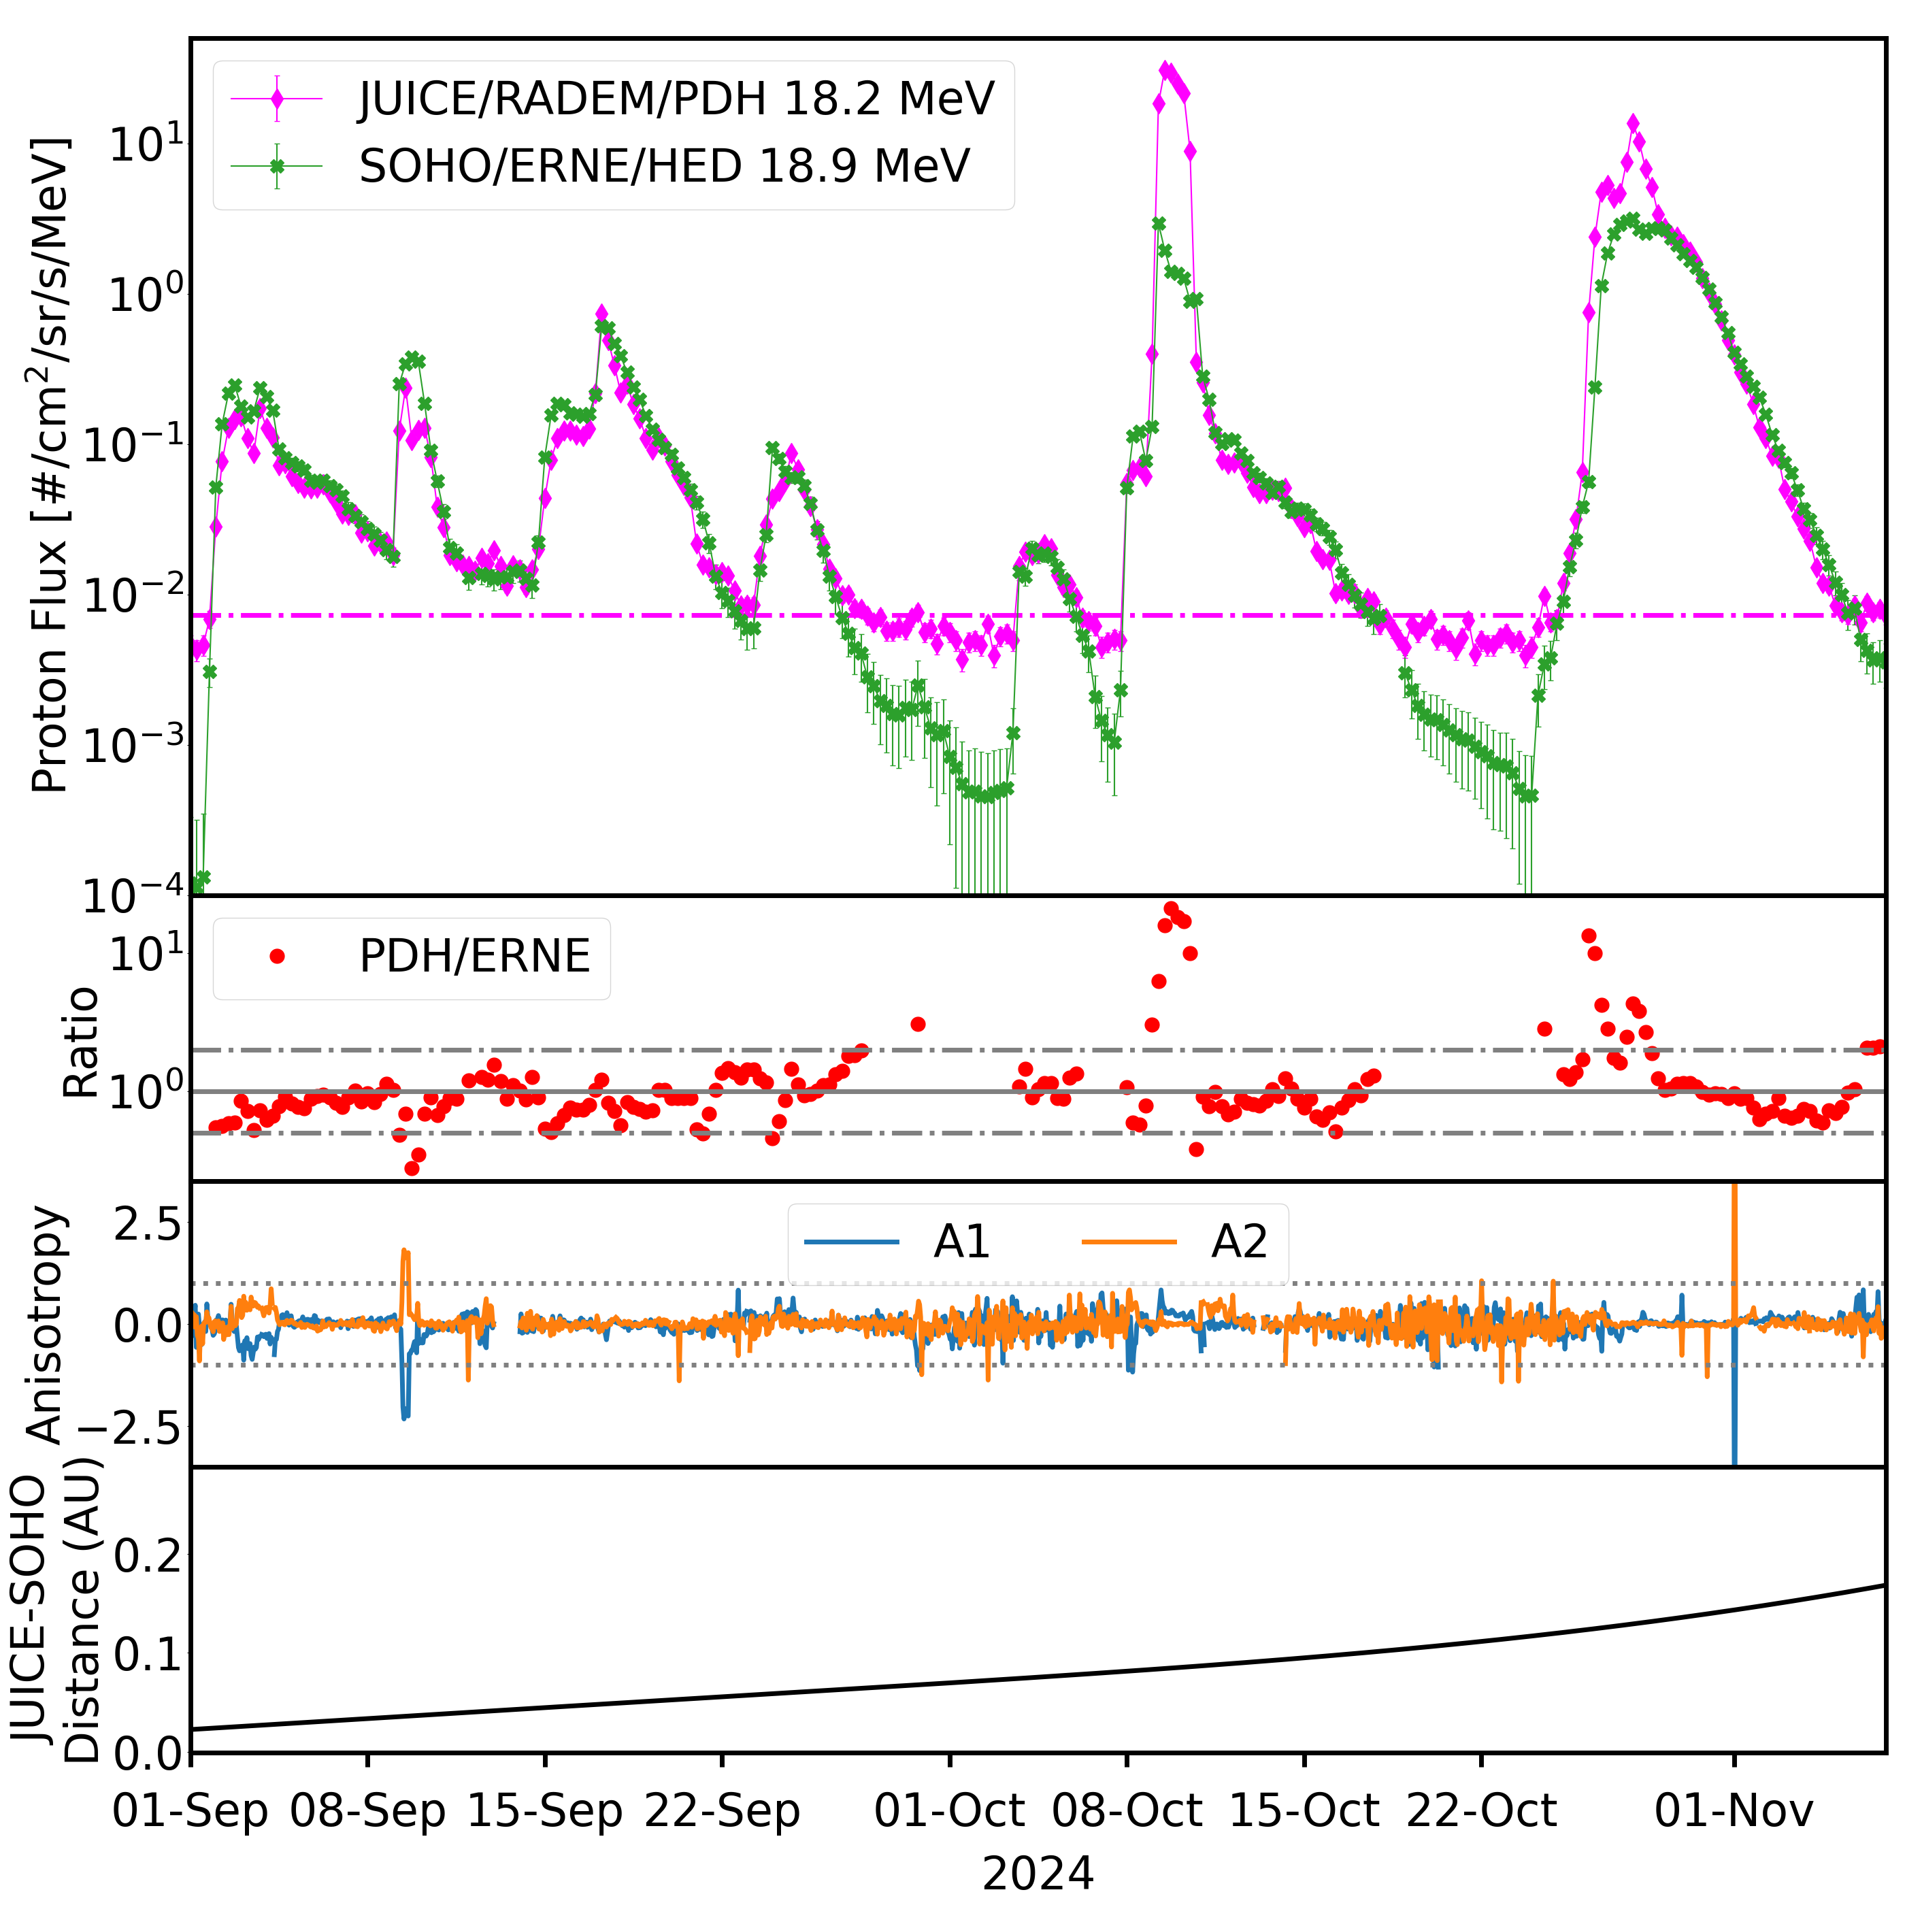
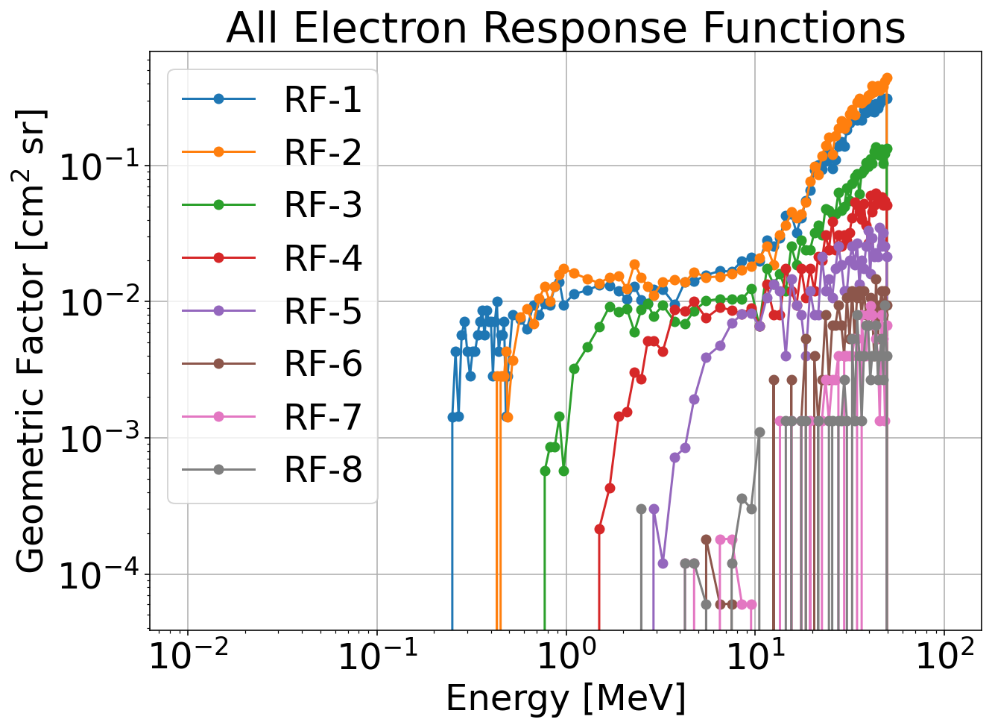
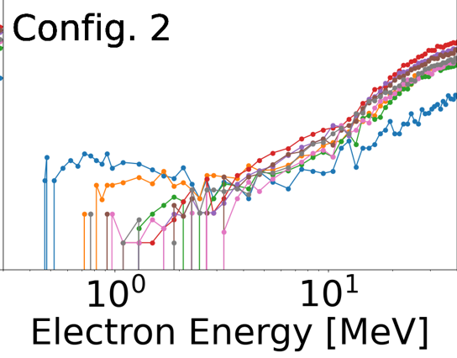
RADEM @JUICE
Proton channels well calibrated
Preparing for next EGA flyby September 2026
Working on a new configuration (3) for electron detection
RADEM
Protons
Electrons
Notes:
We also expect to reduce contamination of the electron channels by high-energy protons by adding coincidences between EDH sensors to the coincidence logic.

Slide 10
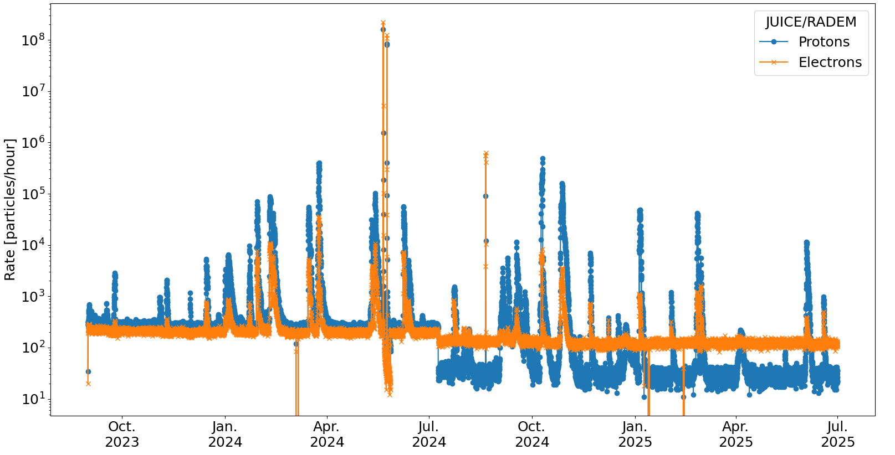
RADEM @JUICE
More than 30 SEP events registered
Interesting SEP events measured in 2025 are being analysed in collaboration with experts from other missions (e.g. Stereo-A, Parker Solar Probe, Solar Orbiter, Maven etc).

Slide 11
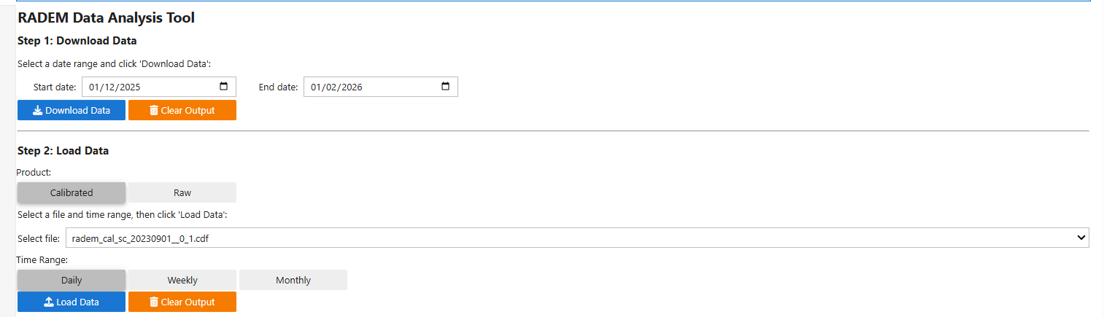
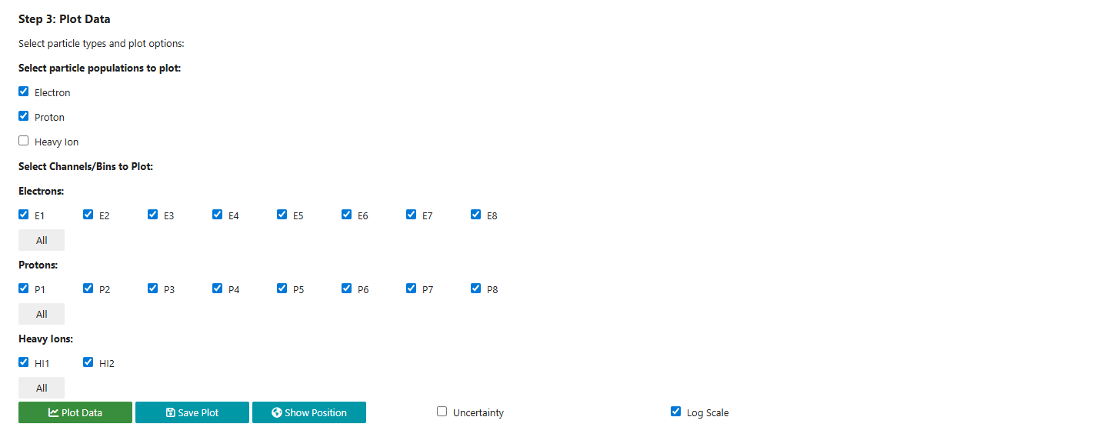
RADEM @JUICE
NN successfully applied to reconstruct RADEM fluxes
QLA tool developed @LIP

Slide 12
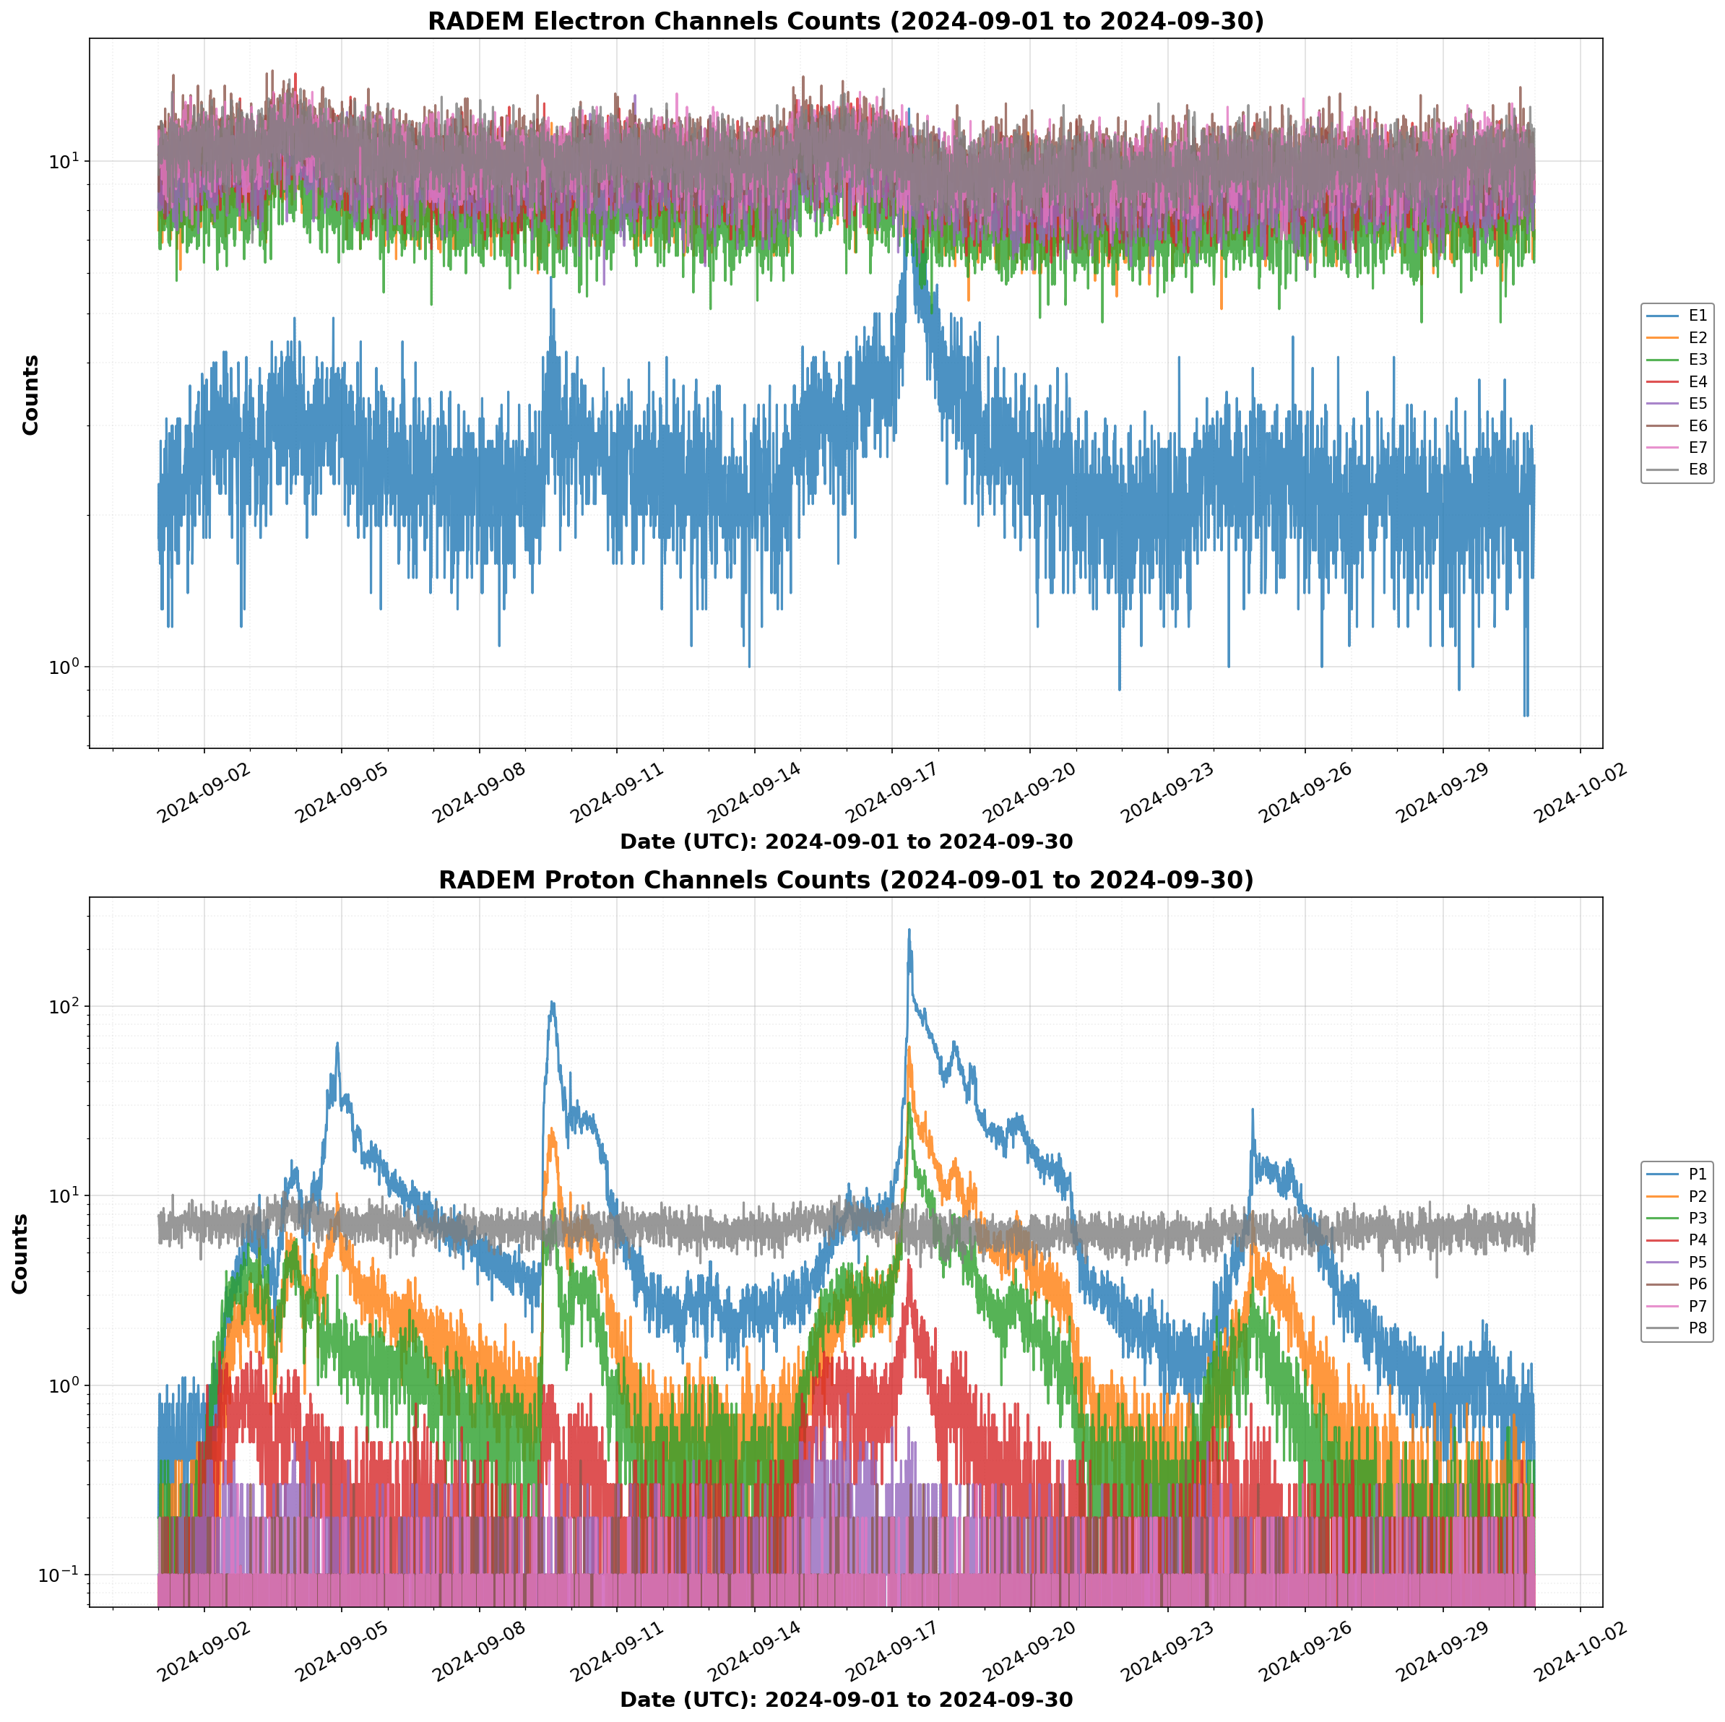
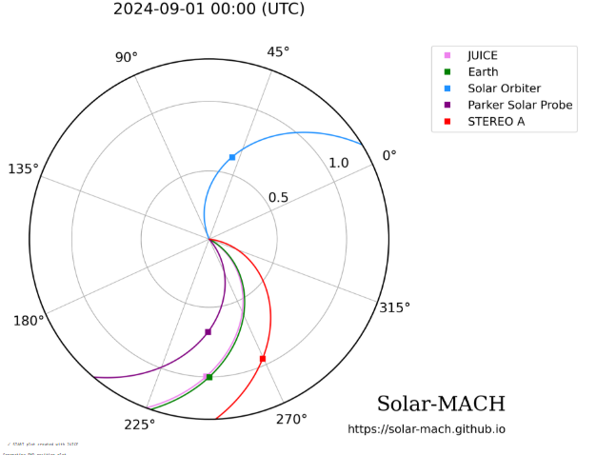
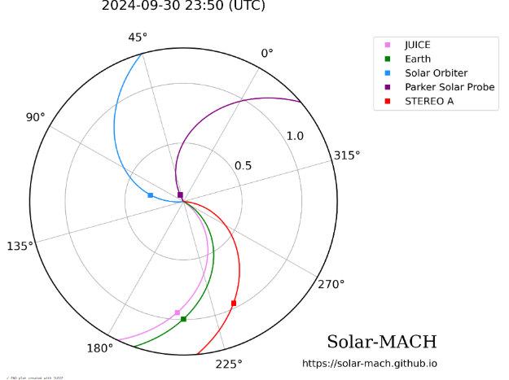

Slide 13
Recent publications
Published
Takashi Minoshima, Yoshizumi Miyoshi, Go Murakami, Marco Pinto, Daniel Schmid, Ayako Matsuoka, Wolfgang Baumjohann, David Fischer, Kazumasa Iwai and Shinsuke Imada; “A study of solar energetic particle transport on 30 March 2022 using multi-spacecraft data assimilation”, Earth, Planets and Space, Earth Planets Space 78, 64 (2026). https://doi.org/10.1186/s40623-026-02389-9
Gaku Kinoshita; Beatriz Sanchez-Cano; Yoshizumi Miyoshi; Laura Rodríguez-García; Emilia Kilpua; Benoit Lavraud; Mathias Rojo; Marco Pinto; Yuki Harada; Go Murakami et al., Spatiotemporal Evolution of the 2022 March Interplanetary Coronal Mass Ejection Revealed by Multipoint Observations of Forbush Decreases, the Astrophysical Journal, 2026-01-20, DOI: 10.3847/1538-4357/ae1834
M. Pinto et al., Calibration of the BepiColombo Environmental Radiation Monitor (BERM) and Cross-Calibration with Solar Intensity X-Ray and Particle Spectrometer (SIXS) during Solar Energetic Particle Events, Astronomy & Astrophysics, Volume 701, id.A13, (2025) doi:10.1051/0004-6361/202555301
M. Pinto et al., “In-flight calibration of RADEM, the JUICE mission radiation monitor”, A&A, 708 (2026) A319, DOI: https://doi.org/10.1051/0004-6361/202558601
A. Gomes et al., “Intercalibration between energetic particle instruments BERM on board BepiColombo and EPD aboard Solar Orbiter”, https://doi.org/10.5194/egusphere-egu26-723
In preparation/submitted
A. Gomes et al., “Calibration of the BepiColombo Environmental Radiation Monitor (BERM) and Cross-Calibration with Solar Intensity X-Ray and Particle Spectrometer (SIXS) during Solar Energetic Particle Events” – resubmitted after major review
Pinto, M., Rodrigues, A., Roussos, E., Schmid, D., Volwerk, M., Kotsiaros, S., Brown, P., Dougherty, M., Arruda, L., and Witasse, O.: RADEM observations of the Van Allen belts during the JUICE Lunar-Earth Gravity Assist, EGUsphere [preprint], https://doi.org/10.5194/egusphere-2026-2055, 2026. (submitted, under discussion)
R. Parente et al., “Flux reconstruction with Machine Learning techniques for the ESA JUICE mission radiation monitor, RADEM” – in prep.
M. Mewes et al., “Solar energetic particle events observed by JUICE on its way to Jupiter” – in prep.

Slide 14


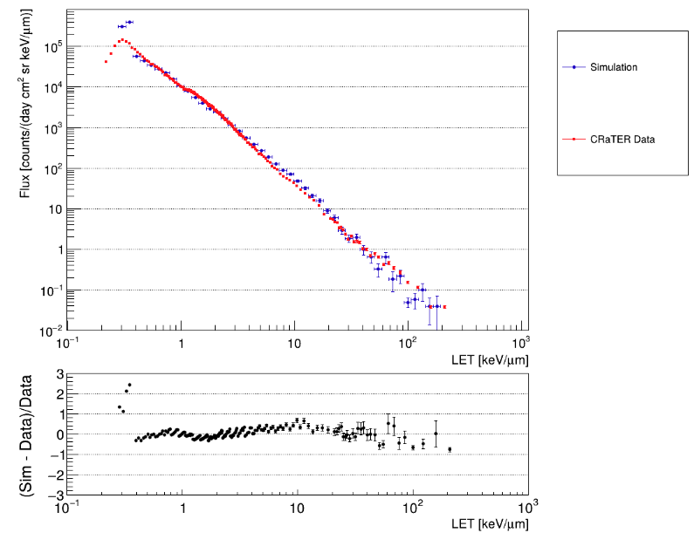
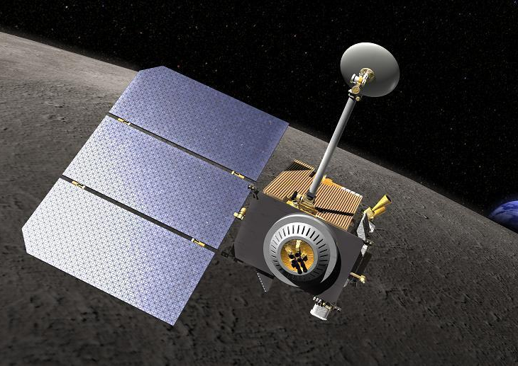
SpaceRad: An integrated framework for the Radiation Environment, on Mars and on Moon and its implications for Human Space Flight
LET Comparison with CRaTER – July 2009
3-years funding
Start: 01.03.2024
SpaceRad is a Geant4 based software that will provide critical knowledge of radiation exposure:
Moon
Mars (using dMEREM developed @LIP for ESA)
Interplanetary Space 1 -1.5 A.U.
“Artist's concept of LRO at the Moon.”
(Credit: NASA)
B. Lima PhD Thesis (on going)
LUNAIRE - LUnar Ionising Radiation Environment model developed in Geant4
Validated using GCR data from CRaTER (LRO)
B. Lima MSc Thesis
“Artist's concept LRO @ Moon.”
(Credit: NASA)
+ Lead the analysis of space weather at Mars through an International Team headed by M. Pinto, funded by the International Space Science Institute, Bern

Slide 15





Particle Radiation Instrument and Spectrometer for Europe (M-PRISE)
Objectives:
Design a new instrument (slightly larger mass, power, volume, data)
Measure SEPs and GCRs
Near-Earth and IP
Modular design
Details:
Led by ASRO (Finland)
LIP contribution: design the silicon detector and high-level signal processing
KO: January 2026
Duration: 18 months
Notes:
The idea is to develop a new modular instrument concept with slightly larger budgets (mass, power, volume, data) than traditional radiation monitors for characterizing the relevant external trapped protons and electrons, as well as SEP and Galactic Cosmic Radiation (GCR) environments, for a variety of near-Earth and interplanetary orbits.

Slide 16
Strenghts
Expertise in Geant4 for Space Applications, data Analysis and detector design
Solid Physics competences, diverse scientific backgrounds, and active participation in international collaborations
More than 20 years of activity with several contracts completed
Weaknesses
Short ESA contracts → overlaps strain staff; gaps disrupt funding & planning
National funding uncertainty → variable rules + limited expert evaluators
Student pipeline issues → timing misalignment; loss to industry
Postdoc retention limits → few academic career paths
Opportunities
Broad funding & collaboration base → EU consortia, missions, and LIP synergies
High-profile ESA missions → strong visibility; BARD renewal ensures continuity & stability
Future data initiatives → ML collaborations to enhance analysis
M. Pinto member of ESA Future Exploration Radiation Facility Definition Team
RADLIP Centre → consolidates radiation expertise + expands consultancy & applied role
Threats
Talent retention challenge → industry offers higher pay & stability; risk to continuity
High funding pressure → constant effort for ESA/EU calls
Limited baseline funding → shift toward services may reduce research innovation

