Slide 1
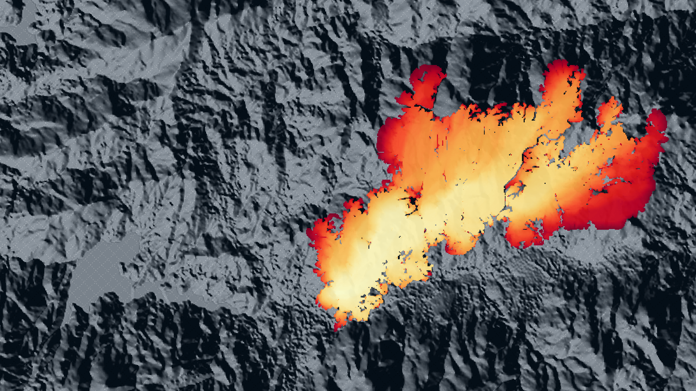

SPIGAL
IBERGRID 2026 · Santiago de Compostela
Simulador de Propagación de Incendios de Galicia
Coupled fire–atmosphere forecasting with WRF-Fire
Pablo Enrique Carracedo García · Carlos Otero Casal
Silvia Souto Pérez
MeteoGalicia · Consellería de Medio Ambiente e Cambio Climático · Xunta de Galicia
Simulated fire arrival time, Randín (Ourense), 24–25 Sep 2026

Slide 2
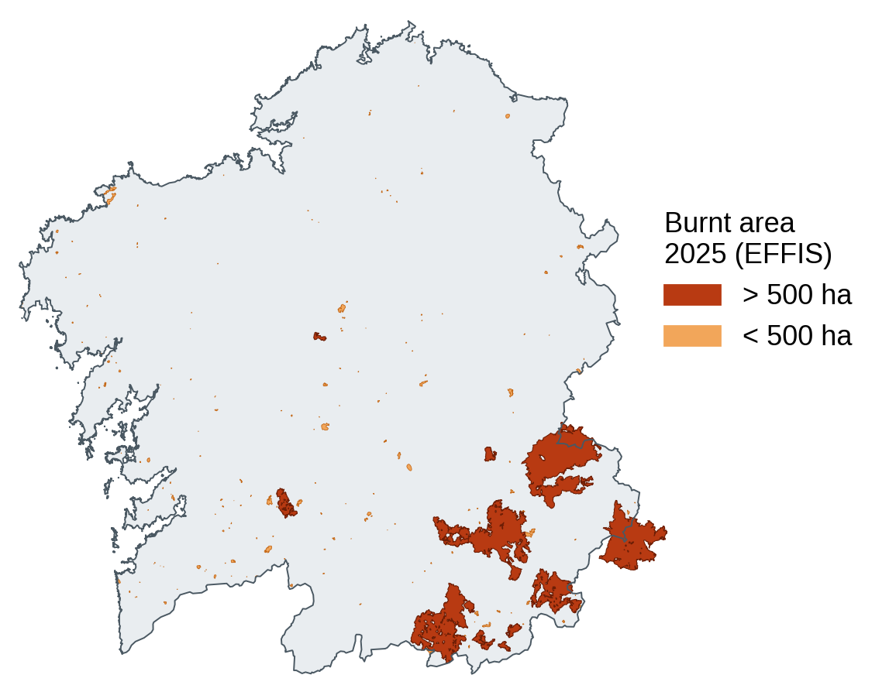
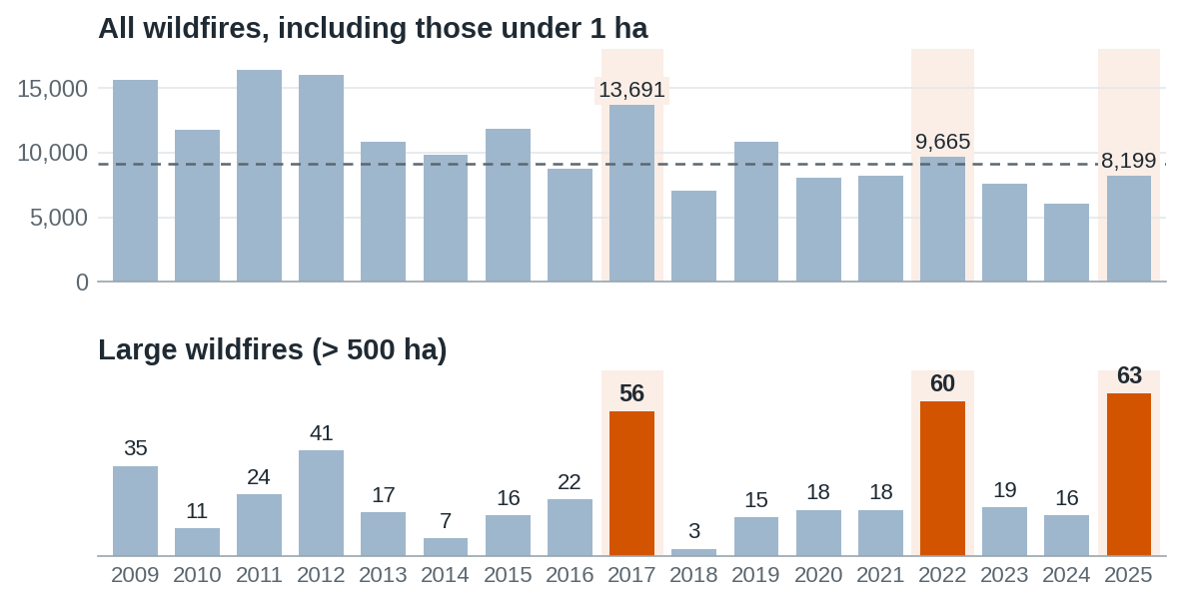
Large wildfires: more than 500 ha
MOTIVATION · THE MODEL · INPUT DATA · SOFTWARE AND INFRASTRUCTURE · REAL FIRES · WRAP-UP
Spain, 2009–2025: fewer fires, but larger ones
63
large wildfires in 2025
87 %
of the area burned in 2025, in just 0.8 % of the fires
18
in Galicia, three above 20,000 ha
Chart: MITECO, Estadística General de Incendios Forestales (EGIF), annual reports 2019–2025; 2025 provisional · Map: EFFIS burnt areas in Galicia, 2025.

Slide 3
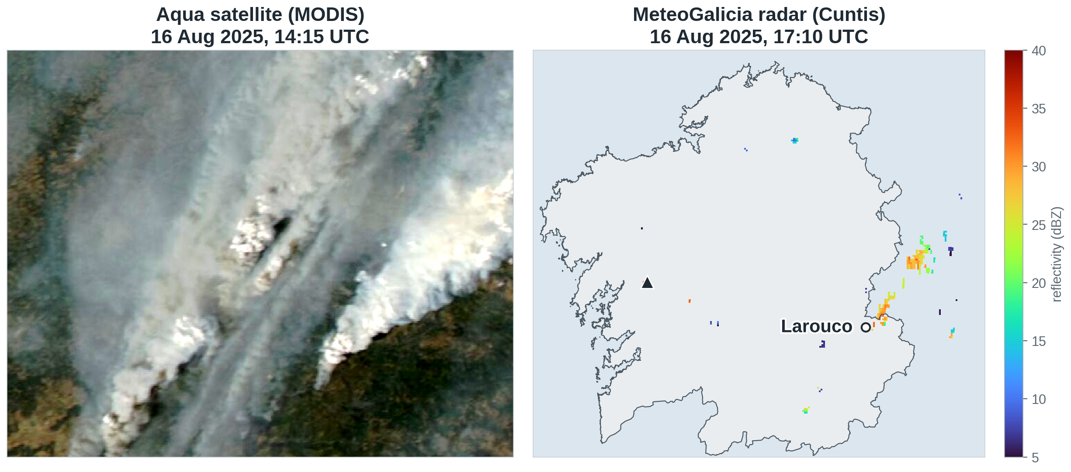
Fires that create their own dynamics
MOTIVATION · THE MODEL · INPUT DATA · SOFTWARE AND INFRASTRUCTURE · REAL FIRES · WRAP-UP
Larouco, 16 August 2025: the fire built its own cloud, up to 12 km high
Satellite: NASA Worldview (MODIS/Aqua) · Radar: MeteoGalicia (THREDDS)

Slide 4
What is WRF-Fire?
MOTIVATION · THE MODEL · INPUT DATA · SOFTWARE AND INFRASTRUCTURE · REAL FIRES · WRAP-UP
The weather and the fire, simulated together
1
2
3
4
ATMOSPHERE
SPREAD
FUEL
COUPLING
WRF
Rothermel (1972)
Scott & Burgan (2005)
Two-way
wind, temperature and humidity
fuel, moisture, slope and wind
40 standard fuel models
the fire's heat changes the wind
WRF-Fire / WRF-SFIRE: open-source OpenWFM community (Mandel et al.), built on WRF (NCAR/NOAA) · First application to Galicia: Senande-Rivera (2023), PhD thesis, USC

Slide 5
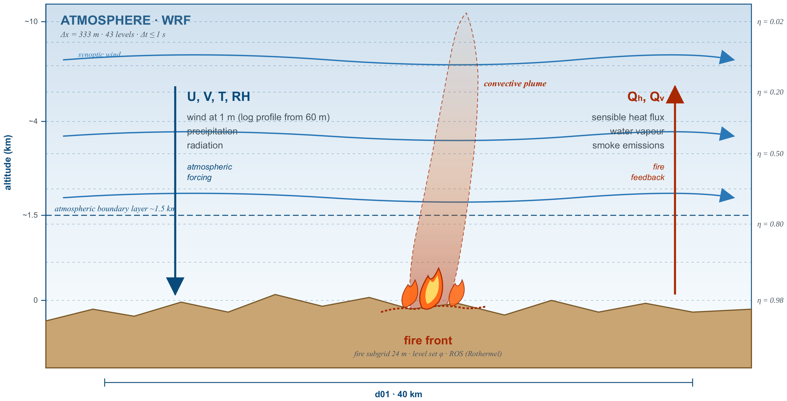
Fire–atmosphere coupling
MOTIVATION · THE MODEL · INPUT DATA · SOFTWARE AND INFRASTRUCTURE · REAL FIRES · WRAP-UP
The atmosphere drives the fire; the fire's heat and moisture change the wind and can build its own cloud

Slide 6
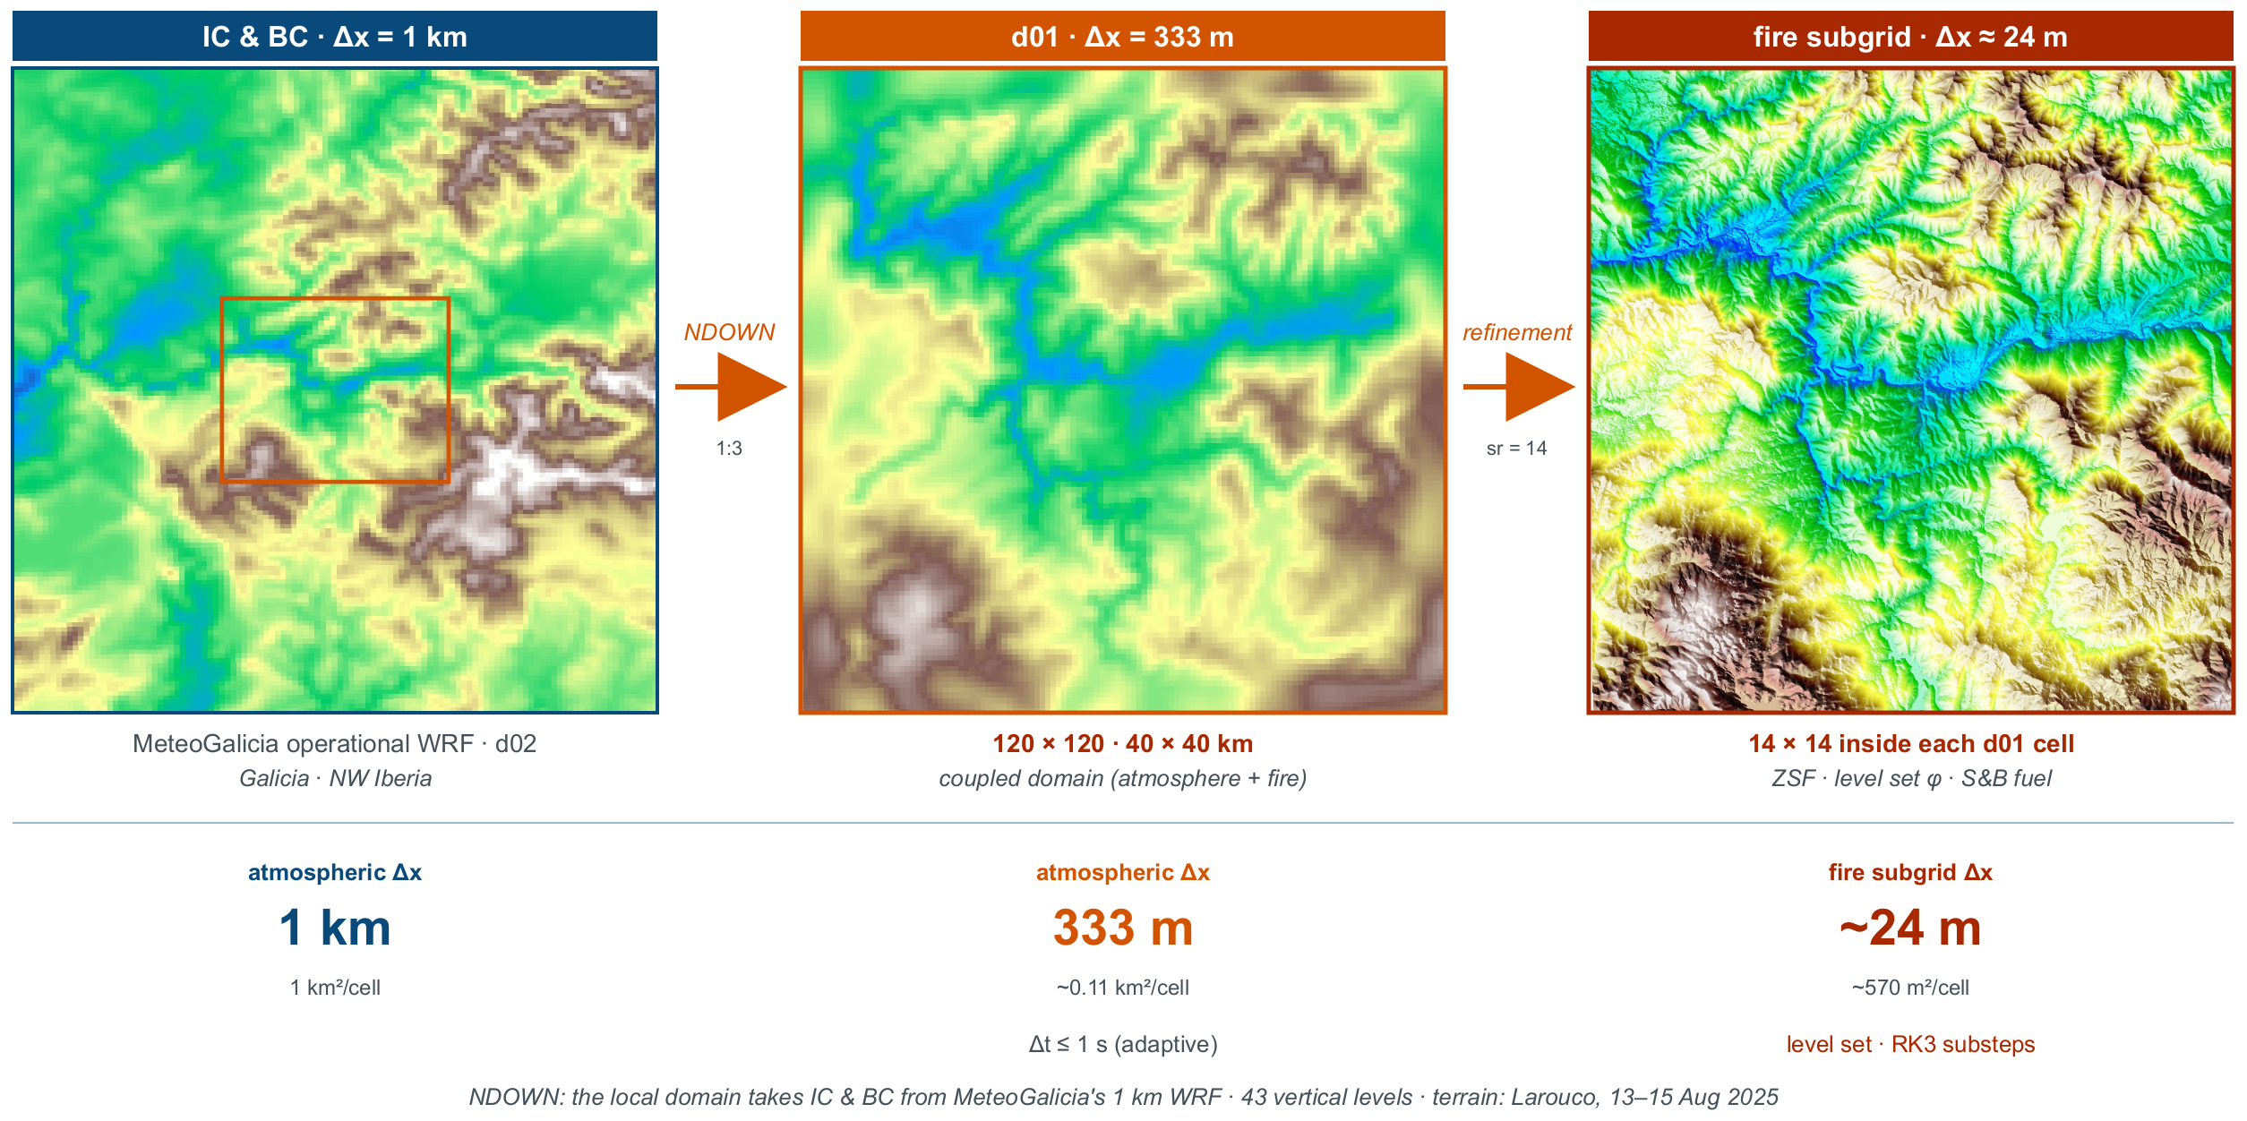
From a 1 km forecast to a 24 m fire grid
MOTIVATION · THE MODEL · INPUT DATA · SOFTWARE AND INFRASTRUCTURE · REAL FIRES · WRAP-UP

Slide 7
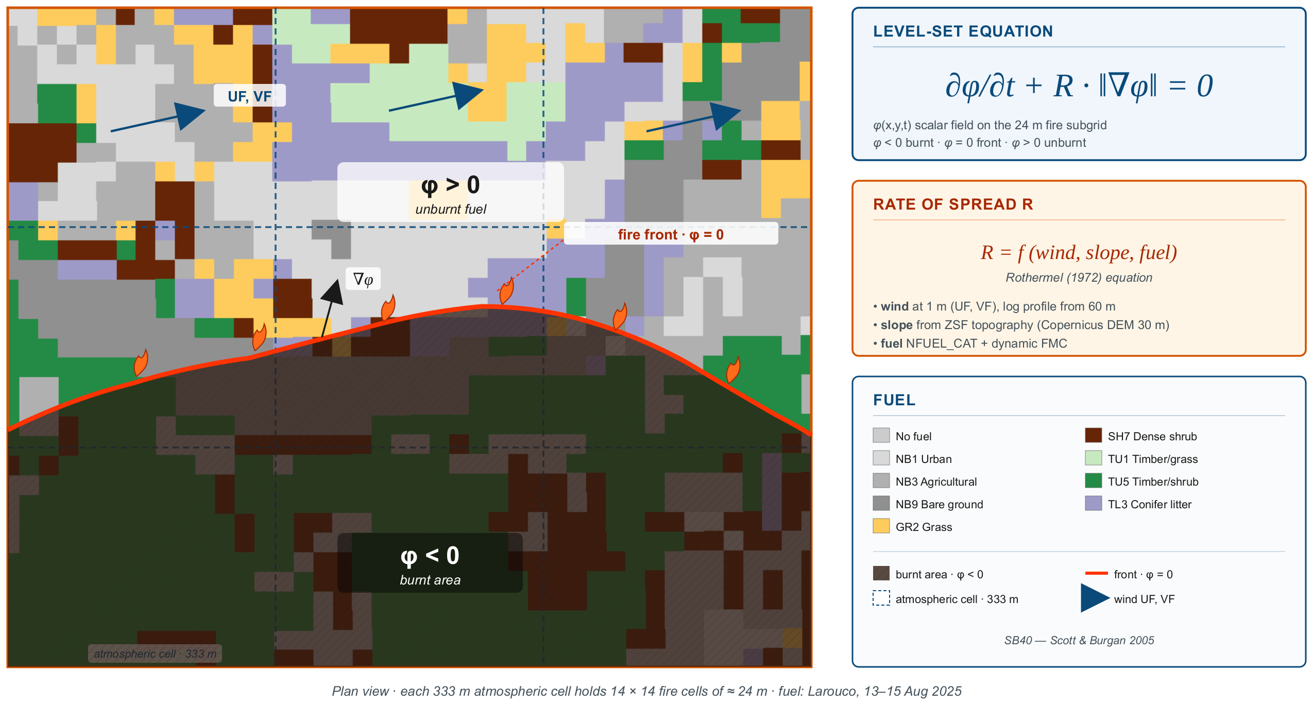
How the fire front advances in the model
MOTIVATION · THE MODEL · INPUT DATA · SOFTWARE AND INFRASTRUCTURE · REAL FIRES · WRAP-UP

Slide 8
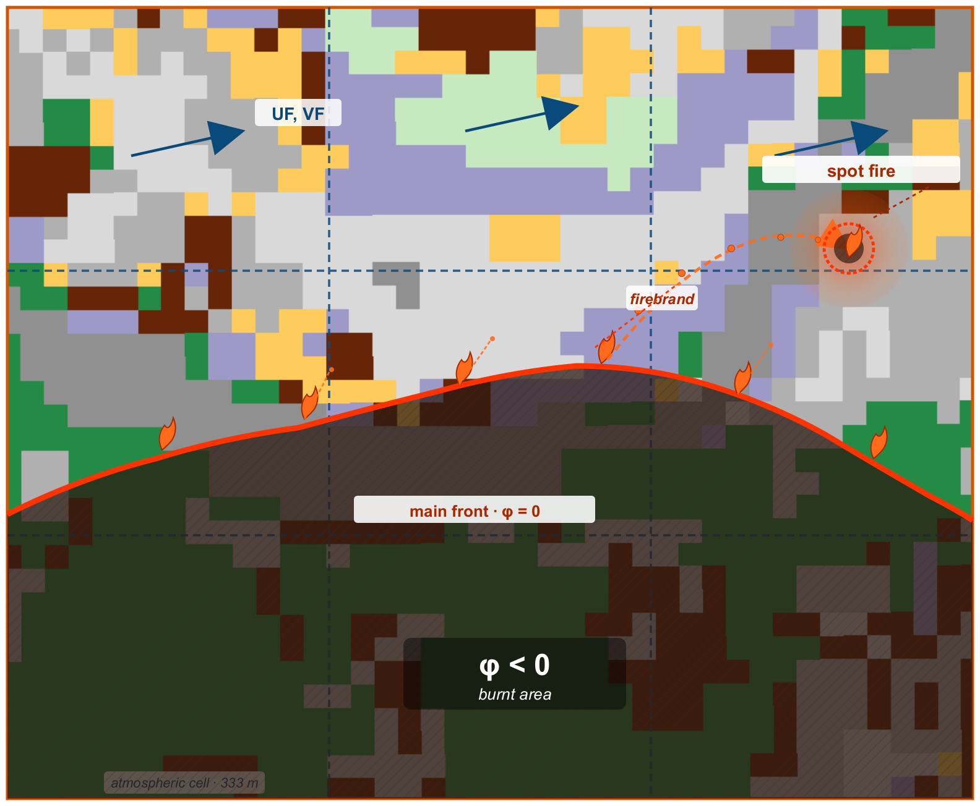
Firebrands: Lagrangian spotting
MOTIVATION · THE MODEL · INPUT DATA · SOFTWARE AND INFRASTRUCTURE · REAL FIRES · WRAP-UP
1
Release
Fast-moving front cells emit firebrands
2
Transport
Carried by the 3D wind resolved by WRF
3
Burnout
They lose mass in flight
4
Spot ignition
Where enough of them land on fuel, a new fire starts
Galicia 2025: spot fires 200–300 m ahead of the front (Pobra de Brollón), up to 2 km (Oimbra)
module_firebrand_spotting (Frediani & Juliano, NCAR) in WRF 4.x

Slide 9
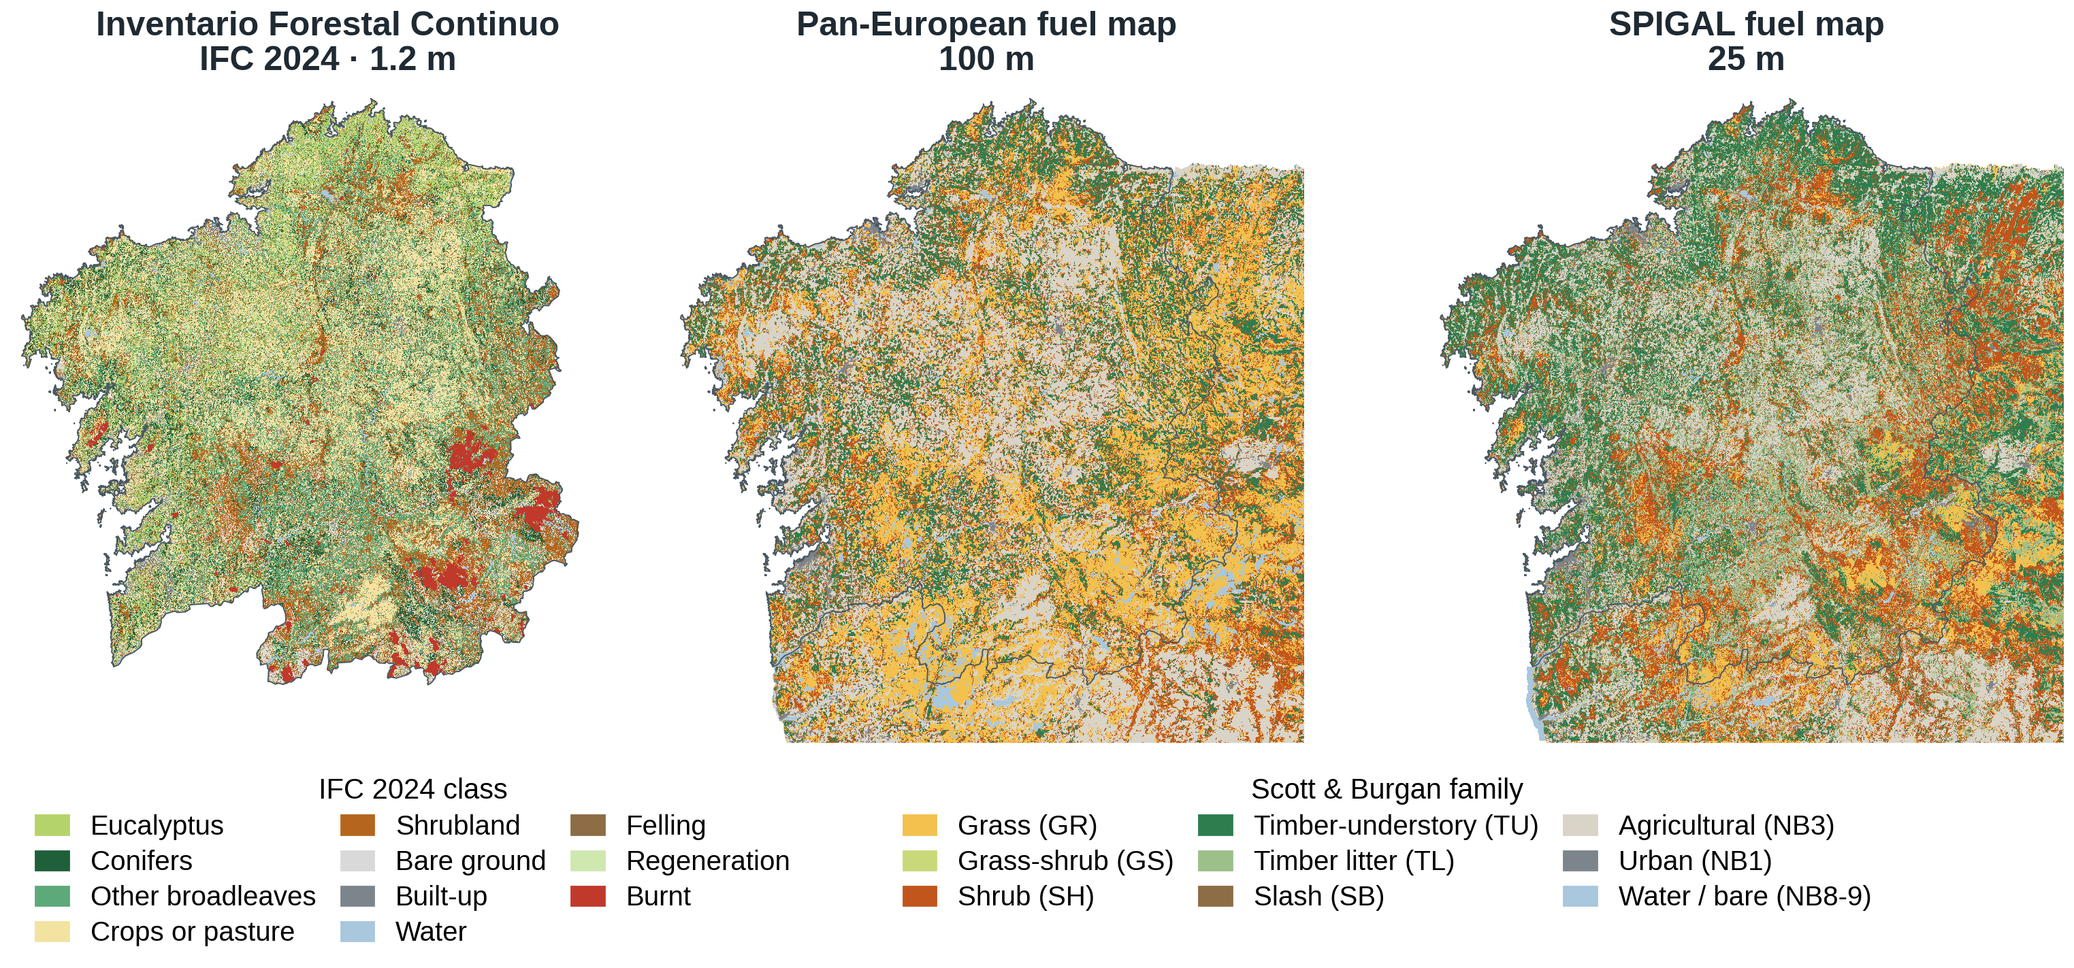
Our own fuel map for Galicia, at 25 m
MOTIVATION · THE MODEL · INPUT DATA · SOFTWARE AND INFRASTRUCTURE · REAL FIRES · WRAP-UP
IFC 1.2 m
Lourizán key
Scott & Burgan
25 m by majority
Pan-European: FirEUrisk/FIRE-RES, 100 m (Aragoneses et al. 2023) · IFC 2024: Xunta de Galicia · Ring: COSc 2023 (DGT, Portugal) and MFE25 (MITECO, Spain)

Slide 10
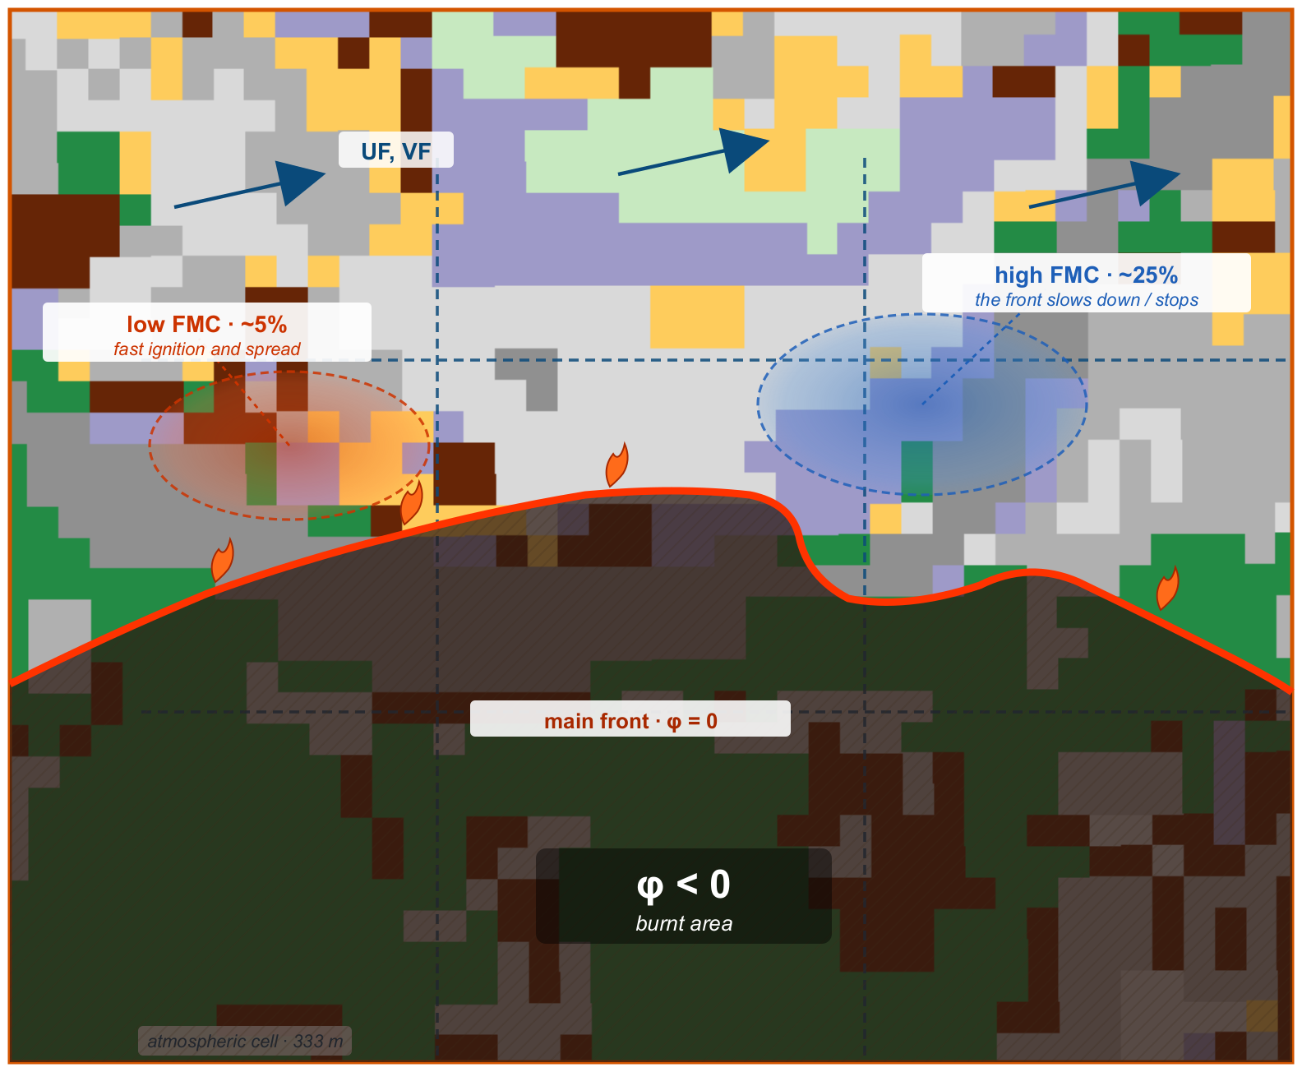
Fuel moisture evolves inside the run
MOTIVATION · THE MODEL · INPUT DATA · SOFTWARE AND INFRASTRUCTURE · REAL FIRES · WRAP-UP
Five classes: dead 1, 10, 100 and 1000 h, plus live
Each drifts towards equilibrium with T and RH at its own pace; rain wets it
Live moisture stays fixed during the run
Share of the initial value still present after a 14 h run
Slow classes remember how they started: initialisation matters

Slide 11
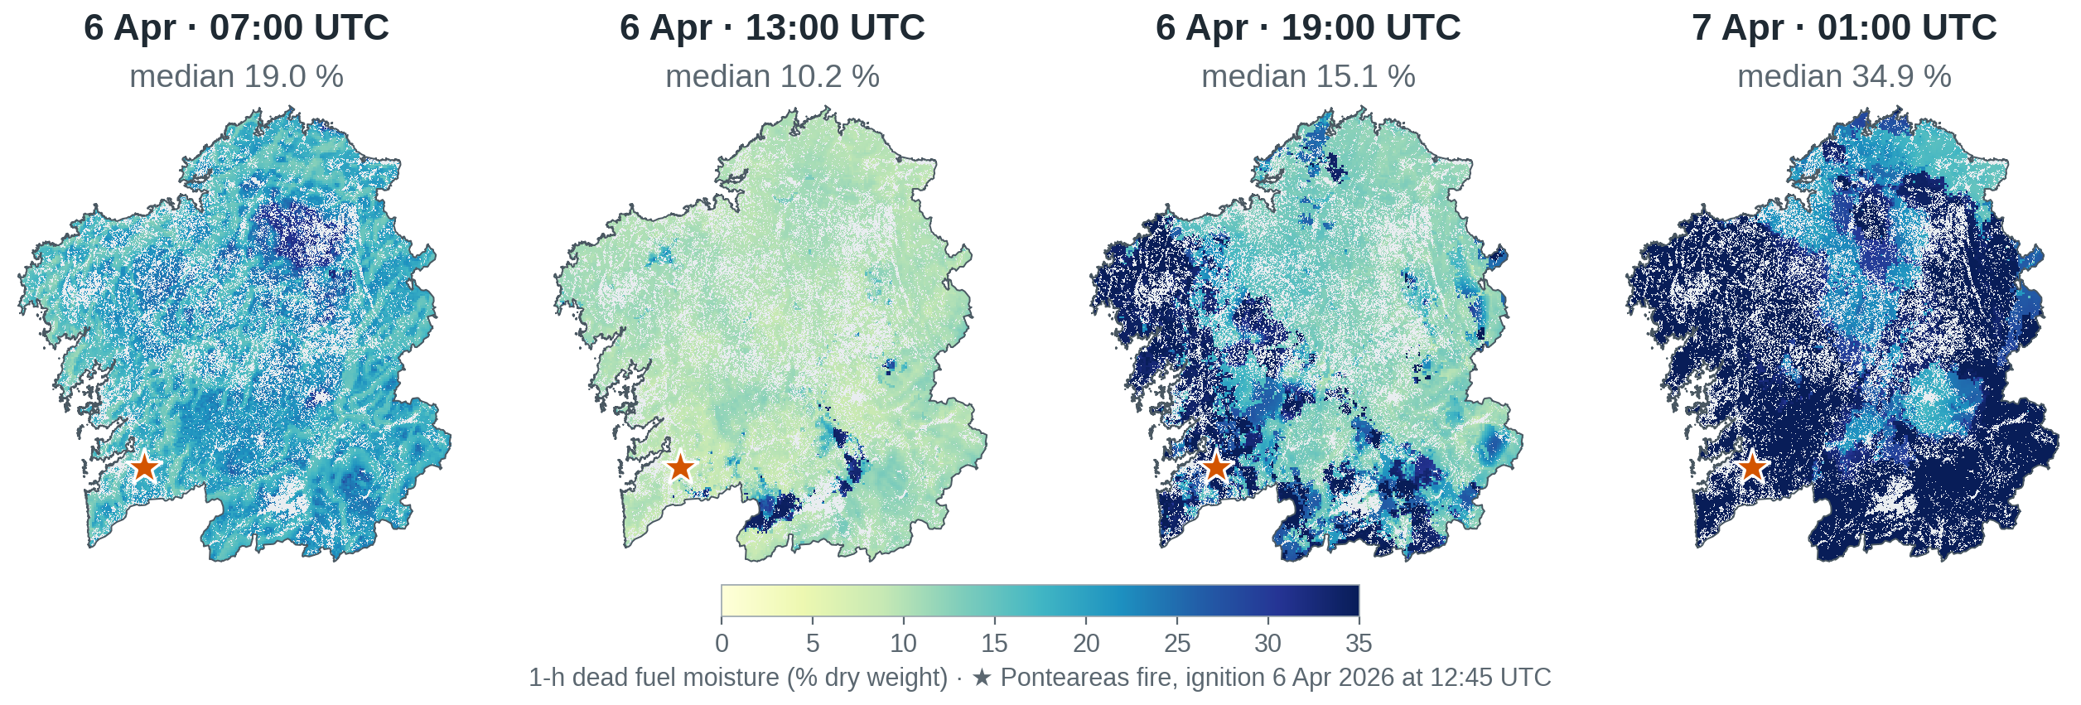
Seeding moisture from NFDRS4-Galicia
MOTIVATION · THE MODEL · INPUT DATA · SOFTWARE AND INFRASTRUCTURE · REAL FIRES · WRAP-UP
Model
NFDRS4, 25 m grid
Forcing
WRF + radar–gauge rain
Use in SPIGAL
Seeds the dead classes
Dead fuel moisture, Galicia median (%) · 28 Mar – 7 Apr 2026 · 4 samples a day (01/07/13/19 UTC)
NFDRS4: Jolly et al. (2024), Environmental Modelling & Software 181, 106181 · open-source code: github.com/firelab/NFDRS4

Slide 12
Ahead of the fire: from supercomputer to cloud
MOTIVATION · THE MODEL · INPUT DATA · SOFTWARE AND INFRASTRUCTURE · REAL FIRES · WRAP-UP
Simulated fire
Laxe, July 2026
27 h
FinisTerrae III
12 nodes × 12 cores · InfiniBand
1 h 26 min 19 times faster than the fire
AWS · One Health DataSpace
1 node × 144 cores
33 min 49 times faster than the fire
The same fire on both machines: same domain, time steps, 144 MPI processes and binary
×2.6
1 binary
Pure MPI
faster on AWS for the same case: newer CPU (Zen 5 vs Ice Lake) and all 144 MPI processes on one node
the same Intel wrf.exe from CESGA, packaged with its libraries (≈ 40 MB), with no rebuild
OpenMP threads make it up to 3.4 times slower: at 144 cores each process holds only about 10 × 10 cells

Slide 13
Maps reach the panel while the model runs
MOTIVATION · THE MODEL · INPUT DATA · SOFTWARE AND INFRASTRUCTURE · REAL FIRES · WRAP-UP
1 · WRF-Fire
2 · NetCDF
3 · Converter → zarr
4 · Panel and 3D viewer
a fire map every 10 simulated minutes: about every 38 s of compute
one file per simulated hour, 6 maps; the last one may still be half-written
same job; every 60 s it appends the complete maps: int16, lat/lon, one chunk per map
read the zarr directly: the browser downloads only the instant it shows
Real Randín run, 7 minutes of wall-clock time: when WRF writes each map and when it appears in the panel
WRF writes
In the panel
min 23
min 24
min 25
min 26
min 27
min 28
min 29
min 30
≈ 1 min
151 maps
54 times smaller
from WRF to the panel, per map: median 71 s, 90 % within 94 s
all in the panel during the run; the last one, 9 s before the job ends
74 GB of NetCDF become 1.4 GB of zarr

Slide 14
Starting the fire and representing suppression
MOTIVATION · THE MODEL · INPUT DATA · SOFTWARE AND INFRASTRUCTURE · REAL FIRES · WRAP-UP
1
Start the fire
2
Represent suppression
Point or line ignition
Or restart from an observed perimeter, taken from XeoCode
Barriers drawn in the panel become no-fuel cells
Rivers and main roads are added automatically
For now, barriers are static
Randín, 24–25 Sep 2026: each new observed perimeter can start a new run
restart run
24 Sep 17:57
266 ha
24 Sep 18:38
315 ha
24 Sep 19:54
410 ha
25 Sep 11:28
492 ha
25 Sep 12:19
523 ha

Slide 15
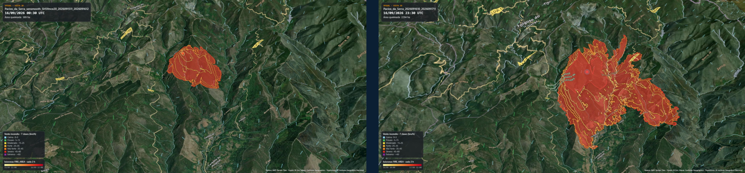
Pacios da Serra: from a point or from a perimeter
MOTIVATION · THE MODEL · INPUT DATA · SOFTWARE AND INFRASTRUCTURE · REAL FIRES · WRAP-UP
From the ignition point · 15 Sep, 11 UTC
From the XeoCode perimeter (378 ha) · 16 Sep, 10 UTC
SPIGAL 3D viewer: isochrones every 2 h, wind at the fire coloured by speed

Slide 16
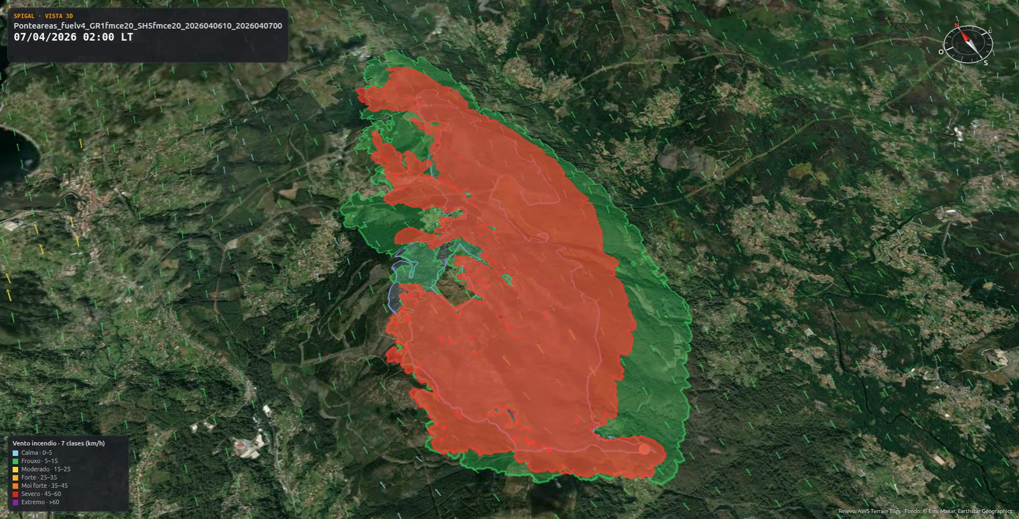
Ponteareas fire, 6 April 2026: with and without the counterfire
MOTIVATION · THE MODEL · INPUT DATA · SOFTWARE AND INFRASTRUCTURE · REAL FIRES · WRAP-UP
With the counterfire
Without the counterfire
Official perimeter (888 ha)
−39 %
burnt area at 00:00 LT (22 UTC): 1,200 vs 1,955 ha
SPIGAL 3D viewer · wind at the fire coloured by speed

Slide 17
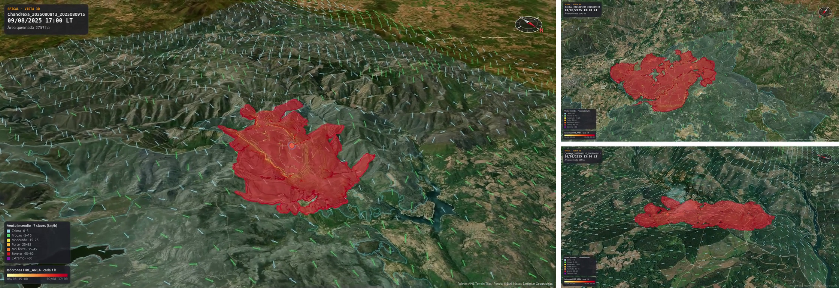
Summer 2025 fires simulated with SPIGAL
MOTIVATION · THE MODEL · INPUT DATA · SOFTWARE AND INFRASTRUCTURE · REAL FIRES · WRAP-UP
Left: Chandrexa de Queixa (8 Aug) · top right: Oimbra (12 Aug) · bottom right: Quiroga (25 Aug)
SPIGAL 3D viewer: the first day of each fire, from the ignition point · blue outline: final burnt perimeter (EFFIS)

Slide 18
Where SPIGAL stands today
MOTIVATION · THE MODEL · INPUT DATA · SOFTWARE AND INFRASTRUCTURE · REAL FIRES · WRAP-UP
INPUTS
MODEL
OUTPUTS
Weather
MeteoGalicia WRF, 1 km
Fuel
our own 25 m map
Fuel moisture
NFDRS4: radar + stations
Static data
terrain: Copernicus, 30 m
Fire
ignition or perimeter (XeoCode)
Suppression
barriers and counterfires
WRF-Fire 4.7.1
atmosphere at 333 m
fire at 24 m
144 MPI processes
FinisTerrae III
a day of fire
in 1–1.5 h
burnt area
heat flux
firebrands
arrival times
rate of spread
vertical profile
CAPE
in the web panel and the 3D viewer, from the start of the run
Status: tuning and implementation, 2026
1
One panel for the whole workflow
2
Learning from past fires
We set up each run, draw barriers and counterfires, launch it and watch the results live.
We re-run real fires from 2025 and 2026 to tune and configure the model: fuel, moisture, firebrands and barriers.

Slide 19
Thank you
COMPUTING, DATA AND REFERENCES
Computing: CESGA, FinisTerrae III · AWS, One Health DataSpace
Model: WRF (NCAR) · WRF-Fire / WRF-SFIRE, OpenWFM (Mandel et al.) · Senande-Rivera (2023)
Fire: Rothermel (1972) · Scott & Burgan (2005) · spotting: Frediani & Juliano (NCAR)
Fuels: INVEGA, Inventario Forestal Continuo de Galicia, IFC 2024 (Xunta de Galicia)
Fuel key: Centro de Investigación Forestal de Lourizán (Vega Hidalgo 2013)
Outside Galicia: FirEUrisk (Aragoneses et al. 2023) · COSc 2023 (DGT) · MFE25 (MITECO)
Moisture: NFDRS4 (Jolly et al. 2024) · MeteoGalicia radar and stations
Terrain and perimeters: Copernicus GLO-30 DEM · XeoCode
Wildfire statistics: MITECO (EGIF) · EFFIS (JRC) · NASA Worldview (MODIS)

