Slide 1
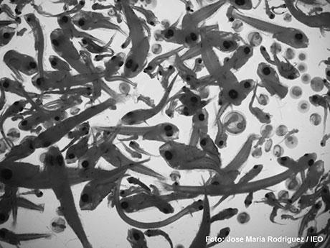




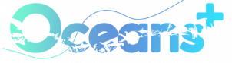

Digital Infrastructures for Marine Research in the Iberian Atlantic: Implementing FAIR Principles, OGC Standards, and Advanced Data Services
Rodríguez-Abal, D.; Sanz-Pinilla, L.; González-Nuevo, G.; Tel, E.; Ruiz-Villarreal, M.
daniel.abal@ieo.csic.es

Slide 2
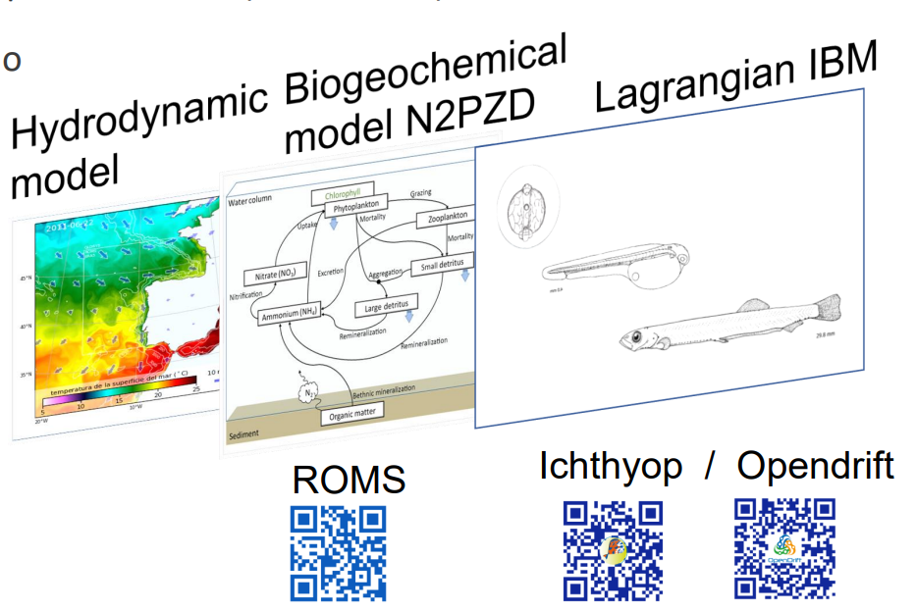
IBMs Early Life Stages
Hydrodynamic model
Biogeochemical model
IBM Lagrangian model
Eggs
Ichthyoplancton

Slide 3
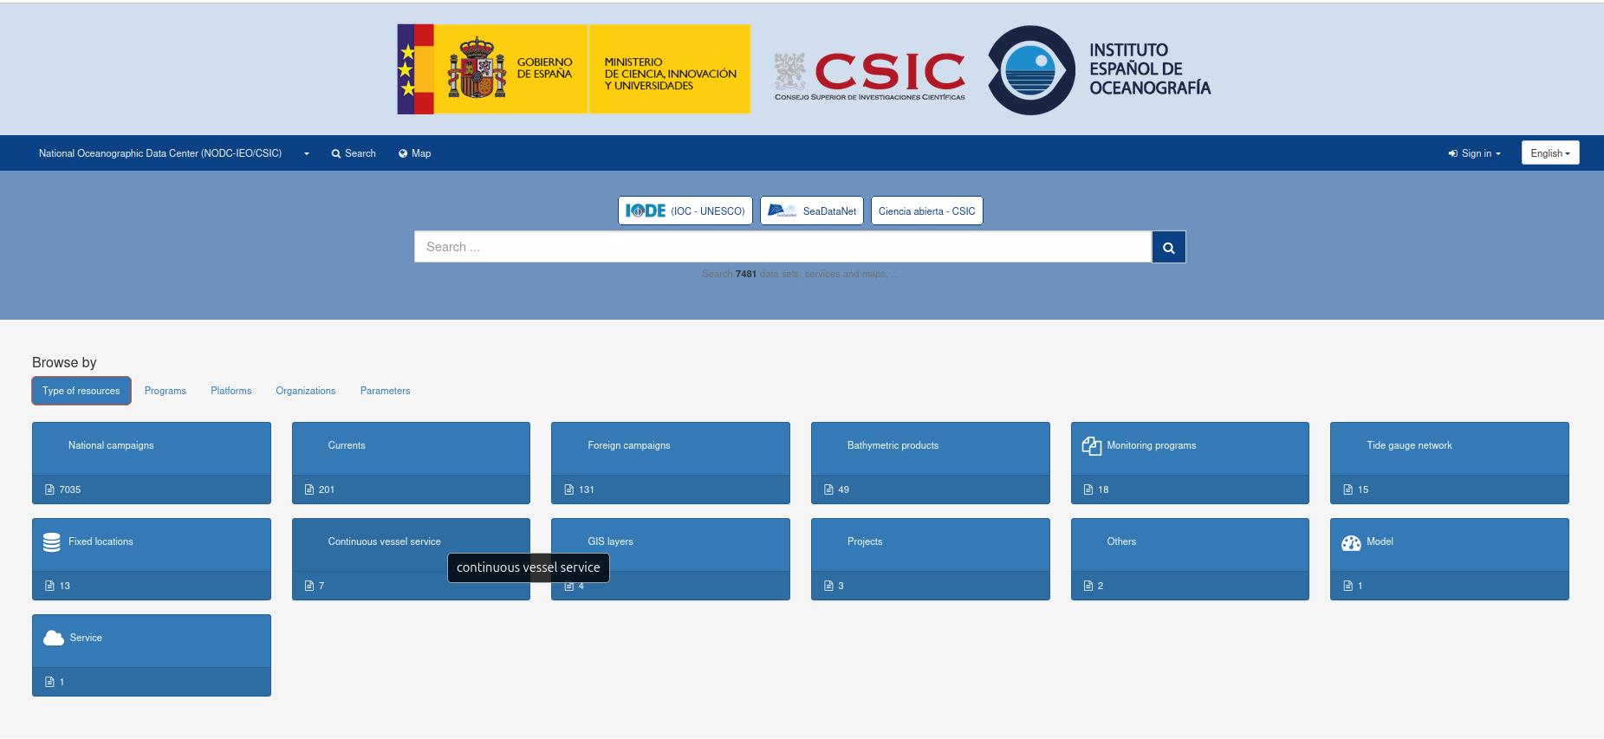

NODC IEO Geoportal
https://nodc.ieo.es/geonetwork
Sanz-Pinilla et al. A geonetwork-based catalogue for marine data management. Earth Sci Inform 19, 14 (2026).

Slide 4
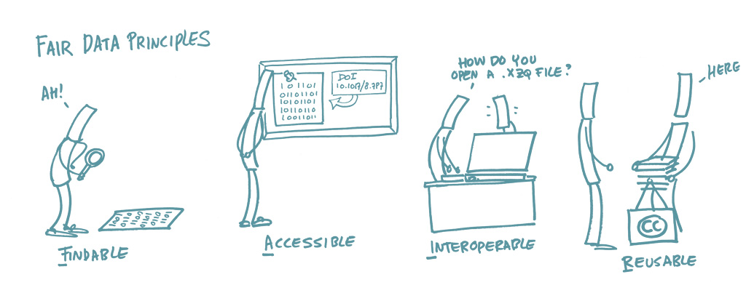
FAIR data
Sonja Bezjak, April Clyburne-Sherin, Philipp Conzett, Pedro Fernandes, Edit Görögh, Kerstin Helbig, Bianca Kramer, Ignasi Labastida, Kyle Niemeyer, Fotis Psomopoulos, Tony Ross-Hellauer, René Schneider, Jon Tennant, Ellen Verbakel, Helene Brinken, & Lambert Heller. (2018). Open Science Training Handbook (1.0). https://book.fosteropenscience.eu/

Slide 5





FAIR data = Standards
Findable
Accesible
Interoperable
Reusable
Catalogue
CWS
Node GIS
WMS WCS WFS
Files
ISO19139 GeoJSON
Semantic
Vocabularies

Slide 6
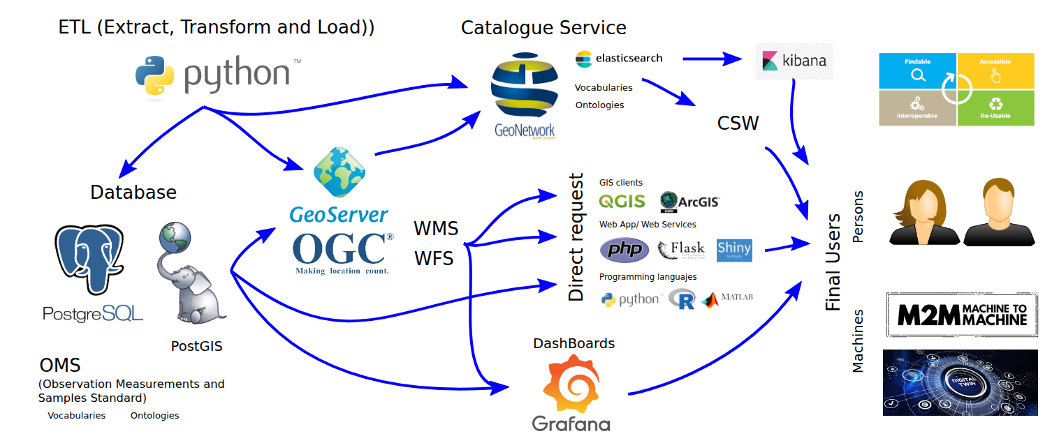
Data Ecosytem
Notes:
The activity of these vessels are oriented to respond to different issues.

Slide 7
Vocabularies and Ontologies
Vocabulary: A list of standard terms used in a specific field.
  https://vocab.nerc.ac.uk/
  https://vocab.seadatanet.org/search
Ontology: A formal definition of the types, properties and relationships between entities that exist within a particular domain.
  https://earthportal.eu/

Slide 8
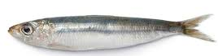
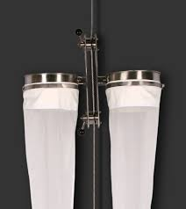
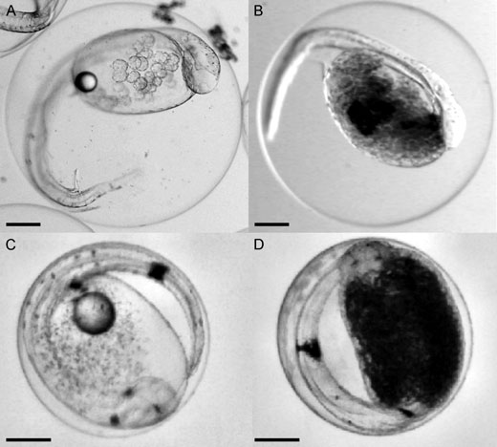
Vocabularies Example
Pelagic fish species (S25): Sardina pilchardus
  http://vocab.nerc.ac.uk/collection/S25/current/BE004978/
Stage of development (S11): Eggs
  https://vocab.nerc.ac.uk/collection/S11/current/S1122/
Parameter (S06): Abundance
  https://vocab.nerc.ac.uk/collection/S06/current/S0600002/
Units (P06): Number per cubic meter.
  https://vocab.nerc.ac.uk/collection/P06/current/UPMM/
Sampling Devices (L22): Calvet
  https://vocab.nerc.ac.uk/collection/L22/current/NETT0009/
Sampling net gear deployment (B07): Vertical tow
  https://vocab.nerc.ac.uk/collection/B07/current/NDT001/

Slide 9
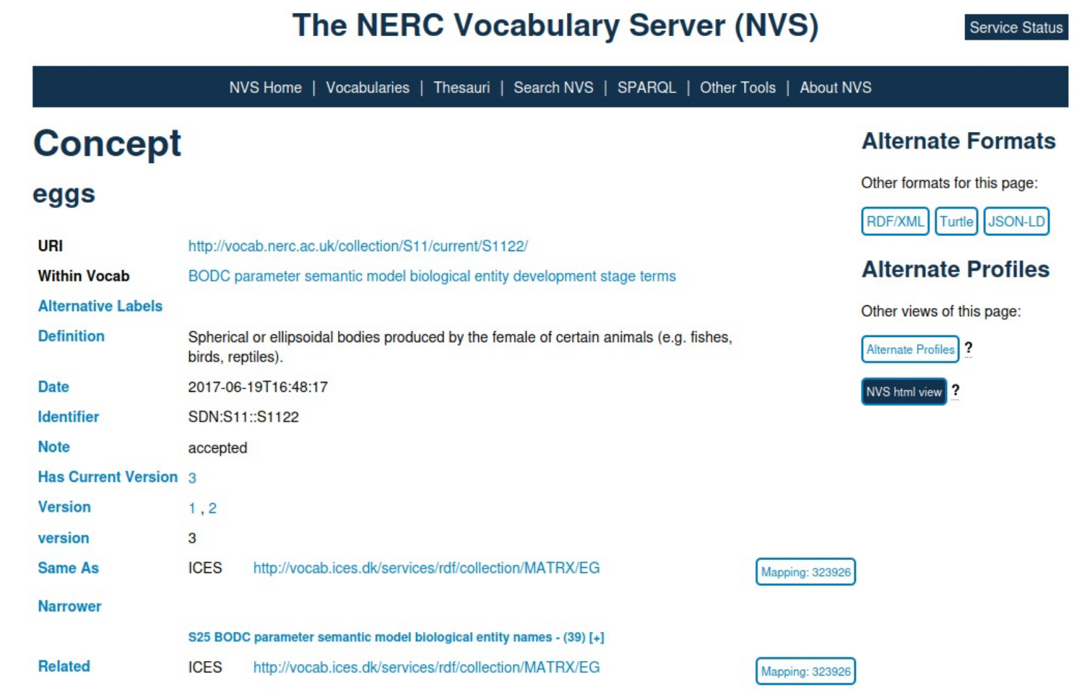
Vocabularies Example:
Natural Environment Research Council, del Reino Unido

Slide 10
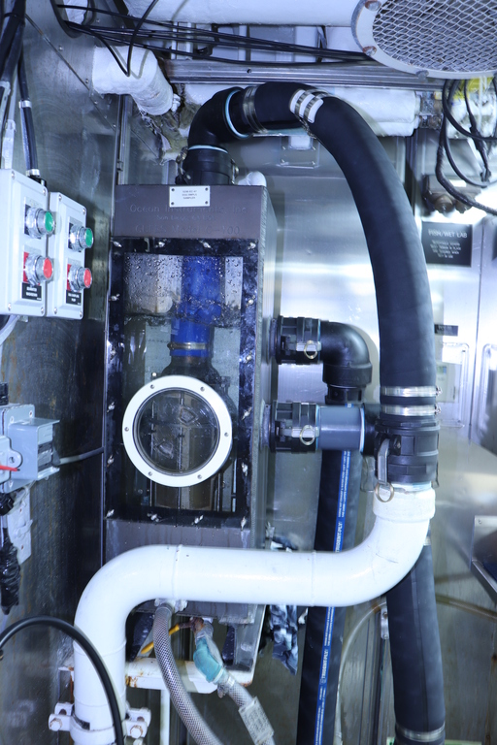
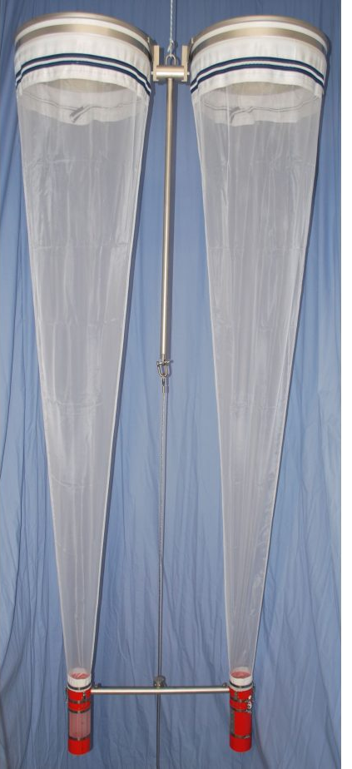
Why these efforts?
CUFES
CALVET
Samplig Devices
Notes:
The activity of these vessels are oriented to respond to different issues.

Slide 11
Data Ecosystem
Notes:
The activity of these vessels are oriented to respond to different issues.

Slide 12
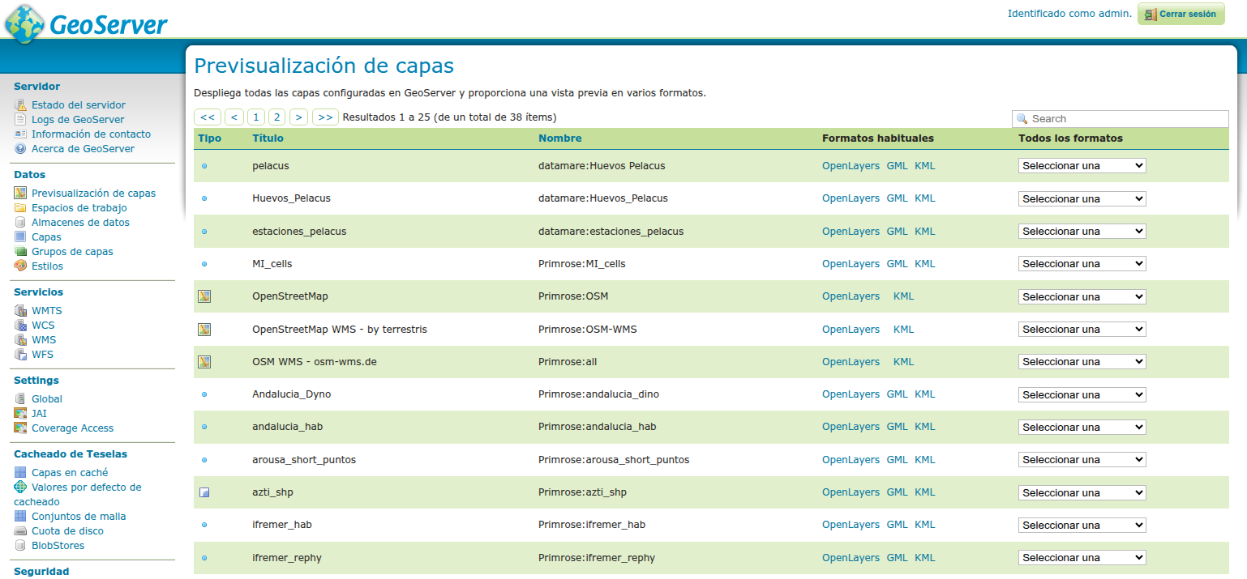
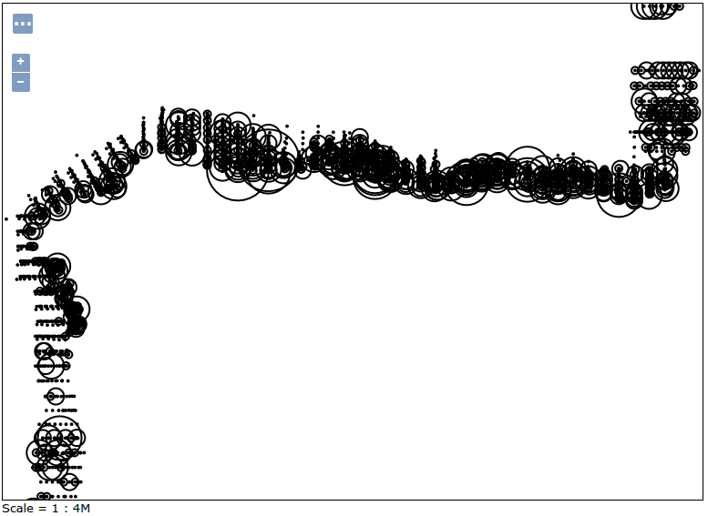
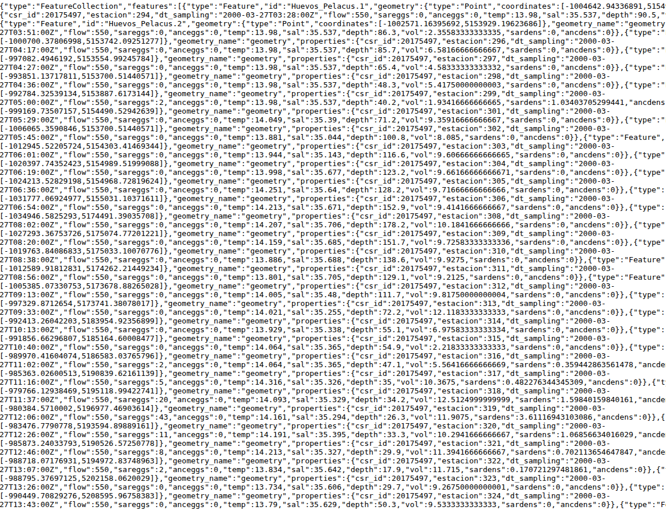
Data dissemination: Geoserver
Spatial data infraestructure (SDI)
Direct connection postgresql
  PostGIS Support
Limited catalogue services
OGC standard services
  Web map service (WMS)
  Web feature service (WFS)
WMS
WFS
Notes:
The activity of these vessels are oriented to respond to different issues.

Slide 13
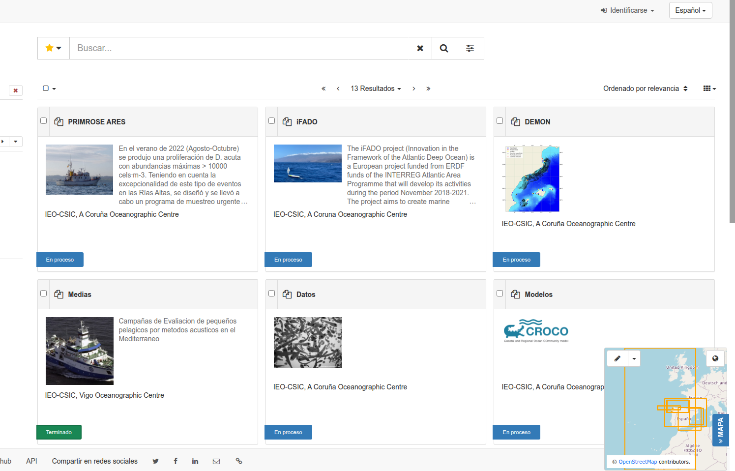
Data dissemination: Geonetwork
Data catalogue
  Human Interface
    Map visualization
    Filter and download
  Machine (supervised)
    Catalogue Service (CSW)
    Filter and redirect to the source
Notes:
The activity of these vessels are oriented to respond to different issues.

Slide 14
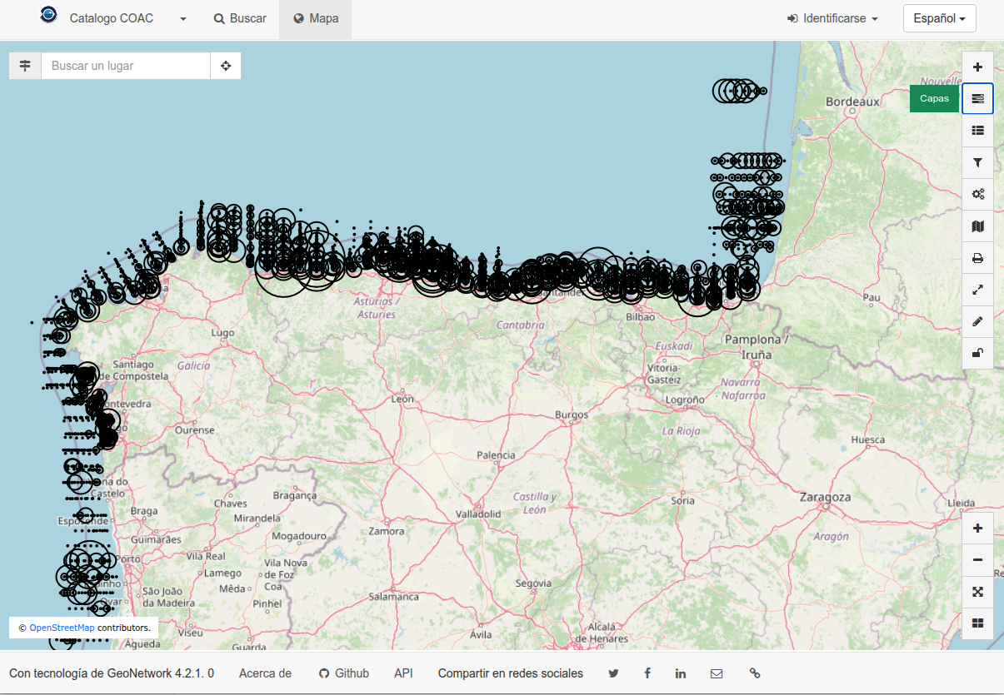
Data dissemination: Geonetwork
Data catalogue
  Human Interface
    Map visualization
    Filter and download
  Machine (supervised)
    Catalogue Service (CSW)
    Filter and redirect to the source
Notes:
The activity of these vessels are oriented to respond to different issues.

Slide 15
Data Ecosystem
Notes:
The activity of these vessels are oriented to respond to different issues.

Slide 16
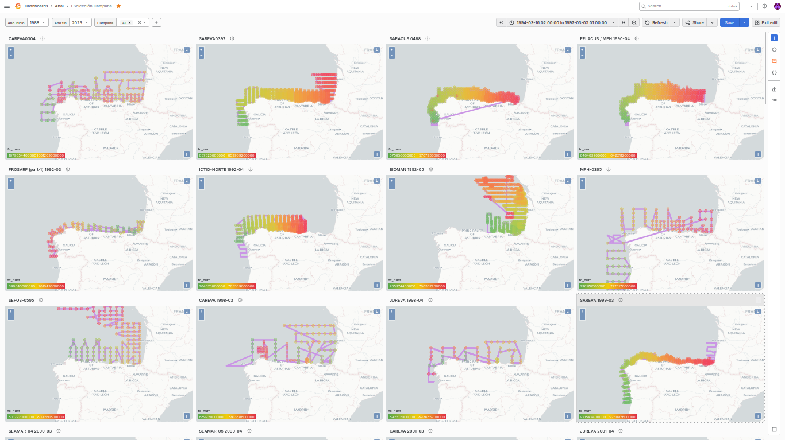

Slide 17
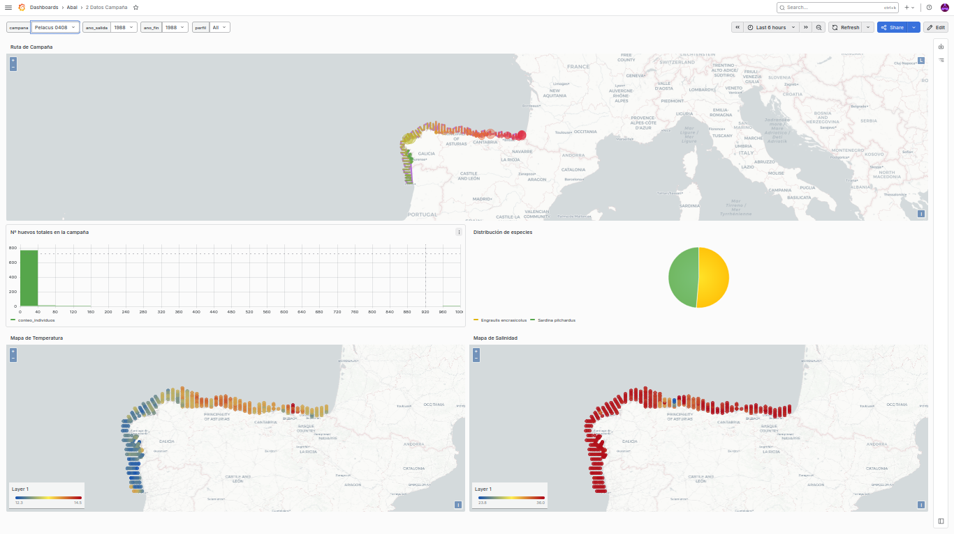

Slide 18
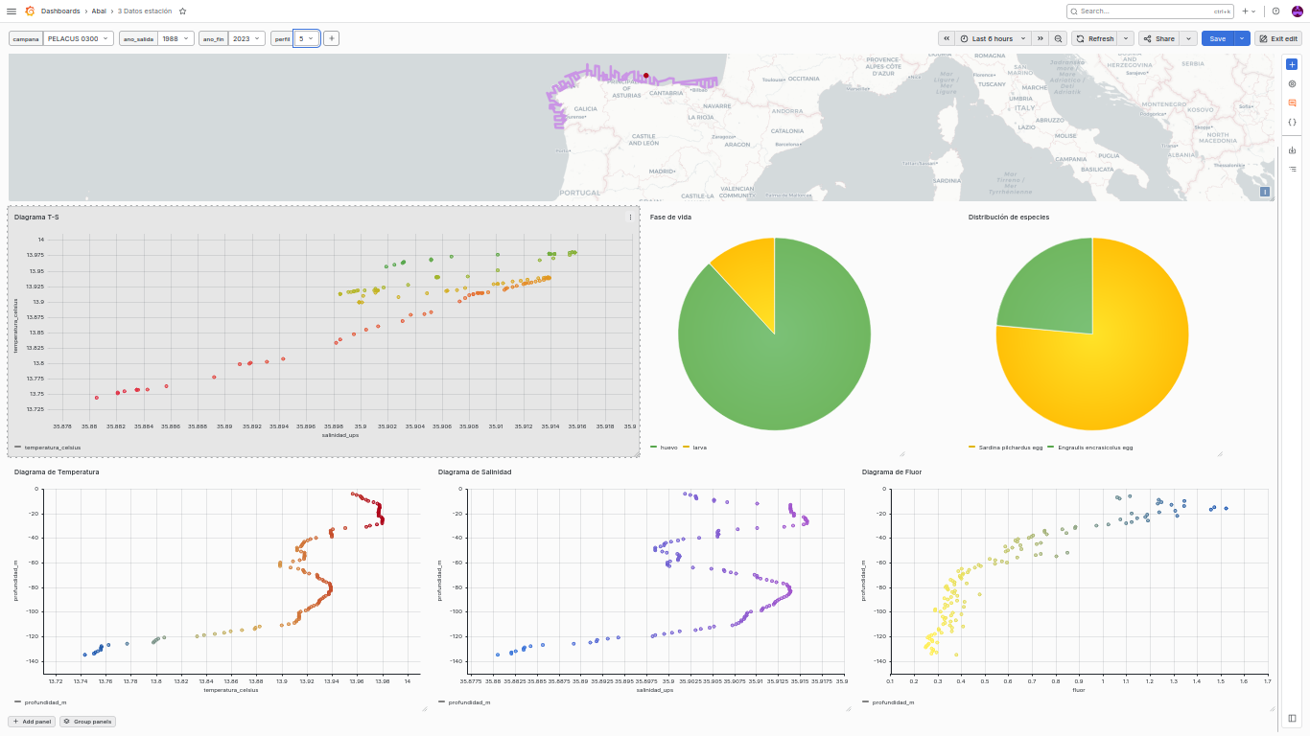

Slide 19
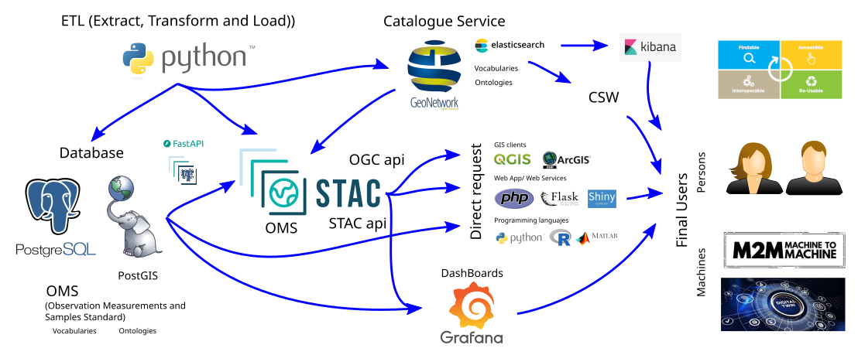
Data Ecosystem

Slide 20
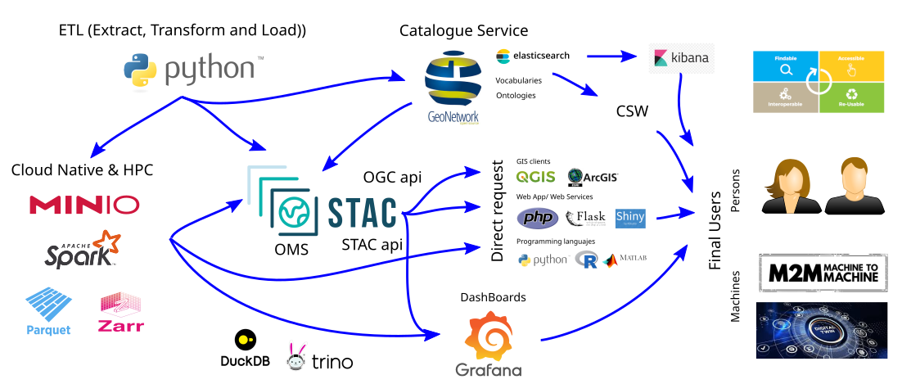
Data Ecosystem

Slide 21
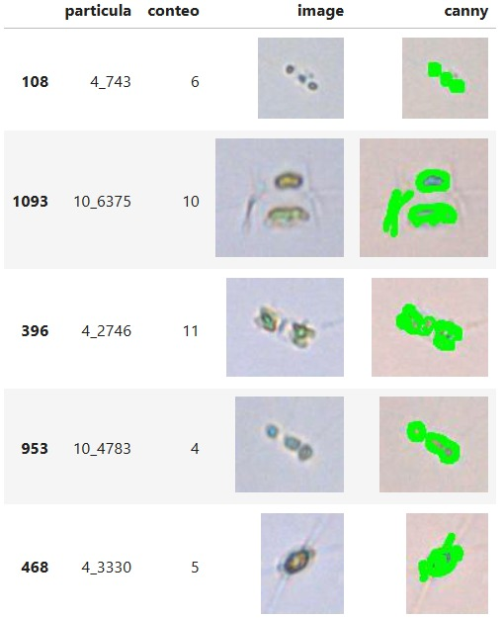
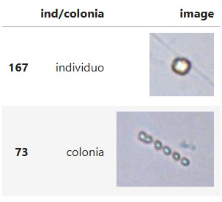
Image analysis
Examples of individual phytoplankton cells and phytoplankton cell colonies captured using a FlowCam. Source: own work.
Results of applying the Canny algorithm for edge detection and cell counting in phytoplankton photographs taken with a FlowCam. Source: own work.

Slide 22
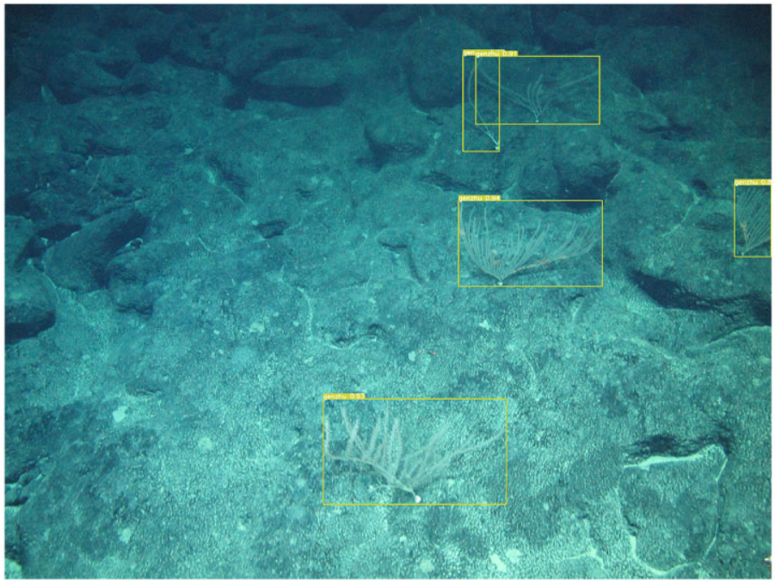
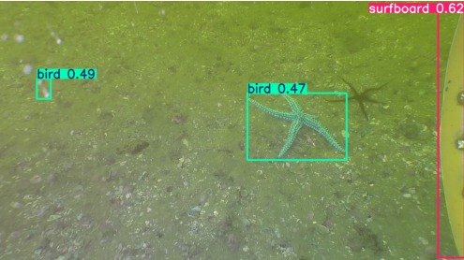
Computer vision in video
Detection results following specific training of DS-YOLO (based on YOLOv5) for benthic megafauna.
Source: Wang et al. (2024). Quantitative detection algorithm for deep-sea megabenthic organisms based on improved YOLOv5. Frontiers in Marine Science, 11. https://doi.org/10.3389/fmars.2024.1301024
Results of applying YOLOv8 to frames from the AMORES project video without any specific training. Source: Own work.

Slide 23
Conclusions
We are moving from FAIR for people to FAIR for machines (AI-ready).
These advances enable us to accelerate knowledge-generation processes as an institution.
Making data available in this way means it can be used by other sectors of society, thereby amplifying the impact of data.

Slide 24
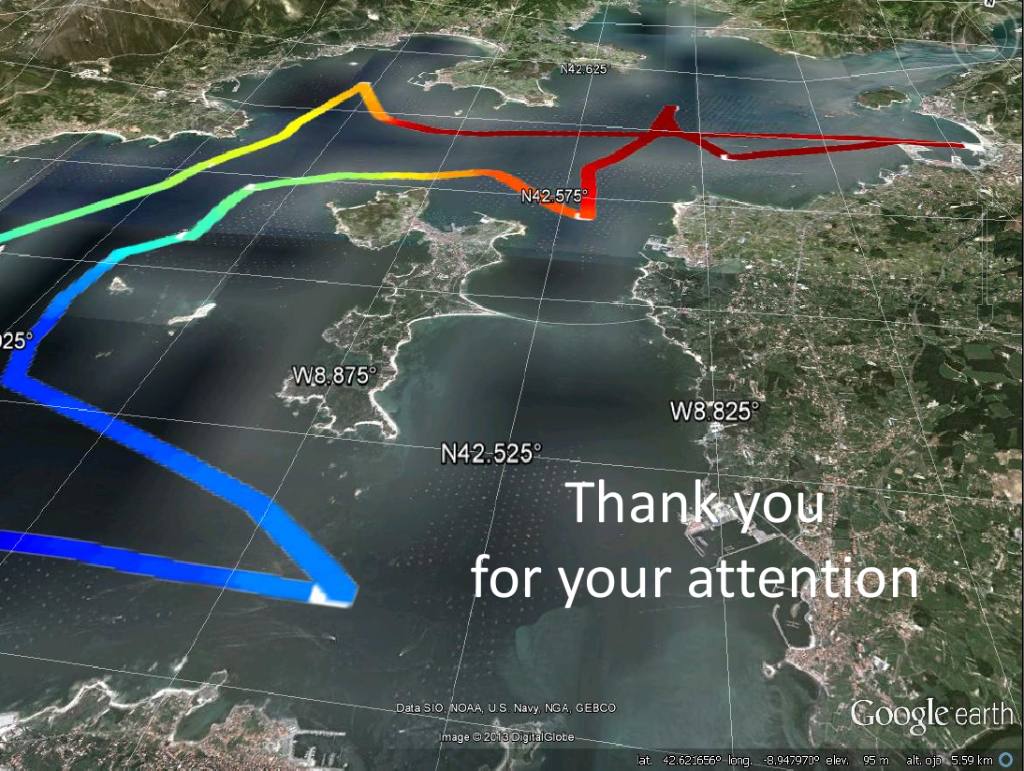
Notes:
‹#›

