Slide 1


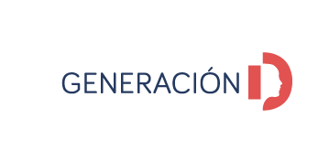



One Health AI:
Habitat Monitoring and Early Warning
Alberto Castelló
María Begoña García

Slide 2
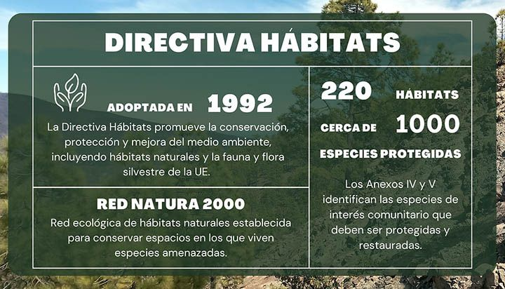
Background
Habitats Directive (92/43/CEE)
Birds Directive (2009/147/CE)
Natura 2000 (SCI -> SAC / ZEPA)
Anex I, II: habitats
Anex IV, V: fauna and flora species
Six-year report (range, area, structure and function, future porspects, pressures and threats, conservation measures)
*https://cobio.csic.es/index.php/component/content/article/505-en-que-consiste-la-directiva-habitats?catid=68

Slide 3



Background
Mapping mountain habitats using remote sensing data approach
EUNIS categorization (hierarchical classification related to Habitats of Community Interest)
Vegetation plots and habitat maps as ground truth data

Slide 4
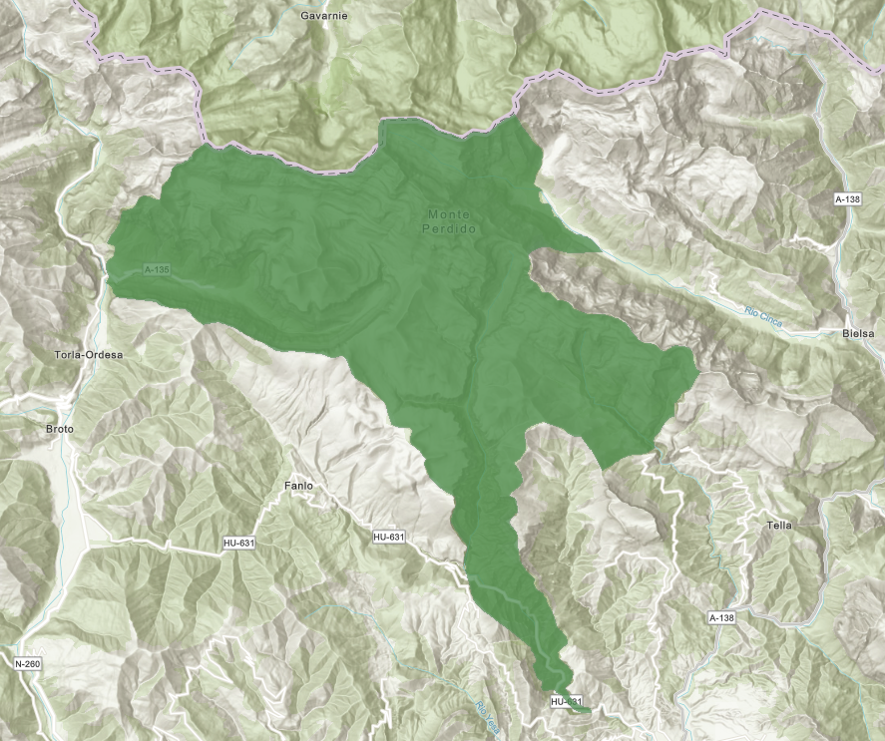
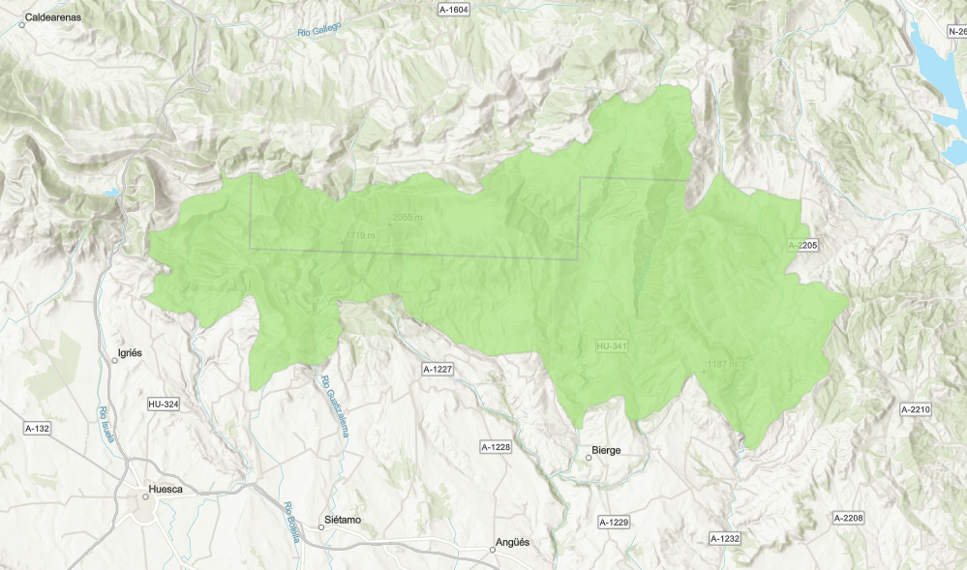
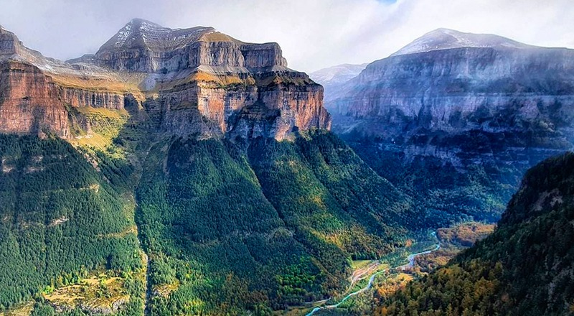
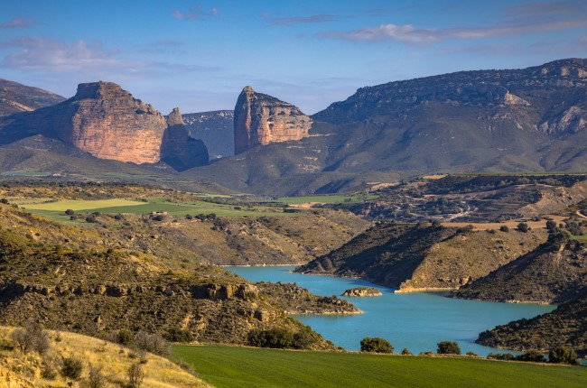
Research area
15k-20k Ha 50k-80k Ha
*https://cimanorte.com/parque-nacional-de-ordesa-y-monte-perdido/
*https://www.tuscasasrurales.com/blog/sierra-de-guara/

Slide 5
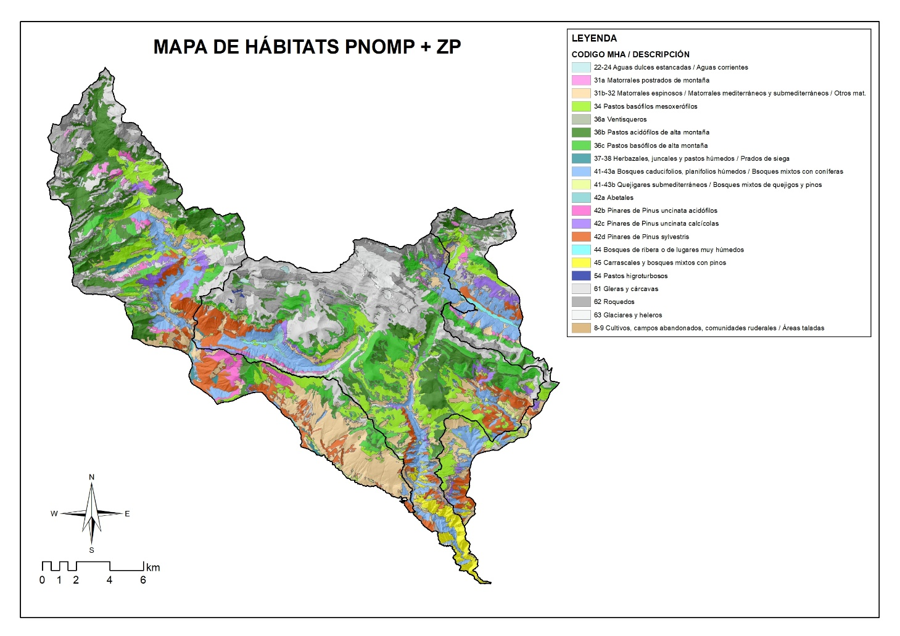
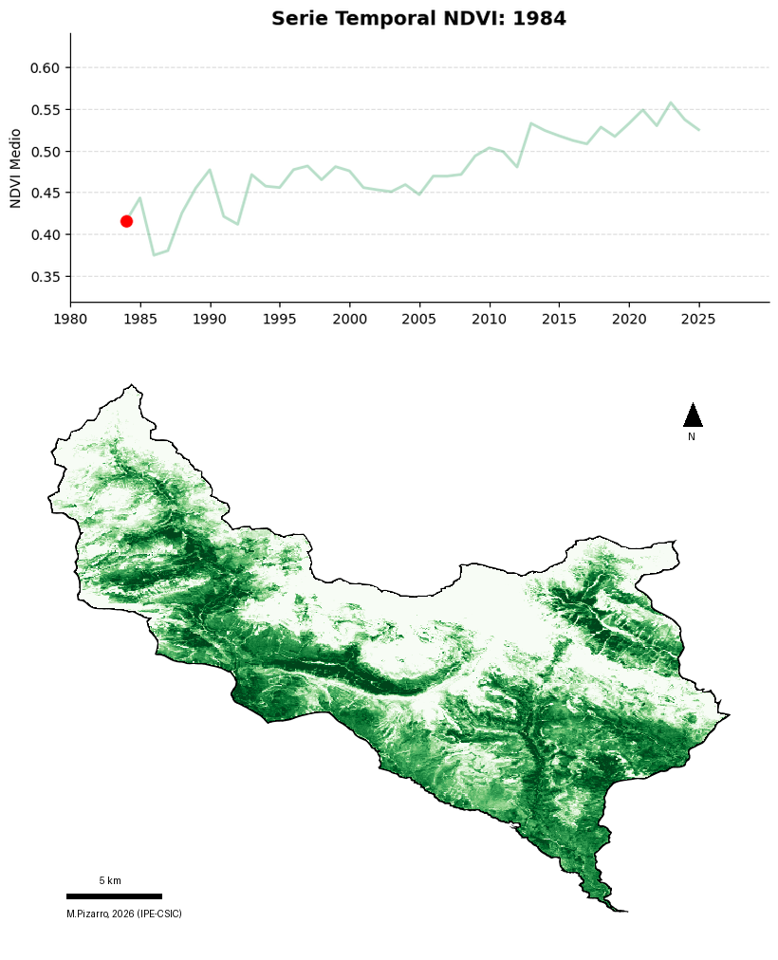
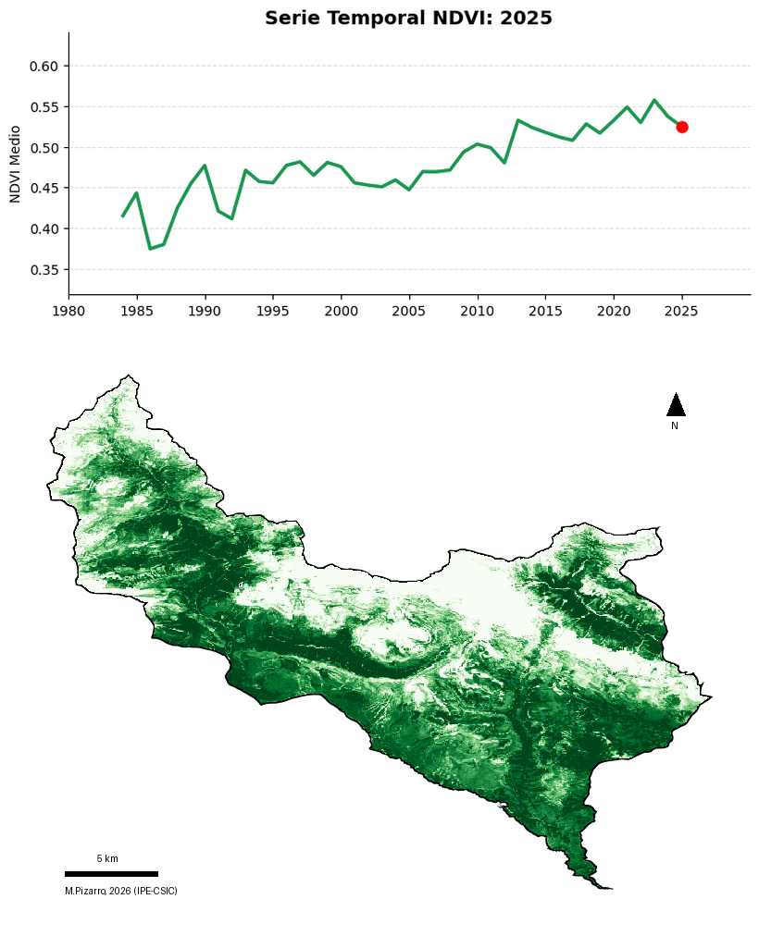
Research area

Slide 6
Workflow
Data adquisition
Landsat: 40 years (1987), 35 scenes/year, 2.5 scenes in Ordesa (3500 scenes, 4 TB) 30m
Sentinel-2: 10 years (2017), 75 scenes/year, 2.5 scenes in Ordesa (1875 scenes, 3 TB) 10m
Data processing
python/R pipelines
Cloud and topographic correction
Data harmonization between both sources to get consistent temporal series

Slide 7
Workflow
Data analysis
Multispectral indexes calculation (NDVI, NDMI, NDWI, SAVI, MSI, EVI…)
Data enrichment: high-def topography, LIDAR, climate
Products and services
Intra- and interannual evolution (Habitat level)
Anomaly alerts: phenology dynamics, water stress, fire risk
Trends analyses and modelling
Vulnerability maps

Slide 8
Conclusions
Operationalizing One Health with AI
Integrating environmental and habitat monitoring into an early warning framework to detect habitat/vegetation anomalies and mitigate risks proactively.
Scalable & Automated Workflow
Standardization of end-to-end data ingestion, processing, and predictive modeling, overcoming the latency of traditional manual monitoring (six year reports).
Advanced Computing (HPC)
CESGA infrastructures are essential to process multi-source, high-volume spatial and temporal datasets efficiently.
Future Outlook
Deploying near-real-time alerting pipelines by integrating heterogeneous remote sensing data. Add more protected areas to pipeline.

Slide 9
Thank you!
alberto.castello@ipe.csic.es

