Slide 1
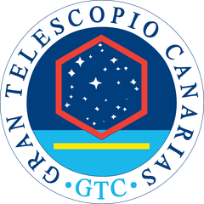
PROGNOSTICS & HEALTH MANAGEMENT
Turning Operational Telemetry into Telescope Health
at the Gran Telescopio Canarias
Manuel Huertas-López ¹ ² · Josué Toledo Castro ¹ · Sebastián Fernández García ² · Romano Corradi ¹ ³ · Oliverio J. Santana ²
¹ GTC, Gran Telescopio Canarias, La Palma ² ULPGC, Universidad de Las Palmas de Gran Canaria ³ IAC, Instituto de Astrofísica de Canarias
IBERGRID 2026 · 14th Iberian Grid Conference
Santiago de Compostela · 27–29 October 2026
Notes:
Good afternoon. I am Manuel Huertas, from the Gran Telescopio Canarias, on La Palma.
Every night on a large telescope is expensive and unrepeatable. Our goal is predictive
maintenance: detect the degradation early, and plan the repair, instead of reacting to a
failure.
So we take the telemetry the control system already stores, years of it. We process it at
CESGA, on the Spanish supercomputing network, and we build models that learn the normal
behaviour of the telescope. That gives us condition monitoring and anomaly detection today,
the first steps towards it.
We started with one subsystem, as a pilot: the tracking system. In this presentation I will
show you how we did it.

Slide 2
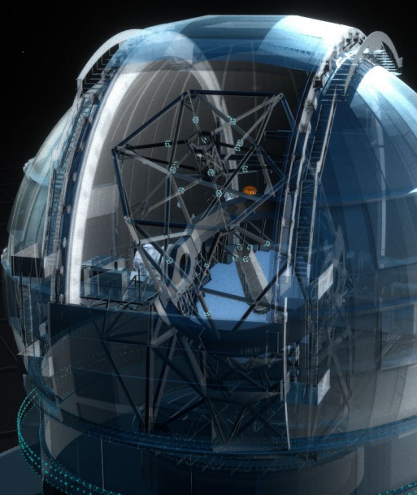
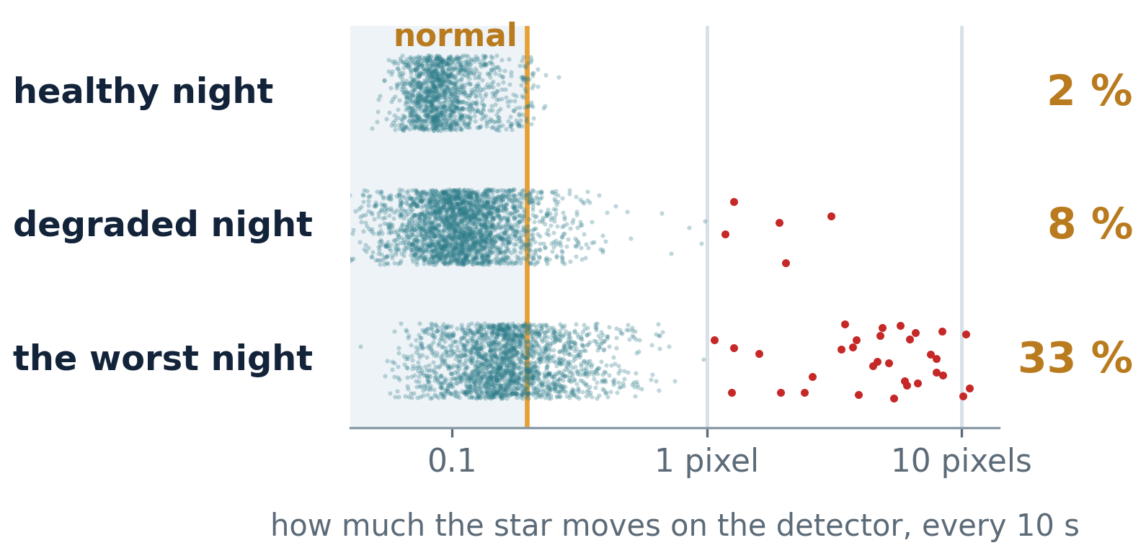
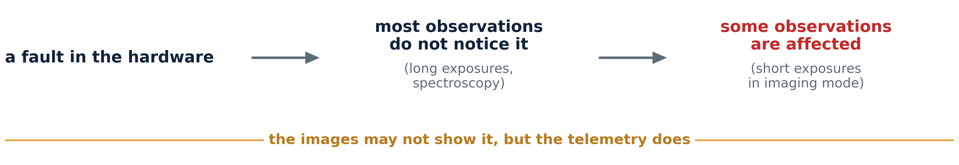
THE PROBLEM
A tracking system precise to a fifth of a pixel. And nothing tells us when it degrades.
The tracking system has one job: keep the image still on the detector.
“Every clear night is
unrepeatable.”
Our goal: detect the anomaly where it starts, early enough to plan the repair.
Notes:
The GTC is an altazimuth telescope. It has two main axes, azimuth and elevation, and they move
together to keep the star still on the detector, to a fifth of a pixel of the science camera.
But sometimes the system fails, or degrades. And it can spoil the image quality at the worst
moment.
Why is this hard to see? Most observations do not notice it: a long exposure, or a spectrum,
collects light for many minutes, and a few seconds of shaking get lost in it. Some
observations are affected: short exposures in imaging mode. The images may not show it, but
the telemetry does.
So: a system precise to a fifth of a pixel, and nothing tells us when it degrades. That is the
problem.

Slide 3
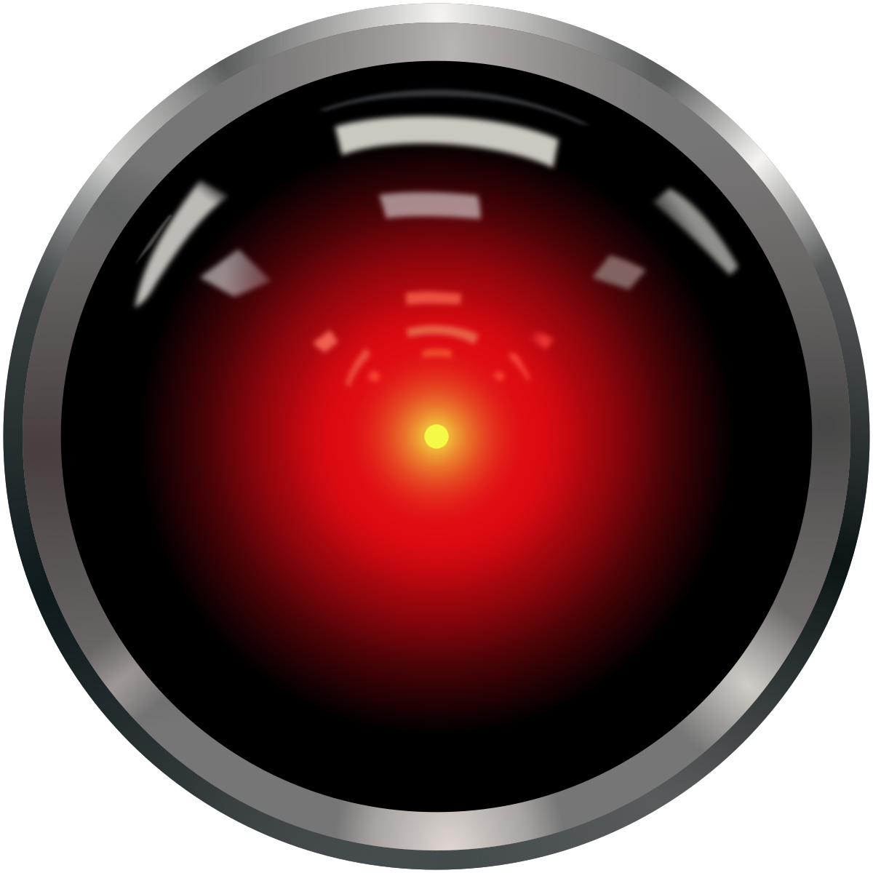
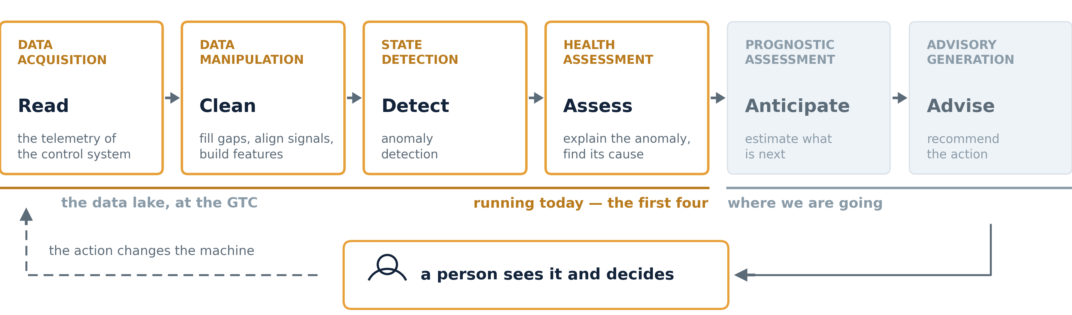
THE DISCIPLINE
What we are building has a name:
prognostics and health management (PHM).
Today the telescope runs four of the six steps. The chain only pays off when it ends in an action.
HAL 9000 eye: Cryteria, CC BY 3.0
Notes:
What we are building has a name: prognostics and health management, PHM. It is the
discipline behind predictive maintenance, and ISO 13374 describes it as a chain of six steps.
You read the telemetry. You clean it. You detect the anomaly. You explain it and find its
cause. You anticipate what comes next. And you advise what to do.
The first two steps are the data lake, at the GTC. Today the telescope runs four of the six:
it reads, it cleans, it detects, it assesses. The last two are where we are going.
And there are two loops. In operation, the chain ends in an alarm, and the alarm leads to a
maintenance action. In training, it ends in an expert, who looks at what the model flagged
and says whether it was a fault or not. That answer goes back into the data, and the model
gets better.

Slide 4
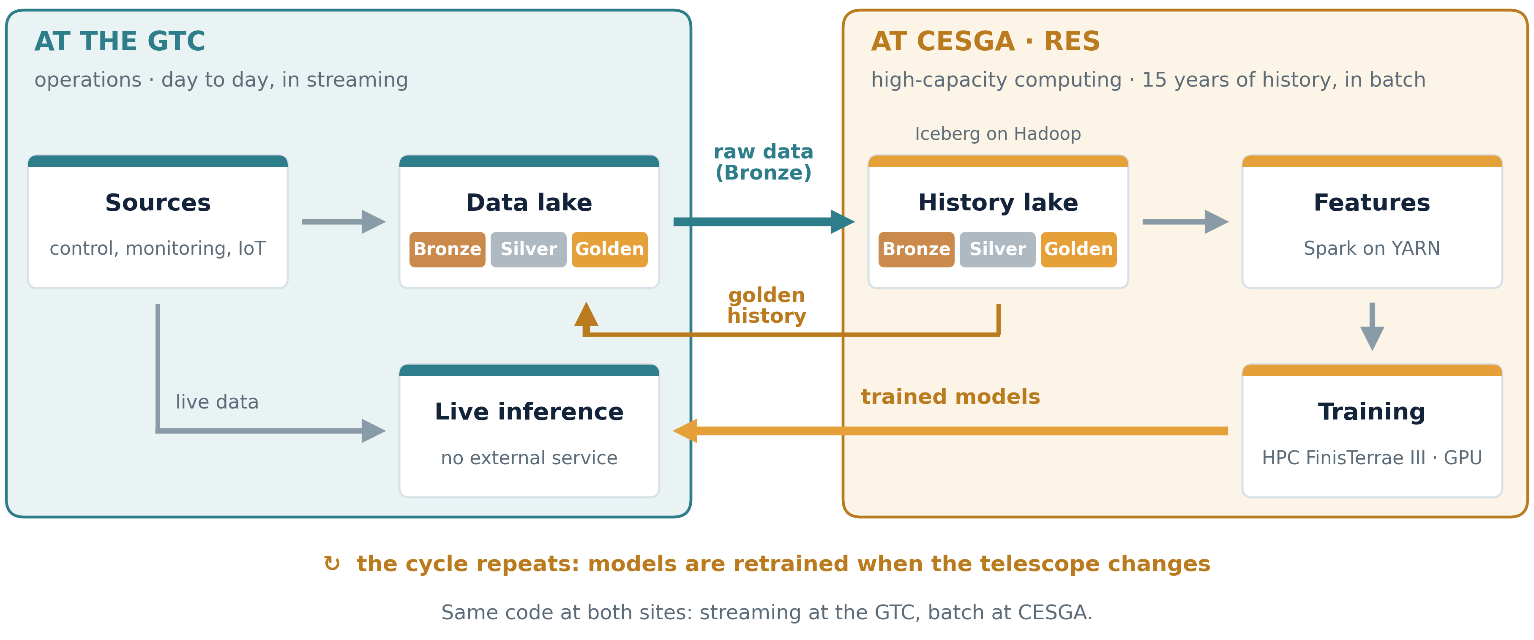
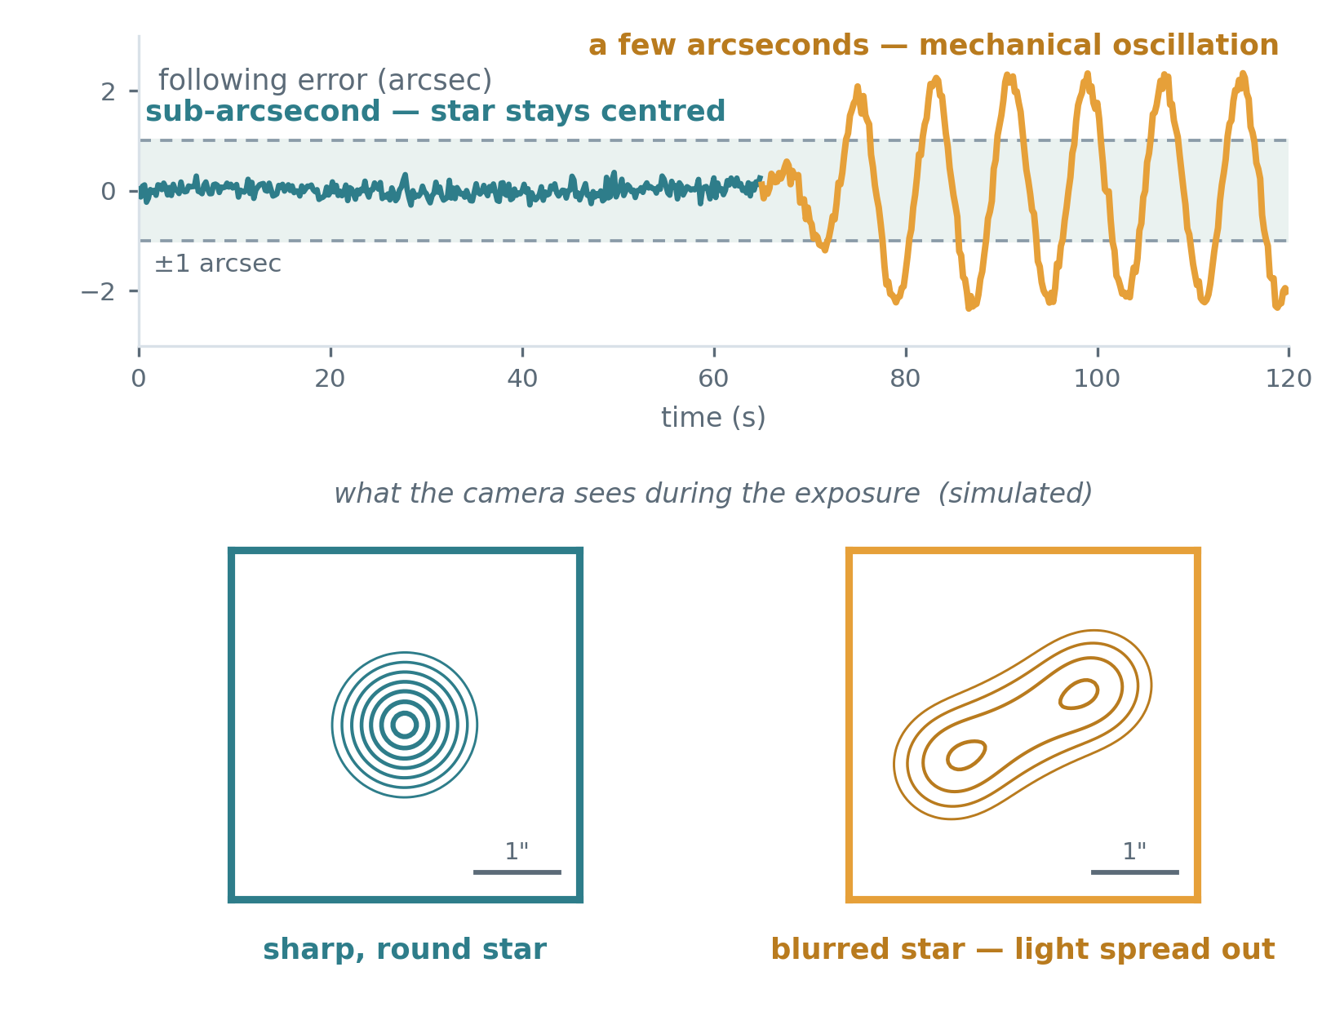
THE ARCHITECTURE · RES PROJECT, YEAR ONE OF THREE
Training on HPC at CESGA, inference on premises at the GTC.
The data lake in detail: Josué Toledo, “A Data Lake for unified data exploitation at the GTC”.
Notes:
Where does all this run? In two places, and each one has one job.
At the GTC, the data lake builds Bronze, Silver and Golden from the day-to-day telemetry, in
streaming.
The raw data also goes to CESGA, on the Spanish supercomputing network. There, the same code
runs in batch over the history: five years today, fifteen as the goal. The big data cluster
builds the history lake and the features, with Spark on YARN. Then the models are trained on
the HPC side, on FinisTerrae III, with GPUs.
Two things come back to the GTC: the golden history, and the trained models. The models run
live, next to the telescope, so operations never depend on an external service.
And it is a cycle. The telescope changes: repairs, new instruments, new software. When it
changes, the models are trained again at CESGA.
How the data lake is built, Josué Toledo will show in the next talk. This is the first year
of a three-year project.

Slide 5
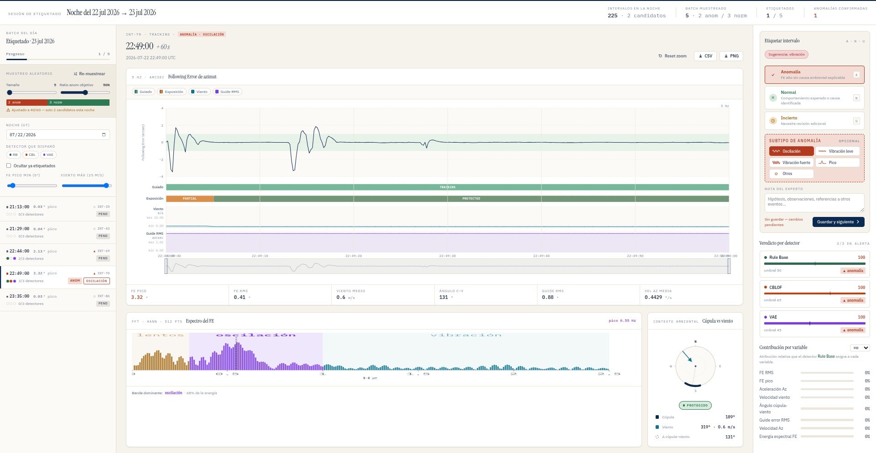
GROUND TRUTH · HUMAN IN THE LOOP
Expert labels are the ground truth for the detectors.
2,453 minutes
147 nights
455 anomalies
labelled by an expert, one by one
of 2025 and 2026
1,895 normal · 103 uncertain
The episode comes with its context
wind, dome angle, exposure, guiding, spectrum, all on one screen
The detectors propose, the expert decides
three automatic detectors (next slide) give their verdict side by side
Sampling is random, with normals mixed in
four out of five labelled minutes are normal, on purpose
It is a taxonomy, and it admits doubt
oscillation, vibration, spike, or uncertain when it is not clear
Notes:
Before any detector can be measured, we need a ground truth. In a telescope in operation, that
is rare: there is no record, minute by minute, of when the machine was healthy. So we built it
ourselves.
An expert looks at one minute at a time, with its full context, and decides: normal, anomaly,
or uncertain. The minutes come at random, with normal ones mixed in on purpose.
With this ground truth we have metrics for the models. Without it, we would be blind: we could
not tell if a change makes them better or worse.

Slide 6
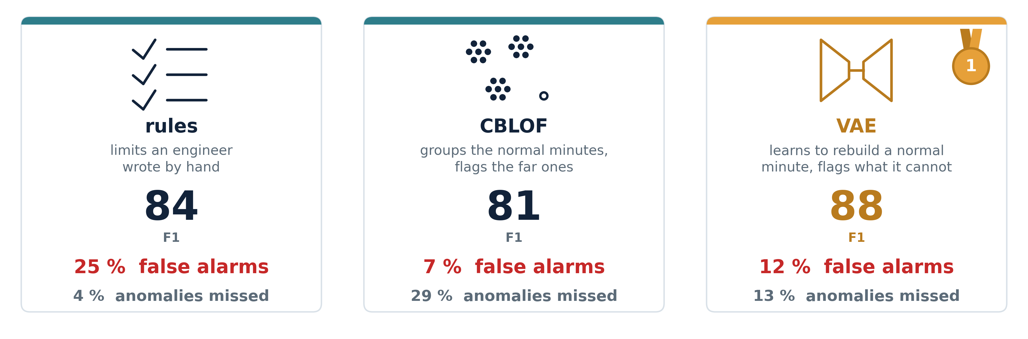
WHAT RUNS TODAY · ANOMALY DETECTION
The three detectors, evaluated.
F1: the balance between false alarms and missed anomalies
Notes:
What runs today: three unsupervised detectors, from simple to complex. A rule-based baseline,
with thresholds set by an engineer. CBLOF, a cluster-based local outlier factor: it clusters
the normal minutes and scores how far each new minute falls from them. And a variational
autoencoder: it learns to reconstruct a normal minute, and the reconstruction error is the
anomaly score.
All three were trained on one year of normal operation, 2024, with no labels. Then evaluated
against the expert ground truth, on 2025 and 2026.
The rules have the best recall, but the lowest precision: one alarm in four is false. CBLOF has
the best precision, but misses almost a third of the anomalies. The autoencoder has the best
balance: F1 of 88, with recall and precision both close to 0.9. And it generalises: trained on
2024, it holds the same score in 2026.
But F1 is not the whole story. For the operator, every false alarm costs time, and too many of
them erode trust in the system. So the next goal is clear: fewer false alarms, without losing
recall.

Slide 7
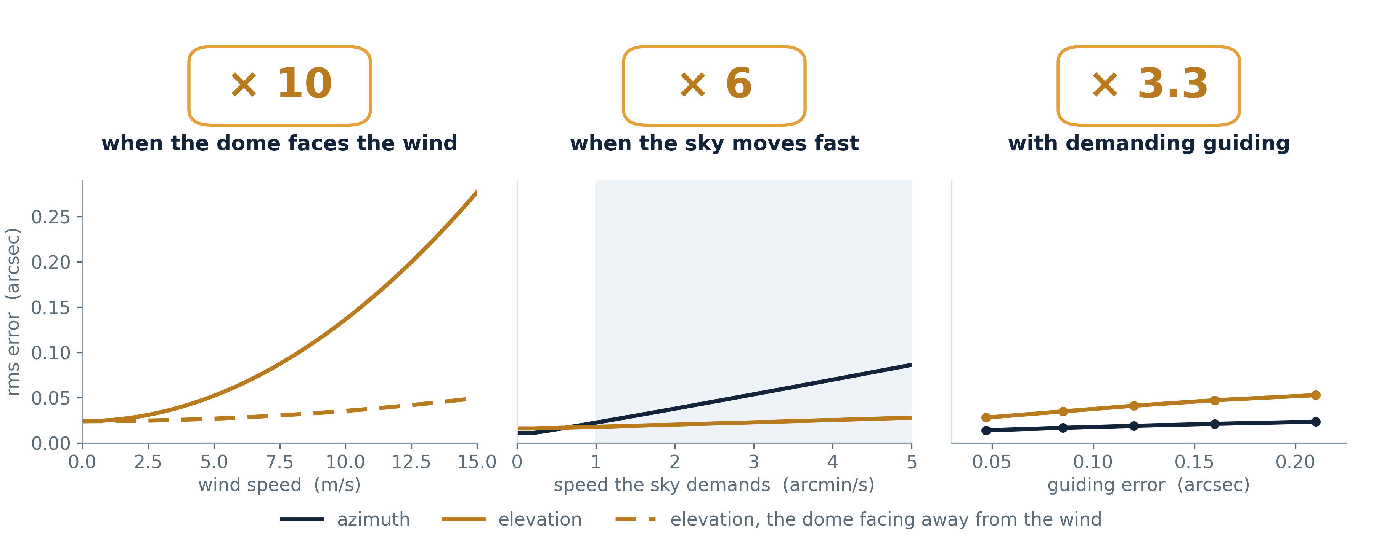
WHY A THRESHOLD IS NOT ENOUGH · MEASURED ON FIVE YEARS AT CESGA
What is normal depends on the operating conditions.
Notes:
And here is what those detectors fight against. The same tracking error can be normal on a
windy night, or an early warning on a calm one. A threshold cannot tell them apart. So we
measured, over the five years, what moves the error and by how much.
Wind, first: when the dome faces the wind, the error is ten times larger. Then where the
telescope is pointing. To follow a star, the two axes move at speeds that depend on where the
star is. Near the zenith, straight up, the azimuth axis has to turn very fast to keep up. Near
the pole, both axes barely move. The faster they move, the larger the error. Then guiding, the
small corrections the telescope makes on a guide star.
And some things we expected to matter do not: crossing the meridian, the direction the axis
turns, or pointing low, close to the horizon. We checked. They do not.
This was only possible with five years of data. With a few nights, you cannot separate one
effect from another. With five years, each effect has been seen on its own, many times, and
the numbers hold.
So what is normal depends on the operating conditions. The next step is to model it.

Slide 8
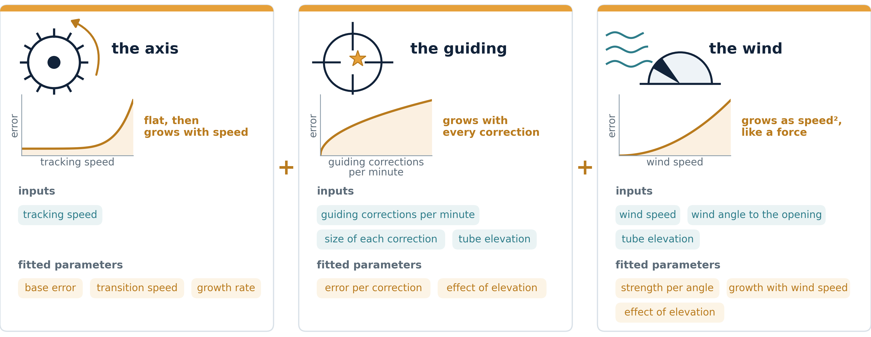
THE PHYSICS · FITTED ON FIVE YEARS AT CESGA
A physics model gives the expected error for any condition.
Hypothesis: the detector flags rare but normal conditions as faults.
Notes:
Our hypothesis: the detector flags rare conditions as faults, because they are
under-represented in the training data. Strong wind into the dome, fast tracking near the
zenith, many guiding corrections. They are rare, but they are normal.
So we built a physics model of the tracking error: three terms, added in quadrature, like an
error budget. The axis: its own base error, which grows when the target forces it to move
fast. The guiding: every correction moves the axis a little, so more corrections, more error.
And the wind through the dome opening, which grows with the square of its speed, like a force.
Each term has its inputs, measured every minute, and a few parameters, fitted on five years of
data at CESGA.
Three checks tell us we can trust it. R squared between 0.70 and 0.79 on the log of the RMS.
It holds on a held-out year. And the parameters are physically consistent: the wind term goes
with speed squared.
The model encodes domain knowledge. The detector only has to learn the residual.

Slide 9
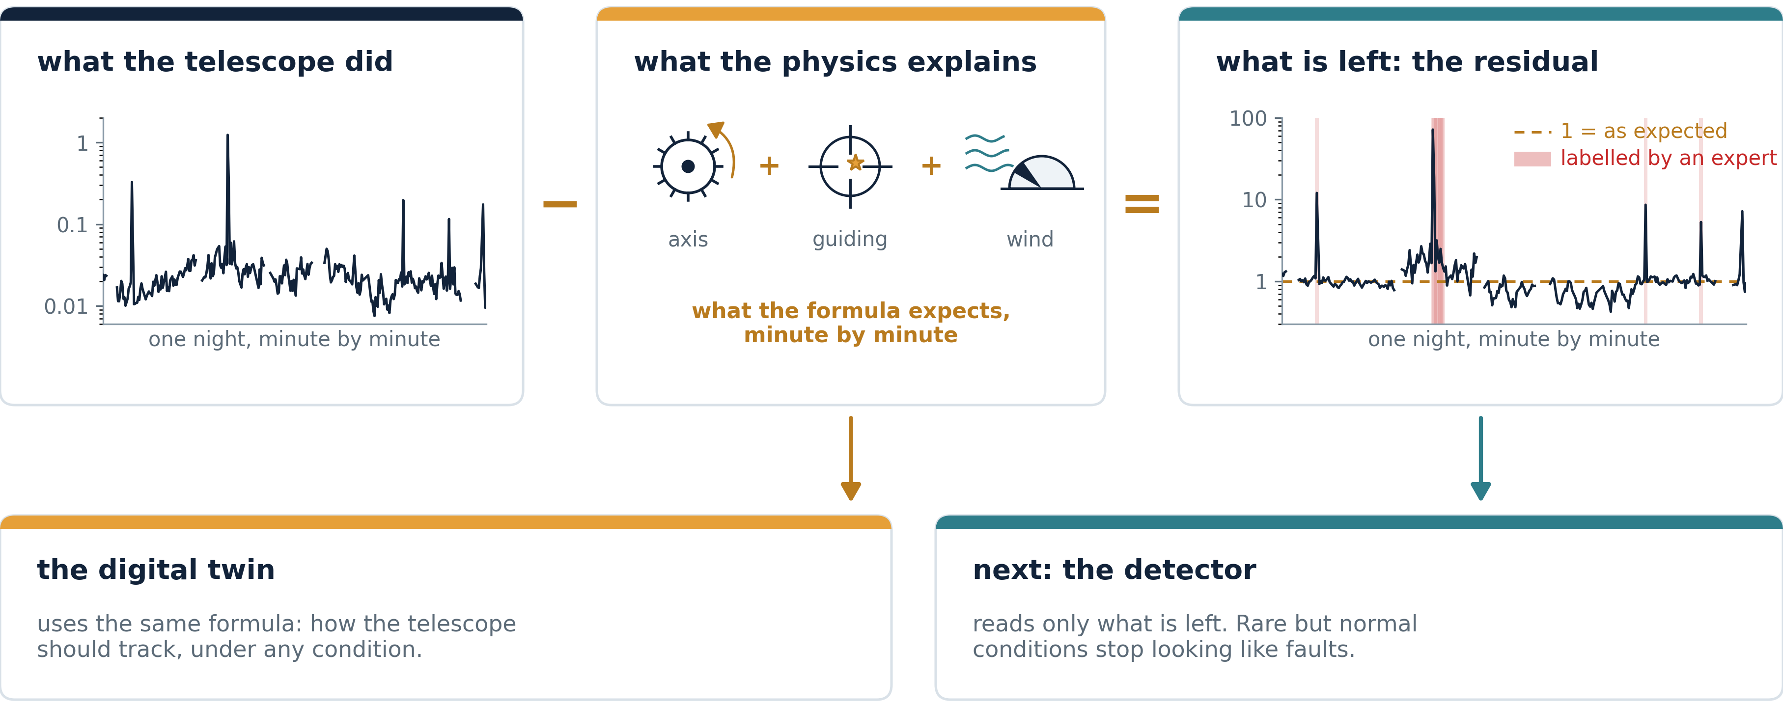
MODEL-BASED DETECTION · WHAT THE PHYSICS CANNOT EXPLAIN
Faults stand out in the residual, not in the raw signal.
Notes:
Here is how we use it. Take one night: what the telescope did, minute by minute. The residual
is the measured RMS over the expected RMS. In log space, that is a subtraction: we take out
what the physics explains, the axis, the guiding and the wind. On a normal minute, the
residual stays at one. In fault-detection terms, the model generates the residual, and the
detector evaluates it.
The red bands are the minutes our expert labelled as anomalies, by hand. The peaks of the
residual fall on them. And the labels never entered the model.
The same formula goes to the digital twin: how the telescope should track, under any
condition. And the next step is the detector: it will read only the residual. The bet is
concrete: rare but normal conditions should stop looking like faults, so precision should
improve, and recall should hold. If not, we will know, with a number.
That is also why this lives at CESGA. Change one term in the model, and five years run again.

Slide 10
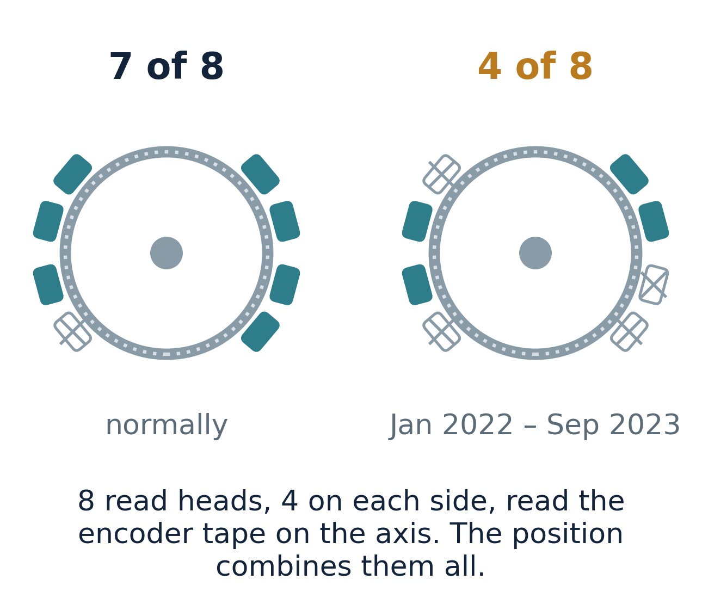
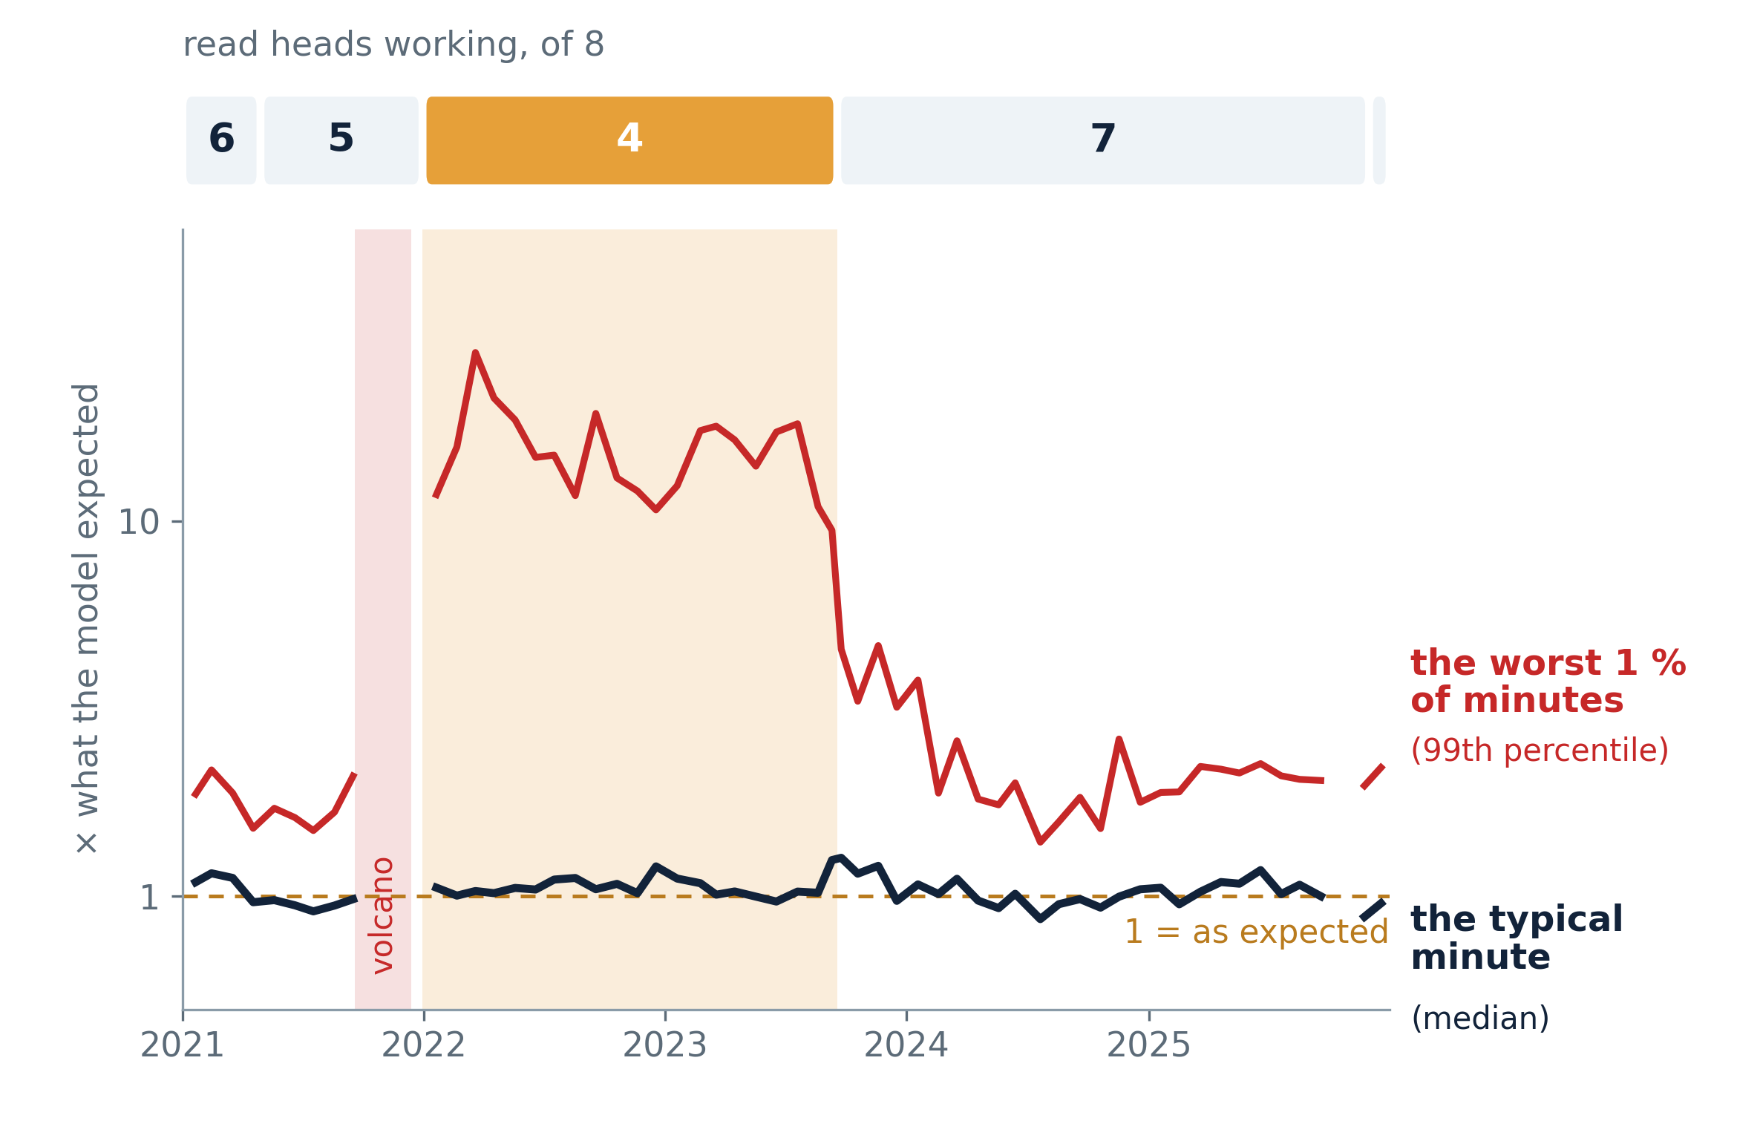
THE ELEVATION ENCODER · THE SENSOR THAT READS WHERE THE TELESCOPE POINTS
A real fault, measured in five years of data.
Fewer heads, and the control loop saturates 60 to 100 times more often.
Notes:
Now a real fault, measured with this same residual over five years, on the elevation axis. It
was not found by the three detectors: it was measured with the physics model.
The elevation encoder reads where the axis points with eight read heads, four on each side.
They are redundant: the position combines them all. It never worked with all eight; normally,
six or seven. At the end of 2021, after the stop for the Cumbre Vieja eruption, it went down
to four, two on each side, until September 2023.
The axis kept working. The median residual stayed at one for five years. The telescope kept
observing, and the images were fine.
The 99th percentile is another story. With four heads, it was seven times worse than after
the repair. With fewer heads, the PID controller saturates sixty to a hundred times more
often, and those are exactly the worst minutes. And it is a step, not a slope: it jumps when
the heads go, it jumps back the same night they come back, and it stays flat in between.
Twenty-one months. And it was in the archive all along.

Slide 11
TAKEAWAYS
Four things to remember.
1
The control system stores billions of samples, and we were getting no knowledge out of them.
The elevation axis was worse than it should have been for twenty-one months, and the images did not show it.
2
Learning from the archive needs HPC and big data, like CESGA.
The work is iterative: when we find a variable is missing, we add it and process the archive again. The operations infrastructure is not built for that.
3
Unsupervised models learn what is normal; a physics model explains the operating conditions.
Measured against an expert ground truth, they detect most anomalies, and the residual shows a real fault.
4
The same chain scales to the rest of the telescope, towards predictive maintenance.
What changes from one subsystem to the next are the features. The chain (archive, model, detectors) is the same.
Notes:
Four things, if you keep nothing else.
The control system stores billions of samples, and we were getting no knowledge out of them.
The elevation axis ran worse than it should for twenty-one months, and the images did not
show it.
Learning from the archive needs HPC and big data, like CESGA. The work is iterative: when we
find a variable is missing, we add it and process the archive again. The operations
infrastructure is not built for that.
Unsupervised models learn what is normal, and a physics model explains the operating
conditions. Measured against an expert ground truth, they detect most anomalies, and the
residual shows a real fault.
And the same chain scales to the rest of the telescope, towards predictive maintenance. What
changes from one subsystem to the next are the features.

Slide 12
Thank you.
An observatory in the Canary Islands and a supercomputing centre in Galicia. Not a plan: running.
Manuel Huertas-López · manuel.huertas@gtc.iac.es · ORCID 0009-0002-8895-4396
GTC, Gran Telescopio Canarias, La Palma · ULPGC, Universidad de Las Palmas de Gran Canaria
Notes:
An observatory in the Canary Islands and a supercomputing centre in Galicia. Not a plan: it is
running, and this is year one of three. Thank you.

