Slide 1
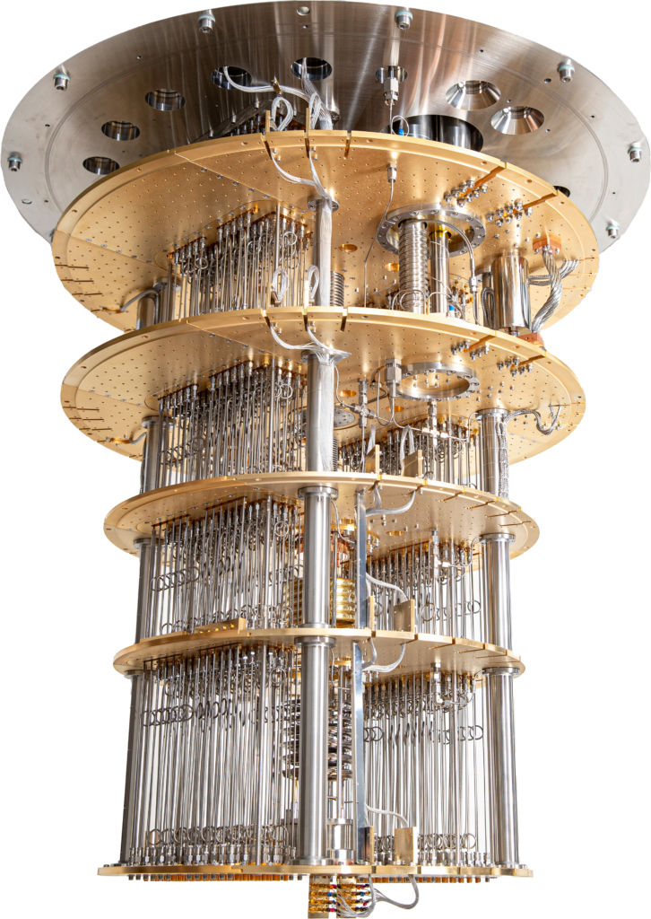
IBERGRID 2026 · Santiago de Compostela · 27–29 October 2026
Benchmarking Distributed Quantum Computing Emulators
Guillermo Díaz Camacho
Quantum Computing Group, CESGA
with I. F. Llovo, F. J. Cardama, I. Bautista, D. Faílde, M. Mussa Juane, J. Vázquez-Pérez, N. Costas, T. F. Pena, A. Gómez (CESGA, CiTIUS/USC) · arXiv:2512.01807
This project has received funding from the European High-Performance Computing Joint Undertaking under grant agreement 101194491. CESGA is co-funded by MICIU/AEI/10.13039/501100011033, grant PCI2025-163133.
Notes:
0:20. Thank the organisers. One line: we built a framework to compare emulators of distributed quantum computing on the same distributed algorithm, on the same HPC cluster, and this talk shows what we found and where the project is now.

Slide 2
Two meanings of “distributed emulation”
Monolithic quantum computation
Distributed quantum computation
Monolithic emulator
Qiskit Aer, PennyLane, myQLM, Qulacs, ProjectQ, IQS, QuEST…
NetSquid, SquidASM, SimulaQron, QuNetSim, Interlin-q, QuISP, SeQUeNCe, DQC Executor…
This study
Distributed emulator
mpiQulacs, QuESTlink, IQS with MPI, Qiskit Aer multi-GPU…
(??)
No tool we know of does both.
Notes:
1:00. This audience knows the first meaning: using classical parallelism, MPI, multi-GPU, to simulate a large circuit. That is the bottom-left cell. We care about the other meaning: emulating physically distributed quantum processors that talk through teleportation, entanglement and classical messages. That is the top-right cell, and it is what we benchmark. The empty cell is the interesting one for a grid conference: no tool we know of emulates distributed quantum computing and also runs on a distributed-memory backend. Distinguish DQC from the quantum internet: the internet wants to maximise Bell pairs, DQC wants to spend as few as possible.

Slide 3
Twelve tools surveyed, four benchmarked
Emulator | Teleport. | QFT | Event sim. | Net model | Noise | Benchmarked | Last active
SquidASM | yes | yes | yes | yes | yes | yes | 2025
Qiskit Aer | partial | yes | no | no | yes | yes | 2025
Interlin-q | partial | yes | no | partial | no | yes | 2021
SQUANCH | yes | yes | no | partial | partial | yes | 2018
NetSquid | yes | partial | yes | yes | yes | no | 2021
SimulaQron | yes | partial | no | yes | partial | no | 2021
NetQASM SDK | partial | partial | partial | partial | partial | no | 2025
SeQUeNCe | yes | no | yes | yes | yes | no | 2025
QuNetSim | yes | no | no | no | no | no | 2023
DQC Executor | partial | partial | partial | partial | partial | no | 2021
QNE-ADK | partial | partial | partial | partial | partial | no | 2024
QuISP | yes | no | yes | yes | partial | no | 2025
Notes:
1:00. We started from the Caleffi et al. survey and scored every tool on criteria in three tiers. Must-have: teleportation, at qubit or gate level, and the gates the QFT needs. Important: discrete-event simulation, more than two nodes, network modelling, noise, the simulation type, parallel execution. Useful: built-in metrics, a usable interface, active development. Partial means it needs user implementation or depends on another tool. Most tools fail a must-have: SeQUeNCe, QuNetSim and QuISP have no circuit-level QFT; NetQASM SDK, DQC Executor and QNE-ADK are layers over SquidASM or NetSquid. The four highlighted rows are the ones we benchmark. Qoala, NetQMPI and SimDisQ appeared too late for this round.

Slide 4
Four points in the design space
Qiskit Aer
IBM · circuit simulator
Teleportation built by hand from mid-circuit measurement and feed-forward. No timing, no network.
Role: monolithic baseline
SquidASM
QuTech · on NetSquid
Discrete-event simulation, explicit nodes, links with delay and noise. Needs a QuTech licence.
Role: full DQC emulator
Interlin-q
Naples / QIA · on QuNetSim
Partitions a monolithic circuit automatically. One teleportation per remote gate.
Role: partitioning prototype
SQUANCH
AT&T · agent-based
Agents in separate processes, density matrices in shared memory. No event engine.
Role: lightweight conceptual tool
Notes:
1:00. Each tool sits at a different point. Qiskit Aer is not a DQC emulator at all; we hand-code teleportation with mid-circuit measurements and classical feed-forward, so it is a best-case baseline with no network. SquidASM, from QuTech on top of NetSquid, is the only one that ran the full protocol with phase encoding, teleportation, classical feedback and discrete-event timing; the catch is that it is not fully open source. Interlin-q partitions a monolithic circuit for you, but it teleports every remote gate separately and cannot use our cat-entangler optimisation. SQUANCH has an intuitive agent model but no event engine; timing is simulated with blocking delays. The colours match the plots later on.

Slide 5
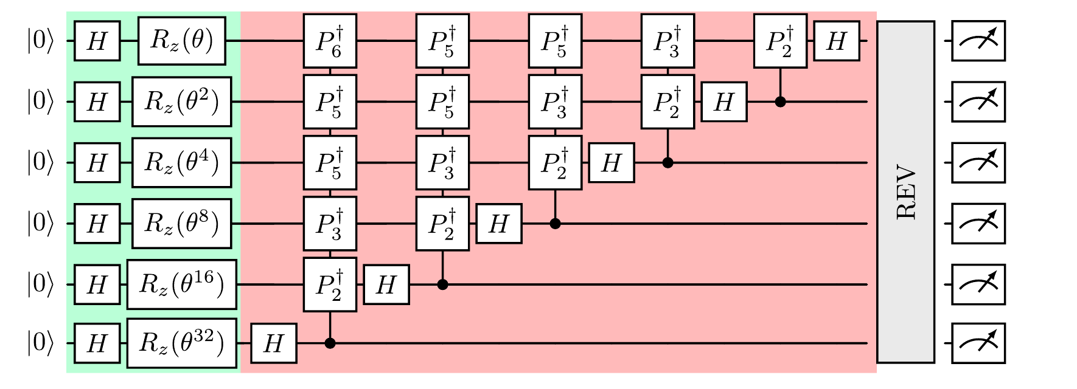
Test case: the inverse QFT on a Fourier state
Green: prepare a known phase θ locally. Red: the inverse QFT recovers θ as a bitstring, so the output can be checked directly.
Notes:
0:50. Why the inverse QFT. It is the core of phase estimation and Shor, and it couples every qubit to every other, which makes it hard to distribute: a good stress test. We use the inverse rather than the forward QFT because the input is easy: each node prepares its own qubits with a Hadamard and an Rz rotation by theta times a power of two, with no cross-node state preparation. The inverse QFT then returns an n-bit approximation of theta, so correctness is checkable by measurement. The REV block, the swaps at the end, is done in classical post-processing, which saves a lot of entanglement.

Slide 6
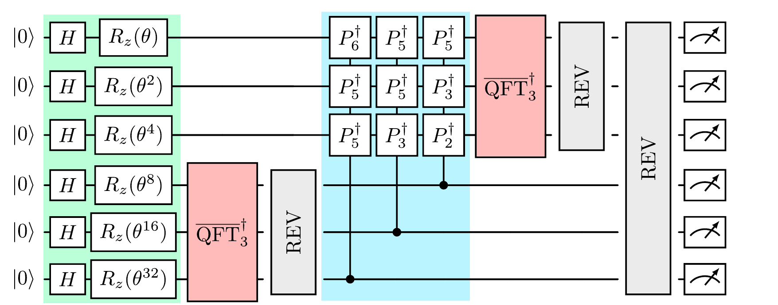
Distributing it: reorder, then teleport
Red: each node runs a local inverse QFT on its own qubits.
Blue: the cross-node phase gradients, the only nonlocal part.
Telegate: teleport the control once with a cat-entangler, apply every gate that shares it, then cat-disentangle.
n/2 EPR pairs for two nodes
Notes:
1:00. Reordering commuting gates turns the monolithic circuit into local inverse QFTs, in red, and one block of controlled phase gradients between nodes, in blue. Only the blue block needs communication. We implement it with telegates: the control qubit is teleported to the other node once, through an EPR pair and a cat-entangler; every controlled phase sharing that control is applied locally; and a cat-disentangler restores the state. For two nodes that costs n over 2 EPR pairs. The local REV operators are pushed to the end by reversing the controls of the gradients, so they also become classical post-processing.

Slide 7
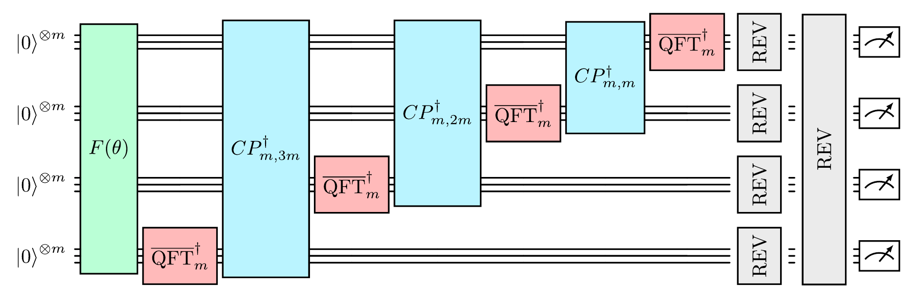
k nodes of m qubits: linear EPR cost
EPR pairs, grouped
m·k(k−1)/2
Example: 20 qubits on 4 nodes
30 EPRs, not 150
Computing blocks, fully parallel
2k − 1
Notes:
1:10. The same idea, applied recursively to k nodes with m qubits each, n equals m times k. Each node does a local inverse QFT, then sends its phase gradient block to the nodes below. Because all gates sharing a control are grouped into one teleportation per control qubit and remote node, the EPR count is m times k choose 2: linear in m and in k. Teleporting each remote controlled phase separately would cost one EPR per cross-node pair, quadratic in both. Concrete numbers: 20 qubits on 4 nodes needs 30 EPR pairs grouped, versus 150 cross-node gates teleported one by one. With full parallelism there are 2k minus 1 computing blocks, and while one node runs its local QFT the others are busy with gradients. Caveat for later: Interlin-q cannot use this grouping, so its numbers include extra teleportations.

Slide 8
Sweep, metrics and hardware
Parameter | Values
Qubits n | 4, 6, 8 … 20
Nodes k | 1, 2, 4, 8
Phase θ | 0.0, 0.33, 0.66 (averaged)
Shots | 100
Topology | All-to-all
Partition | Even, remainder on last node
Metrics
Execution time (Python time) and peak memory (tracemalloc)
Classical fidelity against the monolithic run:
F = Σᵢ √(pᵢ qᵢ)
QMIO cluster, CESGA
2× Xeon Ice Lake 8352Y per node, 64 cores, 256 GB RAM. One core and 4 GB per run, then 1–8 cores. 24 h walltime.
Notes:
1:00. The sweep: even qubit counts from 4 to 20, 1, 2, 4 and 8 nodes, three phase angles averaged, 100 shots, all-to-all connectivity, qubits split evenly with the remainder on the last node. Interlin-q is the exception and needs n to be a multiple of k. Three metrics: wall time and peak memory, measured with Python's time and tracemalloc because not every emulator reports them, and classical fidelity, the Bhattacharyya overlap between the distributed and monolithic output distributions. Fidelity is a sanity check, and it only makes sense for noiseless runs. Everything ran on the QMIO cluster at CESGA: Ice Lake nodes with 64 cores and 256 GB. We started with one core and 4 GB per run, then varied the cores from 1 to 8 to look at parallelism.

Slide 9
One YAML file drives the whole sweep
01 · configure
sweep_params.yaml
Ranges for n, k, θ and the emulators to run.
02 · generate
job_creator.py
One SLURM script per emulator and parameter combination.
03 · template
slurm_template_multinode.sh
Same resources and environment setup for every run.
04 · submit
job_submit_all.sh
Or job_submit_one.sh for targeted tests.
05 · run
emulators/*/env/*.yml
One pinned conda environment per emulator.
06 · analyse
plot_results.py
Parses results/ and draws every figure in this talk.
Emulated quantum nodes live inside one compute node: the cluster’s interconnect is never used.
Notes:
0:50. This is the part closest to this community. Each emulator has a different API and conflicting dependencies, so each lives in its own conda environment with pinned versions: Qiskit Aer 0.17.1 on Qiskit 2.1.1, SquidASM 0.13.4 on NetSquid 1.1.7 and Python 3.8, Interlin-q 0.0.1.post5 on QuNetSim, SQUANCH 1.1.0. One YAML file defines the sweep; job_creator fills a SLURM template per combination; one script submits everything; plot_results draws the figures. Adding an emulator means adding an adapter and an environment. One point to be clear about: an emulated quantum node is not a cluster node. Every simulation runs inside a single compute node, with no inter-node communication. Everything is on GitHub.

Slide 10
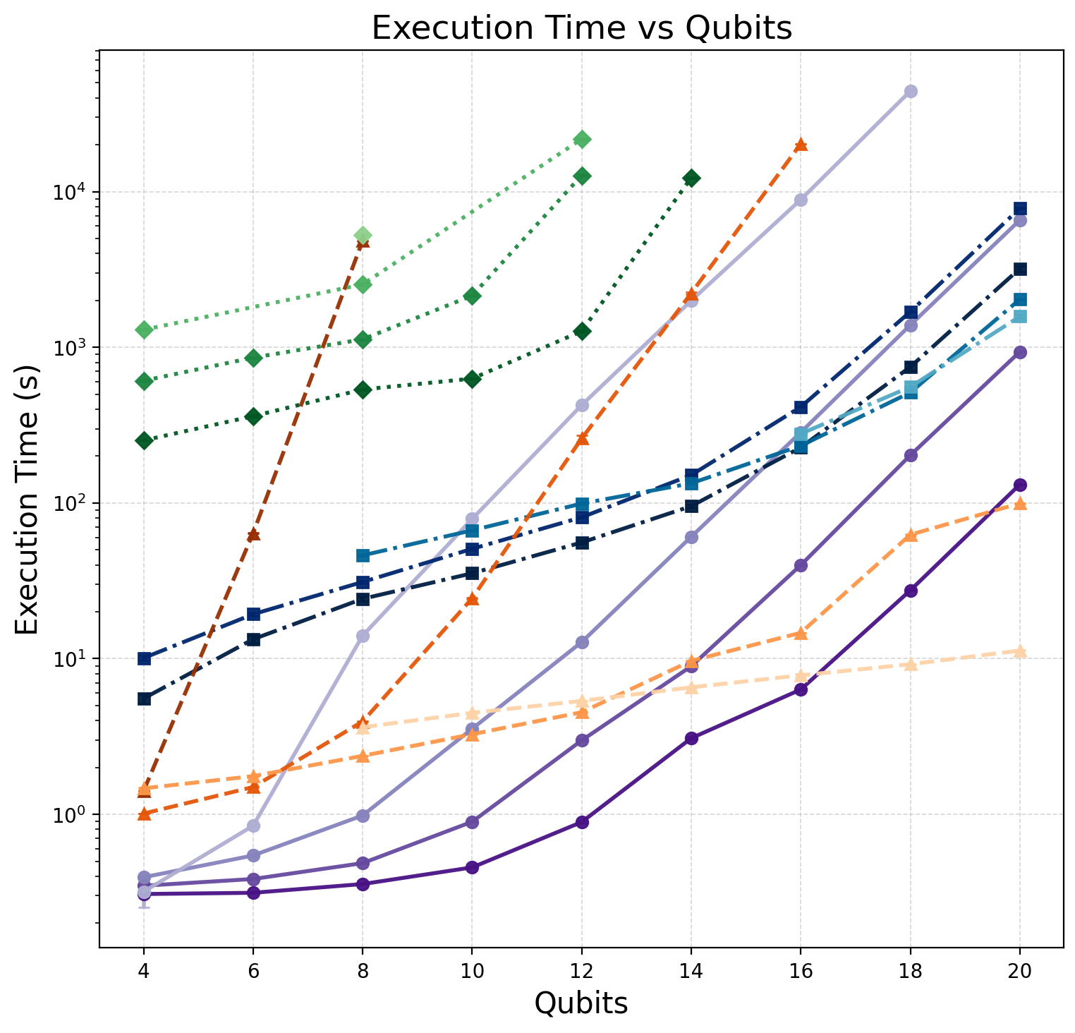
Execution time
Qiskit Aer
SquidASM
Interlin-q
SQUANCH
Darkest = 1 node; lighter shades = more nodes.
Exponential in qubits for every emulator, as expected.
Qiskit Aer is fastest for small sizes; SquidASM catches up as nodes increase.
Interlin-q is the slowest and gets slower with more nodes.
SQUANCH speeds up sharply with more nodes at large sizes.
Most Interlin-q and SQUANCH runs did not finish in 24 h.
Notes:
1:10. Log scale. Every emulator is exponential in the number of qubits; that is the Hilbert space and nothing surprising. The interesting part is the node axis. Qiskit Aer, in purple, is the fastest for small problems, but its curves move up as you add nodes, because of the teleportation overhead. SquidASM, in blue, starts slower, several seconds already at four qubits, but its curves bunch together and it overtakes Aer at higher node counts: it handles distribution better. Interlin-q, in green, starts in the hundreds of seconds and gets worse with nodes. SQUANCH, in orange, collapses for one node but improves sharply when the qubits are split over many nodes. Missing points are runs that did not finish within the 24-hour limit.

Slide 11
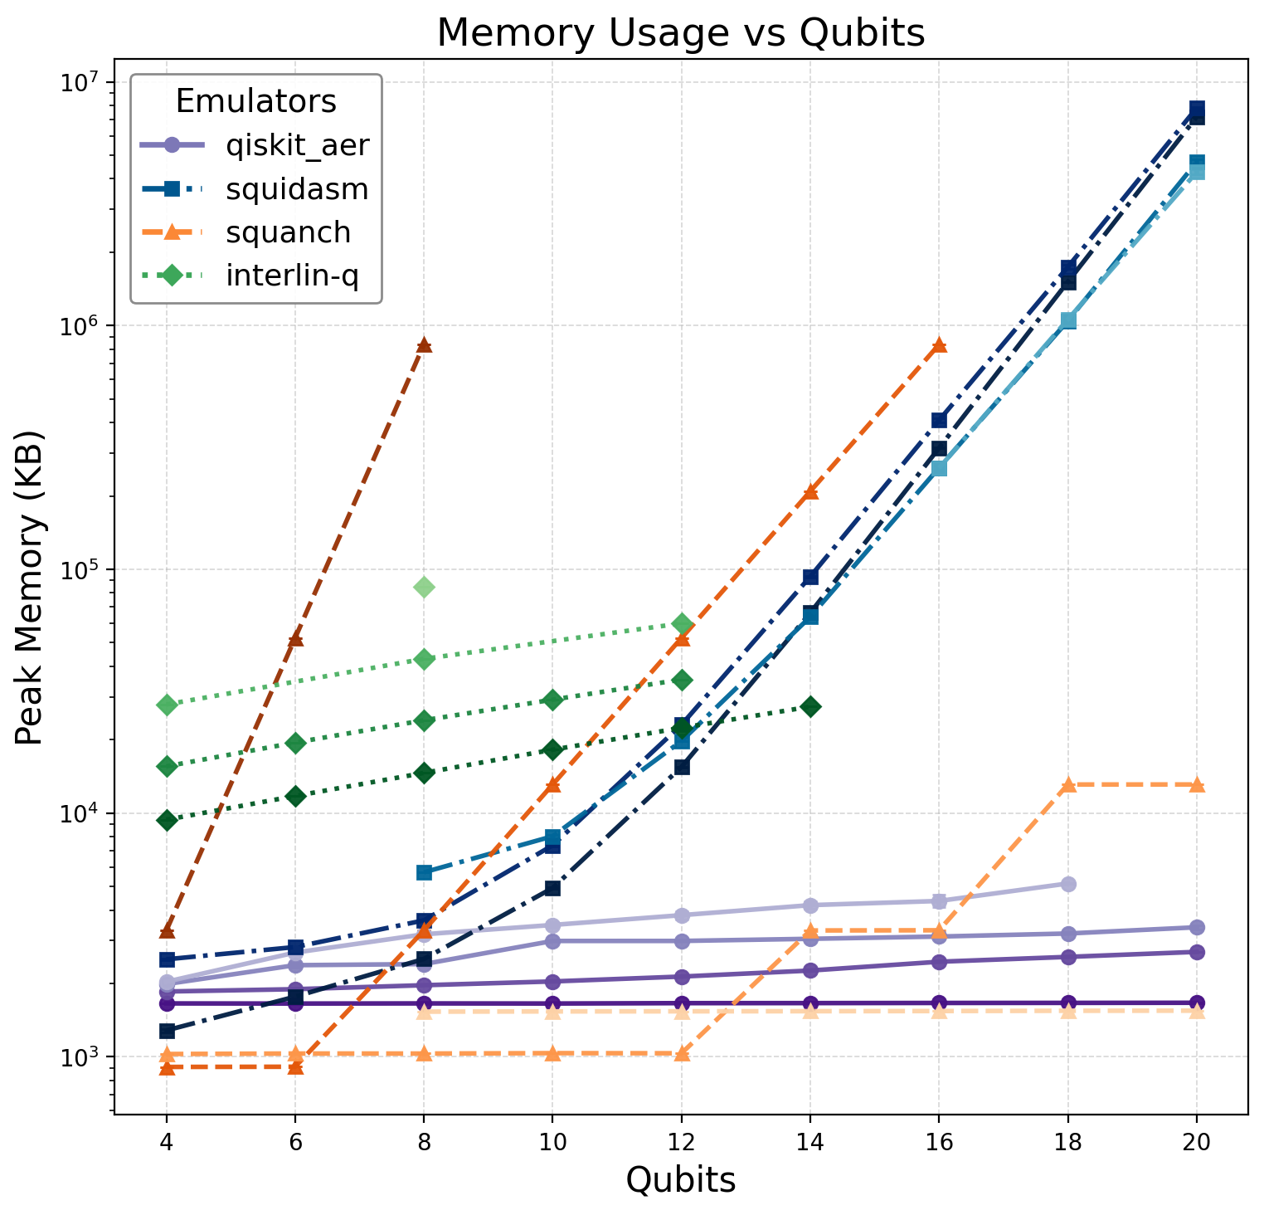
Peak memory
Same colours and shading as the time plot.
Qiskit Aer grows sub-exponentially with qubits, which suggests a memory-efficient internal representation, but more nodes still raise its peak.
SquidASM grows steadily and exponentially, and stays stable as nodes are added.
Interlin-q grows exponentially in both qubits and nodes.
SQUANCH is most efficient with many small nodes.
Notes:
0:50. Memory tells a slightly different story. Qiskit Aer's memory grows much more slowly than a plain statevector would, which suggests it uses a memory-efficient representation internally; that was unexpected. Adding nodes still increases its peak, because of the extra communication qubits. SquidASM shows the clean exponential you would expect, and distributing the same qubits over more nodes does not hurt it. Interlin-q is exponential in qubits and in nodes. SQUANCH, being density-matrix based, explodes on one node but is very light when each node holds few qubits.

Slide 12
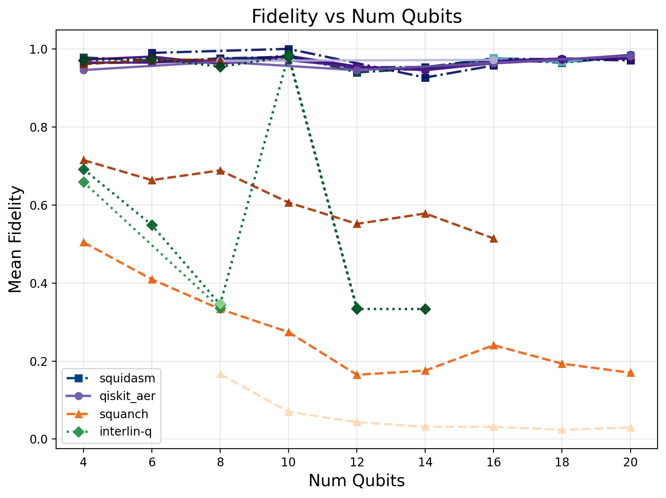
Noiseless fidelity: two emulators hold
≈ 1.0
SquidASM and Qiskit Aer, at every size and node count, within shot noise of 100 shots.
< 0.2
SQUANCH at larger sizes and more nodes. Interlin-q falls to about 0.33.
Notes:
1:10. With no noise, the distributed circuit should reproduce the monolithic distribution exactly, so this is a correctness check. SquidASM and Qiskit Aer stay near one across every qubit count and node count; the small dips are shot noise from 100 shots. Interlin-q and SQUANCH do not: their fidelity falls as qubits or nodes grow, even without noise. For Interlin-q this points to its automatic partitioner. In the preprint we attributed SQUANCH's drop to its lack of a discrete-event engine and teleportation synchronisation. [CHECK BEFORE PRESENTING: we later found two bugs in our own SQUANCH adapter, covered on slide 14. Say clearly that the SQUANCH curve here predates those fixes, or replace it with re-run data.]

Slide 13
Fidelity versus scalability
Emulator | Strength | Limitation
Qiskit Aer | Fastest on small problems; correct output | No network, latency or EPR noise; slows with node count
SquidASM | Correct output, discrete events, noise and delays; scales best with nodes | Slower on small problems; not open source; steep learning curve
Interlin-q | Automatic partitioning and teleportation | No telegate grouping, equal qubits per node, fidelity loss, many runs unfinished
SQUANCH | Intuitive agent API; light with many small nodes | No event engine, fidelity loss, no noise model
SquidASM is the best compromise for algorithmic DQC today.
Notes:
1:00. Putting the three metrics together. Qiskit Aer is the fastest way to check that a distributed algorithm is logically right, but it tells you nothing about the network. SquidASM is the most complete: correct output, discrete-event timing, link noise and delays, and the best behaviour as nodes are added; it is slower on small problems and you need a QuTech licence. Interlin-q is conceptually elegant, but it teleports every remote gate, forces equal partitions, and loses fidelity. SQUANCH is a nice teaching tool but not suitable for quantitative benchmarking. A methodological caveat: the distribution strategies are not identical, because our telegate grouping is not available in Interlin-q. That is a fair comparison of what each tool can do, not of identical circuits.

Slide 14
Conclusions
1
Emulating DQC algorithms is possible, but it takes careful decomposition and tool-specific adapters.
2
Efficiency varies widely: discrete-event SquidASM scales best with nodes; higher-level tools lose fidelity or fail.
3
Fidelity is a concern at scale, above all where communication is abstracted away.
4
Algorithm-aware distribution pays: telegate grouping cuts EPR pairs from O(m²k²) to O(mk).
5
Open gap: no emulator of distributed QC also runs on distributed memory.
gdiaz@cesga.es · github.com/gdiazcamacho/DQC-Emulator-Benchmarking · arXiv:2512.01807
Notes:
0:40. Four conclusions. It can be done, but every emulator needs its own adapter. Resource efficiency varies a lot, and discrete-event SquidASM handles distribution best. Fidelity is a real concern at scale. And algorithm-aware distribution, here telegate grouping, changes the communication cost by an order of growth. Last, the point for a grid audience: nobody yet offers a distributed-distributed emulator, one that emulates distributed quantum processors and spreads the classical simulation over distributed memory. That is where HPC centres like ours can contribute. The code and the preprint are on the slide. Thank you.

Slide 15






Acknowledgements
This project has received funding from the European High-Performance Computing Joint Undertaking under grant agreement 101194491.
CESGA is co-funded by MICIU/AEI/10.13039/501100011033, grant number PCI2025-163133.
Co-funded by the European Union. Views and opinions expressed are however those of the author(s) only and do not necessarily reflect those of the European Union, EuroHPC or any national granting authority. Neither the European Union nor the granting authorities can be held responsible for them.

