Slide 1

The AI-powered innovation catalyst for the One Health sector in Europe
Lois Orosa Nogueira
Scientific Director, CESGA
14th Iberian Grid Conference (IBERGRID) 2026
27th October, Santiago de Compostela

Slide 2
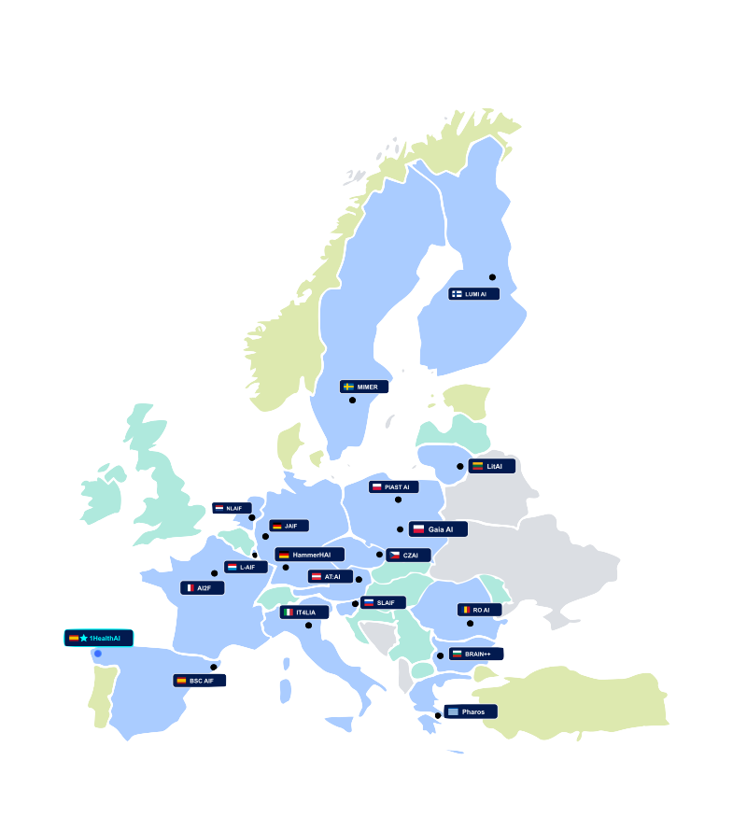



What is a European AI Factory?
STRATEGIC EUROPEAN FRAMEWORK
A specialized EuroHPC ecosystem designed to convert frontier science into sovereign industrial capabilities.
Sovereign Supercomputing
Federated Trust Sandbox
One-Stop Shop Access
Dedicated EuroHPC GPU nodes optimized for training trillion-parameter life-science AI models.
Secure validation environments ensuring full conformity with the EU AI Act and GDPR.
Centralized pipeline facilitating compute, data, and business acceleration for researchers and SMEs.
Aligned with EU AI Continent Action Plan and Common EU Data Spaces
2

Slide 3







EuroHPC Node & Regional Ecosystem
1HEALTHAI Consortium
HOSTING ENTITY & COORDINATOR
CO-LEAD INSTITUTION
ACADEMIC ENGINES
MARKET & TRUST
CESGA
CSIC
USC • UDC • UVigo
DATAlife • gradiant
Operates Supercomputers since 1993. Leads AIF coordination and HPC/AI deployment
Spain's premier public research body and co-leader of AIF
AI science and training provided by the 3 Galician universities: UDC, USC & UVigo
DATAlife brings innovation & SME uptake. Gradiant provides cybersecurity and AI Act conformity
A collaborative Alliance integrating Supercomputing, science, academia and ecosystem
3

Slide 4



The ONE Health Paradigm
INTERDISCIPLINARY THEMATIC DOMAIN
Human Health
Precision clinical diagnostics, rare disease prediction, and multi-modal biomedical models.
Environmental Health
Environmental Health
Antimicrobial resistance (AMR), climate vector spread, and marine microbiome genomics.
Animal Health
Cross-species pathogen tracking, livestock epidemic monitoring, and veterinary pharmacology.
Unified Impact: Breaking clinical and ecological silos with multi-modal AI foundational models.
4

Slide 5



Funding for Sovereign Technological Infrastructure & Services
AIF NUMBERS
State-of-the-Art GPUs
Tiered Storage Fabric
High-throughput nodes optimized for petascale training
Ultra-fast parallel NVMe for massive health dataspaces
EuroHPC JU
Optimized Supercomputer for AI- 54M
41M€
82M€
AI Factory– 24M
Total investment
SPAIN (Ministry / Xunta)
41M€
(24M€/17M€)
Experimental platform - 4M
5

Slide 6

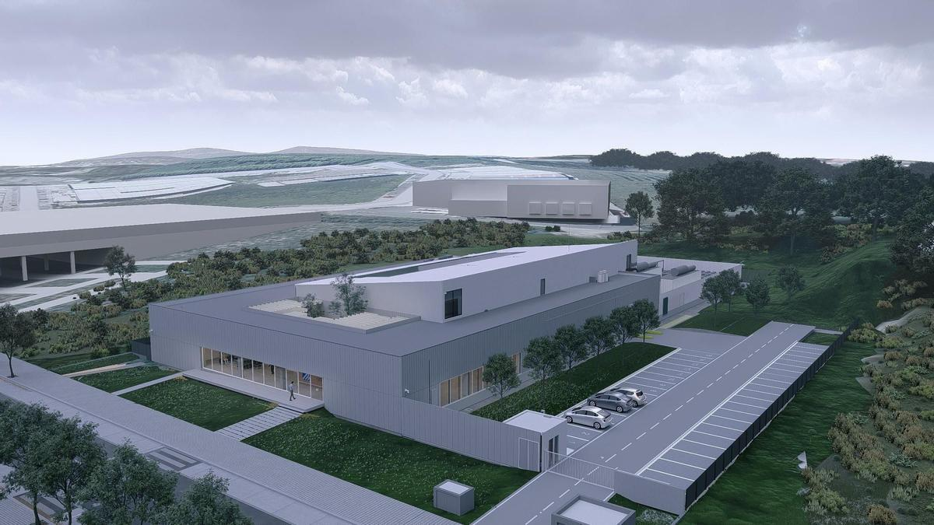
New Data Center in the Sionlla Industrial Park
PAVING THE WAY TOWARDS THE AI FACTORY (I)
WILL MAINLY INCLUDE
European-scale supercomputers
Quantum computers
Laboratories
6

Slide 7
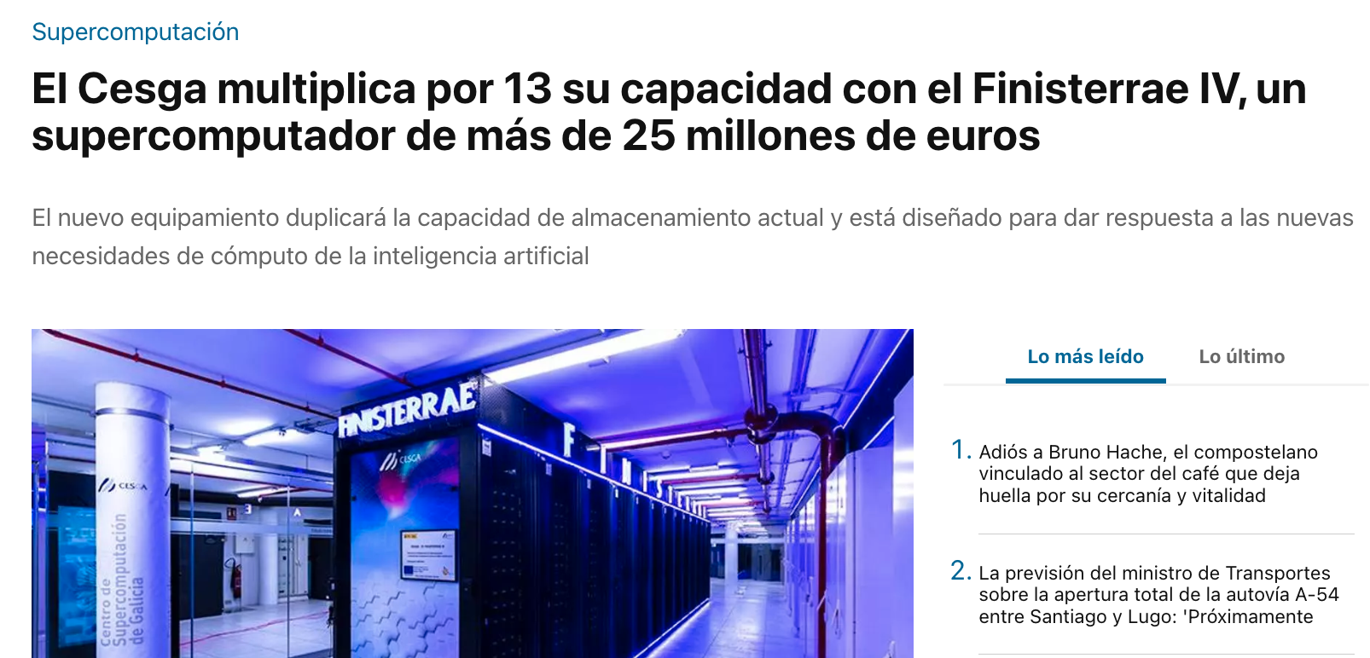
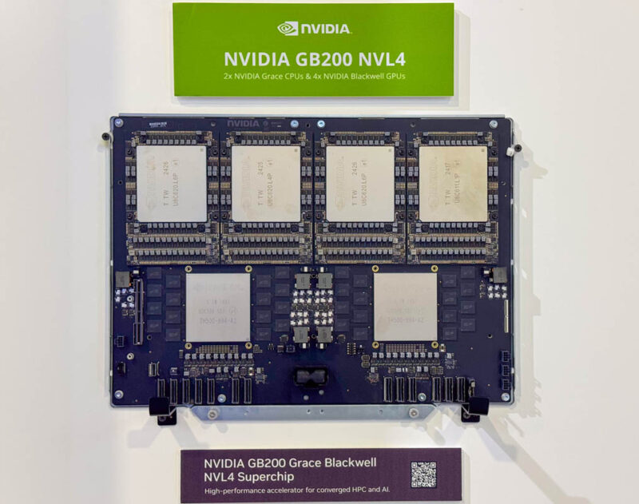
FinisTerrae IV: 13× CESGA's Computing Capacity
PAVING THE WAY TOWARDS THE AI FACTORY (II)
KEY FACTS
13×
computing capacity at CESGA
€25M+
investment in the new supercomputer
2×
storage capacity, designed for AI workloads
7

Slide 8
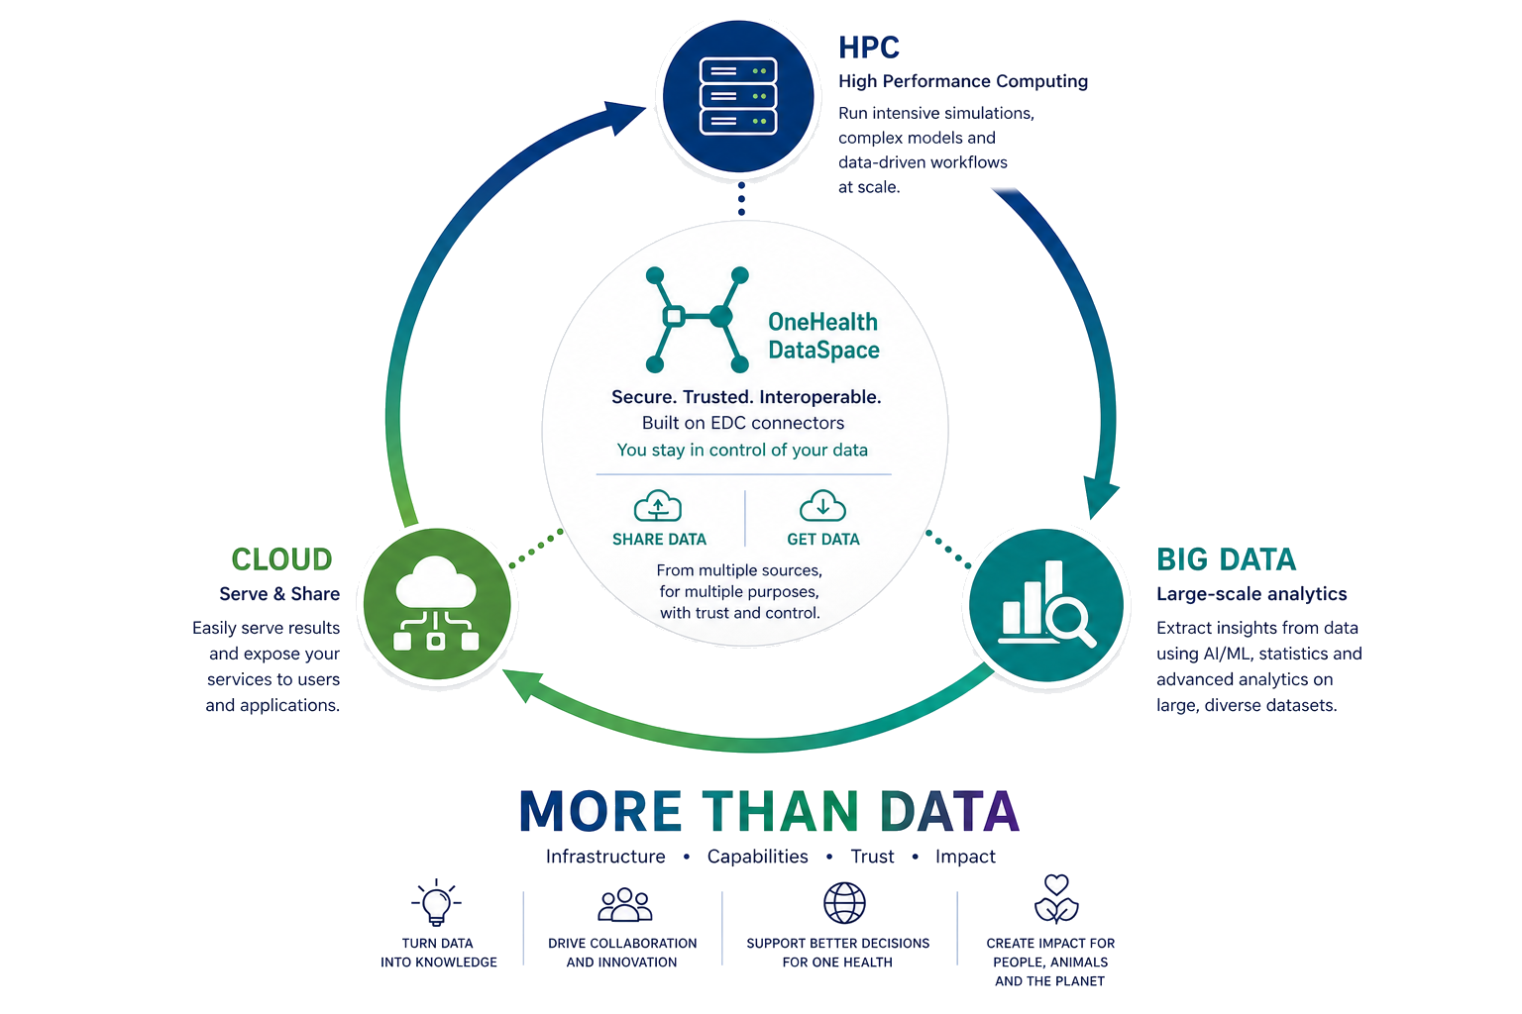

OneHealth Dataspace Project
PAVING THE WAY TOWARDS THE AI FACTORY (III)
8

Slide 9




Modular Service Catalogue
1healthai COMPREHENSIVE OFFER
HPC & AI
Infrastructure
Regulation, Hub
& Talent
Data Services
AI Development
Sovereign Compute
Interoperability
Training & Tuning
Compliance
EuroHPC AI-optimized supercomputing node for AI (GPUs).
Seamless integration with EU Data Spaces (EHDS/Gaia-X).
Pre-training & fine-tuning pipelines for SLMs, LLMs, Computer Vision, and KGs.
EU AI Act Trust Sandbox for validating high-risk models.
Data Augmentation
Validation
Commercialization
Model Availability
Advanced synthetic data generation toolbox for health applications.
Startup acceleration, Fast Track access, and dedicated investor matchmaking.
Local repository for instant, secure access to open-weight models.
Continuous improvement procedures and Trustworthy AI assurance.
Easy 24/7 Access
Architecture
Oversight
Talent
Support to SMEs, spin-offs, innovators, to leverage their ideas with AI + HPC
MLOps, federated analytics utilizing PETs and TEEs, and cloud orchestration.
Rigorous bias auditing and Explainable AI (XAI) verification.
AI Factory Academy offering micro-credentials, MOOCs, and AI-Lab bootcamps.
Acquire Data
Train Models
Audit Compliance
Deploy Solutions
Upskill Talent
9

Slide 10

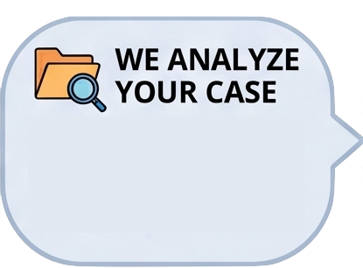
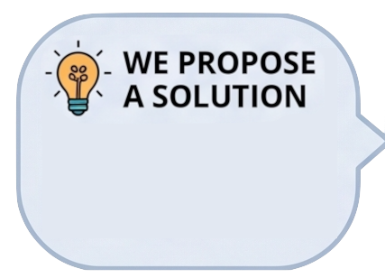
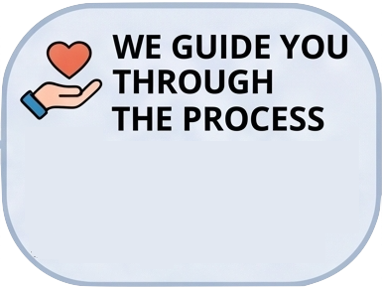

One stop Shop: 5-Stage Procedure
User engagement & delivery model
A structured –and free-process from initial user need to final delivery
Your company explains the problem, idea or project where it wants to implement AI
We understand the most suitable needs and resources for the request
We identify the services and capabilities that align with your needs
The right specialists work on the solution, guiding you through the entire process.
Once completed, we review the results achieved & the impact on your business.
Fast-track onboarding and ticket resolution supported by multi-tiered expert escalation.
10

Slide 11
HPC Resource Access Modes
EUROHPC JOINT UNDERTAKING RESOURCE CHANNELS
Low Friction
Continuous Call
Peer Reviewed
Scientific Impact
Playground
Fast Lane
Large Scale
AI for Science
Rapid code testing, algorithm porting, and benchmark feasibility before formal allocation.
Agile track for SMEs and researchers requiring up to 50k GPU hours with rapid review cycles.
Massive compute allocation for training foundational and trillion-parameter One Health models.
Dedicated track for breakthrough interdisciplinary research in biology, genomics, and ecology.
Turnaround: Immediate Access
Allocation: <50,000 GPU Hours
Allocation: >50,000 GPU Hours
Target: 80+ Science Apps
EuroHPC JU governs 50% of available access time for European strategic calls
11

Slide 12
Example Pilots & Data Ecosystem
REAL-WORLD TRANSLATIONAL IMPACT
Human Health
Translational & Social
Ecosystem & Data Space
AIDATAMED
CeliaSpace / Serenia
Synthetic clinical data generation for medical research (IISGS).
Health conversational assistant with 10,000+ elderly users (UVigo).
Gut microbiome genetic data fused with environmental factors.
GIFT
DatIAcare & SALUSBENCH
Gastroenterology conversational AI for clinical guidance.
Frailty indexing and inter-hospital benchmarking analytics.
Cross-domain repositories covering marine and agrifood data.
Brilliant
Veterinary Pilots
Deep learning sarcopenia analysis on lumbar MRI scans.
Predictive clinical assistants for cross-species pathology.
20+ spin-offs accelerated through EDIH DATAlife mentorship.
Drug Discovery and Pharmaceutical Development - Genomics, Bioinformatics, and Antibiotic Resistance - Earth Observation and Climate-Health Modelling - Healthcare Delivery and Personalized Medicine - Blue Biotechnology and Marine Resource Management - Agricultural Biotechnology and Functional Foods.
12

Slide 13
AI Factory Academy & Next Steps
HUMAN CAPITAL & ONBOARDING ROADMAP
3-Phase Curriculum
EU Standards
Milestones & Access
Academy Portal
Micro-Credentials
Adhesion Roadmap
30+ interactive modules spanning Early Vocations, Youth Specialization, and Market Maturity tracks.
Official European skill certification tagged against DigComp, ESCO, and ResearchComp taxonomies.
Open calls launch at M12, 50+ research fellowships, and the European Community of Practice (CoP).
>1,000 Registered Learners
Interoperable Across EU
Launch: Month 12 (M12)
Empowering Europe's talent pool with stackable, portable life-science AI competencies.
13

Slide 14
What an AI Factory is NOT
COMMON MISCONCEPTIONS
A funding scheme for computing infrastructure
An exclusively academic research framework
✕
✕
A basic IT support center
A commercial services company
✕
✕
A “passive”, stand-alone space
A 36-month European project
✕
✕
It is a long-term, service-oriented AI Center for the One Health ecosystem
14

Slide 15






+ info
1healthai.eu
info@1healthai.eu
The acquisition and operation of the EuroHPC Al-optimised supercomputer is funded jointly by the EuroHPC Joint Undertaking, through the European Union's Digital Europe Programme, as well as by the Participating State of Spain, and by the Regional Government of Galicia, Xunta de Galicia.
Views and opinions expressed are however those of the author(s) only and do not necessarily reflect those of the European Union or EuroHPC Joint Undertaking. Neither the European Union nor the EuroHPC Joint Undertaking can be held responsible for them.
15

