Slide 1





PHOTONIC – Photon data focused
Photon Science - Harmonized Online Tools for Open, Navigable, Interactive Computing
Tim Wetzel, Patrick Fuhrmann, Sophie Servan, Paul Millar, Shruti Ghargi, Sebastian Paripsa,
Linus Pithan, Devin Burke – DESY
Luca Gelisio, Thomas Michelat – EuXFEL
Nicolas Hayen – CAU Kiel
Slides courtesy by Patrick Fuhrmann
https://photonic-project.org/

Slide 2
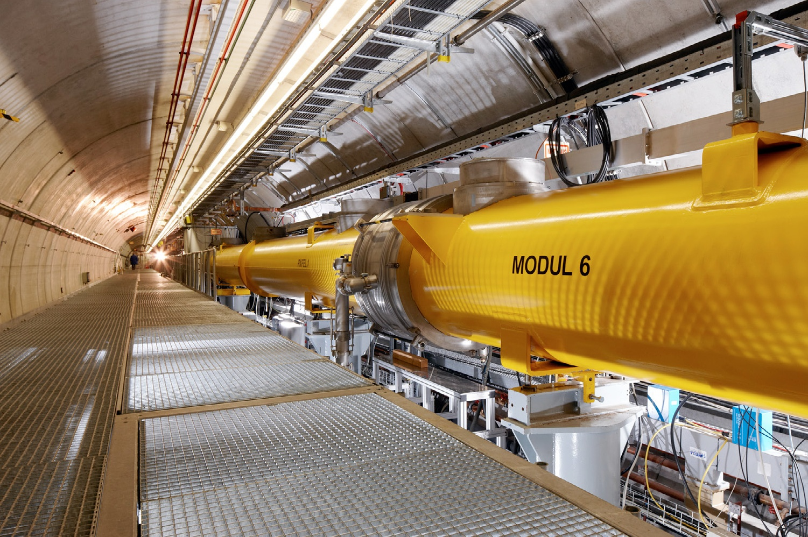
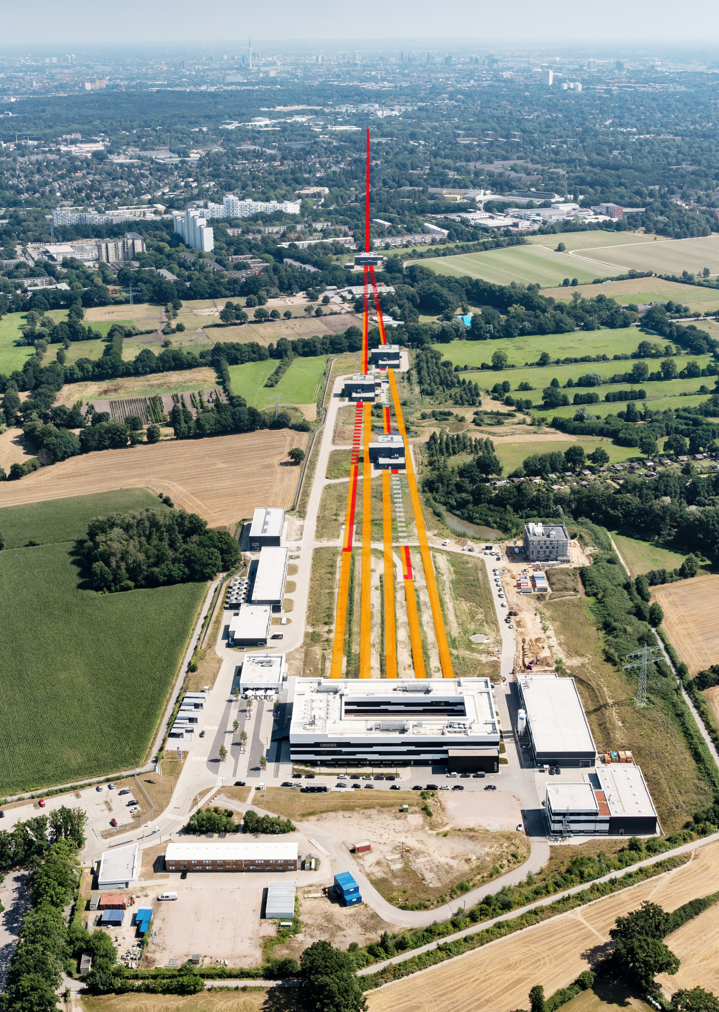
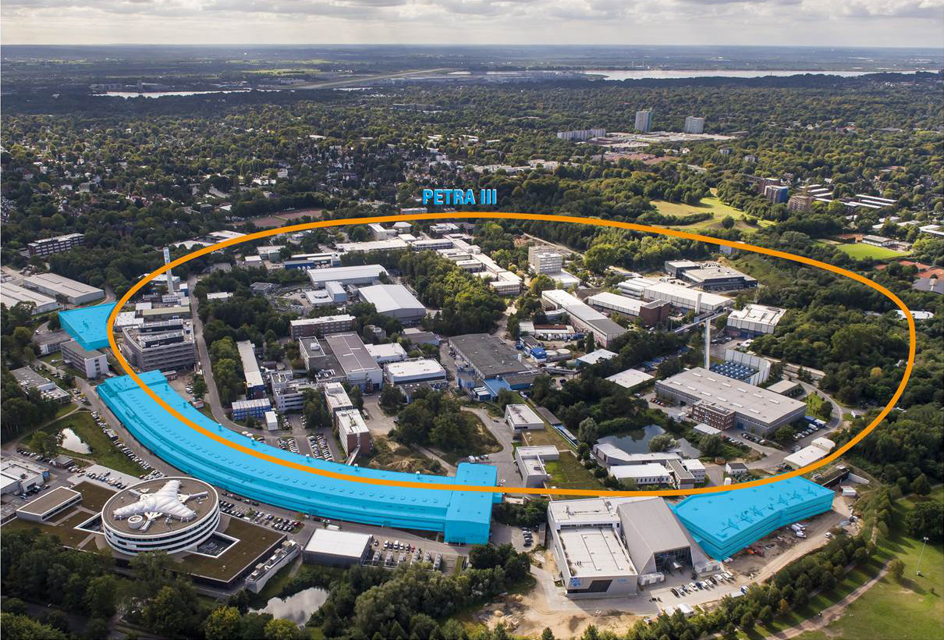
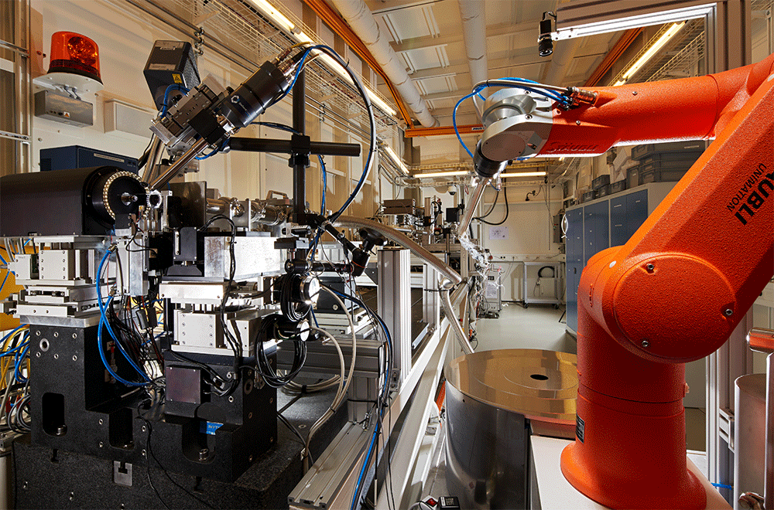
Our Data (light) sources
EuXFEL
FLASH
PETRA III
P11 - High-throughput Macromolecular Crystallography beamline

Slide 3
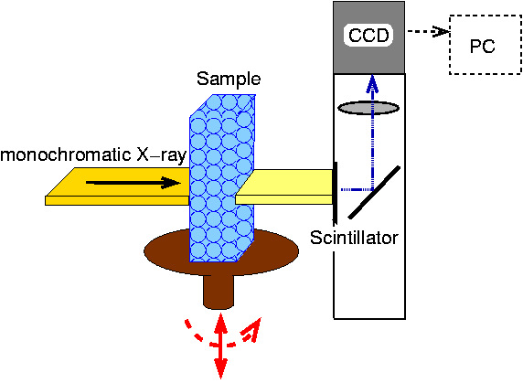
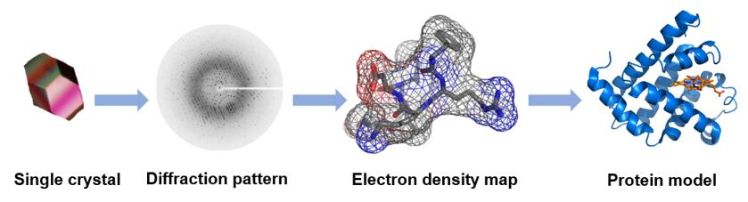
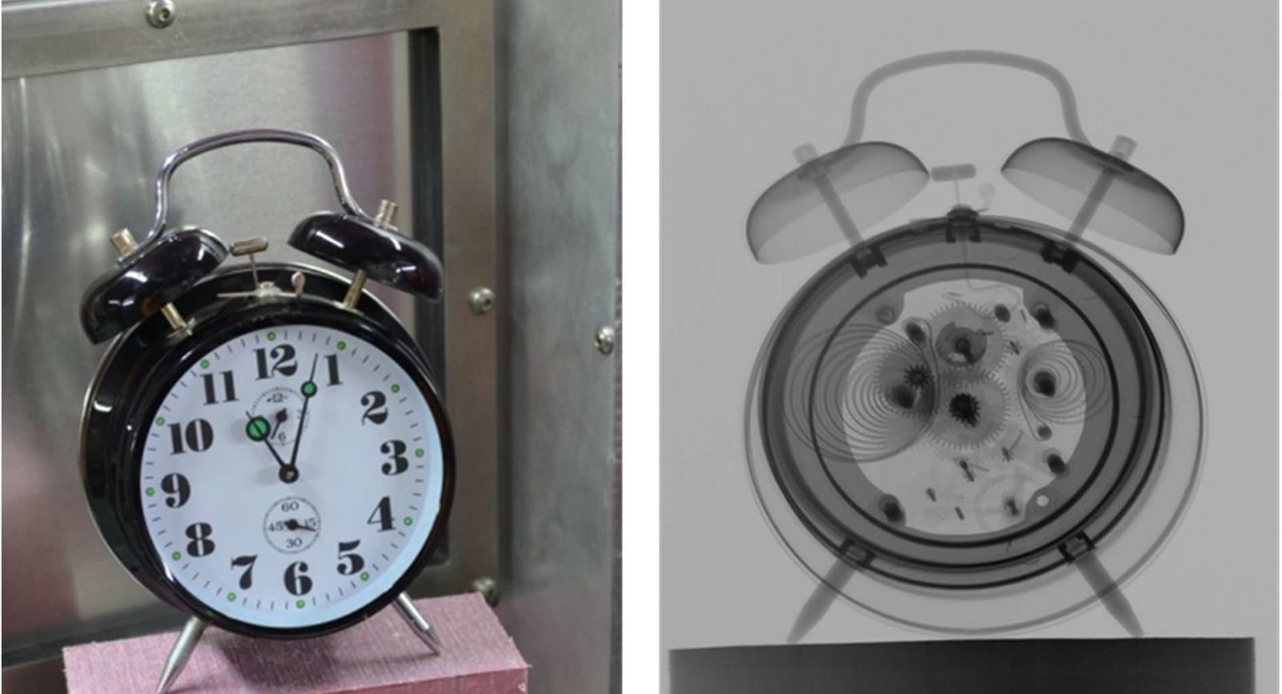
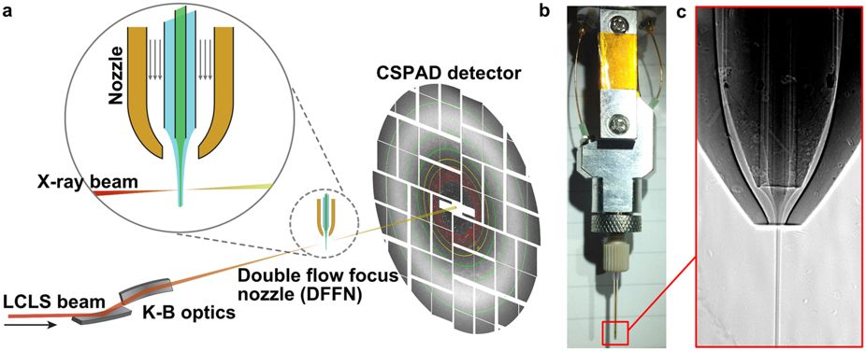
Using Photons and Neutrons
Conservative Crystallography
Photon Tomography
Neutron Tomography
Serial Crystallography
A new Neutron Radiography / Tomography / Imaging Station DINGO at OPAL
Plasma Physics, Quantum Physics,
See Lightsources.org
The experiments at the light sources at DESY range from basic to application-oriented research by science and industry in the fields of physics, chemistry, biology, medicine, life sciences, geosciences, materials science and the study of cultural assets.

Slide 4

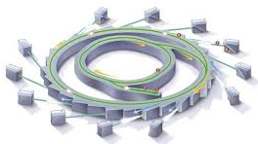

What is the issue we need to solve!
Beamlines produce a huge amount of data, but the time and capacity of the remote compute infrastructure (mostly laptops) is limited.
And a large portion of science is done by research groups (students) at the Universities.
GOAL: Provide universities with access to scientific data generated by high-volume facilities, such as synchrotrons and enable remote visualization and analysis.

Slide 5
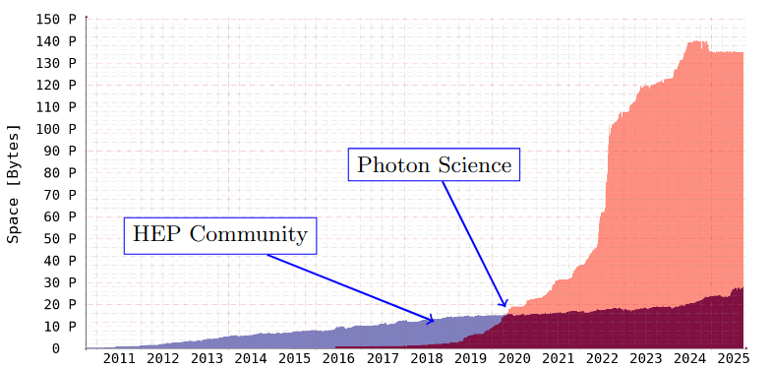
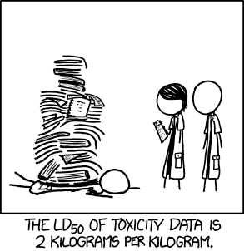
Why would that be an issue ?
There are techniques (beamlines) creating petabytes of data per beamtime within a couple of days.
On DISK storage per scientific community at DESY.
xkcd.com/1260
On DISK storage per scientific community at DESY. With the start of the EU-XFEL and PETRA III, the Photon Science community dominated the storage needs (significantly)

Slide 6
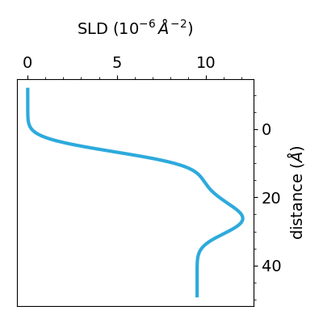

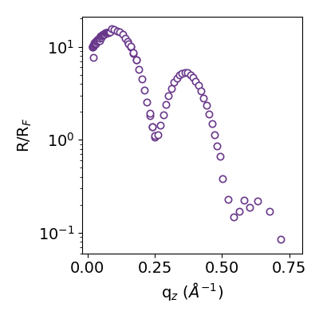



X-Ray Reflectivity (XRR) Analysis
From Nicolas
X-ray reflectivity measurements (XRR) is an established and widely used technique for investigating nanoscale structure at solid and liquid interfaces and surfaces, e.g. semiconductor components and lipid Langmuir films. From the characteristic curve of XRR, conclusions can be drawn about the nature of the sample interfaces, in particular the electron density, layer thickness, and roughness of the interfaces down to atomic resolution.
What can XRR reveal about surfaces and interfaces?
Reflectivity curves are converted to density (Scattering Length Density) profiles
Phase problem: XRR does not uniquely imply SLD
Modeling with prior assumptions + parameter optimization
Time- & Labor-intensive

Slide 7

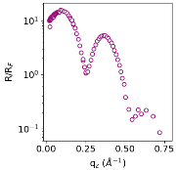

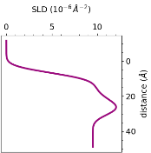
XRR Data Management
From Nicolas
Beamline GPFS
Core Fast Storage
After ≈ 6 months
Tape
Archive
User Needs
Intuitive Real-Time Visualization
Data Comparisons
Access to Data from previous Beamtimes
Full Copy
Raw
Data
Initial
Extraction
User
University
Storage
Re-Extraction
Model
Fitting

Slide 8
XRR Summary
From Nicolas
XRR Requirements
XRR Users need interactive data exploration and visualization
Reusable analysis tools need common standards and stable interfaces
PHOTONIC’s work
Standard XRR data interoperability formats
Accessing & transcoding data
Integration with new client software

Slide 9
High level goals (more specific)
Accessing specific slices of data from a recent or ongoing experiment at their home institutions for visualization or ad-hoc data analysis.
Using a personal laptop during beamtime (e.g., via eduroam Wi-Fi) to conveniently access live data generated during the ongoing measurement.
Exploring experimental data after completing a beamline experiment, using facility-provided computing clusters for initial data reduction and analysis to identify publishable results.
Training on open datasets to prepare for and optimize upcoming beamtime experiments.
Supporting Open and FAIR data principles by enabling the download of datasets from other experiments once the embargo period has ended

Slide 10
The Architecture
Existing
New Components
Data Sources / Facilities / Infrastructures
Universities
PETRA
EU-XFEL
Bessy II
Tiered
Storage
API Server
API Client
REST API
H5 web
Beamline
e.g.
ASAP:O
.nexus
e.g.
ASAP:O
Transcoding
Plugins
Analysis Pipeline
Beamline
nexus
.ort
ort
XPCS domain core
Beamline
.h5
xdi
Beamline
fio
XRR Visualization
.fio
Access Permissions
Helmholtz ID

Slide 11
Tiled by Bluesky
https://github.com/bluesky/tiled
https://blueskyproject.io/tiled/
From Devin
Tiled is a service that enables secure, structured access to scientific data.
Supports search, remote slicing, format conversion, and live data streaming.
Developed at NSLS-II, it is seeing production beamlines at American facilities and experimental use at Diamond and HZB BESSY-II.
Ships with a python client API for easy integration into server and client systems.
Two development instances now run in our DMZ-photonic Kubernetes cluster at DESY.

Slide 12







Service Infrastructure Architecture
Service to
Universities
Bluesky Tiled Services / REST Services
High Performance
Highly Redudant
ASAP:O
Tiered Storage

Slide 13





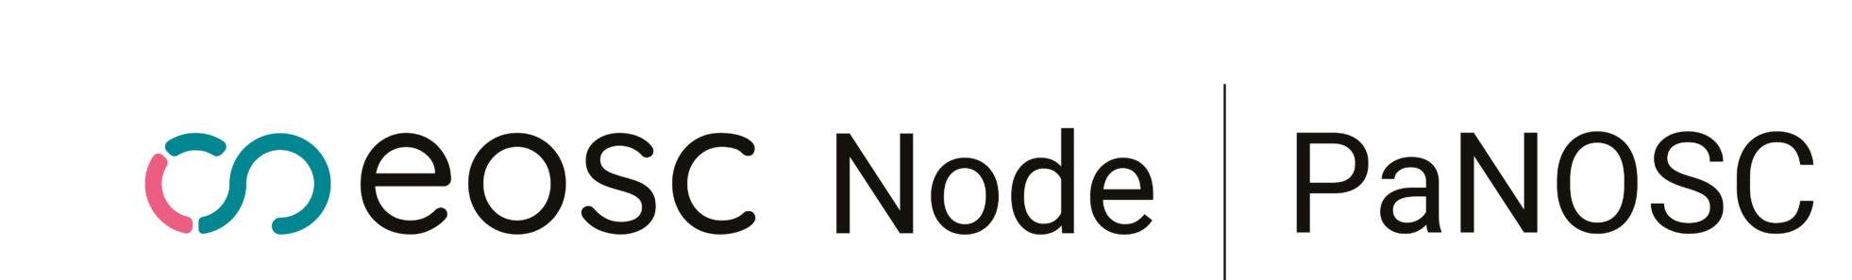
Other friends

Slide 14
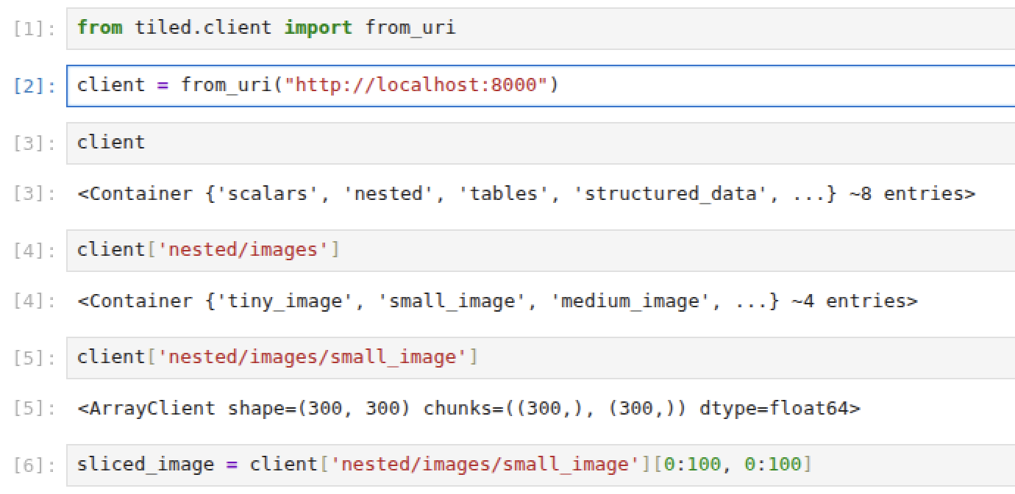
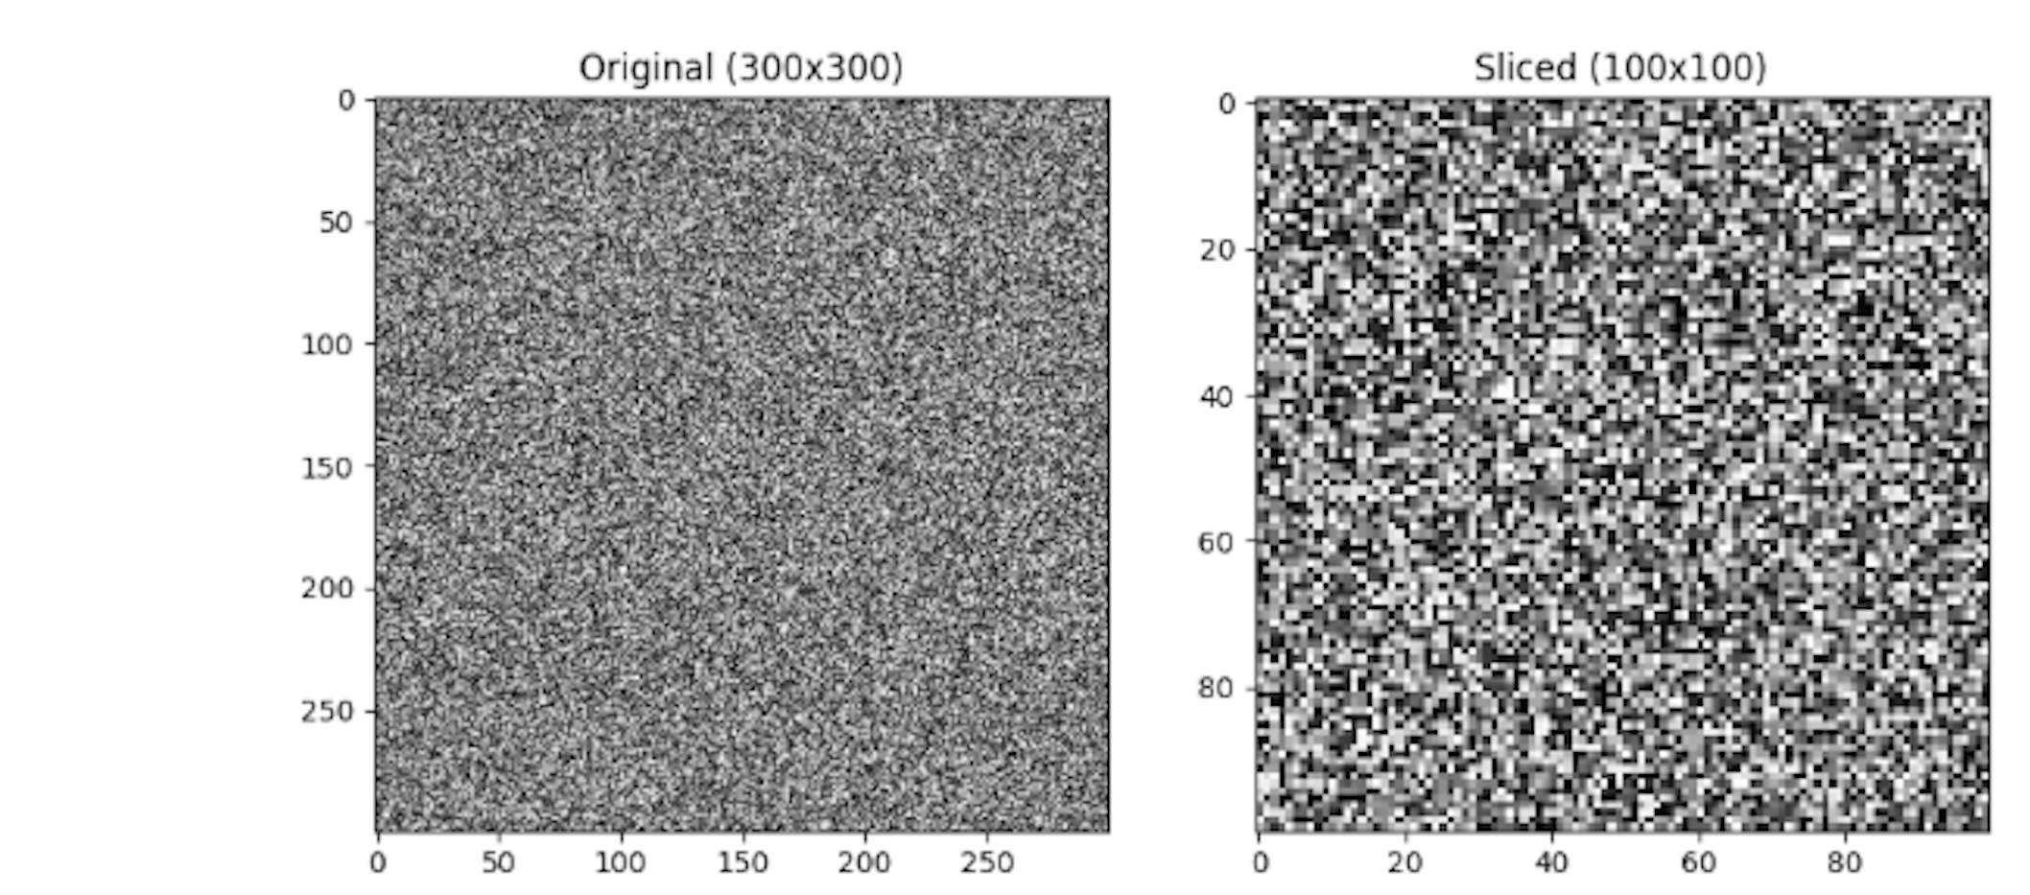
Already done ….
From Shruti
Checking server – tiled client in a Jupyter Notebook
Original (300 x 300)
Slice (100 x 100)
Client understands the data structure from the server side!
Client only downloads the slices needed!

Slide 15
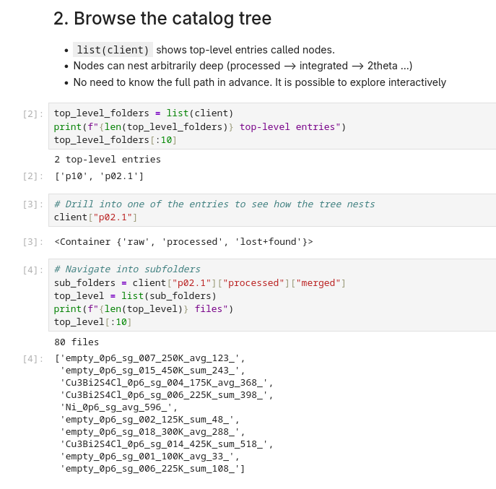
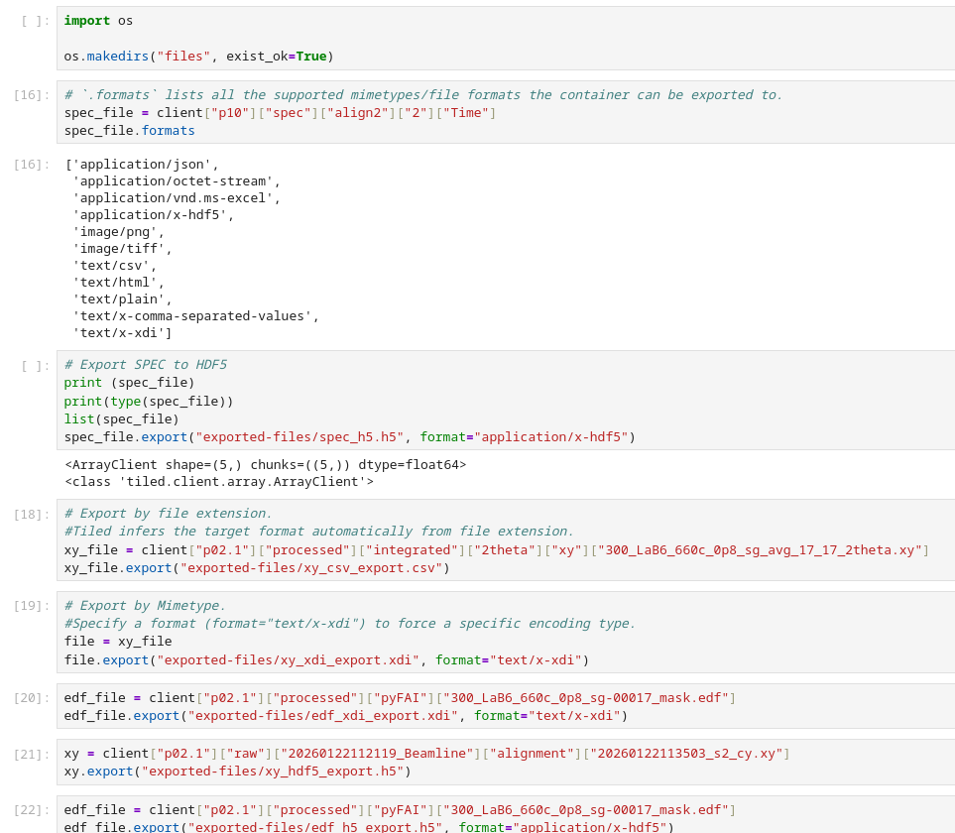
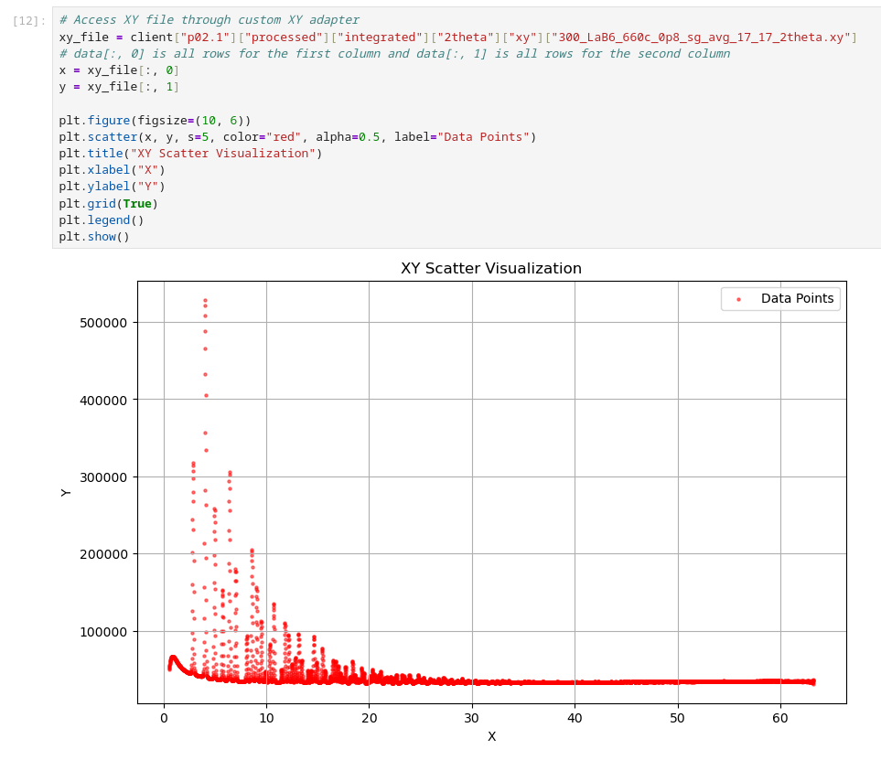
Already done ….
From Shruti
Browsing, visualising & exporting to different formats

Slide 16
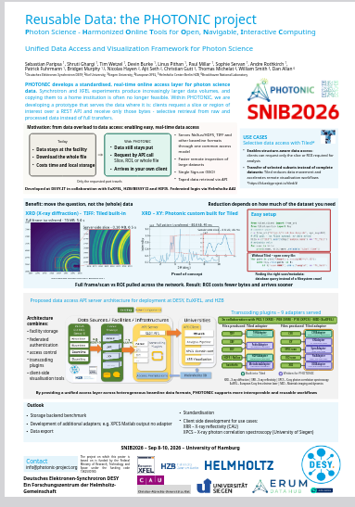
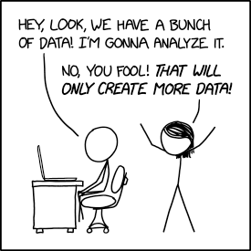
Thanks
Questions?
Our poster at SNIB2026:
https://doi.org/10.5281/zenodo.22769688
Contact:
Tim Wetzel
tim.wetzel@desy.de
xkcd.com/2582

