Slide 1
OPENHIDRA: coastal and port climate-adaptation forecasting delivered as an EOSC service on Iberian computing infrastructures
Alberto Azevedo
Laboratório Nacional de Engenharia Civil, LNEC

Slide 2

Overview
Outline
CLIMATE-ADAPT4EOSC
Horizon Europe RIA · GA 101188248
1
Context and IT challenges
What a port and coastal forecasting service has to deliver
OPENHIDRA architecture
OPENCoastS (circulation) + HIDRALERTA (waves, overtopping, ships)
11
real-case scenarios in
5 EU Member States
TRL 4→7
OPENHIDRA maturity
target in the project
2
3
Deployment on Iberian infrastructures
Cloud and batch resources at CNCA; jobs via EGI DIRAC
4
From per-site systems to a relocatable service
What changes for HIDRALERTA and OPENCoastS
1 + 3
sites to run in parallel:
1 pilot + 3 replicator ports
72 h
alert horizon,
forecasts updated daily
5
EOSC integration, FAIR data
Four layers; EGI Check-in, B2SAFE, DIRAC; RO-Crate and PIDs
6
OPENHIDRA is Use Case 2, led by LNEC; runs on CNCA cloud resources. Pilot: Aveiro Lagoon (PT). Replicators: Piraeus, Rhodes (GR), Dunkirk (FR).
Summary and next steps

Slide 3






Challenges in port and coastal management
Coastal hazards set the demand; the IT side decides whether forecasts arrive on time, at scale
WHAT DRIVES DEMAND
Sea-level rise and storms
Overtopping and flooding
Port downtime
Mean sea-level rise and more frequent, stronger storms raise extreme water levels, while more people live on the coast.
Wave overtopping damages breakwaters, seawalls and terminals, and floods the assets and people behind them.
Waves, wind and currents disturb ship manoeuvres and moorings, forcing closures that hit supply chains.
WHAT MAKES DELIVERY HARD: THE IT CHALLENGES
Mixed, sensitive data
Daily compute at scale
System-by-system set-ups
EMODnet, CMEMS, ECMWF, buoy and port inputs in NetCDF, GRIB, GeoTIFF and CSV; some port data are confidential.
SCHISM, WAVEWATCH III, SWAN, then DREAMS, SWASH, SWAMS, TRANSIT: daily, for several sites, on shared resources.
Each HIDRALERTA system is installed for one port: costly in staff time, slow to update, hard to replicate.

Slide 4
OPENHIDRA - A Climate Change Adaptation Service for Ports and Coastal Areas
OPENHIDRA is envisioned as an innovative climate adaptation service designed to enhance the resilience of European ports and coastal areas against climate-related hazards
By integrating Hidralerta (a port alert system) with OPENCoastS (an EOSC-based coastal forecasting service), OPENHIDRA aims to provide on-demand, high-resolution simulations for coastal and lagoon circulation, overtopping assessment, and port operations, enabling both long-term climate adaptation planning and real-time early warning systems
Once developed, this open-access service will empower port authorities, coastal managers, and communities to make data-driven decisions, reducing risks from coastal flooding, sea-level rise, and extreme weather events while fostering collaboration through the European Open Science Cloud (EOSC)

Slide 5
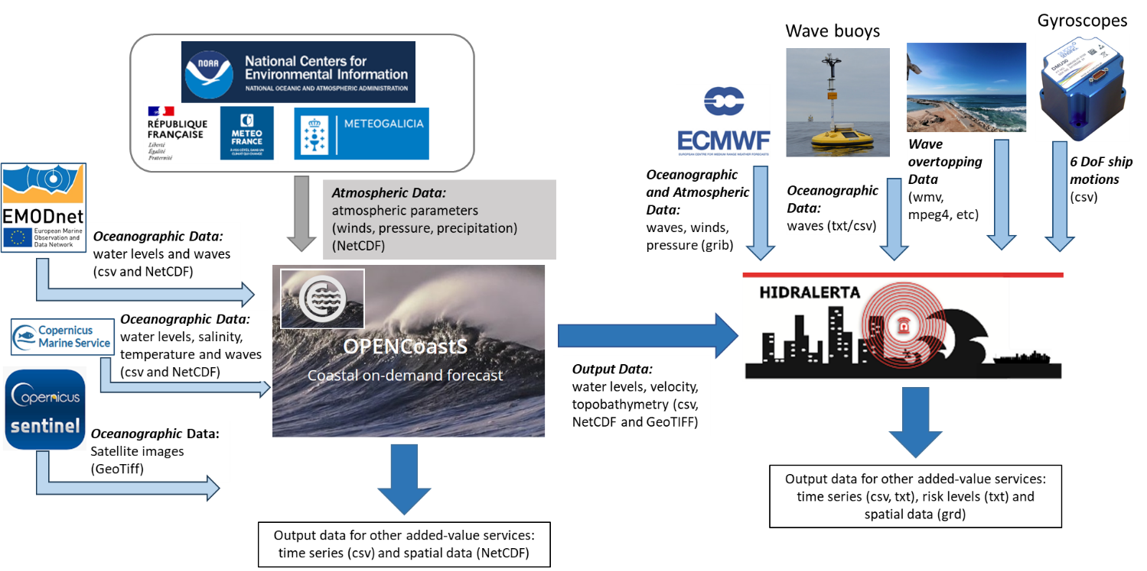
OPENHIDRA

Slide 6

+
OPENCoastS - A service for empowering users to build coastal forecasts
Develop forecast systems for user-selected locations with a browser-based, user-friendly interface
Enable configuration of forcings, processes, and model parameters for greater flexibility
Support circulation processes, including tides, surge, wind, waves, wave-current interactions, and baroclinic flows, along with water quality modelling for faecal contamination, tracers, and sediment-related processes
Design a scalable IT architecture adaptable to additional processes, models, and processing tools
Leverage CNCA/EOSC infrastructure and core services for computational resource access.

Slide 7
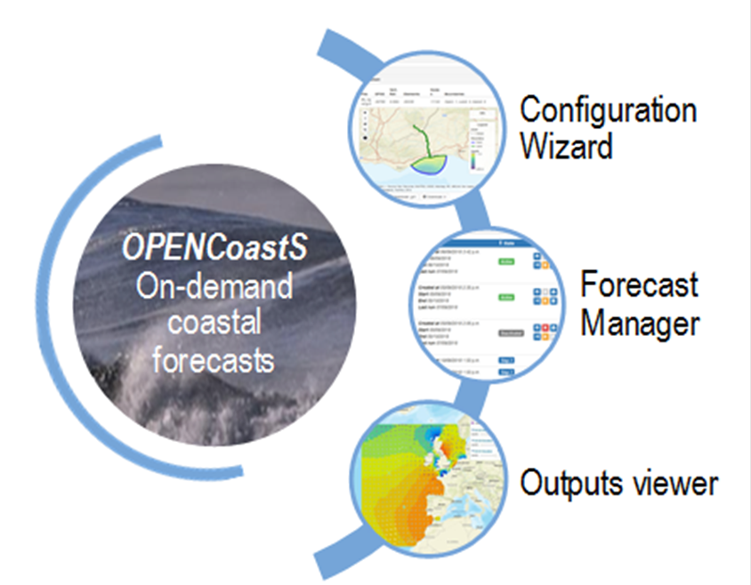
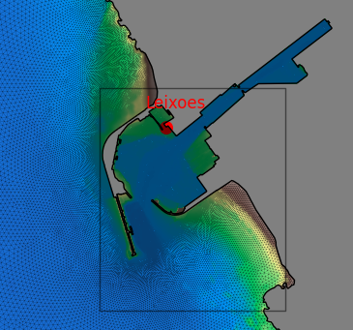

+
Daily forecasts of water levels, wave parameters, 2D and 3D velocities, and 3D salinities, temperatures and water quality variables
Numerical simulations of all relevant physical and biogeochemical processes using the modelling suite SCHISM, with unstructured triangular grids for adequate cross-scale representation/land interactions
Multiple forcings:
  Atmosphere: NOAA, Météo-France, MeteoGalicia, IPMA
  Ocean: FES2014, CMEMS
  Rivers: climatology, tailored forecasts using the AI4Rivers service
Automatic comparison with data from EMODnet
Comparison with land/water interface from processed Sentinel-2 images (embedded WORSICA remote sensing service)
Grid generation

Slide 8
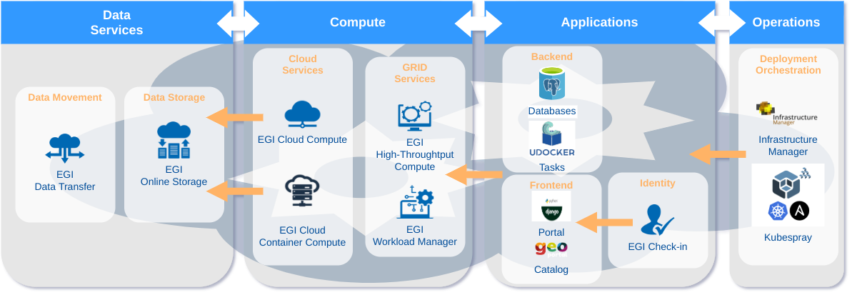
OPENCoastS deployment in CNCA
+
Notes:
OPENCoastS multisite deployment support
EGI Data Transfer using StoRM WebDAV with OAuth support
EGI Online Storage with EGI block storage for cloud and EGI file storage for GRID
EGI Cloud Compute to deploy the required Virtual Machines
EGI Cloud Container Compute for HPC computations that require dedicated hardware
EGI Workload Manager to submit less urgent jobs to EGI HTC infrastructure
OPENCoastS service deployment now is only using VMs provided from EGI Cloud Services. In the scope of EGI ACE, OPENCoastS platform is being improved to offload the resources demand on computation to dedicated HPC infrastructure.
The deployment of OPENCoastS platform also aims to be easily deployed on EGI using Infrastructure Manager and Kubernetes recipes and EGI Check-in.

Slide 9

HIDRALERTA - Early Warning System for Coastal regions and Ports
EWSs allow local authorities to implement necessary measures to avoid major destruction and risk
HIDRALERTA issues alerts with 72 h anticipation
  Contributes to people’s safety and reduces damage costs (restricting access, protecting or displacing assets, adapting port operations)
It can construct risk maps to support decision-making processes, people awareness, and legislation
It will continuously feed a database of wave conditions and events to support management

Slide 10




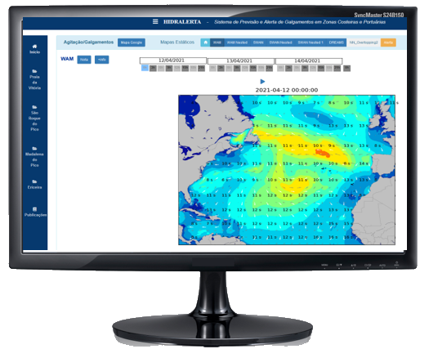

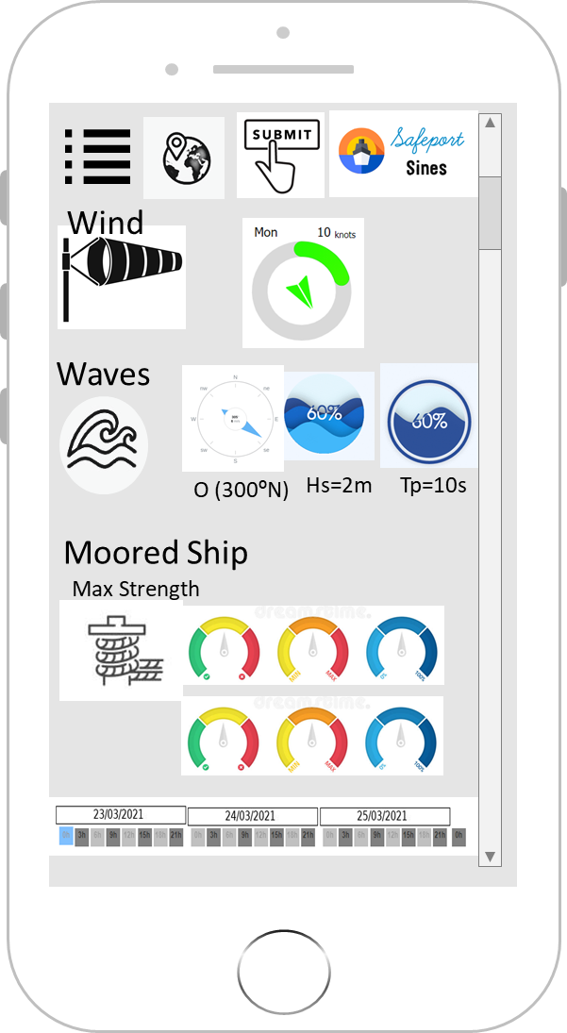






Overview application/product
In-house applications
Forecast data from ECMWF and Copernicus
Data from wave buoys
Video cameras
Scientists and technical expertise
R&D Expertise in ports and coastal areas
Freeware
models
72 h
Forecast updated daily
In-house models

Slide 11
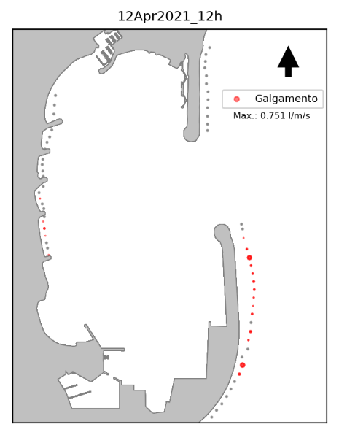
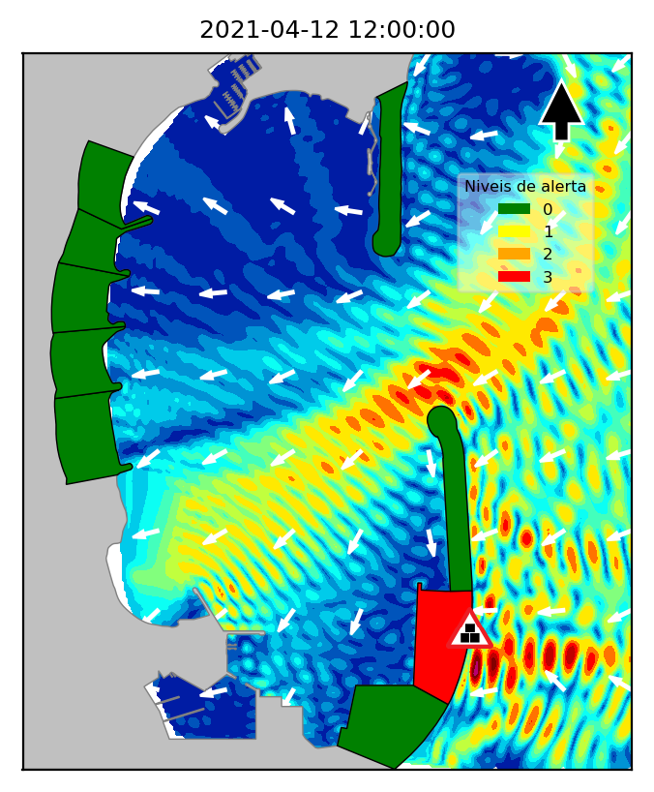


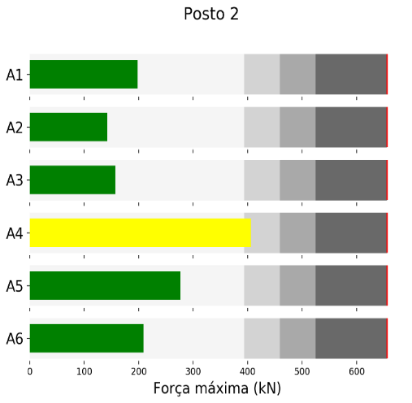
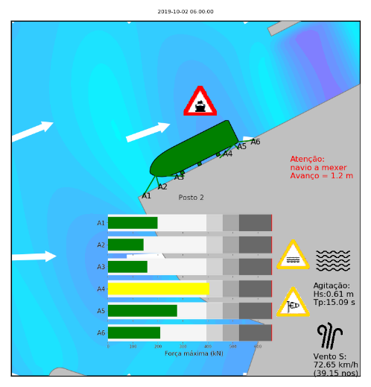


Local forecasted general parameters
Specific effects parameters
Alert
Overtopping Volumes
Overtopping Alert
Neural Network
&
Process
based models
Tide Level
Safety
Thresholds
Waves
In-house
Numerical models
Moored Ships Movements & Forces
Moored ships Alert
Wind
Port Safety & Operational Limits
Currents

Slide 12
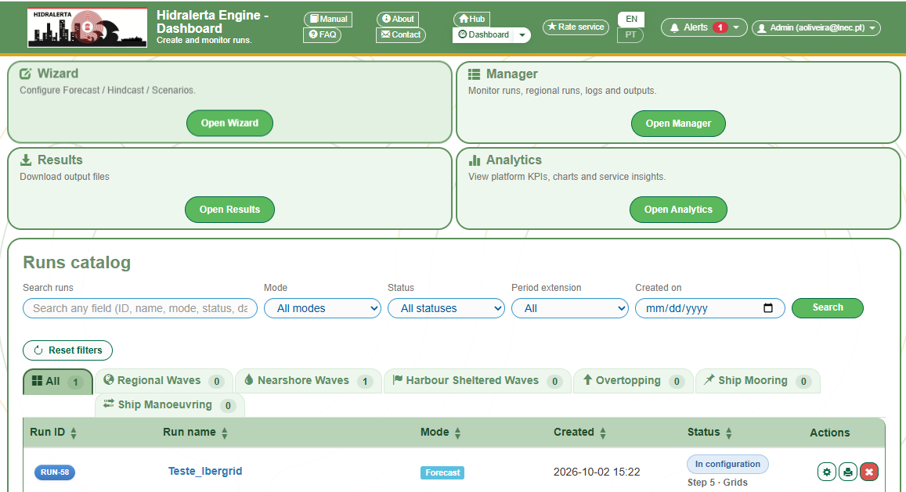
OPENHidra contributions to port and coastal management
Hidralerta
However, the current Hidralerta product is implemented on a system-by-system basis, which requires considerable human resources and limits software updates
Through OPENHidra, the Hidralerta product will evolve to become a relocatable computational service, operating through CNCA computational services
It will also include multi-modal operation (forecast, hindcast scenarios) and forcing with OPENCoastS
OPENCoastS
include multi-modal operation (forecast, hindcast scenarios)
72-hour forecasts

Slide 13
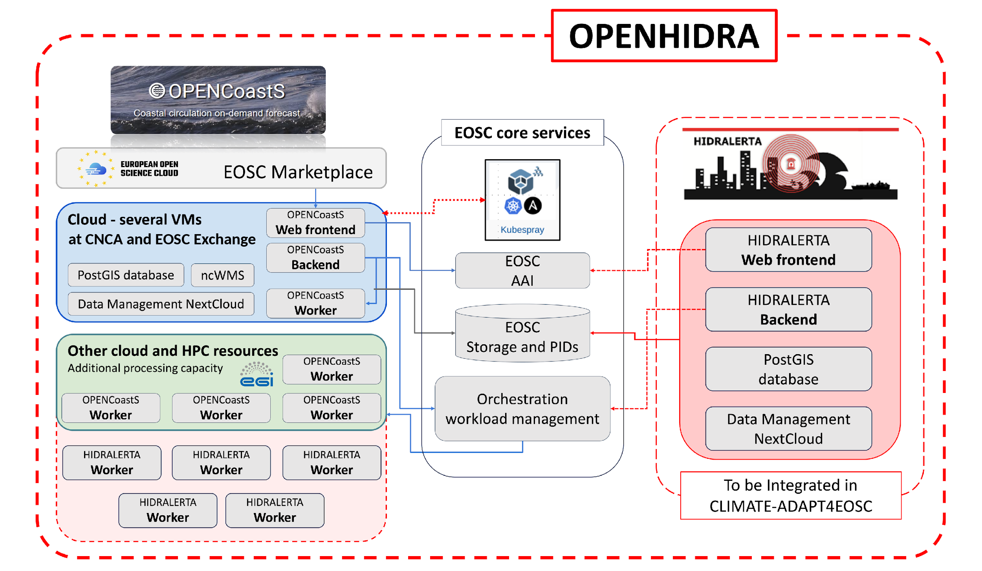
EOSC services adaptation and infrastructure integration
AAI: EGI Check-in single sign-on
Storage and PIDs: EUDAT B2SAFE, EOSC PID services
Orchestration: EGI DIRAC workload manager, WIFF
Data: PostGIS and NextCloud per system

Slide 14







FAIRification of OPENHIDRA data
Inputs and outputs travel as FAIR Digital Climate Objects, not loose files
1 Extract
2 Package
3 Identify, publish
4 Link and govern
Simpl-Open agents connect to the data spaces
Detect format (NetCDF, GRIB, GeoTIFF, CSV, SHP) and pull mandatory metadata
RO-Crate with embedded metadata
Provenance: Workflow Run Crate, W3C PROV (sources, model version, run settings)
PIDs (DOIs, Handles) from EOSC PID services
Persistence in EUDAT B2SAFE
DCAT-AP 3.0 records harvested by EOSC
Knowledge graph, Ontop OBDA, SPARQL queries
Policy engine for licences and confidential use
Inputs
Outputs
Access
EMODnet, CMEMS, Sentinel-2, ECMWF, NOAA, Météo-France, MeteoGalicia, IPMA, wave buoys, video, port data (APA)
Water levels, currents, salinity, temperature, waves, overtopping, ship motions and mooring forces, hazard and risk maps
Free at the point of use; EGI Check-in SSO via the OPENHIDRA portal; port-authority products kept under confidentiality rules

Slide 15

Summary and next steps
One service, two assets
OPENHIDRA joins OPENCoastS circulation forecasts with HIDRALERTA wave, overtopping and ship alerts.
Next steps
Built on Iberian e-infrastructure
Cloud and batch resources at CNCA, jobs through EGI DIRAC; EGI Check-in and EUDAT B2SAFE.
Demo round 1 · M19–M30
Aveiro Lagoon pilot with APA (PT)
Two operating modes
Planning (climate change and what-if scenarios) and early warning (daily runs, 72 h alerts).
Dec 2026 · D4.1 (M24)
Initial service development reported; version 2 at M36
Relocatable, not bespoke
Two independently operable systems behind one portal, configurable for any European port.
Demo round 2 · M28–M38
Replication in the ports of Piraeus and Rhodes (GR)
FAIR by design and free to use
RO-Crate, PIDs and a knowledge graph; free at the point of use; TRL 4 → 7.
Demo round 3
Replication in the port of Dunkirk (FR)

