Slide 1
The EGI Federation AI Strategy and the RAISE initiative
Andrea Manzi
Gergely Sipos
Sergio Andreozzi
Marco Rorro
27/Oct/2026
IBERGRID 2026
EGI Foundation

Slide 2
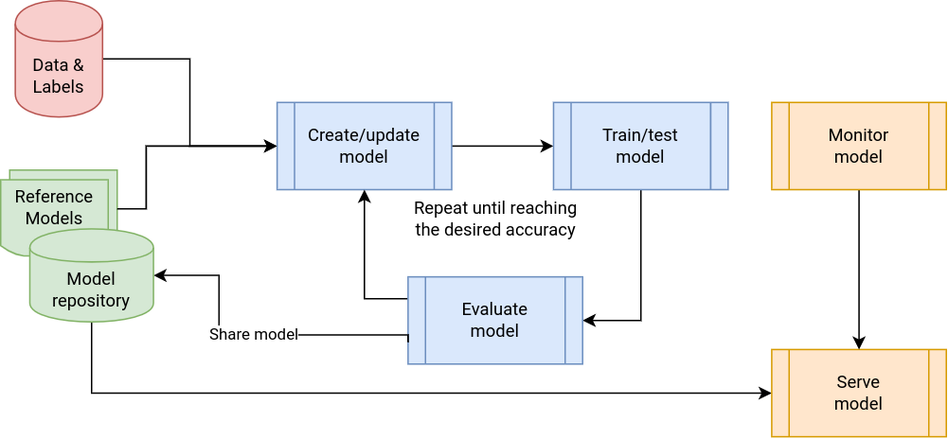
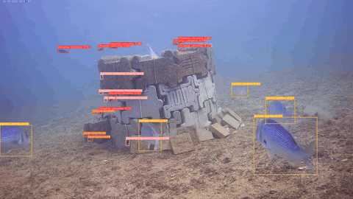
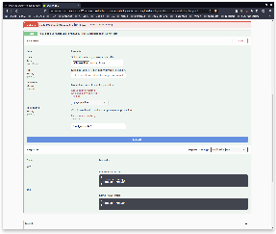
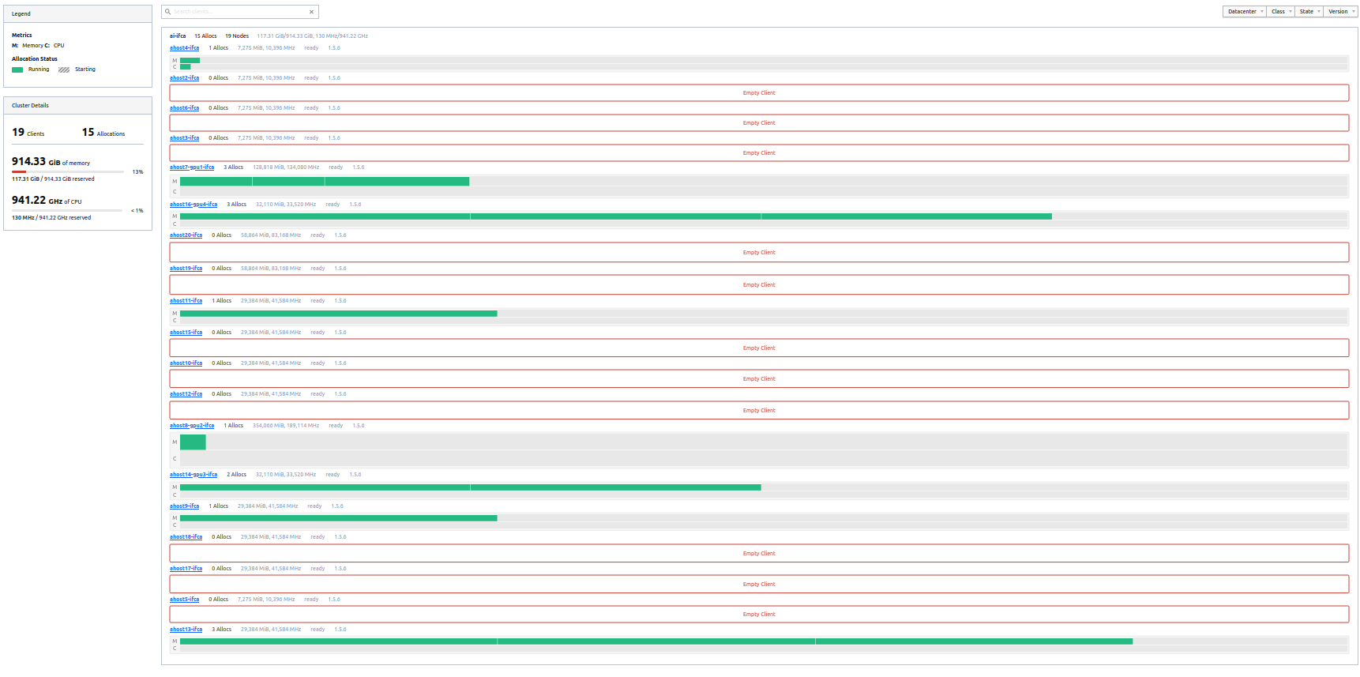
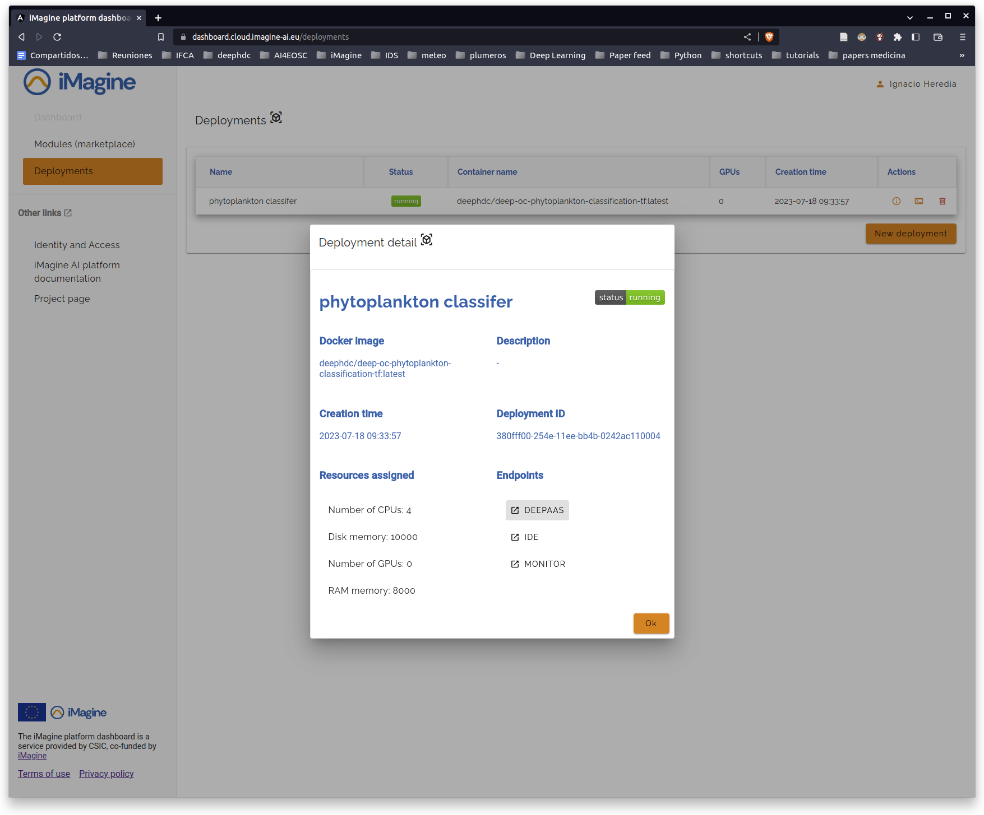






We started 4 years ago
Thematic Services
Generic, scalable platform for developing and sharing AI/ML applications.
Platform Service
Infrastructure
https://imagine-ai.eu/
Notes:
Our journey in AI projects, started 4 years ago with teh iMagine project, where we built a platform for AI in aquatic science, in collaboration with Infrastructure providers from EGI , the AI4EOSC Platform that was built in parallel and a set of thematic services for this particular community

Slide 3
Since 2023 - Mega-trends rewriting the AI playbook
01
02
03
High precision models
Customisation shift
Grassroot initiatives
Models are now broadly available and high-quality - training a model is rarely where an AI project should begin.
New customisation methods make domain adaptation cheap - a few GPUs now do what once took a cluster
Value is experienced in pilots and personal experiments - time to move to community-wide adoption
04
05
Agentic AI
Memory & storage costs spike
From single-shot answers to autonomous long-running tasks - trust and cost now hinge on every step in a chain
Prices are at record highs - capacity now needs careful planning.
Notes:
Since then major new mega trends have been rewriting the AI playbook, High precision models have been built and made available. Training a model is not where AI project should begin. Also new customisation methods are making domain adaptation cheaper than before ( few GPUs compare to a cluster). We have seen also many grassroot initiatives which bring high value and they are moving to community wide adoptions. Also Agentic AI is now a reality with long running autonomous task. Memory and storage are unfortunately record high so we should carefully plan new capacity.

Slide 4

Towards collective and holistic AI adoption
AI ready infrastructure
Connected compute, data and application resources - across the whole continuum
Research Performing Organisations
&
Research Infrastructures
Sovereign and trusted AI at scale
2. Human skills
Knowing what’s possible with AI and the best implementation route to follow
3. Trust in AI
Confidence to run AI - even in high risk environments
Notes:
In EGI we are planning a collective and holistic approach AI adoption, based on 3 pillars which would enable sovereign and trusted AI at scale for RPOs and RIs
First building an AI ready infra, capable of connecting compute data and application resources across the continuum. Then enhancing Human skills, in order to understand what’s possible with AI and best implementation route to follow. And finally building Trust in AI so we can confidently run AI even in high risk environment.

Slide 5






AI ready infrastructure
Connected compute, data and application resources - across organisations and communities
First solutions already emerged
Compute continuum: Growing the federation (HTC, Cloud, HPC) to enable cross national model portability and inference - and ‘frugal AI’
  GreenDIGIT & ENSURE
Data continuum: Connecting scientific data repositories to AI applications
  RI-SCALE (see later) and EOSC Data Commons projects
Application continuum:
  Federated LLM services across EGI sites - the “shared brain” (see later)
  Available for early adopters - To users and providers (!)
  Community contributions - ‘AI Labs’: to customise, deploy and operate models for inference. Established and emerging community solutions:
  AI4OS (iMagine); Bioimage.IO and itwinai (RI-SCALE)
Notes:
For the 1 pillar we have already solutions, in compute data and application continuum. For compute continuum we are growing our federation towards HPC and working on cross national model portability and inference and frugal AI ) with GreenDigit and ENSURE projects)
For data continuum we are working on connecting scientific repositories with AI applications. Both RI-SCALE project and EOSC Data commons are working towards that. While for application continuum we are delivering a new Federated LLm services across EGI site available for early adopters and delivering AI labs as community contributions. AI4OS in iMagine project , bioimage.io and itwinai in RI-SCALE.

Slide 6



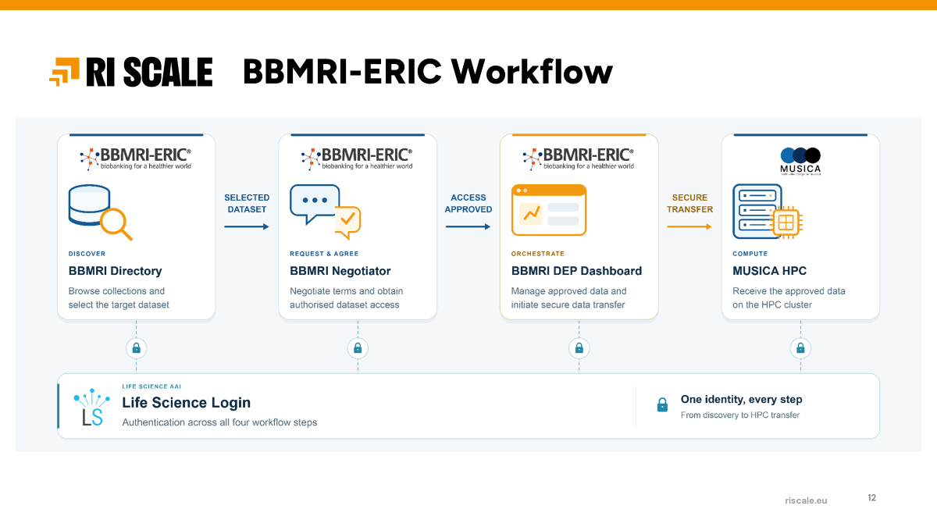
Data continuum: RI-SCALE Data Exploitation platform
AI ready infrastructure
Connected compute, data and application resources - across organisations and communities
Data repositories
Many custodians, many governance regimes
Trusted pipeline
e.g. RI-SCALE Data Exploitation Platform: pooling, privacy-preserving
Compute for training
National HPC, AI Factories, EOSC Compute sites
EXAMPLE · Training an AI model for colorectal cancer prediction
Call for use cases open till end of Feb 2027
Interfacing BBMRI data holding with Austrian HPC
New technology for RIs: Data Exploitation Platform
Notes:
An example of Data continuum are the DEP that we are building in RI-SCALE. Where we developed trusted pipelines from data repositories to compute systems ( national HPC, Ai factories or EOSC Compute sites) , one of the pilot is BBMRI-ERIC which is connecting their repos with MUSICA HPC in Austria.

Slide 7

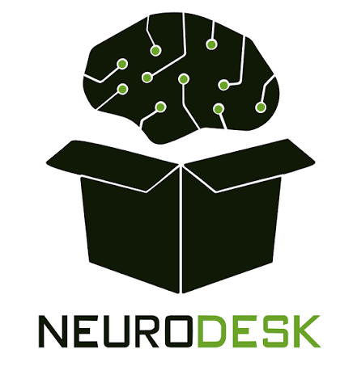










Application Continuum: EGI FedLLM
AI ready infrastructure
Connected compute, data and application resources - across organisations and communities
OpenAI, Meta, …
Gpt-oss, Llama, Qwen, ...
EGI FedLLM
NeuroDesk JupyterLab
Neuroimaging analysis notebooks
OpenAI-compatible API, EGI Check-in
Masaryk University (CZ)
GPU inference
Mistral AI
Mistral models
EOSC Data Commons
Research data & application discovery
SZTAKI (HU)
GPU inference
European public HPC
Domain specific models
Your own app or agent
Scripts, RAG pipelines, agents
National/institutional compute servers
GPU inference
Open-weight frontier model suppliers
Where researchers use it
Close to users and live data
Models run at national public centres and are called from where researchers already work.
Sovereign operation
European public infrastructure, federated login; prompts are not kept or reused for training.
New needs
Long-term model hosting, versioning and lifecycle; agent-ready access.
Notes:
For application continuum, we have this new service FedLLM which is providing an unique entrypoint to EGI federation inference endpoints ( now MU and SZTAKI) hosting open weight frontier models. It provides close to users models and live data and guarantees sovereign operation in Eu infra. New users are the Neurodesk community and the EOSC Data Commons project ( AI discovery driven)

Slide 8
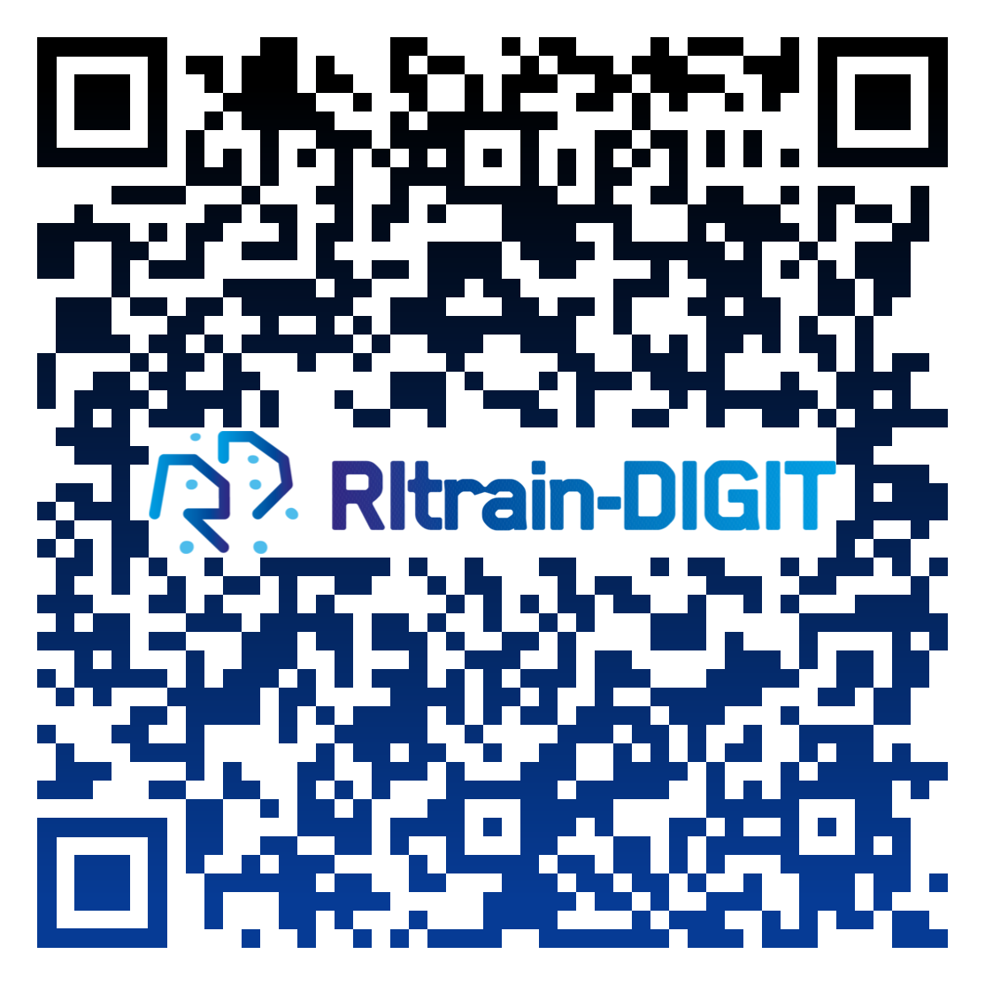


2. Human skills
Knowing what’s possible with AI and the implementation route to follow
Starting now
Subscribe for updates
Training and mobility visits: RItrain-DIGIT project (started in Sept 2026).
To deliver online and f2f events;To support visit to national compute centres
        Subscribe for updates on the project website (or QR code above)
Advisors for adoption: Competence Centre
        Core team in the FLUID-AI4EOSC project (started in Oct 2026)
        Expansion to additional technologies, AI use cases, disciplines by EGI
Notes:
From the Human Skills side, we are starting a new project (RITrain-DIGIT)which will deliver online and F2F training events to support and visits to national compute centres. While we are acting as Advisors for adoption by leading the competence center of the FLUID-AI4EOSC Project ( just started)

Slide 9
3. AI trust
Confidence to run AI - even in high risk environments
Our next move
Augmented → Automated → Autonomous AI - - -> Automated scientific discovery
      Compounding errors
      Human checkpoints
      Reproducibility problem
Institutional policies, Project/experiment level policies, Sectoral policies
      Tools for implementation
      Compliance and auditing
      Ethical use
Notes:
And finally in the AI trust, which is our next move, ATM we don’t have project in the area ( waiting for results) we are planning to work towards transitioning from Augmented to Automated Scientific discovery via AI. Which means having compounding errors and human checkpoints and tackle reproducibility problems. There is also the need to have policies and institutional/experiment and sectoral levels.

Slide 10

EGI AI Working Group
go.egi.eu/aiwg
Notes:
We have also started an AI working group involving federation members to advance in the aspects which i have presented.

Slide 11
We are not in a vacuum
Complementary scopes: a division of labour across Europe's AI initiatives
Databases
LLM + Domain model
AI FACTORIES AND DATA LABS
Agents
EGI and RPOs
Model training
Fine-tuning
Customisation
Long-term inference
Interoperability ships models, data and software between them
EuroHPC
RIs AND EOSC
RAISE
AI Factories and Data Labs
Research infrastructures and EOSC
Resource for AI Science in Europe
Shared EGI-EuroHPC members
Form a shared vision
Common topics to work on
Data Labs and Data Exploitation platforms, training, trust and ethics, sustainability
Already under way
AI initiatives in the EOSC Federation
More to come
For example the TECH-01-01 and 2025-EOSC-05 projects
SCIANCE and its working groups
First outputs soon
EGI's contribution
Compute, data and expertise, pooled across disciplines
Notes:
Of course we are not in a Vacuum and we think that we are quite complementary with initiatives at EU level like AIFactories/data labs which are covering model training and fine tuning while we are more suitable for customization and long term inference, hence we think that we should work more on interoperability between then. For EuroHPC we have already shared members where we could form a shared vision with common topics to work on ( Data Labs, DEPS, training , trust ect). EOSC and RIs where we have already collaboration with AI initiatives in EOSC Federation and new projects in the area. And RAISE where we are in a partners in SCIANCE project bringing compute and data expertise.

Slide 12
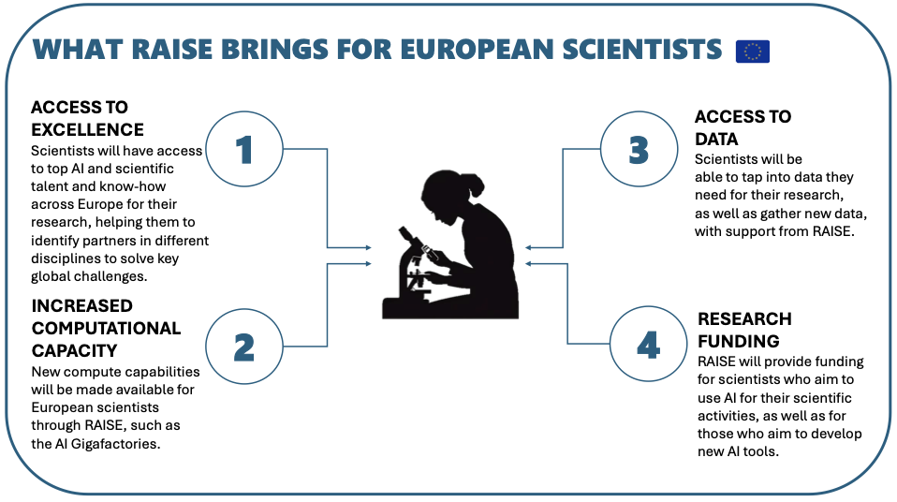
RAISE: The Resource for AI Science in Europe
What is it?
A virtual European institute that pools, aligns and coordinates essential AI resources.
Part of the Apply AI Strategy and the European Strategy for Artificial Intelligence (AI) in Science
Launched in Nov 2025
Source: RAISE - Resource for AI Science in Europe
https://research-and-innovation.ec.europa.eu/strategy/strategy-research-and-innovation/our-digital-future/european-ai-science-strategy/raise-resource-ai-science-europe_en
Notes:
RAISE is a virtual EU institute to pool align coordinate essential AI resources. Launched in Nov 20225 is part of Apply AI strategy and AI in science. What will bring to scientists. Access to Excellence -> access to top AI and scientific talent in EU. 2) more compute capacity with AI gigafactories. Access to Data with support from RAISE and dedicated research funding.

Slide 13





AI in Science Coordination project (RAISE)
Map the European
AI in Science Landscape
Co-Define Research
& Innovation Priorities
Assess Infrastructure
Scenarios
Enable Community
Building & Sustainability
Evidence baseline with cross-disciplinary and thematic reviews
Co-creation workshops,
AI in Science challenges, interdisciplinary cooperation
Identify gaps in computing, data, governance, and skills; co-design upgrade scenarios
Pilot RAISE Secretariat, Digital Hub, Academy;
co-organise AIS Summits
SCIANCE feeds Evidence Base, SRIA, and Implementation Roadmap into RAISE
13 partners (including EGI Foundation) | Coordinated by European Science Foundation | https://raise4science.eu/
Notes:
RAISE is piloted by the SCIANCE project, which started in Dec 2025 with 13 partners including EGI. coordinated by ESF. The project is feeding evidence base, SRIA and implementation roadmap into RAISe. Map the landscape, co-defining research priorities. Assess infrastructure upgrade scenarios and enabling community building.

Slide 14





Scientific
Pilot Areas
Physics & Astronomy
Nikhef & University of Manchester
Materials
Science
Constructor University
Life
Sciences
Euro-BioImaging
Earth
Sciences
Twente University ITC
Social Sciences
& Humanities
CNR-ISTI
(SoBigData)
10 AI in Science Working Groups established
Astronomy and Fundamental Physics
Materials Science
Life Sciences
Earth Sciences
Social Sciences and Humanities
AI Research and Experimental Design
Data Science and Advanced Analytics
Open Science and Trustworthy AI
AI and Computing Infrastructures
Industry, Innovation and Frugal AI
Notes:
Based on 5 scientific pilot areas and with the collaboration of 150 experts working in 10 WGs

Slide 15
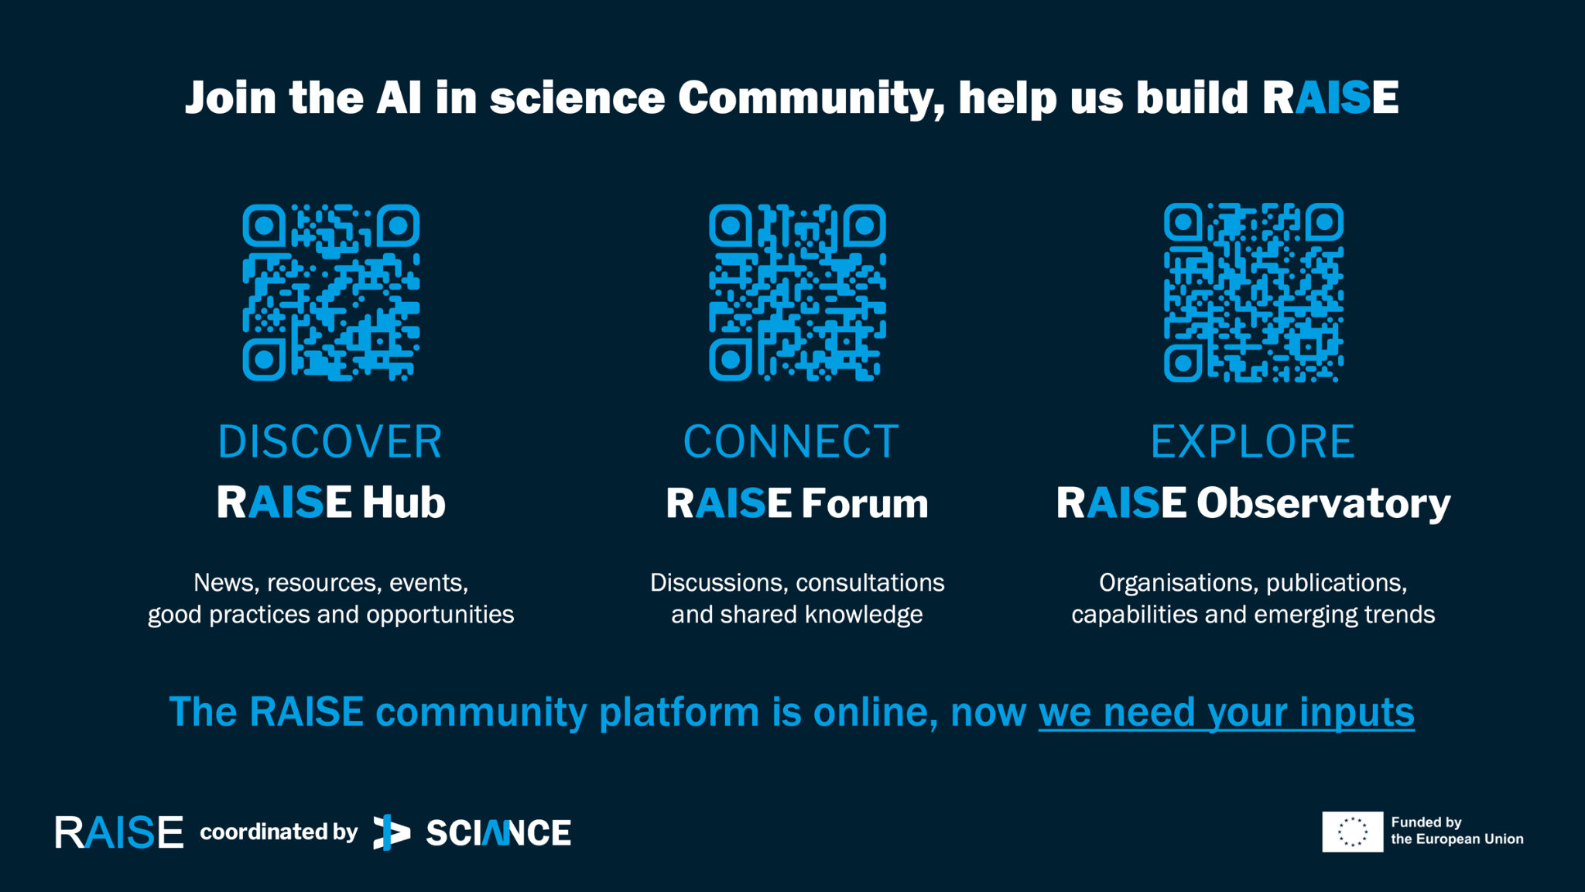
Notes:
In AIS25 in 15 Oct, the Raise Hub, Forum and Observatory are open to public as a central point for the RAISE community.

Slide 16
Thank you!

