Slide 1




Research and Development of Trustworthy Data Spaces for the Deployment of Digital Projects in Security-Critical Sectors
IBERGRID 2026 - Lightining talk
    Speaker: Mariana García González
    Date: 27 octubre
    Location: Santiago de Compostela

Slide 2
Project Funding
This development has been funded by the Project SOTERIA: Research and Development of Trustworthy Data Spaces for the Deployment of Digital Projects in Security-Critical Sectors (expediente EXP 00177383 / ITC-20251151) a project funded by the Centro para el Desarrollo Tecnológico y la Innovación E.P.E. (CDTI), through the “convocatoria 2025 de la actuación de Consorcios Regionales (INNTERCONECTA-STEP)”, co-financed by the European Regional Development Fund (EDER, Programa Plurirregional de España FEDER 2021 - 2027).

Slide 3




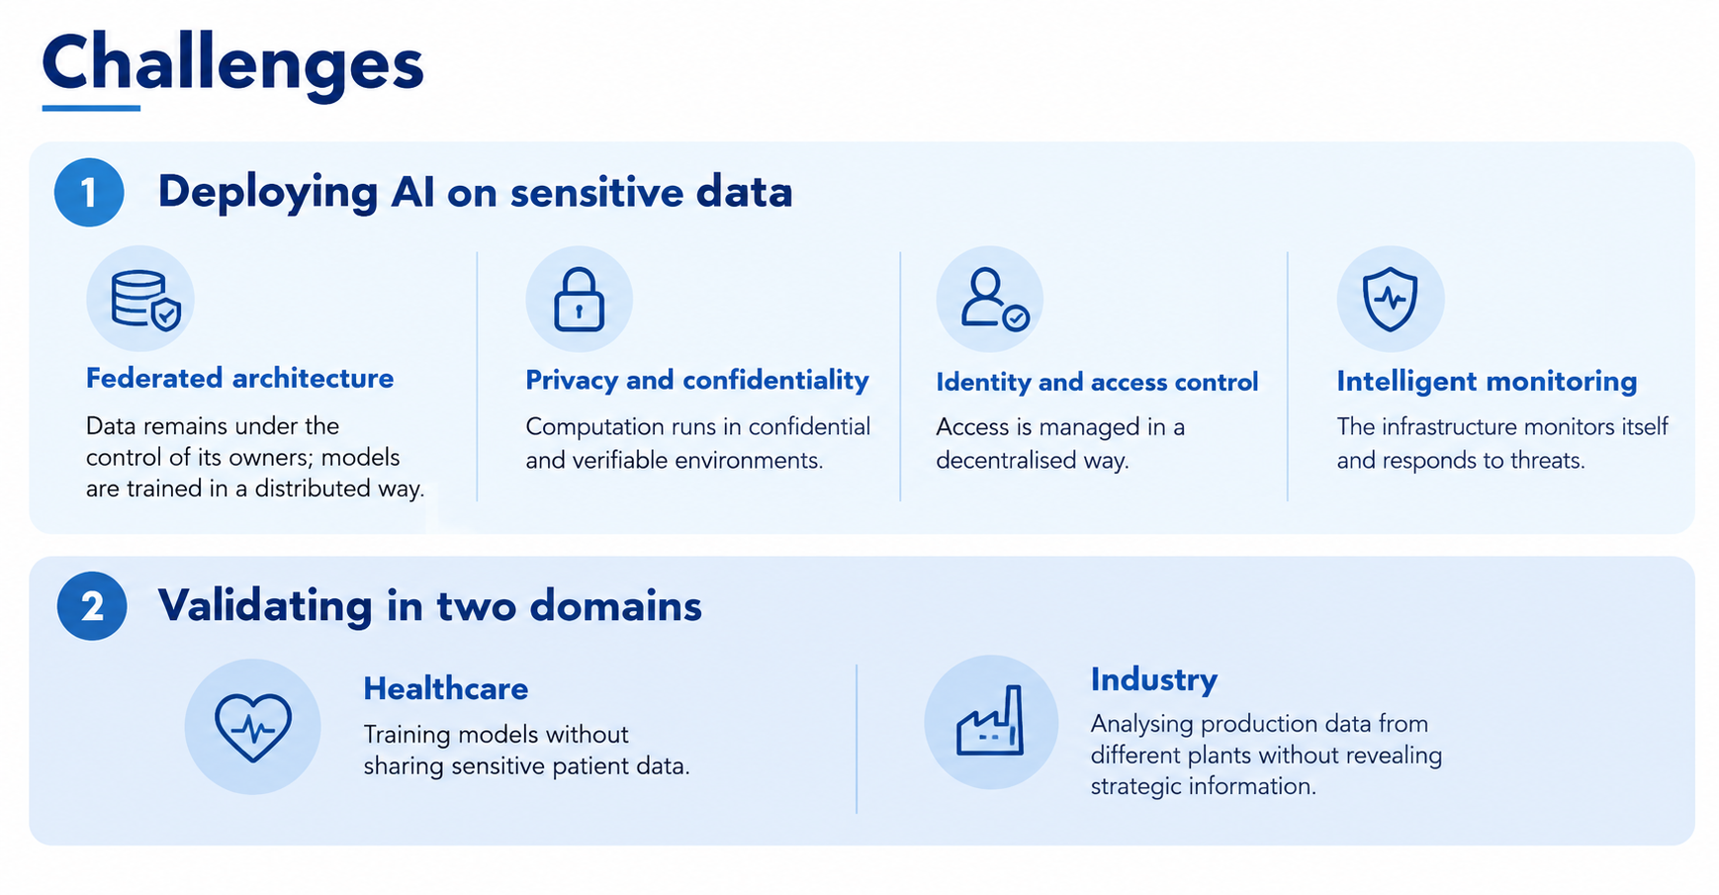



Challenges
Deploying AI on sensitive data:
Validating in two use cases:
  Federated Architecture
  Confidential computing
  Identity and Access control
  Intelligent monitoring
1
2
3
4
      Healthcare
      Industry

Slide 4
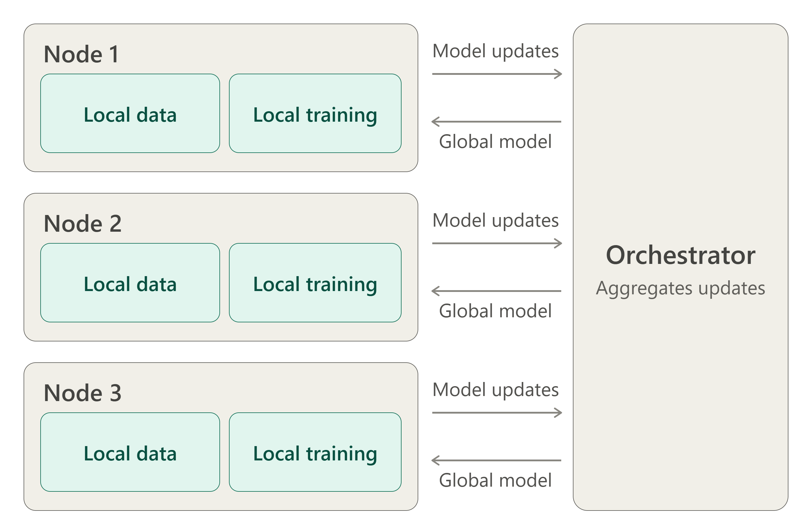
Federated Architecture
Data stays under the control of its owner

Slide 5
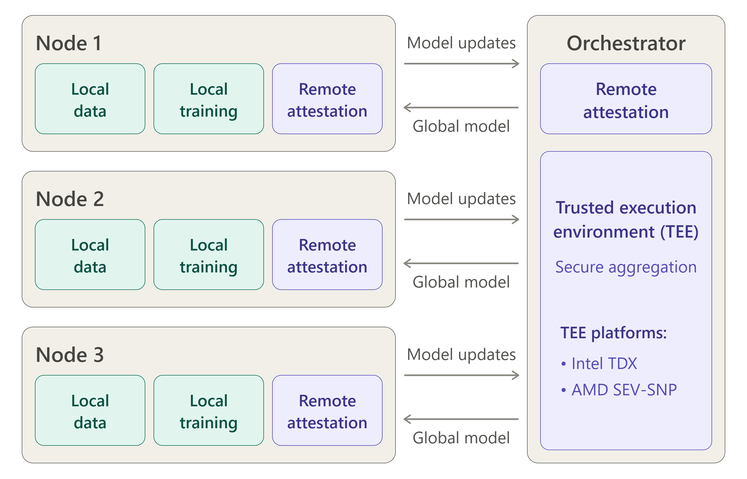
Confidencial computing
TEE-based orquestration:
  The orquestrator runs inside a TEE, protecting data during computation.
Mutual remote attestation:
  Each participant verifies the TEE through remote attestation.
  The orquestrator verifies each node thorugh remote attestation on a TPM following the RATS architecture.
Secure communications:
  Model updates are transmitted over TLS-secured channels.
Advanced chripography techniques:
  SMPC, HE, data minimization.

Slide 6
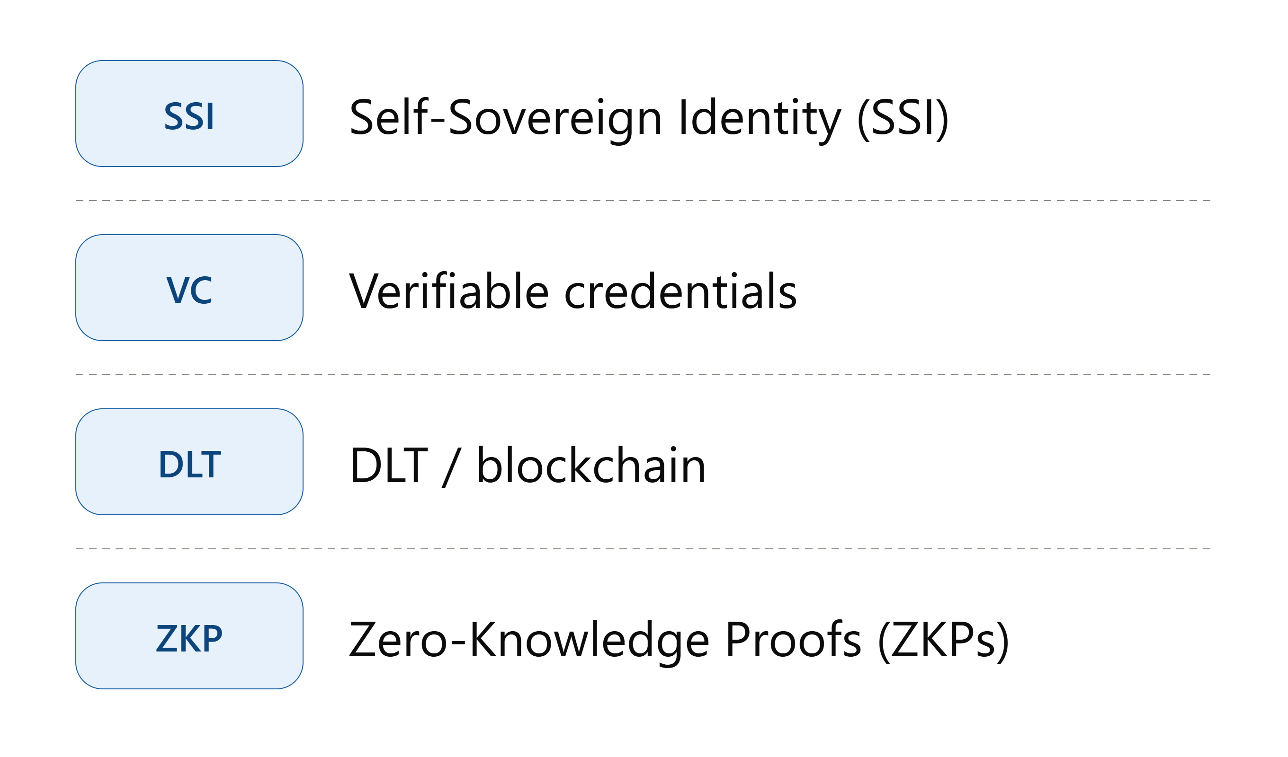
Identity and access control

Slide 7
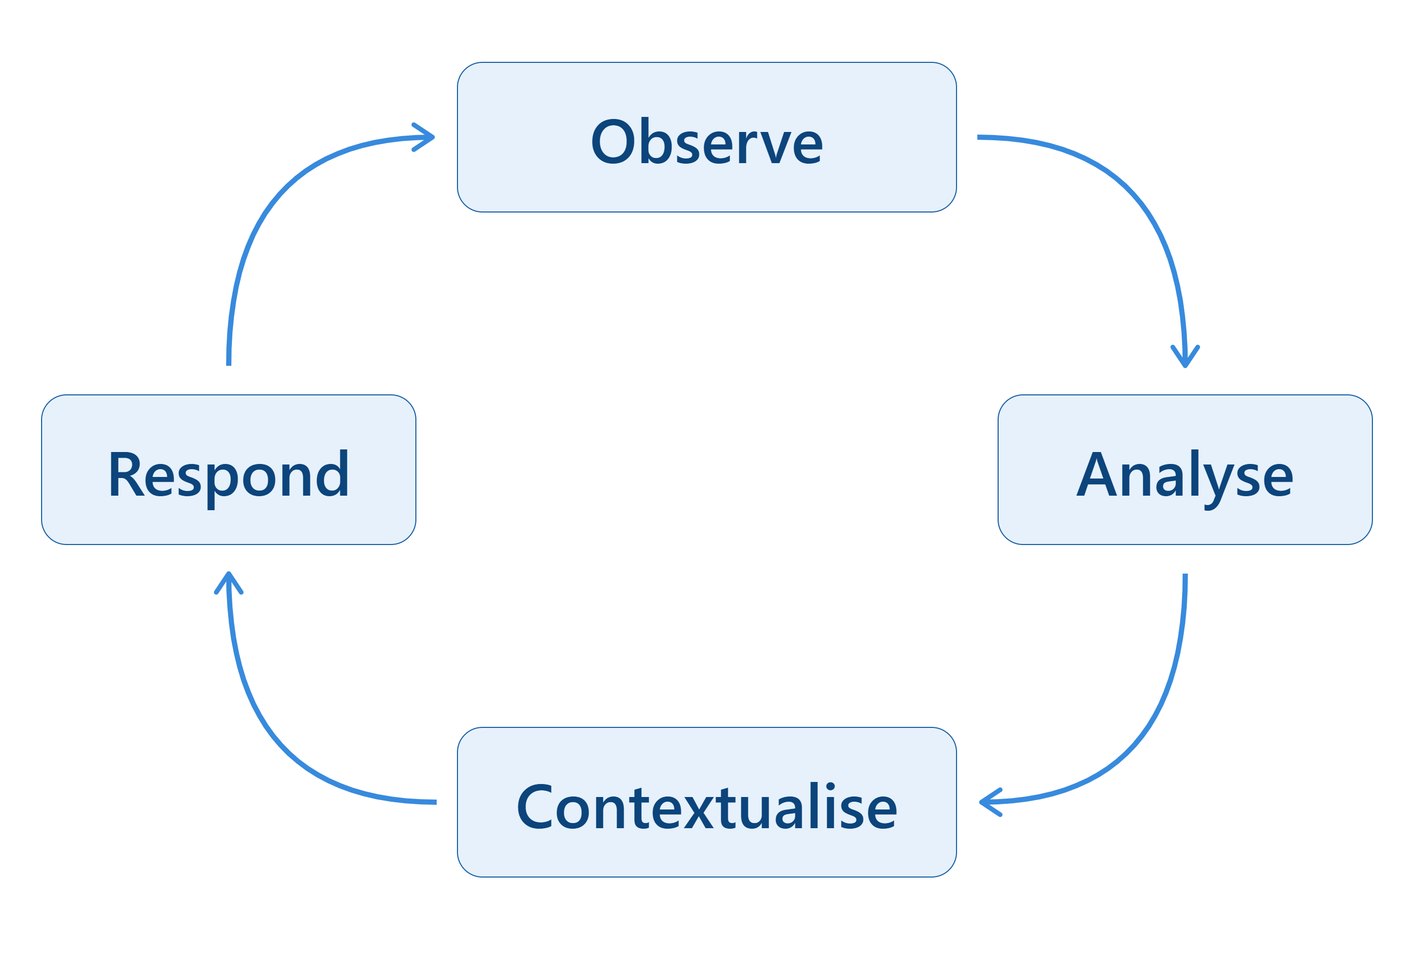
Intelligent monitoring
Zero Trust by design: no node, identity or workload is trusted by default.

Slide 8
Validation in two use cases
      Healthcare Use Case
Detection of cerebral microbleeds in magnetic resonance imaging, in the context of Alzheimer's disease, without sharing sensitive patient data.
Interoperability
      Industrial Use Case
Modelling key production parameters, including actual cycle-time variation, start-up scrap rates, and the probability and impact of unplanned stoppages, to create a dynamic Digital Twin of the process.
Interoperability
HL7/FHIR
DICOM
MES
OPC UA
B2MML

Slide 9
Evaluation
This table shows our starting hypotheses, to be tested experimentally.
Dimension | Local | Federated Learning | Federated Learning + TEE
Data sovereignty | High | High | High
Data available for training | Limited | Extensive | Extensive
Exposure surface | Low | Moderate | Moderate
Communication cost | Low | High | High
Environment verifiability | N/A | Low | High
Resistance to vulnerabilities | Moderate | Moderate | High

Slide 10
Conclusions
In summary, SOTERIA aims to create an integrated and trustworthy infrastructure where:
  Data stays under the control of its owners and AI models are trained in a distributed way.
  Data and algorithms can run in secure and verifiable environments.
  Access can be managed in a decentralised way.
  The infrastructure can monitor and respond to security threats.
The final goals are:
  To provide a technological foundation for secure collaboration between organisations.
  To support the development of trustworthy European data spaces.

Slide 11
¡Thank you for your attention!
mariana.garcia@bahiasoftware.es

