Slide 1
The EGI EOSC Node and EOSC Mesh
Andrea Manzi
Diego Scardaci
Federico Drago
EGI Foundation
28/Oct/2026
IBERGRID 2026

Slide 2


Outline
EOSC Federation
EGI EOSC Node
  Service portfolio
  Core Capabilities
  Cross-Node Use cases
  Timeline
EOSC Mesh
  EOSC Mesh Hub
  Adoption program
  EGI Discussion Paper

Slide 3
EOSC Federation
Europe’s federated ecosystem for research data and services
Connects existing investments: EOSC does not build a new infrastructure from scratch. It federates existing national and European research infrastructures (Nodes).
Makes research resources interoperable: Common standards and coordination allow data and services to work together across countries and disciplines.
Enables Europe's digital research ecosystem: EOSC links with initiatives such as EuroHPC and can support emerging AI Factories through access to high-quality research data.
slide from Bob Jones
Notes:
The EOSC Federation is Europe's network of connected research infrastructures, enabling researchers to seamlessly discover, access, share and reuse data and services across borders.

Slide 4
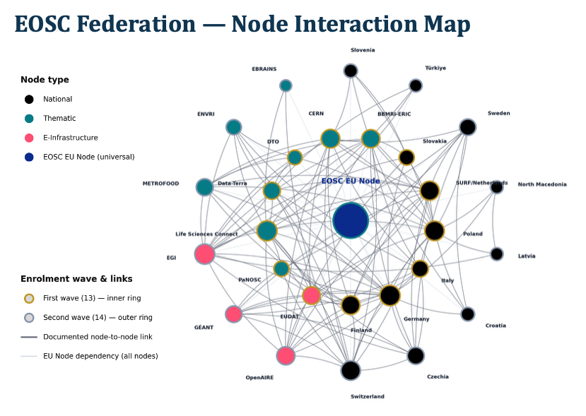
EOSC Federation
Shared access to:
  Research Data
  Research Services
  Resources such as compute
  and storage
  Scientific tools
Benefits for users:
Find data across borders
Reuse trusted datasets, repositories
and services
Collaborate more easily across borders
Accelerate discovery and innovation
slide from Bob Jones
Notes:
The EOSC Federation is Europe's network of connected research infrastructures, enabling researchers to seamlessly discover, access, share and reuse data and services across borders.

Slide 5
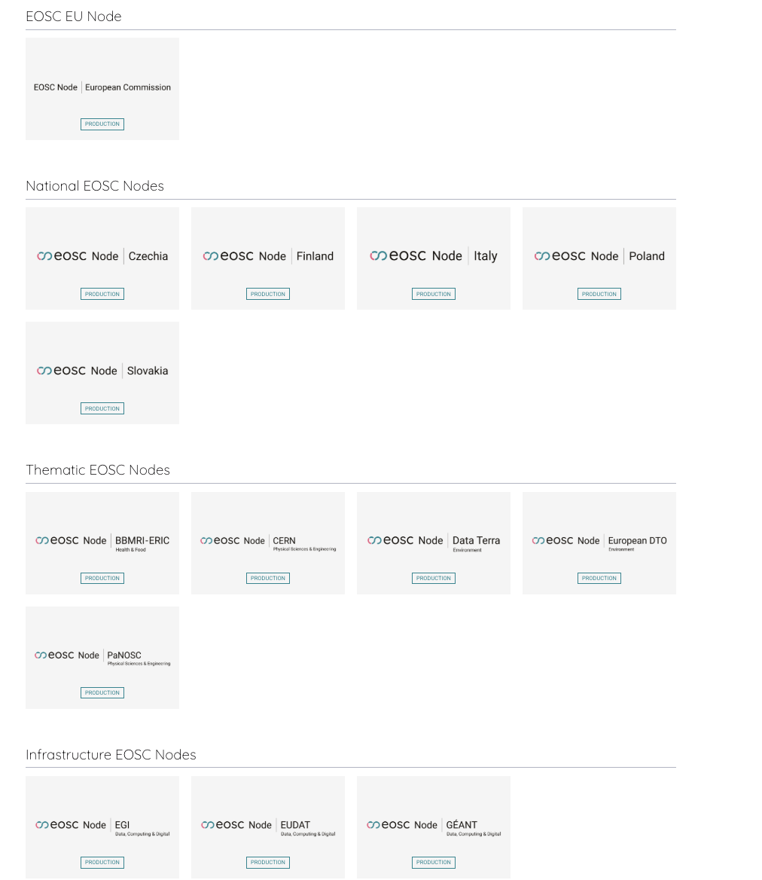
EOSC Federation in production
Officially entered the production phase during the EOSC Symposium 14-16 October 2026
14 Nodes officially marked as Production Ready
14 more Nodes in candidate state
More Nodes to apply for enrollment in 2027 and 2028 waves

Slide 6
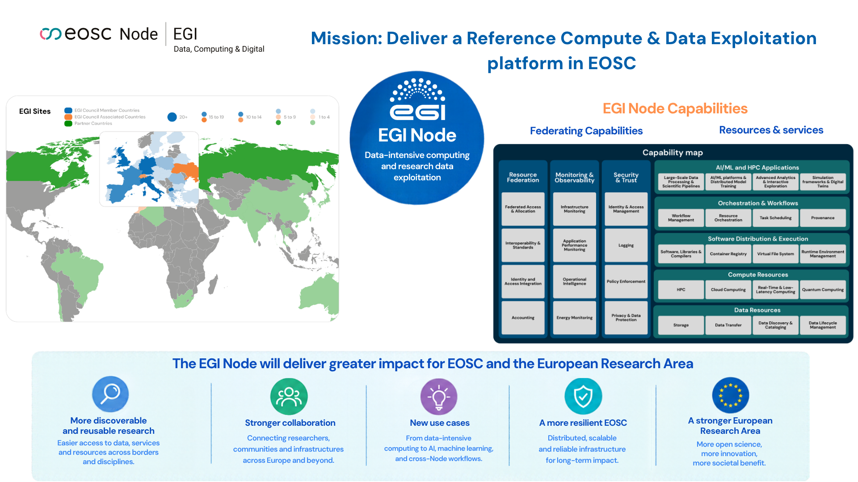
EGI Node in the EOSC Federation
Bringing EGI’s scale and experience to a stronger, more distributed EOSC
Notes:
Good morning everyone.
EGI is a federation of research data centers supporting data-intensive research and innovation. It provides large-scale distributed infrastructure, data management and advanced digital services to research communities across Europe and beyond.
The EGI Node brings this computing and data exploitation infrastructure into the EOSC Federation, along with the experience and expertise of the EGI community.
Its main objective is to support data-intensive research, giving researchers and other EOSC Nodes access to cloud platforms, workflows, data repositories, and advanced data-processing capabilities.
But the EGI Node is more than just a resource provider. It also aims to act as a federator and hub, contributing core EOSC Federating Capabilities to make the EOSC Federation more scalable, resilient and fault-tolerant.
Finally, the EGI Node contributes to the evolution of EOSC itself. Through the EOSC Mesh project, building on experience from EOSC Beyond and EOSC Data Commons, we are contributing to the evolution of the federation, moving towards a more distributed EOSC Federation.
In summary, the EGI Node brings EGI’s compute and data exploitation infrastructure, scale, communities and operational experience to EOSC, helping turn the EOSC Federation into a powerful European Research Commons.

Slide 7
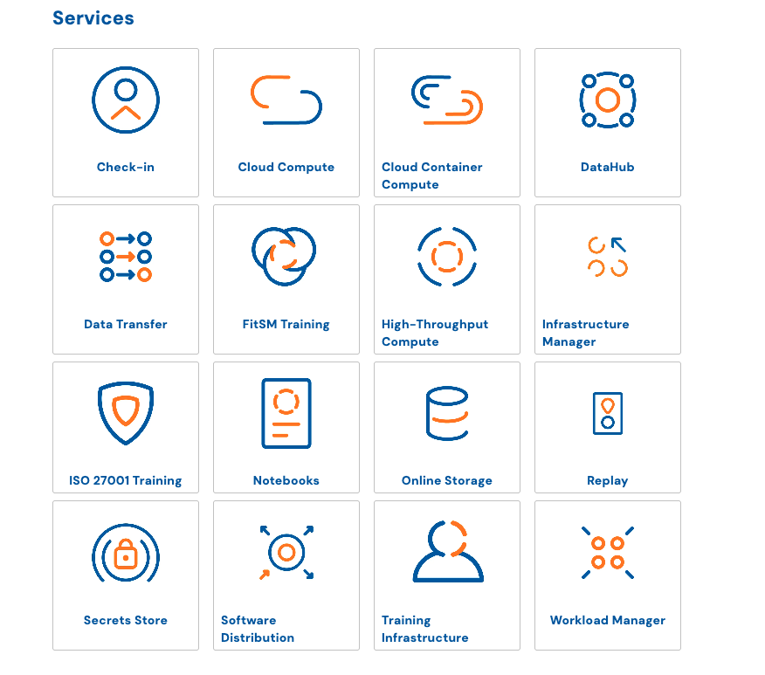
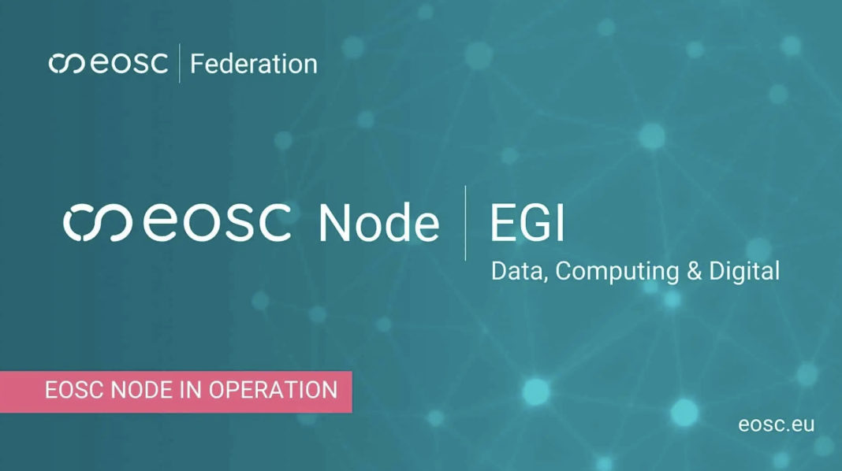
EGI Node - Service Portfolio
https://www.egi.eu/egi-node

Slide 8
EGI Node - NGI services (1/2)
TO BE ONBOARDED
Service | Category | Access Policy | Federation Contributions & Value to Users | TRL
NGI-AT: EODC Data Catalogue | Data repo | Open Access | Data Repository for High resolution EO Data | TRL 9
NGI-DE: Galaxy | VRE | Access Policy | Resources to run tools, WF and VREs | TRL 9
NGI-DE: GWDG AI Services | AI | Costs occur | Specialised services for analysis of sensitive data | TRL 9
NGI-FR: HAL | Data repo | Open Access | French multidisciplinary research open archive | TRL 9
NGI-FR: VIP | Compute | Open Access | Portal providing scientific apps as a service | TRL 9
NGI-FR Rech. Data Gouv | Data repo | Open Access | French platform for sharing research data | TRL 9
NGI-FR FAIDare API | Data repo | Open Access | Plant genotype and phenotype data | TRL 9
NGI-FR REPET-VRE | VRE | Quota Access | Tools and pipelines for genomics analyses | TRL 9
NGI-NL WeNMR portal | VRE | Open Access | Infrastructure for NMR and structural biology | TRL 9
NGIs/RIs services
First wave: AT, DE, FR, NL, ES, ENES RI, PITHIA
Already expressed interest: Belgium, Ukraine, EISCAT

Slide 9
EGI Node - NGI services (2/2)
TO BE ONBOARDED
Service | Category | Access Policy | Federation Contributions & Value to Users | TRL
NGI-ES OSCAR | Compute | Open Access | Serverless platform for data-processing | TRL 8
NGI-ES DATAlife | Data & Storage | Access policy | Data Space focused on OneHealth Sector | TRL 7
NGI-ES SQAaaS platform | CI/CD | Open Access | Provides CI/CD pipelines to check sw quality | TRL 9
ENES RI yProvStore | Provenance | Open Access | Provenance management in workflows | TRL 7
PITHIA e-Science | Data repo | Open Access | Data for ionospheric and plasmaspheric research | TRL 9

Slide 10
Compliance with
EOSC Federation Core Capabilities - Mandatory
Integration with EOSC AAI
  AAI integration is provided through EGI Check-in, EGI’s production AAI implementing the AARC Blueprint Architecture and operated at scale across the EGI Federation
  EGI Check-in is compatible with the EOSC AAI Architecture 2025 .
Exposure of Resources through the EOSC Federated Catalogue:
  First version of the service catalogue available compliant with the interoperability guidelines for Registration of EOSC Service Catalogues and Registration of EOSC Research Product Catalogues in the EU Node.
  Working on exposing resources via products developed in EOSC Beyond project (Service and Research product catalogues, User Space)
Helpdesk service available
  EGI GGUS - https://helpdesk.egi.eu/, based on Zammad

Slide 11
More Core capabilities available
Mandatory by the end of 2026
Capabilities defined in the EOSC Federation Handbook
Node Core Capability | EGI Services | Technology
Service Monitoring | ARGO - https://argo.egi.eu/ | ARGO
Service Management System | IT SMS Coordination | FitSM
Service and Research Product accounting | EGI Accounting - https://accounting.egi.eu | APEL
Configuration Management System | EGI GOCDB - https://goc.egi.eu/ | GOCDB
Application Deployment Mgmt | EGI Infrastructure Manager - https://im.egi.eu/ | Infrastructure Manager
Resource Provisioning | EGI OLA/SLA Framework | n/a

Slide 12
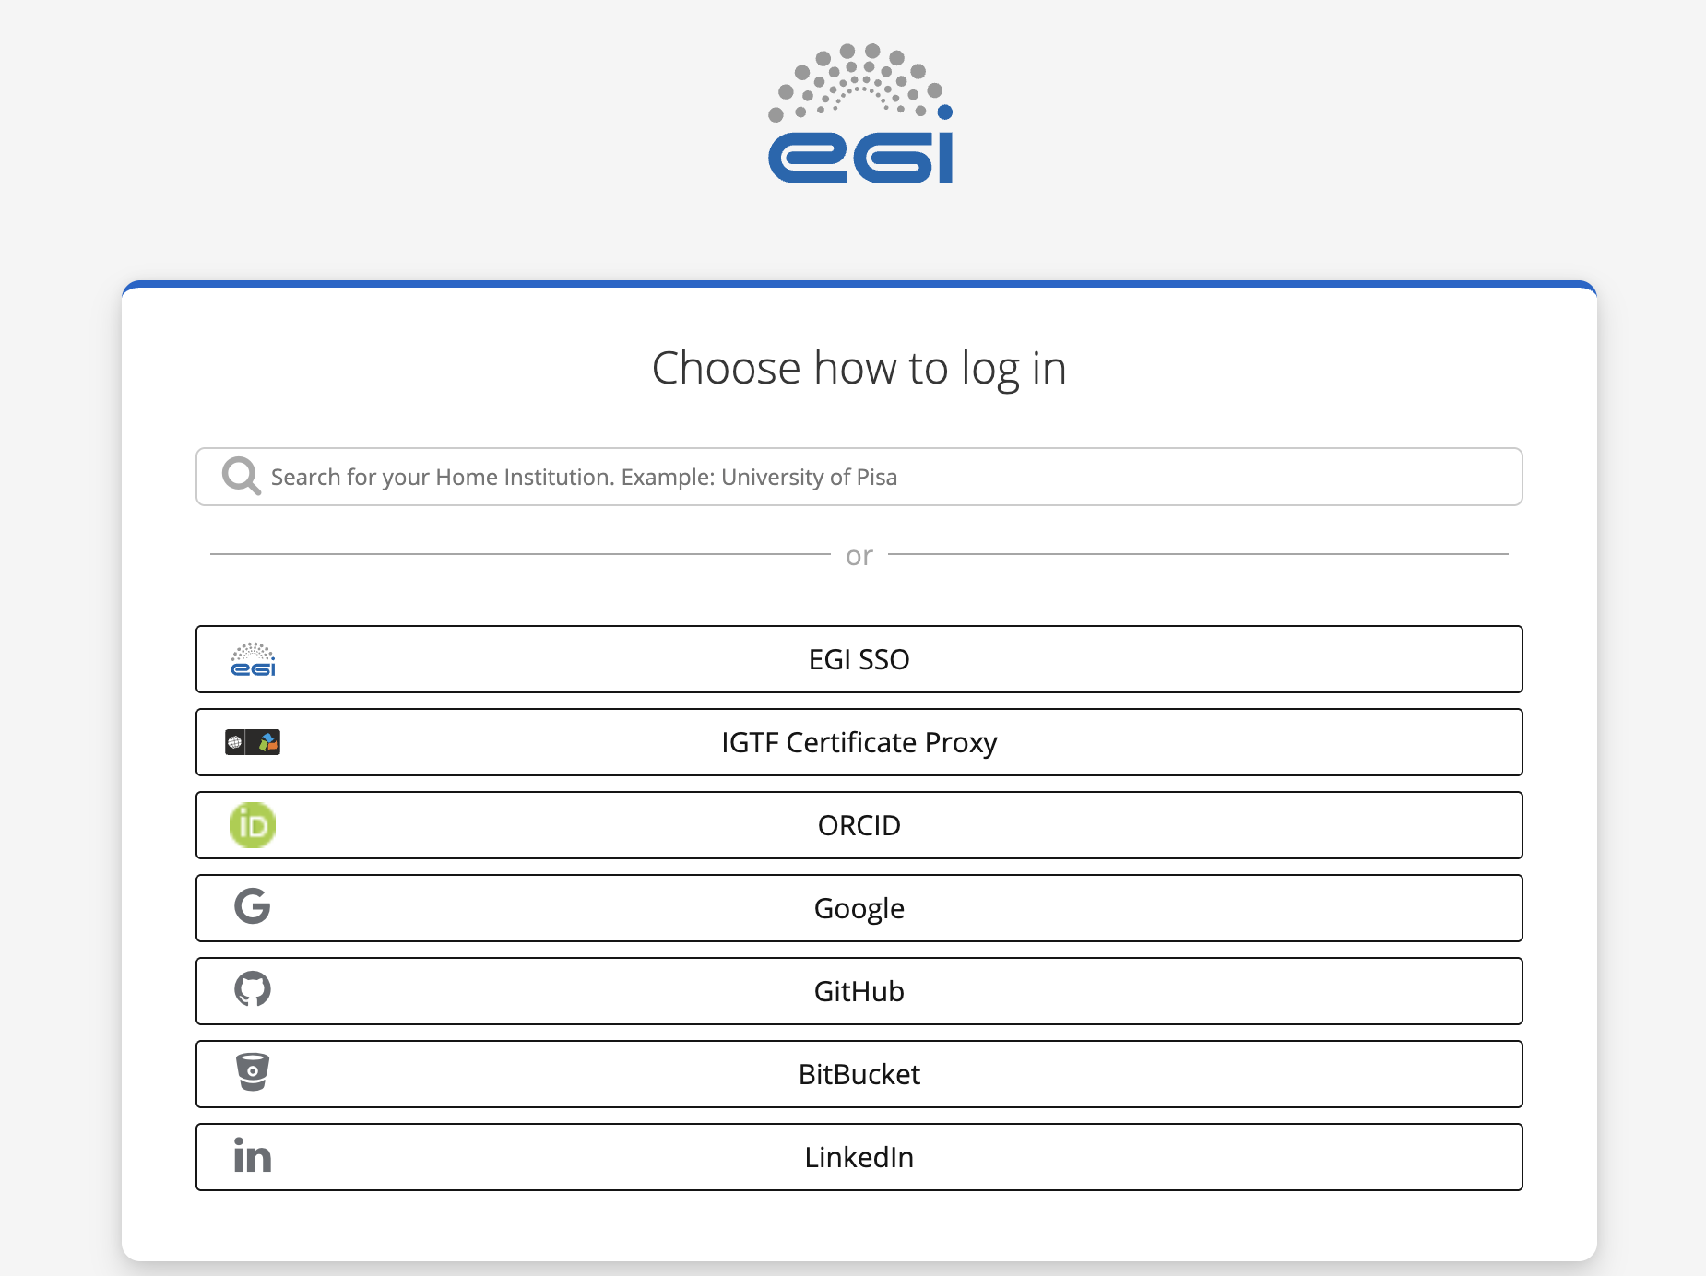
Core capabilities offered to Nodes: AAI
Description:
EGI Check-in is a managed AAI solution based on the AARC Blueprint Architecture and aligned with the EOSC AAI Architecture 2025.
Infrastructure Proxy as a Service: provides a Node-specific gateway connecting onboarded services to the EOSC AAI Federation through OpenID Connect and OAuth 2.0, enabling Single Sign-On and token-based access.
Community AAI as a Service. Enables communities to manage Virtual Organisations, groups, memberships and roles, and make this information available to services to support their authorisation policies.
Technologies:
RCIAM, Keycloak
Documentation:
https://docs.egi.eu/providers/check-in/
https://rciam.github.io/rciam-docs/

Slide 13
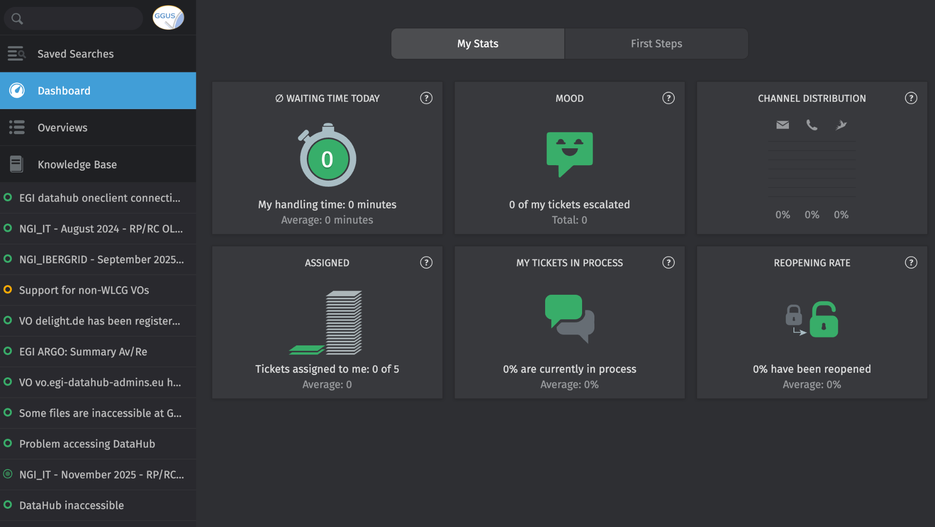
Core capabilities offered to Nodes: Helpdesk
Description:
Helpdesk solution integrated with Nodes’ existing support frameworks
Highly scalable. Already successfully used across EGI Federation
Different integration options. Ticket synchronisation to mailing lists.
AI integration for streamlining ticket management, knowledge base generation etc.
Technologies:
Zammad (https://github.com/zammad/zammad)
Documentation:
https://docs.egi.eu/internal/helpdesk/

Slide 14
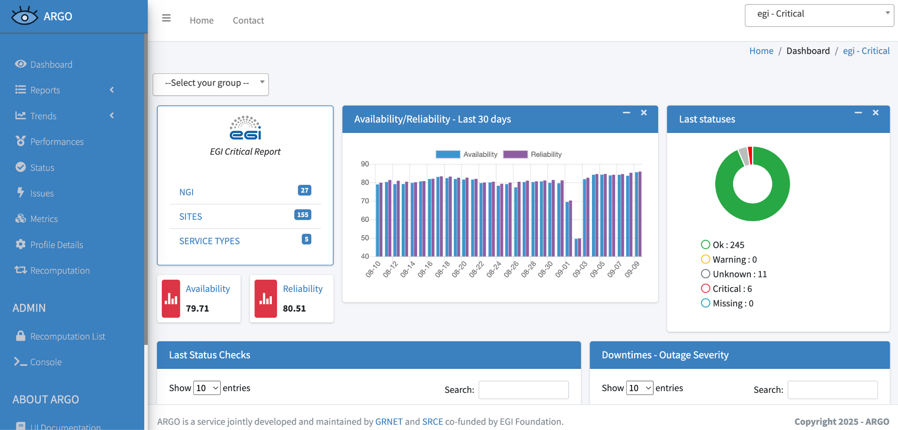
Core capabilities offered to Nodes: Monitoring
Description:
Central resource monitoring supporting uptime (availability/reliability) reporting and enabling early detection/resolution of problems.
Agile monitoring frontend supporting high level infrastructure view down to individual test results
Technologies:
Argo (https://github.com/ARGOeu)
Documentation:
https://docs.egi.eu/internal/monitoring/

Slide 15
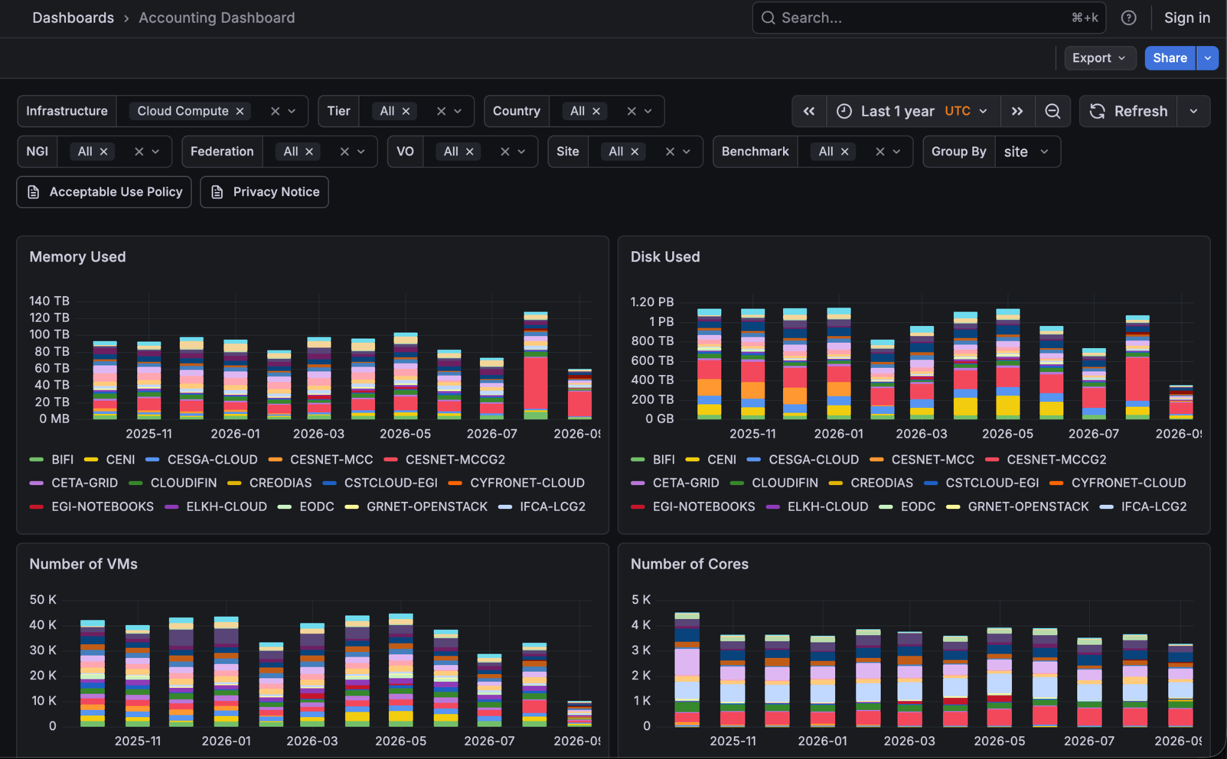
Core capabilities offered to Nodes: Accounting
Description:
Stores usage records for compute and storage services, which are collected at sites of the Federation and are securely transferred via message brokers to a central repository.
The data can be consulted online through a portal.
Technologies:
APEL Client (https://github.com/apel/apel)
APEL SSM ( https://github.com/apel/ssm )
Grafana
Documentation:
https://docs.egi.eu/internal/accounting/

Slide 16
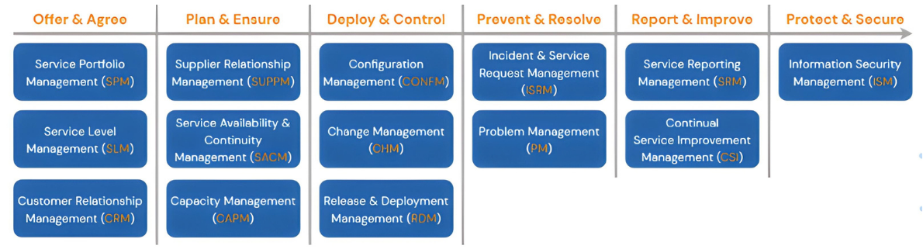
Core capabilities offered to Nodes: SMS and Security Coordination
Description:
The service designs and implements structured processes for the improvement of service delivery to users.
Complemented by trainings and certifications for service providers
It incorporates both Security Coordination activities and Incident Response capabilities
Technologies:
FitSM standard’s family and the suite of collaboration tools behind the SMS (wiki, workflow management, configuration management system etc.)
Security monitoring solutions (Pakiti)
Documentation:
https://www.fitsm.eu/

Slide 17
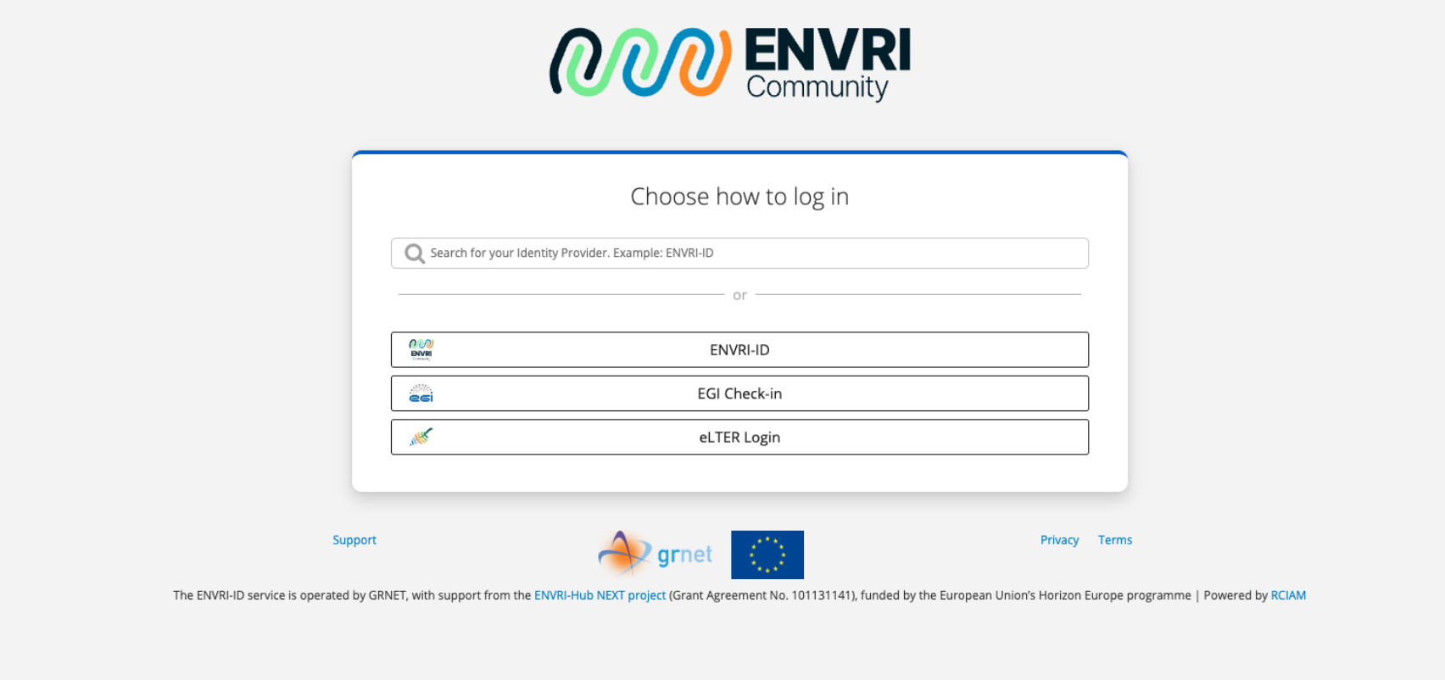


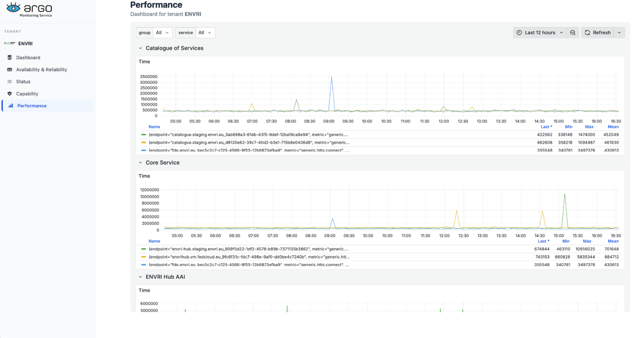
Core capabilities offered to Nodes: examples
ENVRI Node:
AAI (ENVRI-ID)
Helpdesk
Monitoring
Monitoring

Slide 18
Cross-Node use cases
Use Case ID | Use Case Description | Federation Contributions & Value to Users | List of the participating nodes
UC1 | Cross-Node workflows for consistent validation of sensor data from ARGO floats | Accessible, reproducible, and scalable platform to control and validate biogeochemical profiles from ARGO floats | EGI Data Terra Tubitak (Turkish Node)
UC2 | AI model validation on sensitive health data | Secure access to sensitive medical data for AI models ensuring compliance with data protection regulations | EGI BBMRI e-infra CZ (Czech Republic Node)
UC3 | “Encapsulated analysis tarballs” for cross-Node reproducibility of workflows | Execution of workflows across nodes in the federation, simplifying scientific reproducibility and avoiding unnecessary data transfers | EGI CERN
UC4 | Cross-Node execution of Machine Learning pipelines | Execution of cross-node ML pipelines to operate a FAIR and scalable analytical service for the marine community | EGI CNR (Digital Twin of the Oceans Node)
UC5 | Cross-Node Federated LLMs | Access to advanced open source LLMs with the ability to federate across Nodes | EGI e-infra CZ (Czech Republic Node)

Slide 19
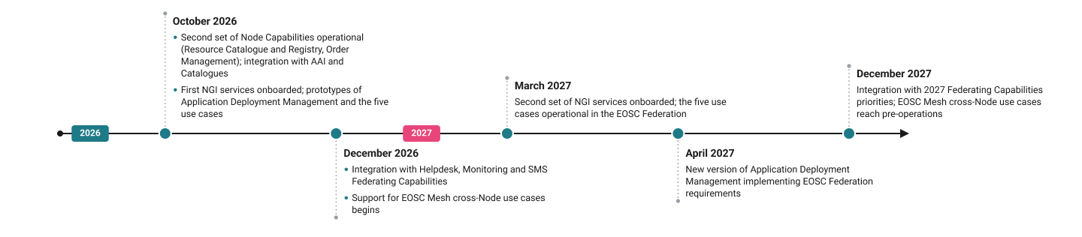
Timeline and Key milestones
https://eosc.eu/building-the-eosc-federation/eosc-node-egi

Slide 20
EOSC Mesh
Connecting Nodes to Advance the EOSC Federation

Slide 21
EOSC Mesh Project Factsheet
Budget: 9.6 Million € (from EC) + 1.85 Million € (Unfunded)
Start: 01/09/2026
Duration: 36 months
Consortium: 30 Partners + 16 Affiliated entities
e-Infrastructures: EGI, EUDAT, OpenAIRE
Research infrastructures and communities: BBMRI, ENVRI, DARIAH, CLARIN, CERN, DataTerra, GlobalCoast, METROFOOD, LIFEWATCH
National Initiatives: NFDI, EOSC PL, JISC, Czech Republic, CSIC, LIP
Technology providers: UPV, DESY, FZJ, GRNET, KIT, ATHENA, EODC, UFR, Uni Trento
Call topic: HORIZON-INFRA-2025-EOSC-01-01: EOSC Nodes with federating capabilities for the EOSC Federation
6
Work packages±
24
Deliverables
17
Milestones
Coordinator: EGI Foundation

Slide 22
EOSC Mesh Specific Objectives
1
Establish federating Nodes as members of the EOSC federation (EOSC Supply Side)
2
Deliver federating capabilities through the EOSC Mesh Hub
3
Augment EOSC capacities and capabilities (B2B adoption)
4
Integrate research environments and support user communities (B2C adoption)
5
Define and validate business models and establish financial plans

Slide 23








Establishes and Enrols 7 Nodes within the EOSC Federation
3 e-Infrastructure Nodes: EGI, ScholComm, and EUDAT
4 thematic Nodes: ENVRI Cluster, SSHOC Cluster, BBMRI, and CERN
Governance:
  Set up Node governance structure
Business Models:
  Cost-sharing and recovery models including Credits mgmt (B2B and B2C)
  Financial/Sustainability Plans
Service Mgmt
  Set up Node SMS
Technical Services
  Support to implement the EOSC Node Architecture
  Connection to federating capabilities
  Deliver building blocks to implement Nodes
green = Production
1st Wave
Data & Services
Data & Services
Data & Services
2nd Wave
Data & Services
Data & Services
Data & Services
+1,000 datasets, research artefacts, thematic services and compute and storage facilities
2027/2028
Data & Services
Build upon existing digital infrastructures, and existing digital platforms at TRL 7 or higher
Other supported Nodes
Data Terra, NFDI, Polish, Czechia, IberGrid, GlobalCoast, MetroFood, EODC, JISC/UK

Slide 24
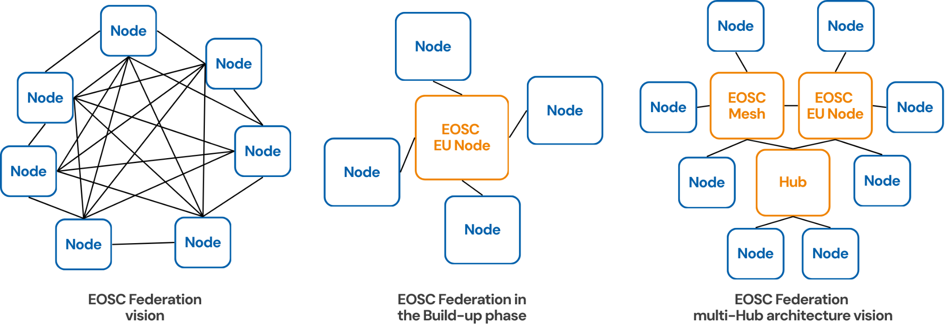
Collaborative multi-Node federating capabilities within the EOSC Federation
Establish the EOSC Mesh hub as a group of 7 EOSC Nodes collaboratively delivering a catalogue of federating capabilities
Common governance and ITSM/FitSM-compliant common federated Service Management System
Cross-Node SMS to coordinate the delivery of the federating capabilities
Benefits of a multi-Hub architecture
  Fault tolerance: failures in one hub are isolated and do not affect others
  Improved scalability: new hubs can be added without redesigning the entire federation
  Decentralised management: each hub can deliver its own set of Nodes, enabling tailored governance
  Flexibility and customisation: each hub can be adapted to the needs of a specific technical/thematic domain or to a geographical area
Fed Caps
Fed Caps
Fed Caps
Fed Caps
Fed Caps
Fed Caps

Slide 25
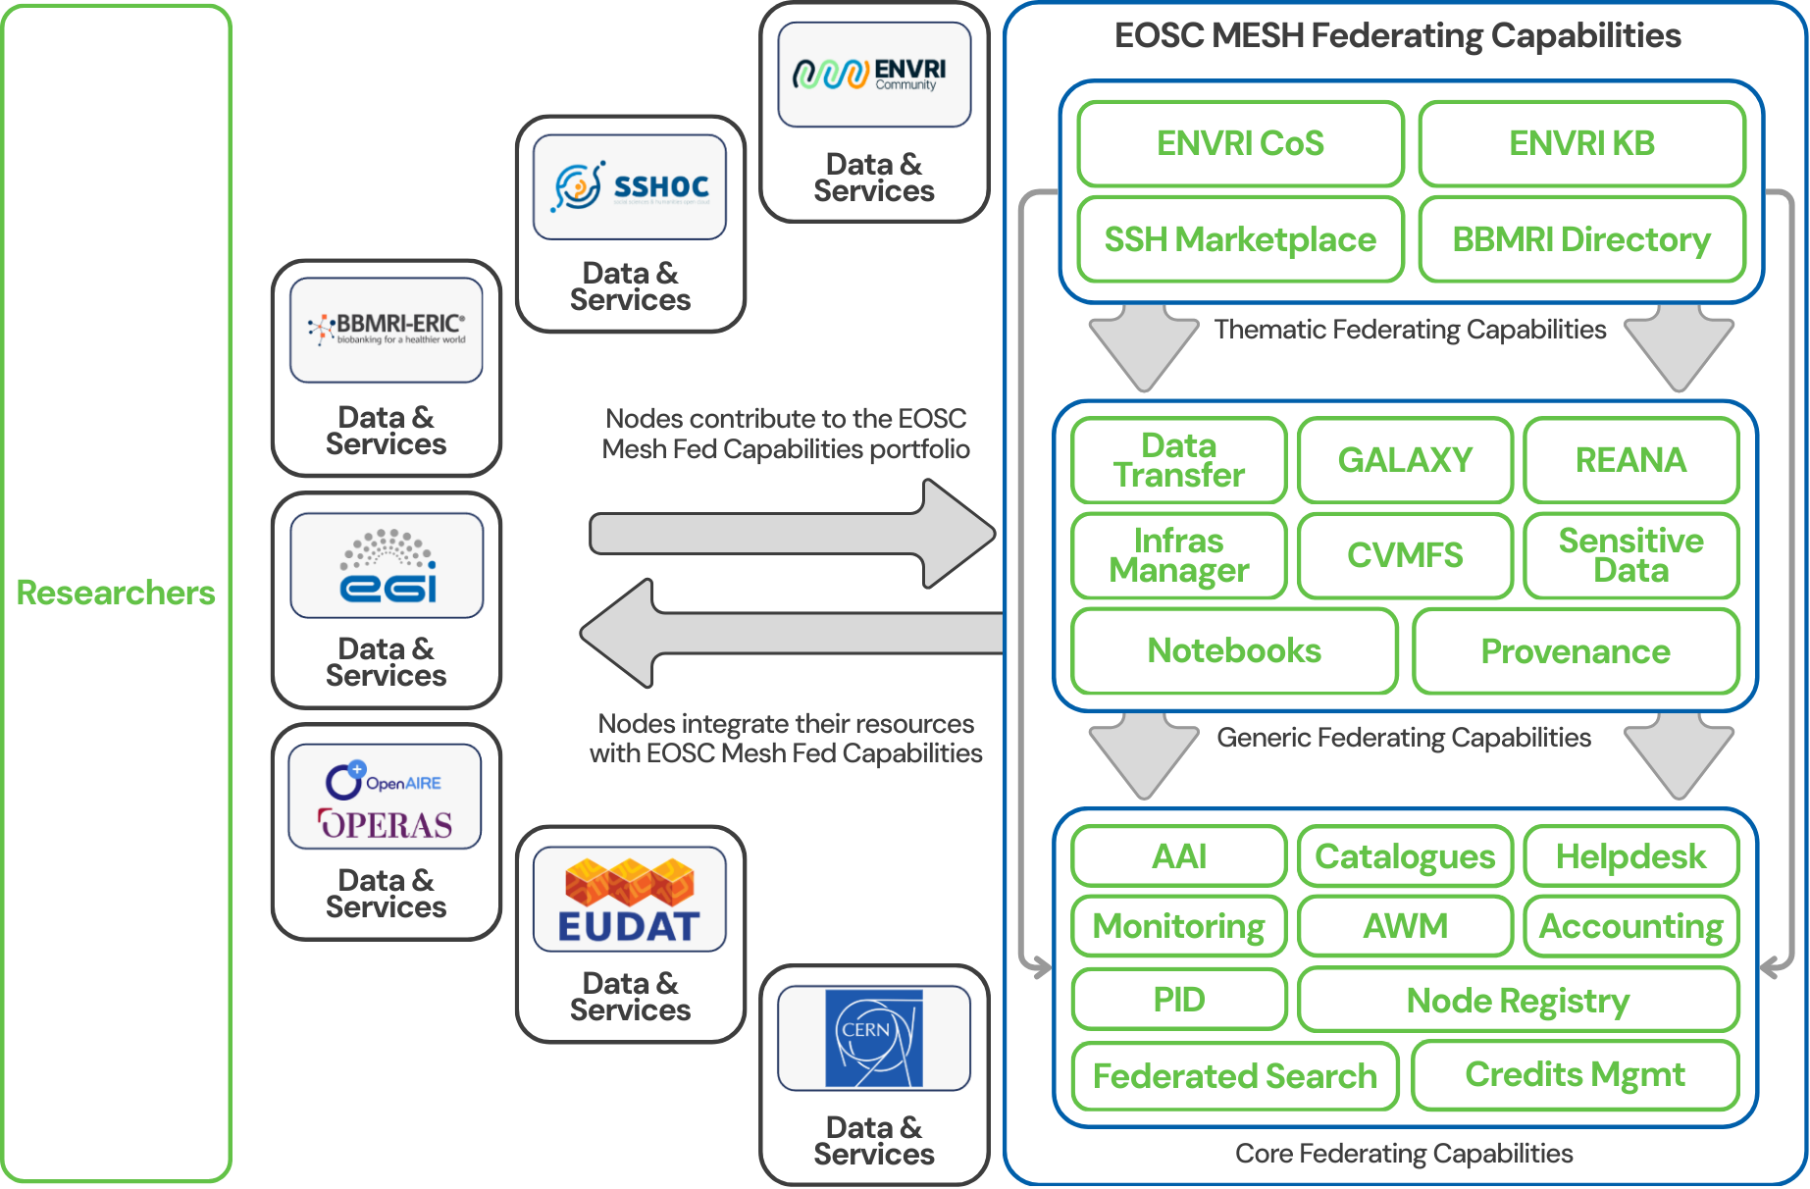
EOSC Mesh Hub Federating Capabilities
Generic and Thematic capabilities: Access to distributed EOSC resources
Distributed hub within the EOSC Federation delivering 25 Federating Capabilities
  Core (AAI, Accounting, Help Desk, Monitoring, etc.)
  Generic (IM, Sensitive Data Processing, Interactive Notebooks, Data Transfer, Workflow management, etc)
  Thematic (ENVRI Catalogue of Services, ENVRI Knowledge Base, SSHOC MP, BBMRI-ERIC Directory and Negotiator)
Offered to the whole EOSC Federation
Sustainability of the fed capabilities guaranteed by the underlying digital infrastructures
EOSC Business Models defined by the project
Core capabilities:
Supporting the operation of EOSC Nodes

Slide 26
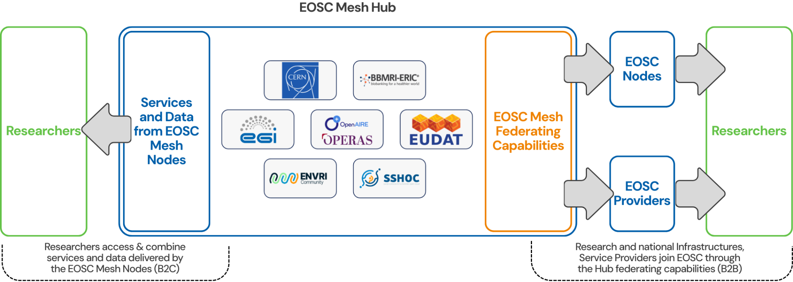
EOSC Mesh Adoption Programme
10 B2B Use cases: Node enhancements, preparatory work to set up Nodes, onboarding and integration of research environments into Nodes
7 B2C Use cases leveraging EOSC Nodes: Addressing Environmental Science, Health, Social Sciences and Humanities, and Multidisciplinary Science
Open Calls: Onboarding of 5 high-impact services into the EOSC Mesh Nodes
  Calls launched in the second half of 2027 and selected projects executed in 2028

Slide 27
EOSC Mesh B2B Use Cases
Augment EOSC capacities and capabilities
Node/Initiative | Status in the EOSC Federation | Main Activities
Data Terra | 1st wave Node | Core services integration, Onboard new thematic services from other nodes, Integration of thematic capabilities into the EOSC ecosystem
NFDI | 1st wave Node | Core service integration, Selecting and onboarding of new services, Integration of thematic capabilities into the EOSC ecosystem, IT-Security considerations for node operations
Poland - EOSC.PL | 1st wave Node | Core service integration, Selecting and onboarding new services, Biobank database, federated storage harmonisation
IberGrid (CSIC + LIP) | Preliminary study to set up a Node | Core service integration, Scaling up to European level AI user-level software and tools for MLops provisioning (Alphafold, Pytorch,....) in federated environments, Integration of Confidential computing capabilities for sensitive data processing
Czech Republic | 2nd wave Node | Core service integration, Data analytics services integration - Jupyter Notebooks, Galaxy
GlobalCoast (CMCC) | Preliminary study to set up a Node | Core service integration, Integration with generic capabilities
MetroFood | 2nd wave Node | Core service integration, Selecting and onboarding of new services, Integration of thematic federating capabilities into EOSC ecosystem
EODC | Preliminary study to set up a Node | Assessment: setup a Node or onboard services in existing Nodes
JISC (UK) | Preliminary study to set up a Node | Preliminary work to set up a Node

Slide 28
EOSC Mesh B2C Use Cases
Integrate research environments and support user communities in EOSC
Community | Use case | Nodes involved | New use case/Evolution of an existing EOSC Federation use case
BBMRI (IACS, FFIS) | AI model validation on sensitive health data | BBMRI, CERN, EGI, Scholarly Communications and ICSC | Evolution
CERN | Multi-disciplinary, reproducible cross-Node data analysis workflows | BBMRI, CERN, EOSC_PL, METROFOOD | Evolution
CMCC/GlobalCoast | Extreme coastal ocean events | GlobalCoast, EGI, ENVRI, EUDAT and Scholarly Communications | New
Data Terra | Environmental impact of volcanic eruptions | DataTerra, EGI, ENVRI, and Scholarly Communications | Evolution
EMSO(PLOCAN, UPC) | Ocean Monitoring for Risk Prevention and Biodiversity Conservation | DataTerra, ENVRI, EGI, and Scholarly Communications | New
NFDI | Data deposition and access through cross-disciplinary generalist repositories | NFDI, EGI, METROFOOD, and Scholarly Communications | New
SSH (UDJ, UPV/EUH) | Discovery, access and integration of data from historical newspapers | EGI, Scholarly Communications, and EOSC4SSH | New

Slide 29
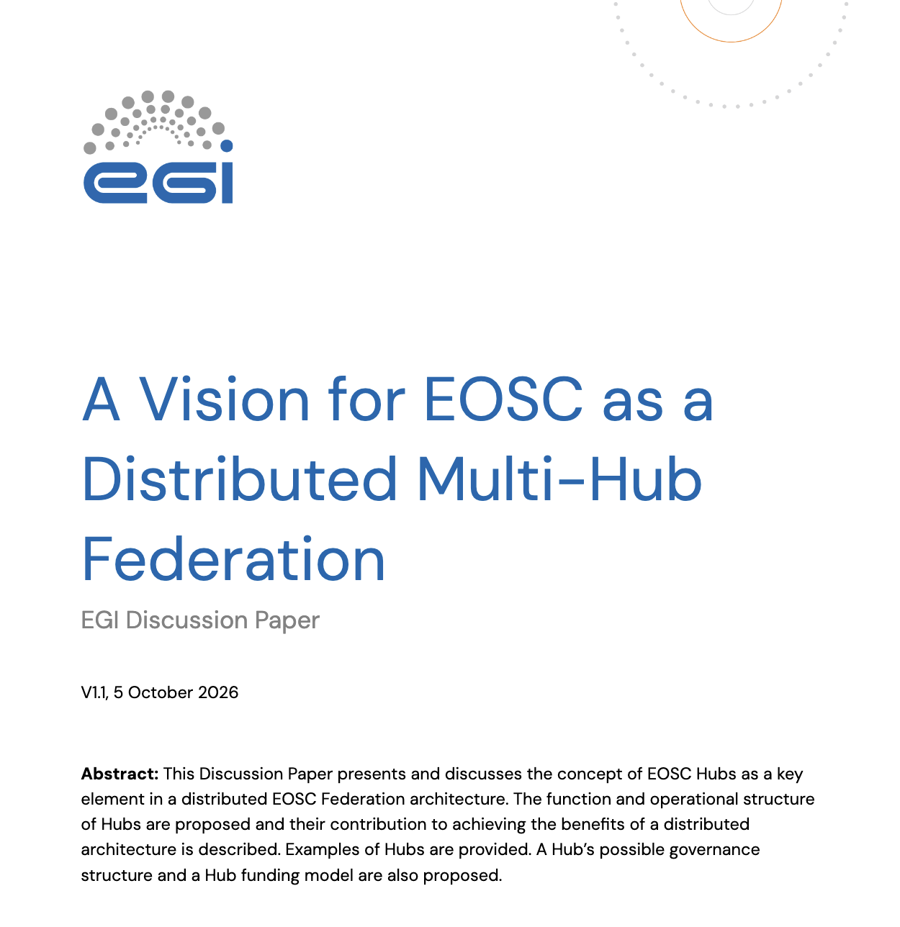
EGI Discussion paper
https://zenodo.org/records/23155668

Slide 30
Thank you!

Slide 31
UC1 - Cross-Node workflows for
consistent validation of sensor data from ARGO floats
Value Proposition: Accessible, reproducible, and scalable platform to control and validate the biogeochemical profiles from ARGO floats.
Argo is an international programme for researching the ocean. It uses profiling floats to observe ocean carbon uptake, acidification, deoxygenation, and marine ecosystem health. However, the quality control and validation process for data generated by Argo floats remains a critical and resource-intensive step
Role of the involved Nodes: DataTerra Node: Deliver and operate the ARGO platform. EGI Node: Offer Galaxy integrated with the ARGO platform and with the EGI Infrastructure. Turkish Node: Federate its HPC resources in the EGI Node (made accessible via Galaxy).
Support stakeholders participating in the processing of data generated with Argo floats using Galaxy. Participating Nodes to integrate compute and storage resources with the Galaxy platform to ensure seamless cross-node execution of workflows (including HPC resources). AAI activities to ensure SSO to the services.

Slide 32
UC2 - AI model validation on
sensitive health data
Value Proposition: Enabling secure, privacy-preserving access to sensitive medical data for AI model validation while ensuring compliance with data protection regulations.
Supports researchers seeking to validate or (re)train an AI model using sensitive patient data from different sources via a secure platform which deploys a secure, isolated processing environment where the researcher performs the validation.
Role of the involved Nodes: BBMRI Node: Owner of the scientific use case. It will provide the AI models and the patient data. EGI Node: It will act as a federator and broker for ISO27k-compliant compute resources. Czech Republic Node: It will federate in the EGI Node its ISO27k-compliant compute resources
The platform will expose ISO27k-compliant compute resources from multiple EGI providers and EOSC Nodes as a unified resource set. The BBMRI Node will establish a data controller-processor agreement directly with the EGI Node The EGI Node will establish agreements with the federated providers, shielding the BBMRI Node from heterogeneity.

Slide 33
UC3 - “Encapsulated analysis tarballs”
for cross-Node reproducibility of workflows
Value Proposition: The same workflow can be executed across Nodes in the federation, simplifying scientific reproducibility and avoiding unnecessary data transfers.
A researcher performs a data analysis on Node A and wants to test its reproducibility beyond his environment. The researcher packages the analysis code, the container environment, the input data from the Node A into an “encapsulated analysis tarball” and ships it to another Node B to run and verify its results and inform back
Role of the involved Nodes Both CERN and EGI Nodes operate REANA to execute the data analysis and, in turn, reproduce it and verify the results.
Check the reproducibility of research workflows with REANA. Galaxy workflows may also be tested Participating Nodes will have to deploy and manage an instance of REANA.

Slide 34
UC4 - Cross-Node execution of
Machine Learning pipelines
Value proposition: Enabling execution of cross-node pipelines to operate a FAIR, and scalable service for the marine research community with access to EGI high-end GPUs.
Relies on the DTO Node Modelling service, where ML models are used to link biological functions with environmental context, enabling the assessment of ecosystem responses and impacts on the marine biological carbon pump. It requires access to EGI high-end GPUs to process high-dimensional, multi-year biomolecular and environmental datasets efficiently.
Role of the involved Nodes: EGI Node: Act as a provider of computing services that can be federated into other Nodes. DTO Node: Deliver the Modelling service.
Supports stakeholders dealing with off-loading computational workloads from the DTO Node to EGI Node supported by Jupyter Notebooks and cloud providers. DTO Node will federate EGI computing resources into the Node Modelling services, scaling the available capacity to process larger datasets.

Slide 35
UC5 - Cross-Node Federated LLMs
integration with Neurodesk
Value proposition: offer transparent and secure access to LLM services in a federated environment, ensuring control over data processing and compliance with data sovereignty.
Secure access to LLMs through a web interface and an OpenAI-compatible API. The service enables researchers to integrate LLM capabilities into scientific workflows. It supports Single Sign-On through existing federated identity systems.
Role of the involved Nodes: EGI Node: Act as a federator of LLMs delivered by Nodes and EGI providers and expose a unified interface to EOSC users. Sztaki as EGI member will provide an LLM service. Czech Republic Node: Federate its LLM service with the EGI Federated LLMs service
Supports stakeholders in integrating LLM capabilities into their workflows by providing documentation, reference implementations, and support. Nodes will integrate LLM inference frameworks into the service to enable seamless cross-Node operation.

