Slide 1




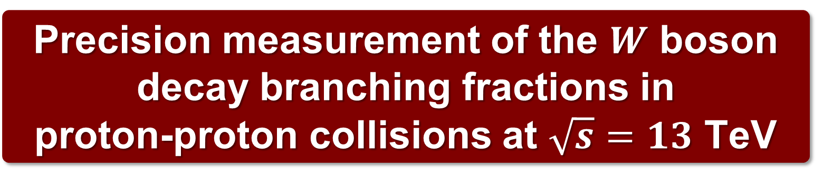
COURSE ON PHYSICS AT THE LHC
LIP, Lisbon, Portugal, July 15, 2026
Precision measurement of the $W$ boson decay branching fractions in
proton-proton collisions at $\sqrt{s}=13$ TeV
José Rebelo Rocha
jose.r.rocha@tecnico.ulisboa.pt
CFTP-IST, Lisbon
Collaboration: CMS
Published in: Phys. Rev. D 105 (2022) 7, 072008
arXiv: 2201.07861 [hep-ex]

Slide 2
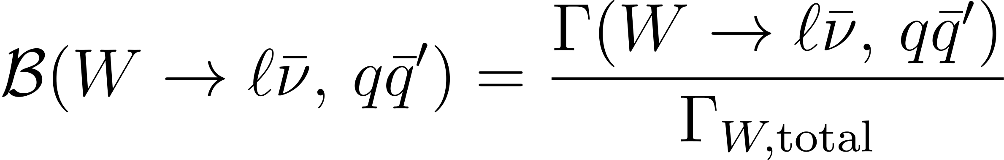



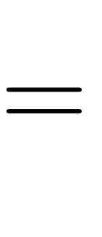
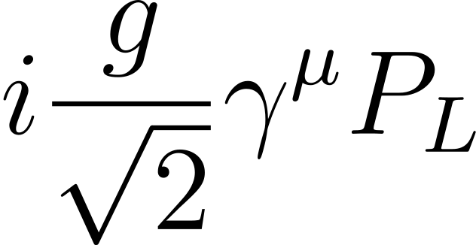

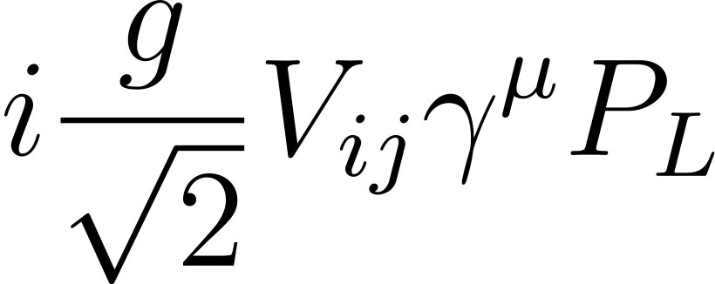

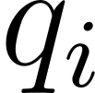
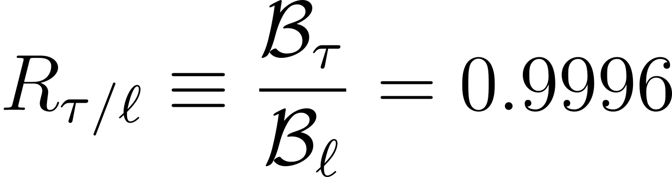
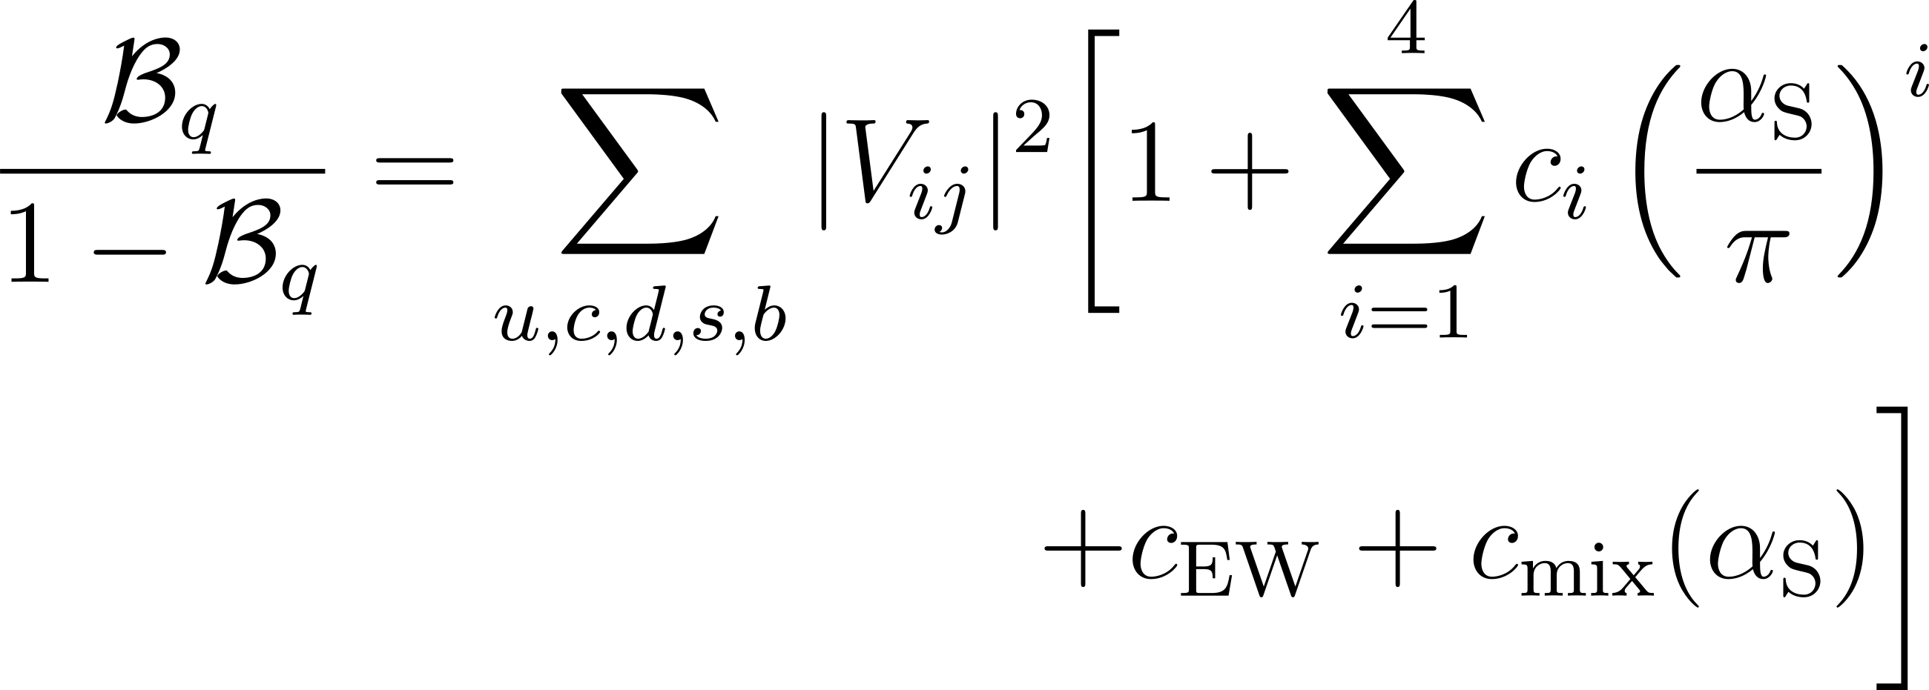




Introduction
$W$ boson branching fractions provide a test of the Standard Model
Leptonic decays
Lepton flavour universality
Hadronic decays
CKM unitarity & strong coupling
$$=2$$
$2.6σ$ departure from the SM
LEP:
CKM unitarity of first two rows
ATLAS:
$V_{cs}$ coupling
1

Slide 3
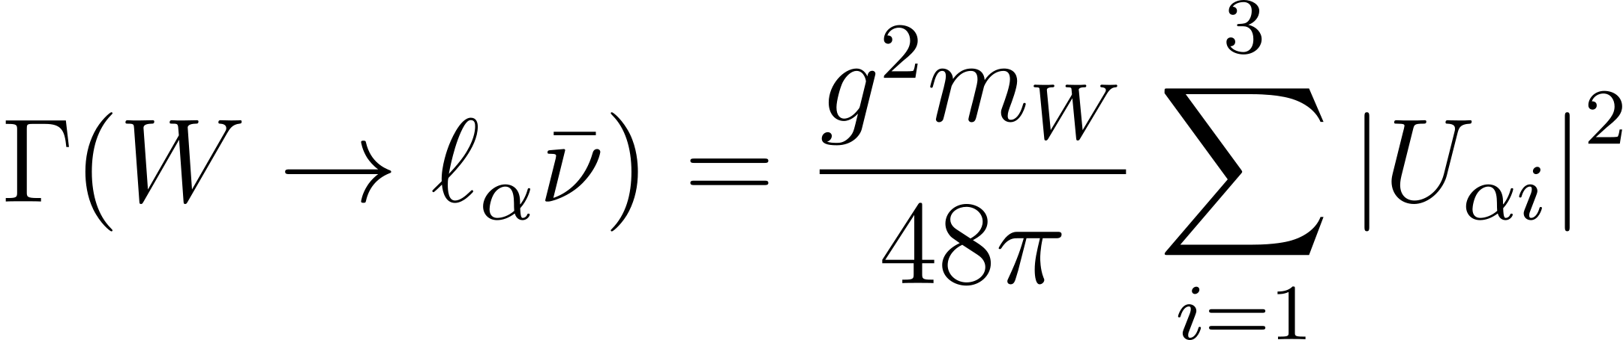
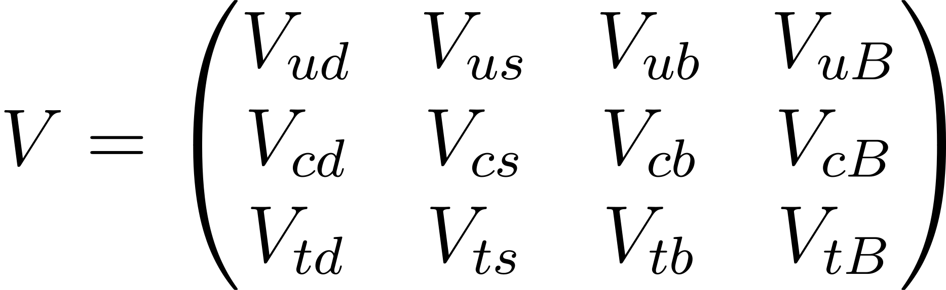
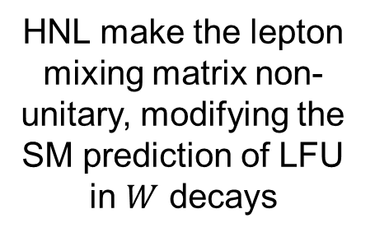
Beyond the Standard Model
Heavy Neutral Leptons
Vector-like Quarks
LFU
CKM unitarity
HNL make the lepton mixing matrix non-unitary, modifying the SM prediction of LFU in $W$ decays
A down-type SU(2)_{L} singlet VLQ induces non-unitarity in the effective CKM matrix
Minimal extensions of the SM may alter these observables!
2

Slide 4
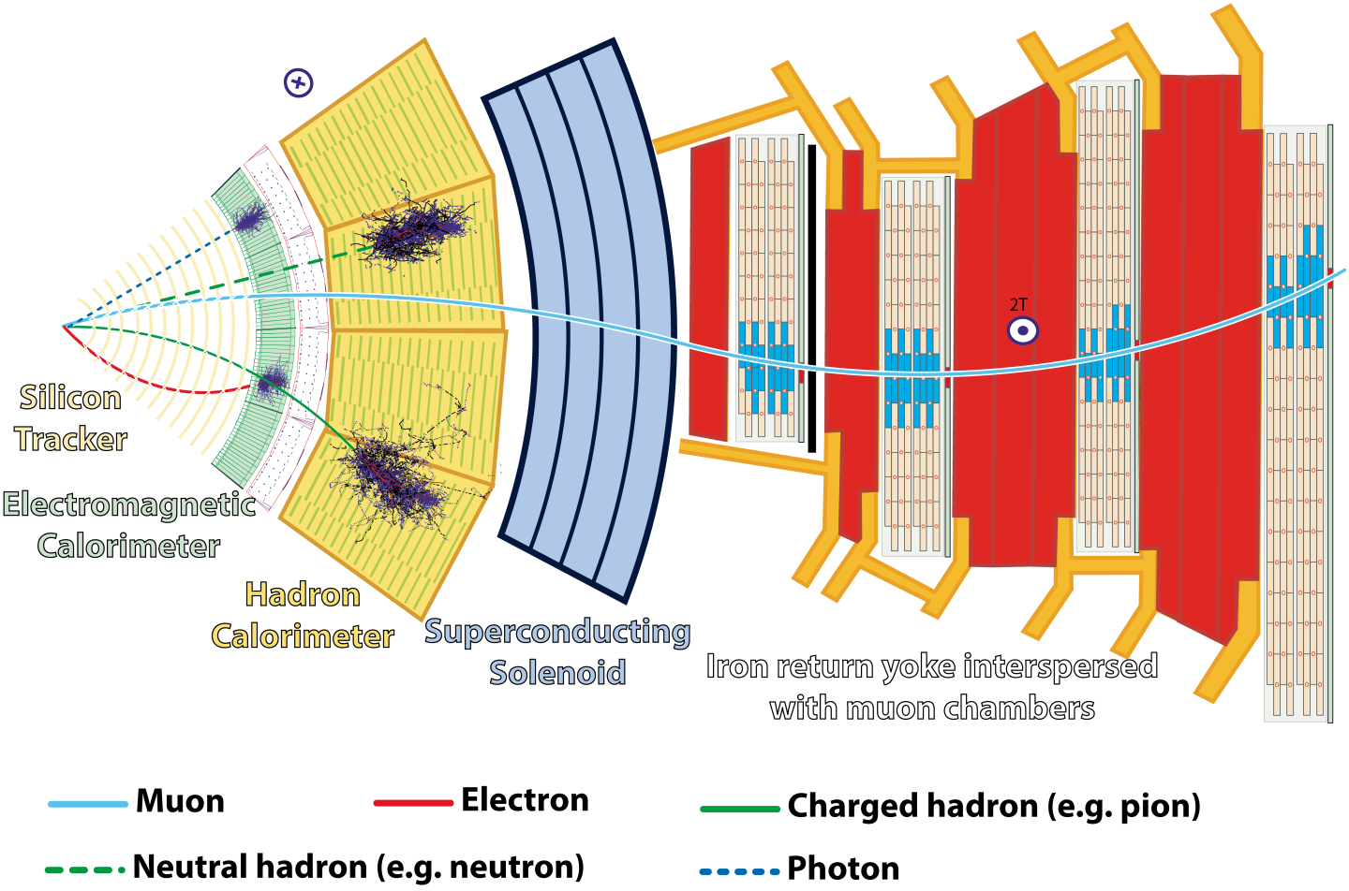
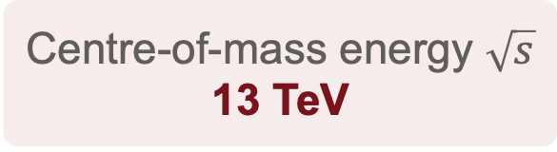
The CMS detector (2016)
Centre-of-mass energy $\sqrt{s}$
13 TeV
Integrated luminosity
35.9 fb⁻¹
Charged Particles: trajectories measured by silicon pixel and strip trackers
Electron / photon / jets of hadrons: Energy measured by calorimeters
Muon: identified and measured in gas-ionization detectors
Neutrino: inferred as missing transverse momentum
3

Slide 5
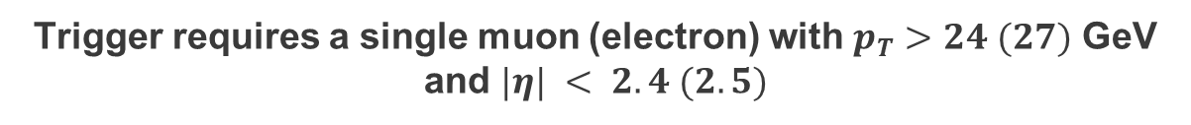
Event Selection and Reconstruction
Two-tier trigger
LHC collisions
40 MHz
Level-1 trigger
~100 kHz
High-Level Trigger
~1 kHz
Recorded
for analysis
Trigger requires a single muon (electron) with $p_{T}>24 (27)$ GeV and $|η| < 2.4 (2.5)$
Primary vertex
The PV is the candidate vertex with the largest summed physics-object p_{T}²
Physics objects are the jets, clustered together using the anti-k_{T} jet finding algorithm
Quality requirements ensure the PV comes from a hard-scattering interaction
beam
pileup
Primary Vertex
pileup
4

Slide 6
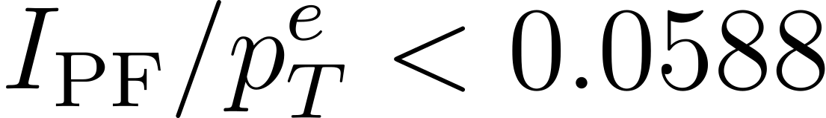
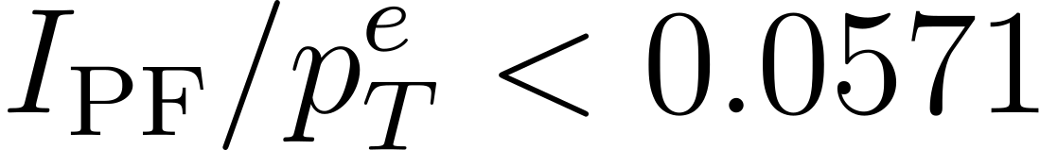
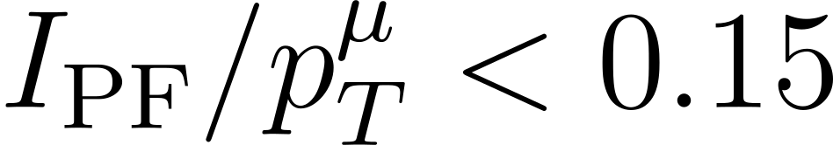



Event Selection and Reconstruction
Lepton reconstruction
Electron
Lepton isolation
Reconstructed by combining information from the ECAL and tracking system
p_{T} > 10 GeV; |η| < 2.5
Isolation Criteria:
To select leptons that originated from the prompt decay of an electroweak boson
Barrel:
$$Δϕ$$
Endcap:
$$Δη$$
Muon
e/μ
Reconstructed using both the muon and tracker subsystems
p_{T} > 5 GeV; |η| < 2.4
Isolation Criteria:
$$ΔR= 0.4$$
5

Slide 7
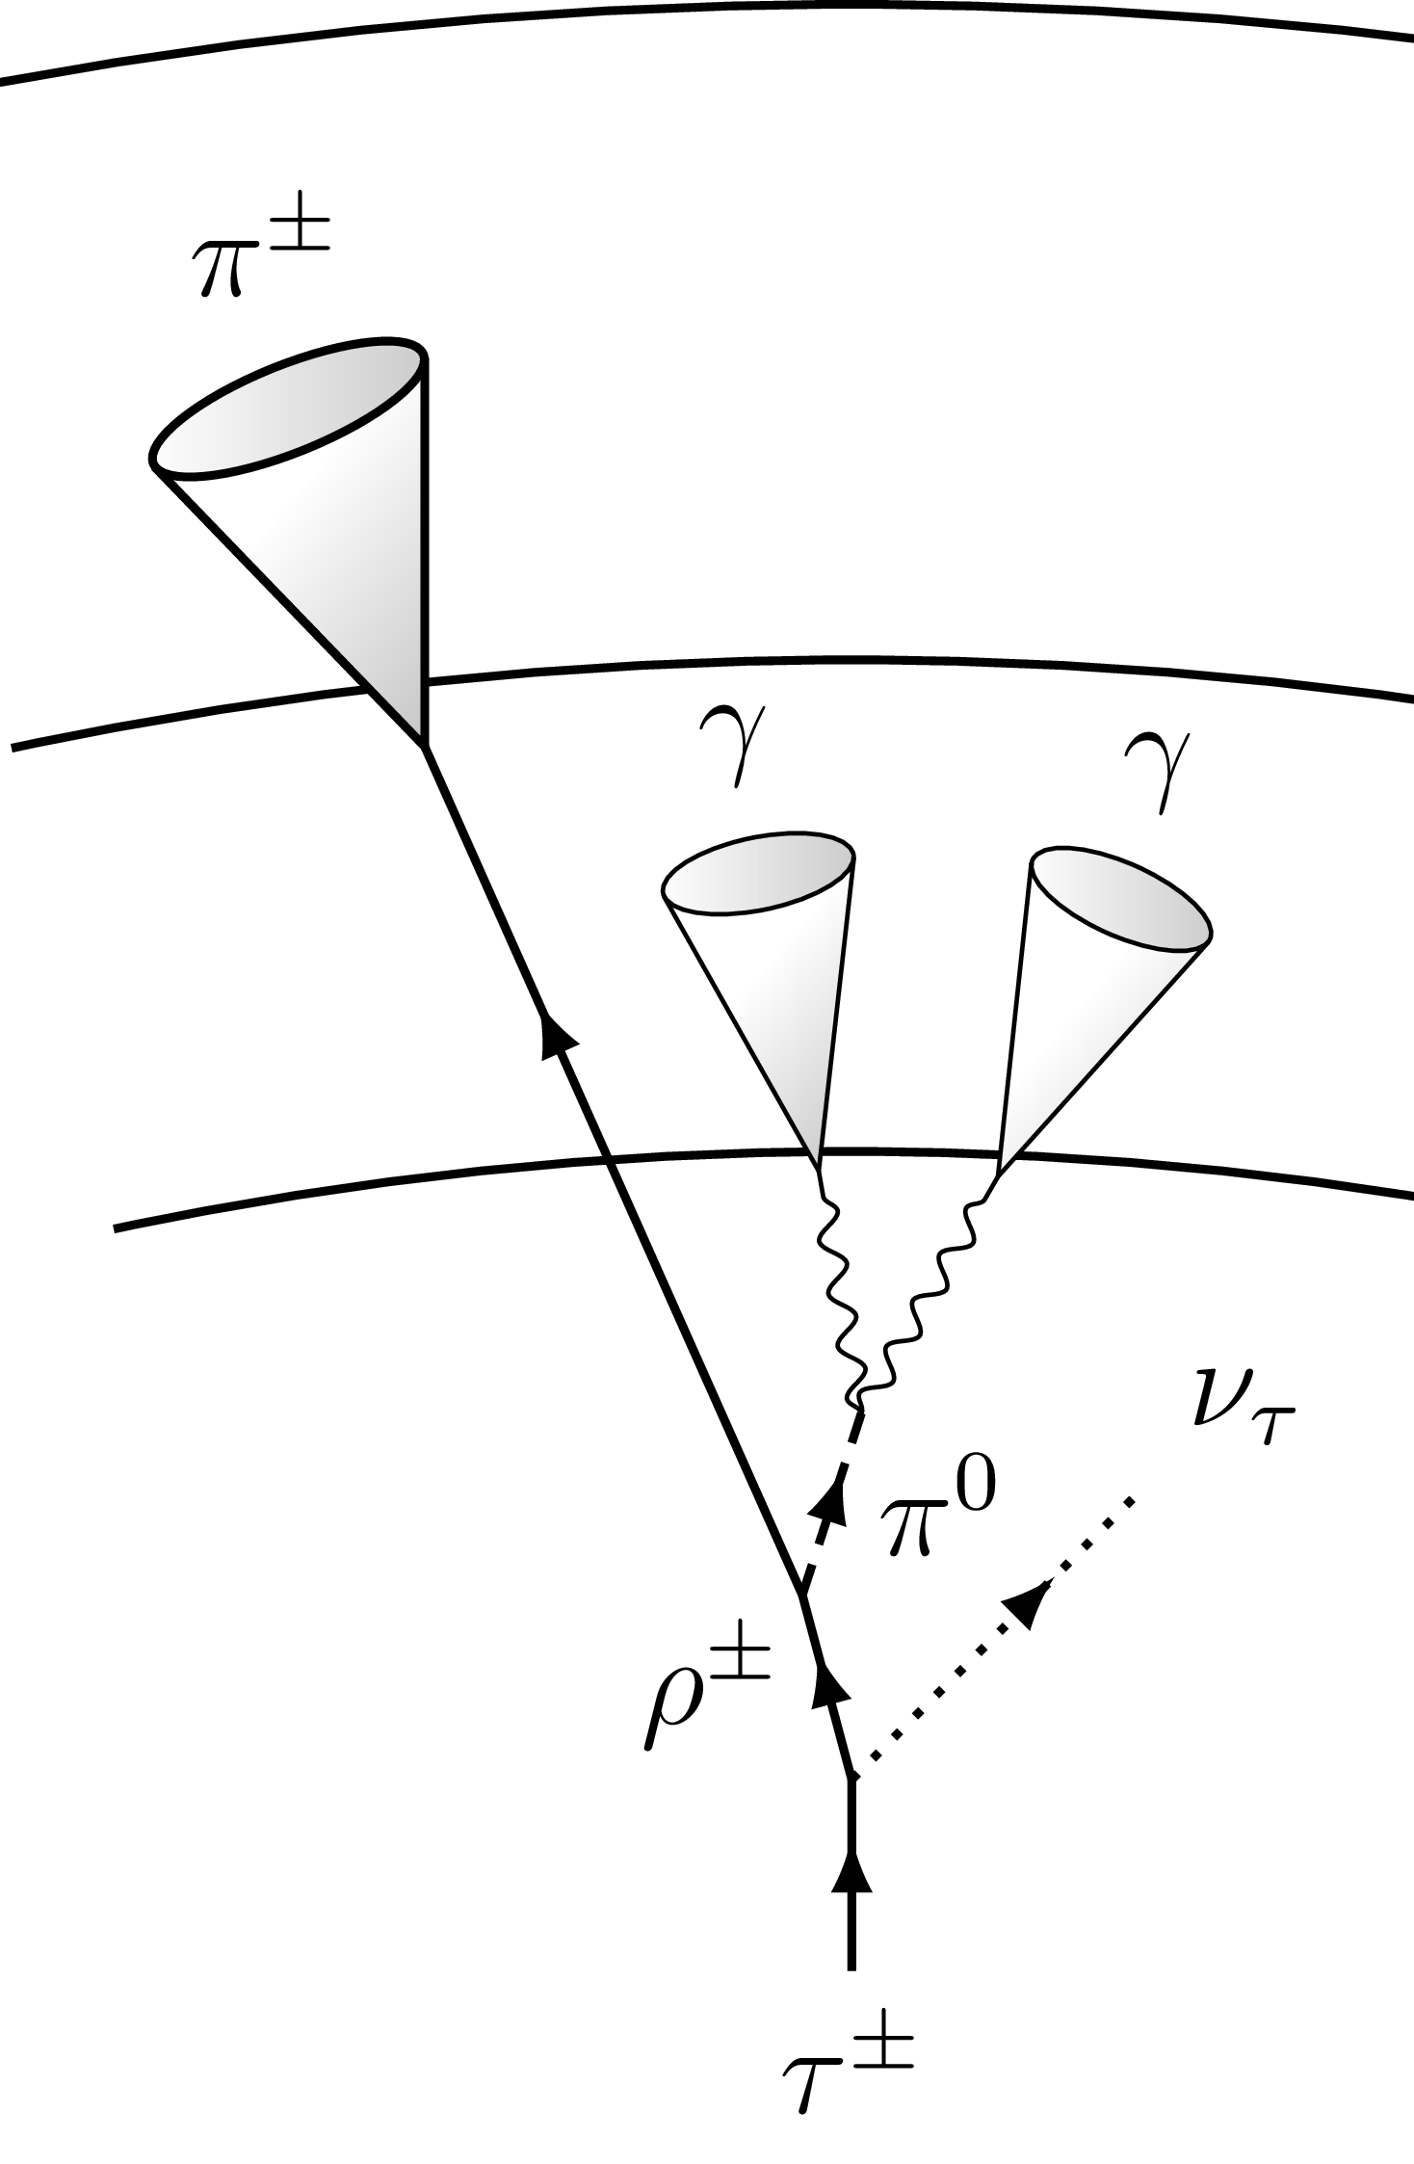
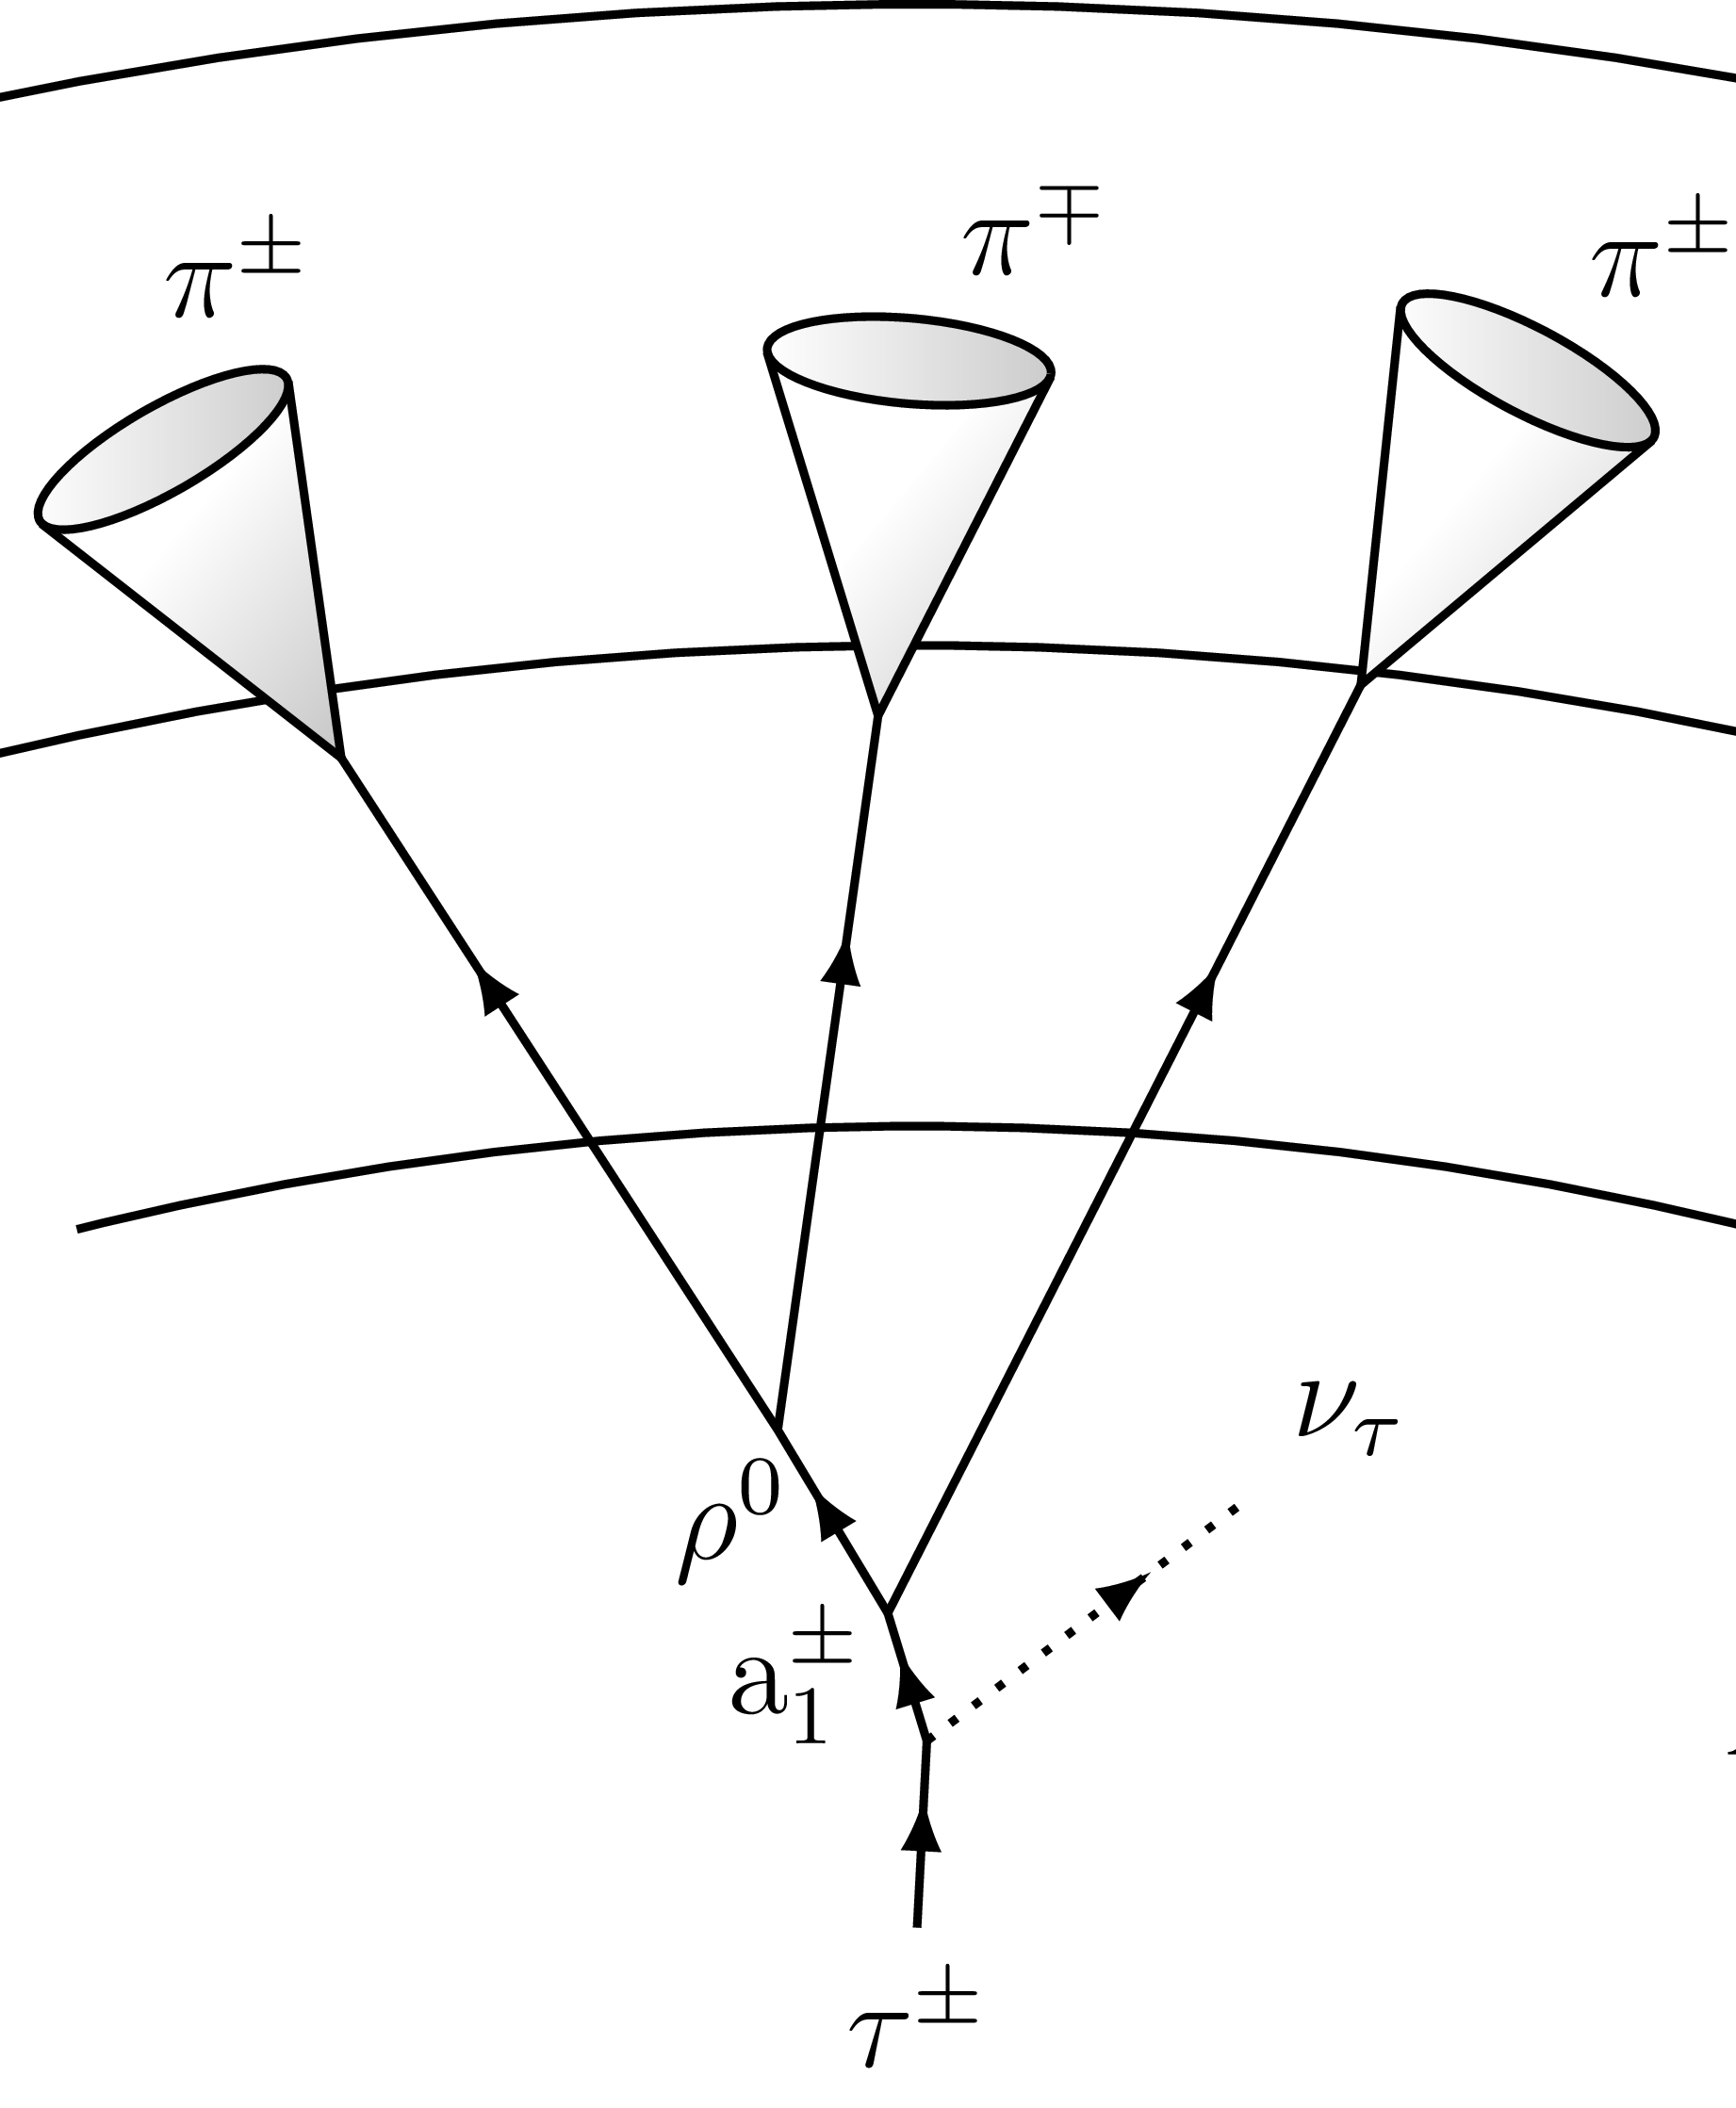
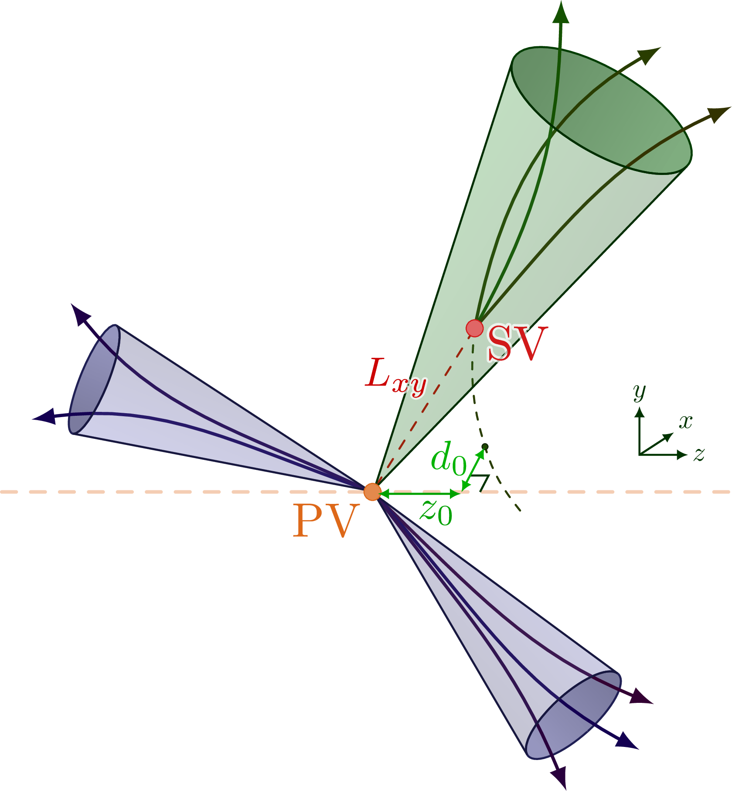
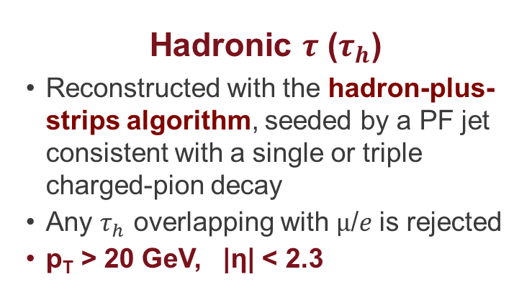
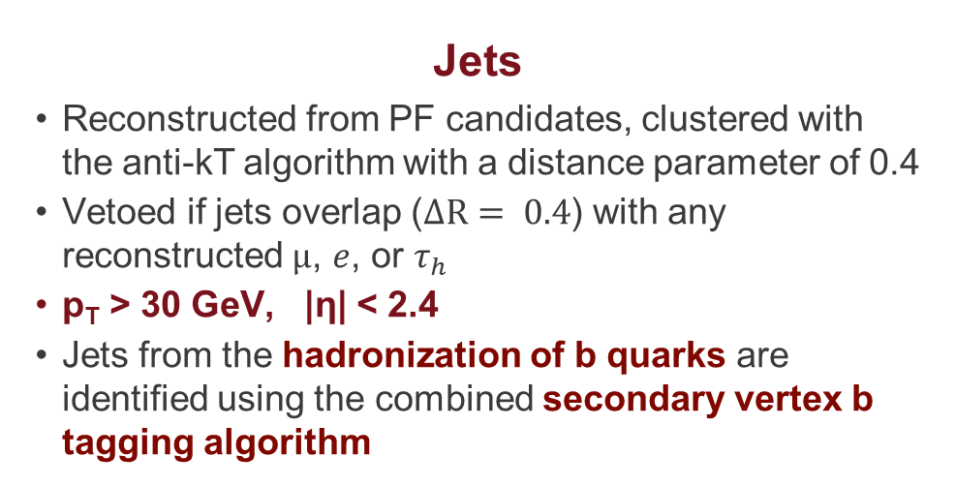
Event Selection and Reconstruction
Images by Izaak Neutelings in tikz.net
Hadronic $τ$ ($τ_{h}$)
Reconstructed with the hadron-plus-strips algorithm, seeded by a PF jet consistent with a single or triple charged-pion decay
Any $τ_{h}$ overlapping with $μ$/$e$ is rejected
p_{T} > 20 GeV, |η| < 2.3
Jets
Reconstructed from PF candidates, clustered with the anti-kT algorithm with a distance parameter of 0.4
Vetoed if jets overlap ($ΔR= 0.4$) with any reconstructed $μ$, $e$, or $τ_{h}$
p_{T} > 30 GeV, |η| < 2.4
Jets from the hadronization of b quarks are identified using the combined secondary vertex b tagging algorithm
6

Slide 8




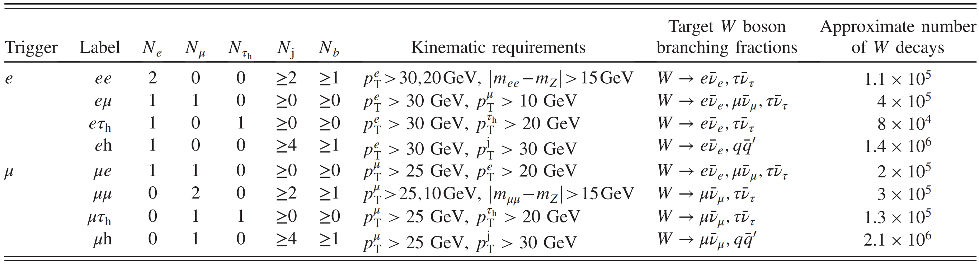

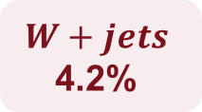

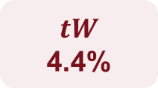
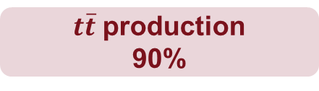

Event Categorization
Percentages = share of selected W decays
pp collision
$t\overline{t}$ production
90%
$tW$
4.4%
$WW$
1.4%
$W+jets$
4.2%
$$W→ℓν$$
$$W→qq′$$
7

Slide 9
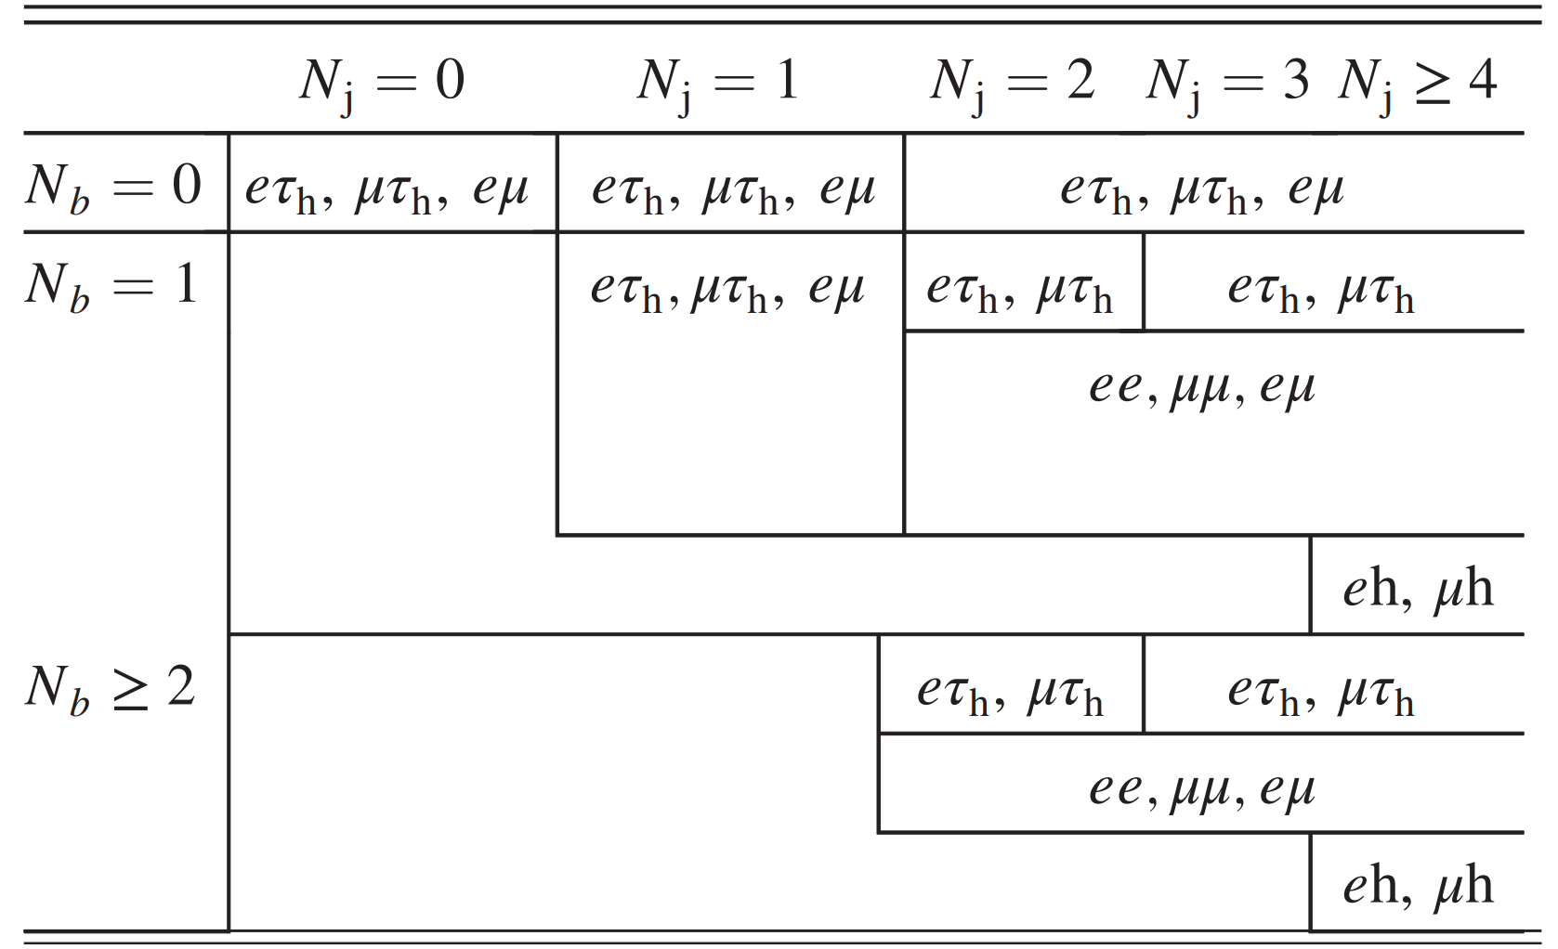
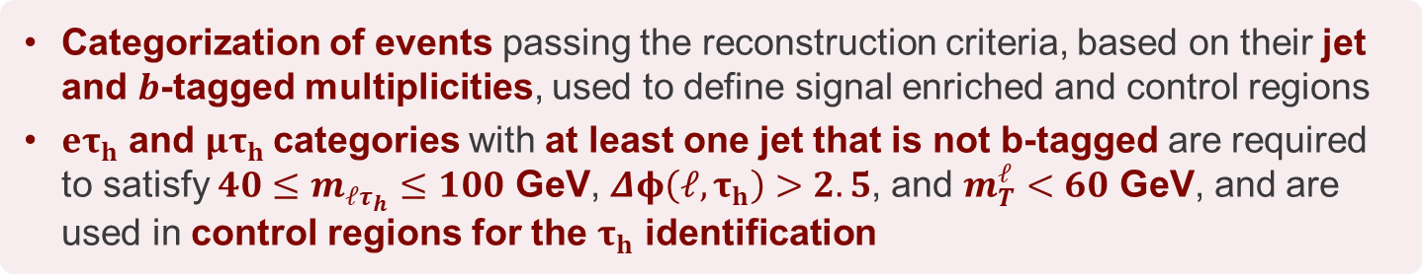
Event Categorization
Categorization of events passing the reconstruction criteria, based on their jet and $b$-tagged multiplicities, used to define signal enriched and control regions
${eτ}_{h}$ and ${μτ}_{h}$categories with at least one jet that is not b-tagged are required to satisfy $40≤m_{ℓτ_{h}}≤100$ GeV, $Δφ\left(ℓ,τ_{h}\right)>2.5$, and $m_{T}^{ℓ}<60$ GeV, and are used in control regions for the $τ_{h}$ identification
8

Slide 10

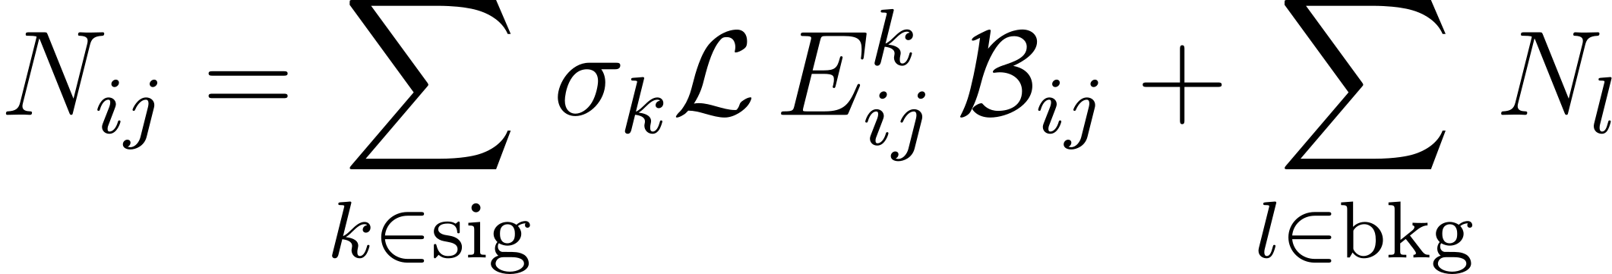
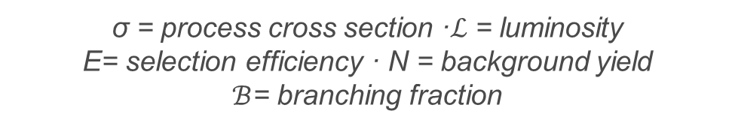
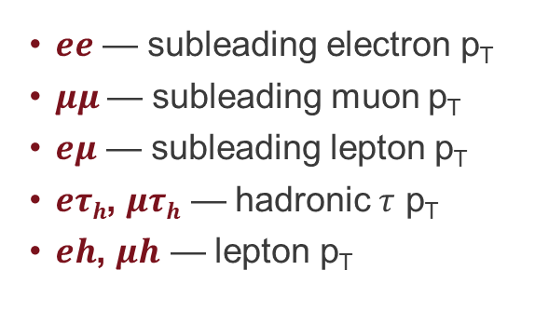

Extraction of Branching Fractions
The determination of the $W$ branching fractions is carried out using a Maximum Likelihood Estimation (MLE)
The branching fractions are encoded in the vector
W-pair decay combinations
Estimated number of events in bin $i$ and category $j$
$ee$ — subleading electron p_{T}
$μμ$— subleading muon p_{T}
$eμ$ — subleading lepton p_{T}
$eτh$, $μτh$ — hadronic $τ$ p_{T}
$eh$, $μh$ — lepton p_{T}
σ = process cross section ·$ℒ$ = luminosity
E= selection efficiency · N = background yield
$ℬ$= branching fraction
9

Slide 11
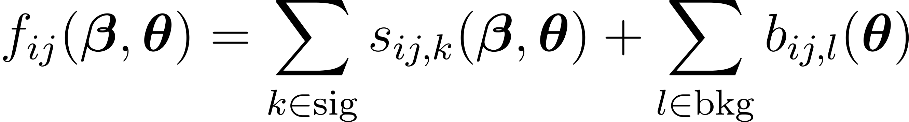
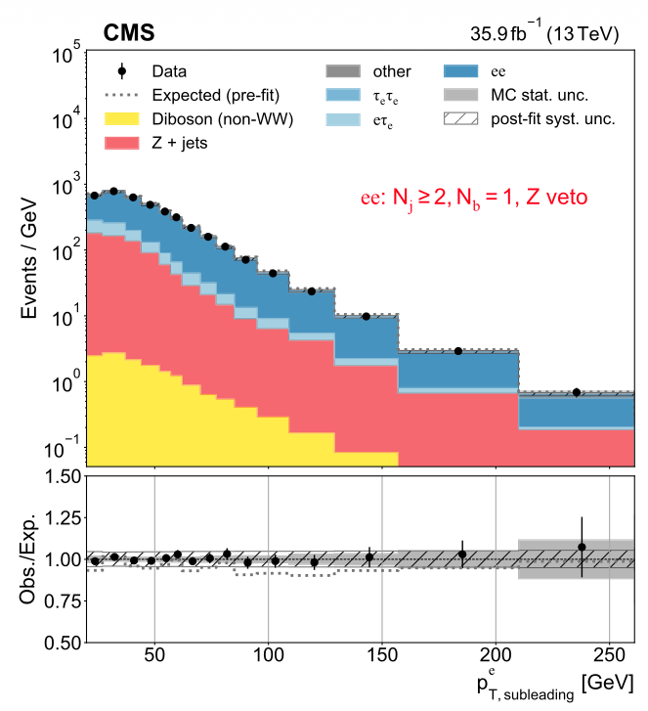
Extraction of Branching Fractions
Predicted yield in each bin and category
Templates depend on the $W$ branching fractions and nuisance parameters θ, which account for the effects of systematic uncertainties
Negative log-likelihood
y = measured data yield · π= prior uncertainty
Branching fractions are estimated by minimizing the negative log-likelihood with respect to all parameters over all categories simultaneously
10

Slide 12
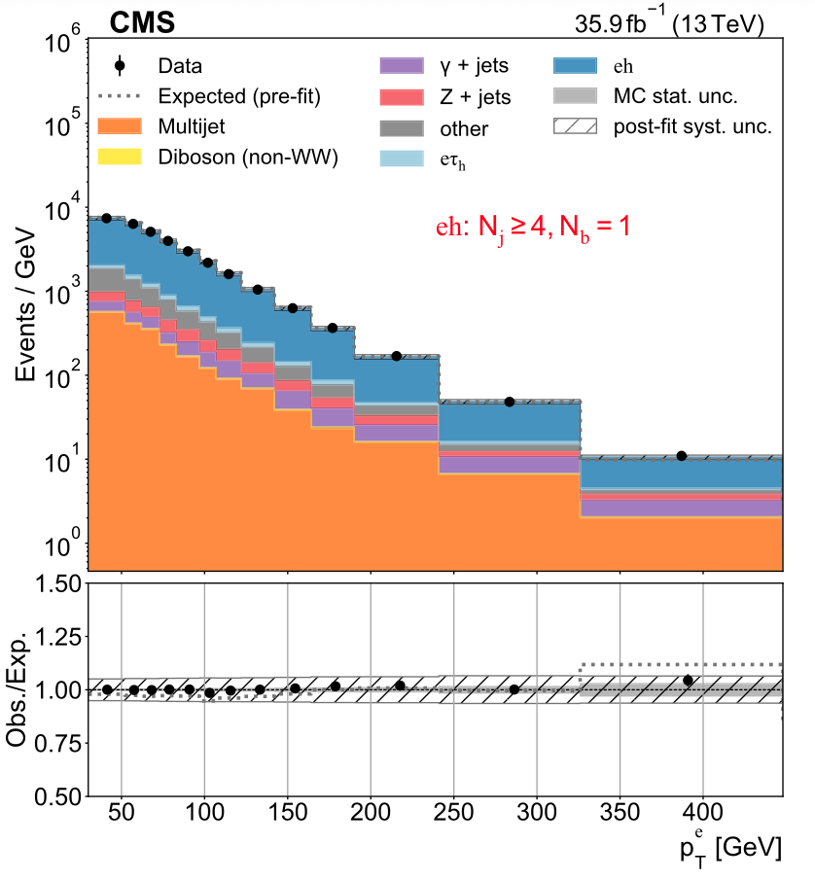
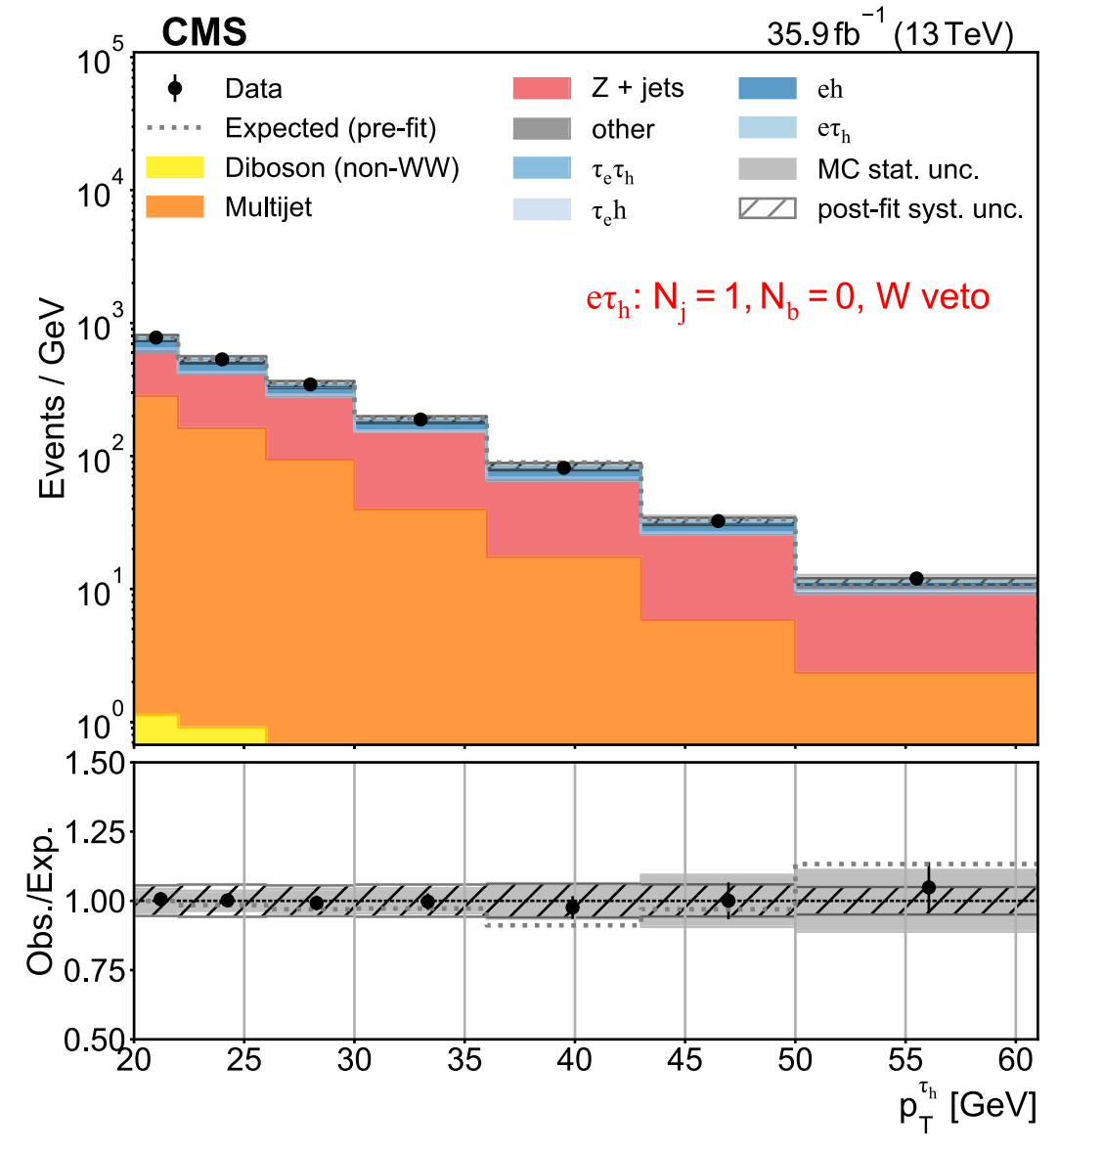
Extraction of Branching Fractions
11

Slide 13

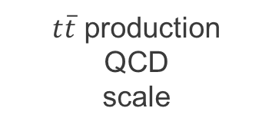


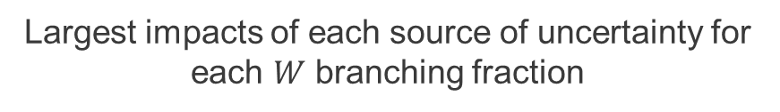


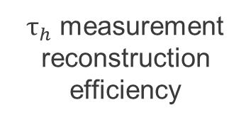
Systematic Uncertainties
Impacts quoted as a percent of the total systematic uncertainty
Largest impacts of each source of uncertainty for each $W$ branching fraction
$$W → e{\overline{ν}}_{e}$$
$$W → μ{\overline{ν}}_{μ}$$
electron reconstruction efficiency
$t\overline{t}$ production
QCD
scale
50%
47%
$$W → τ{\overline{ν}}_{τ}$$
$$W →q\overline{q}′$$
$τ_{h}$ measurement
reconstruction efficiency
$tW$
normalization
21-46%
46%
The precision of the measurement is virtually entirely determined by the systematic uncertainty
12

Slide 14
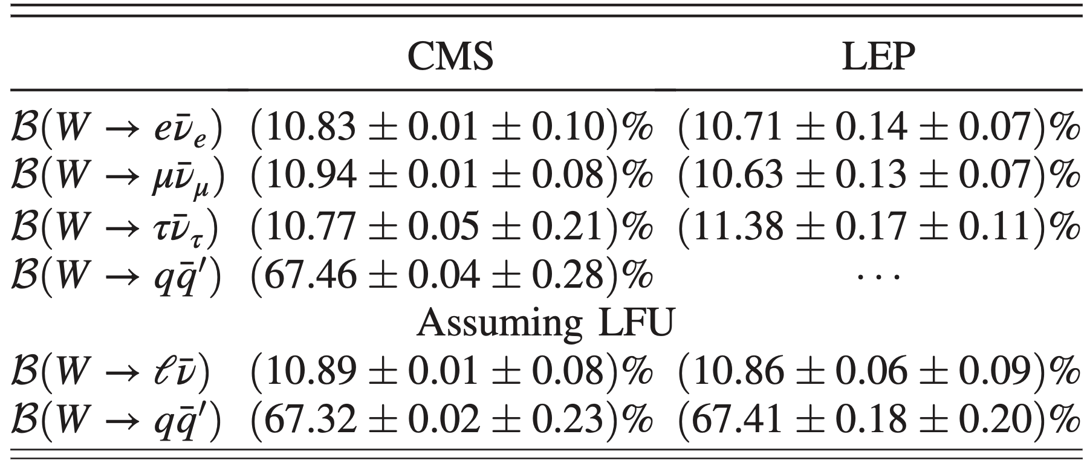
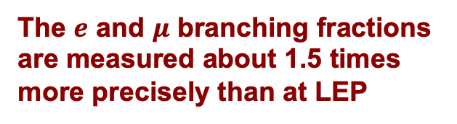

Results
Measurements 3–10 times more precise statistically than those from LEP
The $e$ and $μ$ branching fractions are measured about 1.5 times more precisely than at LEP
$τ$ have similar total uncertainties but mostly systematic origin in the CMS case
Assuming LFU, the inclusive hadronic branching uncertainty is 15% smaller than LEP
13

Slide 15
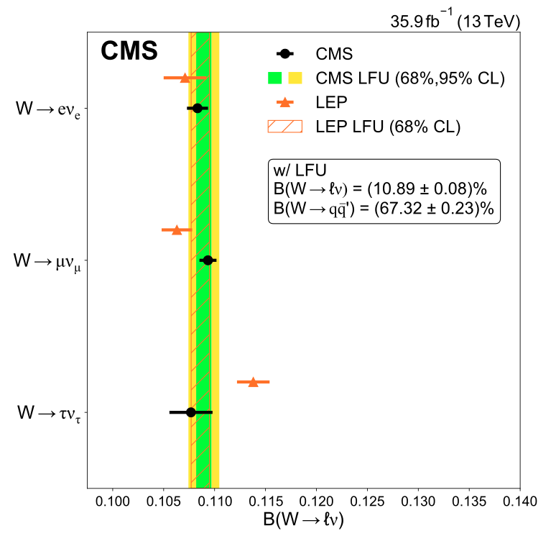
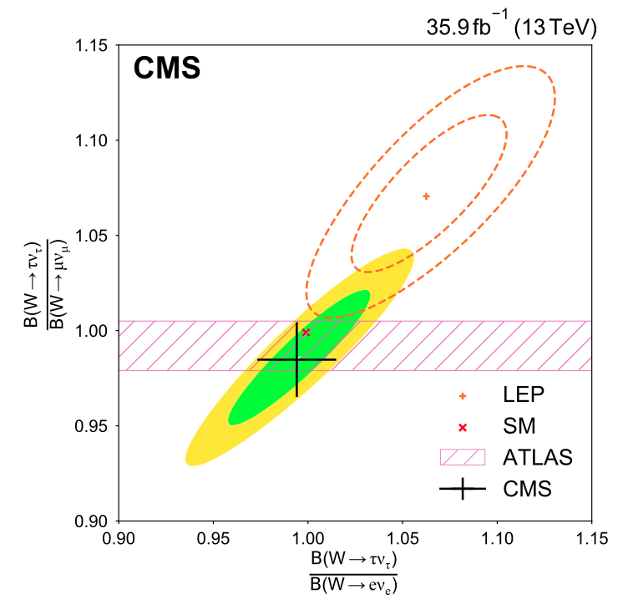
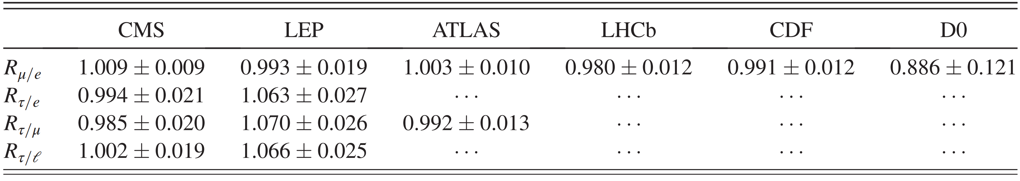

Results: Lepton Flavour Universality
CMS result is consistent with LFU at the $1 σ$ level
14

Slide 16
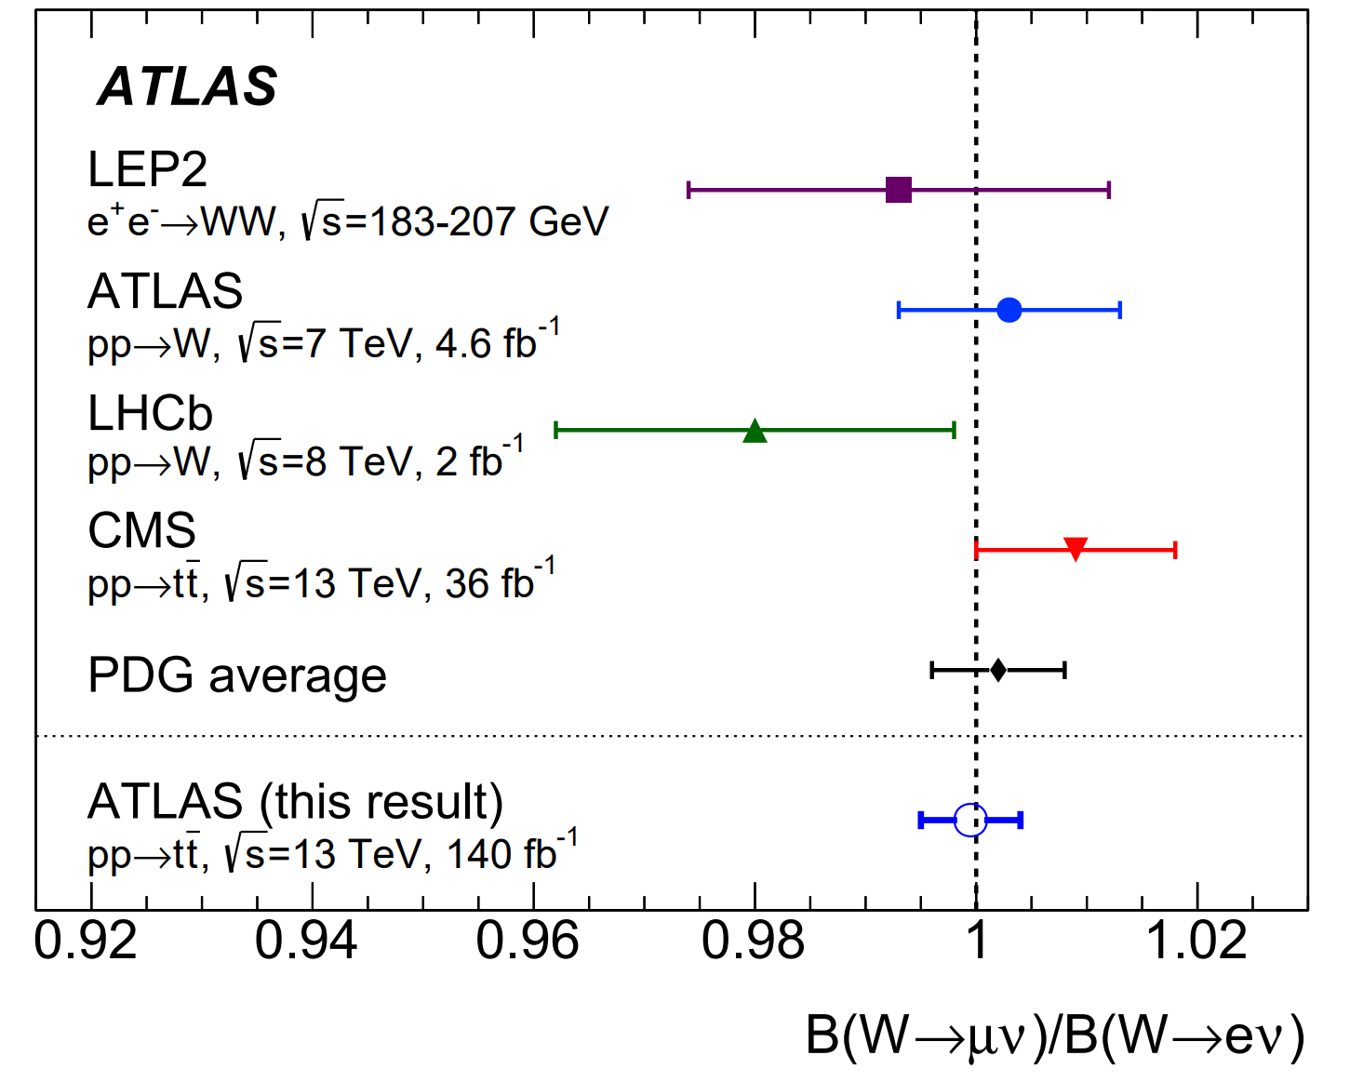
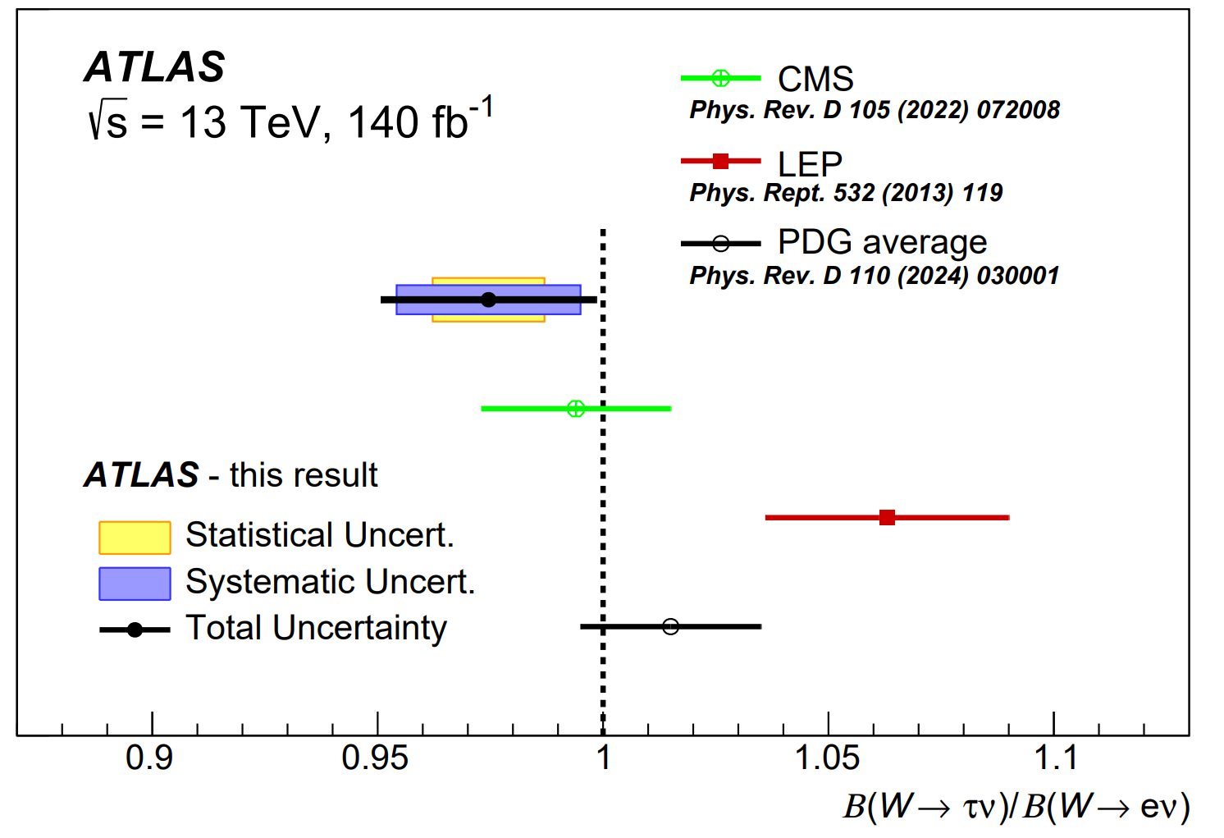


Updated Results: Lepton Flavour Universality
$$R_{μ/e}=0.9995 ± 0.0045$$
$$R_{τ/e}=0.975±0.012±0.020$$
ATLAS · 2024
arXiv: 2403.02133
ATLAS · 2024
arXiv: 2412.11989
15

Slide 17
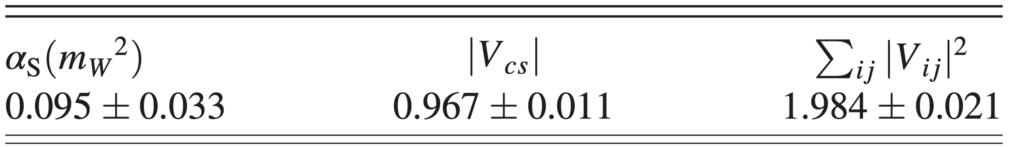
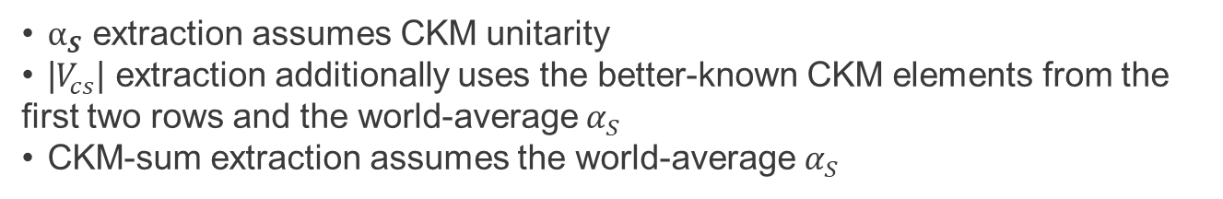
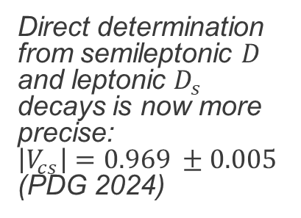
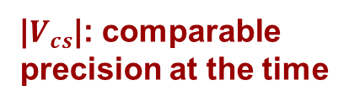

Results: Hadronic Decays
Assumptions
$α_{S}$ extraction assumes CKM unitarity
|$V_{cs}$| extraction additionally uses the better-known CKM elements from the first two rows and the world-average $α_{S}$
CKM-sum extraction assumes the world-average $α_{S}$
$α_{S}$: useful, but not competitive
|$V_{cs}$|: comparable precision at the time
CKM unitarity: no deviation
The uncertainty is much larger than the world average, but remains a promising handle for future colliders such as FCC-ee or CEPC
Direct determination from semileptonic $D$ and leptonic $D_{s}$ decays is now more precise:
$\left|V_{cs}\right|=0.969 ±0.005$ (PDG 2024)
The measured value is within 1σ of the expected value coming from unitarity
16

Slide 18
Summary and Outlook
The $W$ boson branching fractions $ℬ(W→ℓ\overline{ν})$, $ℬ(W→q\overline{q}′)$ are measured, allowing tests of the SM and the extraction of further parameters:
The CMS result is consistent with LFU at the 1σ level;
$\left|V_{cs}\right|= 0.967 ± 0.011$and $Σ|V_{ij}|² = 1.984 ± 0.021$, consistent with CKM unitarity;
Strong coupling $α_{S} (m_{W}^{2}) = 0.095 ± 0.033$: bigger uncertainty than world average but promising for future colliders.
All results agree with the Standard Model and are several times more precise statistically than the earlier LEP measurements
Thank you !
17

