Slide 1
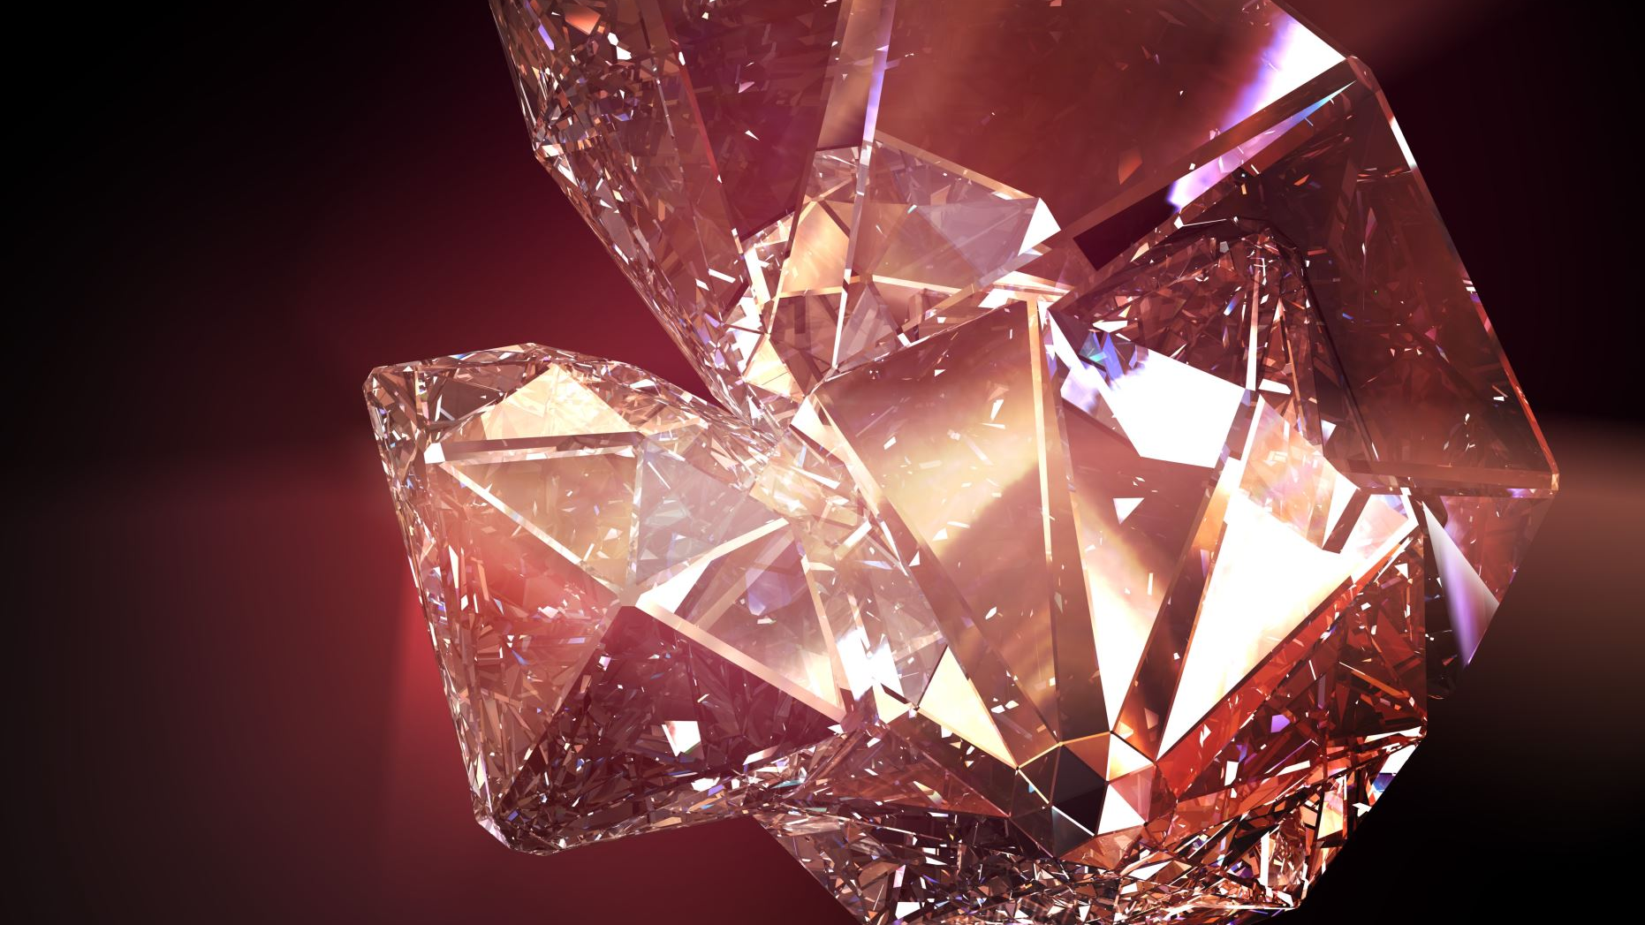


The Effect of Heterogeneous Heating on the Mineralogical Composition and on the Luminescence Dosimetry of Ceramic Materials
Author: Ana Beatriz Costa
Supervisor: Doctor Ana Luísa Rodrigues Supervisor: Doctor Rosa Marques
PIC2 Presentation

Slide 2
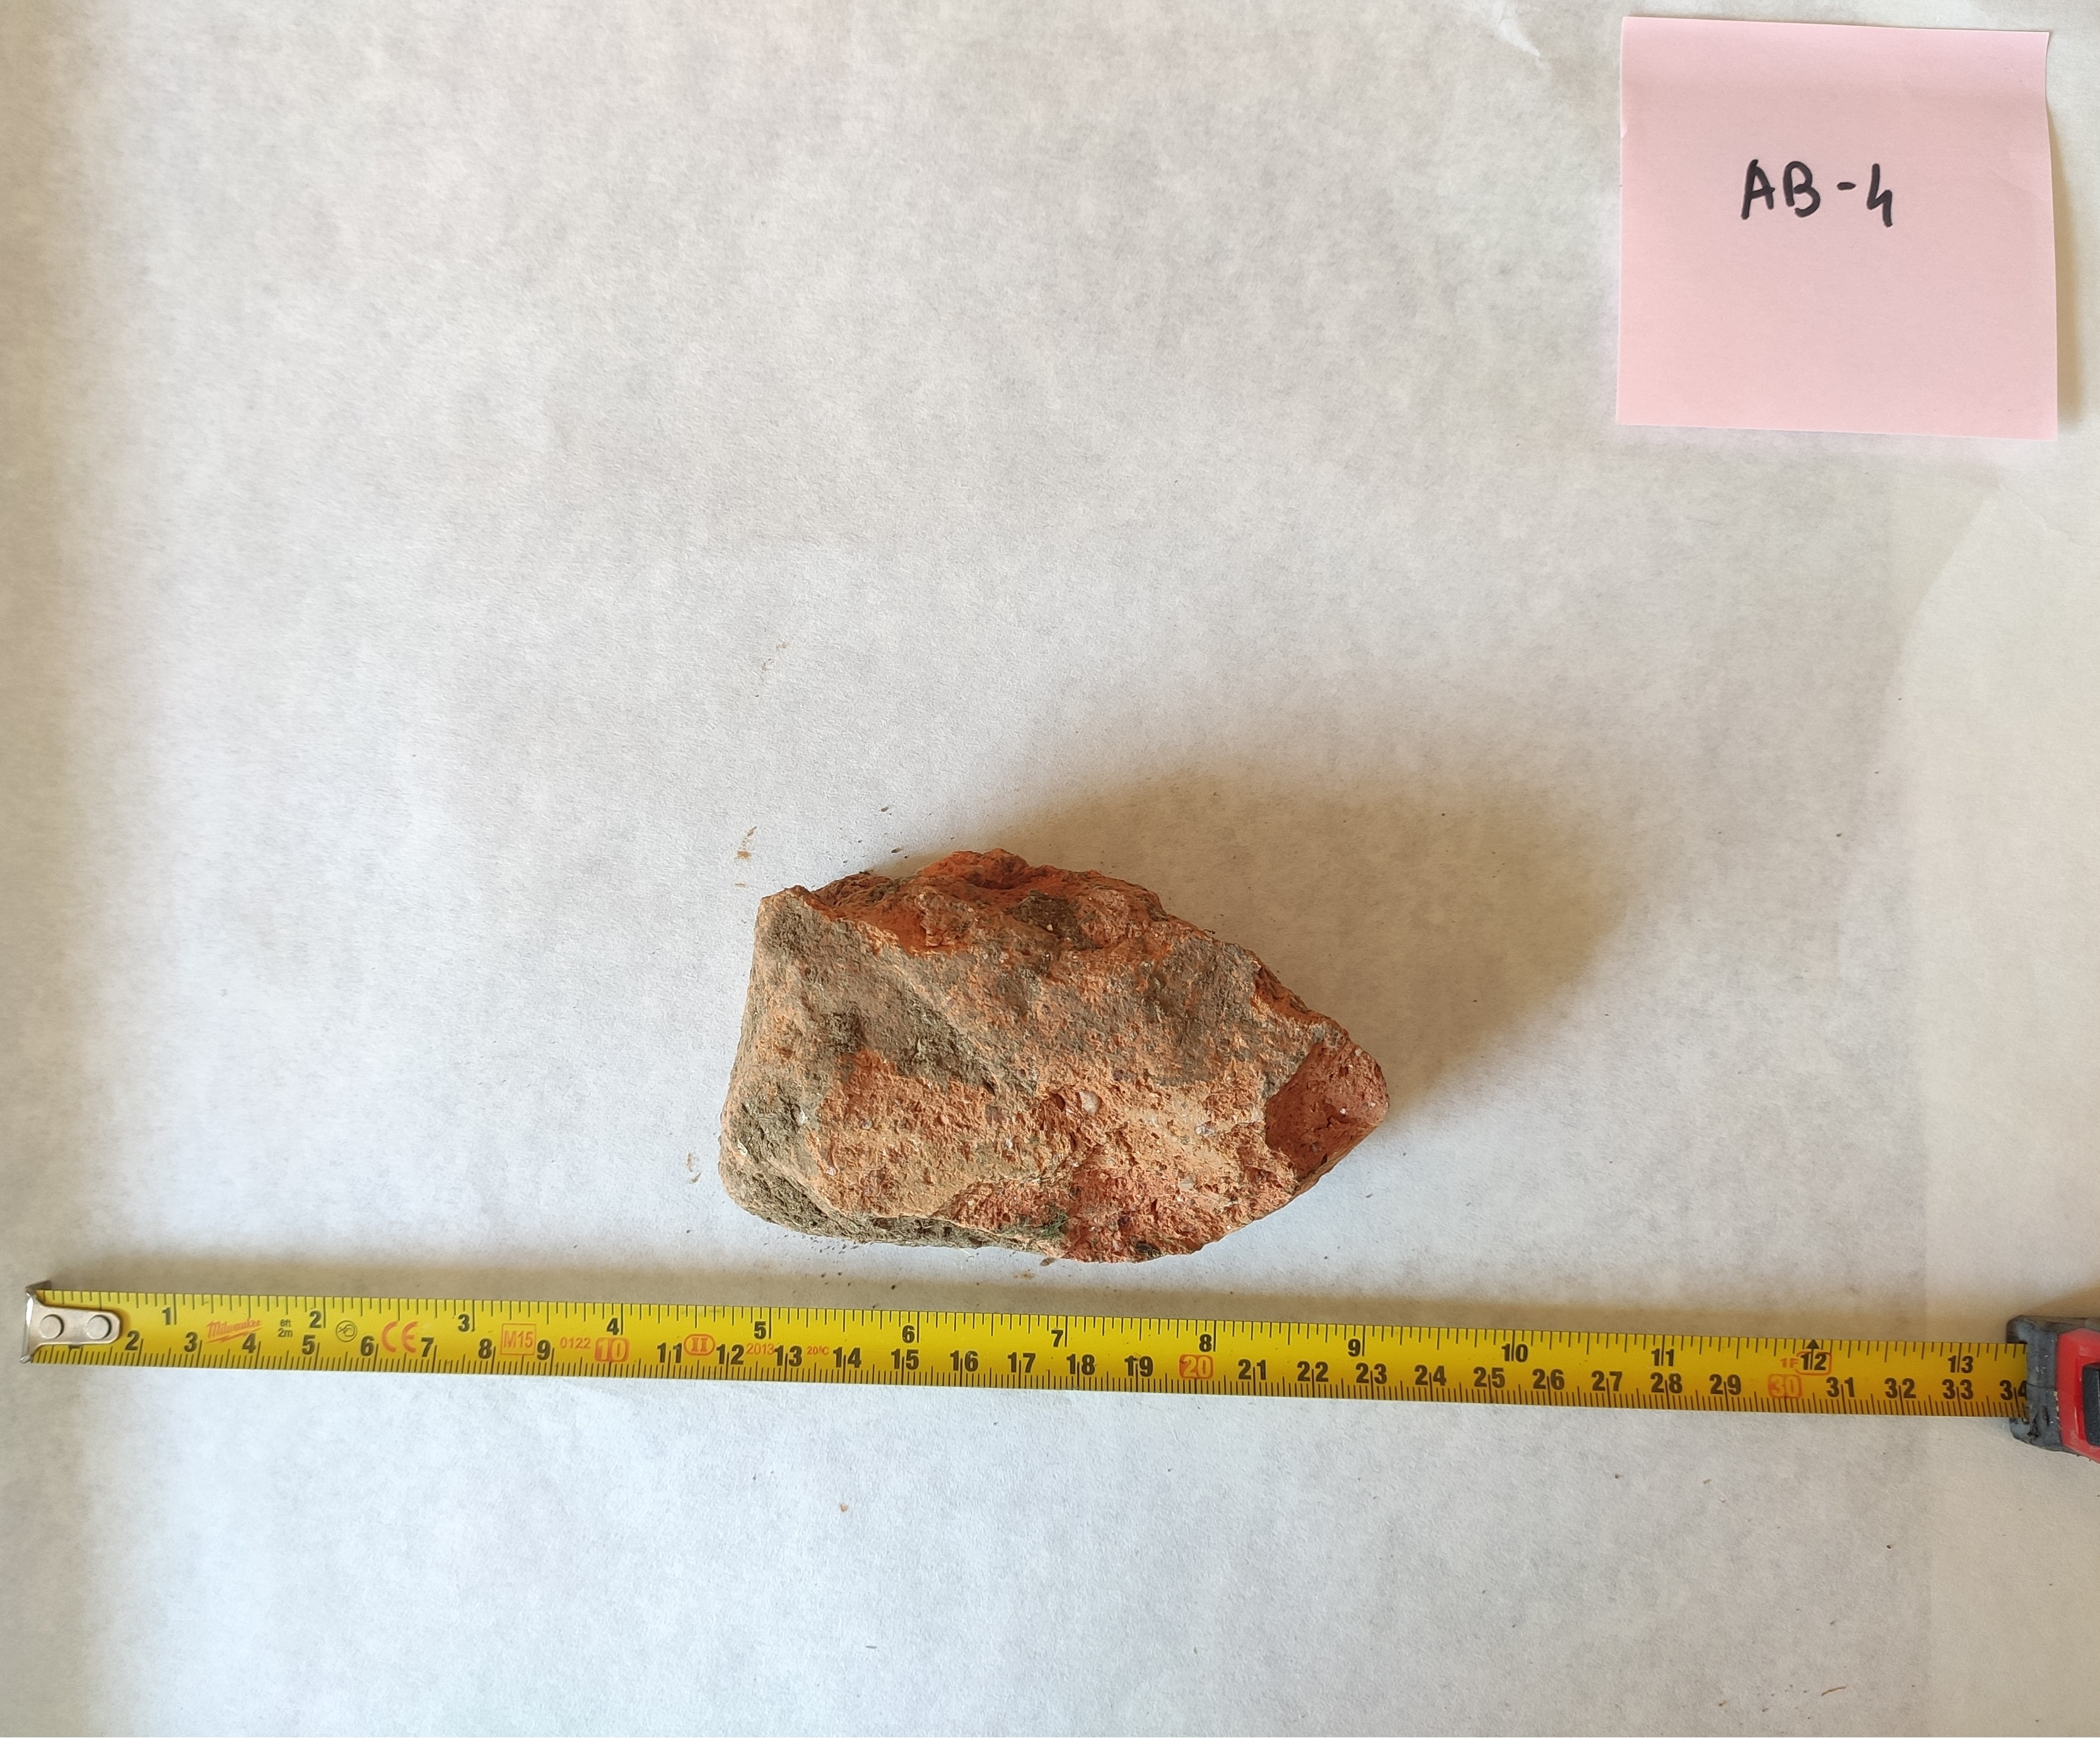
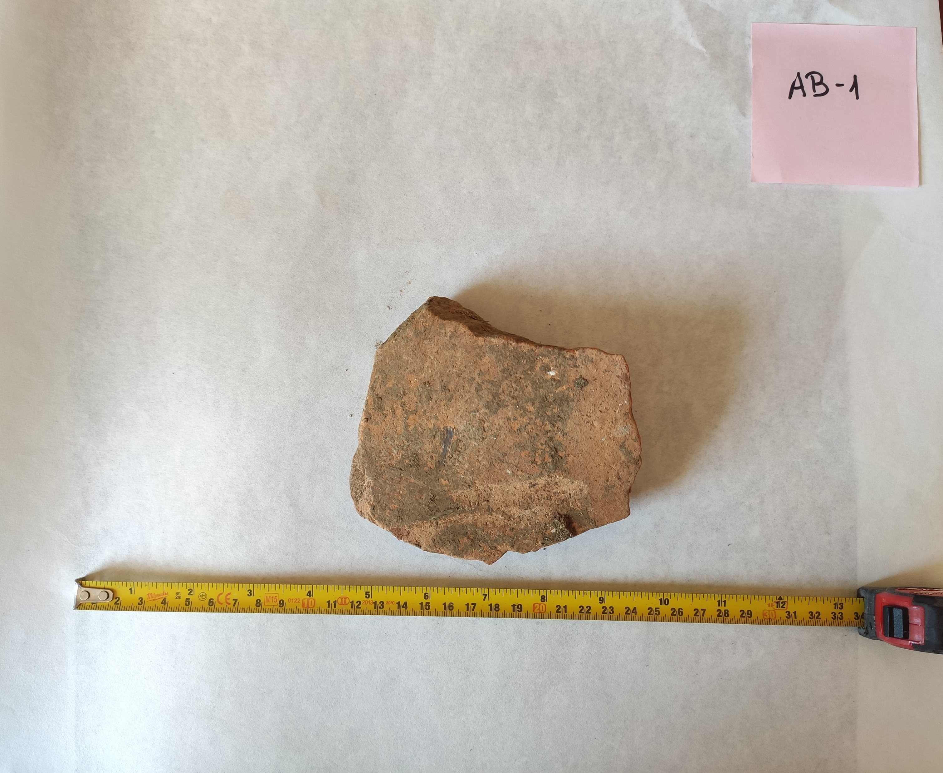
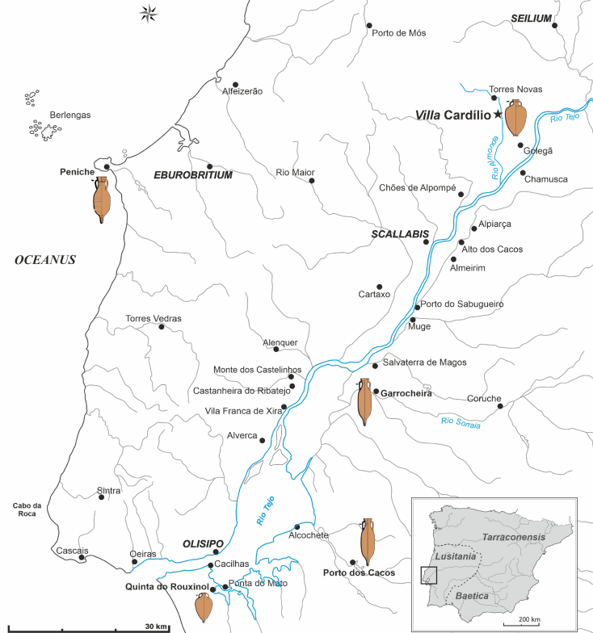
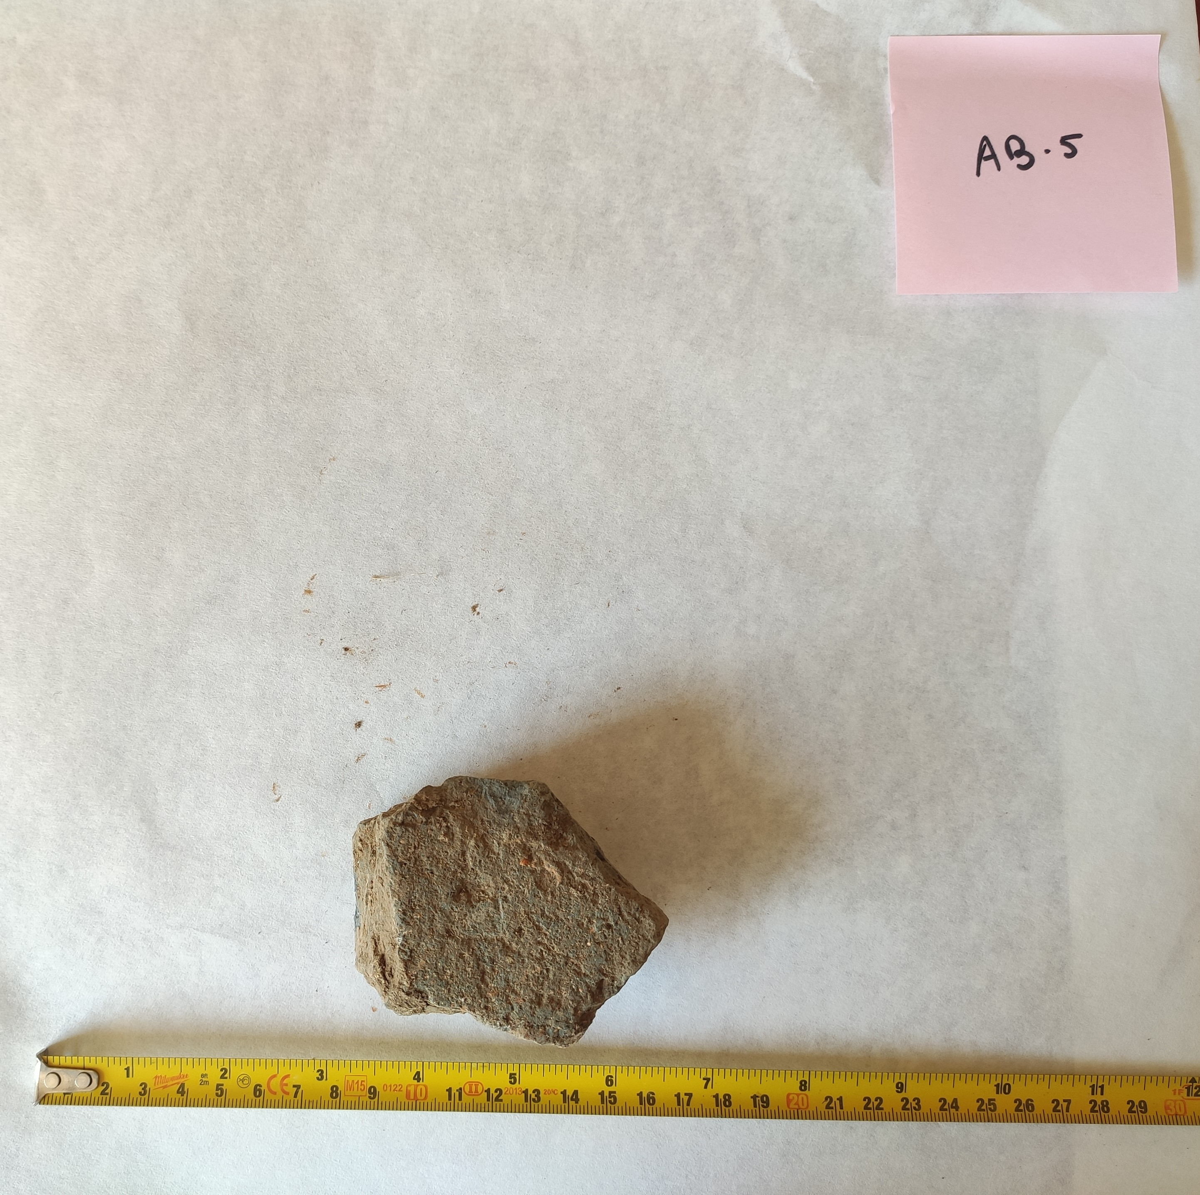
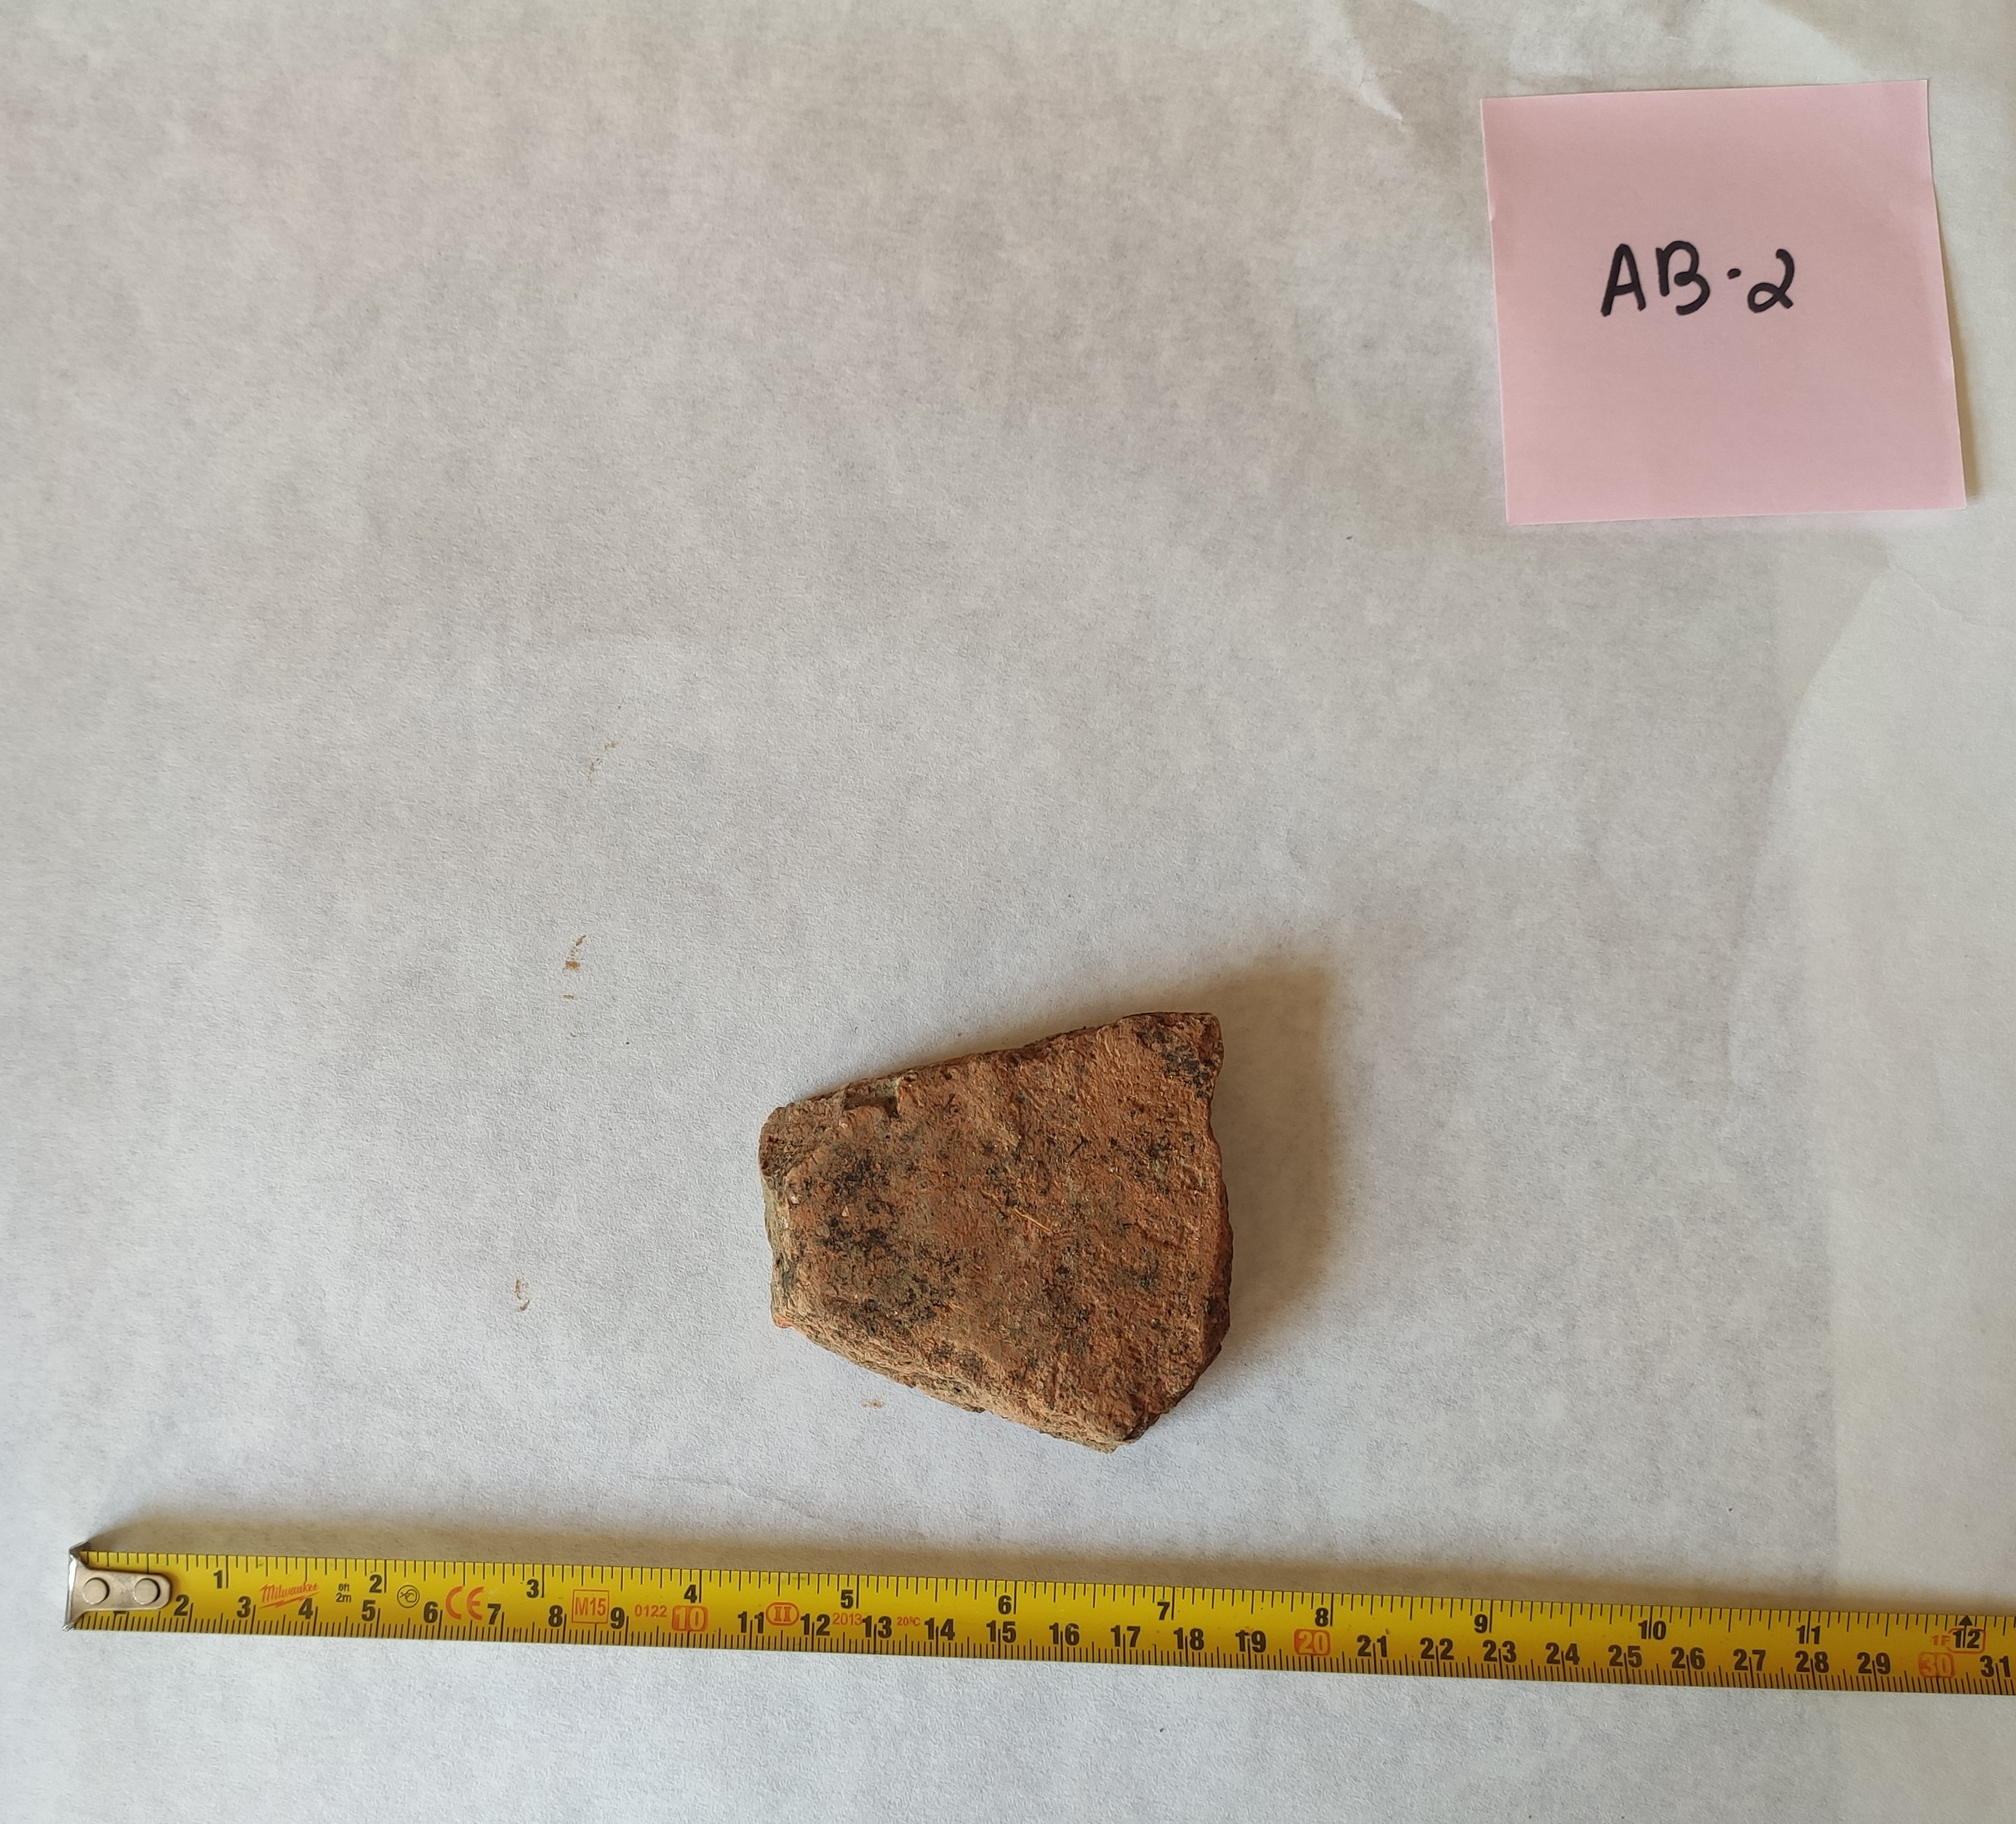
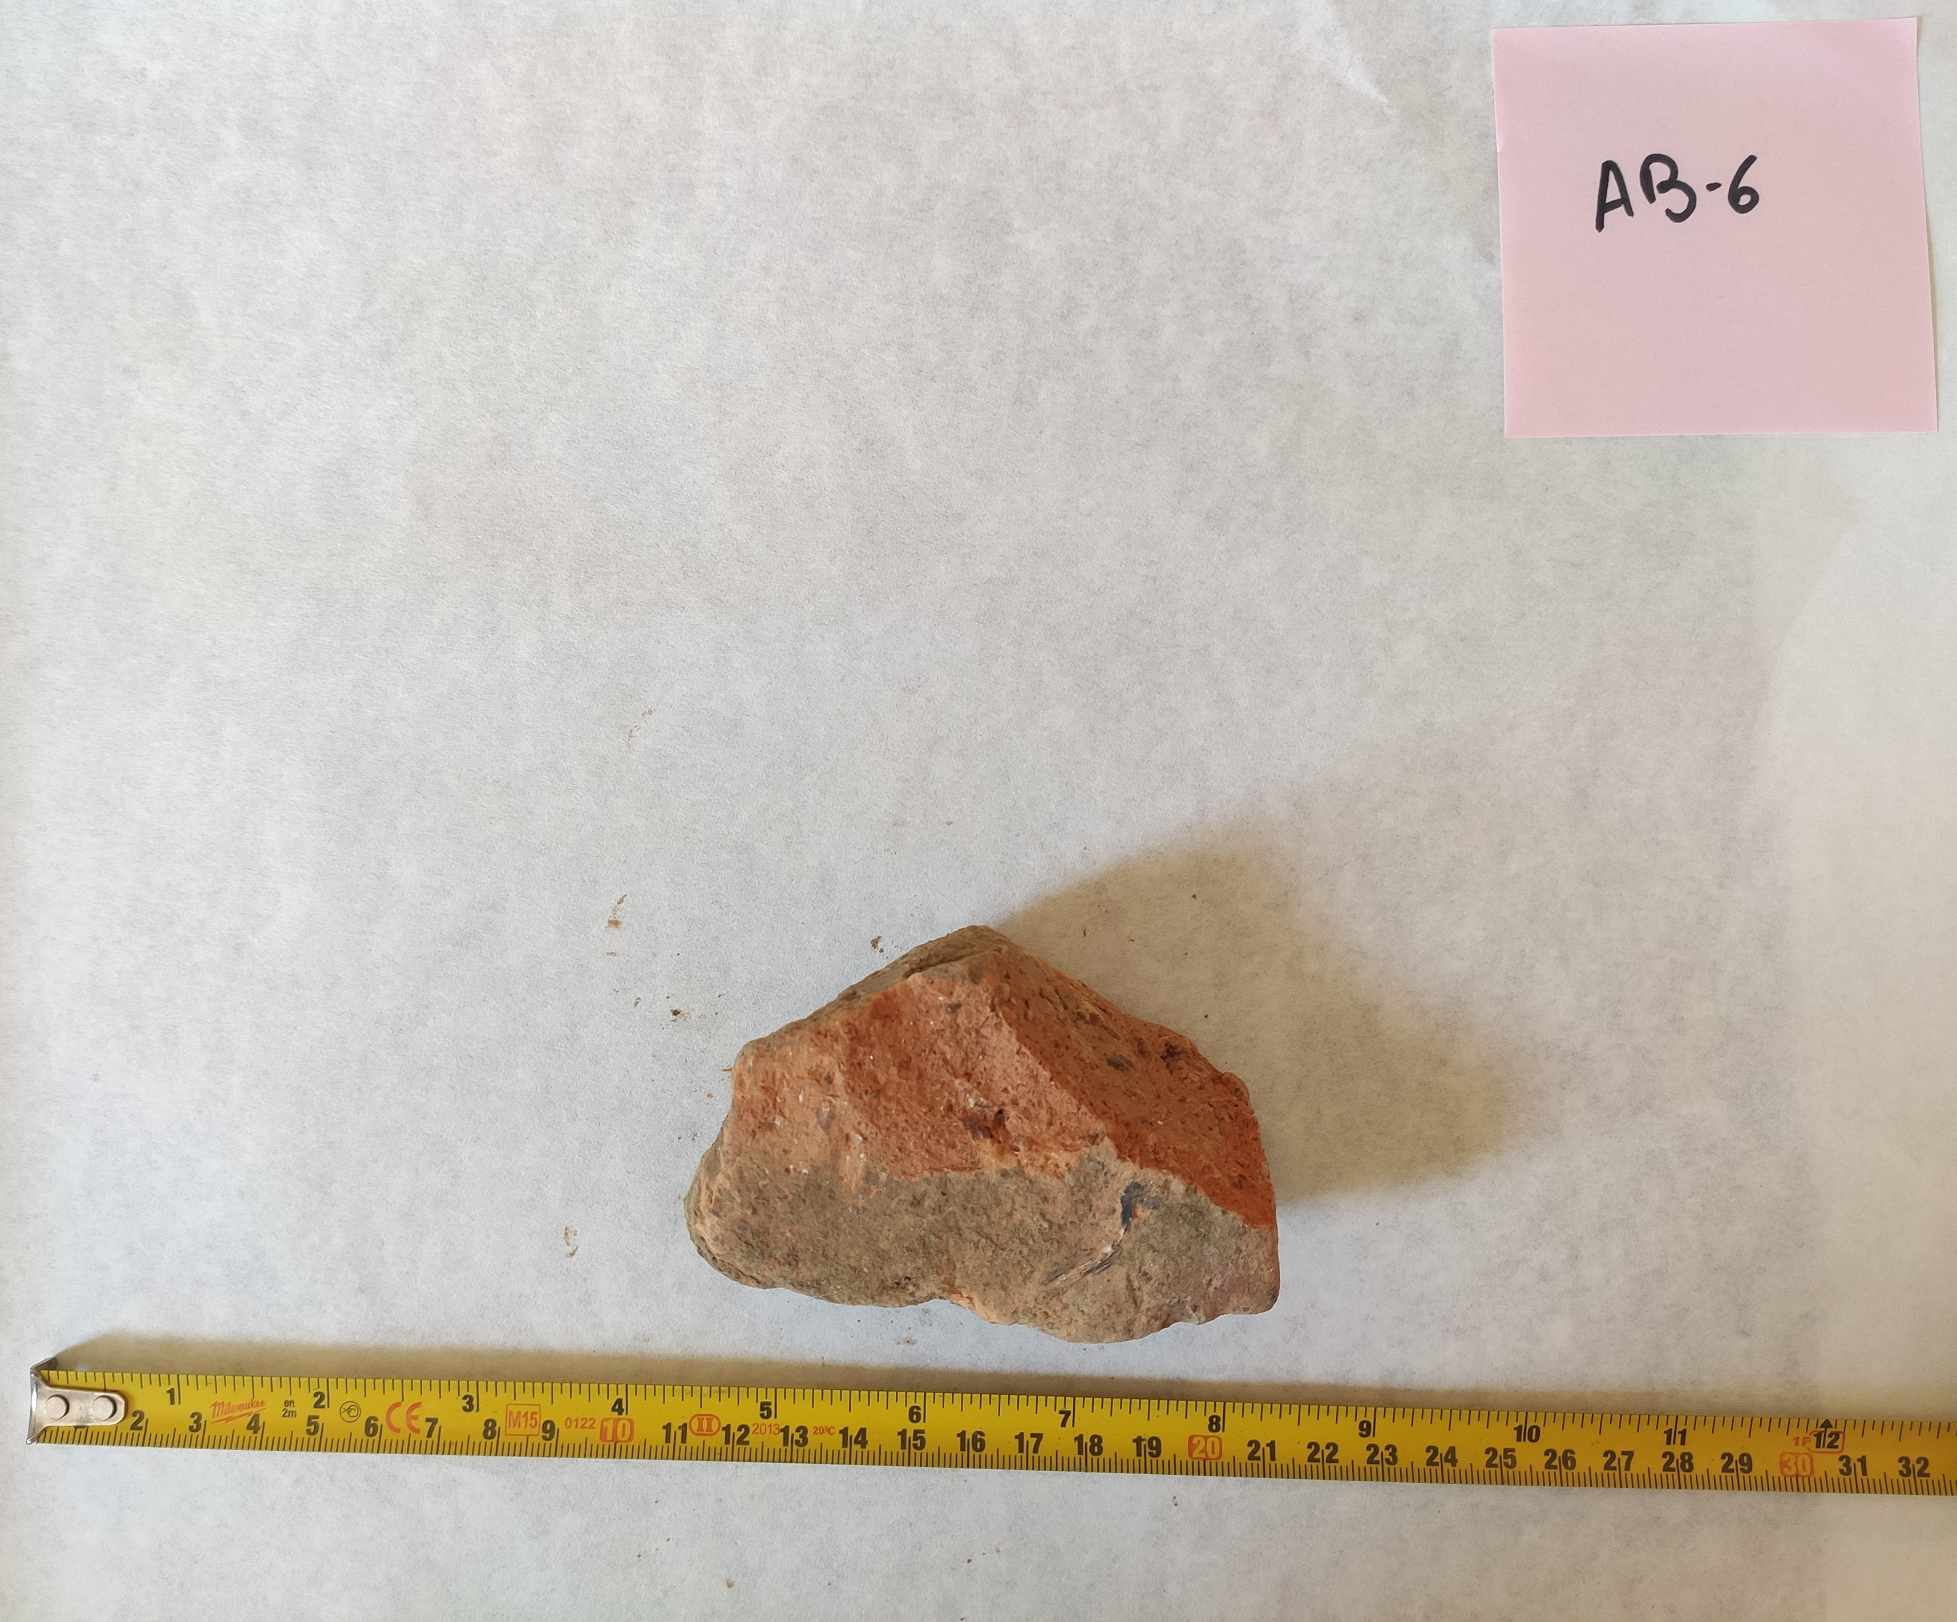
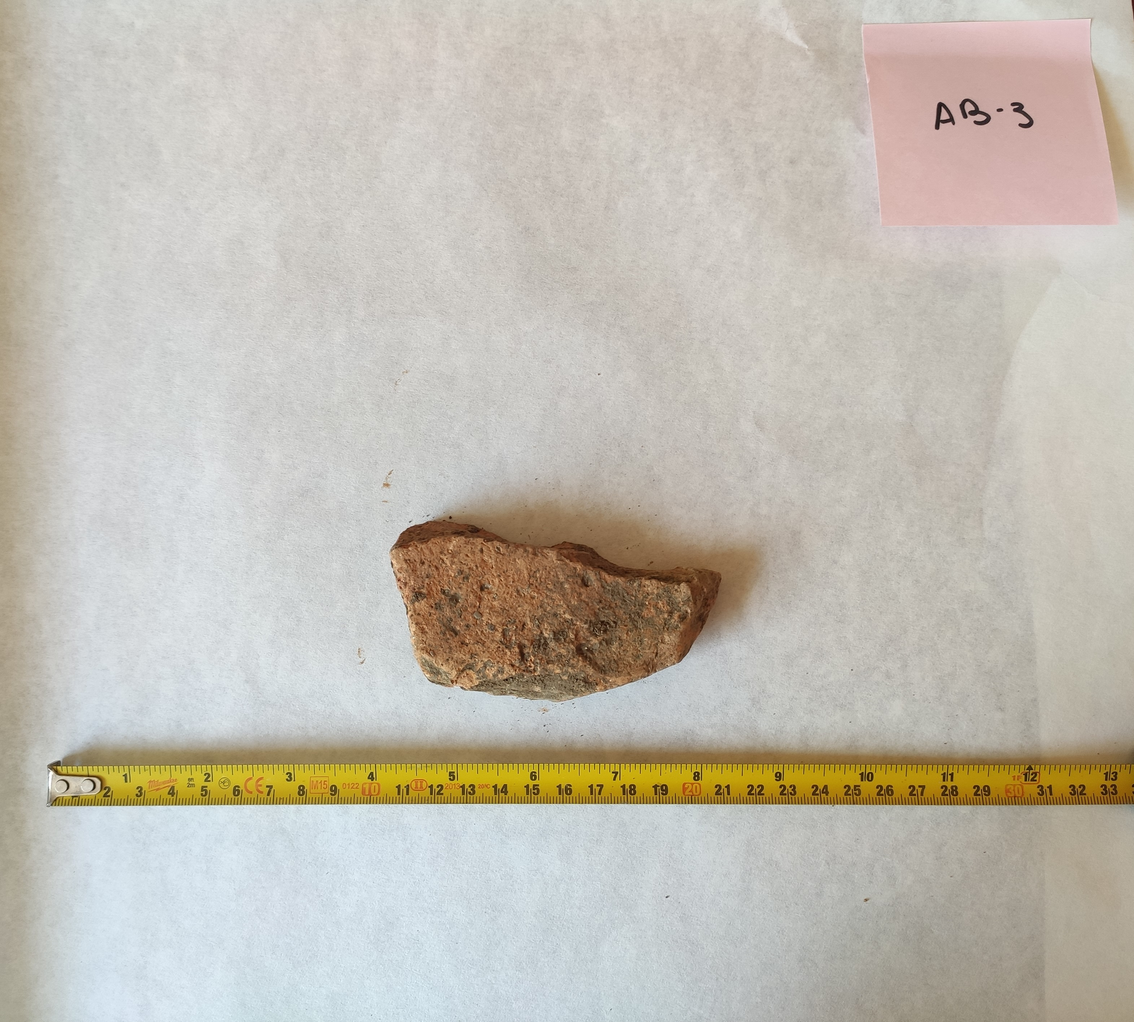
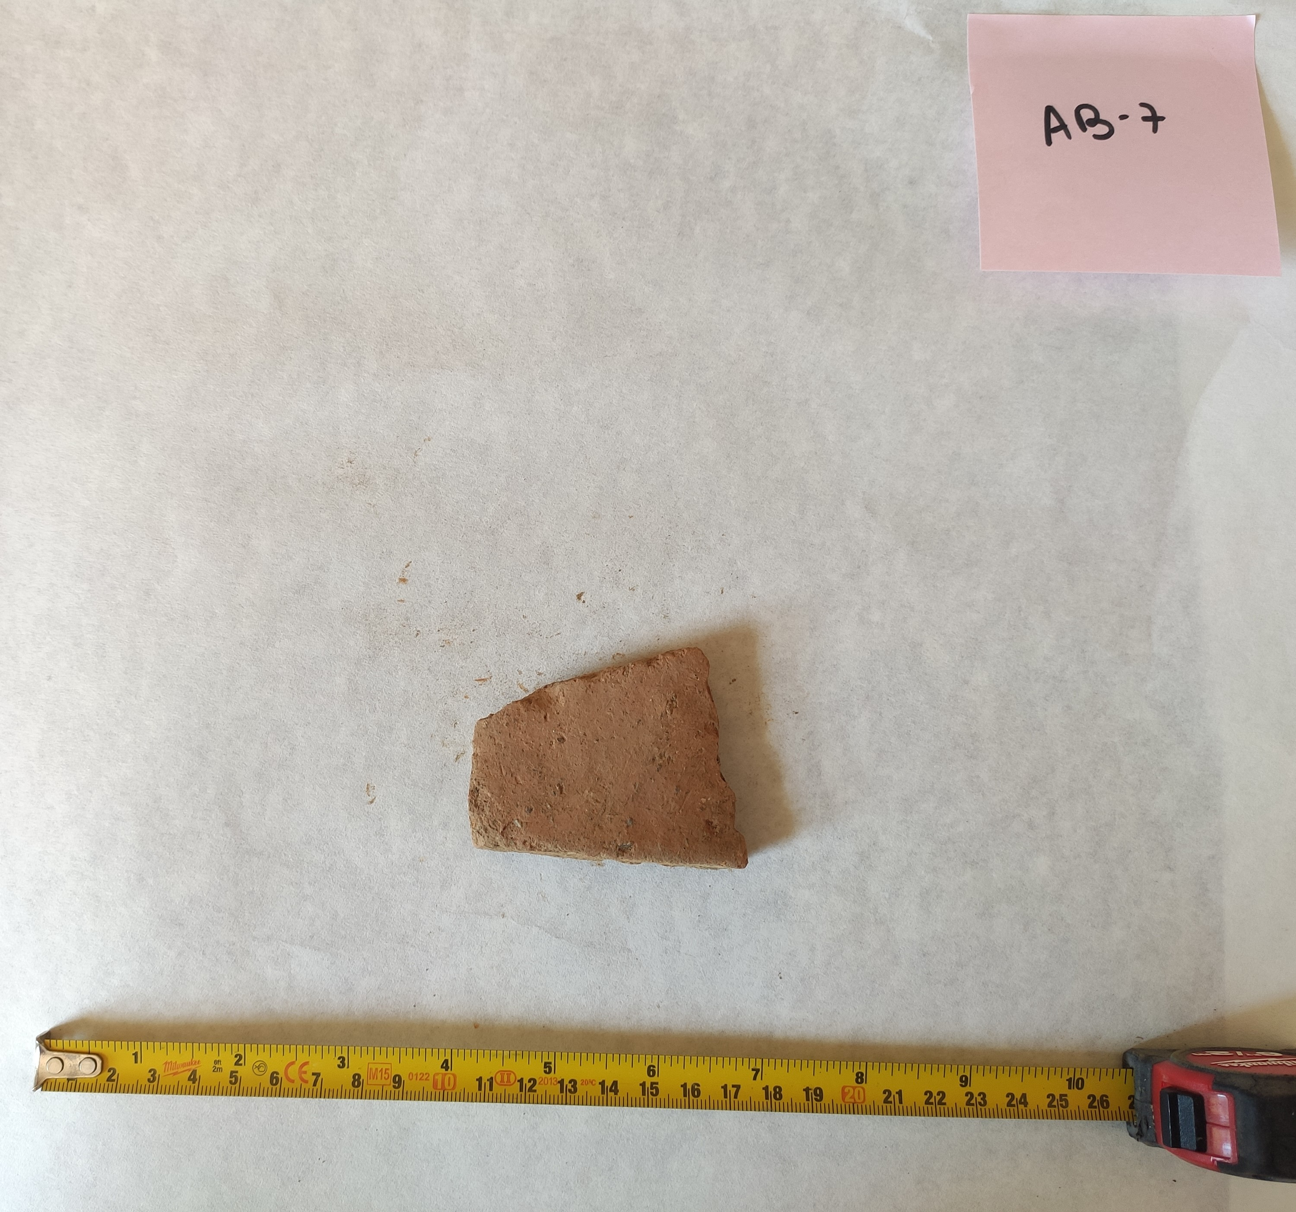
Samples - Observable characteristics
Samples taken from the unexcavated kiln area of Villa Cardílio – Roman amphorae production center in Torres Novas – Map adapted from
V. Filipe, R. Marques, et. al, 2025, SPAL, https://dx.doi.org/10.12795/spal.2025.i34.19

Slide 3
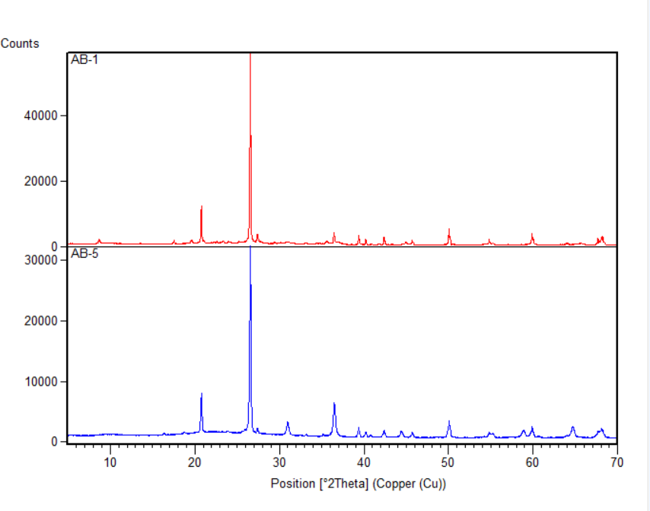
Results and discussion: semi-quantification
Sample | AB-1 | AB-2 | AB-3 | AB-4 | AB-5 | AB-6 | AB-7
Quartz | 77% | 52% | 66% | 57% | 76% | 74% | 56%
Phyllosilicates | 14% | 42% | 26% | 38% | - | 20% | 38%
Alkali-Feldspars | 7% | 4% | 6% | 4% | 12% | 4% | 4%
Plagioclase | traces | traces | - | - | - | - | -
Calcite | traces | traces | traces | traces | - | traces | traces
Haematite | traces | traces | traces | - | traces | traces | traces
Ti Oxides | - | traces | traces | traces | - | traces | -
Spinel | - | - | - | - | 9% | - | -
Mullite | - | - | - | - | traces | - | -
Diffractograms of AB-1 and AB-5

Slide 4
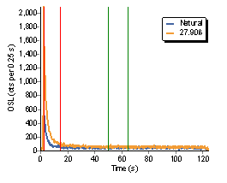
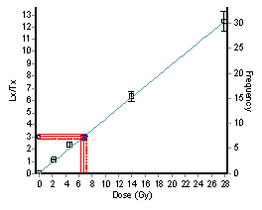
Results and discussion: OSL
Sample | AB-1 | AB-2 | AB-3 | AB-4 | AB-5 | AB-6 | AB-7
Arithmetic average of D_{e} (Gy) | 5.4 ± 0.2 | 7.1 ± 0.1 | 6.8 ± 0.4 | 6.8 ± 0.2 | 1.9 ± 0.2 | 6.0 ± 0.3 | 7.2 ± 0.1
Decay Curve
SAR - OLS dose-response curve
Radial plot of the equivalent dose
Graphs obtained using the software Risø Analyst

Slide 5
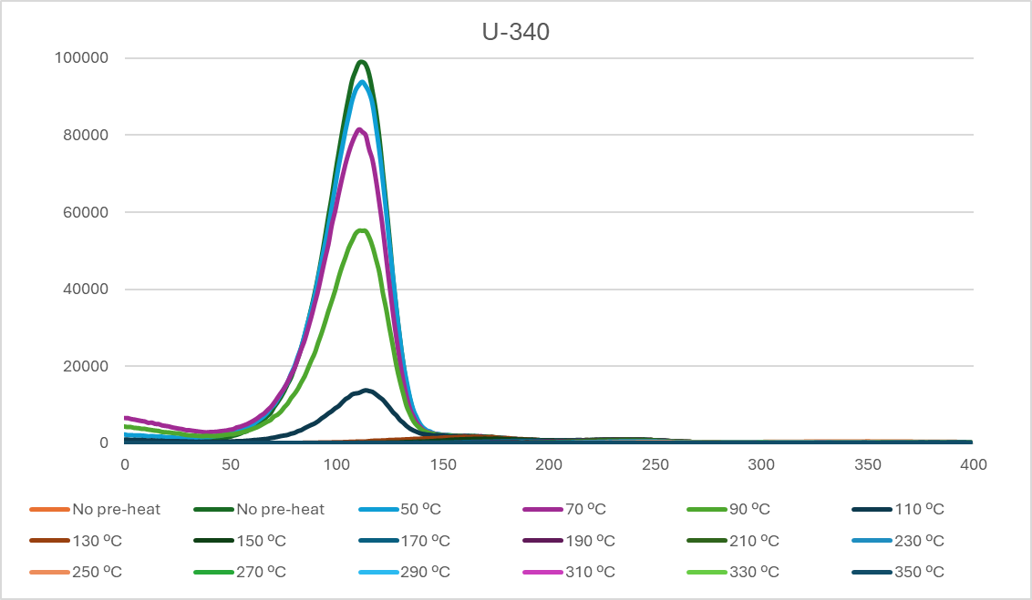
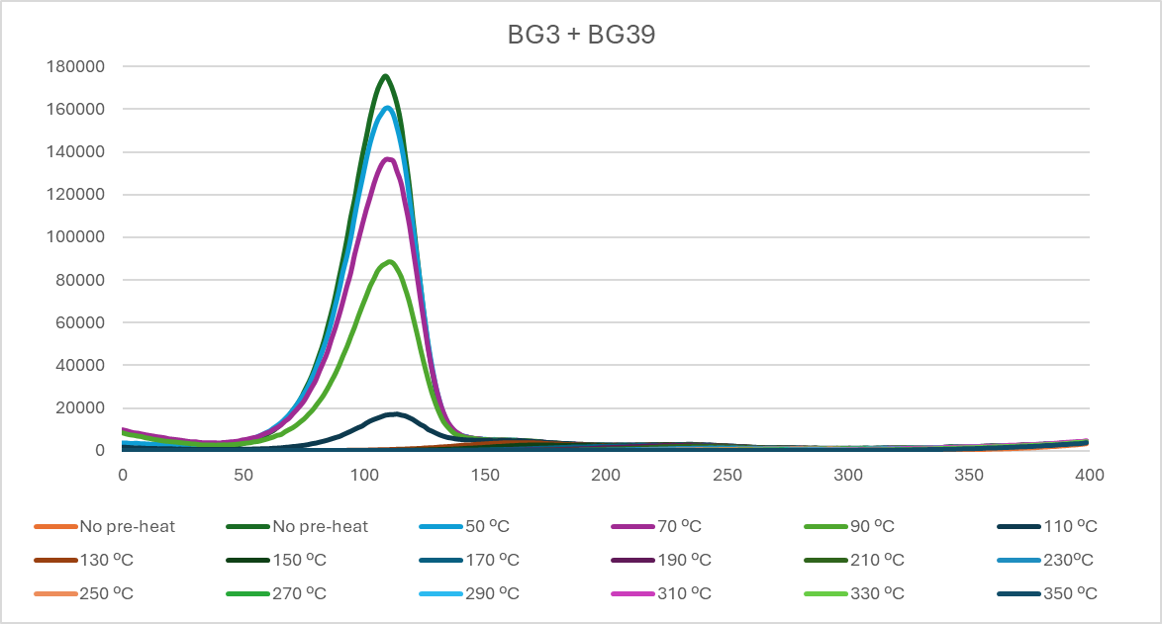
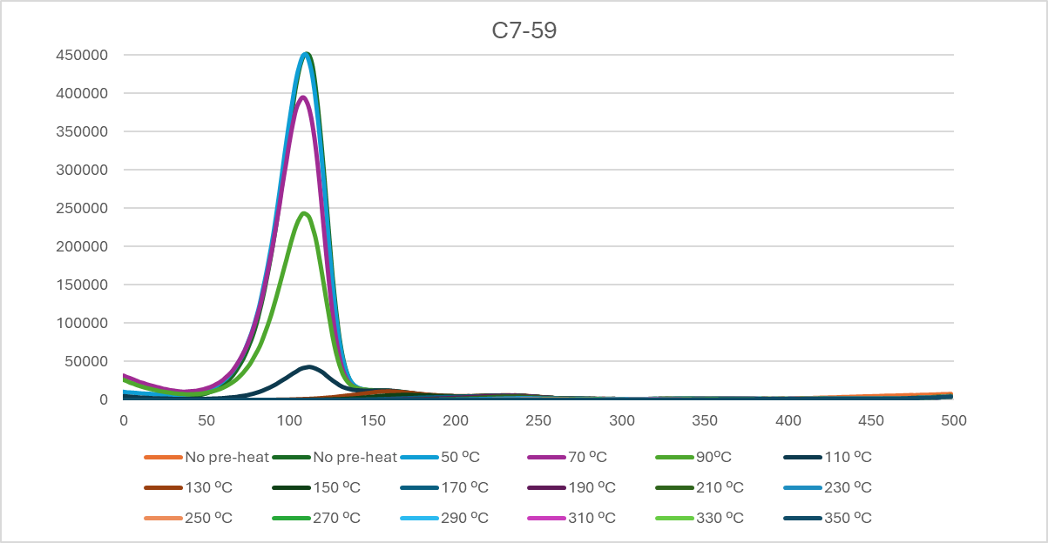
Results and discussion: TL
Glow curves obtained for one aliquot of sample AB-1
Graphs obtained using the software Excel

Slide 6
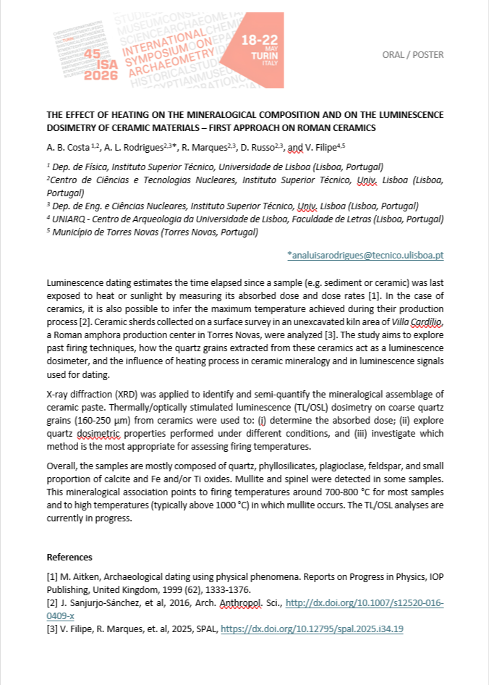
Conclusions and Future Work
Do an in-depth analysis of the aliquots of the remaining samples
Study and compare different methods and conditions to conclude which one is the most suitable
Apply the methodological approach to samples with different chronologies and production technologies
In the context of cultural heritage preservation, it is important to test different methods depending on the samples and update methodology

