Slide 1

Multi-Level Magnetic Tunnel Junctions
Author: João Nóbrega
Supervisers: Prof. Dra. Susana Freitas

Slide 2
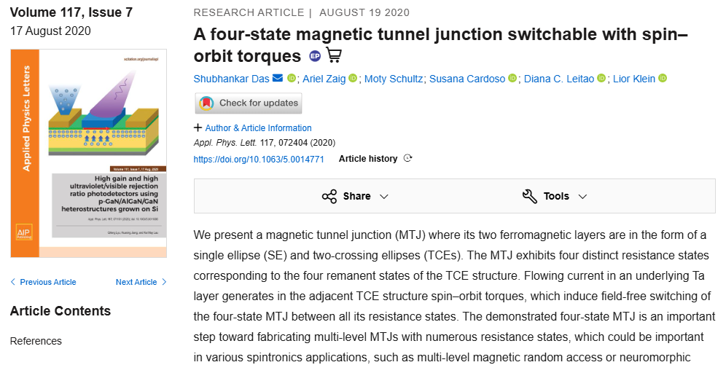


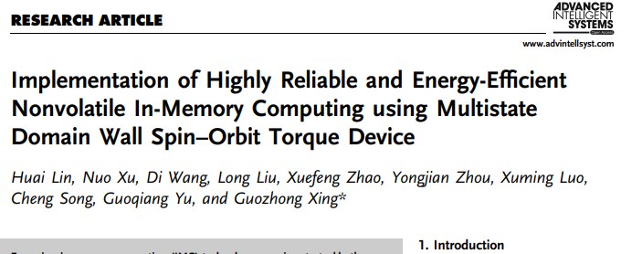
Motivation
Need for denser and energy-efficient non-volatile memories
Multi-level MTJs enable more than 2 bit per cell
Spin-Orbit Torque offers reliable and efficient writing
Shape anisotropy enables geometry-controlled magnetic states
Micromagnetic simulations are essential for design and optimization
2

Slide 3
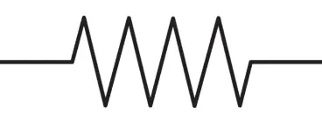
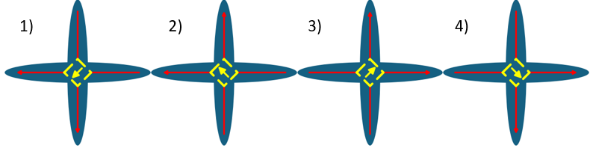





Magnetic Memories
Reading
Top layer: fixed
Ttu
FM
Tunnel magnetoresistance
$$R_{P}$$
TB
$$TMR=\frac{ΔR}{R_{P}}$$
$$ΔR=R_{AP}−R_{P}$$
FM
Lower Resistence
$$R\left(θ\right)=\frac{R_{P}+R_{AP}}{2}−\frac{R_{P}{−R}_{AP}}{2}cos{θ}$$
Bottom layer: free
Writing
Ttu
FM
Spin Orbit Torque
$$R_{AP}$$
TB
FM
Higher Resistence
3

Slide 4
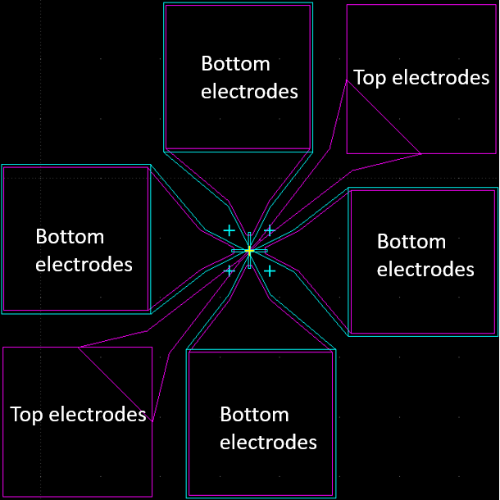
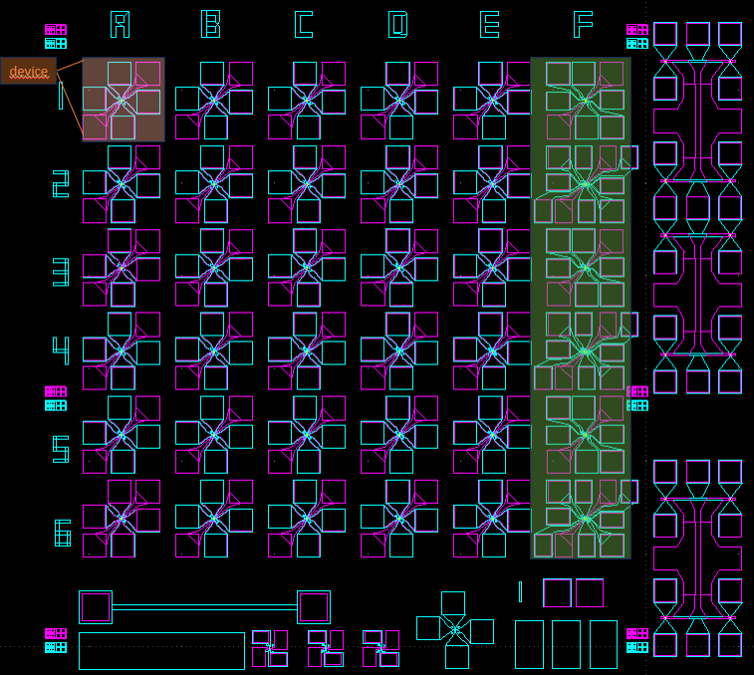
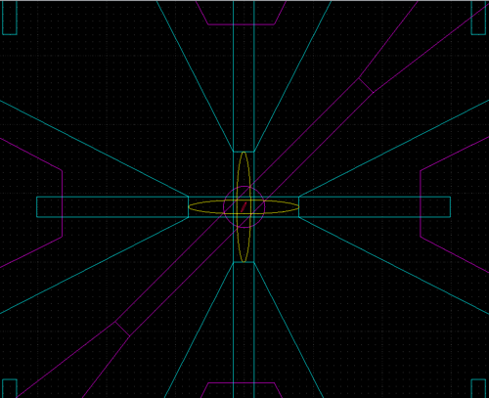
Device Fabrication
16 dies per wafer, each containing multiple MTJ devices with geometric variations
Independent bottom and top electrodes for electrical access
Step:
Part 1 | 0 | Junction deposition | Materials
 | 1 | 1st DWL lithography | Ta bottom electrode definition
 | 2 | 1st etch by ion milling
 | 3 | Resist strip
Part 2 | 4 | 1st e-beam lithography (double ellipses) | Magnetic elliptical BE definition & protection
 | 5 | 2nd etch - elliptical BE definition & pad protection
 | 6 | 1st passivation AI₂O₃
 | 7 | Oxide lift-off
Part 3 | 8 | 2nd e-beam lithography (junction definition) | Pillar and free layer definition
 | 9 | 3rd etch
 | 10 | 2nd Passivation AI₂O₃
 | 11 | Oxide lift-off
Part 4 | 12 | 2nd DWL Lithography | Top electrode definition and BE reinforcement
 | 13 | Metallization
 | 14 | Metal lift-off
Die
5

Slide 5
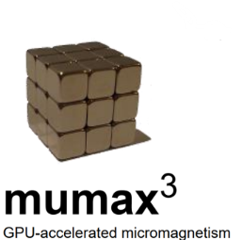
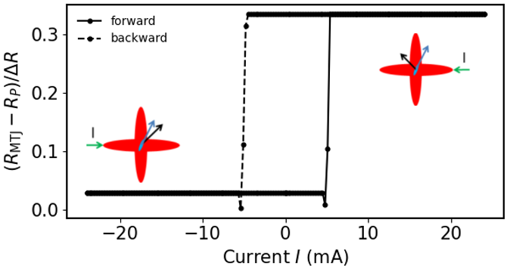
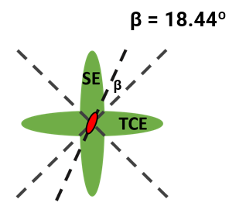
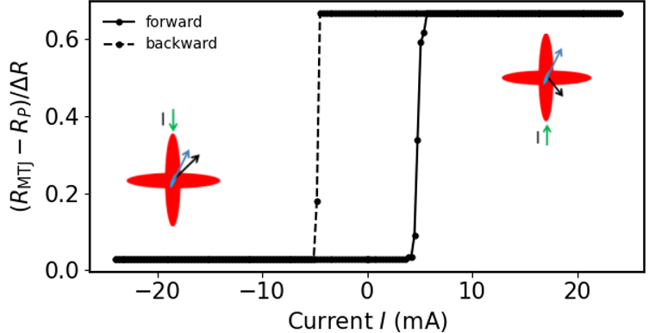
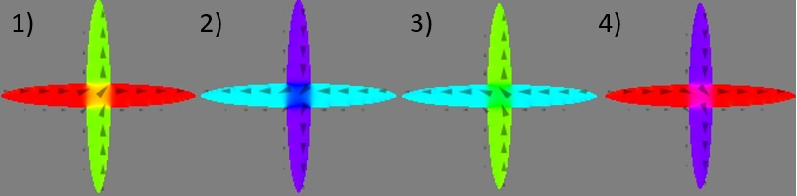

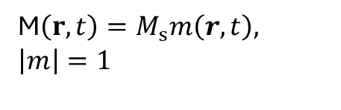


Mumax3 Simulations – SOT
Effective Field
$$H_{eff }(r)=−\frac{1}{u_{0}M_{s}}\frac{δE}{δm}$$
M$\left(r,t\right)=M_{s}m\left(r,t\right), \left|m\right|=1$
Landau-Lifshitz-Gilbert (LLG)
$$\dot{m}=−\frac{γ}{1+α}[m×H_{eff } +α m×(m×H_{eff })]$$
$$R\left(β\right)=R_{AVG}−\frac{ΔR}{2}cos{β}$$
10

Slide 6
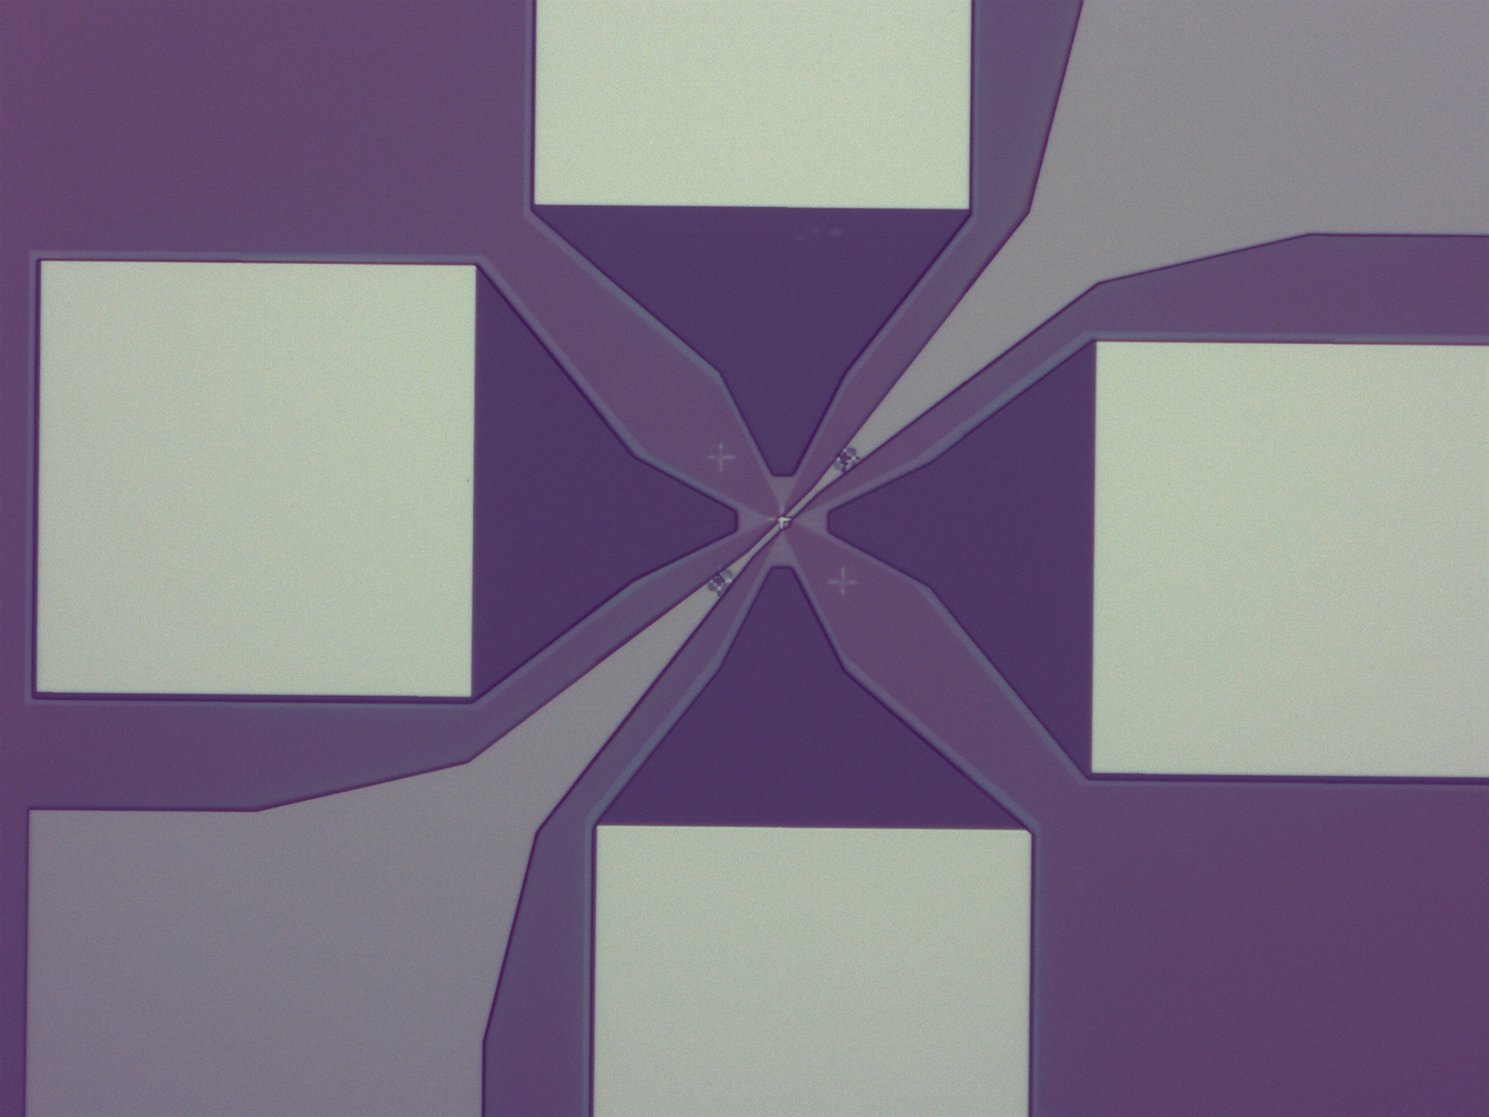
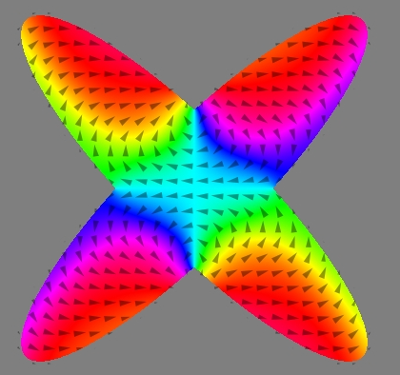

Conclusions
Extension to more complex geometries
Spin–orbit torque was identified as a suitable writing mechanism
Fabricate the proposed multi-level MTJs
Electrical and magnetic characterization
Optimization of materials and device parameters
Experimental fabrication of the proposed multi-level MTJs
12

Slide 7
Conclusions
End!
13

