Slide 1



Exploring the mechanisms of visual place learning in the fruit fly
Supervised by
Eugenia Chiappe
Hugo Marques
Jorge Vieira
João Rodrigues
Nº 103250

Slide 2
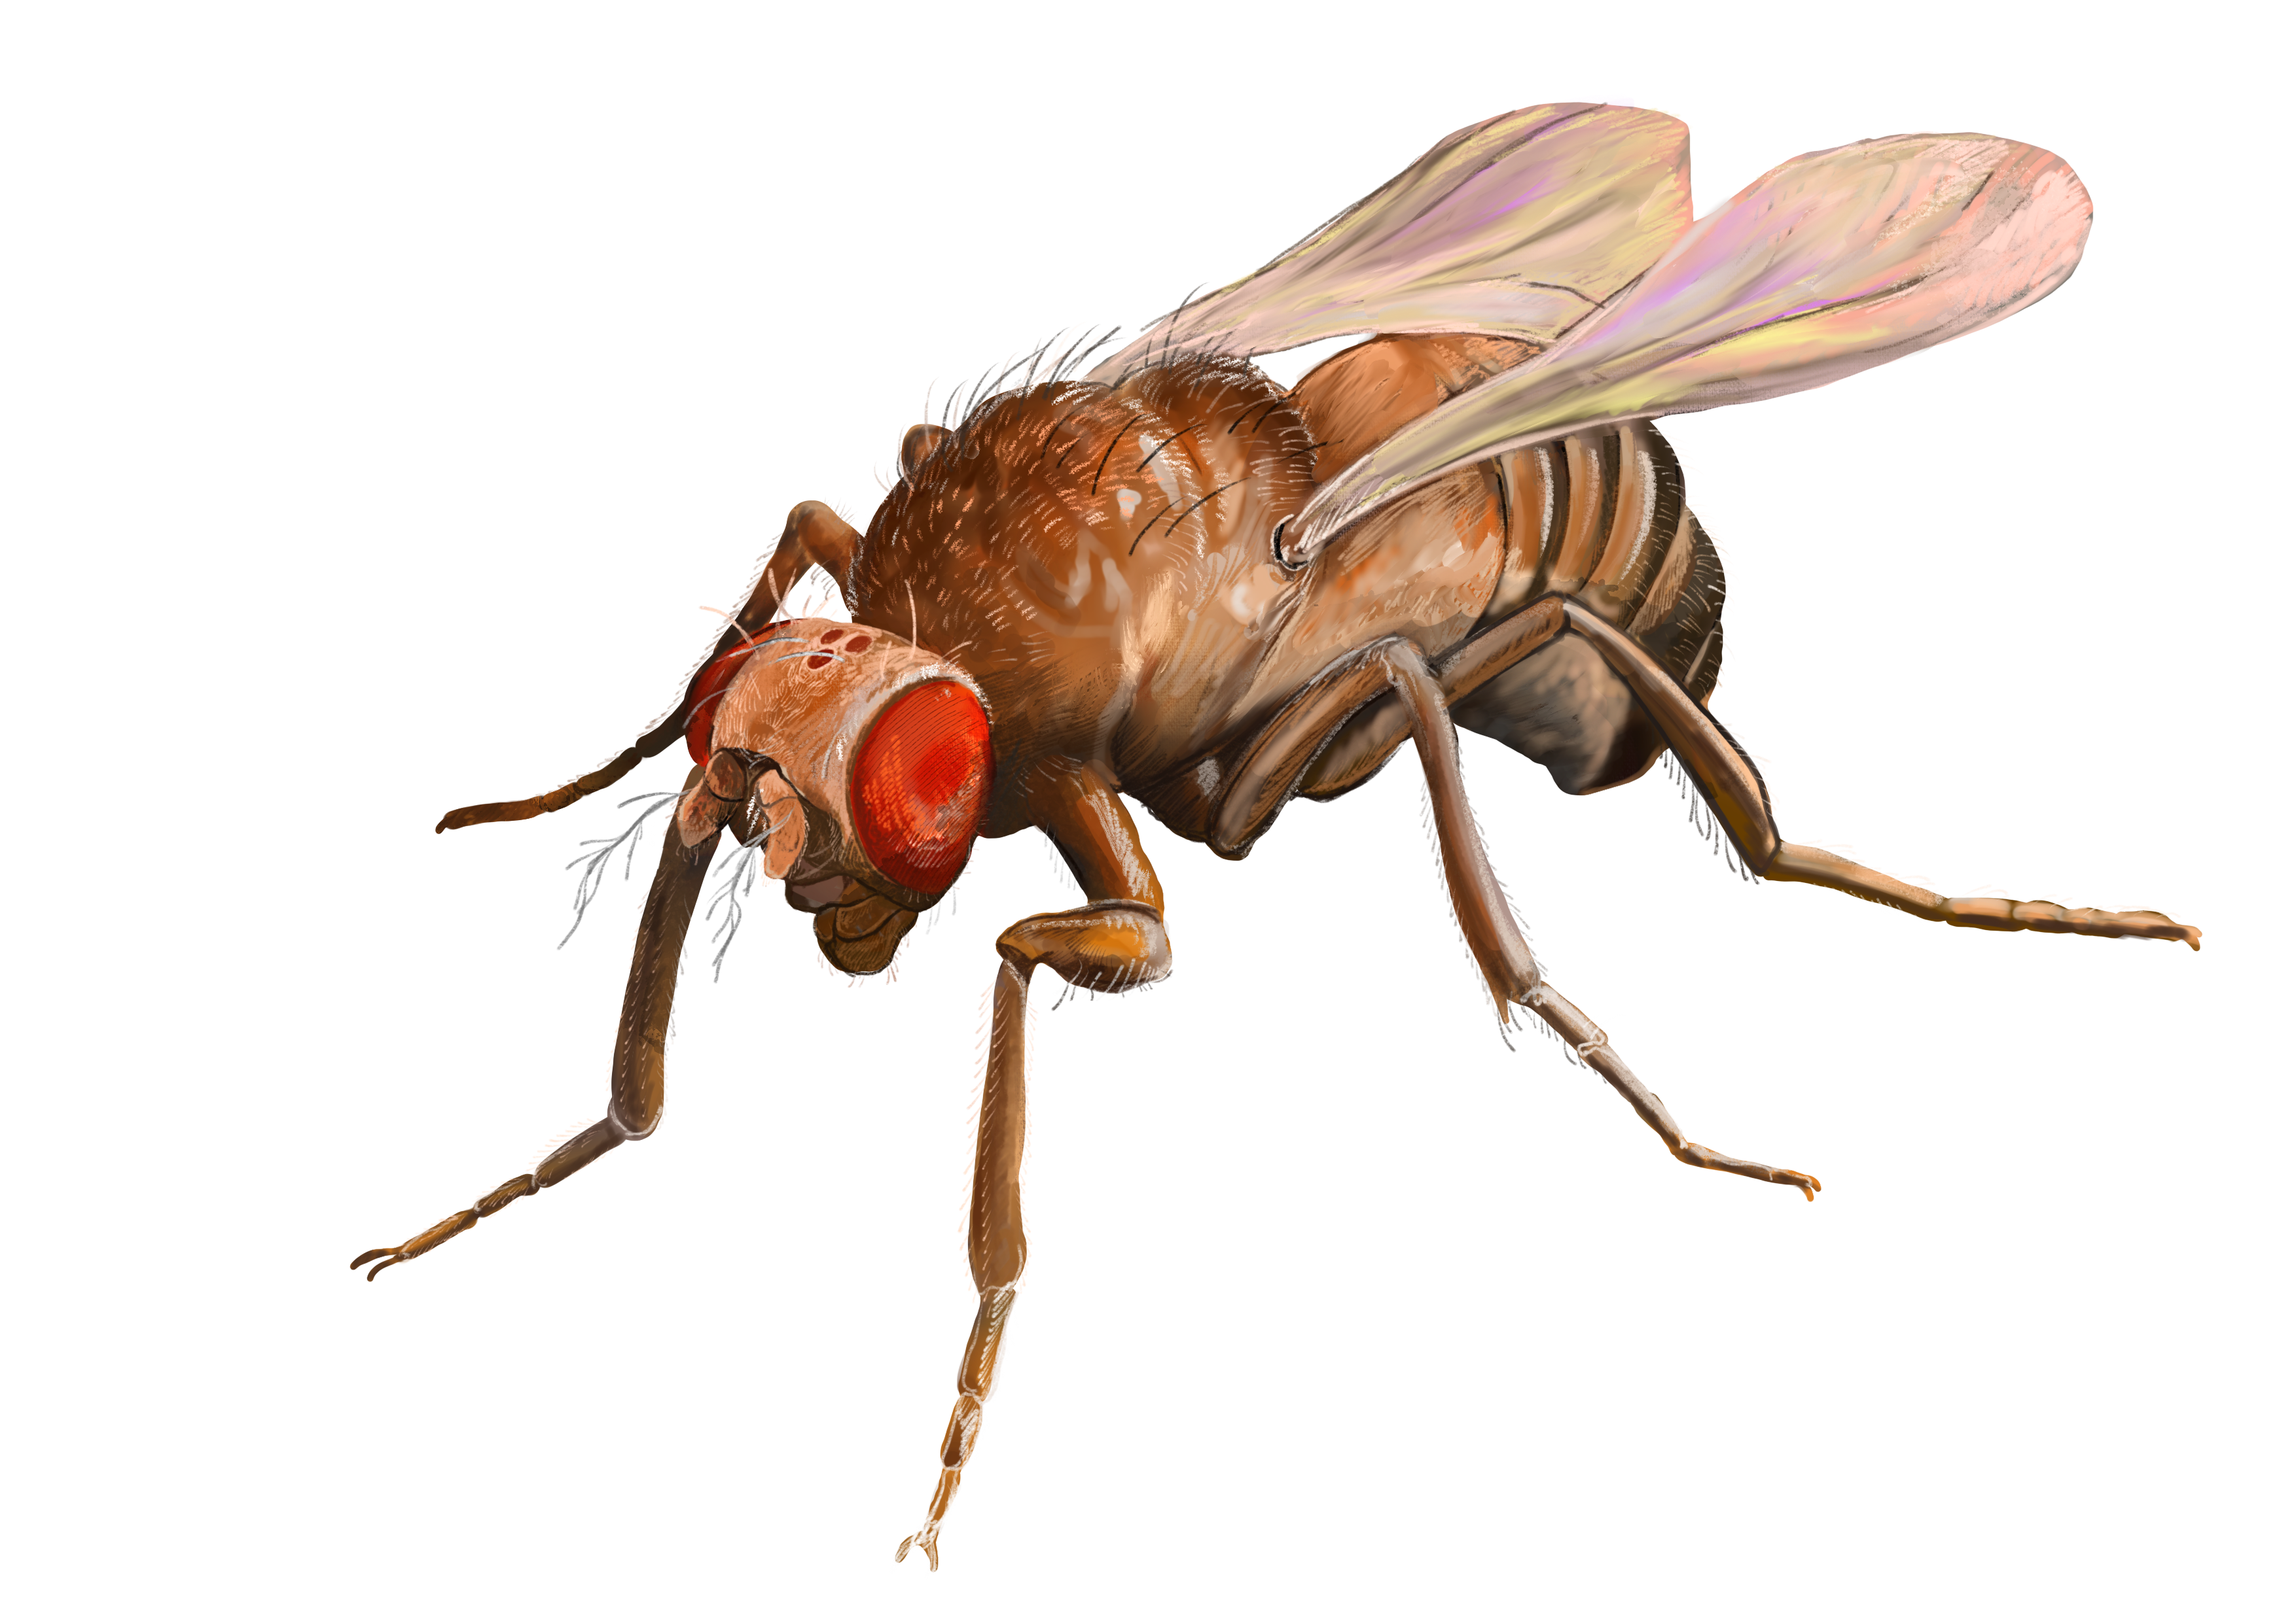
Argument for Drosophila
We want to understand the sensory and motor features underlying place learning in insects.
Why use the fruit fly as a model for our purposes?
Complex and quantifiable navigational behavior
Replicable in artificial settings
Many experimental advantages:
Short life cycle
High fecundity
Small size
Low cost
Great statistics
Short time

Slide 3
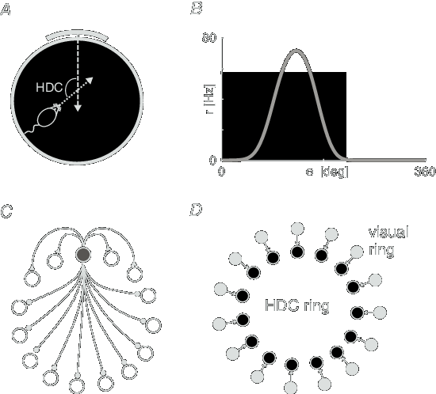
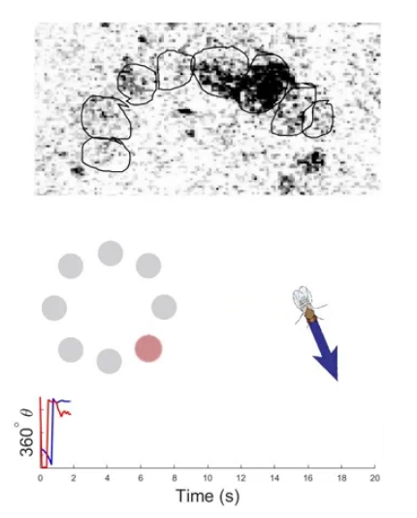
Argument of significance
Why study insect navigation?
Low neuron counts -> tractable circuits
Analogous functions & conservation across species
Applications for neuroscience and bio-inspired robotics

Slide 4
Conclusion
Future goal – build a navigational system for a robot
Understand the mechanisms of place learning in insects
Build an experimental paradigm for path integration in fruit flies

Slide 6
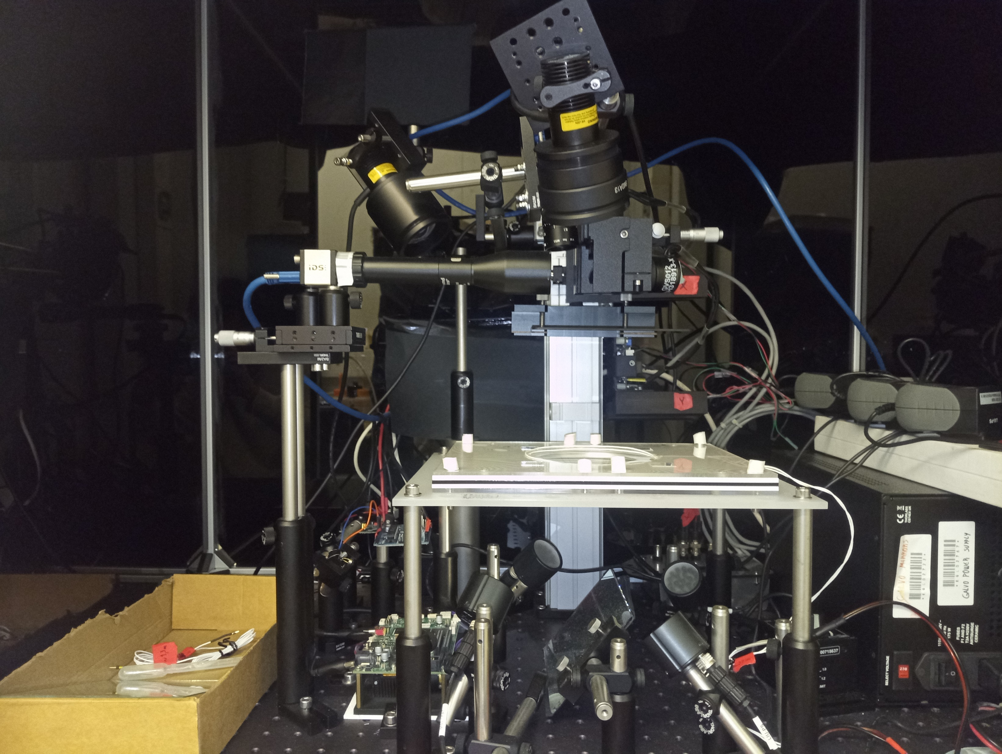
Methods & experimental setup
Aim 1: comparing exploratory behavior with and without the presence of projected landmarks
1. Acclimation phase: fly is placed in the arena and left without stimuli (5min)
2. Gradual projection of landmark at position A for (2 min)
3. No projection (30 sec)
4. Sudden projection of a landmark at position B (2 min)
5. No projection (30 sec)
Quantitatively analyze the behavior of flies when presented with 2D landmarks
Understanding their reaction to visual stimuli provides a basis for the next experiments

Slide 7
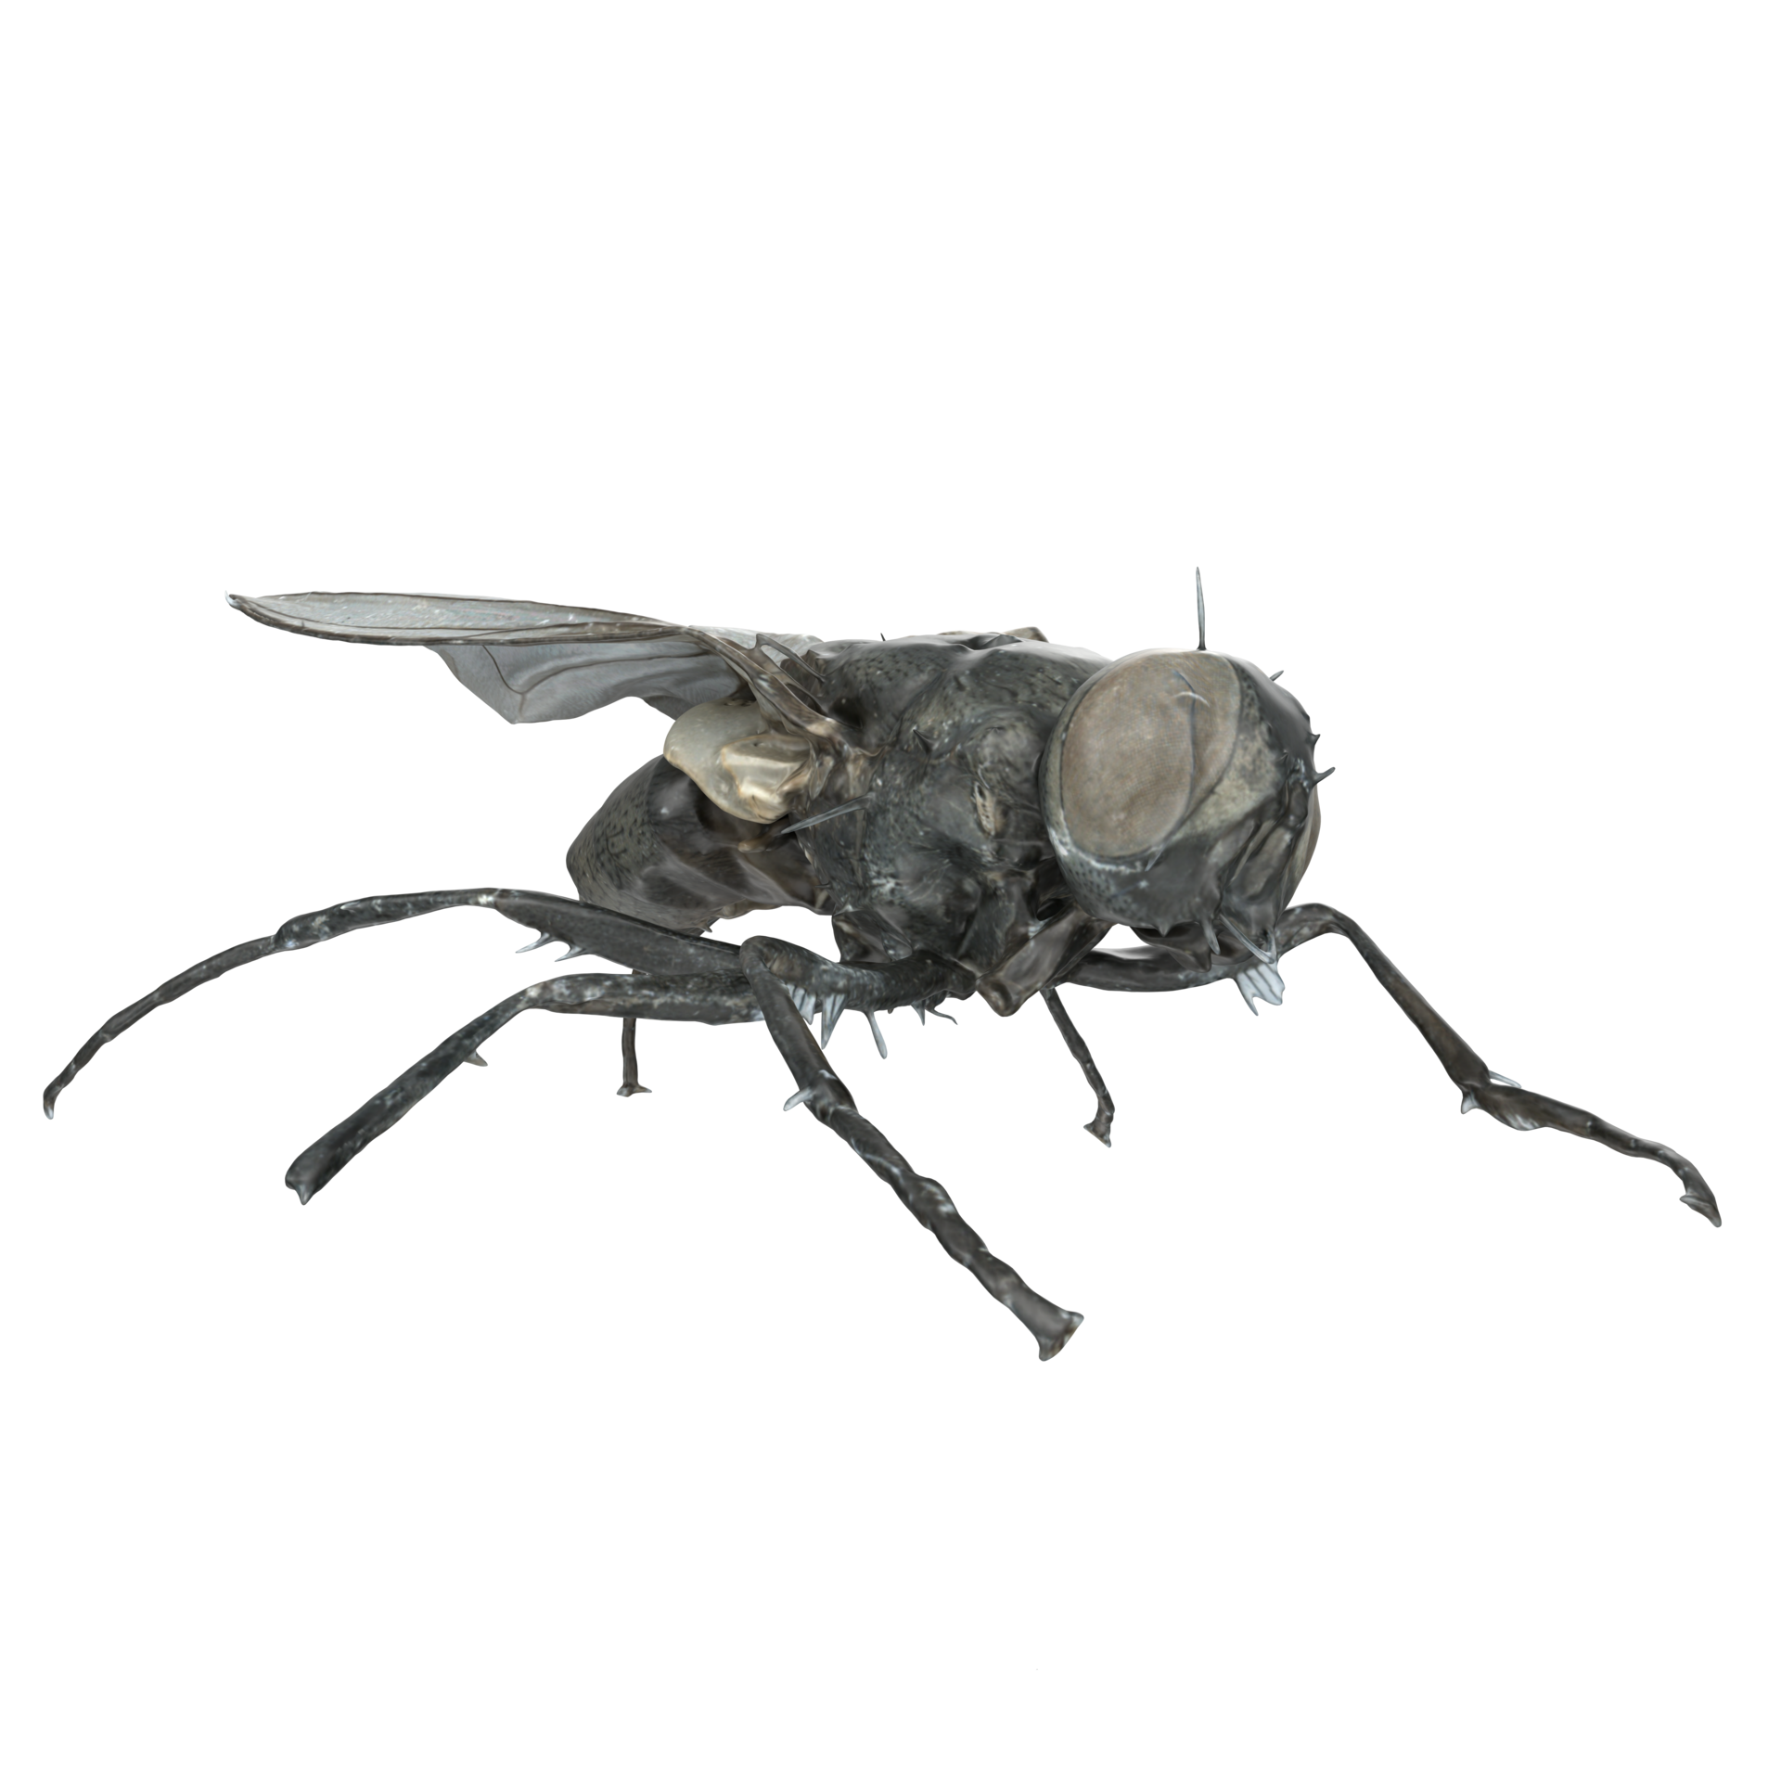
Aim 2: testing visual place learning abilities with projected landmarks and evaluating the contribution of internal cues
The fly will be tracked live using the low resolution camera;
Its coordinates will be translated to mirror movement, redirecting the laser Whenever it is not in the area defined as the ‘cool spot’, the fly is irradiated
Projection (landmark)
Cool spot
Place fly in the arena; no stimuli (1min)
Activate the laser, define a cool spot and project landmark on it (5min);
No stimuli (or heat entire arena) (1 min)
Repeat steps 2 and 3 ten times or until fly shows evidence (or lack thereof) of place learning;
Probe trial with projection but no laser (also 5min)
Fixed
(between trials)
Moving
Training trials
Probe trial

Slide 8
Aim 3: investigating the nature and complexity of visual memories
With similar setup and training, we will investigate how place learning performance changes when using more complex visual panoramas with changing landmark parameters, such as:
Shape
Number
Size
Distance from cool spot
Landmarks
Cool spot
We predict place learning scores will drop when features are changed for the probe trial.
Analyzing which features make the score drop and by how much will give insight on the nature and complexity of visual place memories
Training trials
Probe trial

Slide 9
Aim 4: Testing path integration in this system
Procedure: Same setup and training as previously, but remove projection/landmarks for probe trial (turn everything off)
We expect that:
Fly should start a ‘local search behavior' around the place it last saw the cool spot
This is a basis for the next experiment
Landmark(s)
Cool spot
Local search
Training trials
Probe trial

Slide 10
Aim 5: Looking at the interaction between path integration and visual place learning
Procedure: Same setup and training as before, but in probe trial a landmark will reappear after some time.
We expect that:
Flies will start 'local searching behavior' around last seen location
As fly moves outwards without finding cool spot, it should begin less structured, more random exploration
At some point, the same landmarks will reappear at a different location.
Question: When path integration and visual memory disagree, how does the fly choose between the two systems?
Landmark(s)
Cool spot
Local search
Training trials
Probe trial
(t = 0)
Probe trial
(t = 1)

