Slide 1



Exploring the mechanisms of visual place learning in the fruit fly
Supervised by
Eugenia Chiappe
Hugo Marques
Jorge Vieira
João Rodrigues
Nº 103250

Slide 2
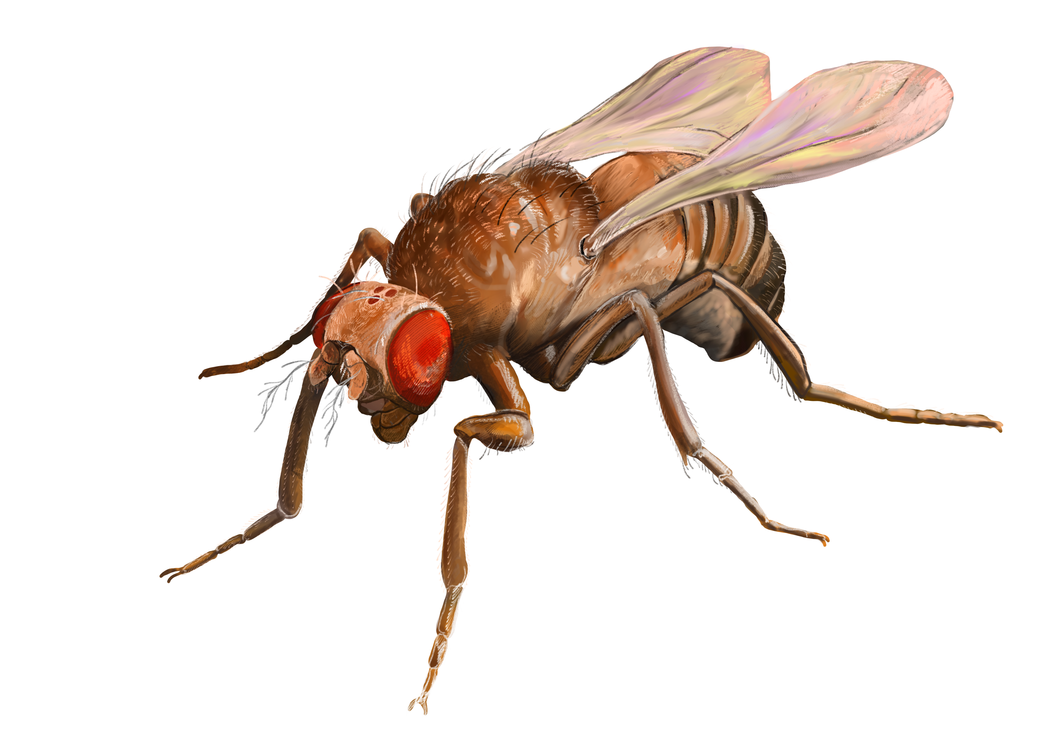
Argument for Drosophila
We want to understand the sensory and motor features underlying place learning in insects.
Why use the fruit fly as a model for our purposes?
Complex and quantifiable navigational behavior
Replicable in artificial settings
Many experimental advantages:
  Short life cycle
  High fecundity
  Small size
  Low cost
Great statistics
Short time

Slide 3
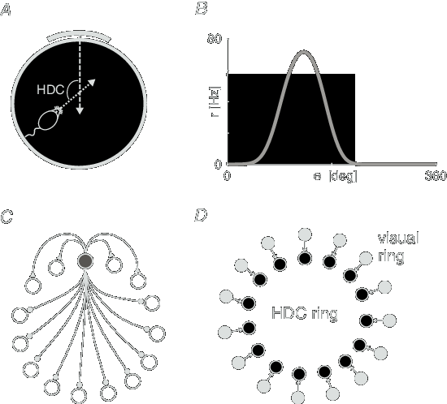
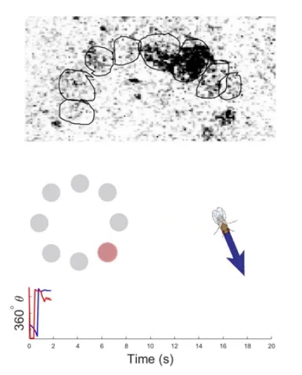
Argument of significance
Why study insect navigation?
Low neuron counts -> tractable circuits
Analogous functions & conservation across species
Applications for neuroscience and bio-inspired robotics

Slide 4
Conclusion
Future goal – build a navigational system for a robot
Understand the mechanisms of place learning in insects
Build an experimental paradigm for path integration in fruit flies

