Slide 1

Data-driven Fault Detection, Isolation, and Recovery (FDIR) for spacecraft
Projeto Integrador de 2º Ciclo em Engenharia Física Tecnológica
Author: Rita Vieira
Supervisors: Rodrigo Ventura (PhD), Vasco Guerra (PhD)
With additional supervision from: João Paulo Monteiro (PhD)

Slide 2
Fault Detection Isolation and Recovery (FDIR)
Fault Detection Isolation and Recovery
Detection: identify non-nominal behavior in data.
Isolation: determine the exact location of the fault and its origin.
Recovery:
restore nominal operation with minimal impact on the mission.

Slide 3
Graph-based Isolation using ML
Graph–based System Models
Probabilistic Graphical Models (PGMs)
Causal Models
Encode dependencies between spacecraft components.
Define which components can influence others.
[1]
Distinguish fault propagation paths by identifying cause–effect relationships rather than mere simultaneous anomalies.
[10]
Capture statistical dependencies and uncertainty in data.
Model correlated anomalous behavior across connected components.
[9]
[1] J. P. L. Monteiro, “A new approach for modern space systems engineering,” eng, Ph.D. dissertation, University of Lisbon (Instituto Superior Tecnico), Jul. 2024 [9] D. Koller and N. Friedman, *Probabilistic Graphical Models: Principles and Techniques*. Cambridge, MA, USA: MIT Press, 2009. [10] J. Peters, D. Janzing, and B. Schölkopf, *Elements of Causal Inference: Foundations and Learning Algorithms*. Cambridge, MA, USA: MIT Press, 2017.

Slide 4
Dependency Graph
1
2
3
4
5
6
Nodes: system’s components
Edges: connections between components
Node
Edge
[1] J. P. L. Monteiro, “A new approach for modern space systems engineering,” eng, Ph.D. dissertation, University of Lisbon (Instituto Superior Tecnico), Jul. 2024

Slide 5
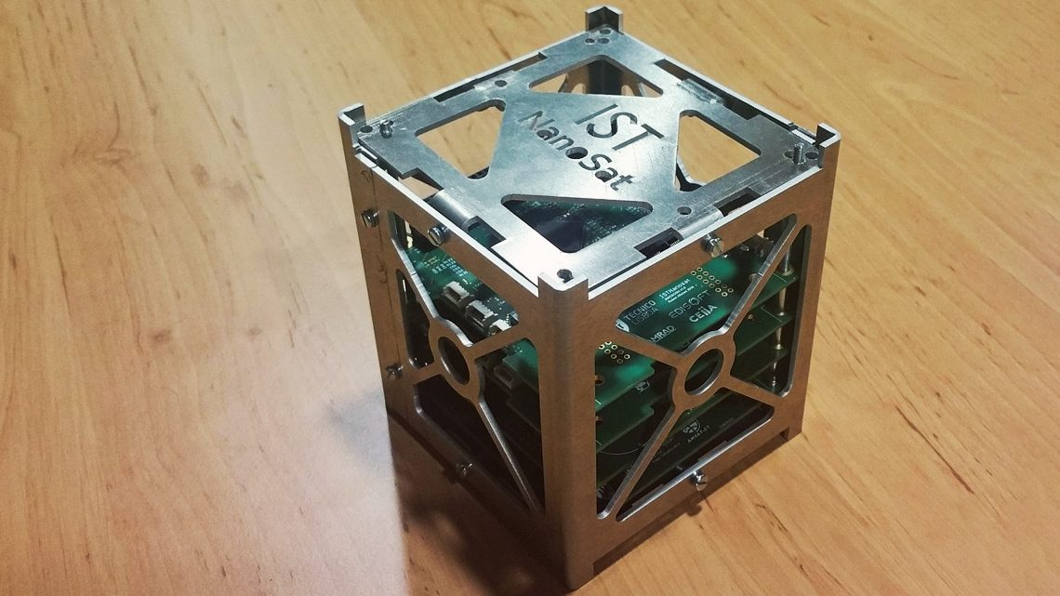
Experimental Phase
Data from IST-SAT
Dependency Graph from IST-SAT
Telemetry Data for Anomaly Detection
Simulation Data

Slide 6
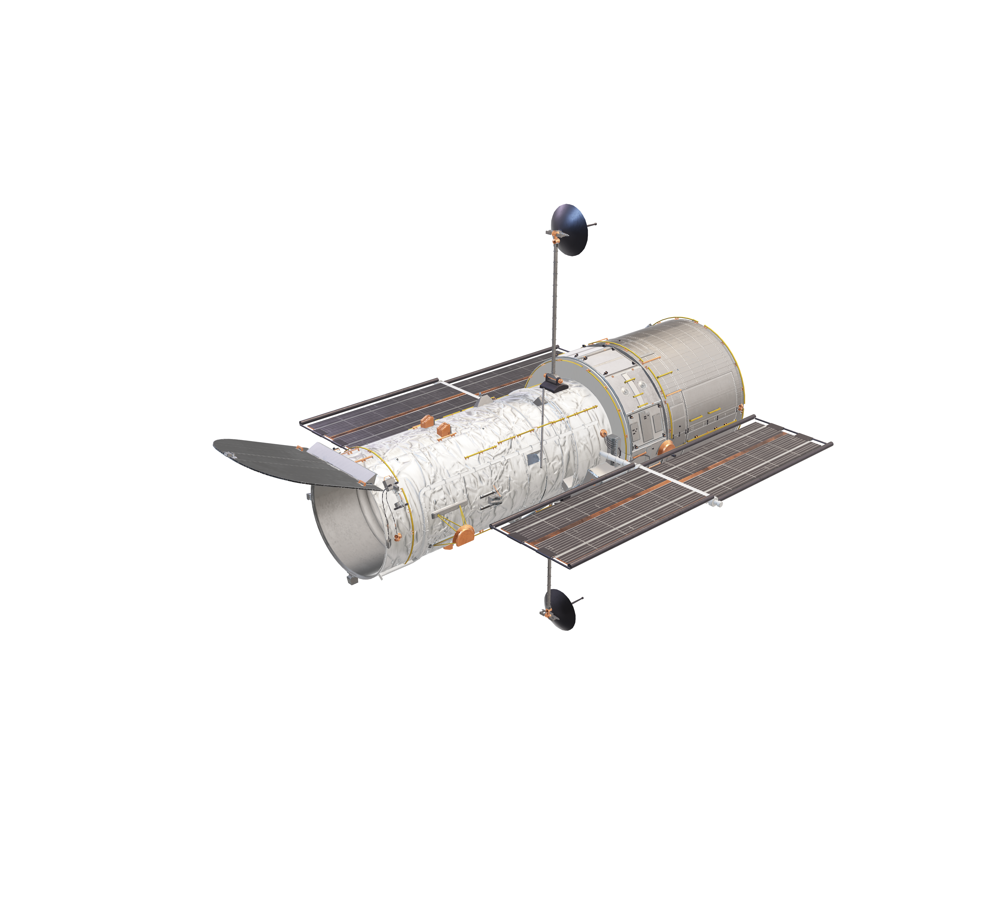
To conclude…

Slide 7
Thank you!
The author would like to thank Professor Rodrigo Ventura (PhD), Professor João Paulo Monteiro (PhD), and Professor Vasco Guerra (PhD) for their guidance and support.

