Slide 1
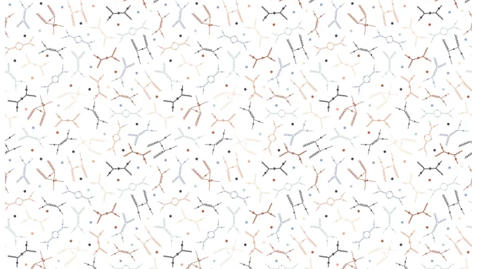
Machine Learning Techniques to explore scalar-fermion couplings
João António Costa Matos | ist1103475
Supervisors: Prof. João Paulo Silva, Prof. Jorge Romão

Slide 2
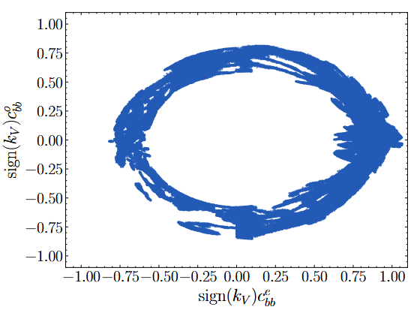


$h_{125}$ couplings
Standard Model
$${−ℒ}_{h_{125}ff}=\frac{m_{f}}{v}\overline{f}fh_{125}$$
C3HDM
$${−ℒ}_{h_{125}ff}=\frac{m_{f}}{v}\overline{f}(c_{h_{125}ff}^{e}+iγ_{5}c_{h_{125}ff}^{o})fh_{125}$$

Slide 3
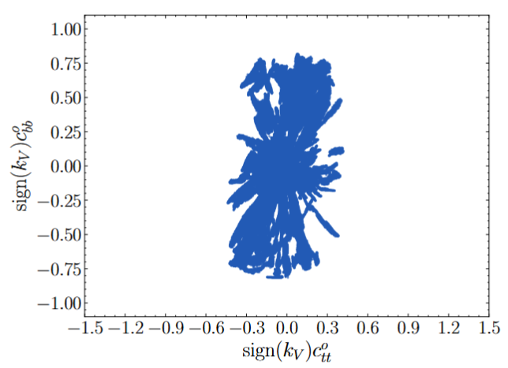
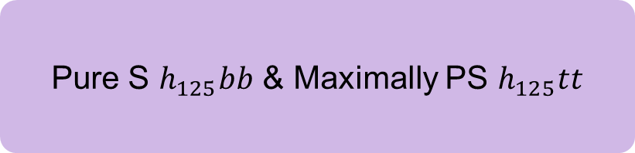
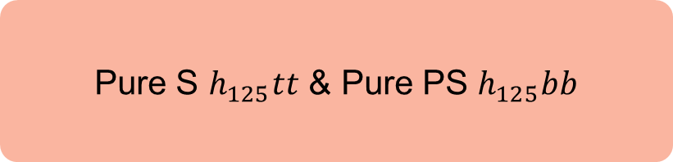
Is $h_{125}$ Scalar (S) or PseudoScalar (PS)?
Pure S $h_{125}tt$ & Pure PS $h_{125}bb$
OR
Pure S $h_{125}bb$ & Maximally PS $h_{125}tt$
Or (almost) anything in between!

Slide 4
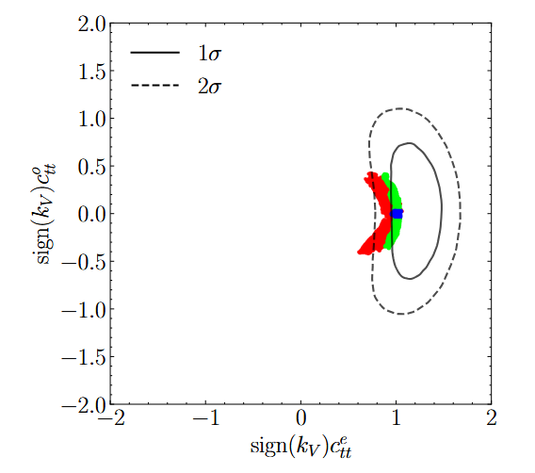


Machine Learning Capabilities
Informed traditional scanning methods
$$c_{tt}^{o}≈0$$
In 3 Months
Machine Learning Techniques
$$|c_{tt}^{o}|≲0.5$$
In 3 Days
[R. Boto et. al., 2505.10625]

Slide 5
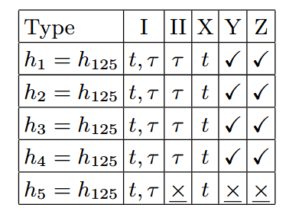
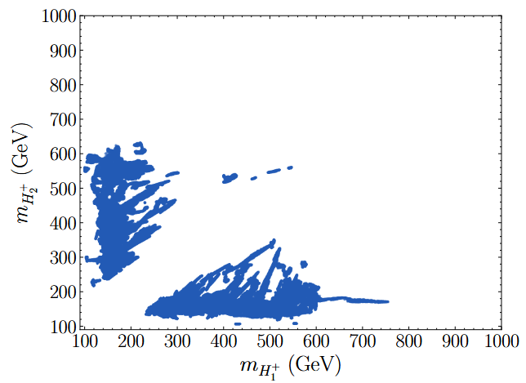



Monitoring Machine Learning
ML
$$Γ\left(B→X_{s}γ\right) vs. STU$$
Physics
$$Γ\left(B→X_{s}γ\right)+STU⇒m_{h_{i}}>125 GeV$$
Ruled out by ordering: $m_{h_{i}}≤125 GeV$

Slide 6
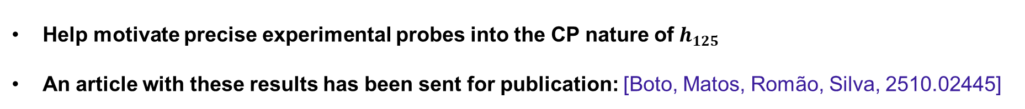
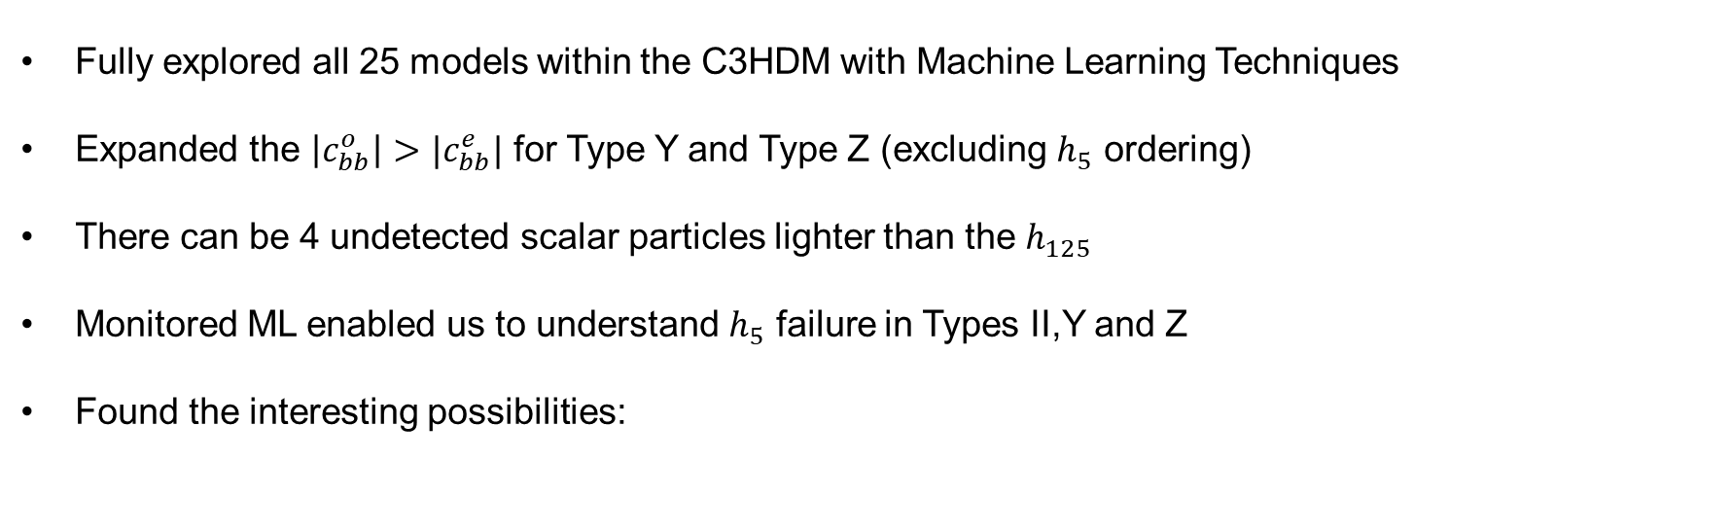


Conclusions
Fully explored all 25 models within the C3HDM with Machine Learning Techniques
Expanded the $\left|c_{bb}^{o}\right|>|c_{bb}^{e}|$ for Type Y and Type Z (excluding $h_{5}$ ordering)
There can be 4 undetected scalar particles lighter than the $h_{125}$
Monitored ML enabled us to understand $h_{5}$ failure in Types II,Y and Z
Found the interesting possibilities:
Pure S $h_{125}tt$ & Pure PS $h_{125}bb$
Pure S $h_{125}bb$ & Maximally PS $h_{125}tt$
Help motivate precise experimental probes into the CP nature of $h_{125}$
An article with these results has been sent for publication: [Boto, Matos, Romão, Silva, 2510.02445]

