Slide 1
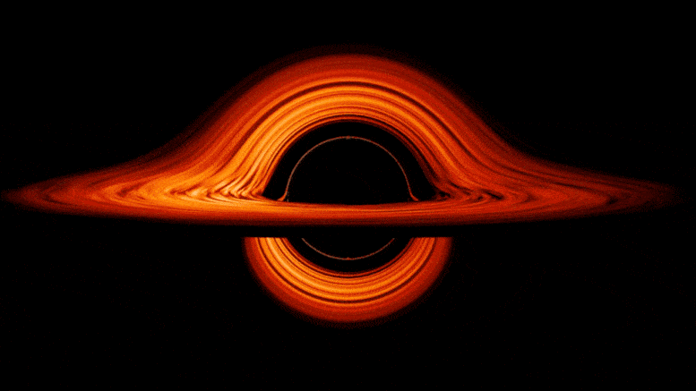
Gravitational critical collapse with a charged scalar field
Supervisors:
David Hilditch
Jorge Expósito Patiño
Author:
Joana Yao

Slide 2
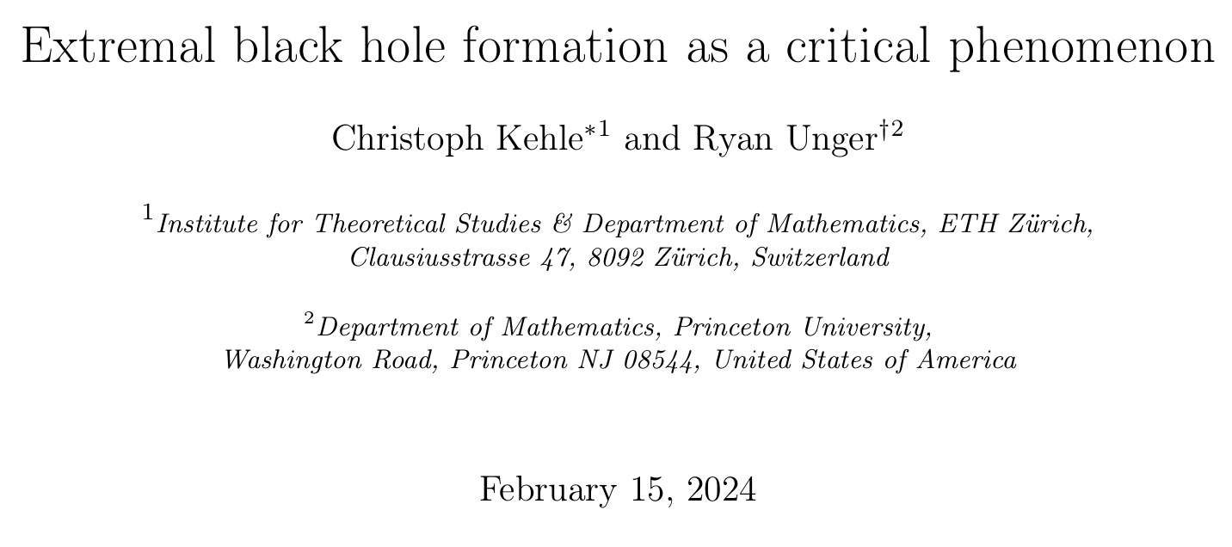
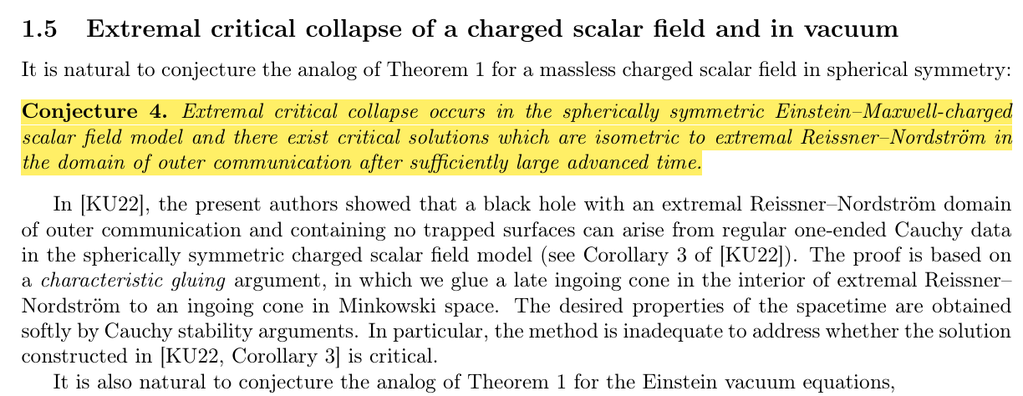
Introduction
Proof of new regime of critical collapse:
Critical solution is an extremal RN black hole
Conjecture:
Extremal critical collapse happens for charged scalar field

Slide 3
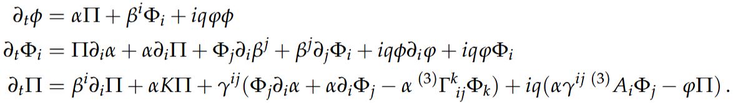
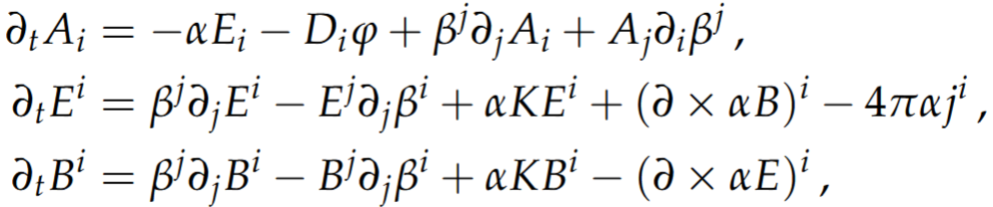
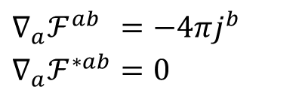


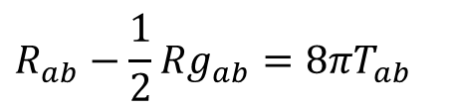
Field Equations
Einstein-Maxwell-Klein-Gordon System:
3+1 Decomposition
$$𝒟_{a}𝒟^{a}φ=0$$
Charged SF
with $𝒟_{a}:=∇_{a}+iqA_{a}$
$$\begin{aligned}&∇_{a}ℱ^{ab}&&=−4πj^{b} \\ &∇_{a}ℱ^{∗ab}&&=0\end{aligned}$$
Maxwell Eqs
$$R_{ab}−\frac{1}{2}Rg_{ab}=8πT_{ab}$$
Einstein Eqs

Slide 4
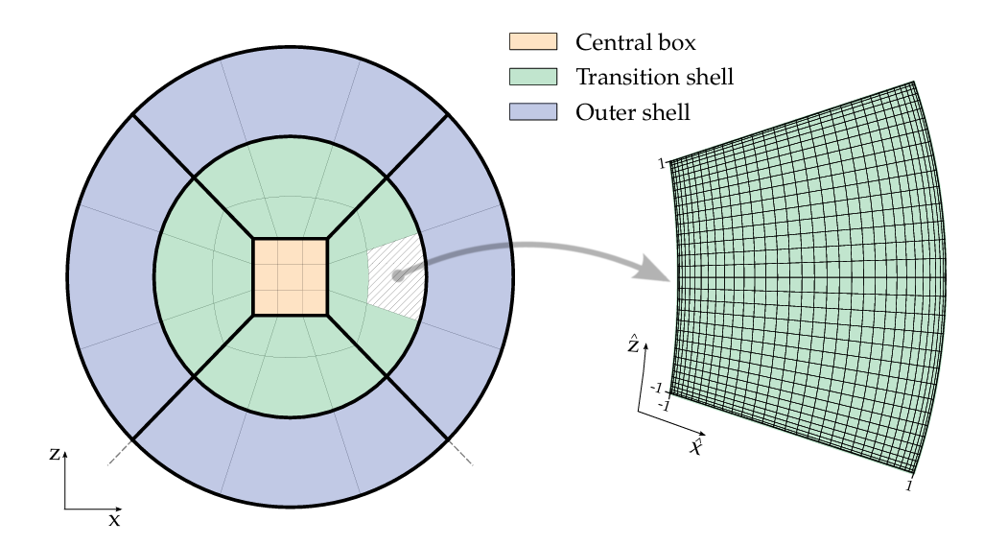
Numerical Implementation: BAMPS
Pseudospectral
Derivatives are calculated with all points
Multidomain
Domain is divided in patches, where each patch solves its own initial boundary value problem
Full 3D code
Cartoon method is used for reductions in symmetry cases
[Hilditch et al. arXiv:1504.04732v2]

Slide 5
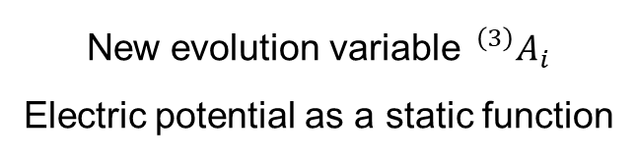






Numerical Implementation: BAMPS
Metric
$$T_{ab}$$
$$T_{ab}$$
$$g_{ab} , Γ_{abc}$$
$$g_{ab} , Γ_{abc}$$
Maxwell
Project
$$A_{a}$$
Complex Scalar Field
Project
New evolution variable $^{\left(3\right)}A_{i}$
Electric potential as a static function
$$j_{a}$$
RHS and reduction variables are changed
Charged-matter interface
Only have results for this part yet

Slide 6
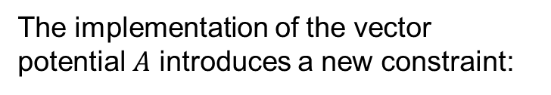
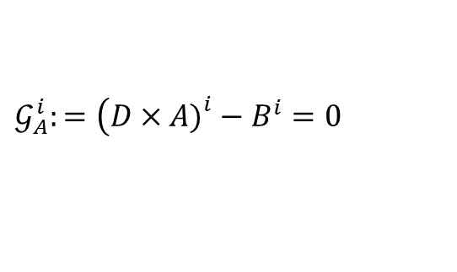

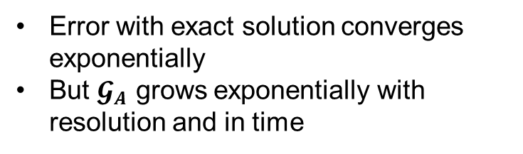
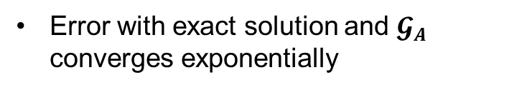
Results and Future work
The implementation of the vector potential $A$ introduces a new constraint:
Curl constraint
$$𝒢_{A}^{i}:=\left(D×A{\left.)\right.}^{i}−B^{i}=0\right.$$
Simulations
EM dipole in flat background
RN black hole with fixed background
Error with exact solution and $𝓖_{A}$ converges exponentially
Error with exact solution converges exponentially
But $𝓖_{A}$ grows exponentially with resolution and in time
Implement constraint damping for $𝓖_{A}$
Follow similar procedure for charged scalar field
Do critical collapse for charged scalar field
Future work:

Slide 7
Backup Slides

Slide 8

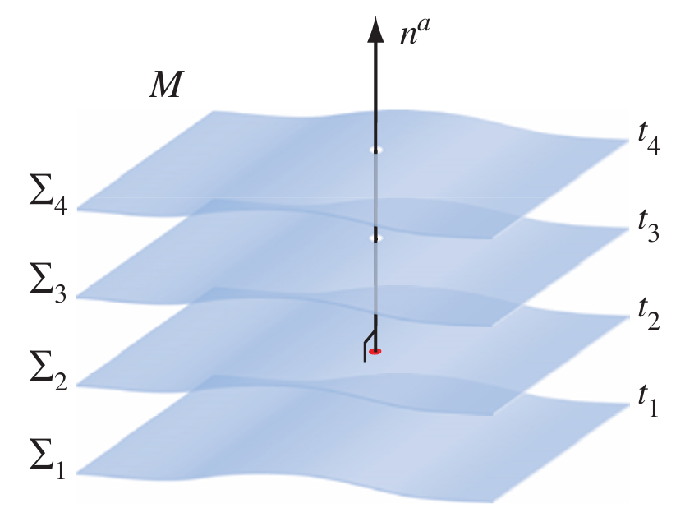


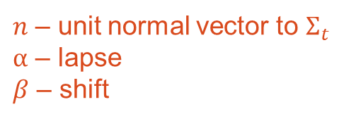
3 + 1 Decomposition
$n$ – unit normal vector to $Σ_{t}$
$α$ – lapse
$β$ – shift
Projection operator
Decomposition of 4-vector
[Baumgarte and Shapiro. “Numerical Relativity”]

Slide 9
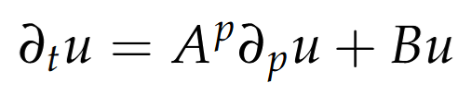
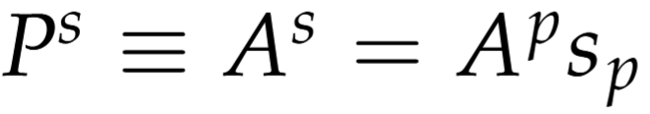
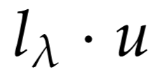
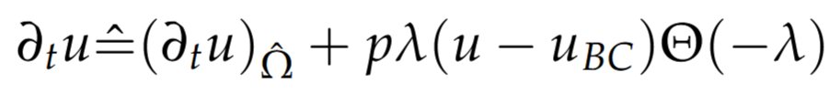

Penalty method
A PDEs system is well-posed if there exists a unique solution that depends continuously on the initial data. Equivalent to being stronly hyperbolic.
Well-posedness
If this is strongly hyperbolic, then for every spatial vector $s$
has real eigenvalues & complete set of eigenvectors
Characteristic variables are travelling waves
are left-eigenvectors of $P^{s}$ with eigenvalue $λ$
Penalty method
Force outgoing charcteristic var to be incoming characteristic var in next patch
Change rhs at boundary

Slide 10
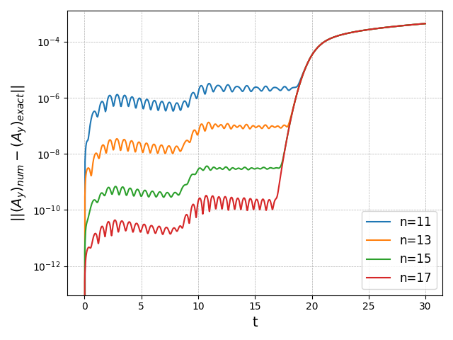
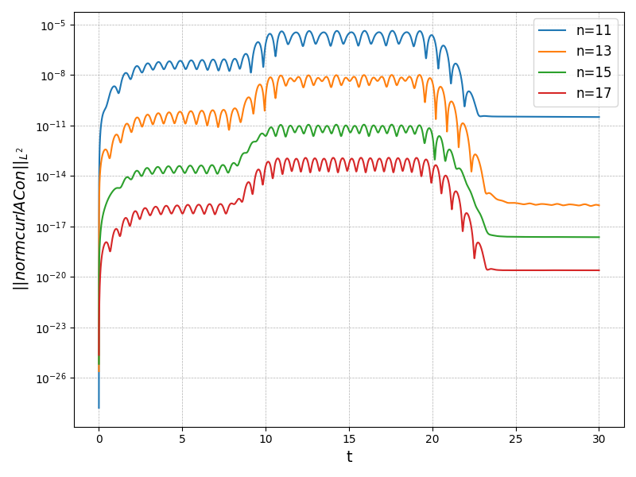
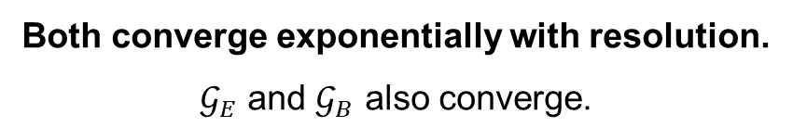

Electromagnetic dipole in flat background
Error of Ay with exact solution
Norm of $𝓖_{A}$
Both converge exponentially with resolution.
$𝒢_{E}$ and $𝒢_{B}$ also converge.

Slide 11
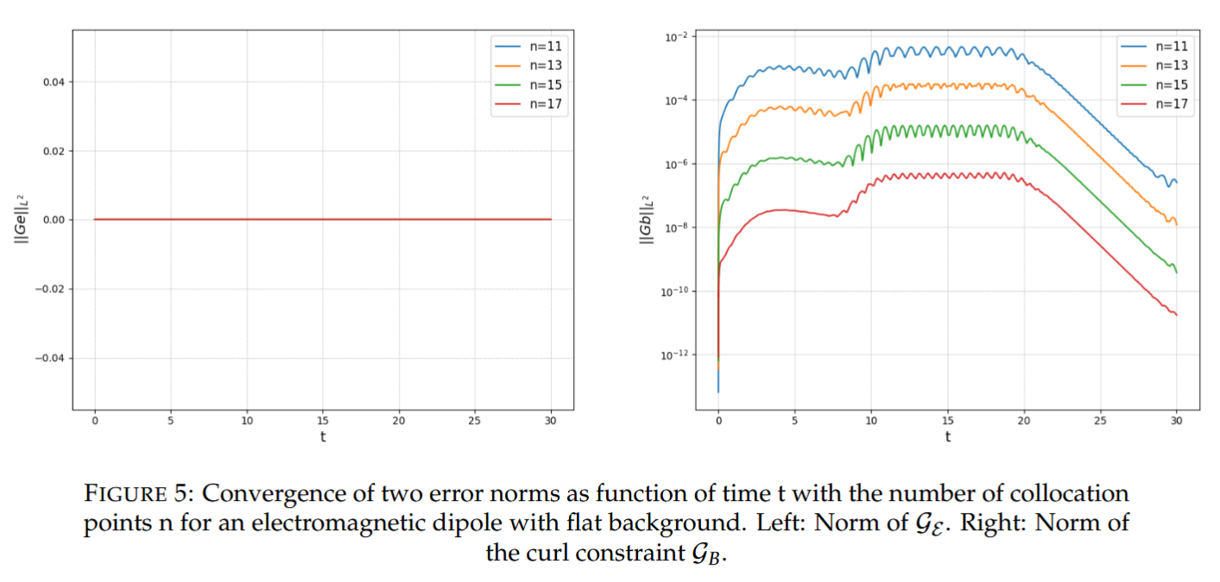
Electromagnetic dipole in flat background

Slide 12
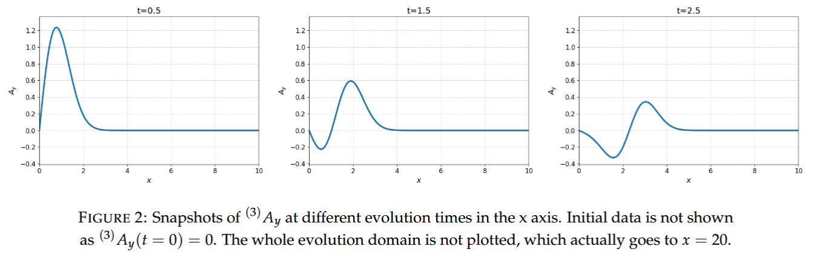
Electromagnetic dipole in flat background

Slide 13
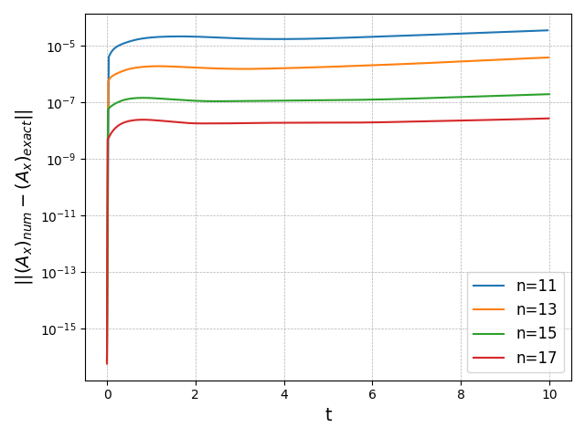
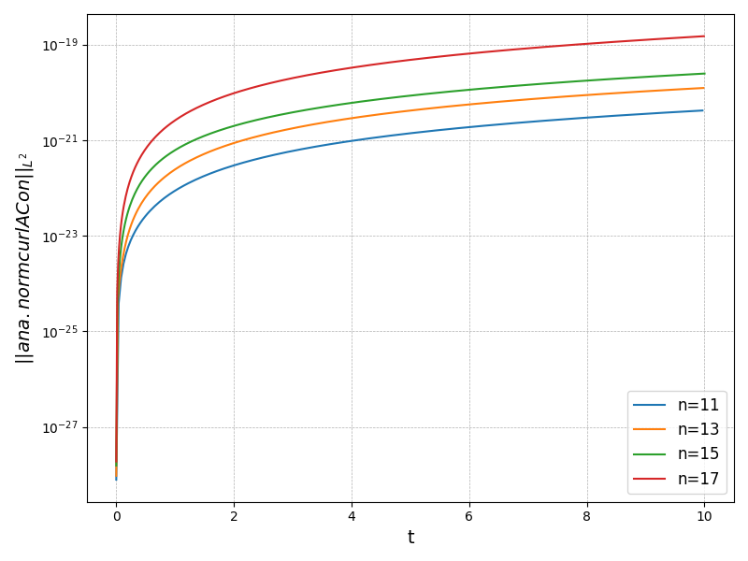
Reissner-Nordström BH in fixed background
Error of Ax with exact solution
Norm of $𝓖_{A}$
Converges exponentially with resolution.
Grows exponentially with resolution and in time!
!

Slide 14
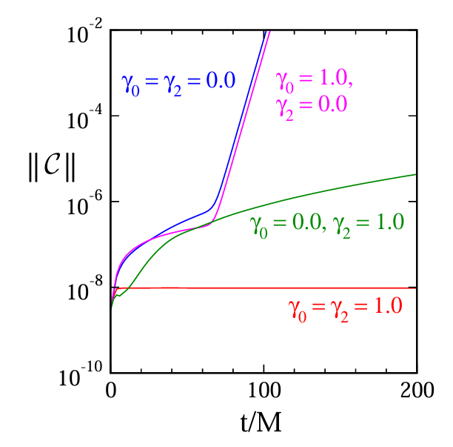

Reissner-Nordström BH in fixed background
Norm of $𝓖_{A}$
Without constraint damping
With damping
Probably need to add constraint damping to equations
[Lee Lindblom et al. arXiv:gr-qc/0512093]

Slide 15
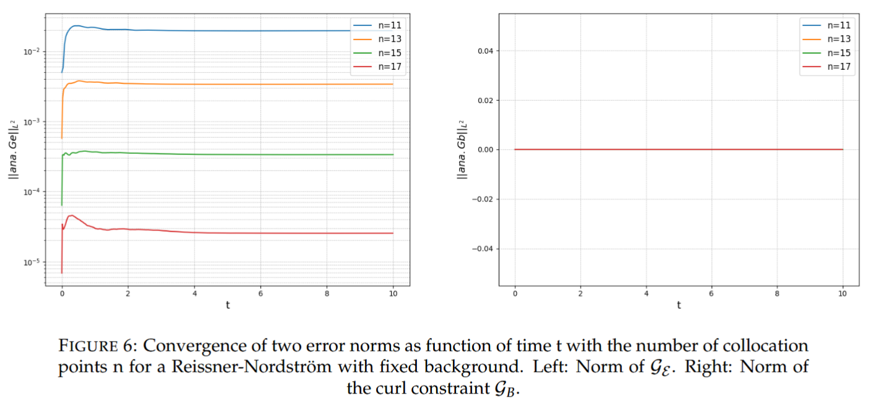
Reissner-Nordström BH in fixed background

Slide 16

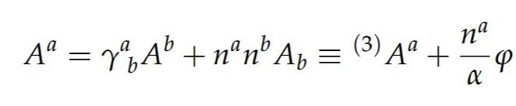
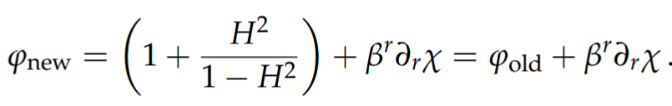
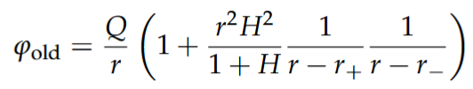
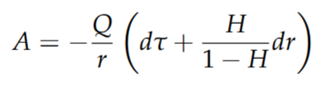
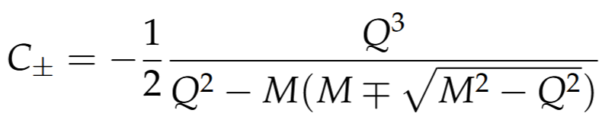
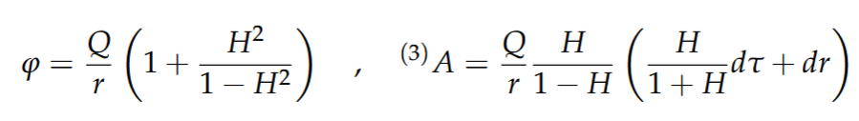
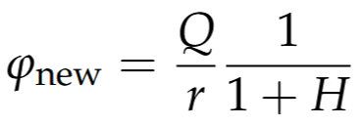
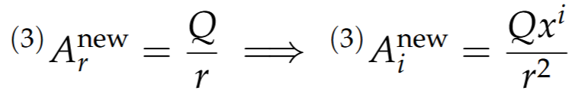







Reissner-Nordström BH Gauge change
Decomposition of A in Kerr-Schild coords
Gauge change
$$⋅$$
$$⋅$$
$$⋅$$
$$⋅$$
$$⋅$$
$$⋅$$
Singular at $r_$ and $r_{+}$

