Slide 1




Analysis of perpendicular mean flows and fluctuations for various magnetic field configurations and heating methods
João Luz
Instituto Superior Técnico
2nd Cycle Integrated Project in Engineering Physics
Dr. Carlos Silva, IPFN, IST
Dr. Thomas Windisch, E5-DYN/Tur, IPP
January 28th, 2026
João Luz
January 28th, 2026
1/20

Slide 2
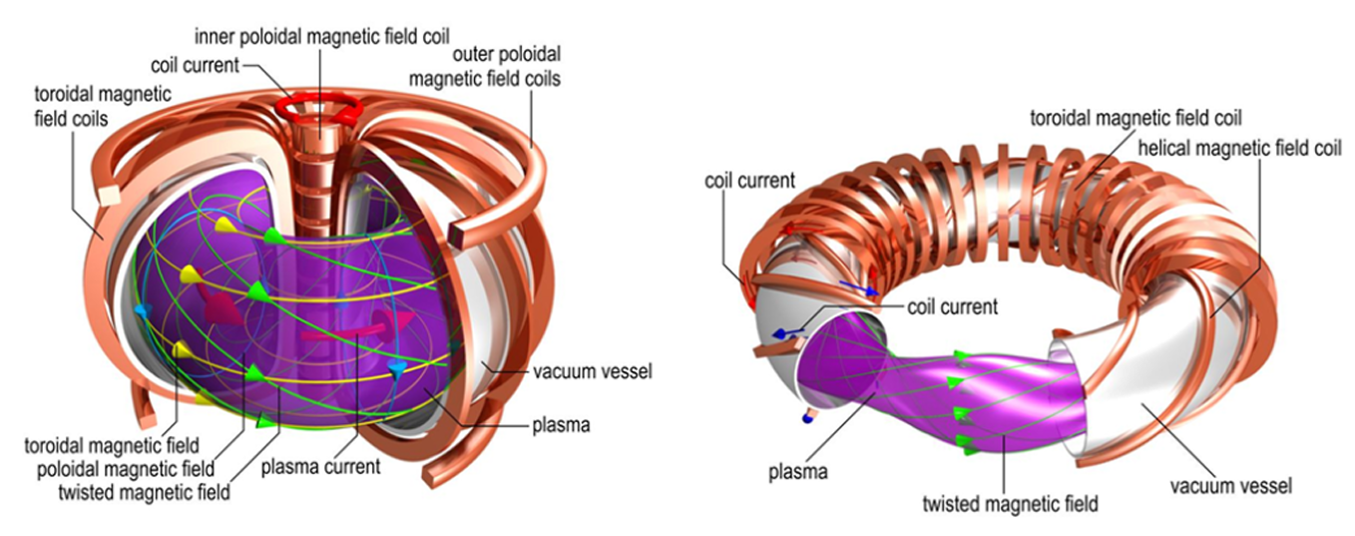


Introduction – Nuclear fusion as a source of energy
$$D+T$$
$${}_{}^{4}{He (3.5 MeV)+n (14.1 MeV)}$$
João Luz
Nuclear fusion
January 28th, 2026
2/20

Slide 3
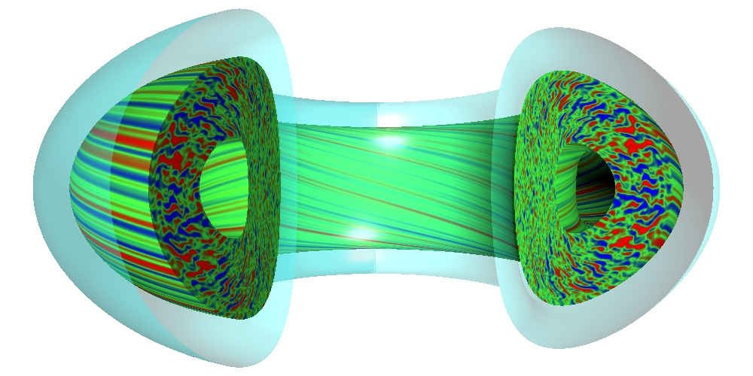
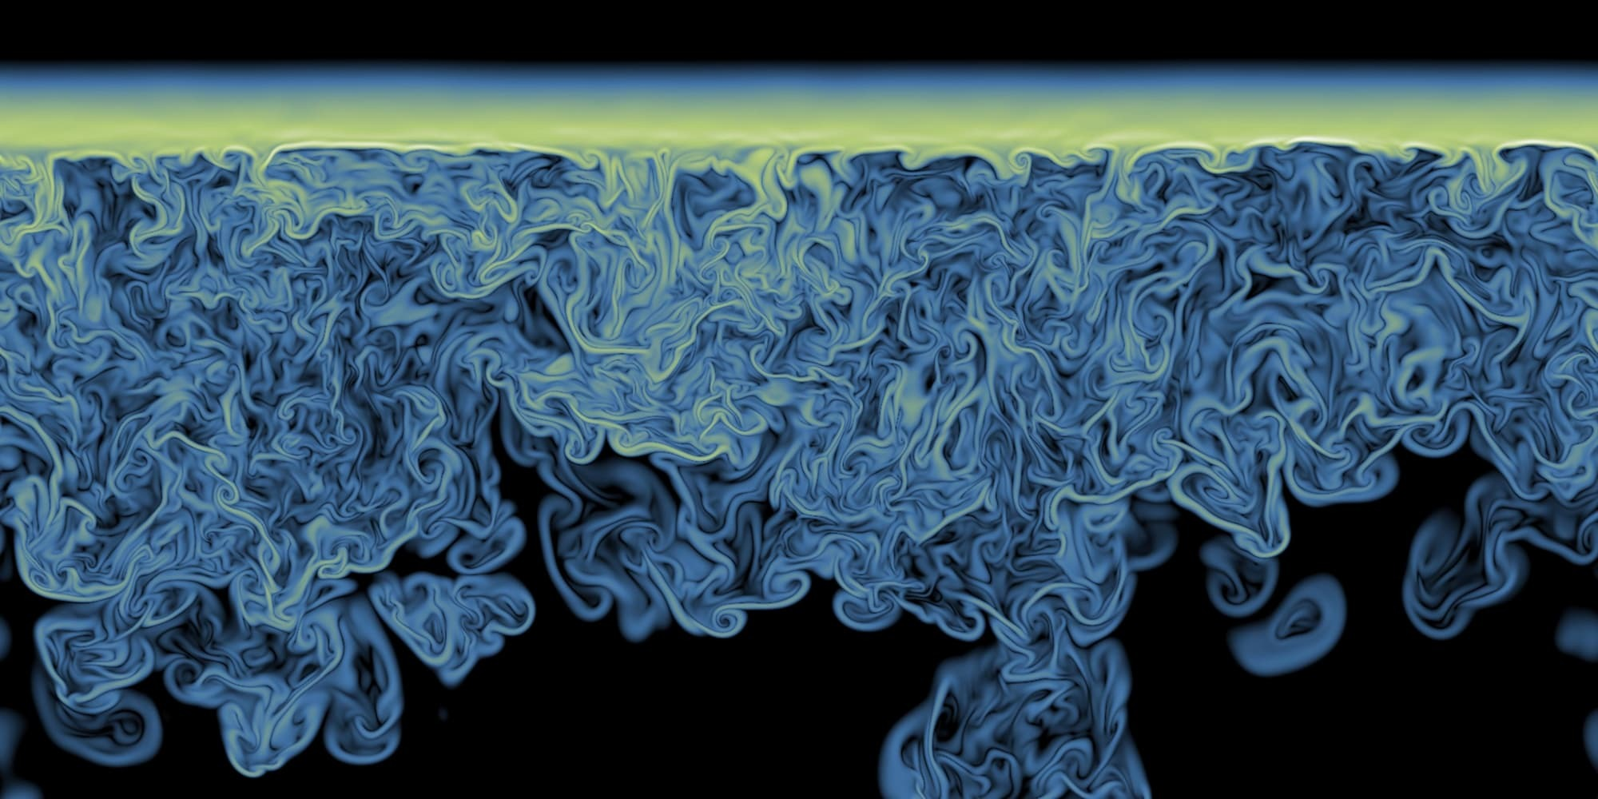

Energy confinement – Turbulence as the main limitation
The reaction process is self-sustainable if the Lawson criterion is satisfied:
The energy confinement time, $τ_{E}$, is limited by turbulence in the plasma:
$$nk_{B}Tτ_{E}>3×{10}^{21} keV s/m^{3}$$
João Luz
Energy confinement
January 28th, 2026
3/20

Slide 4
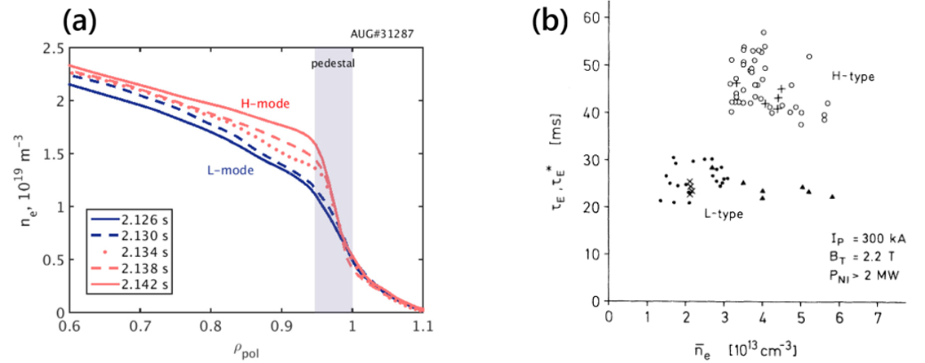
Turbulence suppression – The H-mode
H-mode:
  Low turbulence levels;
  Higher energy confinement times;
  Steeper density and temperature gradients.
João Luz
H - mode
January 28th, 2026
4/20

Slide 5
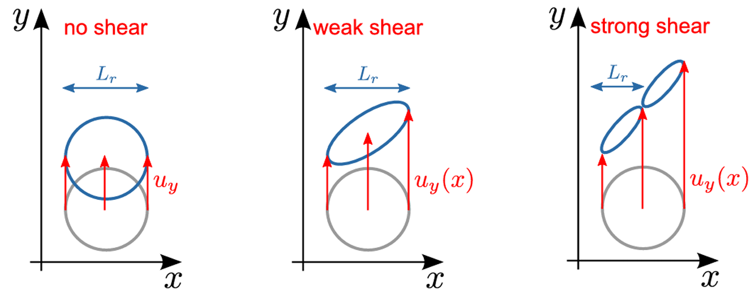
Turbulence suppression – Sheared flows
Sheared plasma flows suppress turbulent transport.
Turbulent structures can self-organize into generating sheared plasma flows.
Combining both models, turbulence and sheared plasma flows are coupled!
João Luz
Sheared flows
January 28th, 2026
5/20

Slide 6
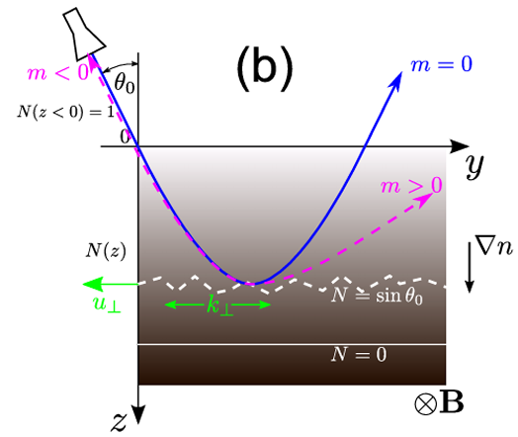
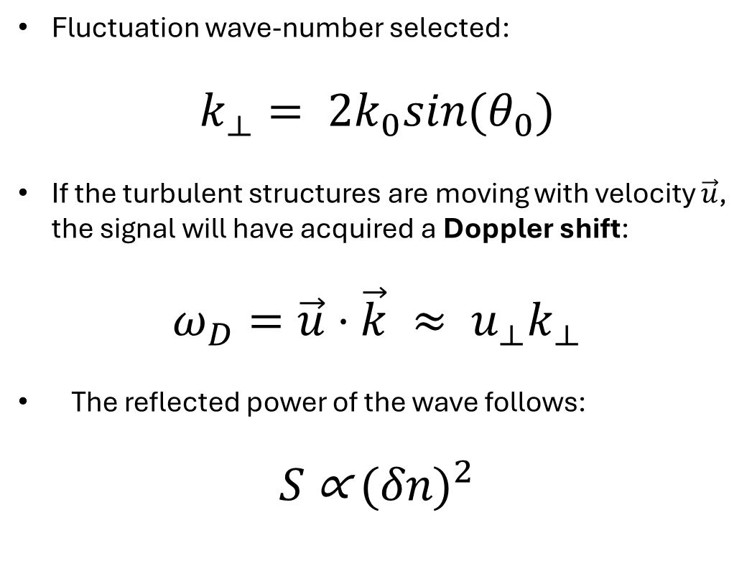
Doppler Reflectometry diagnostic technique
Fluctuation wave-number selected:
$$k_{⟂}= 2k_{0}sin(θ_{0})$$
If the turbulent structures are moving with velocity $\vec{u}$, the signal will have acquired a Doppler shift:
$$ω_{D}=\vec{u}⋅\vec{k} ≈ u_{⟂}k_{⟂}$$
The reflected power of the wave follows:
$$S \text{∝}{ (δn)}^{2}$$
João Luz
Doppler Reflectometry
January 28th, 2026
6/20

Slide 7
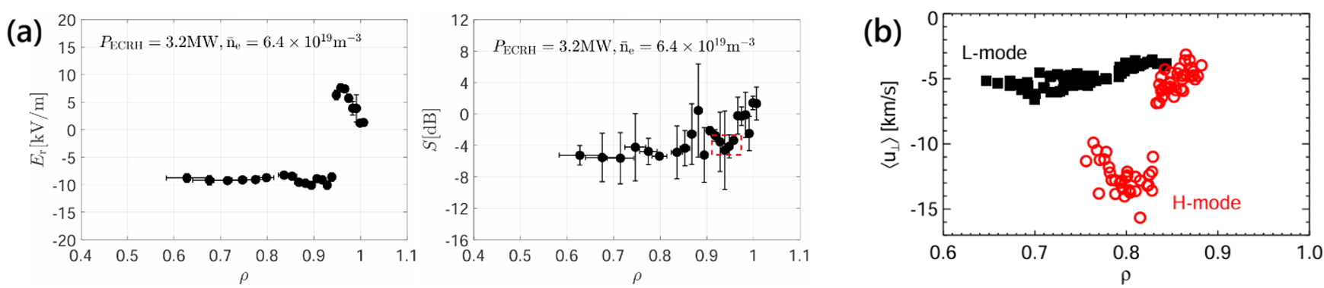
Doppler reflectometry measurements
Doppler reflectometry allows the study of the turbulence suppression mechanisms.
Sheared profiles in the plasma velocity have been measured in regions close to where the turbulence level reaches a local minimum and also in the H-mode, when in the L-mode the profile is relatively flat.
João Luz
Doppler reflectometry measurements
January 28th, 2026
7/20

Slide 8
Doppler reflectometry measurements
Doppler reflectometry allows the study of the turbulence suppression mechanisms.
Sheared profiles in the plasma velocity have been measured in regions close to where the turbulence level reaches a local minimum and also in the H-mode, when in the L-mode the profile is relatively flat.
João Luz
Doppler reflectometry measurements
January 28th, 2026
8/20

Slide 9
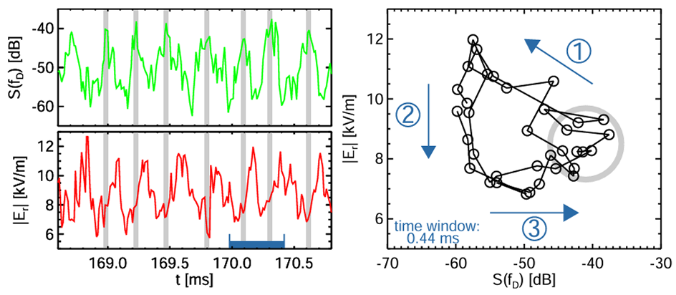
Doppler reflectometry measurements
Experimental evidence of the coupling between sheared flows and turbulence level has also been observed using Doppler reflectometry, for a time interval during a L-H transition.
João Luz
Doppler reflectometry measurements
January 28th, 2026
9/20

Slide 10
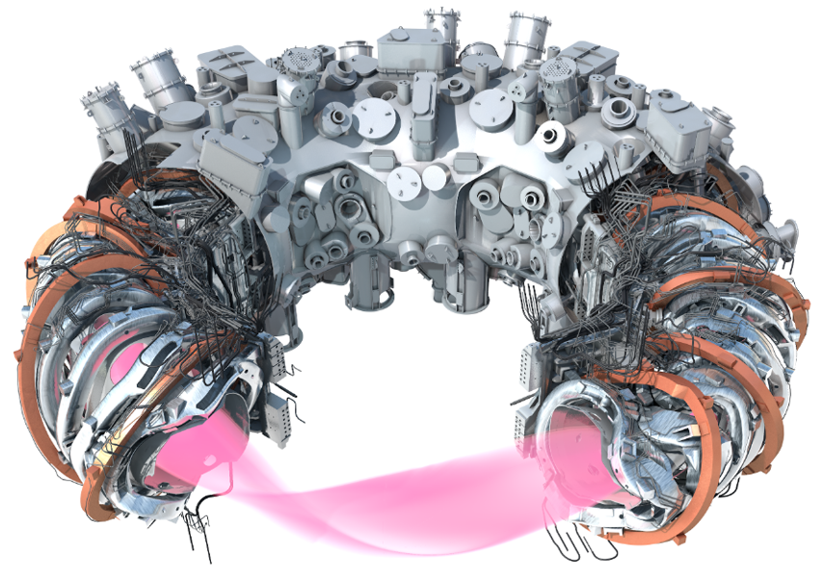
Scope for the thesis – Wendelstein 7-X stellarator
Research work for the thesis to be performed at the Wendelstein 7-X stellarator, of the Max Planck Institute for Plasma Physics (IPP), Greifswald, Germany.
Plasmas subject to various magnetic field configurations and heating methods will be studied.
Doppler reflectometry measurements will allow to continue the study of turbulent transport and its interaction with sheared plasma flows.
João Luz
Scope for the thesis
January 28th, 2026
10/20

Slide 12
Extra material

Slide 13
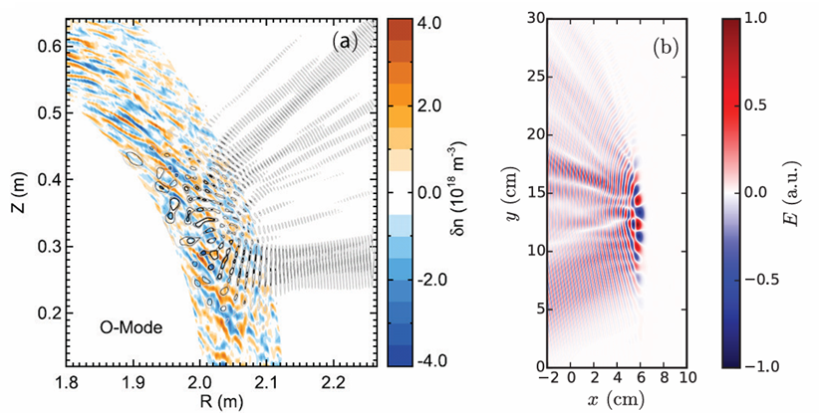
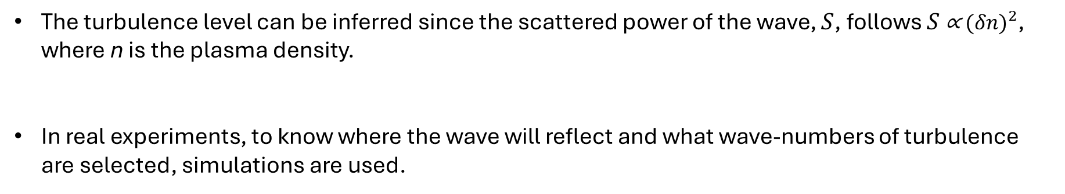
Extracting information from the diagnostic
The turbulence level can be inferred since the scattered power of the wave, $S$, follows $S \text{∝}{ (δn)}^{2}$, where n is the plasma density.
In real experiments, to know where the wave will reflect and what wave-numbers of turbulence are selected, simulations are used.
João Luz
Full-wave simulations
January 28th, 2026
13/20

Slide 14
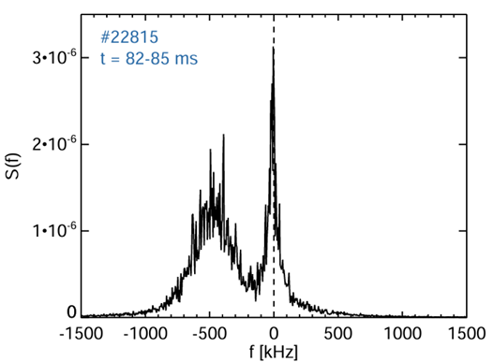
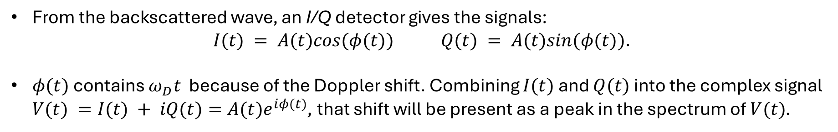
Signal detection
From the backscattered wave, an I/Q detector gives the signals:
$I(t) = A(t)cos(φ(t))$ $Q(t) = A(t)sin(φ(t))$.
$φ(t)$ contains $ω_{D}t$ because of the Doppler shift. Combining $I(t)$ and $Q(t)$ into the complex signal $V(t) =I(t) + iQ(t)=A(t)e^{iφ(t)}$, that shift will be present as a peak in the spectrum of $V(t)$.
João Luz
Signal detection
January 28th, 2026
14/20

Slide 15
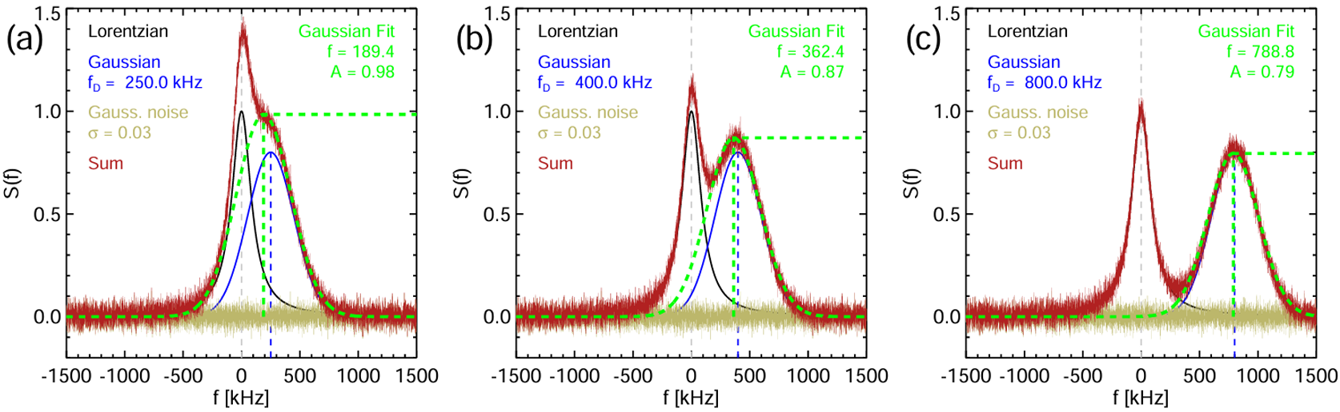
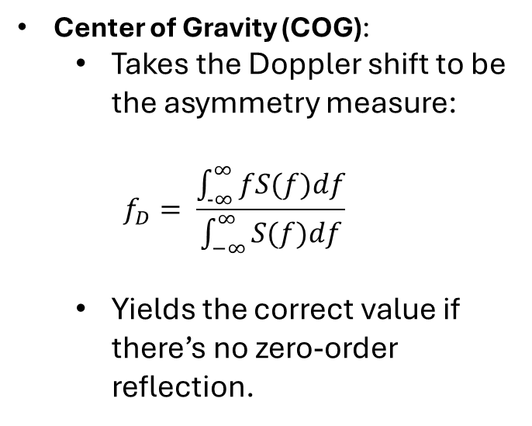
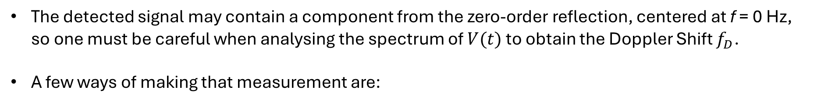
Analysis techniques
The detected signal may contain a component from the zero-order reflection, centered at f = 0 Hz, so one must be careful when analysing the spectrum of $V(t)$ to obtain the Doppler Shift $f_{D}$.
A few ways of making that measurement are:
Center of Gravity (COG):
  Takes the Doppler shift to be the asymmetry measure:
  $$f_{D}= \frac{\int_{−∞}^{∞}{fS(f)df}}{\int_{−∞}^{∞}{S(f)df}}$$
  Yields the correct value if there’s no zero-order reflection.
João Luz
Analysis techniques
January 28th, 2026
15/20

Slide 16
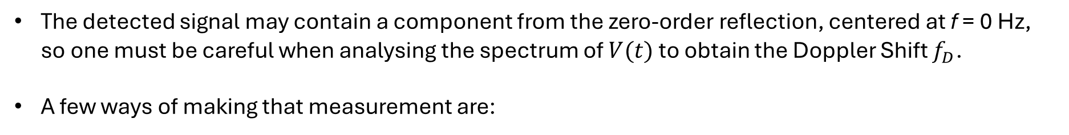
Analysis techniques
The detected signal may contain a component from the zero-order reflection, centered at f = 0 Hz, so one must be careful when analysing the spectrum of $V(t)$ to obtain the Doppler Shift $f_{D}$.
A few ways of making that measurement are:
Fit to the Power Spectrum (SFIT):
  Fits selected points on the spectrum to a gaussian and takes its peak frequency and amplitude.
  Yields the correct value if there’s a significant level of separation between the two reflection components.
João Luz
Analysis techniques
January 28th, 2026
16/20

Slide 17
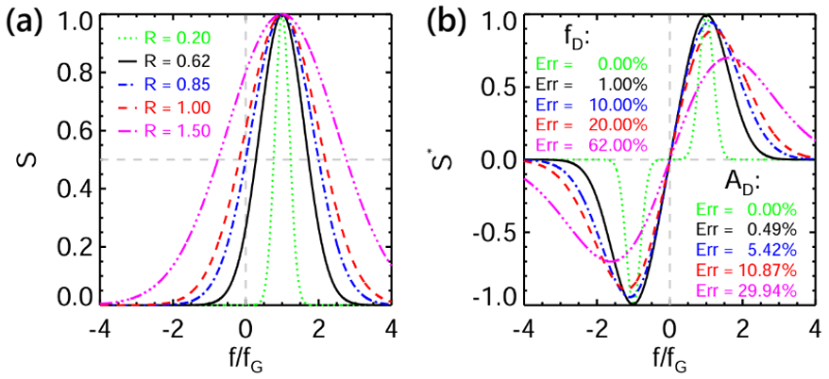
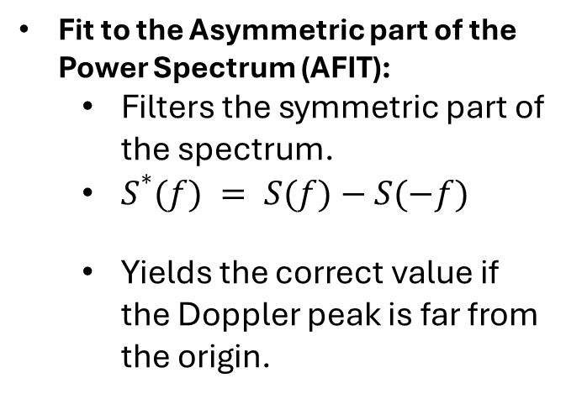
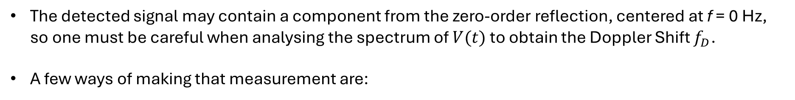
Analysis techniques
The detected signal may contain a component from the zero-order reflection, centered at f = 0 Hz, so one must be careful when analysing the spectrum of $V(t)$ to obtain the Doppler Shift $f_{D}$.
A few ways of making that measurement are:
Fit to the Asymmetric part of the Power Spectrum (AFIT):
  Filters the symmetric part of the spectrum.
  $S^{∗}(f) = S(f)−S(−f)$
  Yields the correct value if the Doppler peak is far from the origin.
João Luz
Analysis techniques
January 28th, 2026
17/20

Slide 18
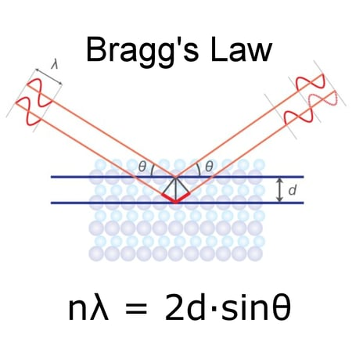
Bragg scattering
João Luz
Bragg scattering
January 28th, 2026
18/20

Slide 19
References
(1) Javier Rodrigo Pinzón Acosta. “Modelling and Application of Doppler Reflectometry for Advanced Turbulence Studies on the ASDEX Upgrade Tokamak and the TJ-II Stel larator”. Joint Doctoral Programme in Nuclear Fusion Science and Engineering (FUSION-DC). PhD thesis. Technische Universität München and Universidad Carlos III de Madrid, Apr. 2018.
(2) J. D. Lawson. “Some Criteria for a Power Producing Thermonuclear Reactor”. In: Proceedings of the Physical Society. Section B 70.1 (1957), pp. 6–10.
(3) Per Helander. “Theory of plasma confinement in non-axisymmetric magnetic fields”. In: Reports on Progress in Physics 77.8 (2014), p. 087001.
(4) MaxPlanck Institute for Plasma Physics. Max Planck Institute for Plasma Physics– Fusion research at IPP.
(5) Emmanouil Maragkoudakis. “Turbulence in Wendelstein 7-X: Characterization and Role in Confinement”. PhD thesis. Madrid, Spain: Universidad Carlos III de Madrid, June 2025.
(6) A. N. Kolmogorov. “The Local Structure of Turbulence in Incompressible Viscous Fluid for Very Large Reynolds Numbers”. In: Dokl. Akad. Nauk SSSR 30 (1941). Reprinted in Proc. R. Soc. Lond. A 434, 9 (1991), p. 301.
(7) A. N. Kolmogorov. “Dissipation of Energy in the Locally Isotropic Turbulence”. In: Dokl. Akad. Nauk SSSR 32 (1941). Reprinted in Proc. R. Soc. Lond. A 434, 15 (1991), p. 16.
João Luz
References
January 28th, 2026
19/20

Slide 20
References
(8) Tim Happel. “Doppler Reflectometry in the TJ-II Stellarator: Design of an Optimized Doppler Reflectometer and its Application to Turbulence and Radial Electric Field Studies”. PhD thesis. Madrid, Spain: Universidad Carlos III de Madrid, 2010.
(9) G. D. Conway et al. “Assessment of Doppler reflectometry accuracy using full-wave codes with comparison to beam-tracing and analytic expressions”. In: Plasma Physics and Controlled Fusion 67.10 (2025), p. 105024.
(10) Oleg Krutkin. “Theoretical analysis and full-wave simulations combined in the development of the synthetic Doppler reflectometry diagnostics for tokamaks”. Doctoral School “C2MP”(ED606). PhD thesis. Nancy, France: Université de Lorraine, 2020.
(11) F. Wagner et al. “Regime of Improved Confinement and High Beta in Neutral-Beam-Heated Divertor Discharges of the ASDEX Tokamak”. In: Physical Review Letters 49 (1982), pp. 1408–1412.
(12) A. Medvedeva et al. “Density profile and turbulence evolution during L–H transition studied with the ultra-fast swept reflectometer on ASDEX Upgrade”. In: Plasma Physics and Controlled Fusion (2017).
(13) H. Biglari, P. H. Diamond, and P. W. Terry. “Influence of sheared poloidal rotation on edge turbulence”. In: Physics of Fluids B 2.1 (1990), pp. 1–4.
(14) P. H. Diamond and Y.-B. Kim. “Theory of mean poloidal flow generation by turbulence”. In: Physics of Fluids B 3.7 (1991), pp. 1626–1633.
(15) P. H. Diamond et al. “Self-Regulating Shear Flow Turbulence: A Paradigm for the L to H Transition”. In: Physical Review Letters 72 (1994), pp. 2565–2568.
João Luz
References
January 28th, 2026
20/20

