Slide 1

2nd Cycle Integrated Project in Engineering Physics
Magnetoresistive devices for industrial applications: improvement of thermal robustness
Mariana Dinis (ist1102424)
Supervisor: Prof. Susana Cardoso de Freitas
January 2026

Slide 2

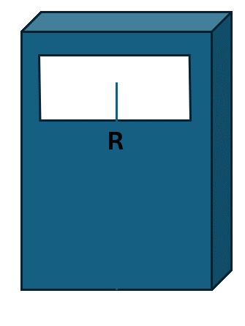
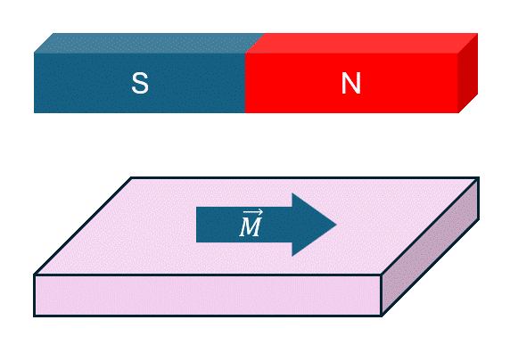
Project Goals: Recap
Project goals
Identify key factors impacting thermal robustness
Compare different TMR stacks
1

Slide 3
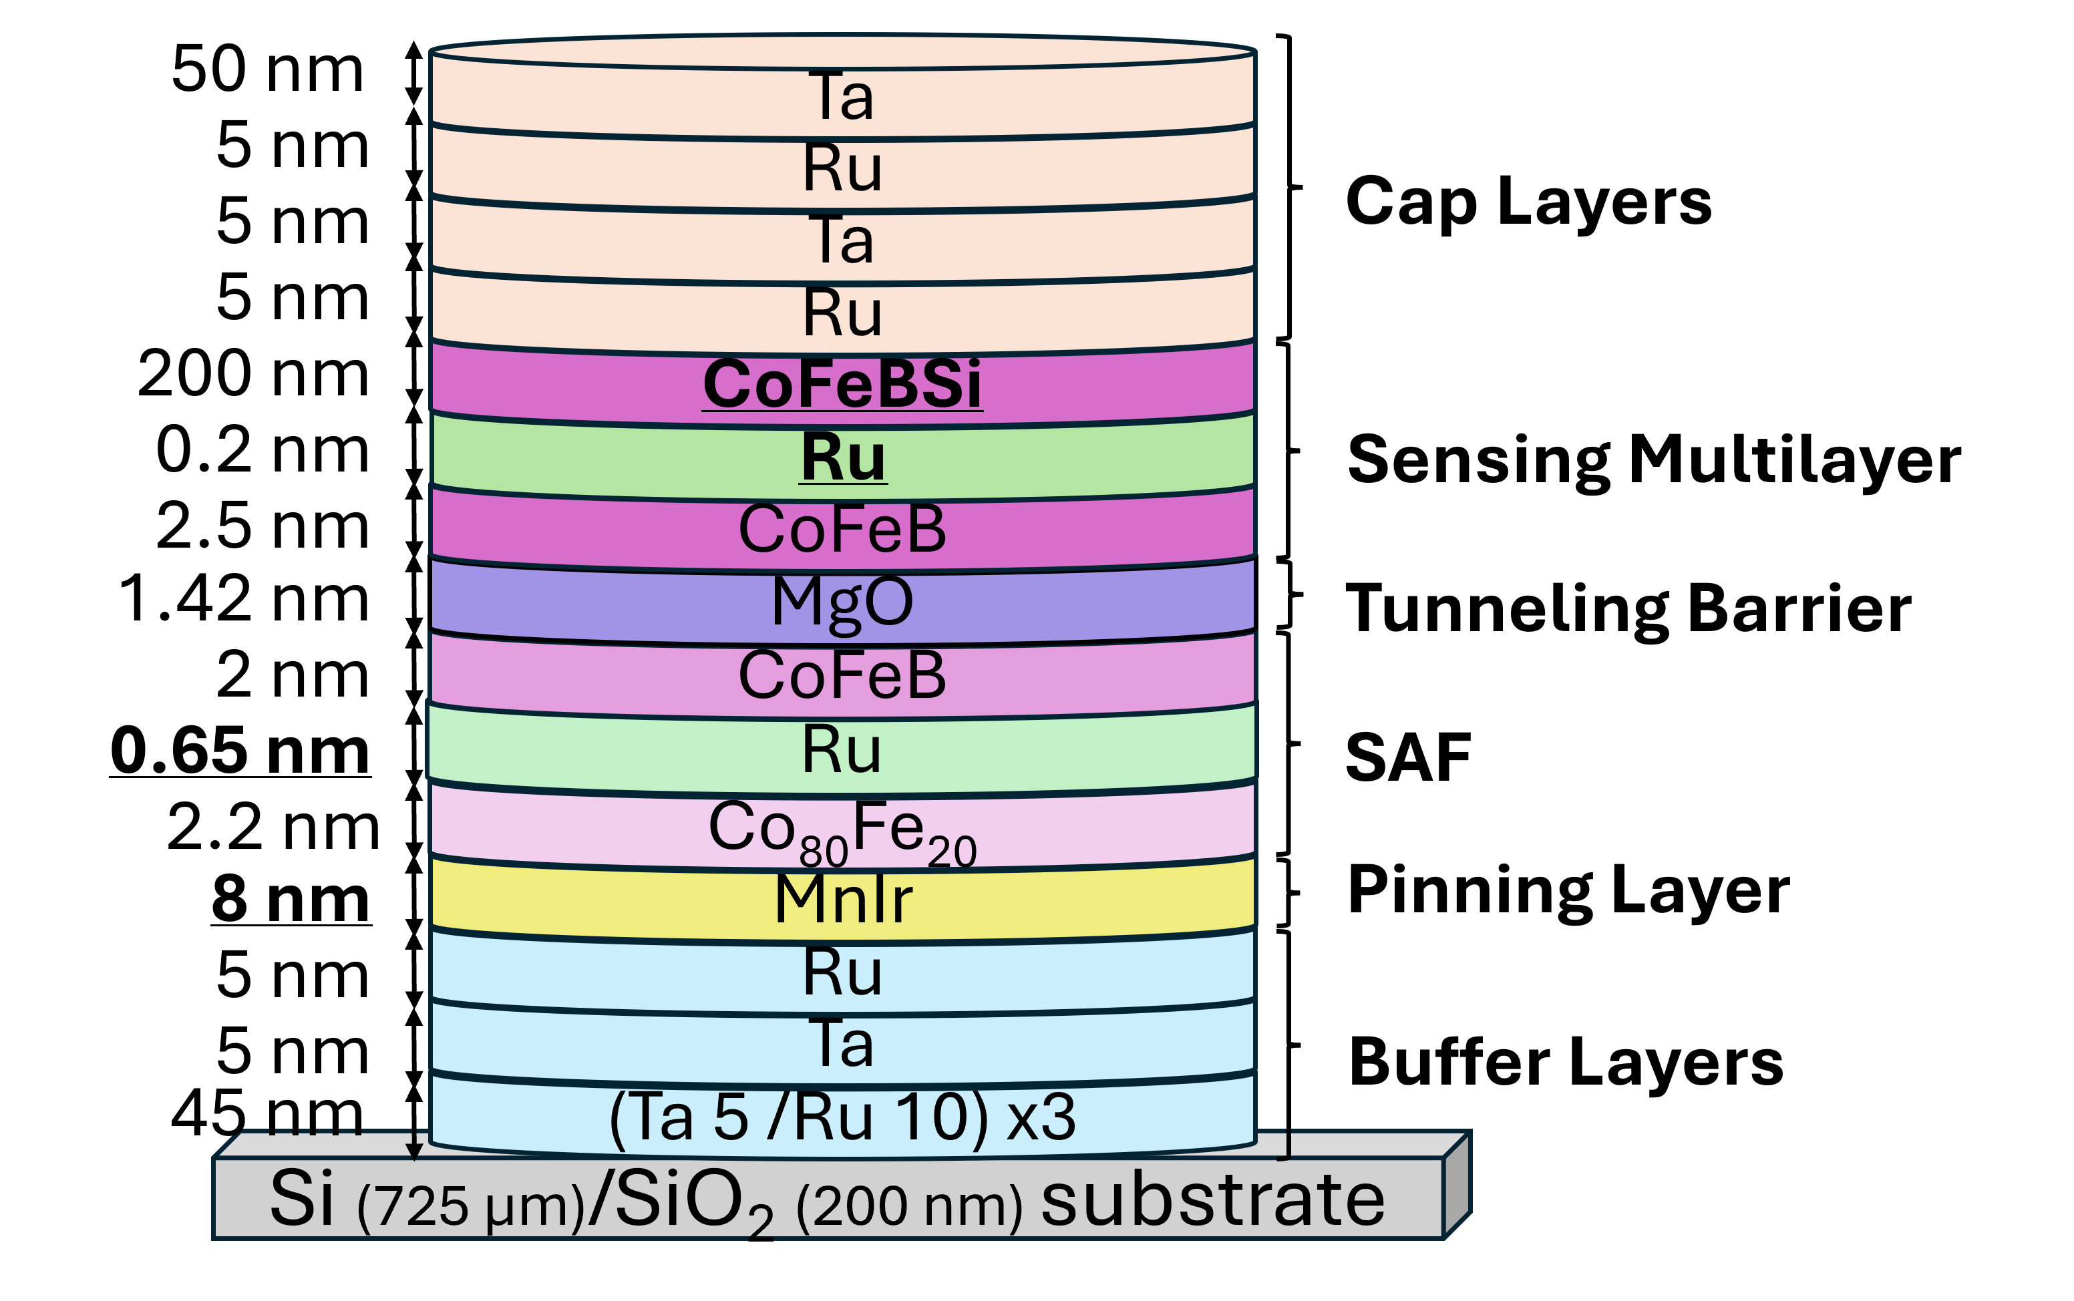
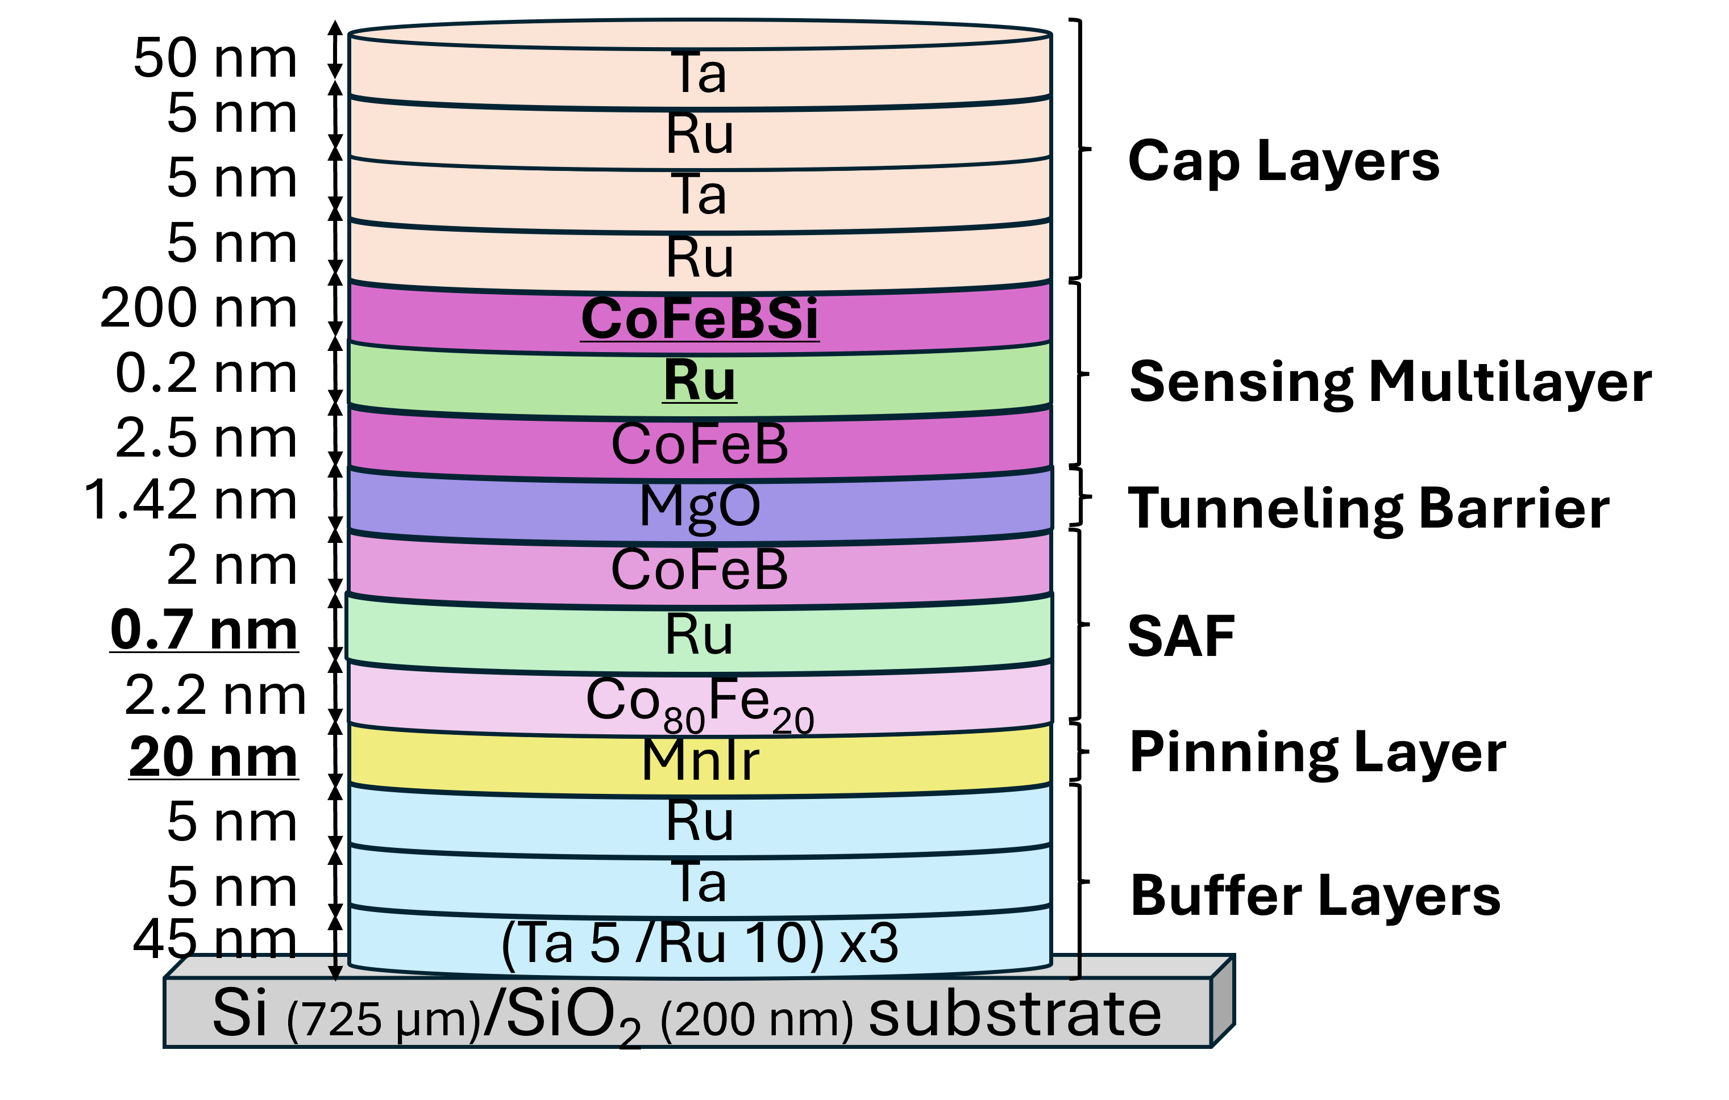
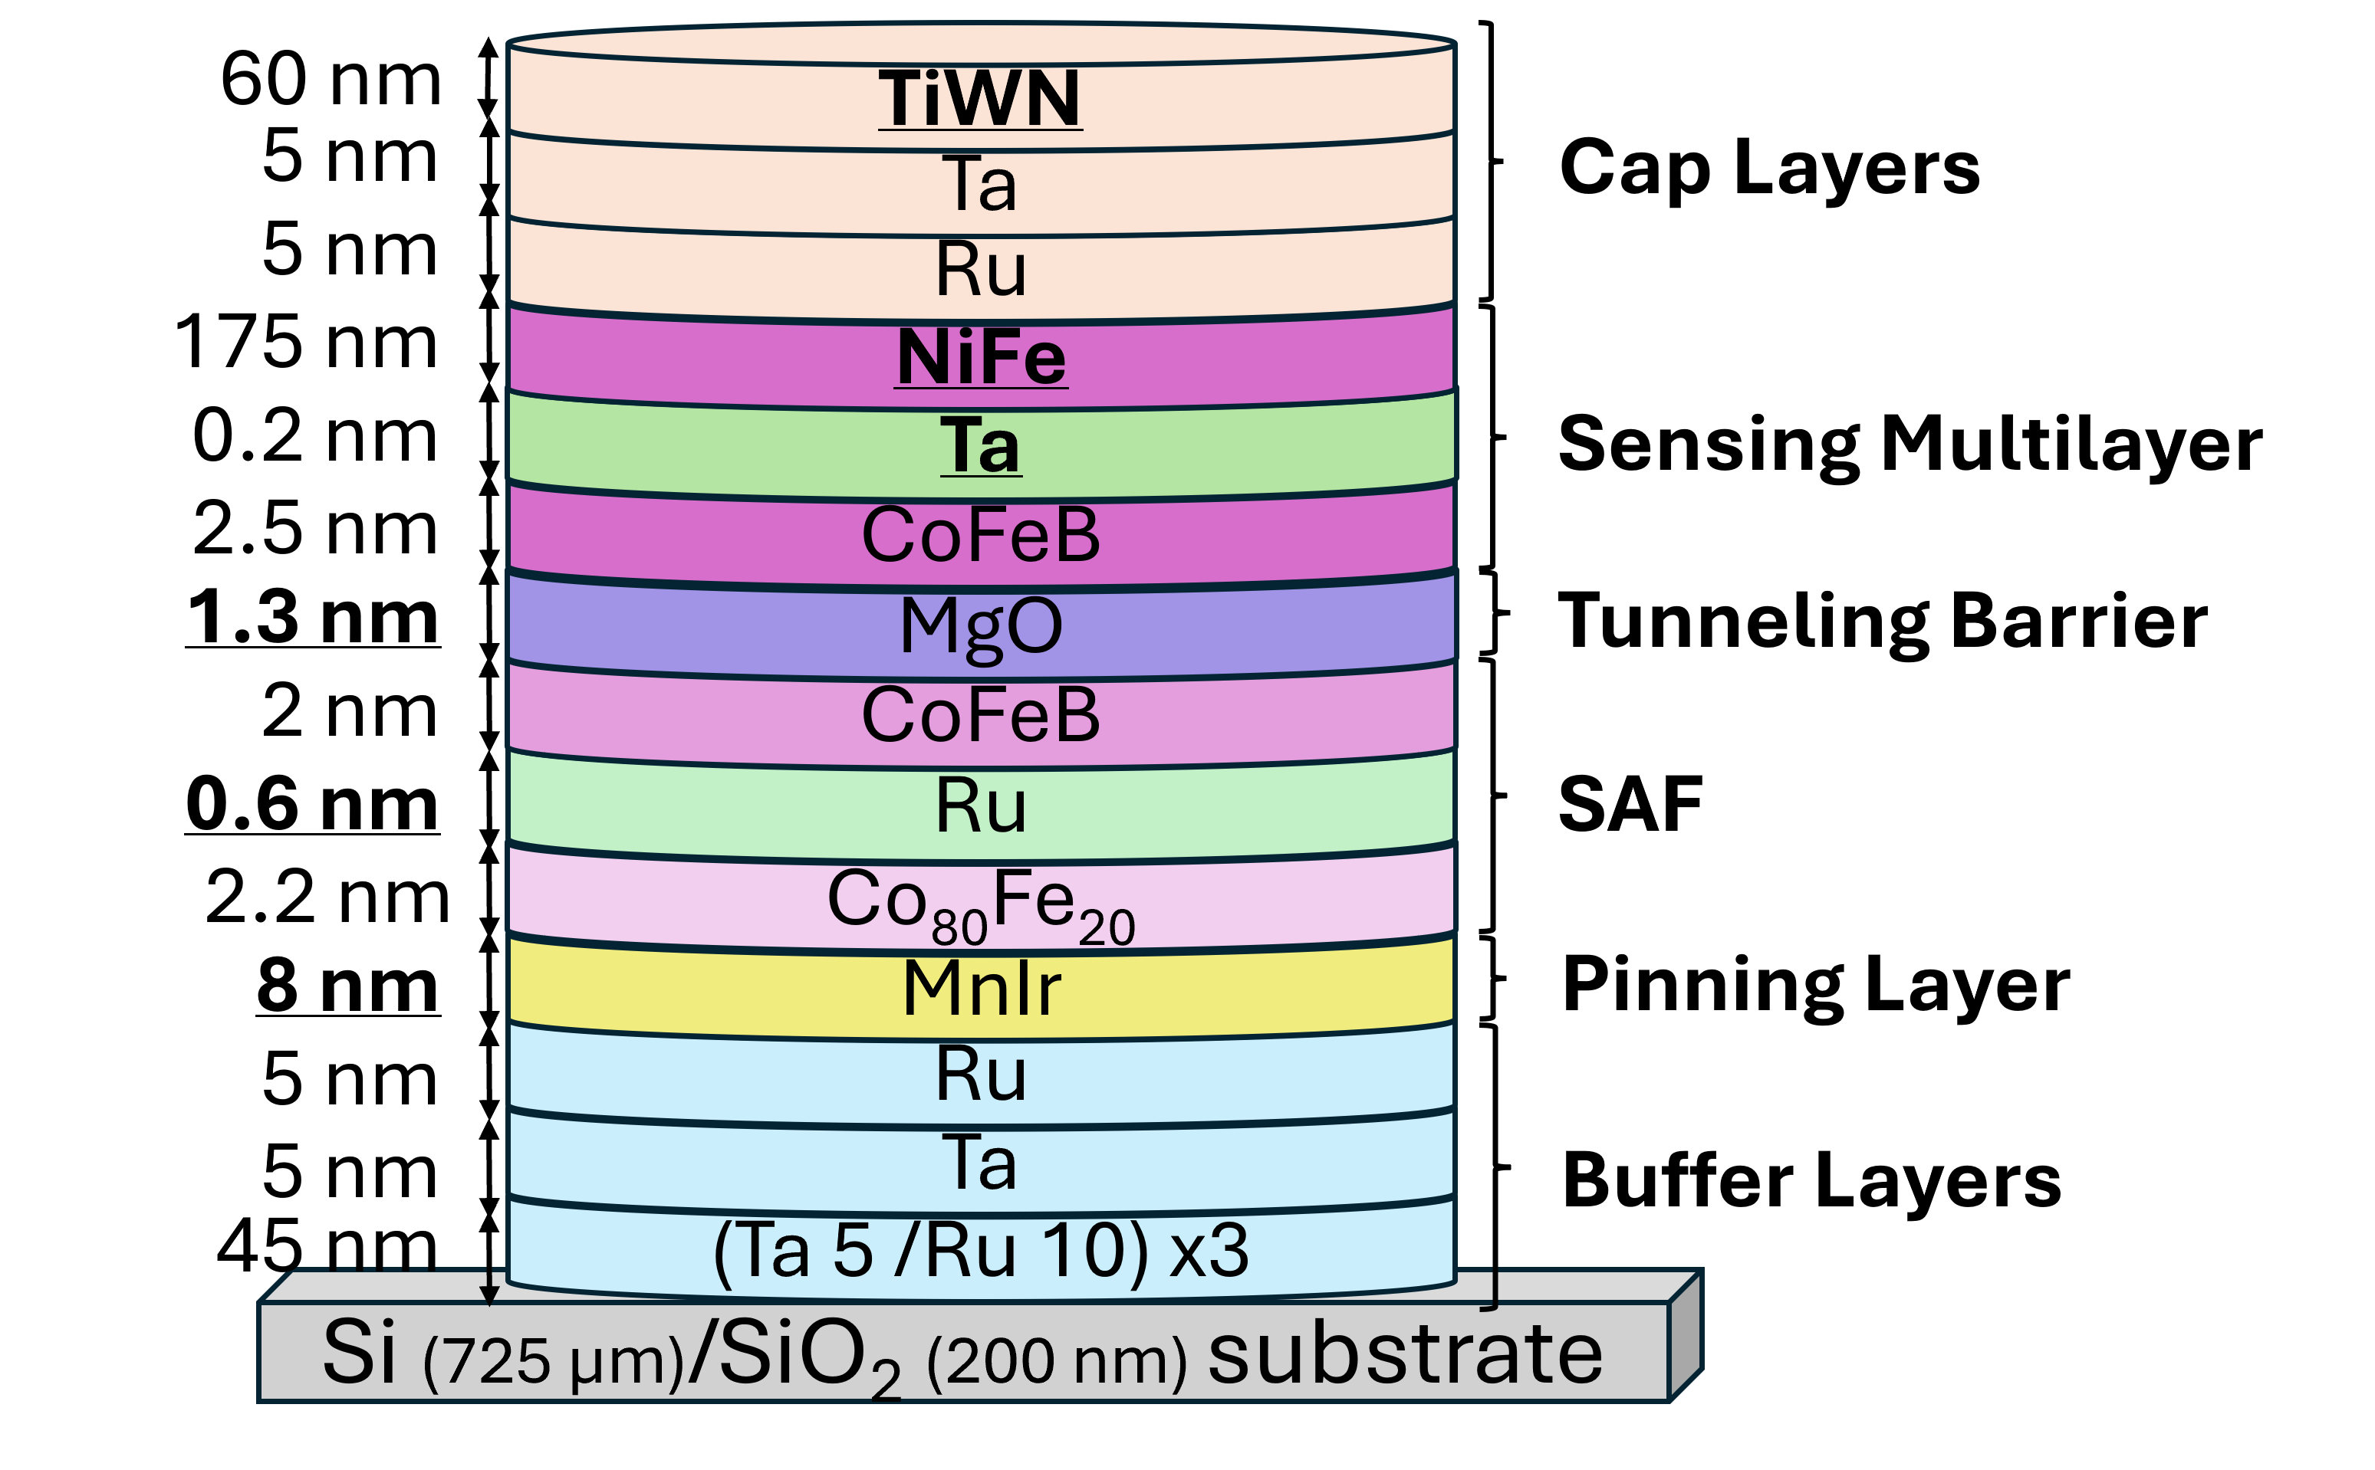
Experimental Work: Samples and their differences
Sample 10252
Sample 10261
Sample 8985
Main Differences
SAF spacer thickness (Ru)
Tunneling barrier thickness
Sensing multilayer materials
AFM Thickness
(pinning layer)
Deposition techniques
Cap Layers
2

Slide 4
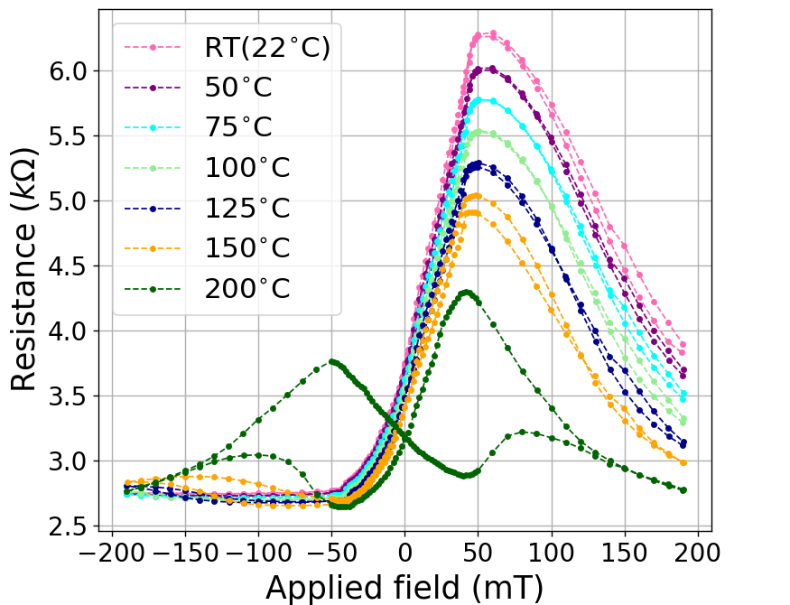
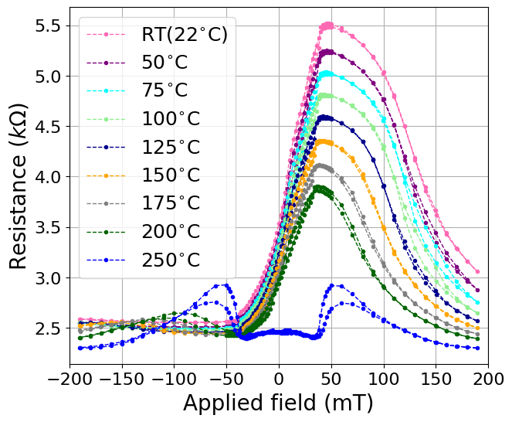
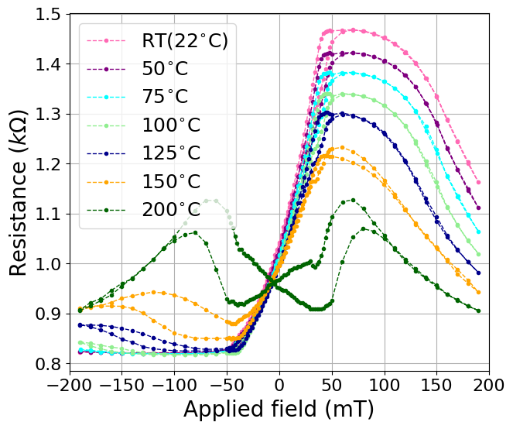
2kOe setup: Resistance as a function of the applied field
Sample 10252
Sample 10261
Sample 8985
AP state
10261 vs 8985
working temperature
AP state stability
3

Slide 5
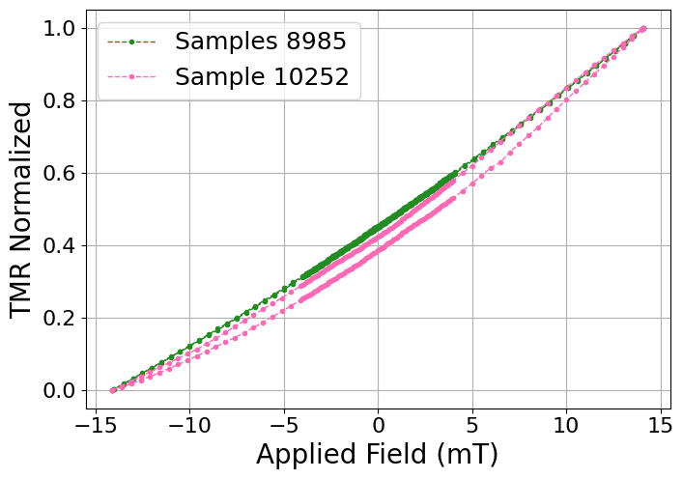

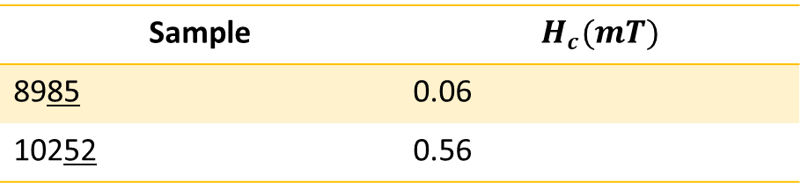
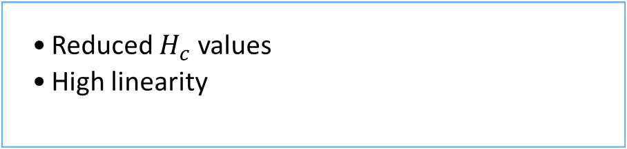
140Oe Setup: Detailed look into samples 10252 & 8985
Sample | Linearity (%)
8985 | 95.9
10252 | 91.7
Sample | $$H_{c}(mT)$$
8985 | 0.06
10252 | 0.56
Coercivity & Linearity
Reduced $H_{c}$ values
High linearity
Magnetic Vortex State
4

Slide 6
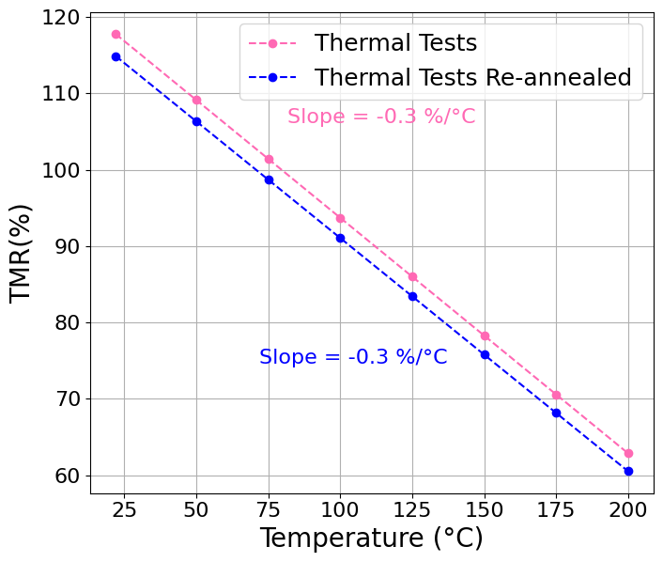
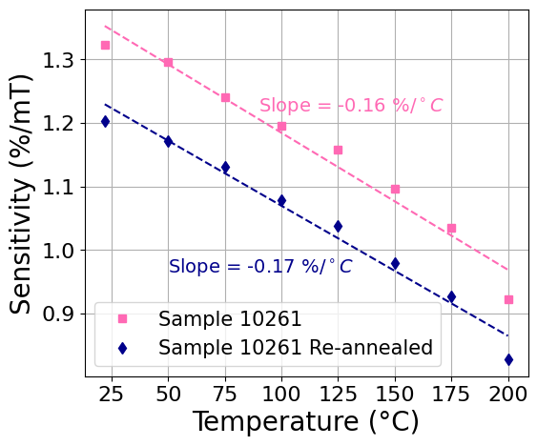
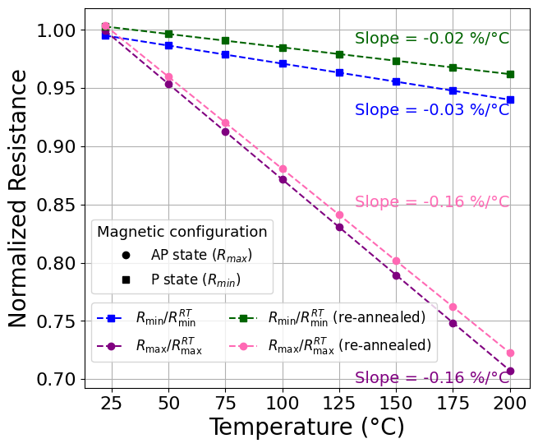
Reversibility Study: Sample 10261
Thermal tests after re-annealing
Similar results
Differences are within experimental uncertainty, due to sensor-to-sensor variation
5

Slide 7

Conclusions and Outlook
Thermal robustness
AFM layer + SAF (reference system)
Vortex Magnetic State
Linearity
Coercivity
Reversibility
Study
Loss of exchange bias
Possible re-pinning
Additional Samples
Different measurements
Improved devices
6

Slide 8
2nd Cycle Integrated Project in Engineering Physics
Questions?
Magnetoresistive devices for industrial applications: improvement of thermal robustness
Mariana Dinis (ist1102424)
Supervisor: Prof. Susana Cardoso de Freitas
January 2026

