Slide 1
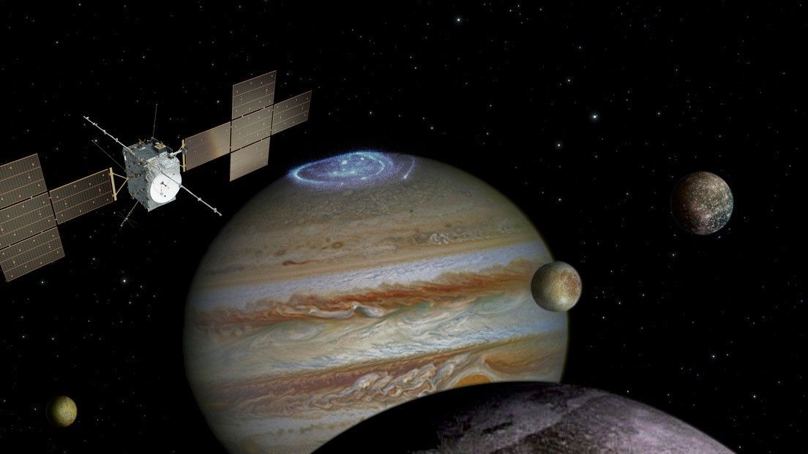


Characterization of the interplanetary radiation environment and optimization of the European Space Agency JUICE mission high-energy Electron Detector Head
Author: André Rodrigues
Supervisor: Marco Pinto
Notes:
My name is André Rodrigues and my work is about the optimization of the JUICE mission high-energy Electrons detector under the supervision of Marco Pinto

Slide 2
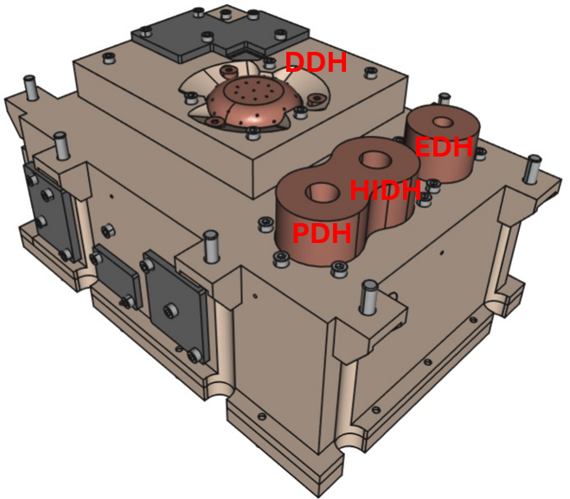
RADiation Electron Monitor (RADEM):
Electron Detector Head;
  0.3-40MeV
  8 deposition layers
Proton Detector Head;
  5-250MeV
  8 deposition layers
Heavy-Ion Detector Head;
  He-O
  2 deposition layers
Directional Detector Head;
  28 directions
Figure 4:Print of the CAD model of the RADEM Detector with the Electron Detector Head (EDH), the Proton and Heavy Ion Detector Head (PDH and HIDH) and the Directional Detector Head (DDH)
2
Notes:
Because radiation can create problems with the spacecraft, JUICE carries the RADEM, short for Radiation Electron Monitor.
RADEM is a compact but sophisticated instrument designed to measure electrons, protons, and heavy ions across a broad range of energies.
For that reason it contains four dedicated detector heads: the Electron WHICH WILL BE THE MAIN FOCUS OF MY WORK, the Proton, the Heavy Ion and the Directionality Detector Head.
Together, they allow RADEM to measure not only the density of particles, but also separate their type and energies.
while also mapping their incoming direction

Slide 3
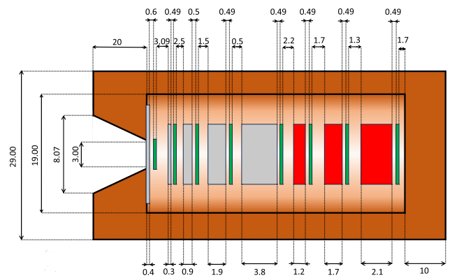
The detectors
PDH, EDH, and HIDH are silicon stack telescope detectors
Sensitive to particles with energies up to tens of MeV/nucleon
Detector stacks combines:
  Thin silicon diodes (energy deposition)
  Thick aluminum and tantalum layers (energy filtering and stopping)
Provides discrete energy segmentation
Figure 6:Cross section cut of the EDH and its components, brown represents copper, gray aluminum, green silicon sensors, and red tantalum.
Low mass and mechanical complexity
Reduced electronics requirements, suitable for space missions
Notes:
The PDH, EDH, and HIDH are silicon stack telescope detectors, which can measure electrons and ions up to the tens of MeV/nucl.
By layering thin silicon diodes with thick aluminum and tantalum layers, the RADEM is capable of indirectly calculate a particle energy from the number of layers penetrated without resorting to a heavy calorimeter
This detectors offers a discrete energy segmentation while maintaining a low mechanical and physical complexity while also minimizing electronics.

Slide 4
RADEM Signal Processing & Energy Determination
Readout Architecture:
  EDH, PDH, HIDH signals processed by a dedicated ASIC
  36 readout channels: 32 High-Gain (HG), 4 Low-Gain (LG)
  Dedicated readout sensor per channel
Trigger & Coincidence Logic:
  LG: 1 discriminator | HG: 2 discriminators (HGLT / HGHT)
  Thresholds programmable via 10-bit DACs
  Coincidence / anti-coincidence masks enable multi-layer detection
ASIC-Application Specific Integrated Circuit
DAC-Digital-to-Analogue Converter
Notes:
Signals from the EDH, PDH, and HIDH sensors are handled by a dedicated ASIC with 36 readout channels.
From which we have 32 high-gain channels for the electron and proton detectors and 4 low-gain ones for the heavy ion detector.
Each channel then has its own readout sensor.
After reaching the sensor, event detection is handled through a programmable trigger and coincidence logic:
the low-gain channels use a single discriminator, while the high-gain channels use two discriminators to separate low and high thresholds.
All thresholds are programmable via 10-bit Digital to analog converter, and coincidence and anti-coincidence masks enabling particle discrimination and energy separation

Slide 5
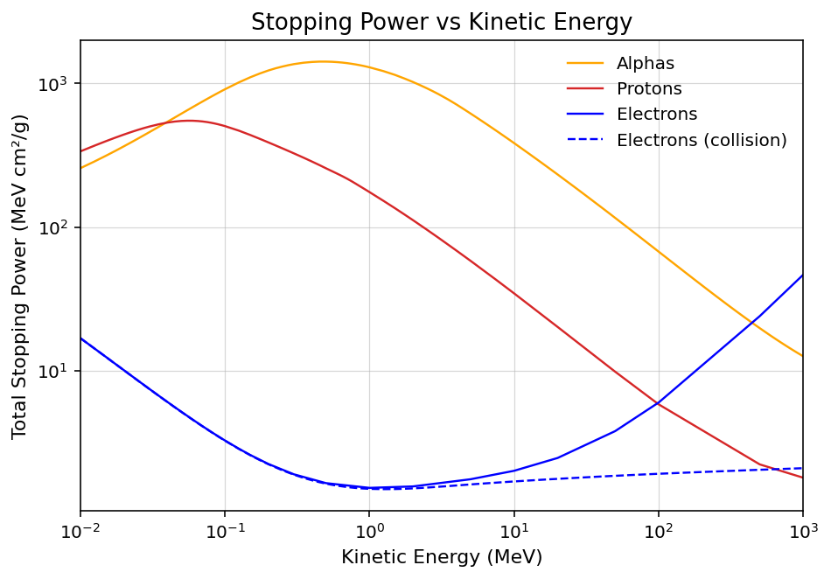
Particle separation
Different particle species can deposit similar energies in silicon detectors;
High-energy protons exhibit stopping powers comparable to electrons;
This superposition leads to particle misidentification in RADEM’s EDH channels creating contaminations;
Illustrated by the overlap in stopping power shown in the figure;
FIGURE 7: Proton(red) and α(orange) particle stopping power in Silicon and electron total, radiative(blue - full line) and collisional(blue- dashed line) stopping power in Silicon. Colored zones refer to the RADEM range for electrons(blue) and protons(red).
5
Notes:
This detectors have some major issues, due to the physical property used to separate different particles, the stopping power.
For example In the case of the EDH this can be especially problematic due to the similar deposited energy of different particles like the high-energy protons, in red in the image having similar Stopping power as the electron range RADEM works with, in blue.
This created two issues:
First, high-energy particles that can penetrate the collimator (bypassing the detector shielding) and be counted as events, hindering energy discrimination.
Second, as said before high-energy protons might be counted as electrons due to their similar stopping power., in both cases creating contaminations

Slide 6
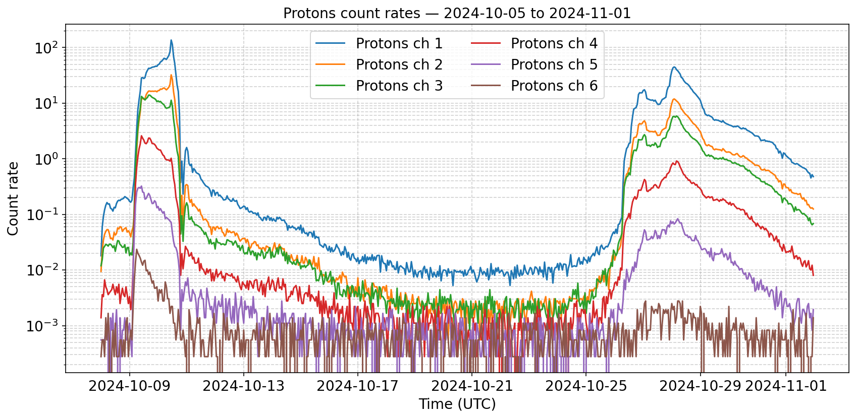
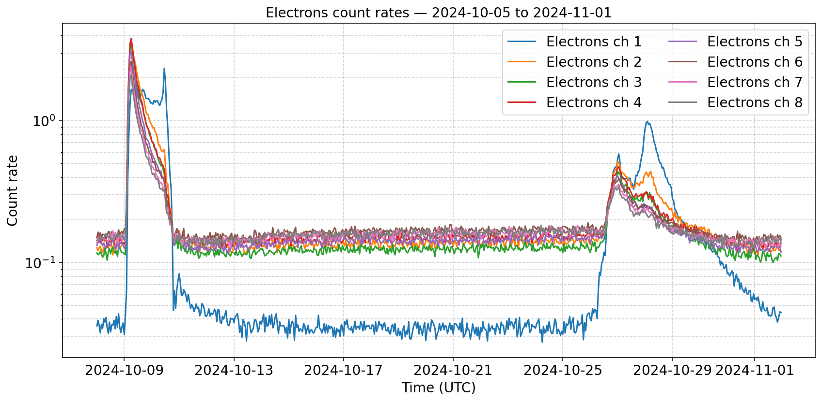
Contaminations in the EDH data
Low-energy EDH channels closely follow proton channels from onset to decay
  Especially evident during the October 10 SEP event
  Indicates strong contamination from protons energetic protons
Higher-energy EDH channels show:
  Much weaker correlation with the proton spectrum
  Faster, near-exponential decay typical of shock-dominated SEP events
  Evidence of being less contaminated
FIGURE 8: Count rates spectrum, from October 2024. All channels of EDH (bottom), the first six channels from PDH (top).
Notes:
Part of my thesis involves searching the extent of the proton contamination in the electron detector data during solar energetic particle events.
Therefore here I have an example of the events I studied:
Where we can that the low-energy EDH channels closely track the higher energy proton channels, both in onset and decay, which is particularly clear during the October 10 SEP event.
This strong correlation indicates that these electron channels are significantly contaminated by energetic protons.
In contrast, the higher-energy EDH channels show a much weaker correlation with the proton spectrum and exhibit a faster, near-exponential decay typical of shock-dominated SEP electrons, suggesting that the higher-energy channels are somewhat less affected by proton contamination and provide a cleaner electron measurement.

Slide 7
Future work
Refine EDH response functions
Optimize trigger thresholds
Improve coincidence masks
Earth flyby September 2026
Increase reliability of particle flux reliability
Improve particle flux reconstruction for JUICE Jupiter operatios
RADEM operation in Jupiter
Uplink the new configuration
Notes:
My future work will involve Optimizing the trigger thresholds, and improve the coincidence masks to refine the EDH response functions so we have a more reliable particle flux in time for the earth flyby in September 2026, with the final objective of having reliable instrument during the JUICE Jupiter operations

Slide 8
Characterization of the interplanetary radiation environment and optimization of the European Space Agency JUICE mission high-energy Electron Detector Head
Author: André Rodrigues
Supervisor: Marco Pinto

Slide 9
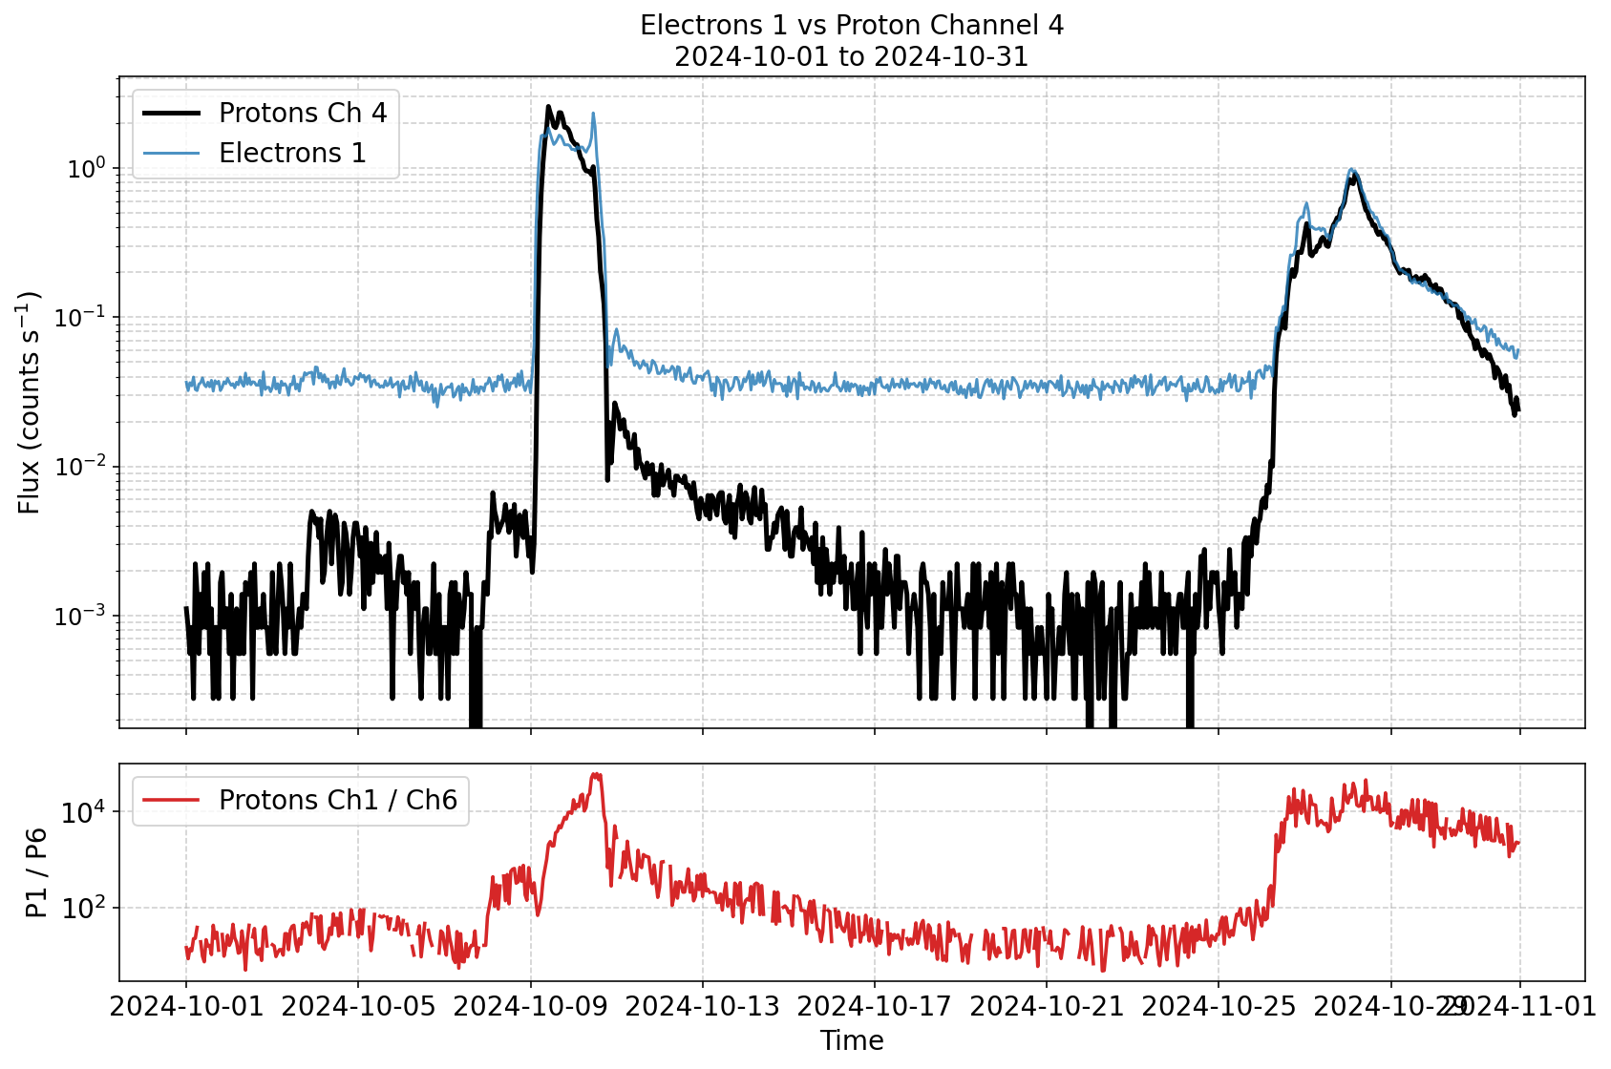
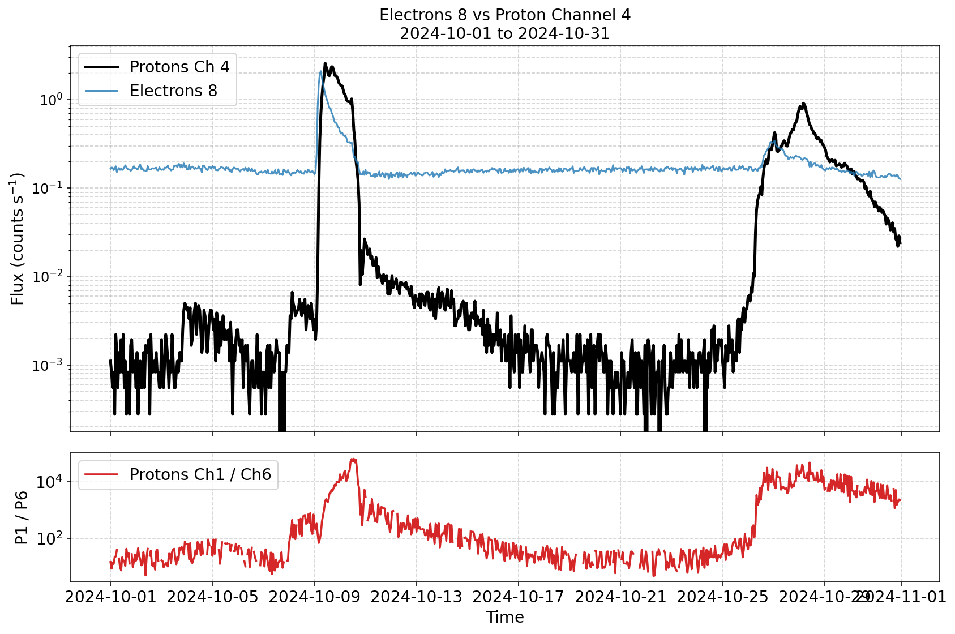
Extra slides

