Slide 1
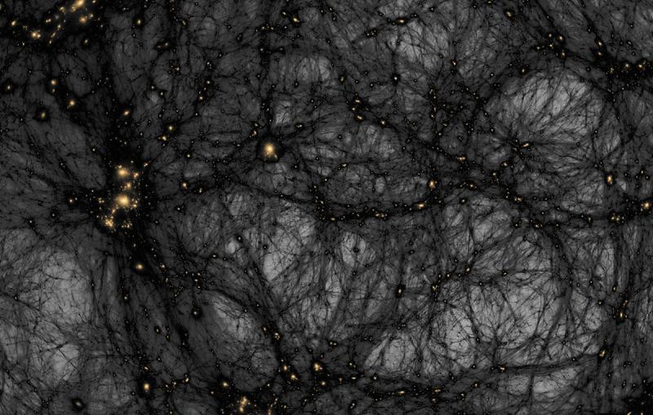

Introduction to Direct Dark Matter Detection
João Marques – Rafael Bento
September 5th, 2025
Ralf Kaehler/SLAC National Accelerator Laboratory, American Museum of Natural History

Slide 2
How do we know Dark Matter exists?
Galaxy cluster’s dynamics
Galaxy Dynamics
Gravitational lensing

Slide 3
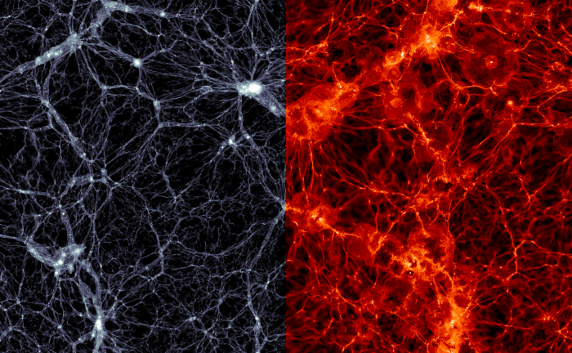
Dark Matter properties:
Doesn’t interact with light or eletromagnetic fields
Has mass
Stable/long-lived
Hot and cold dark matter
http://apod.nasa.gov/apod/ap060824.html
https://phys.org/news/2016-08-dark-matterhot.html

Slide 4
The candidate we are studying
WIMP- Weakly Interacting Massive Particles
Stable heavy particles
Cold dark matter
Mass range ~1 GeV to ~100 TeV
Computer simulation of large structure formation in the Universe using Cold Dark Matter

Slide 5
WIMP miracle
n → p + e- + 𝝂
The weak scale
The Fermi constant(10^(-5) GeV^2)
New particles at the weak scale
Thermal freeze-out
Production and annihilation rate
Universe expansion
Source: LZ Dark Matter Experiment Website

Slide 6
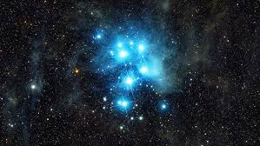
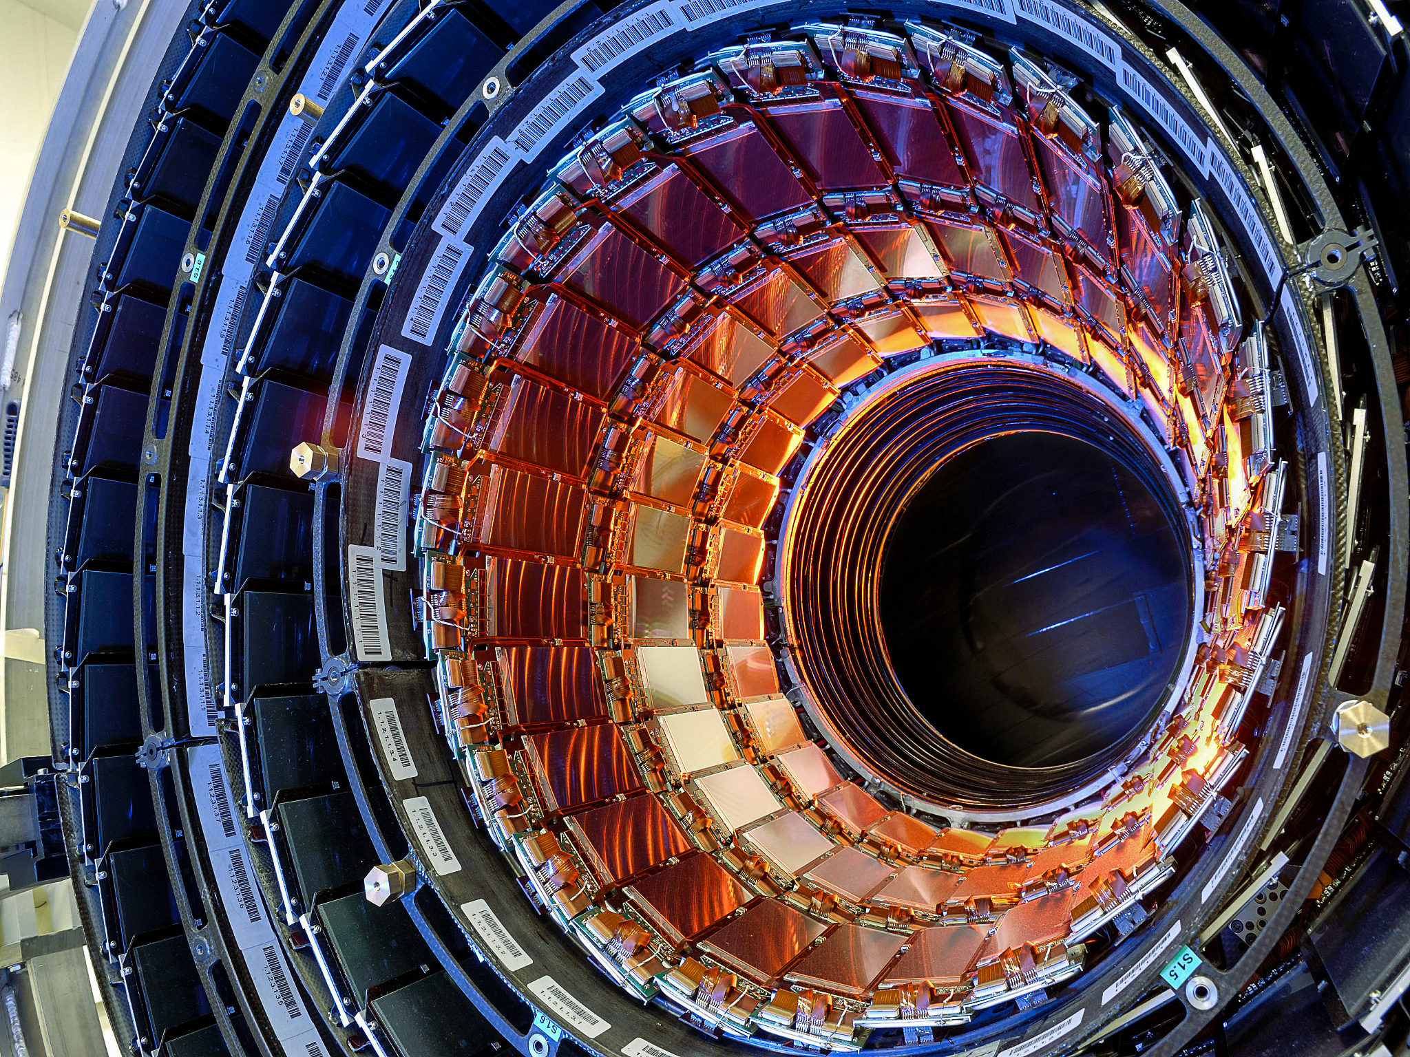
Dark Matter detection
Indirect detection
Direct detection
Particle accelerators
Decays
Annihilations
Scattering
Interactions with baryonic matter
https://www.science.org/do/10.1126/science.aaa7867/full/sn-lhc-1710956803707.jpg
https://www.youtube.com/watch?v=xjNgOnYJwIw

Slide 7
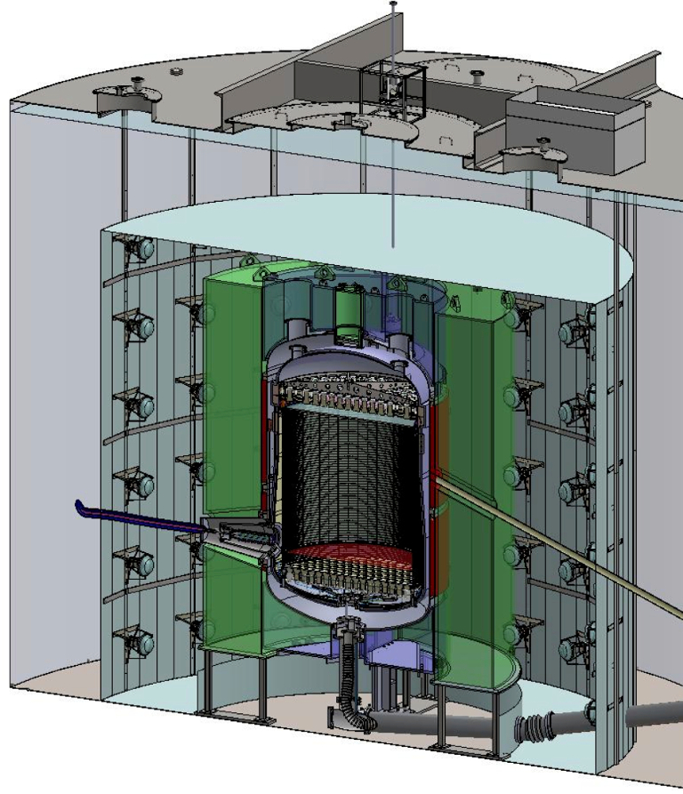
LZ detector
2-phase xenon time projection chamber
Shielding and ventoing
Installed underground
Low threshold
ER and NR discrimination
https://newscenter.lbl.gov/2017/02/13/next-gen-dark-matter-detector-race-finish-line/
Source: LZ Dark Matter Experiment Website

Slide 8
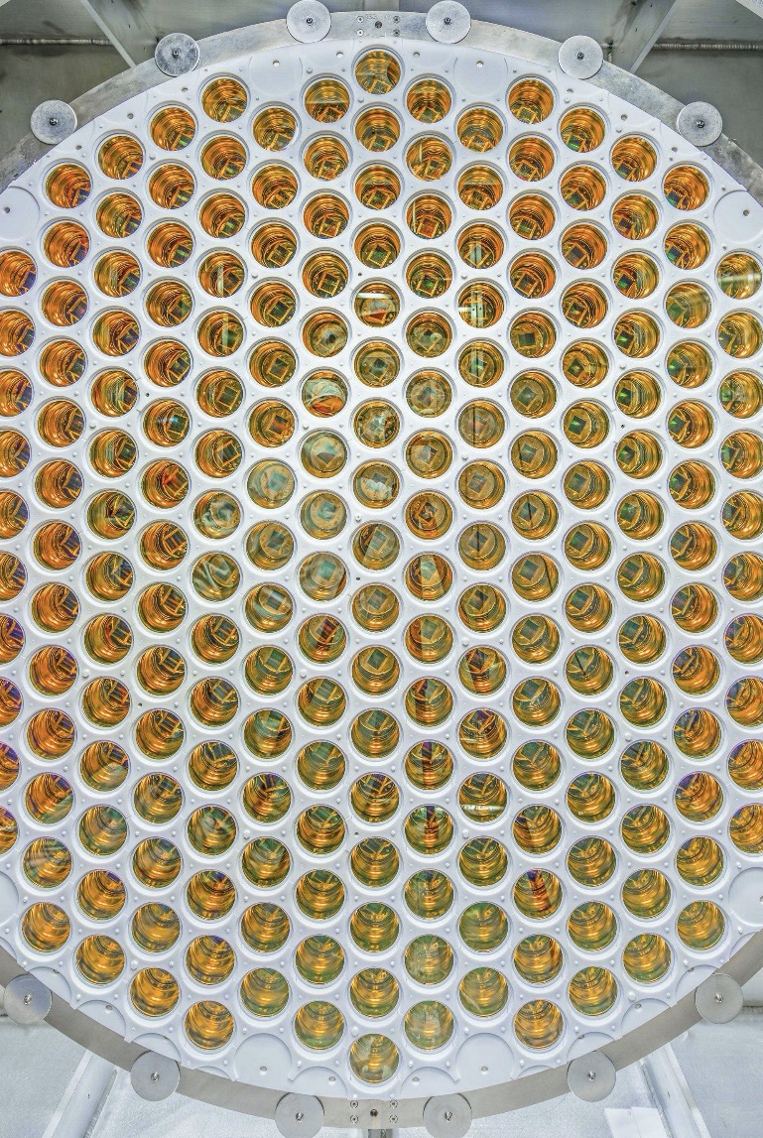
Case studied
Considering a detector that works in a similar way to LZ
We were looking for nuclear recoils caused by wimps in the energy range of 5 to 50 KeV
The expected interactions in our region were 1.5 and we observed 4 interactions
Source: LZ Dark Matter Experiment Website

Slide 9
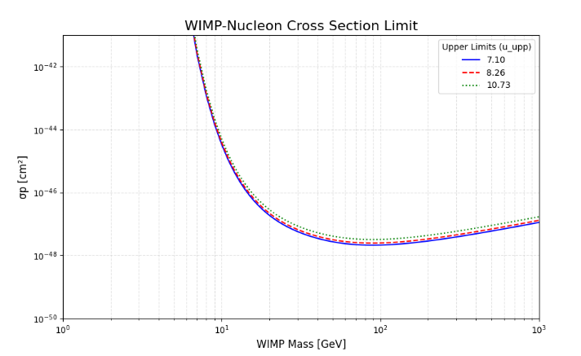
Plot

Slide 10
Question?
João Marques – Rafael Bento
September 5th, 2025

Slide 11
Acknowledgments
LIP Internship Program
Dr. Alenxandre Lindote and Dr. Paulo Brás, for mentorship
The Dark Matter Group at LIP
Thank you for your attention!
João Marques – Rafael Bento
September 5th, 2025

