Slide 1
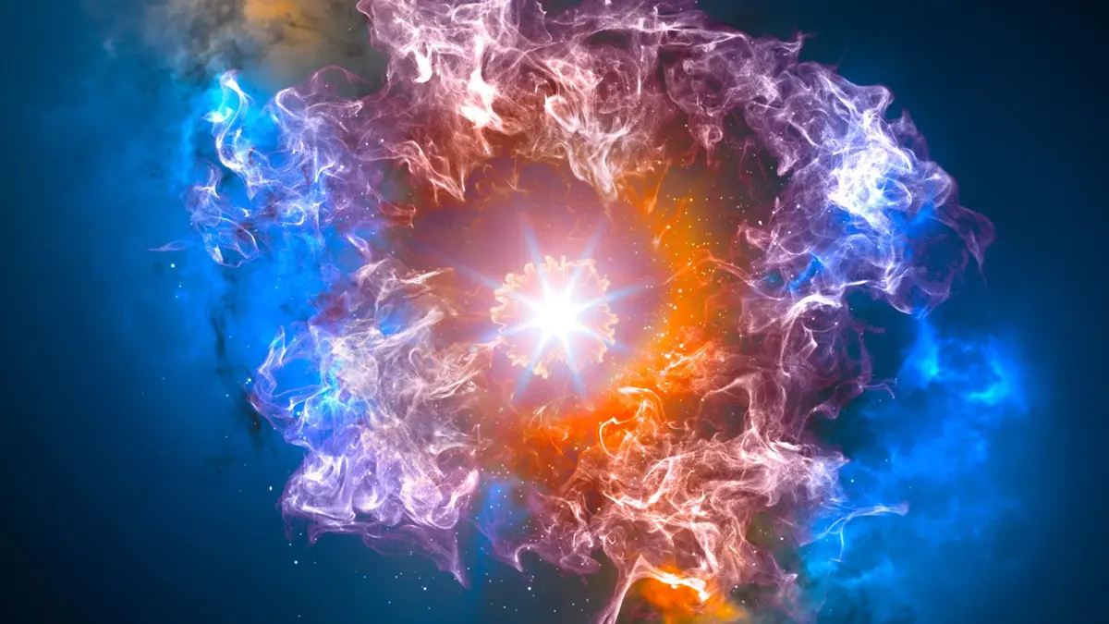

Resolving the Fundamental QCD Degrees of Freedom
LIP Internships 2025
Work by: Dilan Premgi and Carolina Batista
Supervised by: Liliana Apolinário e Nuno Olavo Madureira

Slide 2
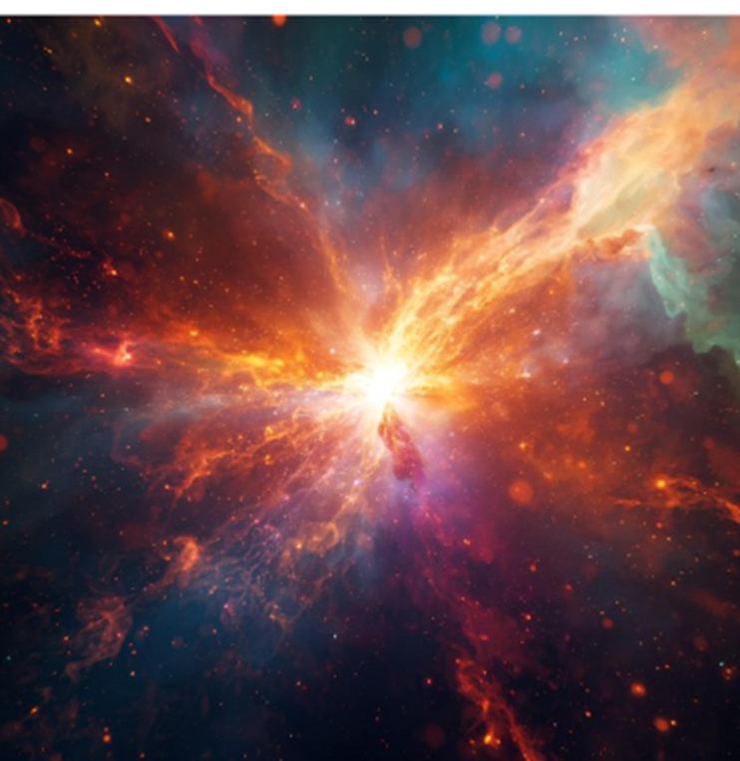

Motivation – What is QGP?
LIP Internships 2025
It's a state of matter which:
  Is asymptotically free for short distances;
  Behaves like a fluid at large distances.
Proposed in the late 1970s.
Experimentally produced in the 2000s by Super Proton Synchrotron (SPS) at CERN.
It was the first complex matter to form in the Early Universe.
It is extremely short lived, but also extremely dense and hot.

Slide 3
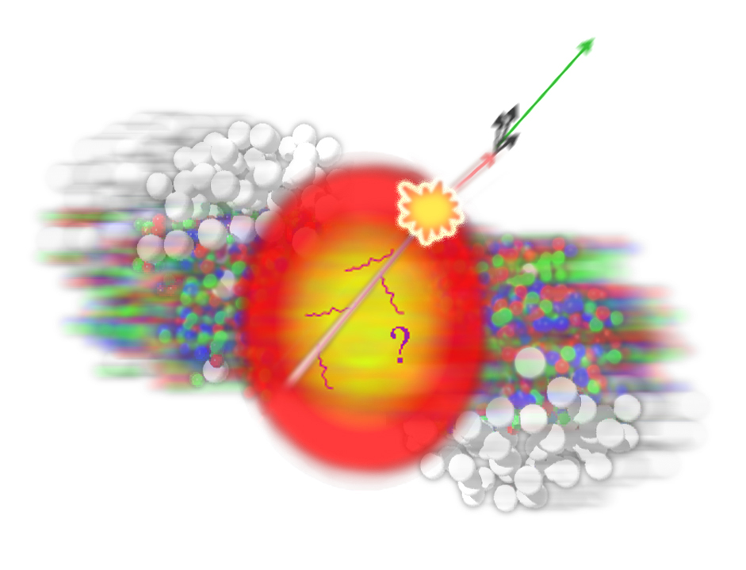
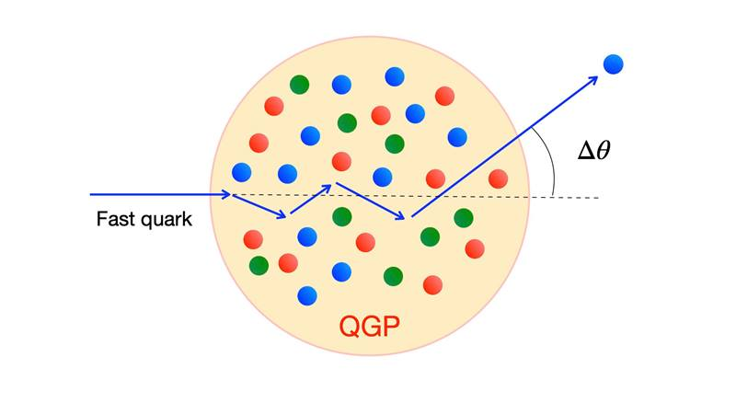
Motivation – Heavy Ions
LIP Internships 2025
QGP was first formed with collisions.
Needs extreme densities (higher than of the atomic nuclei).
QGP needs high energies:
  ~ 200 GeV for Relativistic Heavy Ion Collider (RHIC).
  ~ 5.5 TeV at the Large Hadron Collider (LHC).
At CERN they were produced via collision of heavy Ions (like Pb-Pb).

Slide 4
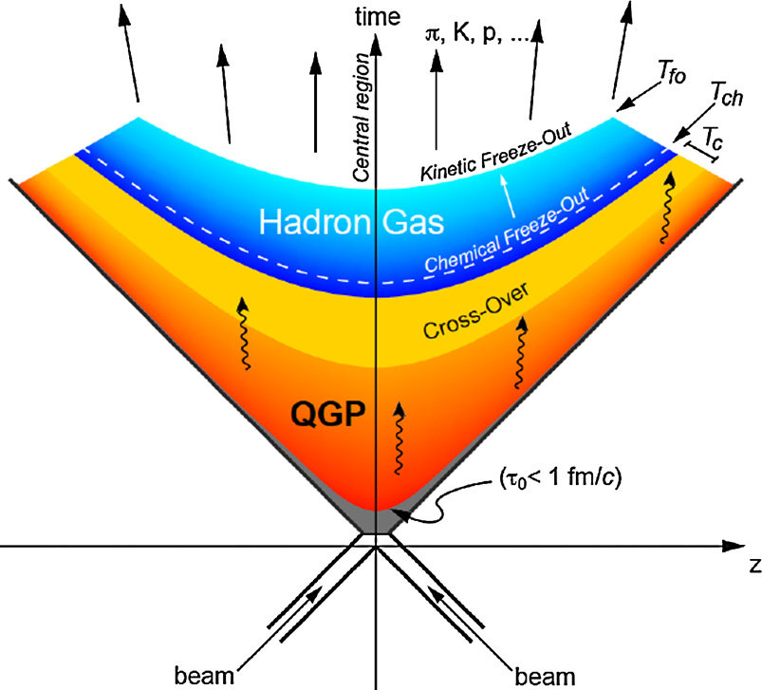
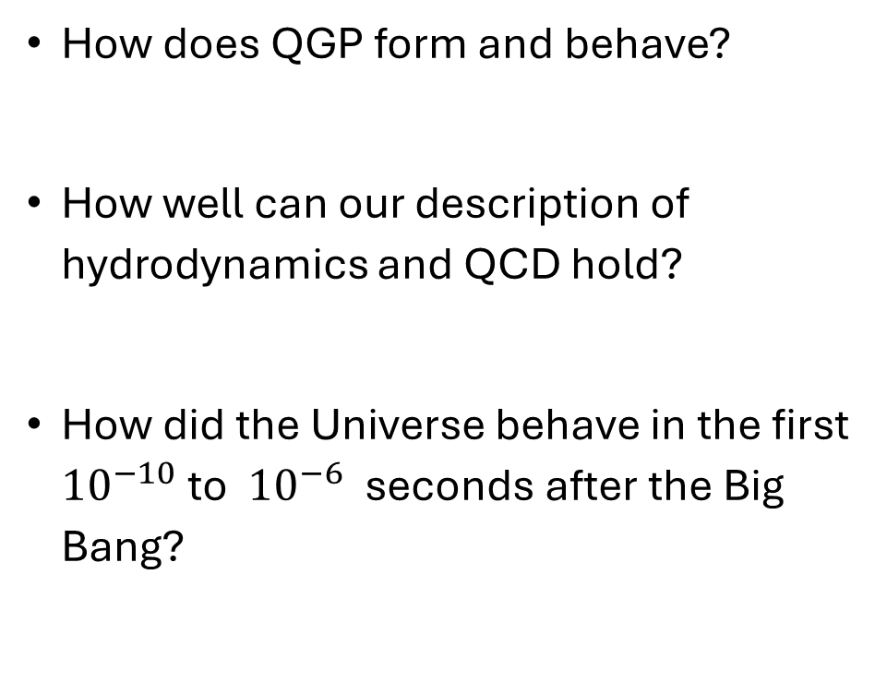
Motivation – Open Questions
LIP Internships 2025
How does QGP form and behave?
How well can our description of hydrodynamics and QCD hold?
How did the Universe behave in the first ${10}^{−10}$ to ${10}^{−6}$ seconds after the Big Bang?

Slide 5
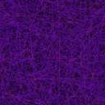
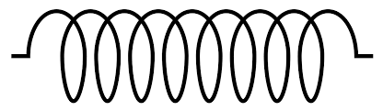


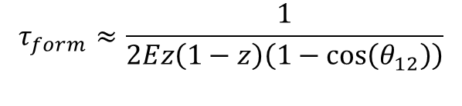

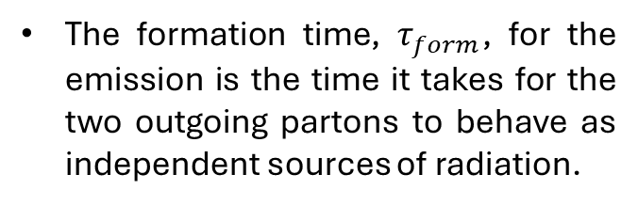









Formation Time
LIP Internships 2025
$$τ_{form}≈\frac{1}{2Ez\left(1−z\right)\left(1−\cos\left(θ_{12}\right)\right)}$$
$$q$$
$$z$$
$$E$$
The formation time, $τ_{form}$, for the emission is the time it takes for the two outgoing partons to behave as independent sources of radiation.
$$θ_{12}$$
g
$$\overline{q}$$
$$(1−z)$$
$$E$$
$$θ_{12}$$
$z$=0.5
$$τ_{form}$$
$E$ – Energy of the incoming “Parent” parton
$z$ – Fraction of energy of the softest outgoing “Child” parton
$θ_{12}$ – Emission angle between the two outgoing partons
$z$=0.2

Slide 6


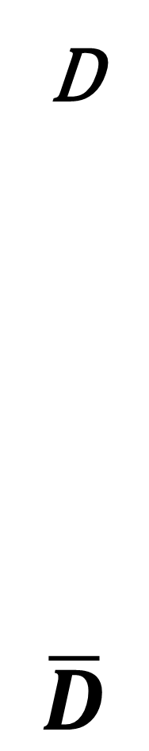



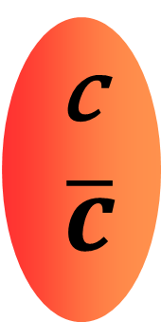



Formation Time- Experimental Motivation
LIP Internships 2025
Experimentally, we only have access to the products of hadronization.
Importance of heavy quarks:​
  Produced early​;
  Easier to tag​;
  Probe the structure of the medium.
Hadronization
g
q
$D\overline{D}$ are mesons with one charm/anti-charm quark

Slide 7
HOW TO STUDY?
LIP Internships 2025

Slide 8
HOW TO STUDY?
LIP Internships 2025
Simulations

Slide 9


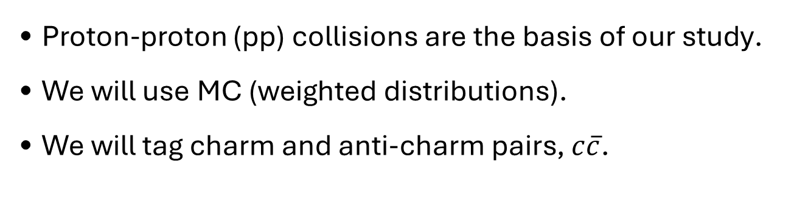
HOW TO STUDY?
LIP Internships 2025
Type: Monte Carlo
Software: Pythia 8.3
SoftDrop: $z=\left[0.2, 0.5\right]$
Jet radius: 0.4
Jet pT > 200 GeV
Simulations
Proton-proton (pp) collisions are the basis of our study​.
We will use MC (weighted distributions)​.
We will tag charm and anti-charm pairs, $c\overline{c}$.

Slide 10
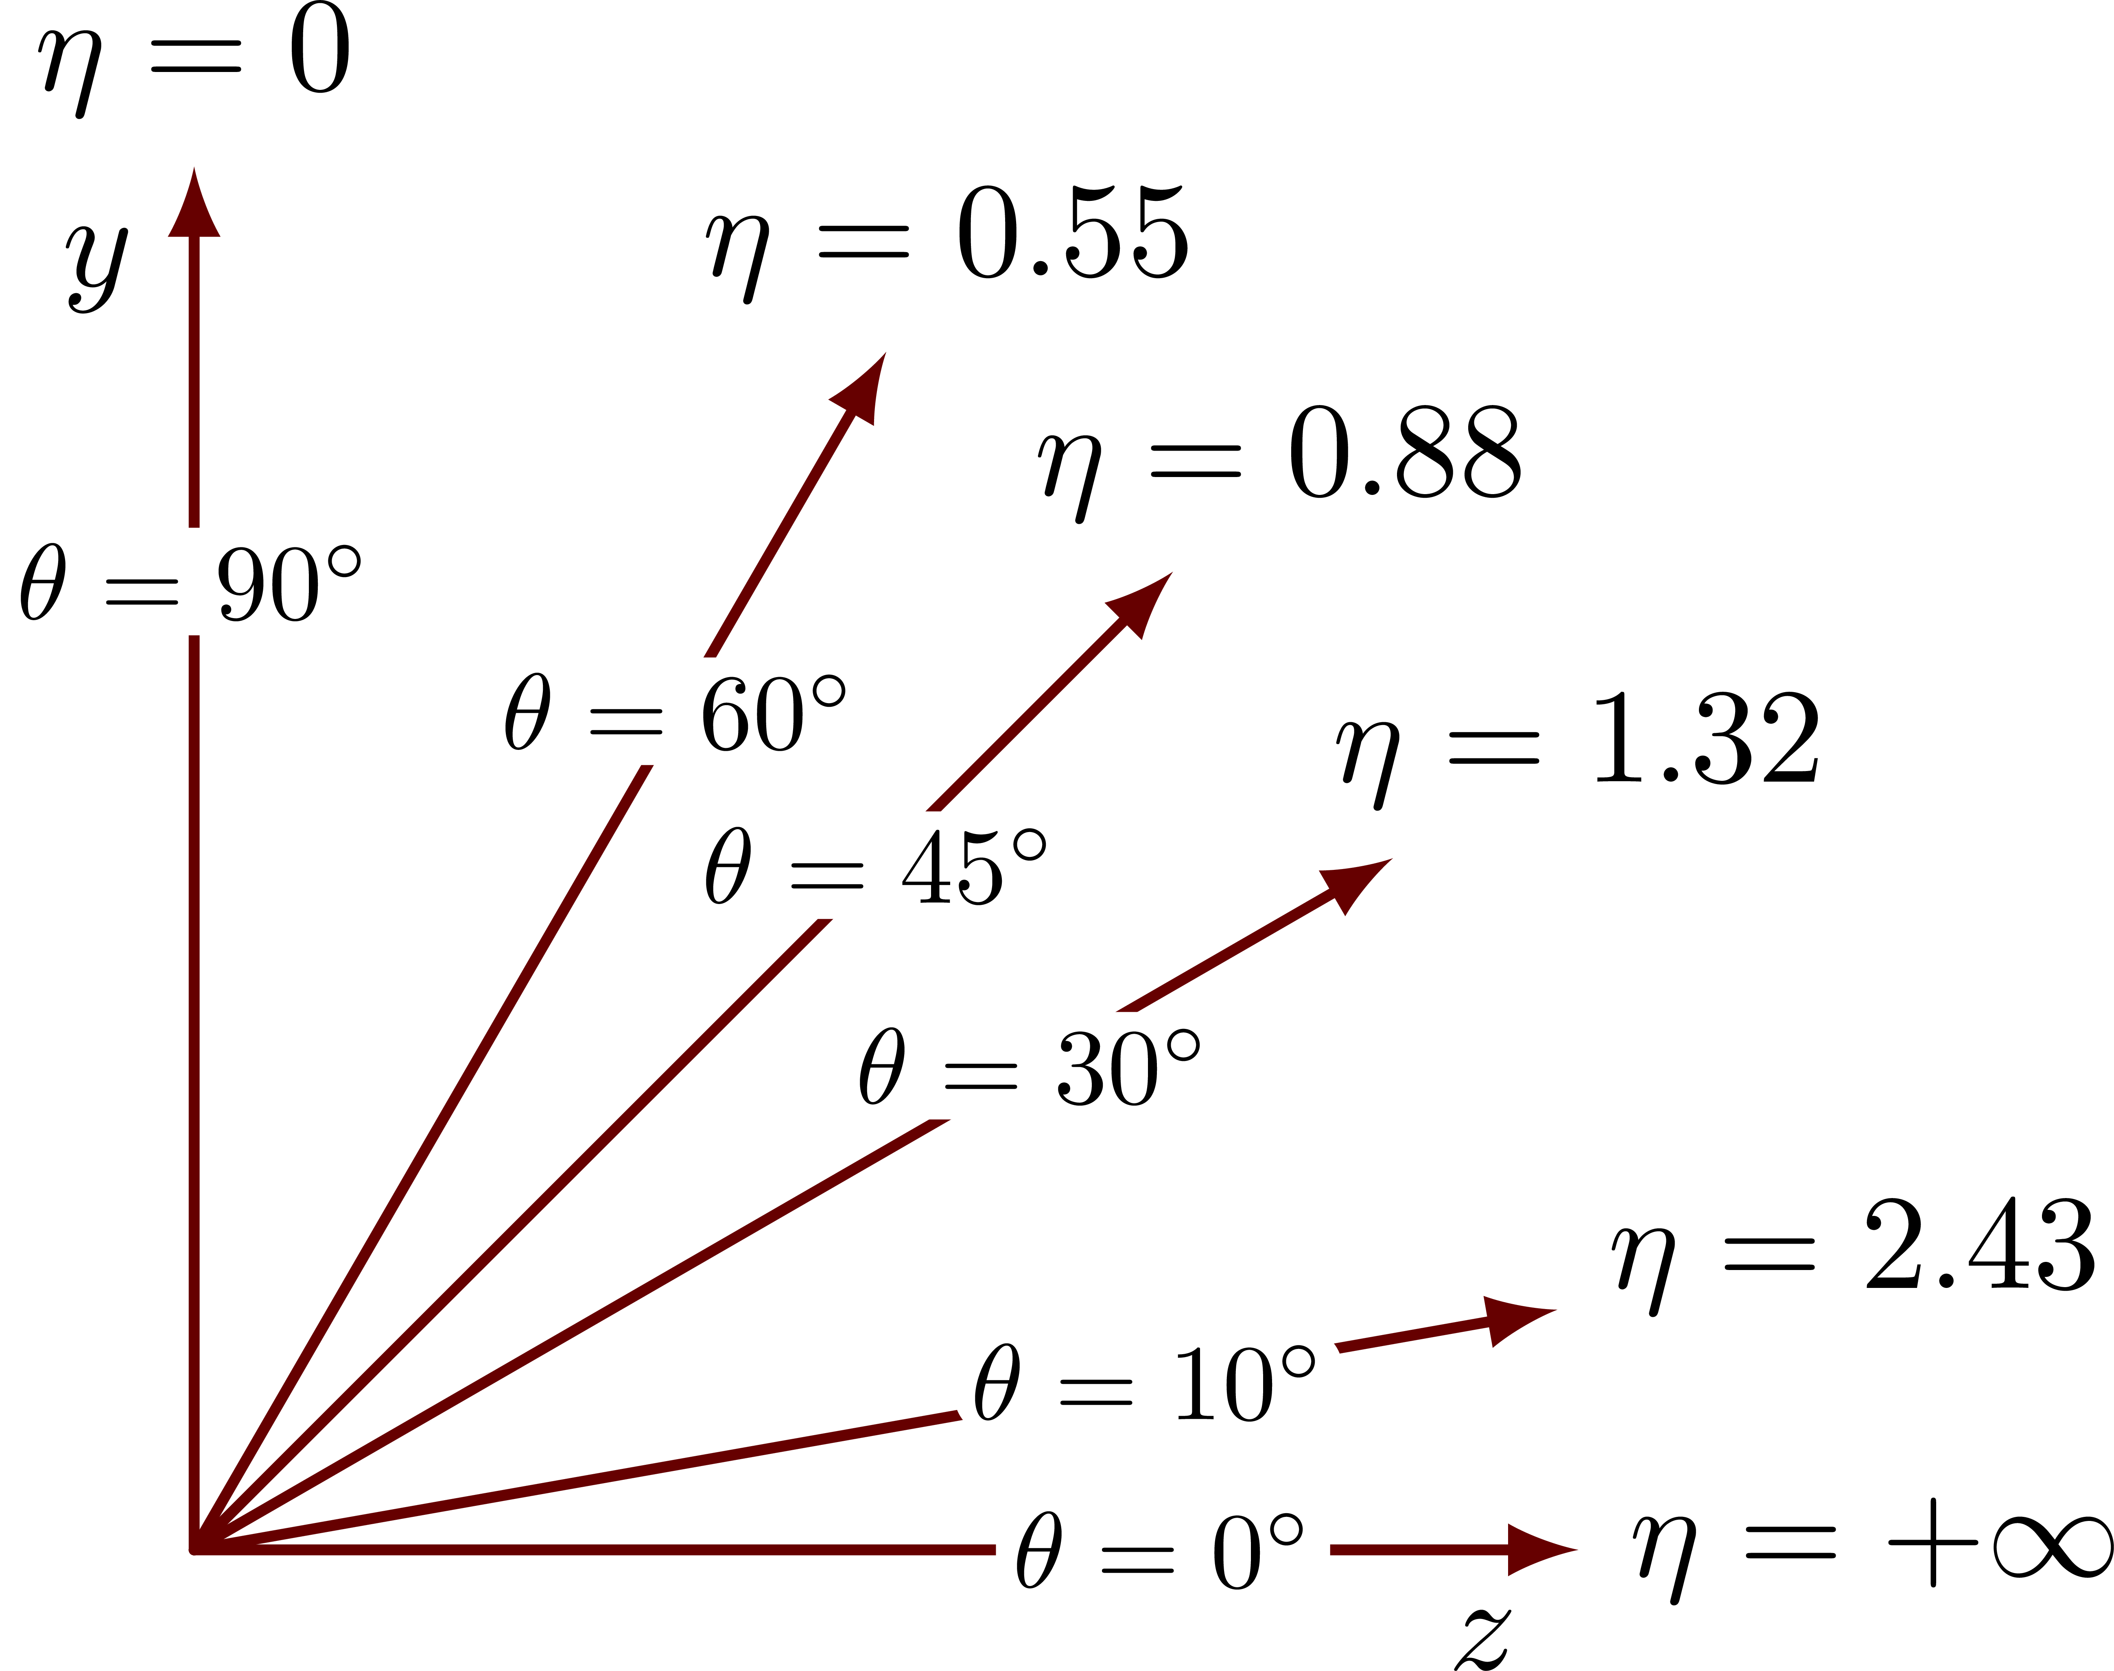
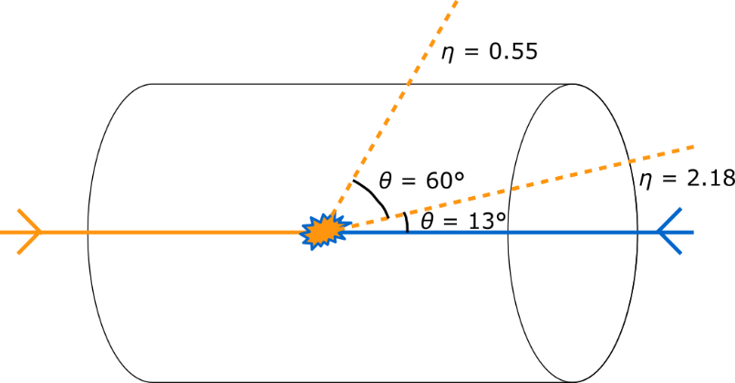



Jets – What are Jets?
LIP Internships 2025
The resulting structure from quark or/and gluon fragmentation and hadronization (i.e. collimated spray of energetic hadrons).
p
Jet pT
Hadronization
g
$$y$$
q
p
$$z$$
$$τ_{form}$$

Slide 11
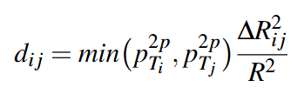




Jets – Clustering/Reclustering
LIP Internships 2025
Clustering Method with Anti-kt Method
Reclustering Method with C/A
$$(p=−1)$$
$$(p=0)$$
φ
Pt [GeV]
φ
Pt [GeV]
Step 4
η
Step 4
η
Step 3
Step 3
Step 2
Step 2
Step 1
Step 1
t
t
Good for identifying the Jet
Good for reconstructing the Jet

Slide 12
HOW TO STUDY?
LIP Internships 2025
MC (weighted distributions)
Clustering (Jets)
Reclustering

Slide 13
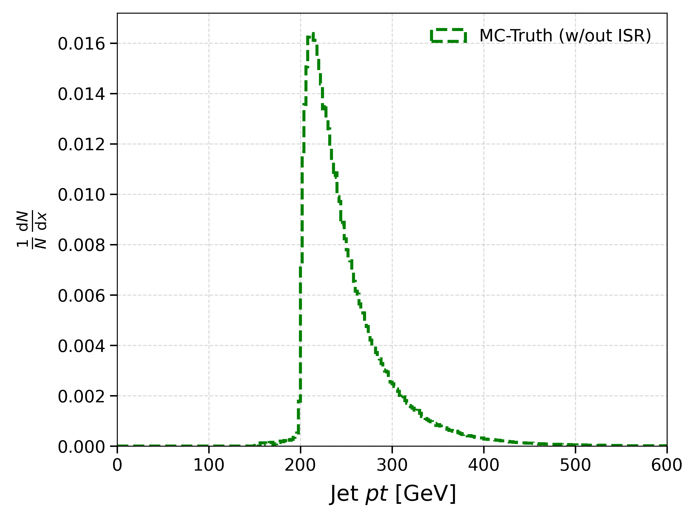
Parton Level
LIP Internships 2025
Note: Jets Start at 200 GeVs
Jet without Initial State Radiation
Doesn't Include Hadronization
Only Parton-Level
g
q

Slide 14
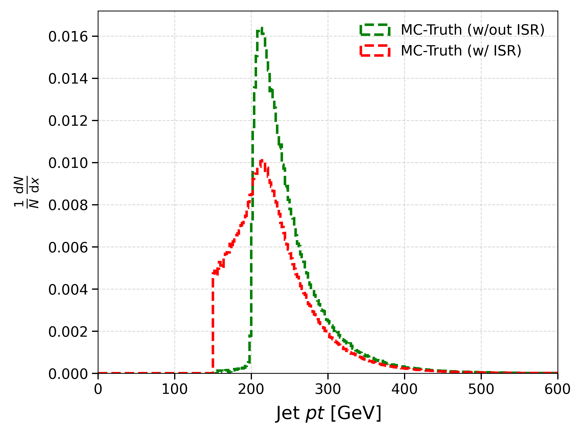

Parton Level
LIP Internships 2025
Initial State Radiation (ISR)
Radiation prior to particle collision (i.e. external partons interfering with the jet)
Includes ISR:
Initial State Radiation (ISR)
g
q

Slide 15
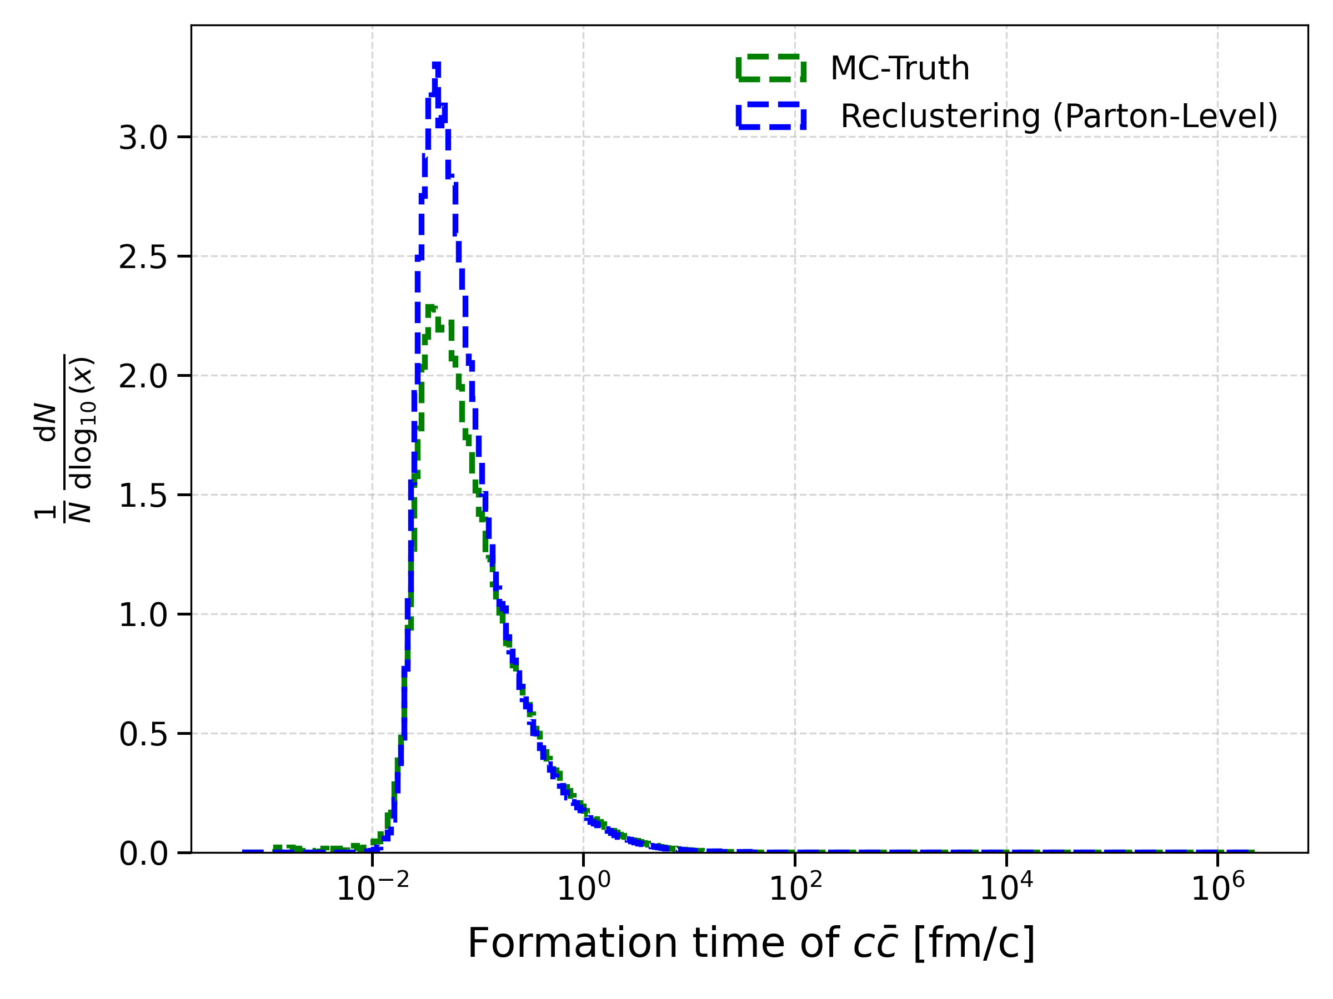

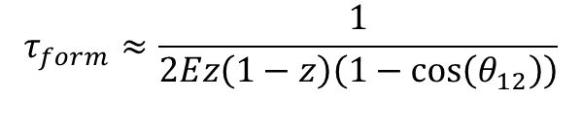
Formation Time – Parton Level
LIP Internships 2025
$$τ_{form}≈\frac{1}{2Ez\left(1−z\right)\left(1−\cos\left(θ_{12}\right)\right)}$$
We can reproduce the Monte Carlo's distribution with the Reclustering;
(With ISR)
$$τ_{form}$$
Jet pT
q
Range Values indicate Slow and Fast Processes;
Similar Averages;
Parton Level is the Simplest case (not realistic).

Slide 16
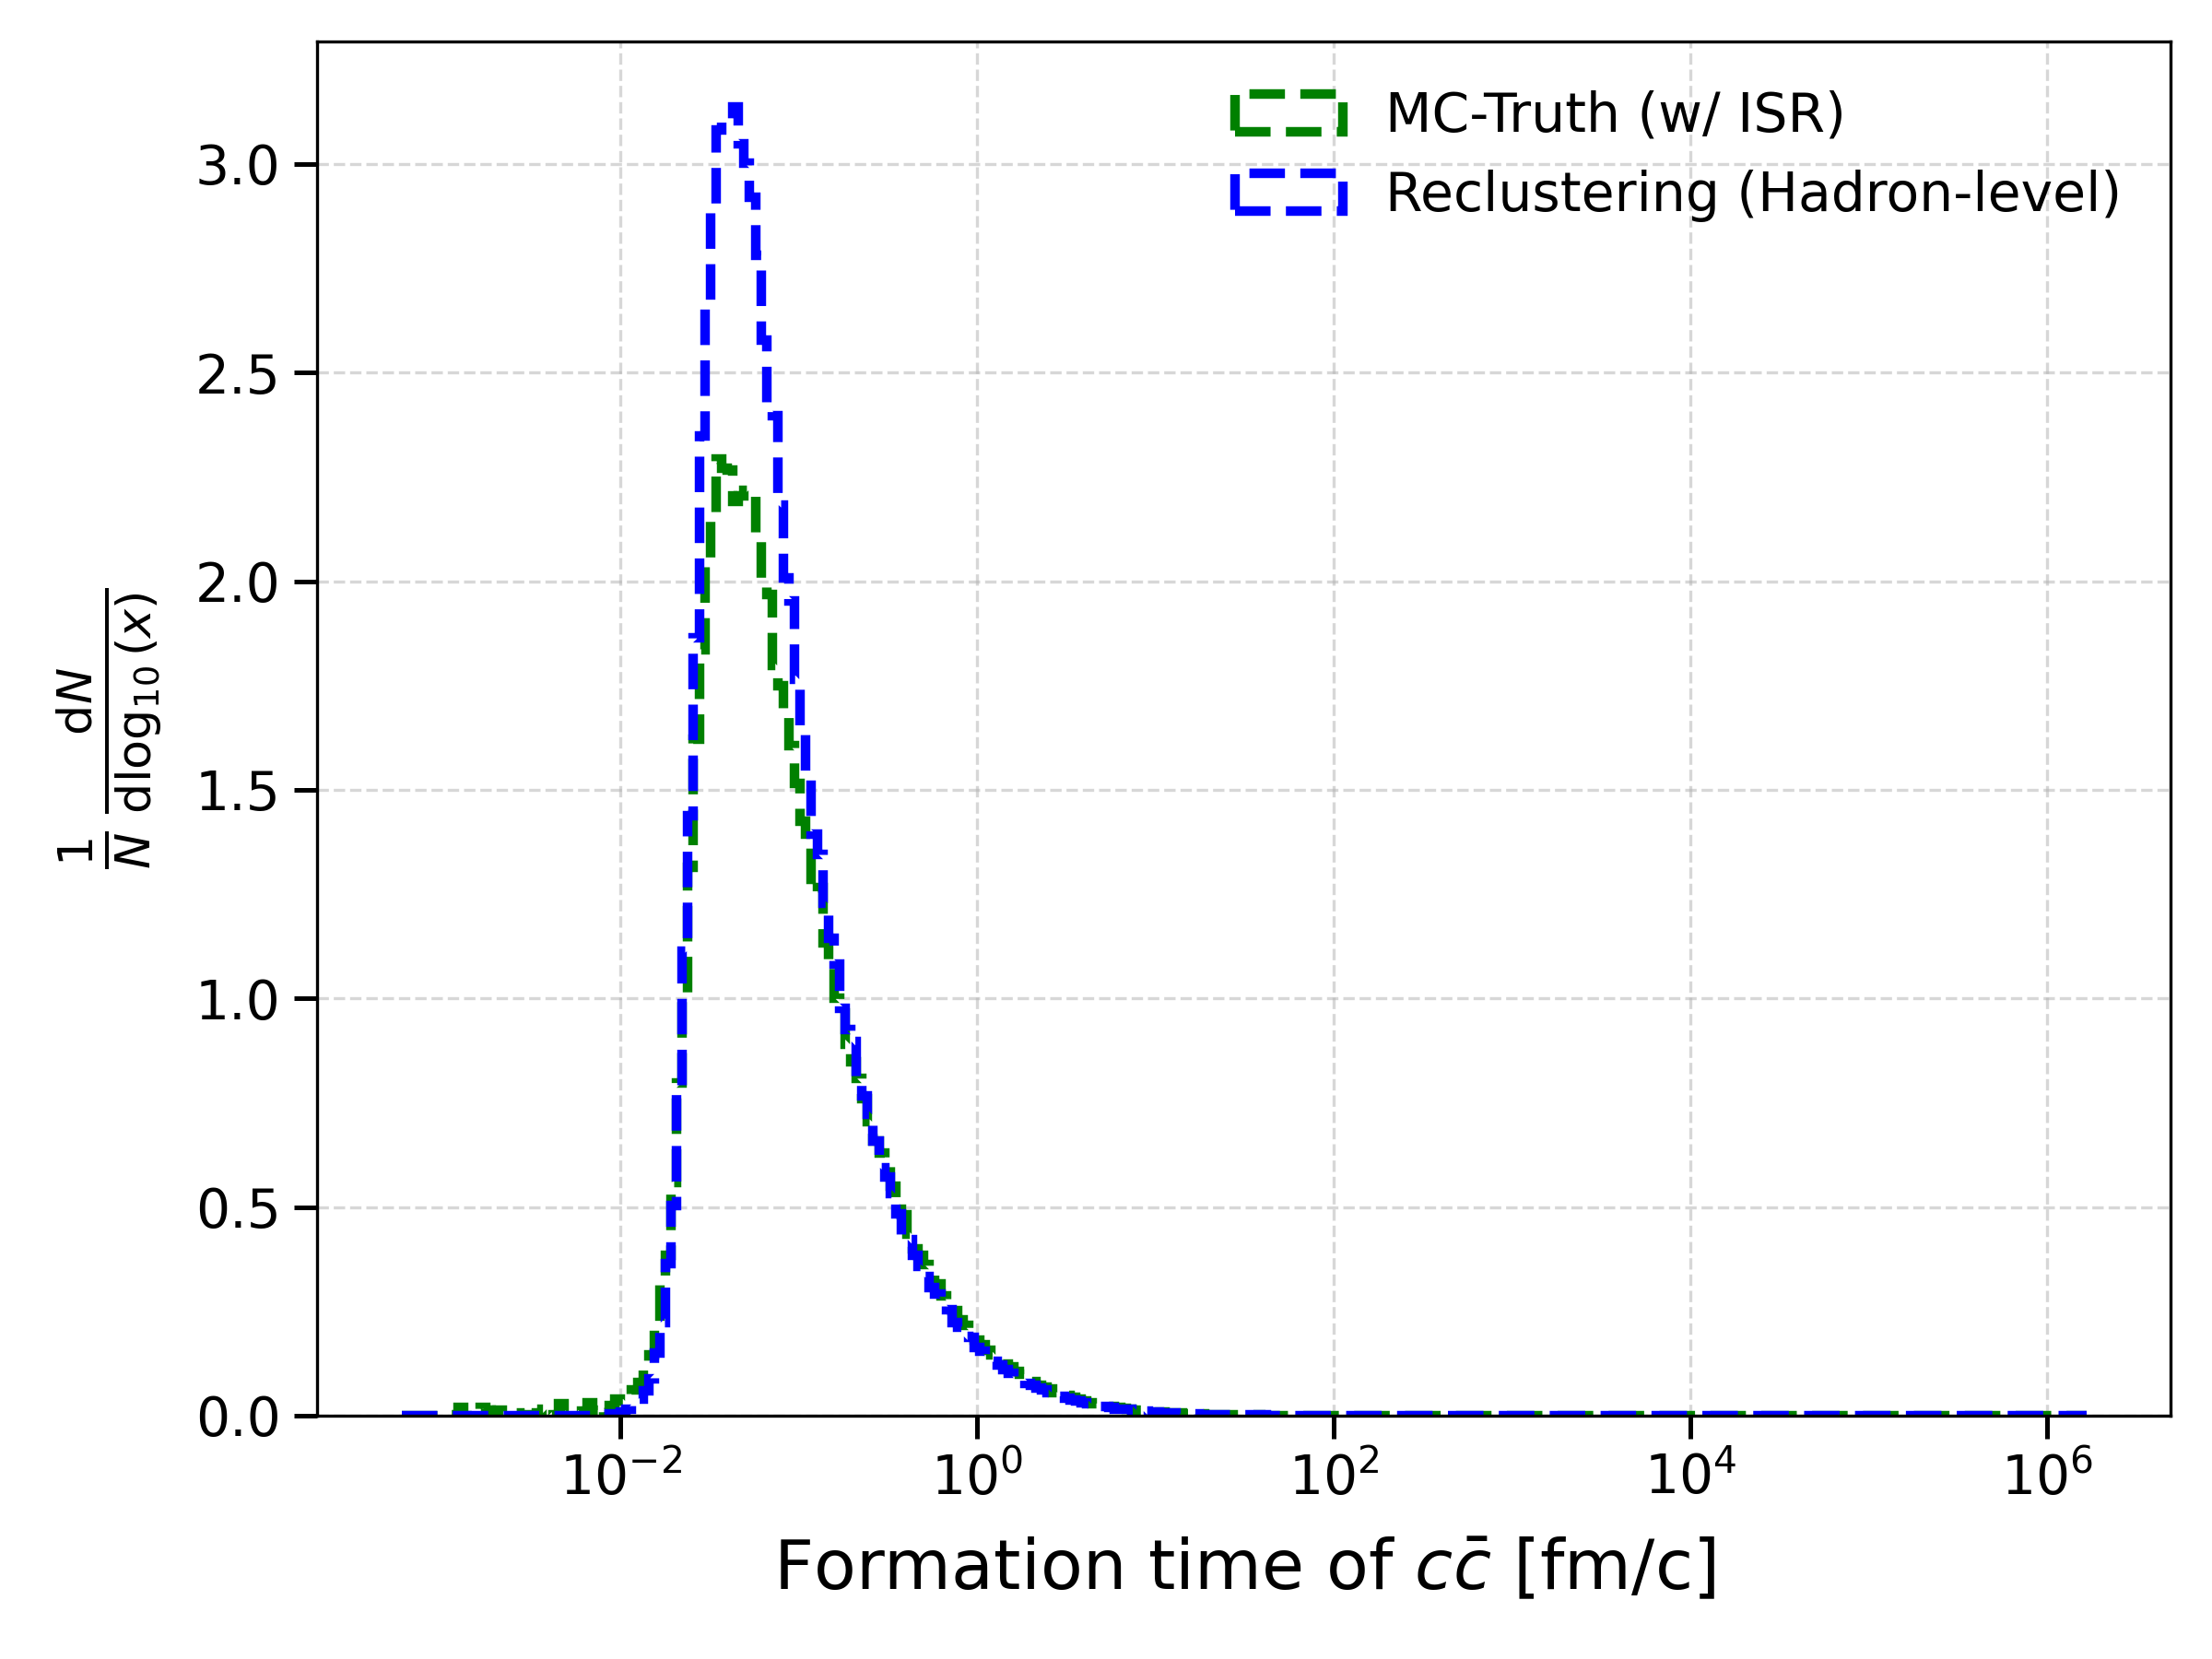
Formation Time – Hadron Level
LIP Internships 2025
Even with Hadronization, our Reclustering Model stands strong!
(With ISR)
ISR
Hadronization
g
q

Slide 17
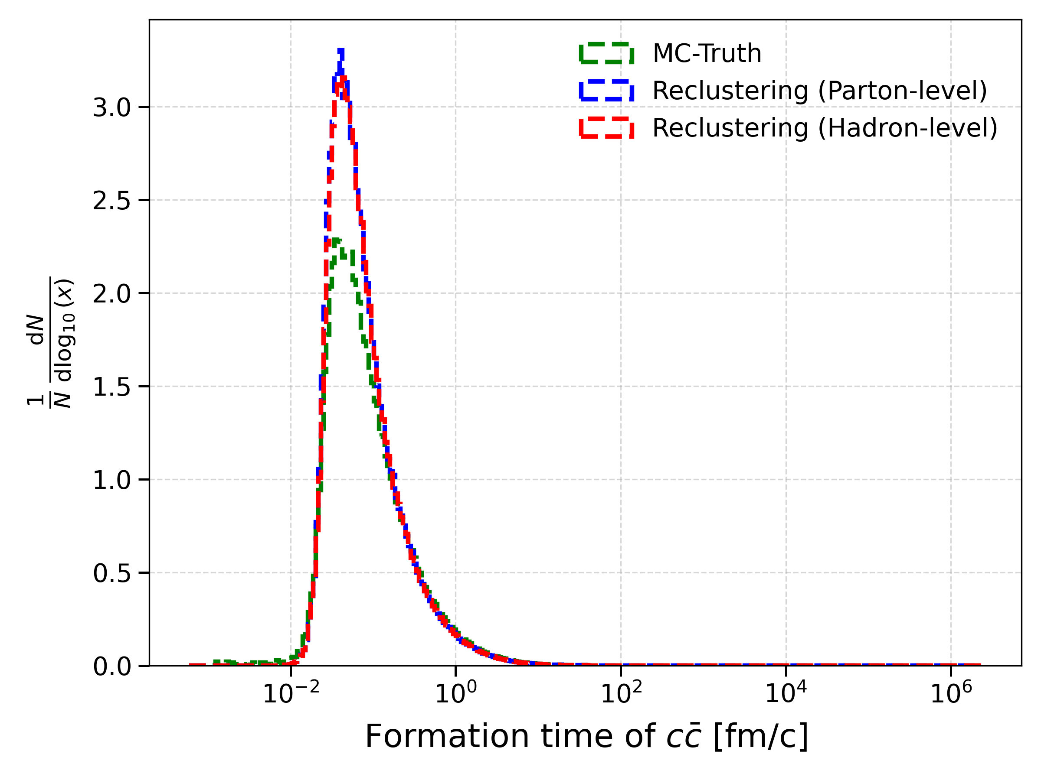
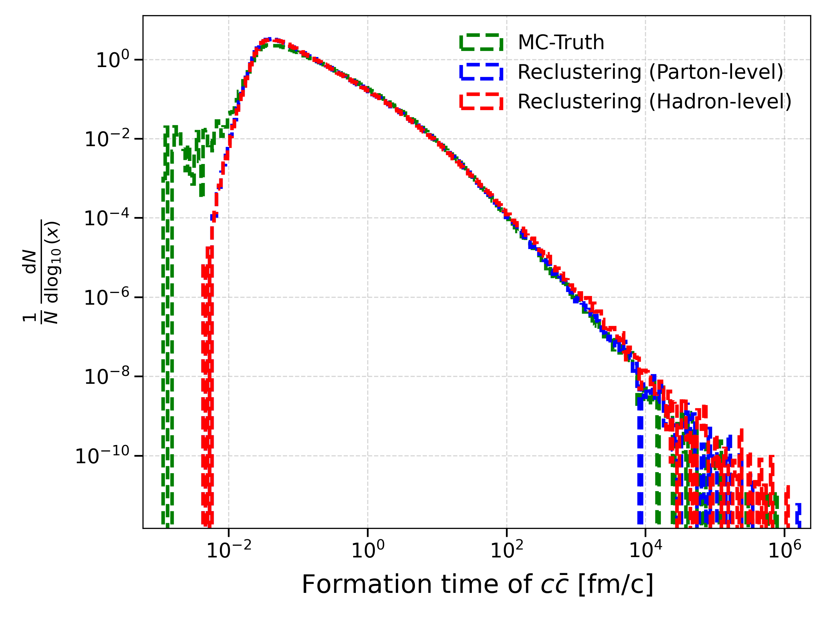
Formation Time – Comparison
LIP Internships 2025
We can reproduce the Monte Carlo's distribution with the Reclustering in both levels: Parton and Hadron.
(With ISR)

Slide 18
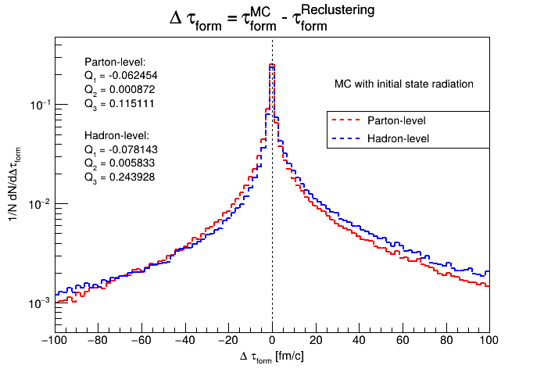
Formation time differences
LIP Internships 2025
Ideally, both distributions should be centered at zero with a narrow shape.
There’s a tendency for MC to present larger values for time formation at hadron-level.
Contradicting results?
No!

Slide 19
Formation time differences
LIP Internships 2025
Distribution shape vs Data correlation

Slide 20
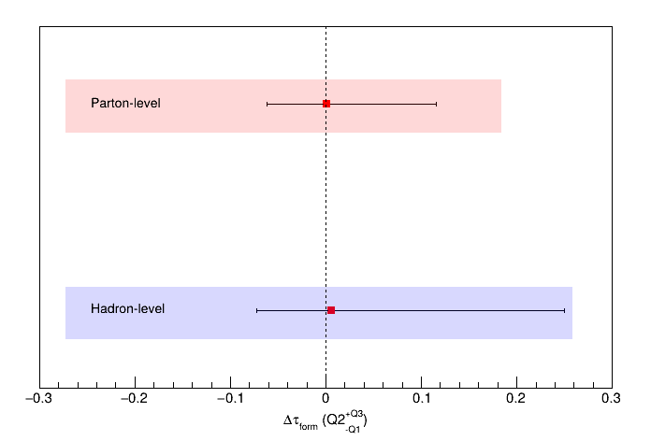
Quantiles
LIP Internships 2025
Larger formation times are more affected by both the parton shower and hadronization.
Lack of models to describe hadronization.

Slide 21
Conclusions
LIP Internships 2025
The Reclustering method used shows a good performance in estimating formation time (gluon to ccbar) for p-p collisions with a parton shower and hadronization.
Methods have a slightly lower performance for hadronization, with a lower correlation for larger formation times.
However, it still gives an accurate description of MC's distribution.

Slide 22
Conclusions – Future Work
LIP Internships 2025
Study performance of both clustering and reclustering methods for Pb-Pb collisions (i.e. jet formation with medium);
Test jet reconstruction in p-p collisions for other reclustering methods.

Slide 23
References
LIP Internships 2025
C. Bierlich et al., A comprehensive guide to the physics and usage of PYTHIA 8.3, SciPost Phys. Codebases 8 (2022). [arXiv:2203.11601]
L. Apolinário, Exploring the time axis within medium-modified jets, Eur. Phys. J. C 82, 244 (2022). [arXiv:2111.05794]
W. Busza, K. Rajagopal, W. van der Schee, Heavy Ion Collisions: The Big Picture, and the Big Questions, Ann. Rev. Nucl. Part. Sci. 68, 339–376 (2018). [arXiv:1802.04801
L. Apolinário, Y-J. Lee, M. Winn, Heavy quarks and jets as probes of the QGP, Prog. Part. Nucl. Phys. 127, 103990 (2023). [arXiv:2203.16352]
L. Apolinário, A. Cordeiro, Time reclustering for jet quenching studies, Phys. Rev. D 106, 074006 (2022). [arXiv:2207.10640]
G. P. Salam, Towards Jetography, Eur. Phys. J. C 67, 637–686 (2010). [arXiv:0906.1833]

Slide 24
Extra Slides
LIP Internships 2025

Slide 25
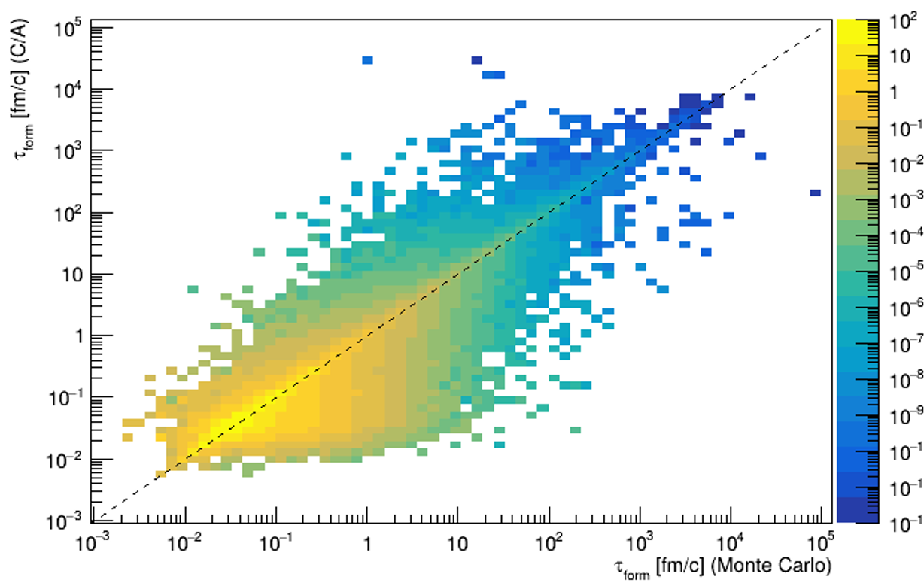
LIP Internships 2025
Formation time - Correlation
Lower correlation for larger formation times.

Slide 26
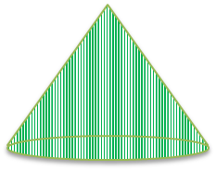





LIP Internships 2025
Soft Drop
Pt [GeV]
Technique in high-energy physics to remove weak, wide-angle radiation from jets for analysis

Slide 27


Formation Time - Boosts
LIP Internships 2025
Pt [GeV]
A frame
B frame
A
B
Lab frame
B
A
Formation times in lab frame

