Slide 1
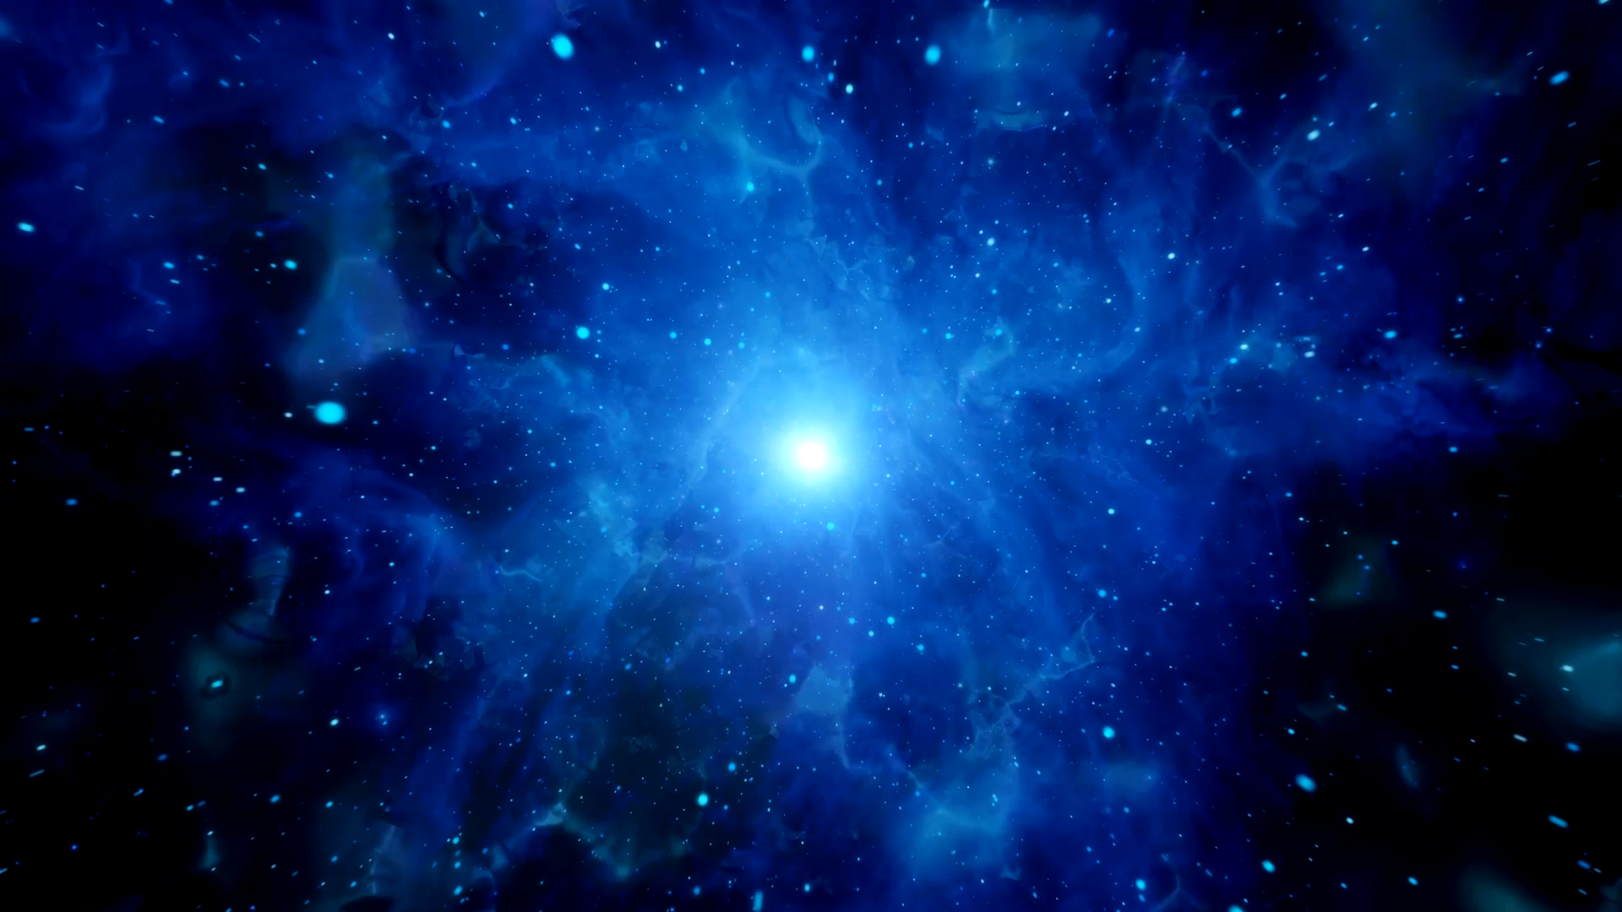



Radiation Environment in Space
Luisa Arruda
luisa@lip.pt

Slide 2
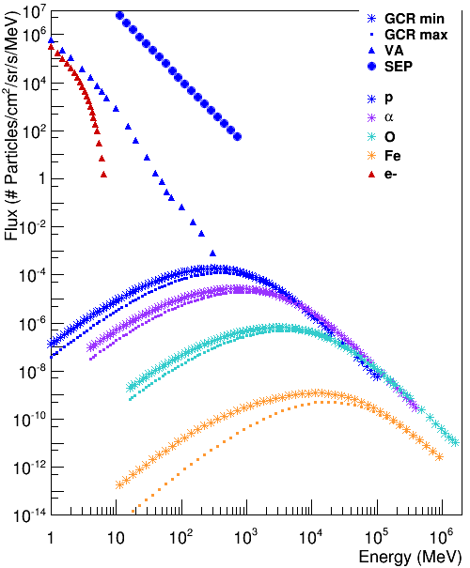
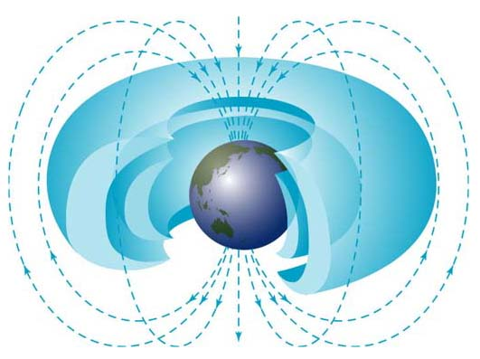
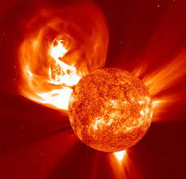
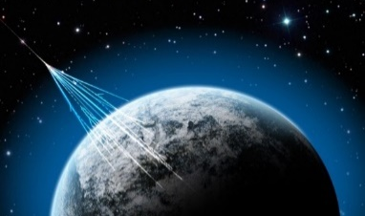

Space Radiation Environment
Van Allen
Radiation Belts
SEP event
Protons and electrons
AP-8 and AE-8 models
Galactic Cosmic
Radiation (GCR)
Protons
Integrated 14 day SEP event of December 2006
p, $α$, O and Fe
ISO 15390
Solar min: 30 Jan 2009
Solar max: 30 Jan 2014
1 AU from Earth

Slide 3
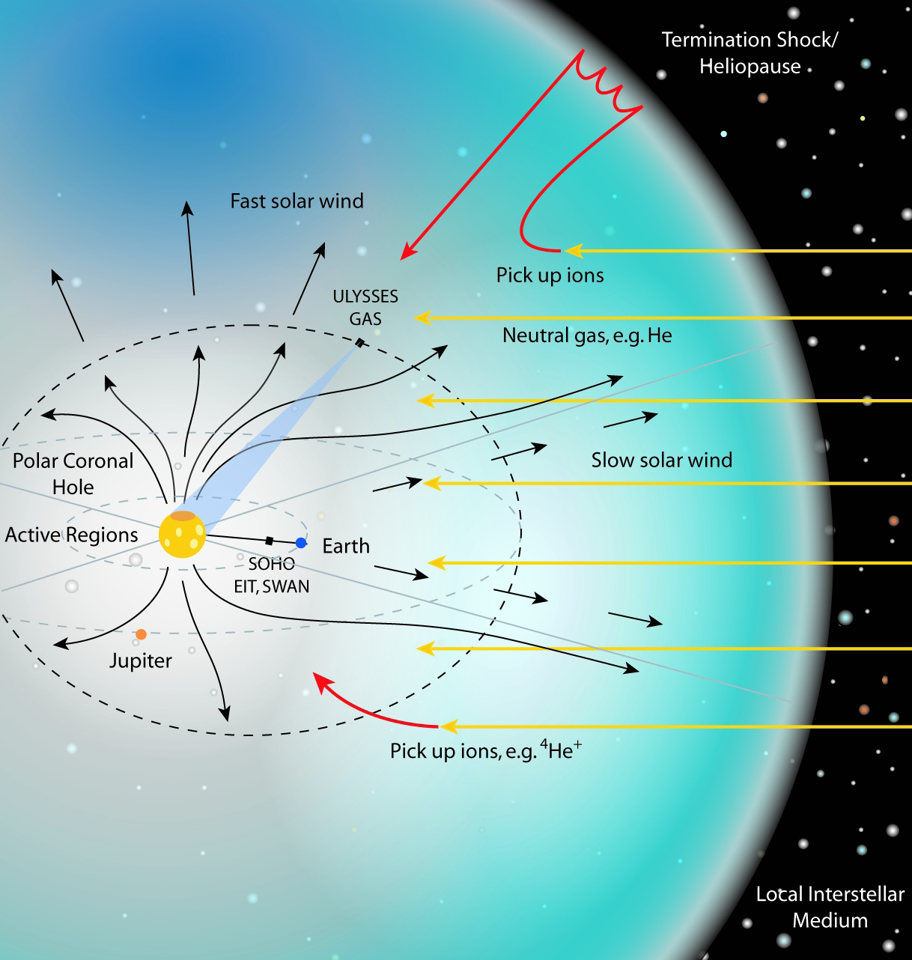
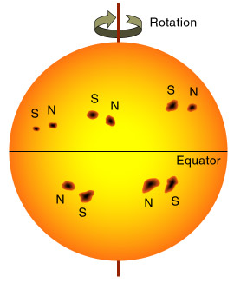
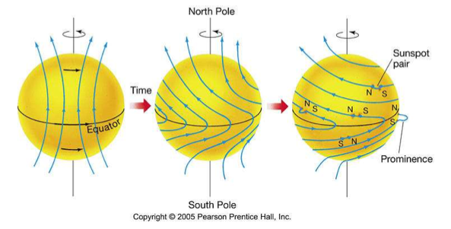
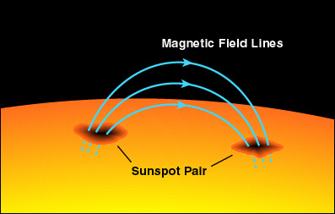
Solar Wind
Continuous flux of charged particles from the Sun ~400km/s
  mainly e- and p (E~0.5MeV)
  ~10¹² particles/m².s
~4 days to reach the Earth (1UA).
First continuous observation by spacecraft Mariner 2 (1962).
Detailed measurement by spacecraft Ulysses (3 orbits).
“Swepts” the solar magnetic field to IP space

Slide 4
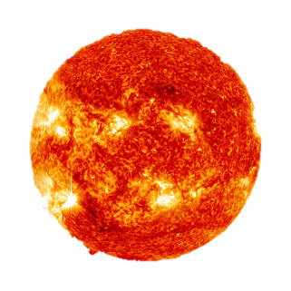
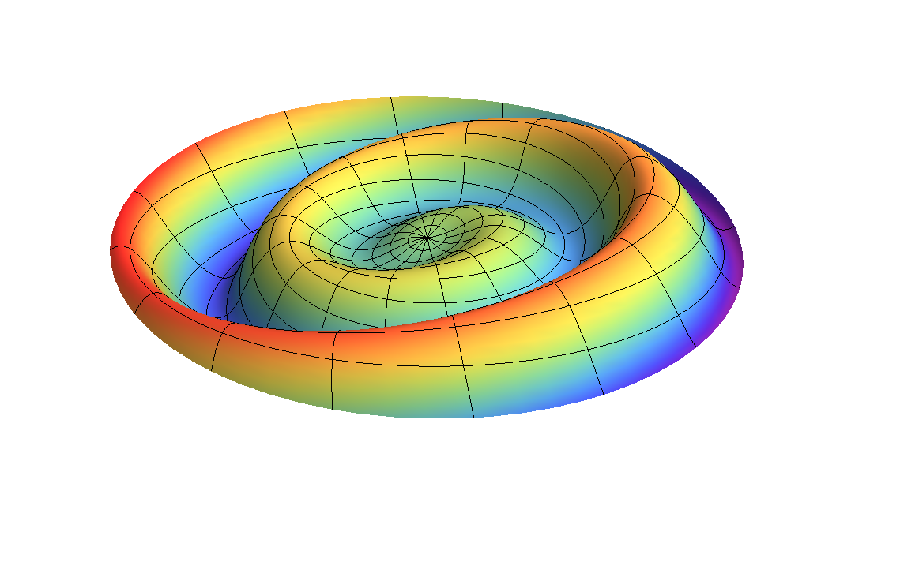
Solar Magnetic Field
α
Sun rotation period ~27.26 days
( Carrington rotation – started 9 Nov 1853)
Magnetic field and magnetic poles approach a dipole.
Continuous Shift between the Sun rotation axis and the magnetic field direction when solar activity comes from Min to Max.
Complex configuration during Solar Max.
Polarity reverses each 11 yrs, returning to its original configuration every 22 years
α

Slide 5
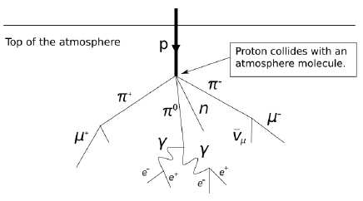
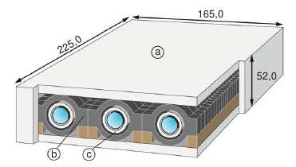
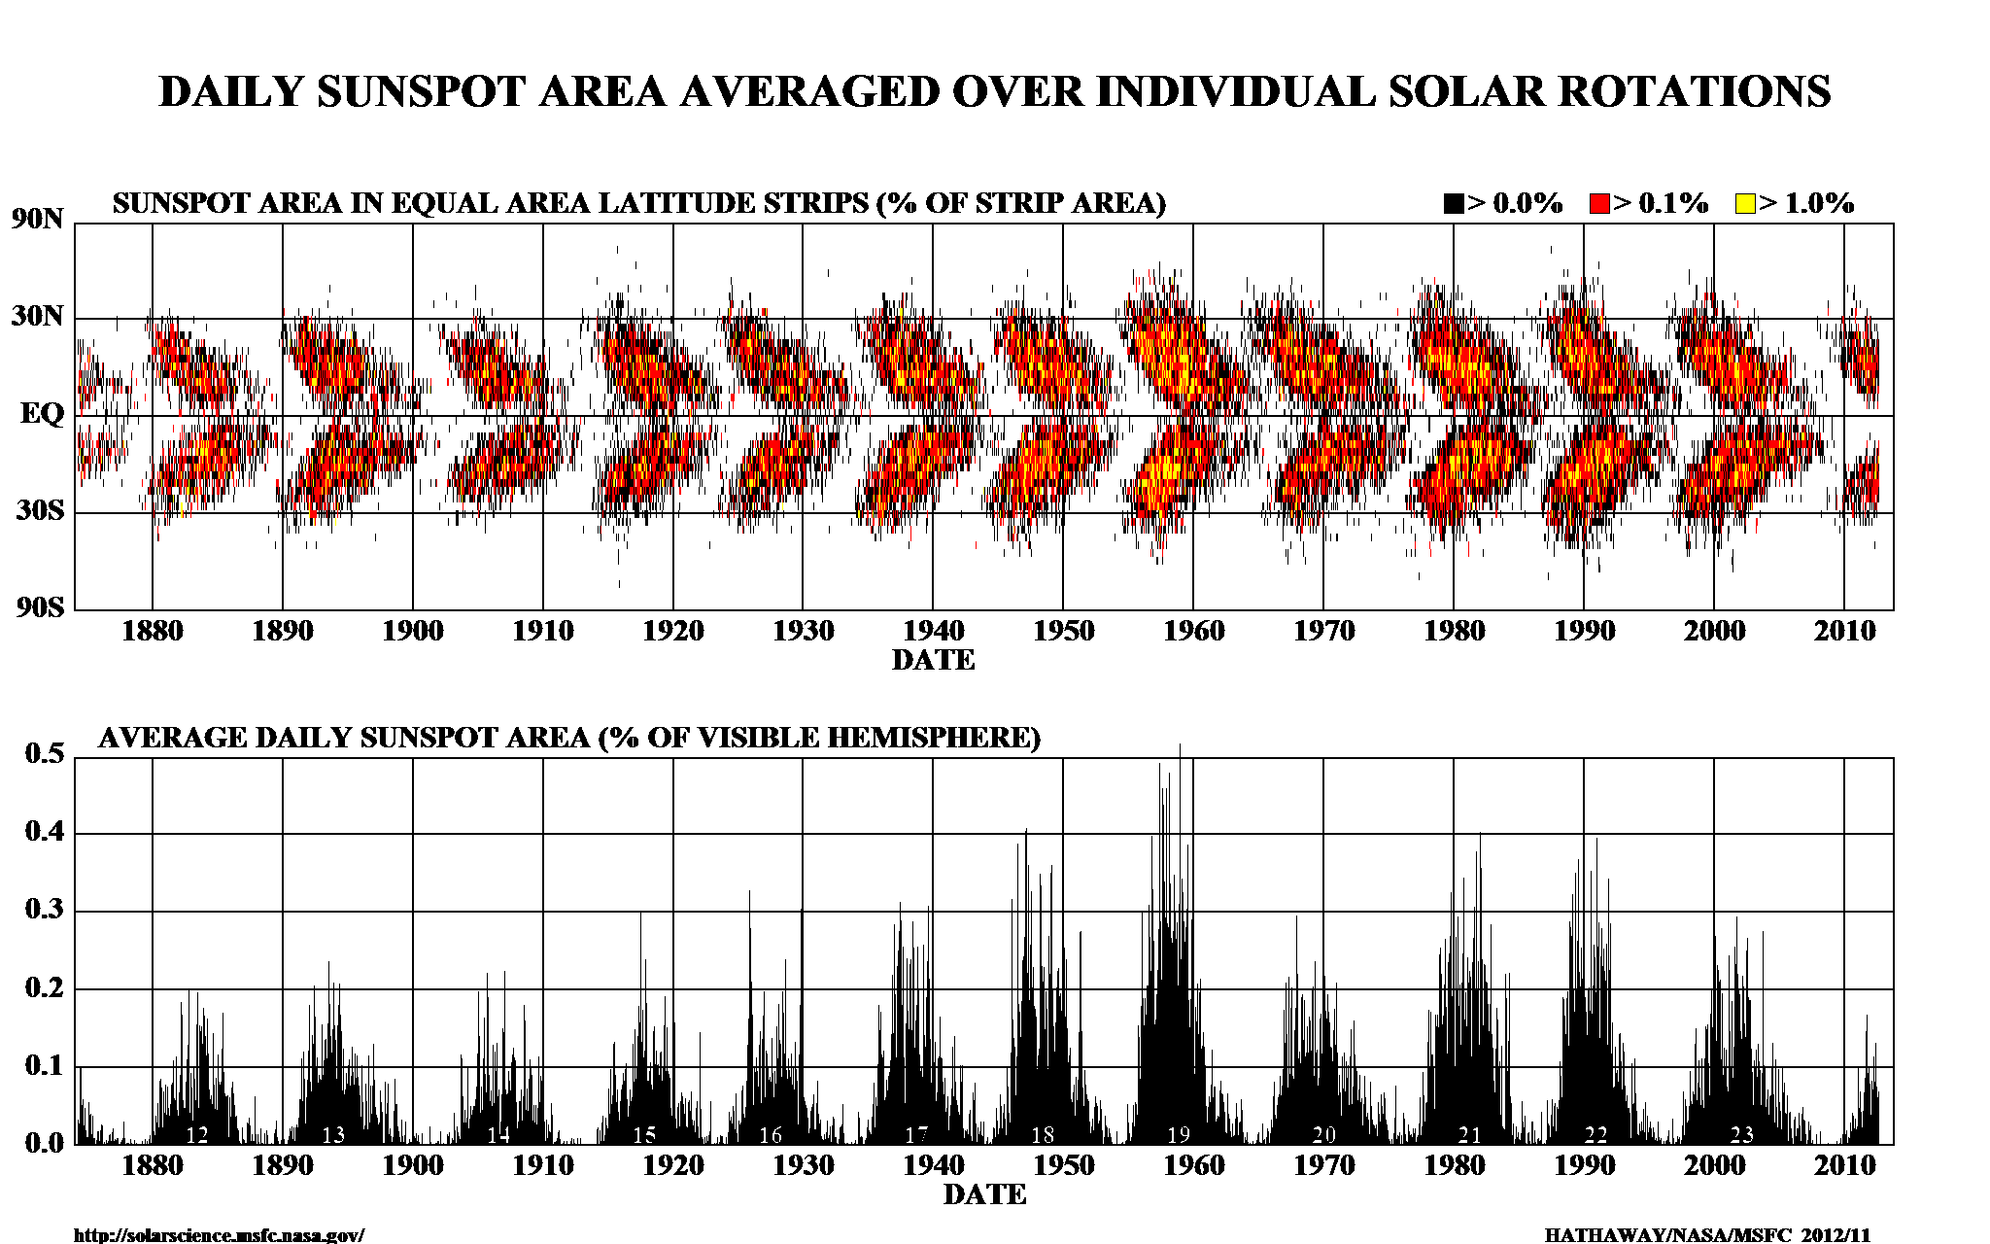
Indicadores de Actividade Solar
Monitores de neutrões
✔ RC primários (protões) interagem com a atmosfera e produzem neutrões secundários
✔ Monitores de neutrões situados a diferentes altitudes e latitudes medem esta componente
✔ detecção por tubos proporcionais rodeados de materiais de elevado-Z (Pb) e baixo-Z (plástico) para amplificar a componente secundária de neutrões e fazer escudo à radioactividade de fundo.
✔ Medidas da taxa de neutrões dá informação da variação da intensidade de RC.
Sunspots
✔ número de manchas solares (regiões + frias que a fotoesfera à volta) monitorizam a actividade Solar
✔ podem ser tão extensas como 105 Km
✔ periodicidade de 11 anos
✔ ciclo solar: de um mínimo ao próximo (1º ciclo : 1755-1766)

Slide 6
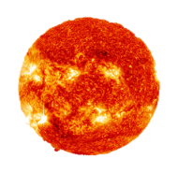
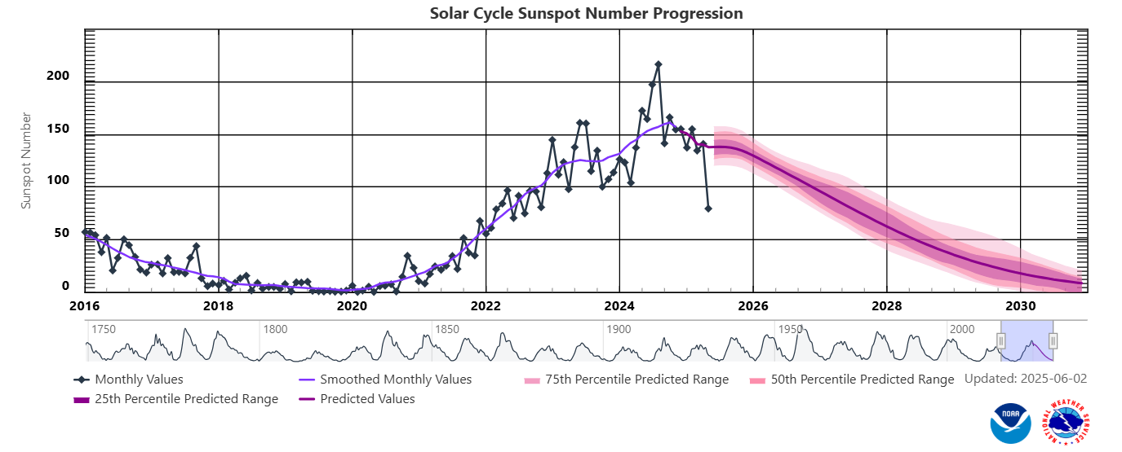
GCR and Solar cycle activity
Modulation with solar activity – 11 yr cycle
Solar cycle modulated flux inversely proportional to the Sun’s activity
α
Maximum: solar storms and SEP
Minimum: more GCR
https://www.swpc.noaa.gov/products/solar-cycle-progression

Slide 7
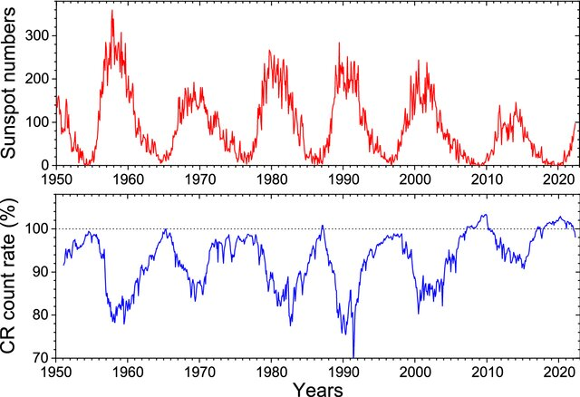
Solar Cycles

Slide 8
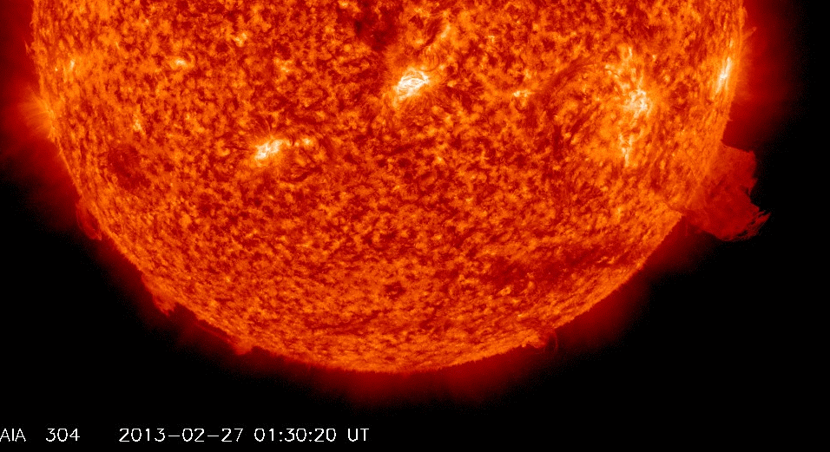
SEP – Solar energetic particles
Associated to
Solar flare
Coronal mass ejections (CME)
Mainly protons and electrons
Energies from several hundred MeV/nuc to GeV/nuc
List from 1976-present @ https://umbra.nascom.nasa.gov/SEP
At Earth's surface, the atmosphere in conjunction with the geomagnetic field provides considerable protection against cosmic rays and solar particle events!
In Space, SEPs are responsible for spacecraft system and component hazard and damage and impose strict constrains on human space exploration.

Slide 9
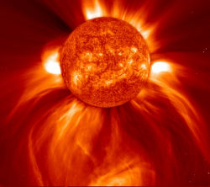
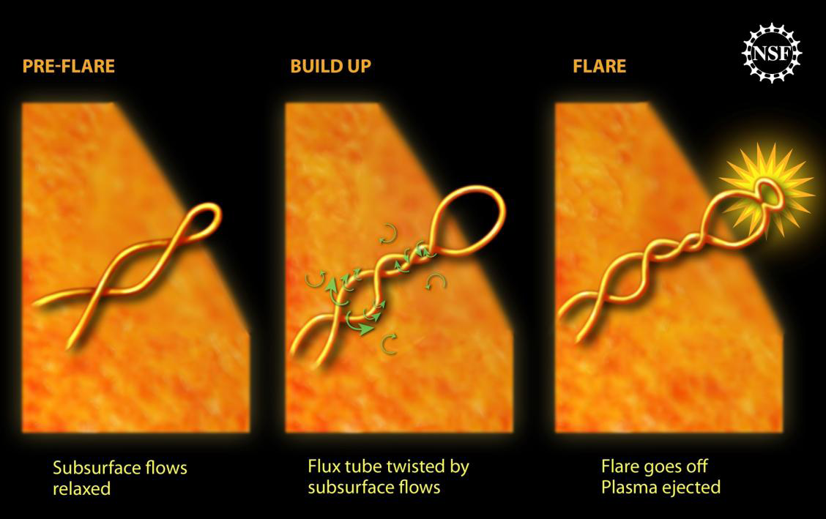
SEP - Eventos solares

Slide 10
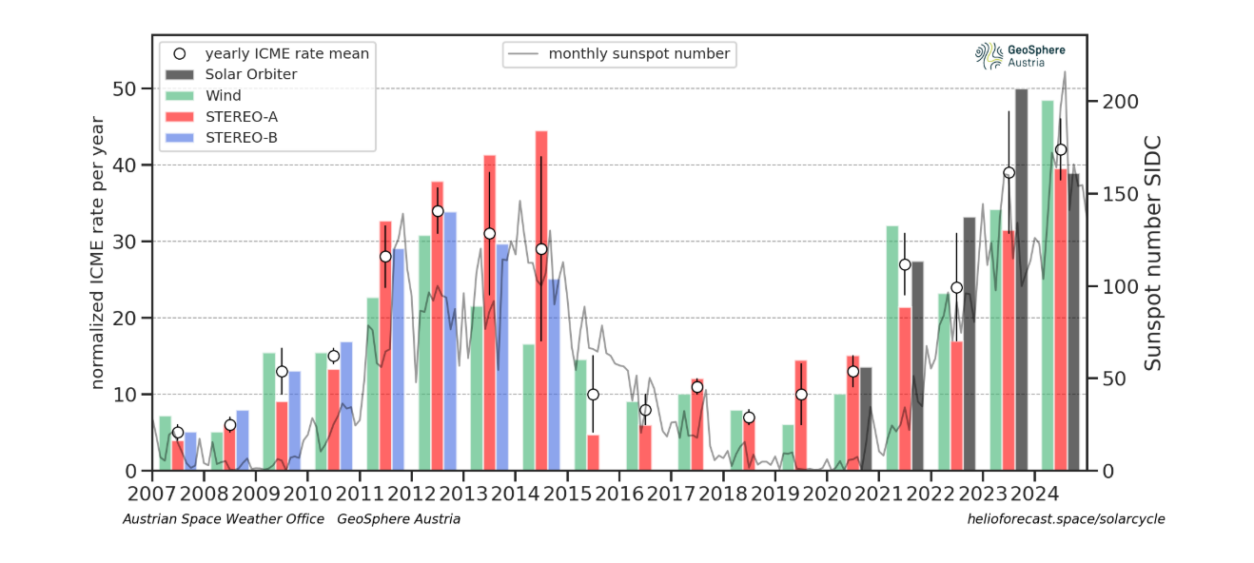
Solar Energetic Particle Events
Long term record
More in “maximum” solar activity years
Highly unpredictable
Design for by making a statistical assessment

Slide 11
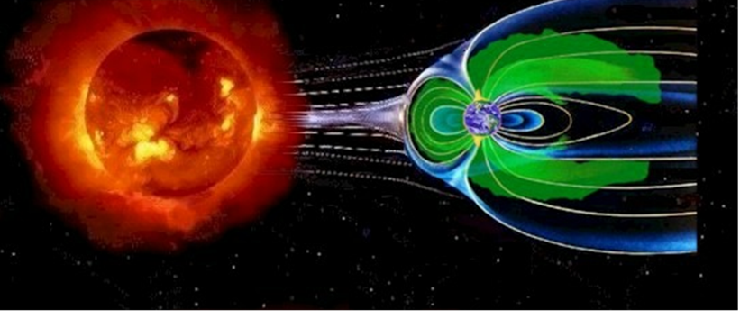
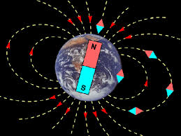
The Magnetosphere: an invisible shield
Particles coming from space and produced in their interaction with the atmosphere are trapped by the Earth’s magnetosphere forming the Earth´s radiation belts
In Earth orbits the radiation belts containing trapped electrons and protons constitute the major radiation source

Slide 12
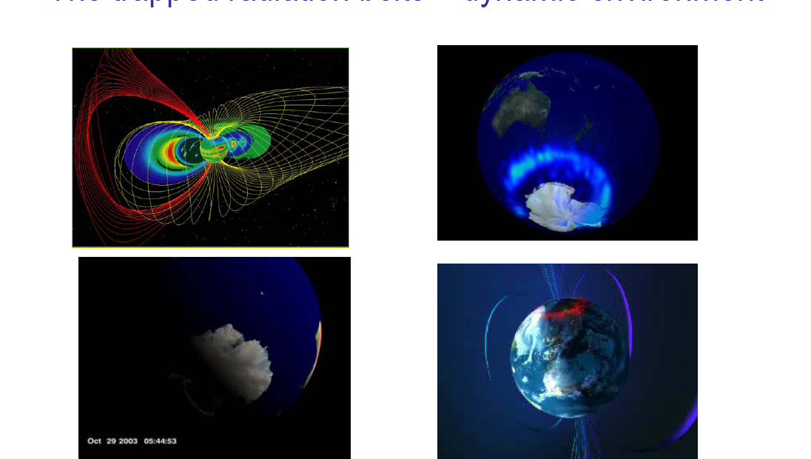
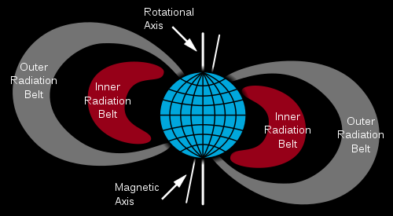
Earth radiation belts
Particles coming from Space depending on their R may be trapped by the geomagnetic field and form the Earth’s radiation belts.
In Earth’s orbits the radiation belts containing trapped e⁻ and p constitute the major radiation source = dynamic environment
Inner belt (700-10000km)
Dominated by p
Product of CR Neutron Decay
E~100’s MeV
Outer belt (~20000-70000km)
    Dominated by e⁻
    Controlled by “storms”
Dominates GEO environment & Navigation (Galileo, GPS) orbits & certain Science missions in highly elliptic orbits (XMM-Newton, INTEGRAL)
    E~ MeV

Slide 13
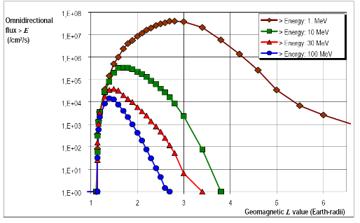
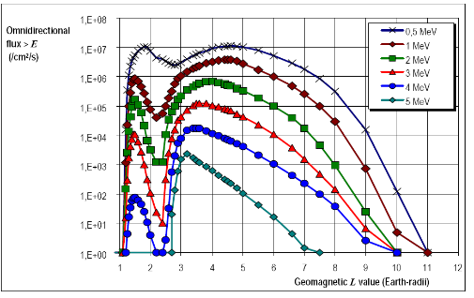
Earth Radiation Belt Models
Examples of models: AP8, AE8 (but there are more…)
Based on data from 1960-1970
Long term averages
but : outer belt is very stormy
ongoing work to update models
protons
electrons
ISS
Nav
GEO
Electrons

Slide 14
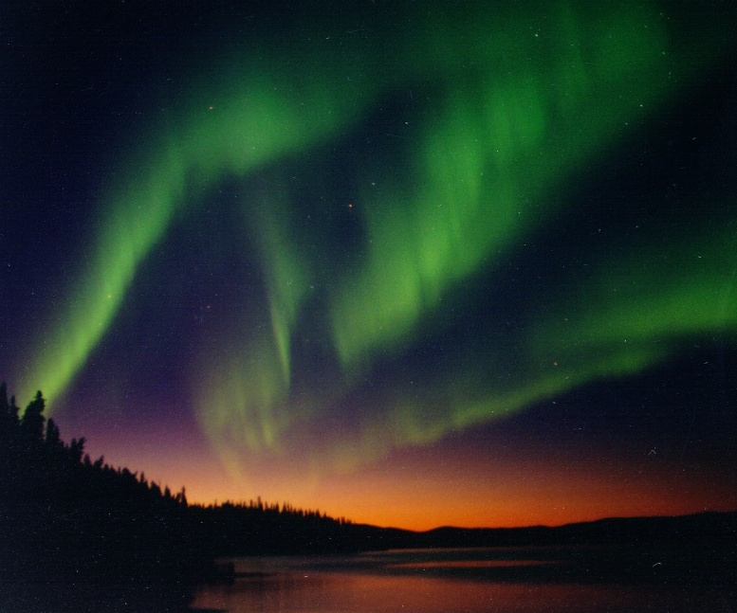
Aurora
The charged particles trapped in the radiation belts may excite the Earth’s atmosphere N₂ and O₂ that when return to the fundamental state emit visible radiation.

Slide 15
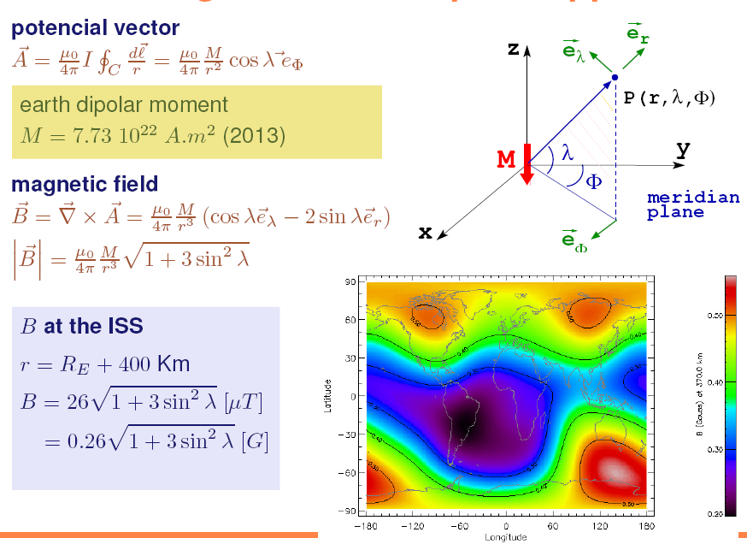
South Atlantic Anomally

Slide 16
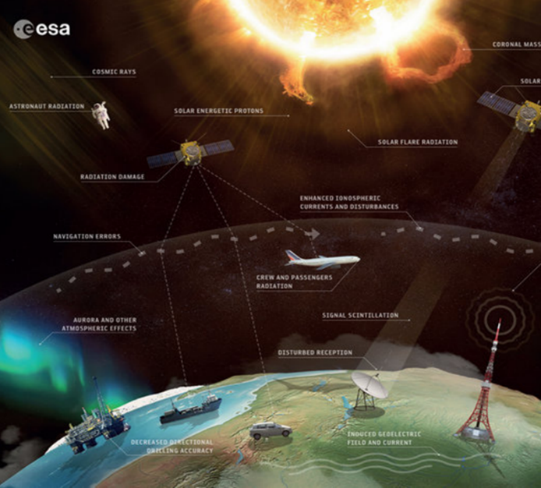
Radiation effects in Earth orbits

Slide 17
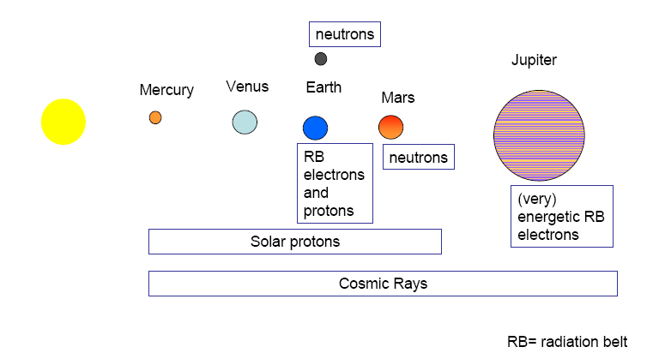
Radiation environment in the Solar system
Courtesy of Eamonn Daly, ESA

Slide 18
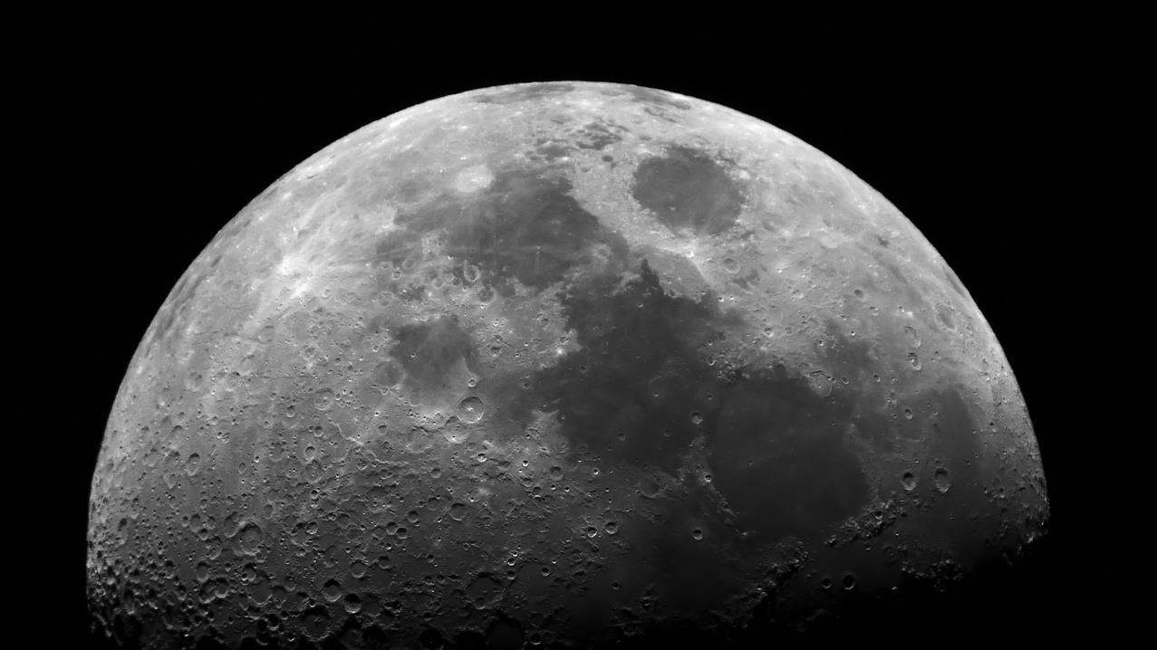
The Moon

Slide 19
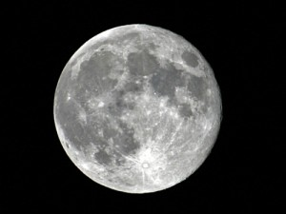
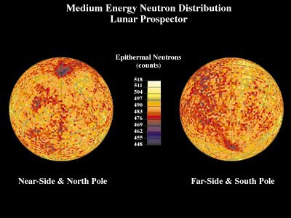
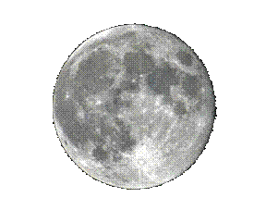
The Moon
No Atmosphere
Very weak localized crustal magnetic field
Radiation environment
SEP and GCR @ 1AU
Albedo neutrons (modulated by H₂O)
No radiation belts
Measured Neutron spectra
(Lunar Prospector)
Radiation environment: similar to Mars
Notes:
0.025–0.4 eV

Slide 20
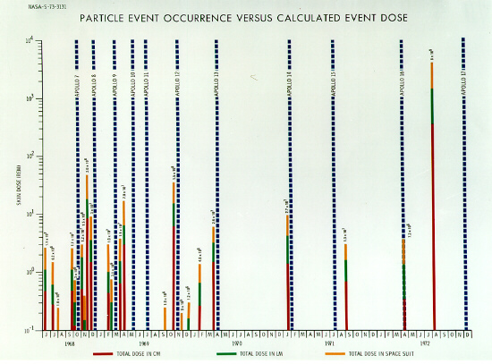
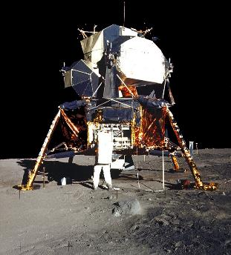
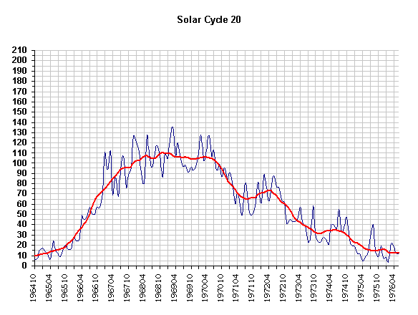
Apollo Programme – Solar Maximum
~ 40 Sv acute skin dose (without shielding) from August 72 SPE. Potentially very serious for the lander/EVA
0.5 Sv annual limit for ISS astronauts
20 mSv annual limit for radiation workers on Earth
~ 2.4 mSv annual dose from natural sources on Earth
1Sv = 1 J/kg
== absorbed dose in Gray for
x- rays, gamma rays, beta particles, muons
x Q factor for neutrons, protons, pions and nuclei
1 unit of dose equivalent (the biological effect of ionizing radiation), equal to an effective dose of a joule of energy per kilogram of recipient mass.

Slide 21
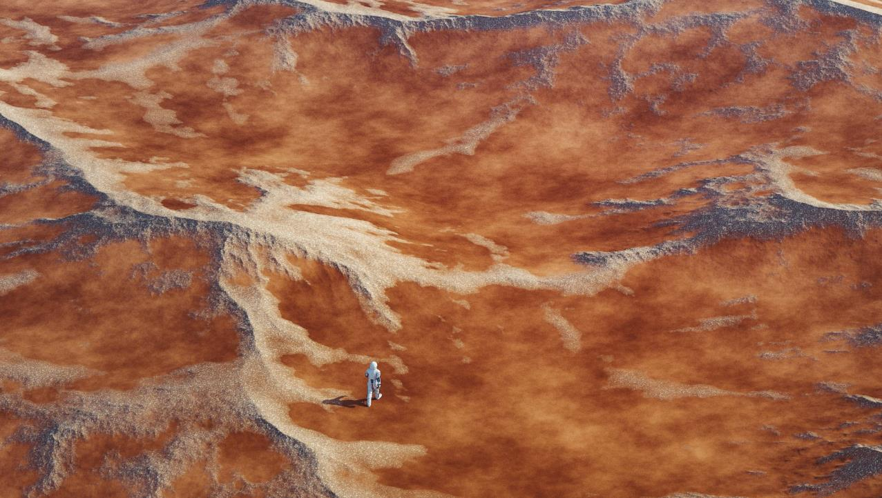
Mars
Away from home

Slide 22
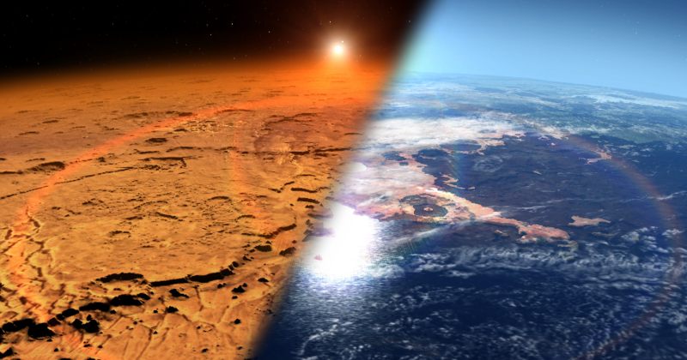
Mars Radiation Environment
Corresponds to proton range on Mars atmosphere
Spectral
changes

Slide 23
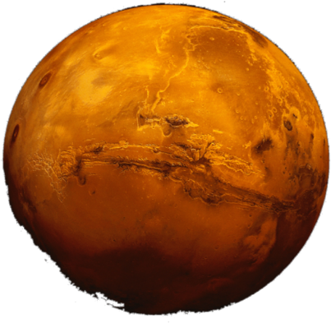
Radiation Environment Modelling
MarsREM: the Mars Energetic Radiation Environment Models
LIP developed dMEREM, a Geant4 based model for the radiation environment on Mars, Phobos and Deimos, including local treatment of surface topography and composition, atmospheric composition and density (including diurnal + annual variations) and local magnetic fields.
Inputs given as a function of latitude, longitude, in a 5º x 5º grid, and season.
Example of dMEREM results:
Particle radiation arriving on Mars surface after GCR-alpha interaction with atmosphere and soil
23

Slide 24
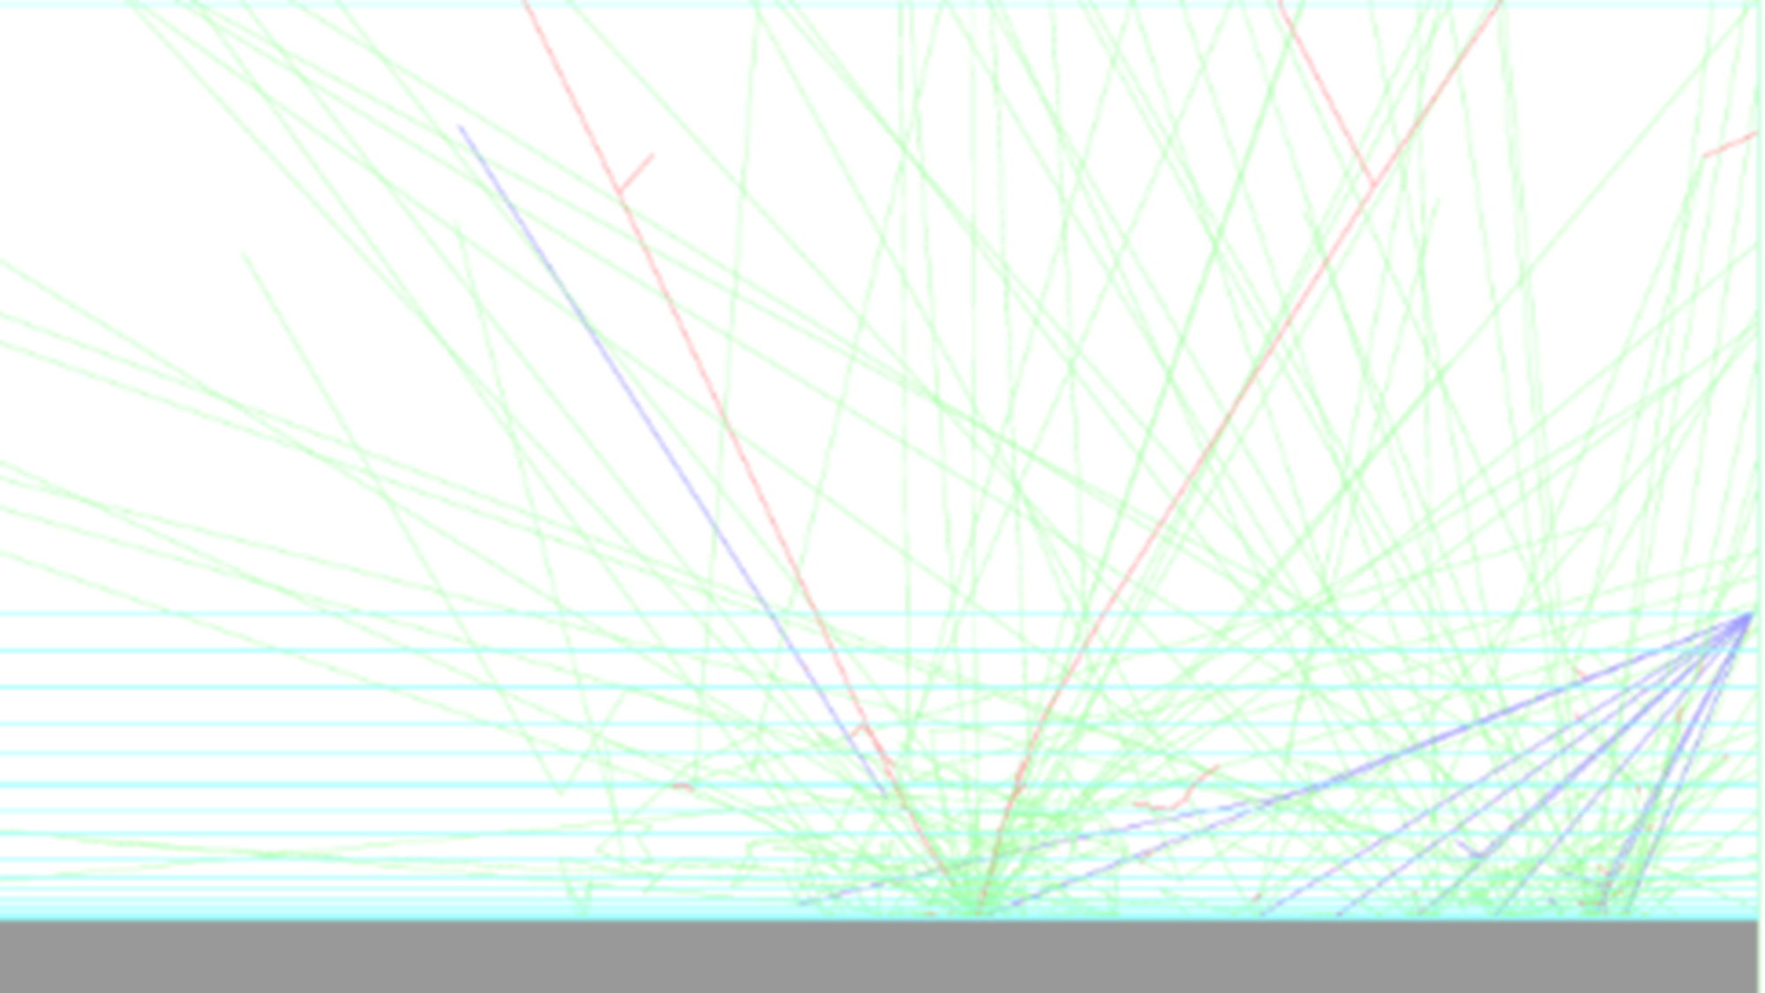
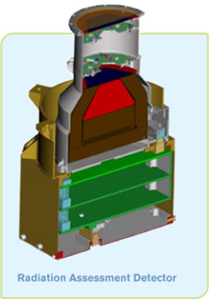
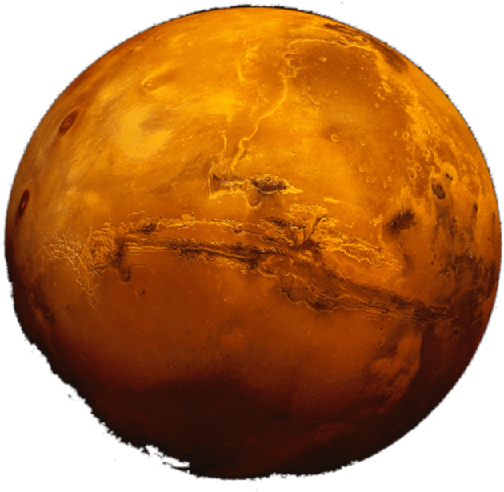
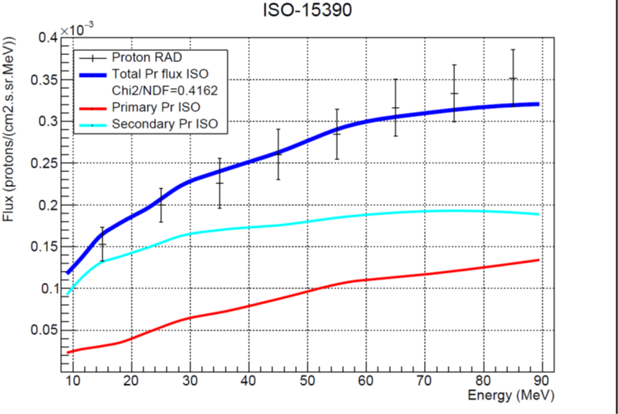
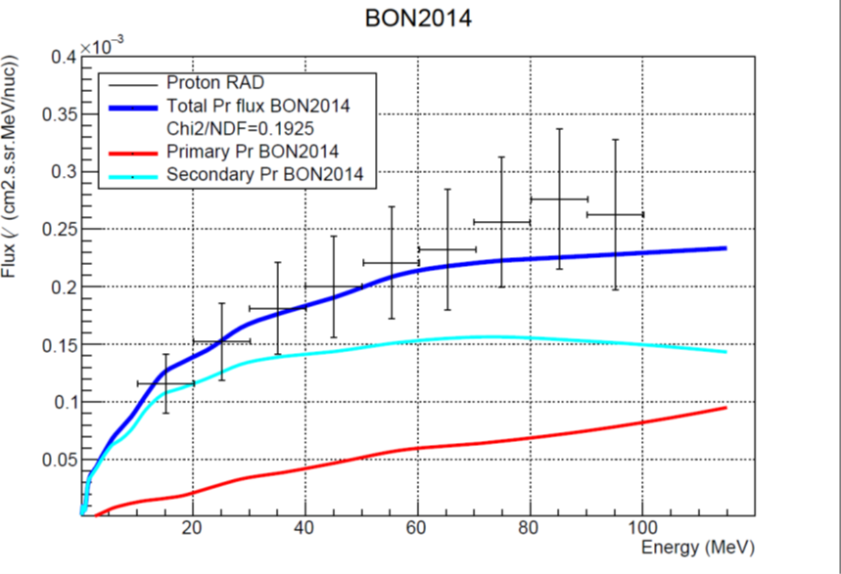
Validation of dMEREM, the Detailed Mars Energetic Radiation Environment Model, with RAD Data from the Surface of Mars
Protons at the surface of Mars
September 2017
Protons at the surface of Mars
Nov 2015 – Jan 2016
P. Gonçalves L. Arruda, M. Pinto, , Front. Astron. Space Sci., 21 February 2022, Sec. Planetary Science

Slide 25
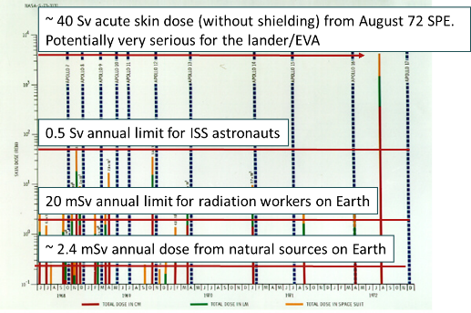
30 days on Mars
30 days on the Martian surface at Solar Minimum (worst case for GCR)
Effect of Galactic Cosmic Rays
Mars location | Ambient Dose Equivalent (mSv)
Viking 1/Phoenix/ Mawrth * | 21.0/20.3/14.4
15-20 mSv/30 days = 0,5- 0,7 mSv /day
~ < anual limit for Earth radiation workers
~ Daily dose on the ISS
In “Characterization of the Martian radiation environment on selected locations using the ESA Mars Energetic Radiation Environment Models”, Icarus 218 (2012) 723–734, S. McKenna-Lawlor, P. Gonçalves, A. Keating, B.bMorgado, D. Heynderickx, P. Nieminen, G. Santin, P. Truscot, F. Lei, B. Foing and J. Balaz

Slide 26
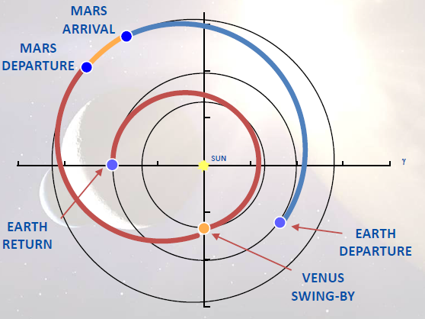
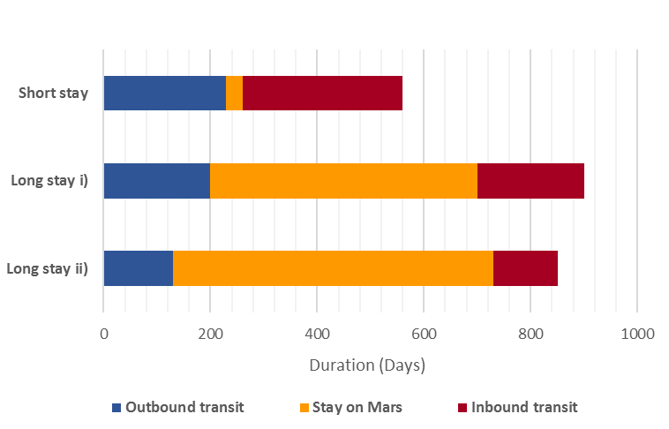
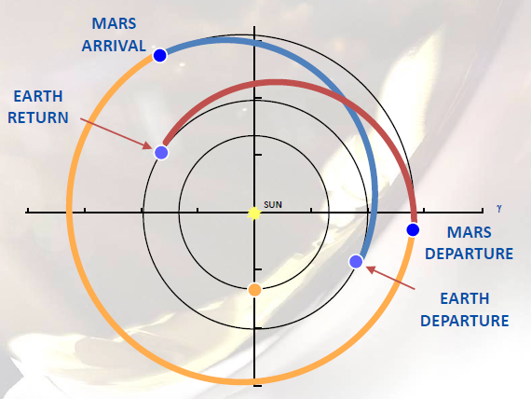
NASA’s three mission profiles
Proposed (2015) by NASA for 2030’s
1 – Short stay
2 – Long stay i)
3 – Long stay ii)
Short stay
Comparison
Long stay i), ii)
https://nssdc.gsfc.nasa.gov/planetary/mars/marsprof.html (Nov. 2015)

Slide 27


Dose Calculations
Results comparison with NCRP/NASA limits
Stochastic - 3% REID
Equivalent doses with shielding are of the same order of astronauts career dose limits
30 days dose limit (deterministic effects): 0.25 Sv ➔ equivalent dose for SEP with shielding is 10% of this value

Slide 28

...it is possible !
It is possible to remain in Martian surface for some time with no serious risk for the astronauts!
For longer permanences shelters are required...
28
Notes:
28

Slide 29

Jupiter
Beyond the belt

Slide 30

JUICE
ESA L-Mission to the Jovian System

Slide 31


Slide: courtesy of Insoo Jun (RADECS 2012)

Slide 32

Very Hard Electron Spectrum
Trapped particles:
Main contributor to the Jovian System
Jupiter’s trapped particles are much more energetic than the ones found on Earth
    Jupiter‘s trapped electrons: up to 100MeV
    Jupiter’s trapped protons: up to 1 GeV
300 keV
40 MeV

Slide 33


JUICE
JUpiter
ICy moons Explorer
Exploring the emergence of habitable worlds around gas giants
7.6 years cruise &
3.5 years in the Jovian system
14th April 2023

Slide 34

The radiation environment in the solar system:
Jupiter
To Jupiter – ESA Juice Mission (2023): RADEM – RADiation hard Electron Monitor
ESA Contract No. 4000137865/22/ES/JD - Expert support to BERM (BepiColombo Environment Radiation Monitor) & RADEM units on board BepiColombo and JUICE spacecraft (LIP)
ESA Contact No. 4000110643/13/NL/HB - RADEM Proto-Flight Model (EFACEC, PSI, IDEAS, LIP)

Slide 35




JUICE Mission

Slide 36



Study the emergence of habitable worlds around gas giants
Characterise the Jupiter Icy Moons:
Ganymede, Europa and Callisto as planetary objects and potential habitats
Explore the Jovian system as an archetype for gas giants
Europa
Callisto
Ganymede

Slide 37



RADEM – RADiation hard Electron Monitor
Measurement
electron and proton spectra
ion LET
electron directionality
ESA Contract No. 4000137865/22/ES/JD - Expert support to BERM (BepiColombo Environment Radiation Monitor) & RADEM units on board BepiColombo and JUICE spacecraft (LIP)
ESA Contact No. 4000110643/13/NL/HB - RADEM Proto-Flight Model (EFACEC, PSI, IDEAS, LIP)

Slide 38



RADEM – Cruise Phase
March 2024
May 2024

Slide 39

Cruise phase so far
Credit
M. Pinto

Slide 40

The radiation environment in the solar system: from Mercury
To Mercury – BepiCOlombo Mission (2018)
BERM – BepiColombo Radiation Monitor
To Jupiter – ESA Juice Mission (2023)
RADEM – RADiation hard Electron Monitor
ESA Contract No. 4000137865/22/ES/JD - Expert support to BERM (BepiColombo Environment Radiation Monitor) & RADEM units on board BepiColombo and JUICE spacecraft (LIP,SE2S)
ESA Contact No. 4000110643/13/NL/HB - RADEM Proto-Flight Model (EFACEC, PSI, IDEAS, LIP)

Slide 41
The radiation environment in the solar system:
Mercury
ESA BepiColombo Mission (2018): BERM – BepiColombo Radiation Monitor
ESA Contract No. 4000137865/22/ES/JD - Expert support to BERM (BepiColombo Environment Radiation Monitor) & RADEM units on board BepiColombo and JUICE spacecraft (LIP,SE2S)

Slide 42

BepiColombo Mission
Understand the origin & evolution of Mercury and its surrounding environment:
The planet closest to the Sun
The only terrestrial planet besides Earth with a self-sustained magnetic field
The smallest planet in our Solar System.
Keyplanet for understanding the evolutionary history of our Solar System and therefore also for the question of how the Earth and our Planetary System were formed.
The scientific objectives focus on a global characterization of Mercury through the investigation of its interior, surface, exosphere, and magnetosphere.
Performe Einstein’s theory of general relativity.

Slide 43


BepiColombo Mission
First European Mission to Mercury
ESA/JAXA
Radiation Monitoring is a task of the
BepiColombo Radiation Monitor (BERM)
Carlota Cardoso, Master’s thesis @LIP/IST July 22

Slide 44



BERM
40º
BERM stack: 11 silicon sensors
Sensors areas: [0.5; 903] mm²
Sensors thickness: 0.2 mm or 0.3 mm
Absorber layers: aluminium and tantalum
Shield walls: tantalum
Entrance: beryllium cut-off layer and 40º FOV
12.00 cm
17.48 cm
10.60 cm

Slide 45



BERM-SIXS SEP Sept 2023
SIXS-P
Particle Spectrometer also on board of the MPO

Slide 46

Cruise phase so far

Slide 47


Slide 48




BERM Proton and Electron data January 2025: 6th Mercury Flyby 6th Jan- 11th Jan
INDEX
BERM Proton
channels
BERM electron
channels
Time UTC

