Slide 1
Dosimetry
Linking biological effects with physical quantities
RADART group coordinator

Slide 2
What is Dosimetry?
Dosimetry
Industry
Research
Medicine
Structural engineering
Calculation and measurement of the absorbed dose by an object (the human body!) exposed to ionising radiation and the evaluation of its biological impact on the organ and tissues.
Nuclear energy
Radiopharmaceutical production
Archaeological dating
Imaging
Space missions
Radiotherapy
Radioimmunoassay
Nuclear medicine

Slide 3
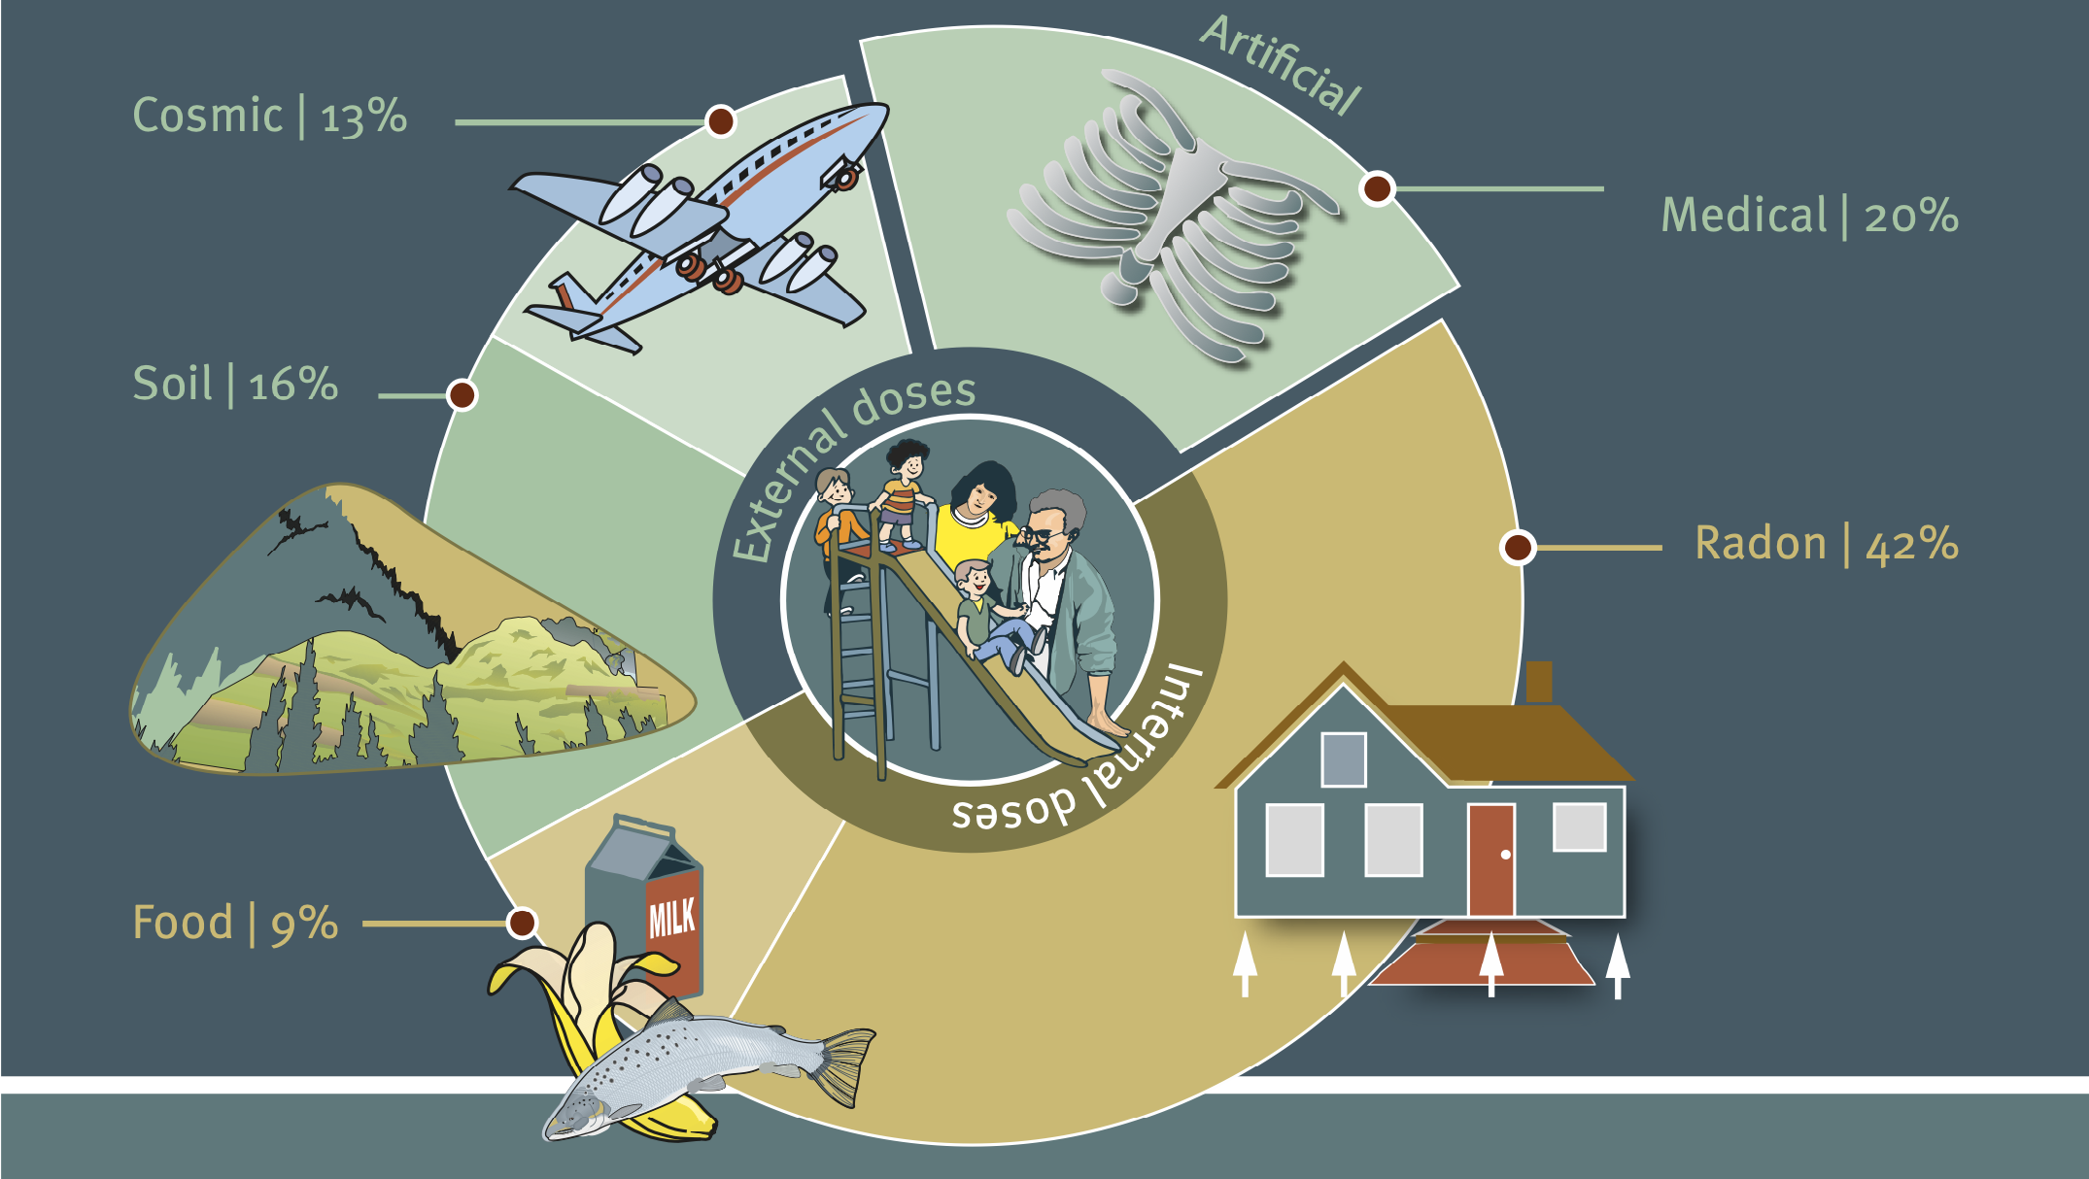
Radiation Sources
UNEP Booklet, Radiation effects and Sources (2016)

Slide 4
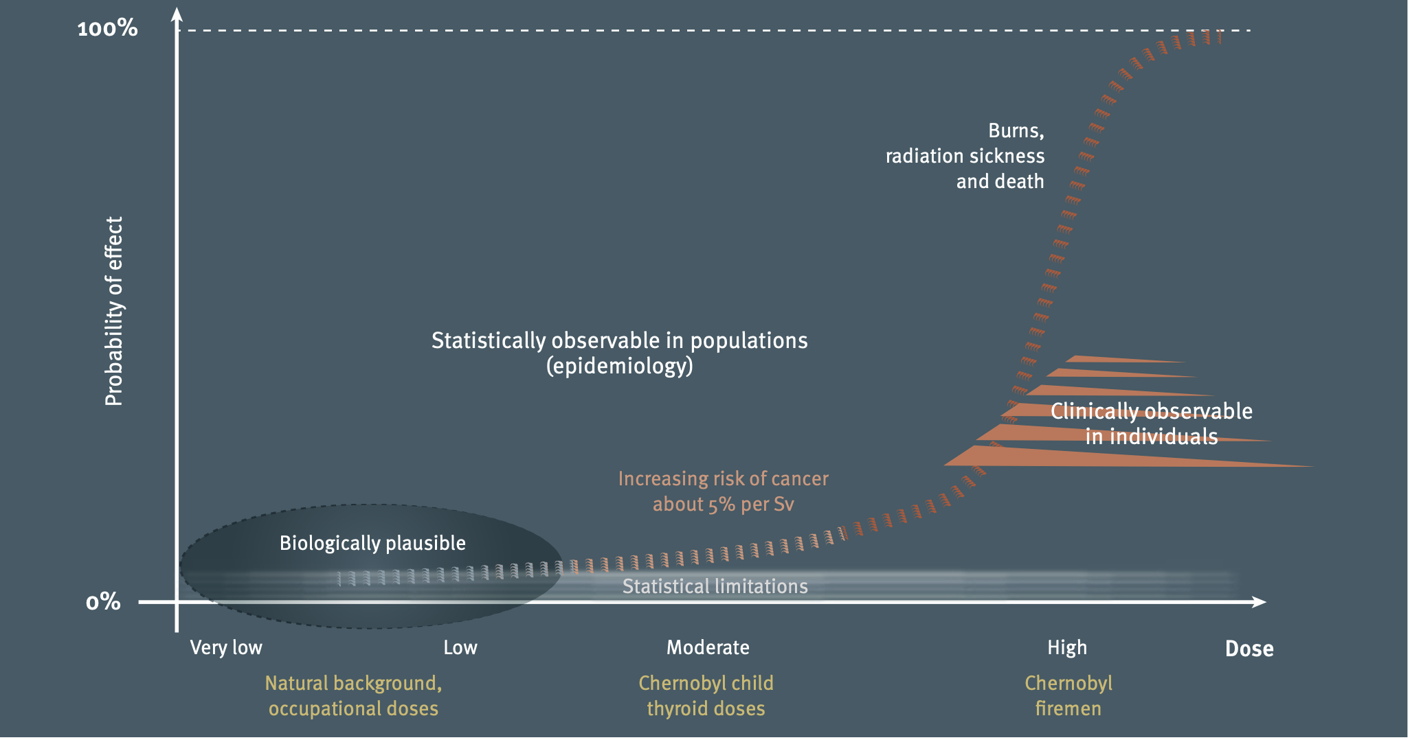
Radiation effects on us
Stocastic
Deterministic
UNEP Booklet, Radiation effects and Sources (2016)

Slide 5
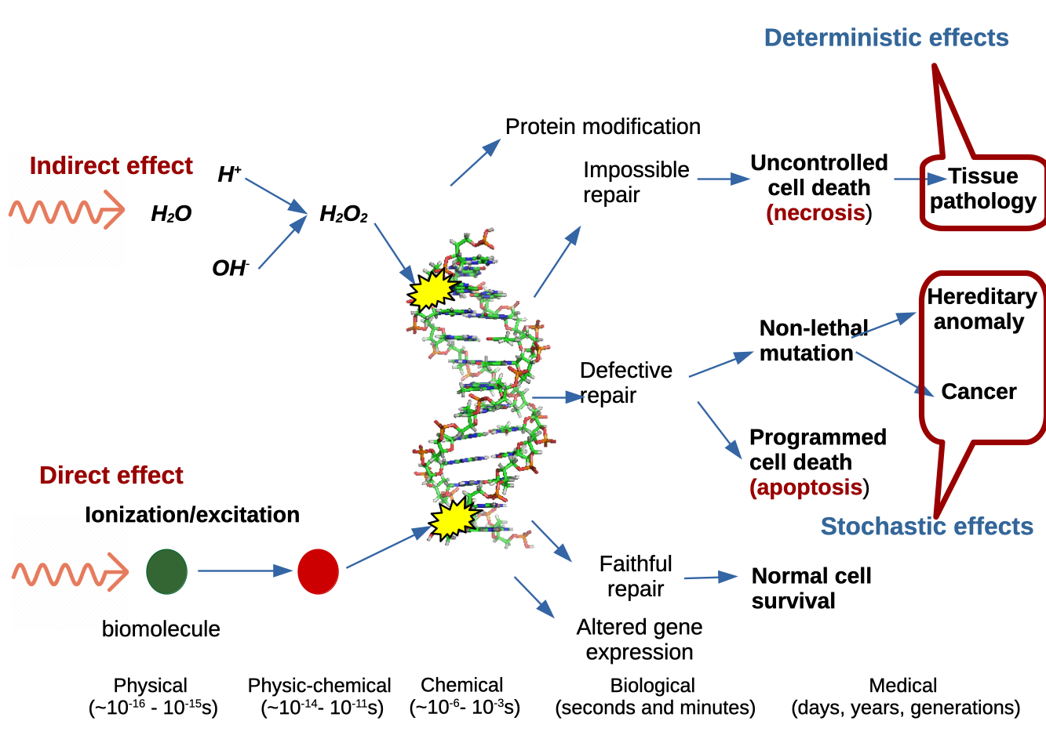
Cellular damage mechanisms

Slide 6
Factors that influence cellular radiosensitivity
Physical
Dose
Chemical
Oxygen content
Biological
Cell line
Dose rate
LET
Fractioning (time and space)
Temperature
Track structure
Presence of antioxidants
Cell cycle
Bystander effects
Immune system response
Cellular end point
ROS production

Slide 7
Absorbed dose
Energy imparted
Related to the fraction of energy kinetic energy that is imparted in the volume
Absorbed dose
SI unit: Gy (gray)
Dose is defined in a point as an average value of stochastic processes in a (small) volume

Slide 8
Stopping power
Energy lost
Accounts for all energy lost by a single particle inside de volume
Stopping power
Unit: keV/μm or MeV/cm

Slide 9
Linear energy transfer
Energy transferred
Accounts for all energy transferred by a single particle inside de volume
Energy transfered inside the volume, but deposited outside.
LET
Unit: keV/μm or MeV/cm

Slide 10
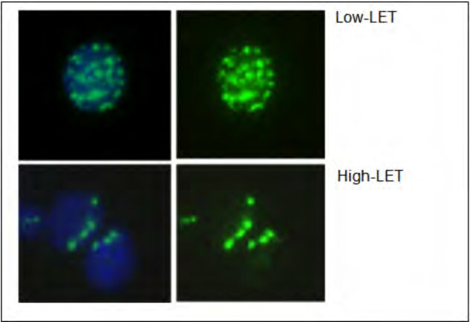
LET and the cell damage
Low-LET: Low density of ionisations and scattered
High-LET: High ionisation density and very localised
Immunofluorescence image of 𝛾-H2AX foci on human lymphocytes cell nucleus
Low-LET: 𝛾-rays
High-LET: 0.88 MeV protons (28 keV/𝜇m)
M. Moganato et al. The DNA-Damage Response to Ionizing Radiation in Human Lymphocytes (2011)

Slide 11
Clonogenic assay: the gold standard of radiobiology
Plating effciency
Survival fraction
E. J. Hall and A. J. Giaccia, Radiobiology for the Radiologist (2012)

Slide 12
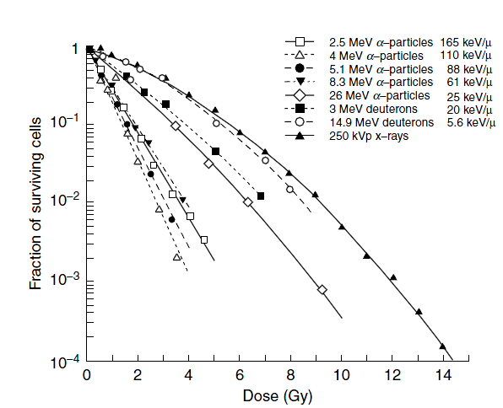
SF dose response: LET dependence
Low-LET: Linear Quadratic Model (LQM)
High-LET: Linear Model (LM)
Radiosensitivity increases with LET

Slide 13
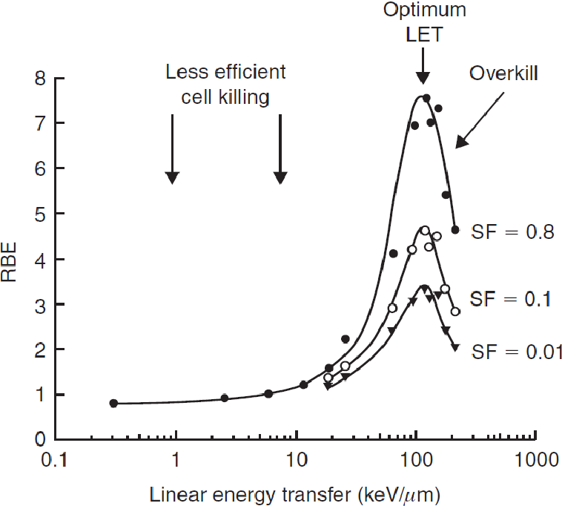
Relative Biological Effictiviness (RBE)
D_{𝛼}
D_{γ}
J. M. Søbstad, Monte Carlo based comparison of constant vs. variable RBE for proton therapy patients (2017).

Slide 14
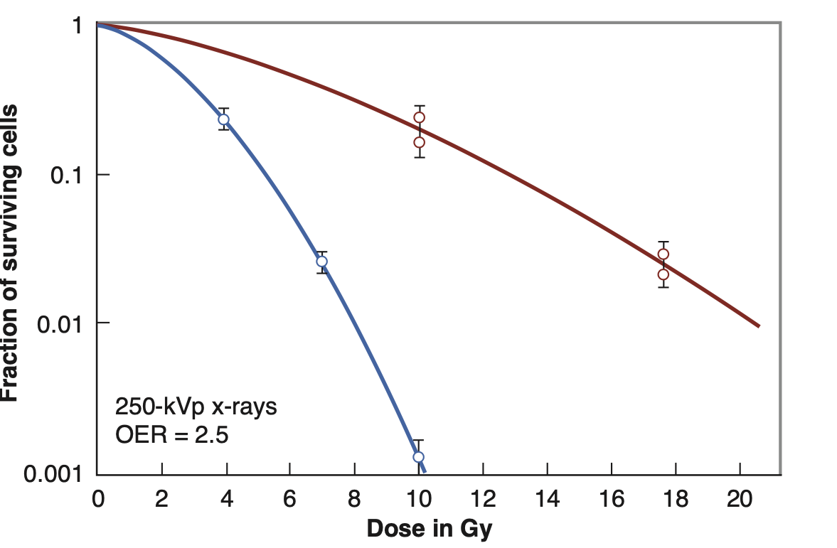
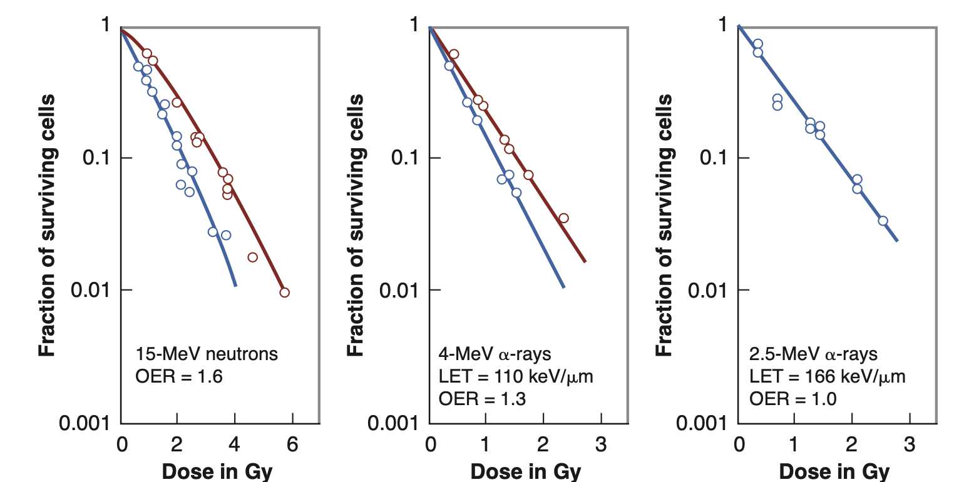
SF dose response: Oxygen enhancement effect
Cells of human origin
Lower LET:
Hypoxic: lower biological effectiveness (tumour cells)
Hypoxic
Oxygenated: higher biological effectiveness (normal cells)
Oxygenated
Higher LET: independent of oxygen conditions
Radiosensitivity increases with oxygen concentration
E. J. Hall and A. J. Giaccia, Radiobiology for the Radiologist (2012)

Slide 15
SF dose response: Cell cycle
Cell division
Cell growth (synthesis of enzymes and RNA)
Cell growth (synthesis of proteins and organelles)
~24 hours
DNA duplication
(synthesis of genetic material)
Radiosensitivity increases during the mitotic phase (G2-M-G1).

Slide 16
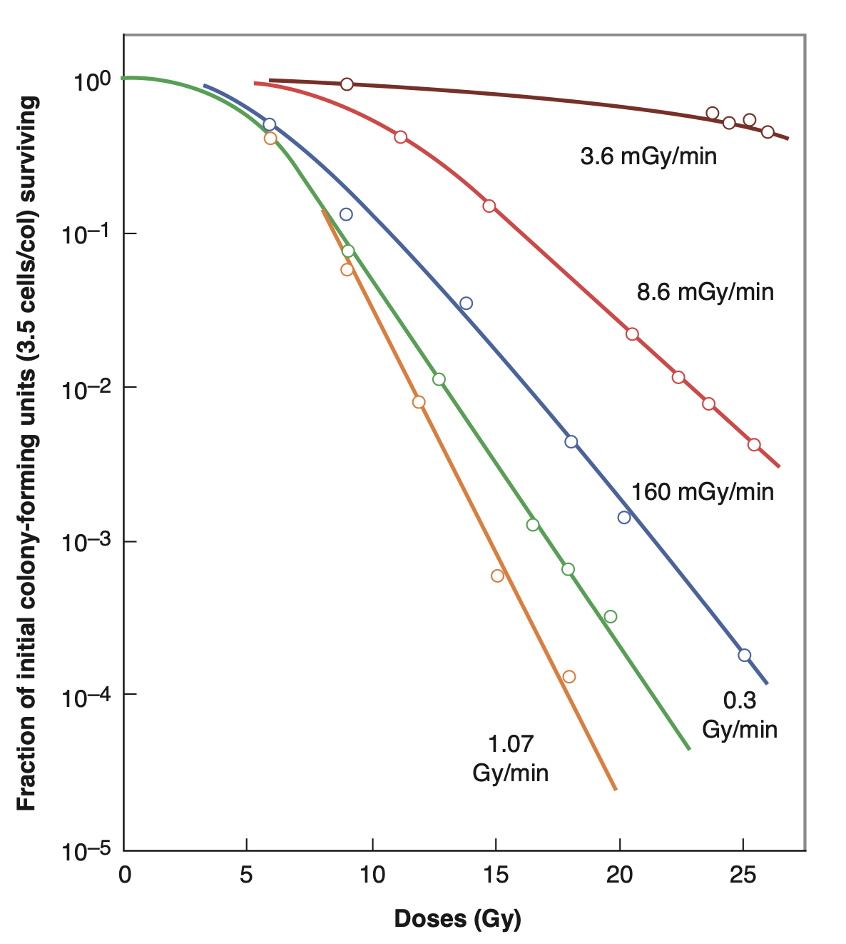
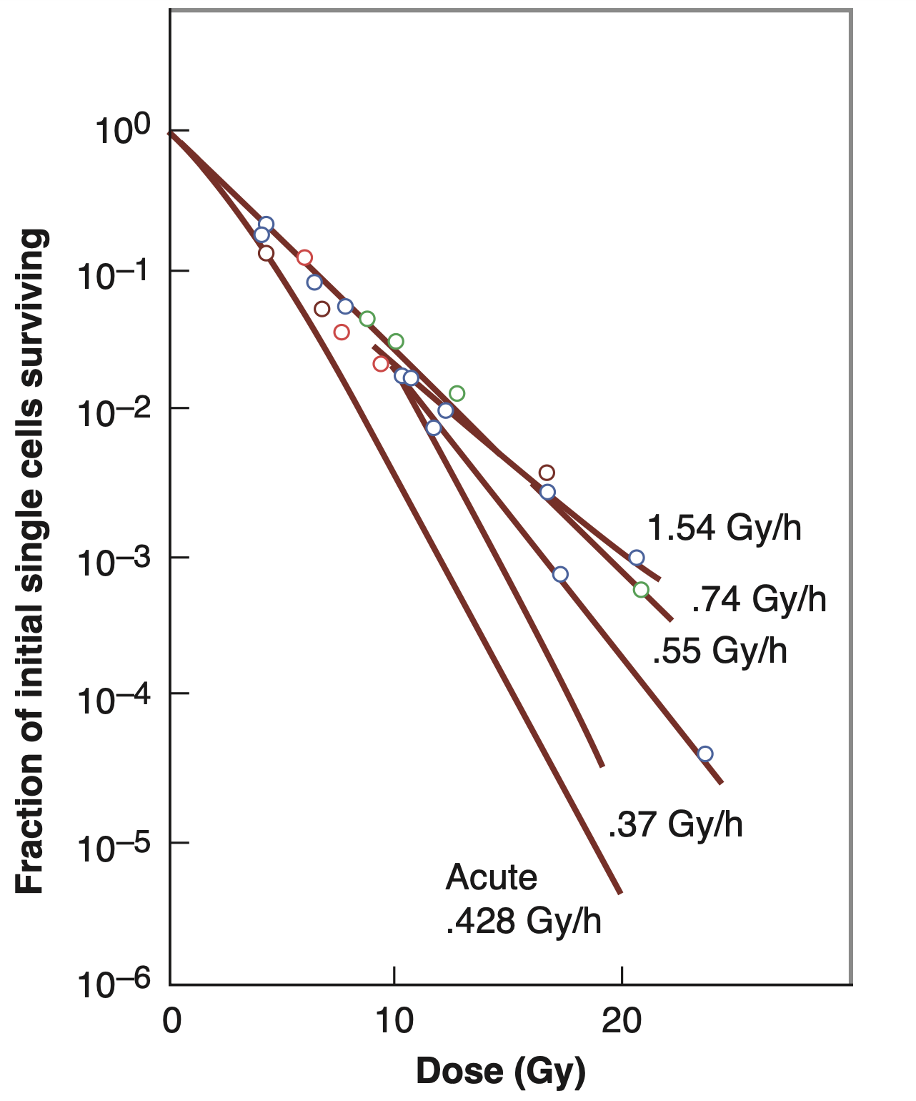
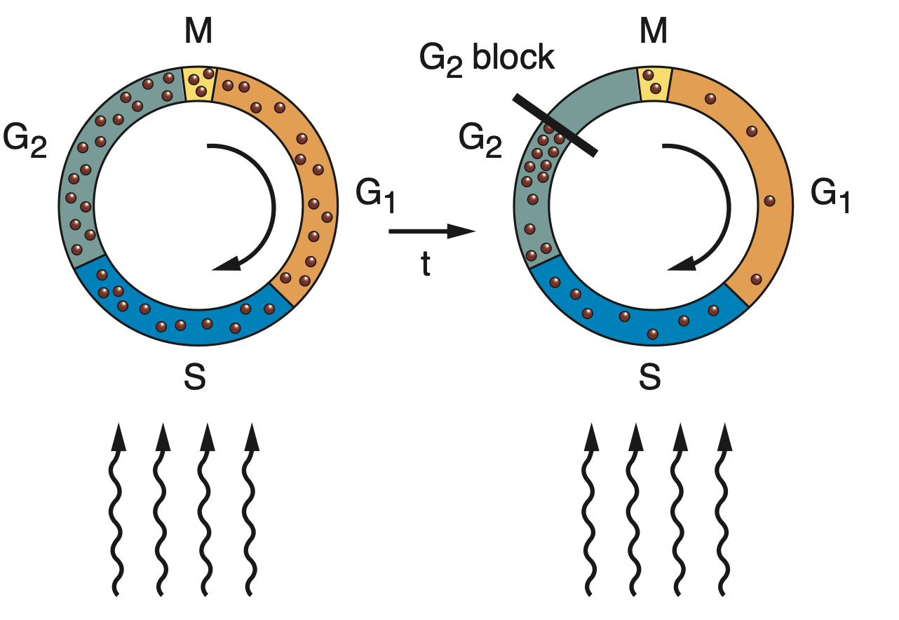
SF dose response: Dose rate effect
In general, radiosensitivity increases with dose rate, but…
Inverse dose rate effect
Some cells (HeLa) become blocked in the G2 phase at low dose rates→Higher radiosensitivity
E. J. Hall and A. J. Giaccia, Radiobiology for the Radiologist (2012)

Slide 17
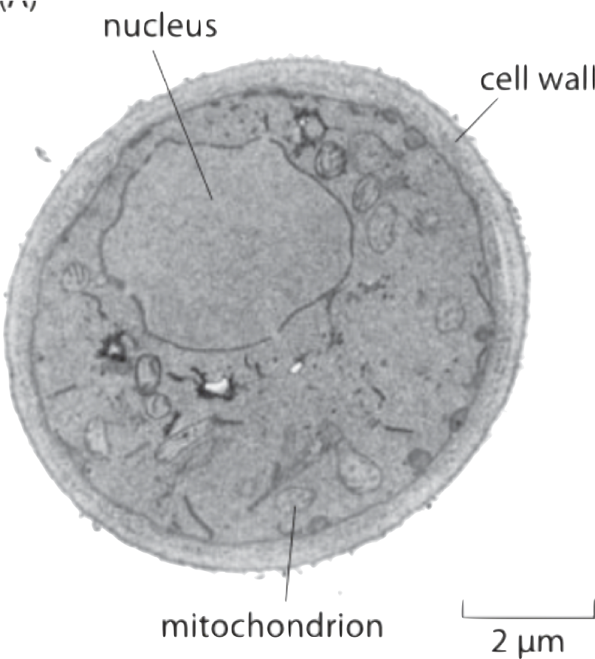
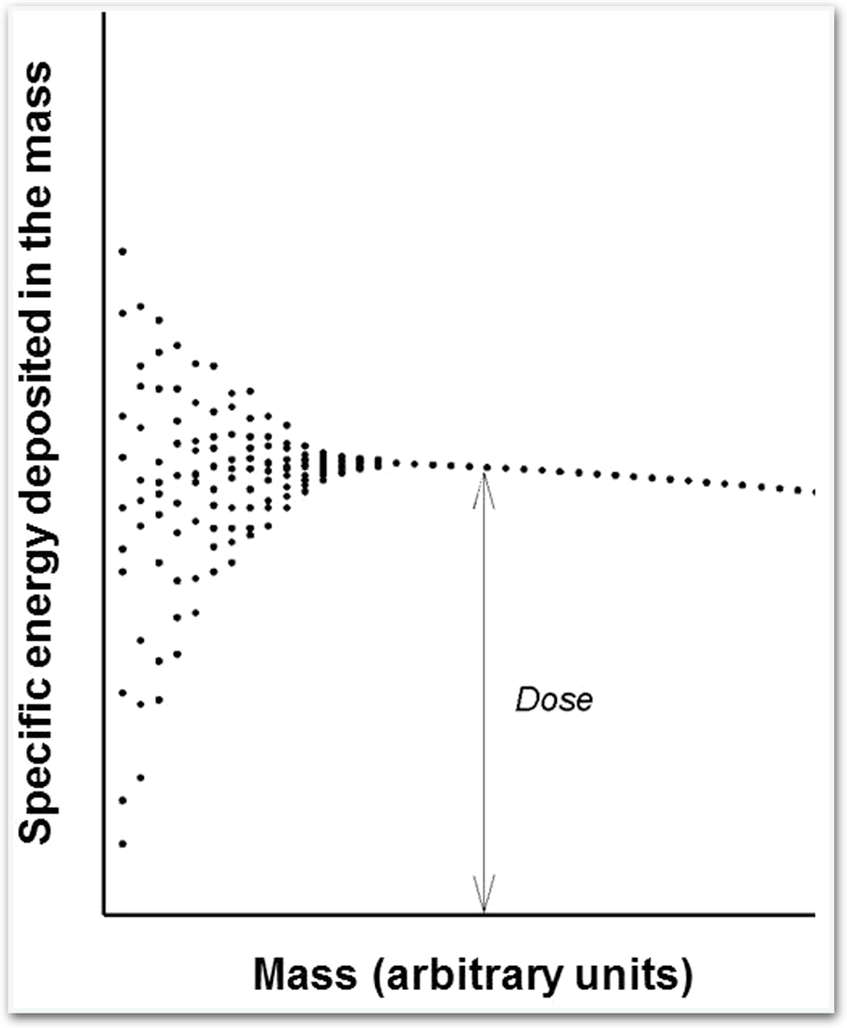
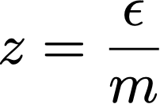
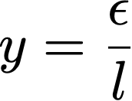
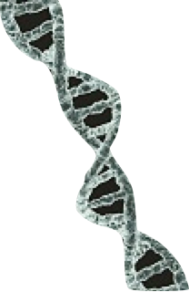
The need for micro- and nanodosimetry
DNA
Cell
Organ
Stochastic quantities
Specific energy
Lineal energy
2 nm
3.4 nm
H. H. Rossi and M Zaider, Microdosimetry and Its Applications (1996)

Slide 18
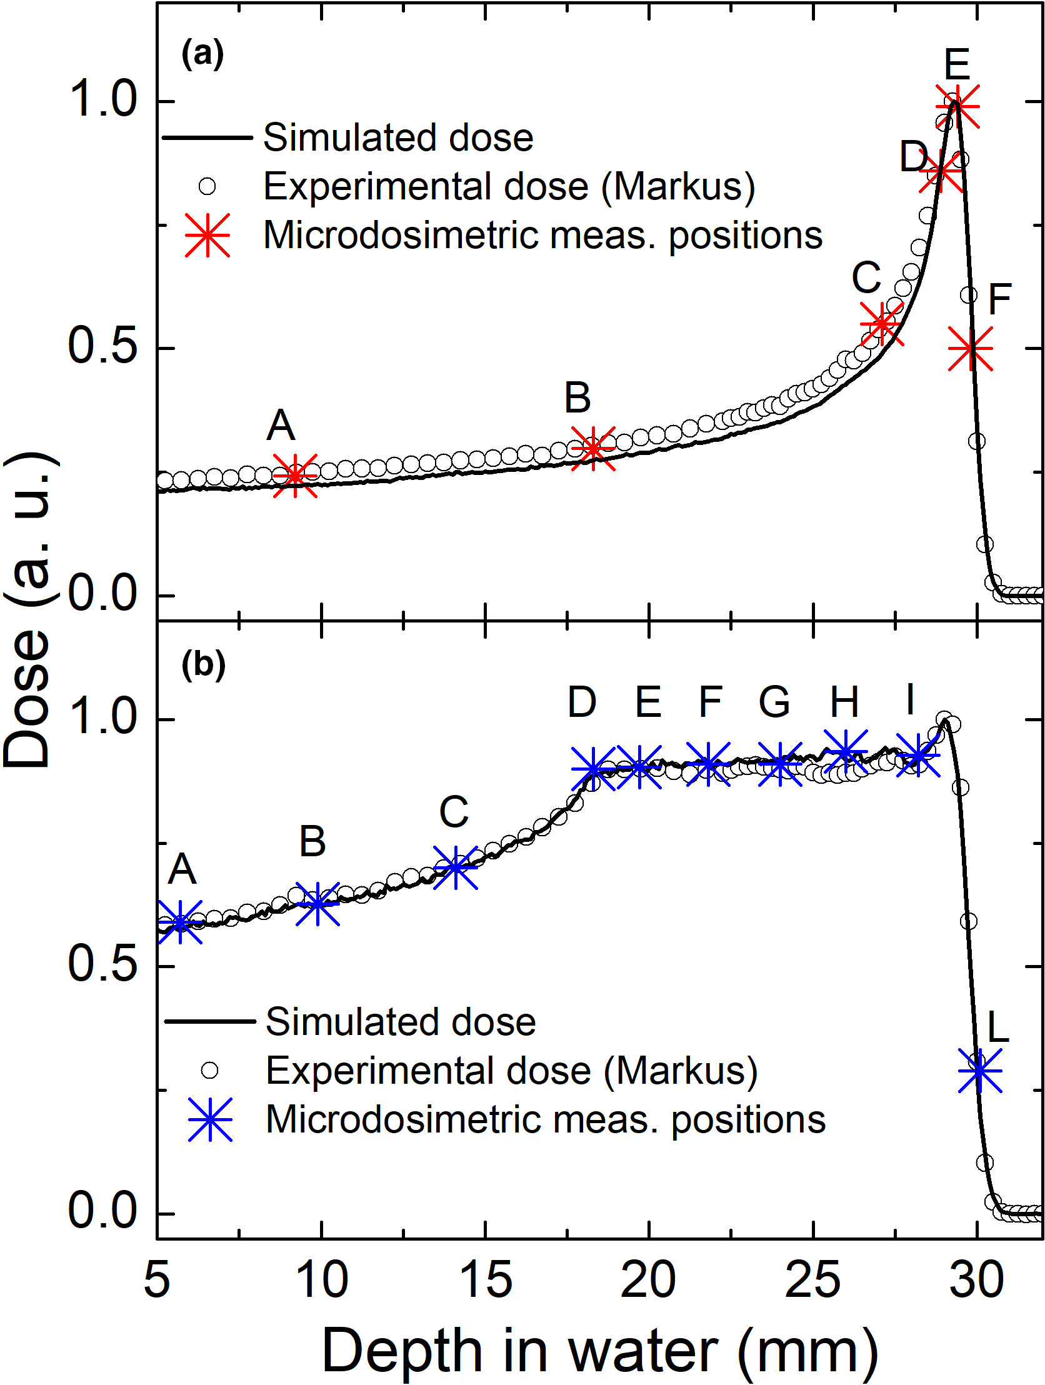
Example: 62 MeV proton beam measurements
At each depth there is no
well-defined LET, but rather a distribution around a mean value.
C. Verona et al. Med. Phys. 47 (2020)

Slide 19
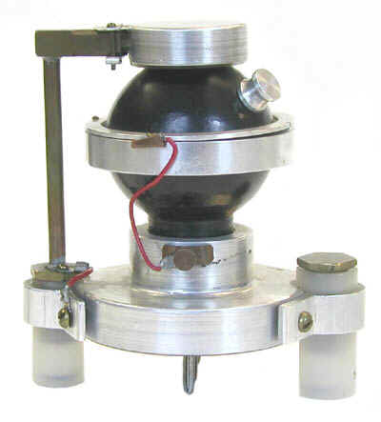
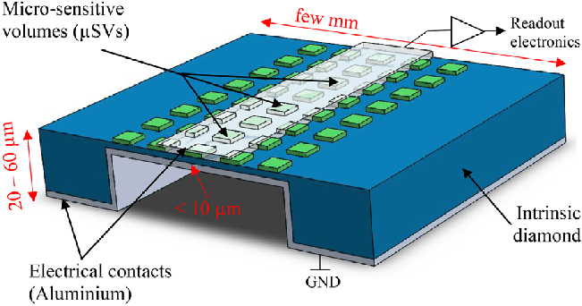
Microdosimeters
Rossi TEPC (1960)
3D SOI μD
A. T. Samnøy et al. Rad. Phys. Chem. 176 (2020)
scCVD Diamond μD
Mini-TEPC
A. Bianchi et al. Rad. Phys. Chem. 202 (2023)
I. A. Zahradnik et al. Phys. Status Solidi A,215 (2018)

Slide 20
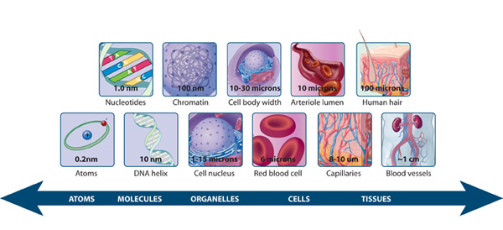
Radiation Dosimetry to Advance RadioTherapy (RADART)
Group thematic lines
Detectors and materials for high-res. dosimetry
New modalities and applications in RT

Slide 21
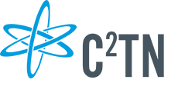
Projects and collaborations
Detectors and materials for dosimetry
Scintillating optical fibre array for high-res. dosimetry
Development of materials for micro and nanodosimetry
New modalities and applications in RT
Modelling radiobiological effects of NPs
Effects of PT in NDDs
RADART

Slide 22
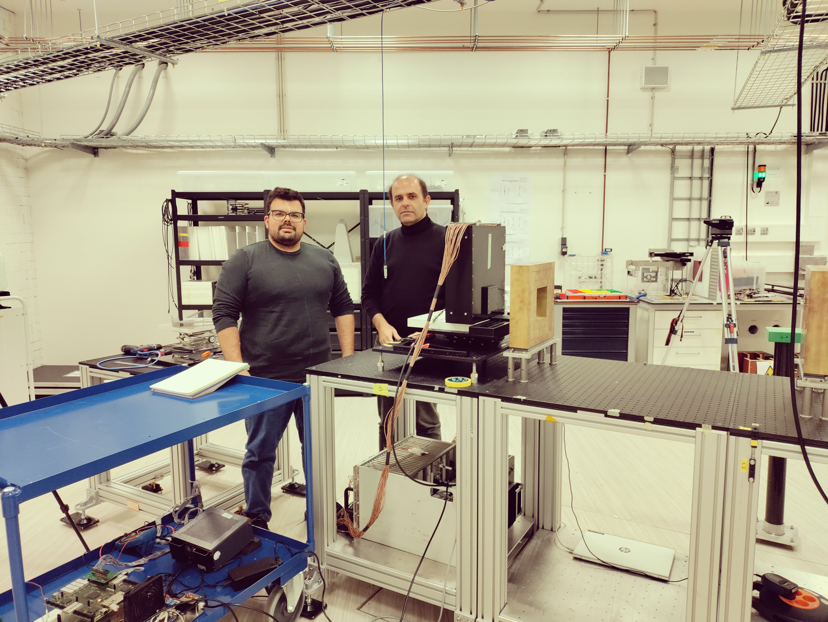
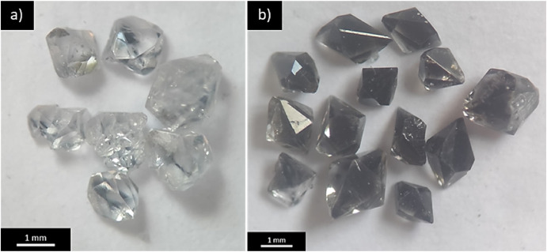
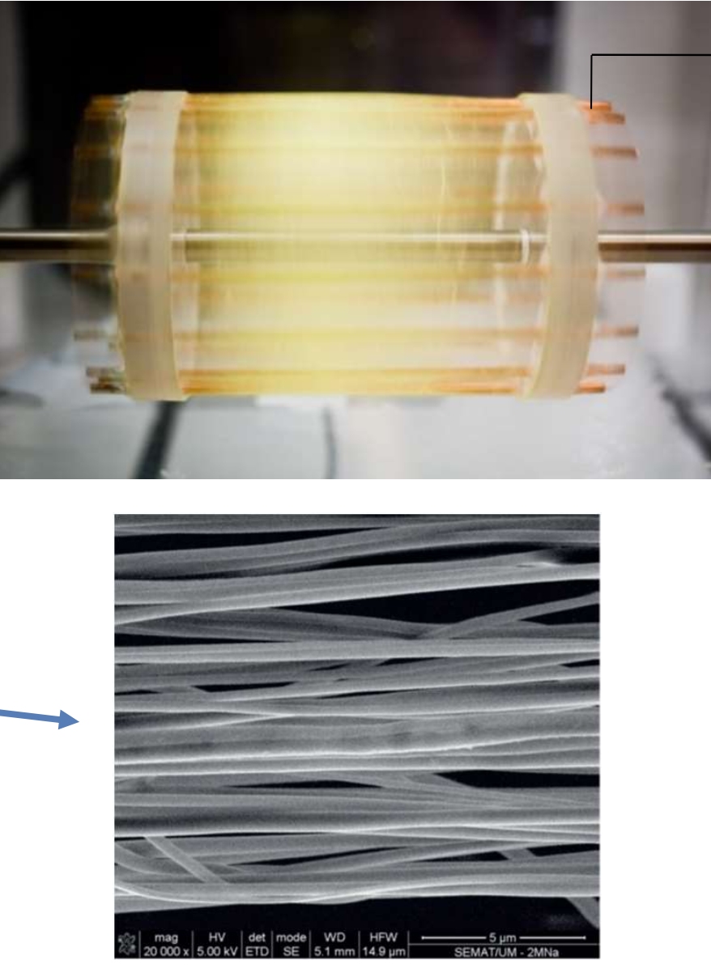
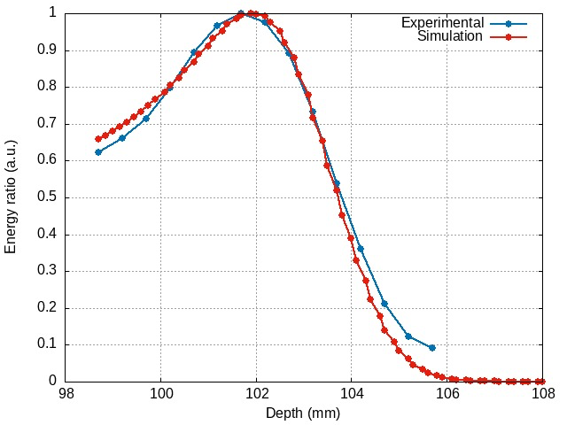
Detectors and materials for dosimetry
Clinical protons @ HollandPTC
OSL-FNTD crystals
Nanofibers OSL dosimetry
D. Guerreiro et al. J Inst 19(5) (2024)

Slide 23
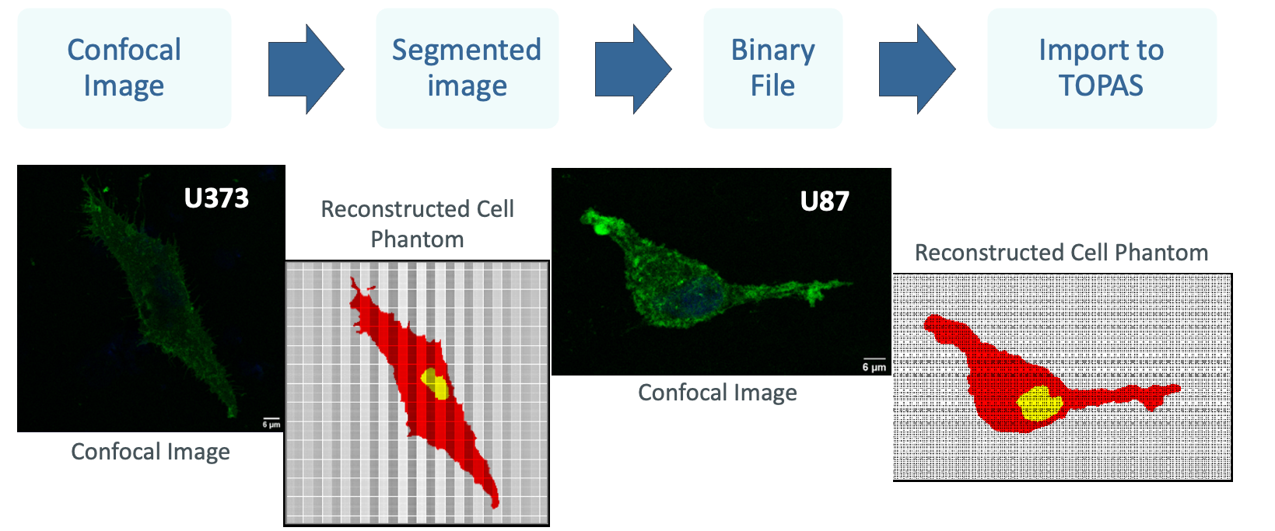
New modalities and applications in RT
Modelling radiobiological effects of NPs
S. Lacombe at al. Cancer Nanotechnol. 8(1) (2017)
Increase production of secondary particles
Increase production of ROS
Monte Carlo simulations (TOPAS nBio)
Radiobiological models
Compare with experimental data
Enhnancement of the therapeutic effect
J. Antunes et al. Bio Phys Express 10(2) (2024)

Slide 24
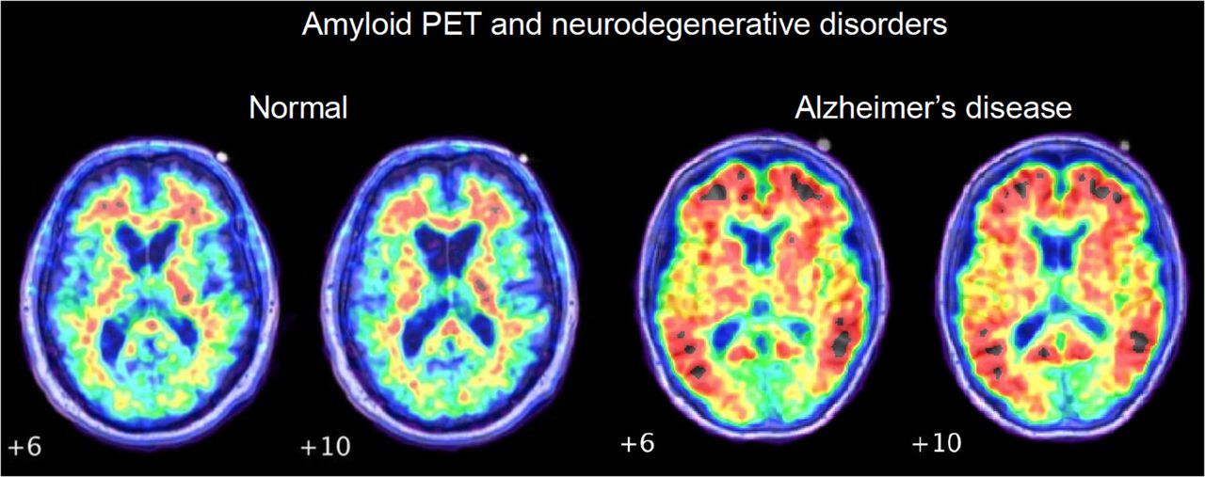
New modalities and applications in RT
Effects of low-dose (< 0.1 Gy) in neurodegenerative disorders (NDDs)
Irradiation of brain cells with different types of radiation
Assess the production of ROS
Effects on the destruction of protein aggregates (amyloidosis)
Model based on Monte Carlo simulations (TOPAS nBio)
NDD are associated with increased protein aggregations (amyloidosis)
M. Chapleau et al. J. Nuc. Med. 63 (2022)

Slide 25
Thanks for your attention!

